Slide 1

ENGLISH FOR BUSINESS & TOURISM · INTRODUCTORY LESSON
English Without Borders
Communicating across cultures, campuses and careers
Global English
Academic English
Professional Communication
Department of Business Administration & Tourism · Hellenic Mediterranean University
Notes:
LECTURER SCRIPT (read or adapt):
Welcome everyone. Today is an introduction to English in international, academic and professional contexts. You do not need to know all the answers: I am interested in your experiences and perspectives.

Slide 2




Our route for today
TODAY'S LESSON
01
02
03
04
05
Meet each other
English around the world
English with a purpose
Spell it right
Academic conventions
Introductions and first ideas
ELF and World Englishes
ESP and EAP
The ICAO spelling alphabet
Common abbreviations
Today's aim: use English clearly and confidently with people from different languages and cultures.
Notes:
LECTURER SCRIPT (read or adapt):
Here is our route for today. We start with you, then look at how English is used around the world, how it is adapted for specific professional and academic purposes, and finally two practical skills: spelling accurately with the ICAO alphabet and understanding common academic abbreviations.

Slide 3

Evi Kotti kottievi@hmu.gr
INTRODUCTIONS
Academic background
Teaching & professional experience
English language educator in higher education
Background in foreign languages, language teaching, translation and interpreting
Postgraduate studies in language teaching, translation and interpreting
Doctoral research on foreign-language communication in academic and professional contexts
Teaching English at the Hellenic Mediterranean University across departments
Erasmus+ teaching mobility and collaborations with European universities
English speaking examiner for language qualifications
Professional translation in English, French and Italian, incl. European projects
Notes:
LECTURER SCRIPT (read or adapt):
Before we begin, let me briefly introduce my academic background. My work brings together English language education, translation, and communication across languages and cultures.
My teaching and professional experience has shown me that effective English depends on context and audience. This is particularly relevant to business and tourism, where communication often crosses national borders.

Slide 4
Getting to know each other
FOR ALL STUDENTS
PAIR DISCUSSION
1
What is your name, and how should we pronounce it?
2
What languages do you speak or use regularly?
3
Why did you choose Business Administration or Tourism?
4
Where have you used English outside the classroom?
Then: introduce your partner to the class with one interesting thing you learned.
Notes:
LECTURER SCRIPT (read or adapt):
Let's begin with you. Turn to someone next to you. Introduce yourselves, discuss two questions, and then tell us one interesting thing you learned about your partner. There is no pressure to speak perfectly.

Slide 5
Four ways of looking at English
PART 1 · GLOBAL ENGLISH
GE
ELF
EAP
ESP
General English
English as a Lingua Franca
English for Academic Purposes
English for Specific Purposes
Everyday communication in familiar and social contexts
Communication among speakers of different first languages
University study, academic reading and writing
Language for particular academic or professional needs
Remember: Business English and English for Tourism are examples of ESP.
Notes:
LECTURER SCRIPT (read or adapt):
The term English does not always refer to the same communicative goal. General English focuses on broad everyday needs. ELF describes communication across different first languages. ESP responds to particular needs, while EAP focuses on academic contexts. EAP is commonly treated as a branch of ESP.

Slide 6






ELF: English as a Lingua Franca
PART 1 · GLOBAL ENGLISH
KEY GOALS
SCENARIO
Intelligibility
English
Clarification
Greek hotel manager
German tour operator
Cooperation
Neither participant needs to be a first-language English speaker.
Intercultural awareness
Discuss: Is a native-like accent necessary for successful communication?
ELF is a use of English, not a single fixed variety.
Notes:
LECTURER SCRIPT (read or adapt):
Consider a Greek hotel manager and a German tour operator. English may be a shared working language for both. In ELF, the key question is whether they understand each other, not whether they sound like native speakers.

Slide 7
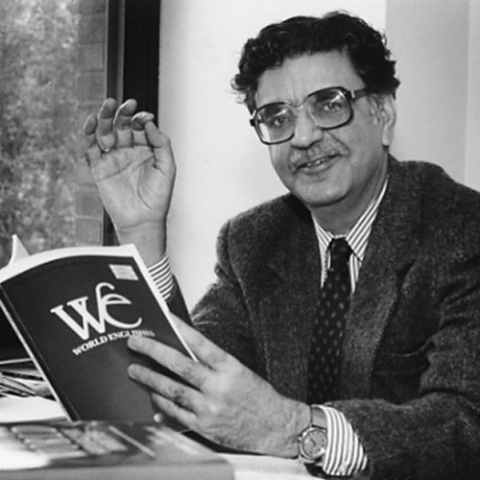
World Englishes: Kachru's three circles
PART 1 · GLOBAL ENGLISH
Inner Circle
e.g. UK, USA, Australia
EXPANDING
OUTER
Outer Circle
e.g. India, Nigeria, Singapore
INNER
Expanding Circle
e.g. Greece, Italy, Poland
Braj B. Kachru (1932–2016)
Indian-American linguist who proposed the Three Circles model of World Englishes (1985).
A framework, not a ranking of speakers.
A historically influential model of English in different sociolinguistic settings
Notes:
LECTURER SCRIPT (read or adapt):
Kachru proposed a historically influential model of World Englishes: Inner, Outer, and Expanding Circles. These refer broadly to different historical and institutional roles of English. They are not rankings of speakers or their proficiency.

Slide 8
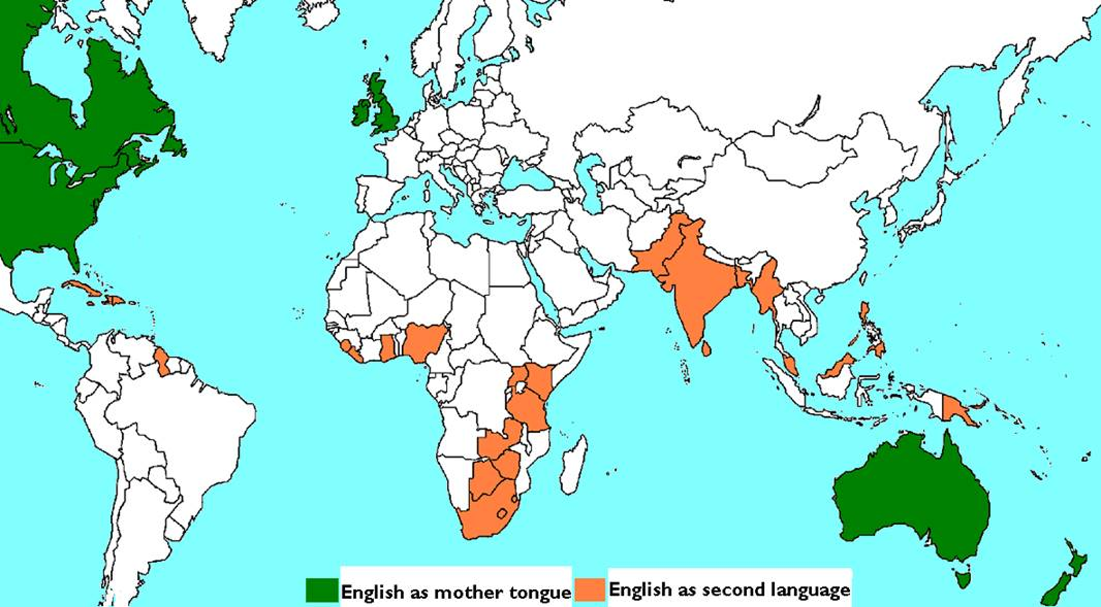
Where English is a first or second language
PART 1 · GLOBAL ENGLISH
Canada
UK & Ireland
Pakistan
USA
India
Nigeria
Philippines
Ghana
Malaysia & Singapore
Kenya
Australia
South Africa
New Zealand
Link to Kachru: green ≈ Inner Circle · orange ≈ Outer Circle · countries in white, like Greece ≈ Expanding Circle
Notes:
LECTURER SCRIPT (read or adapt):
This map shows where English is a mother tongue (green) and where it is an official or widely used second language (orange). Ask students: Which colour connects to Kachru's Inner Circle, and which to the Outer Circle? Where would Greece be? (Expanding Circle: English is learned as a foreign language.) Note that the map is a simplification: many of these countries are multilingual, and English may be one language among several.

Slide 9
Your international experience matters
ERASMUS STUDENTS · YOUR PERSPECTIVE
SHARE & COMPARE
1
What surprised you about communicating in English in Greece?
2
Do you use English differently at your home university?
3
Have you ever misunderstood someone's accent or cultural expectations?
4
What communication advice would you give a new Erasmus student?
Greek students: listen for similarities with your own experiences.
Notes:
LECTURER SCRIPT (read or adapt):
Our Erasmus students bring valuable first-hand experience of studying in another country. Could two volunteers share an example? Greek students: listen for similarities with your own experiences.

Slide 10


Effective English is more than correct grammar
ELF & INTERCULTURAL COMMUNICATION
Clarity
Active listening
Check names, dates, numbers and expectations.
Ask for clarification rather than guessing.
Cultural awareness
Adaptation
Politeness, directness and turn-taking vary.
Adjust pace and wording to your audience.
Discuss: Is “Could you clarify that?” a sign of weakness or professionalism?
Notes:
LECTURER SCRIPT (read or adapt):
Intercultural communication means paying attention not only to words but also to expectations, politeness, and context. Ask students: Can a message be grammatically correct but still sound impolite? Invite one example from each group.

Slide 11
Mixed pairs: find common ground
ONE GREEK + ONE ERASMUS STUDENT WHERE POSSIBLE
MIXED PAIRS
Compare a typical professional greeting in your countries.
1
What counts as polite disagreement in your cultures?
2
Describe one situation where you needed to clarify a message.
3
Report back: one similarity and one difference to the class.
Notes:
LECTURER SCRIPT (read or adapt):
Now compare your perspectives in mixed pairs where possible. Instead of deciding which culture is right, explore how expectations can differ. What can speakers do to avoid misunderstandings?

Slide 12
Example answers
MIXED PAIRS · NEED IDEAS?
IDEAS
1
Compare a typical professional greeting
2
What counts as polite disagreement?
“In Greece, we usually shake hands. With colleagues we know well, we sometimes kiss on both cheeks.”
“In Germany, people often use surnames and titles, like Herr Schmidt or Frau Dr. Weber.”
“In Spain or Italy, greetings are warmer and closer. In Finland or Sweden, people keep more personal space.”
“In Japan, people bow.”
“In Greece, we can disagree quite directly, and it's not seen as rude.”
“In the UK, people often soften it: ‘I see your point, but…’ or ‘That's interesting, however…’”
“In the Netherlands, people are very direct: ‘No, I don't agree.’ That's considered honest.”
“In some cultures, people avoid saying ‘no’ in public and say ‘Maybe’ or ‘We'll see’ instead.”
Notes:
Show this slide only if pairs need support. Ask students whether the examples match their own experience — generalisations about cultures are starting points for discussion, not rules.

Slide 13

Example answers and useful phrases
MIXED PAIRS · NEED IDEAS?
IDEAS
3
A situation where you needed to clarify a message
USEFUL PHRASES
“A tourist asked me for directions and I didn't understand the street name, so I asked him to spell it.”
“At my Erasmus university, I wasn't sure about an assignment deadline, so I emailed the professor to check.”
“I couldn't hear a booking number on the phone, so I asked: ‘Sorry, could you repeat that more slowly?’”
“Someone said ‘Let's meet at half six’ and I wasn't sure if they meant 6:30 or 5:30.”
In my country, people usually…
That's similar to / different from…
Sorry, what do you mean by…?
Could you say that again, please?
Notes:
On “half six”: in British English it means 6:30. A German speaker may understand “halb sechs”, which means 5:30 — a good example of why clarifying matters in ELF communication.

Slide 14

ESP: English for Specific Purposes
PART 2 · ENGLISH WITH A PURPOSE
English teaching designed around the needs and communicative tasks of a particular group.
Business
Tourism
Meetings
Negotiations
Reservations
Guest enquiries
Reports
Customer communication
Complaints
Itineraries
Think: What English tasks might you face in your future career?
ESP: needs · context · genres · skills
Notes:
LECTURER SCRIPT (read or adapt):
ESP stands for English for Specific Purposes. It begins with a question: what do these learners need to do in English? A hotel receptionist, a business student, and a nurse may need different vocabulary, genres, and interaction skills.

Slide 15



EAP: English for Academic Purposes
PART 2 · ENGLISH WITH A PURPOSE
Reading
Listening
Writing
Speaking
Journal articles and textbooks
Following lectures and taking notes
Assignments, reports and research projects
Seminars and presentations
Which of these tasks feels most challenging for you at university?
Some activities can belong to both EAP and ESP.
Notes:
LECTURER SCRIPT (read or adapt):
EAP stands for English for Academic Purposes. Think about lectures, academic readings, seminars, reports, and presentations. Ask: Which of these tasks feels most challenging at university? We will see academic abbreviations later.

Slide 16
English in your future career
GREEK STUDENTS · YOUR PERSPECTIVE
PAIRS, THEN SHARE
1
Which English-speaking situation makes you least confident? Why?
2
Would you feel comfortable answering a foreign guest's complaint?
3
Have you worked in tourism, retail or customer service?
4
What would you like to be able to do in English by the end of your studies?
Share: one idea from your pair with the class.
Notes:
LECTURER SCRIPT (read or adapt):
For students studying in Greece, think of a real situation where English could matter to you. We will return to your answers when we discuss business and academic English.

Slide 17




ESP – The ICAO Spelling Alphabet
Where is it useful?
PART 3 · SPELL IT RIGHT
Hotel bookings
Telephone calls
Email addresses
Invoices
Airports
Guest names and reservation codes
Names, companies and destinations
Letters in usernames and domains
Alphanumeric payment references
Standardised aviation radio communication
It is widely used in aviation to avoid misunderstandings, particularly when communicating names, codes and other important information. Ask yourself: where might one incorrect letter cause a real problem?
Notes:
LECTURER SCRIPT (read or adapt):
Ask: Where might one incorrect letter cause a real problem? Elicit examples such as guest names, email addresses, and reservation codes. Emphasize that spelling conventions help when accuracy matters.

Slide 18
The ICAO spelling alphabet: A–Z
ONE INTERNATIONAL SPELLING SYSTEM
A
B
C
D
E
F
G
Alfa
Bravo
Charlie
Delta
Echo
Foxtrot
Golf
H
I
J
K
L
M
N
Hotel
India
Juliett
Kilo
Lima
Mike
November
O
P
Q
R
S
T
U
Oscar
Papa
Quebec
Romeo
Sierra
Tango
Uniform
V
W
X
Y
Z
Note: Alfa and Juliett are the official spellings. On aviation radio, 9 is often said “niner”.
Victor
Whiskey
X-ray
Yankee
Zulu
Notes:
LECTURER SCRIPT (read or adapt):
Here is the complete ICAO spelling alphabet on one slide. Give students a minute to scan it. Model two examples aloud. Note the standardized spellings Alfa and Juliett; the number nine is often pronounced niner in aviation radio phraseology.

Slide 19
Confirming a reservation
EXAMPLE
PAIR ROLE-PLAY
RECEPTIONIST Could you spell your surname, please?
GUEST P-A-P-A-S — Papa, Alfa, Papa, Alfa, Sierra.
RECEPTIONIST Thank you. Is your booking reference B-D-9?
GUEST Yes — Bravo, Delta, niner.
RECEPTIONIST Let me read that back to confirm.
Find the clarification question. Why does the receptionist read the code back?
Notes:
LECTURER SCRIPT (read or adapt):
Read the short exchange aloud with a volunteer. Then ask the class to identify the clarification question. Why does the receptionist repeat the code? This is a communication strategy, not just a vocabulary exercise.

Slide 20
Challenging real surnames
AUTHENTIC SURNAMES FROM DIFFERENT LANGUAGES
PAIR PRACTICE
Nguyễn
Szczęsny
Papadopoulos
Schwarzenegger
Vietnamese
Polish
Greek
German
Wojciechowski
Guðmundsdóttir
Dvořák
Chattopadhyay
Polish
Icelandic
Czech
Indian
Task: spell the letters using ICAO; explain diacritics (ễ, ę, ð, ř) separately.
Notes:
LECTURER SCRIPT (read or adapt):
These are real surnames from different languages. Do not assume we know their pronunciation from spelling. In pairs, choose one and practise spelling the letters using ICAO. For diacritics, explain that the written form may need explicit clarification.

Slide 21

Your turn: receptionist and guest
PRACTICE · REAL-LIFE COMMUNICATION
PAIR PRACTICE
1
2
3
4
Spell
Dictate
Act
Confirm
your surname using the ICAO alphabet.
a fictional booking reference: MK-472 / BD-305 / TX-618.
Partner A: hotel receptionist. Partner B: international guest.
the name, reference and email address; then switch roles.
Reflection: Which clarification phrases helped you avoid mistakes?
Use fictional details only — never real booking codes or passwords.
Notes:
LECTURER SCRIPT (read or adapt):
Now practise independently. Stronger students can add a noisy-line scenario, request repetition, or explain a spelling correction. Beginners can read from the ICAO chart.

Slide 22
EAP – Academic English abbreviations
PART 4 · ACADEMIC ENGLISH
You will often read academic textbooks, articles and research papers in English.
These texts follow academic conventions, including abbreviations.
Many abbreviations come from Latin and are widely used in academic writing.
Academic English is not just advanced vocabulary — it is also about knowing these conventions.
e.g.
i.e.
et al.
cf.
Erasmus students: Do you use the same abbreviations at your home universities?
Notes:
LECTURER SCRIPT (read or adapt):
As university students, you will often read academic textbooks, articles and research papers in English. These texts follow specific academic conventions, including the use of abbreviations, such as e.g., i.e., et al., and cf. Many of these come from Latin and are widely used in academic writing. Academic English is not just about advanced vocabulary, but also about understanding academic conventions. Now, let's see how many of these abbreviations you already know! And for our Erasmus students: Do you use the same abbreviations at your home universities?

Slide 23
Match each abbreviation with its meaning
WARM-UP
PAIR WORK
NB
ff.
pp.
cf.
n.d.
Ch.
vol.
i.e.
re.
co.
c.
e.g.
fig.
et al.
ed.
a for example
f company
k no date given
b approximately
g editor
l important
c compare
h and other (authors)
m pages
d chapter
i and the following pages
n concerning
e figure
j that is, that means
o volume
Notes:
ANSWER KEY:
NB = l (important) · ff. = i (and the following pages) · pp. = m (pages) · cf. = c (compare) · n.d. = k (no date given) · Ch. = d (chapter) · vol. = o (volume) · i.e. = j (that is) · re. = n (concerning) · co. = f (company) · c. = b (approximately) · e.g. = a (for example) · fig. = e (figure) · et al. = h (and other authors) · ed. = g (editor)
Suggestion: let pairs match first, then show the next slide (reference list) to check.

Slide 24
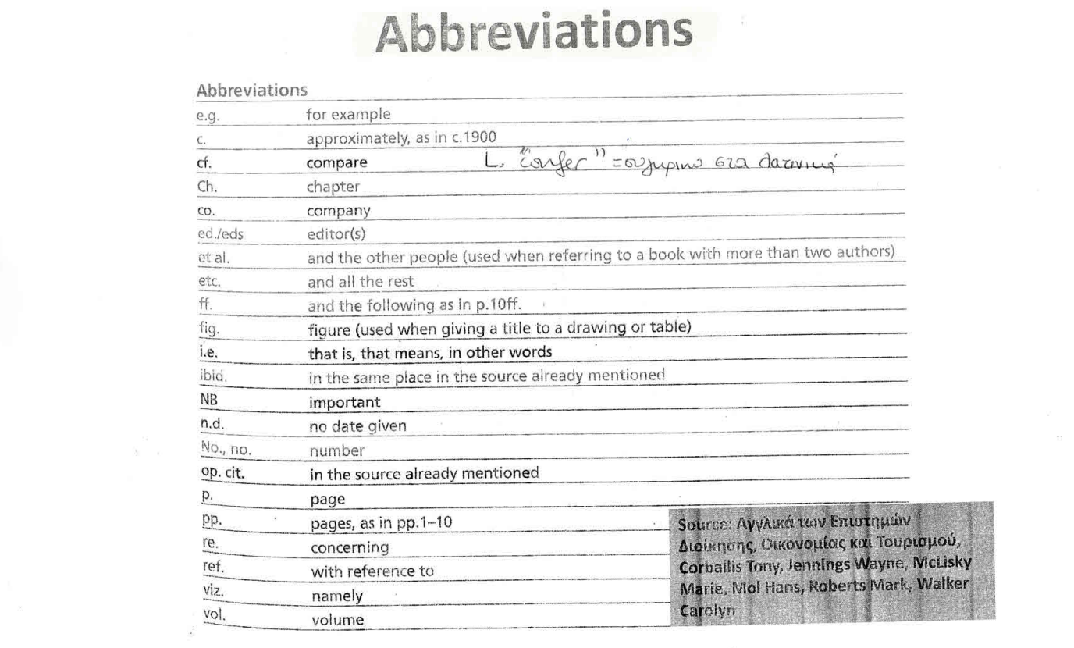
Reference list: common abbreviations
CHECK YOUR ANSWERS
LATIN ORIGINS
e.g. exempli gratia
i.e. id est
cf. confer
et al. et alii
ibid. ibidem
viz. videlicet
c. circa
Notes:
Use this list to check the matching task. The source is shown on the handout (Corballis et al., Αγγλικά των Επιστημών Διοίκησης, Οικονομίας και Τουρισμού). The panel on the right shows the Latin origin of the most common abbreviations.

Slide 25
Fill in the correct abbreviation
ACADEMIC ENGLISH · PART 1
INDIVIDUAL TASK
WORD BANK
c.
Ch.
cf.
eds.
et al.
etc.
f
fig.
ff
ibid.
i.e.
N.B.
n.d.
vol.
1
Efforts towards a sustainable strategy have been initiated by the Swedish government (Gerhardt ______, 2013).
2
We included several characteristics about the measuring sites (whether they were urban, rural, ______) in our data.
3
Convective (θερμαγωγός) initiation is the first stage in any kind of convective event (Groenemeijer et al., ______).
4
Look at ______ 3.
5
______ Charges are liable to be reviewed annually.
6
The famous scientist was born ______ 1700.
Notes:
ANSWER KEY (Part 1):
1. et al.
2. etc.
3. n.d.
4. fig. (Ch. is also possible: “Look at Ch. 3”)
5. N.B.
6. c.
Not every word in the bank is used (e.g. eds., ibid., vol.) — they are distractors.

Slide 26
Fill in the correct abbreviation
ACADEMIC ENGLISH · PART 2
INDIVIDUAL TASK
WORD BANK
c.
Ch.
cf.
eds.
et al.
etc.
f
fig.
ff
ibid.
i.e.
N.B.
n.d.
vol.
Abbott (2010) found supportive results in her memory experiment, unlike those of previous work (______ Zeller & Williams, 2007).
7
Page 35______ means page 35 and at least two pages after that. Page 35______ means page 35 and page 36.
8
“Every genetics student learns the two basic methodologies in the field, ______ forward genetics and reverse genetics.”
9
Check: compare your answers with a partner before we correct together.
Notes:
ANSWER KEY (Part 2):
7. cf.
8. 35ff (page 35 and following pages) · 35f (page 35 and the next page)
9. i.e.

Slide 27
Efforts towards a sustainable strategy have been initiated by the Swedish government (Gerhardt et al., 2013).
We included several characteristics about the measuring sites (whether they were urban, rural, etc.) in our data.
Convective (θερμαγωγός) initiation is the first stage in any kind of convective event (Groenemeijer et al., n.d.).
Look at fig. 3
N.B. Charges are liable to be reviewed annually.
The famous scientist was born c. 1700.
Abbott (2010) found supportive results in her memory experiment, unlike those of previous work (cf. Zeller & Williams, 2007).
Page 35ff means page 35 and at least two pages after that. Page 35f means page 35 and page 36.
“Every genetics student learns the two basic methodologies in the field, i.e. forward genetics and reverse genetics.”
Seidlhofer, B. (2006) Towards making ‘Euro-English’ a linguistic reality. In: Bolton, K. & Kachru, B. (eds.) World Englishes. Critical Concepts in Linguistics. London: Routledge, pp. 47–50.
This phenomenon is analyzed in Ch. 5, vol. 1.
Seidlhofer, B. (2011) Understanding English as a lingua franca. Oxford: Oxford University Press, p. 23.
Ibid, pp. 49-54.

Slide 28
Abbreviations across cultures
GREEK AND ERASMUS STUDENTS
DISCUSSION
Do you use e.g. or a different equivalent in your first language?
1
TASK
Would you use ASAP in an email to a professor? Why / why not?
Rewrite for a formal email:
2
“Please send the file ASAP.”
When can an abbreviation make communication less clear?
3
Notes:
LECTURER SCRIPT (read or adapt):
Invite a Greek student and an Erasmus student to share their views. There is no single answer to the question about emailing a professor: context and relationship matter. Elicit a more polite and explicit alternative, for example: Could you please send the file by 3 p.m. today? Explain that good professional communication balances brevity with clarity and politeness.

Slide 29

Exit questions
ONE MINUTE TO REFLECT
REFLECTION
What did you learn about international English today?
Which ICAO letters do you remember without looking?
What is one intercultural communication strategy you will use?
Notes:
LECTURER SCRIPT (read or adapt):
Before we finish, invite one takeaway from each side of the classroom. Which strategy might be useful in your studies or future career?

Slide 30

WRAP-UP
Key takeaways
English is used globally, academically and professionally.
ELF describes international communication; ESP and EAP focus on specific needs.
Kachru's model helps us discuss the global spread of English.
The ICAO spelling alphabet supports accurate communication in business and tourism.
Academic abbreviations (e.g., i.e., et al., cf.) are conventions worth knowing.
Think about it: what is one communication skill you want to develop?
Notes:
LECTURER SCRIPT (read or adapt):
We have moved from global English to communication strategies and specific academic and professional tasks. The common theme is choosing language that suits the purpose, audience, and situation.

Slide 31
COMING UP NEXT
General vs Business English
Thank you!

