Slide 1
CHRONOLOGICAL CVs
Paraskevi (evi) KOTTI,
DEPT. OF BUSINESS ADMINISTRATION, TEI OF CRETE

Slide 2
Network Elevator Speech (Speech in an ‘elevator’ -> 45 ‘’) α Brief presentation of: Ourselves - Skills - Career goals
Hello. I am Mark Larkham and I have been working as an English Teacher at the Dept. of Business Administration, at the University of Patras, for the last 3 years. I am currently looking for a teaching position at the University of Durham. One of the things I like most about teaching English, esp. to foreign students, is getting to know new cultures and people from all over the world as well as offering those students knowledge and help them grow in their chosen professional field. I am really good at listening to students and helping them with both academic and business English. Do you know if the University of Durham is hiring any new English teachers at the moment?

Slide 3

CV = RESUME
Why do you need a CV?
1. Highlights your skills, education, experience
2. Shows that you are a good match for the job
3. Gets you an interview with the employer.
T I P :
Employers read many resumes from many different applicants. What they actually do is search for KEY WORDS.

Slide 4
BASIC TYPES
OF CVs
A. EUROPASS
B. CHRONOLO-
GICAL CV
C.FUCTIONAL CV
D. VIDEO CV

Slide 5
A. EUROPASS

Slide 6
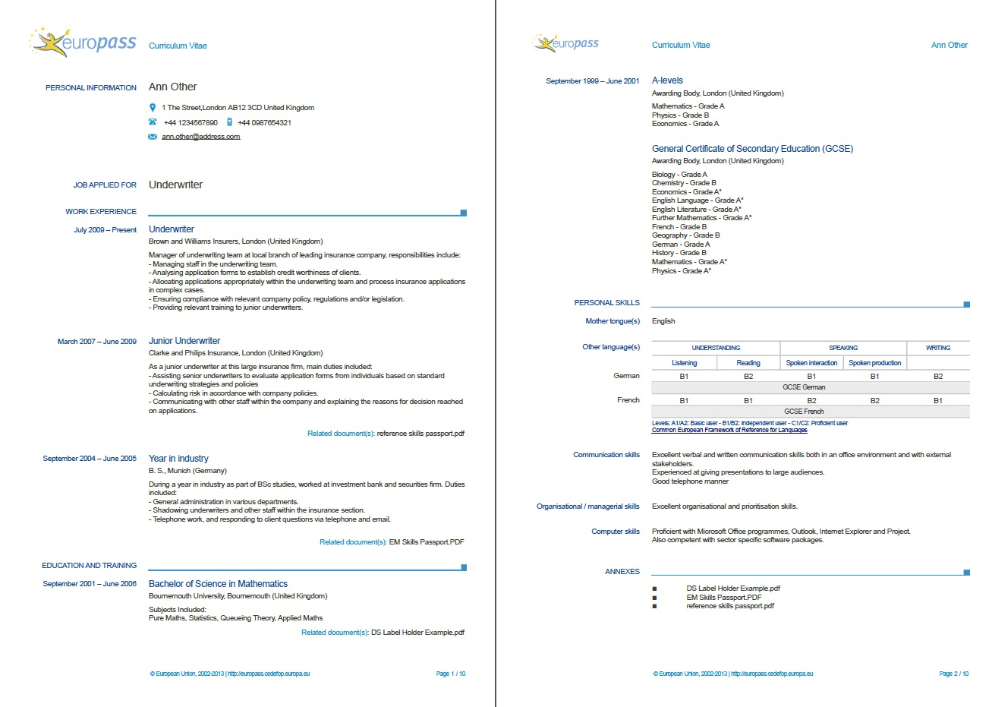

Slide 7
B. CHRONOLOGICAL
CV
The
most traditional
and
widely used format.

Slide 8
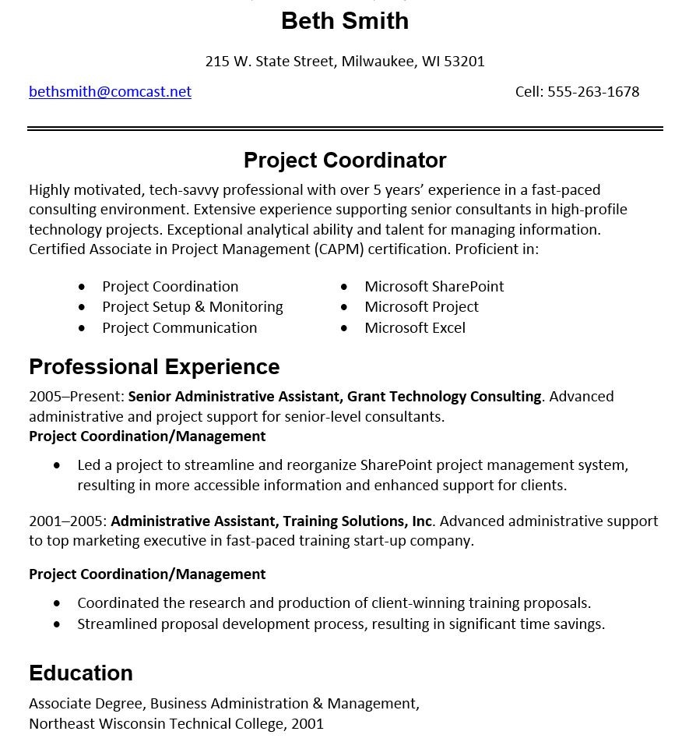

Slide 9
B. Chronological CV
Basically,
it highlights your Educational history and Work experience,
which is presented in
chronological order.
Ideal if:
you have stayed in the same career for long periods,
steadily working your way up.

Slide 10
B. Chronological CV
In other words, it is applicable:
If you have steadily progressed in one chosen field and are looking for promotion or better conditions
If you have no gaps in your work history
If you want to highlight where you have worked rather than what you have achieved

Slide 11
Structure:
A. Header (Name & Contact details)
B. Headline / Summary [Personal profile or career objectives]
C. Highlights / Skills
D. Work Experience (in reverse chronological order)
E. Education (in reverse chronological order)

Slide 12
Make it easy to read!
One page (max. two)
white space
bullet points
limited number of fonts

Slide 13
TIPS
No need to include your date/place of birth
or
a photograph, unless you're applying to work as an actor of a model
You may leave out your home address if you upload your CV on the internet (safety reasons)
‘Study’ the ad, find the key-words, and tailor your CV for the job posting
If two pages long, use: 2 A4 pages
Do not fold your CV

Slide 14
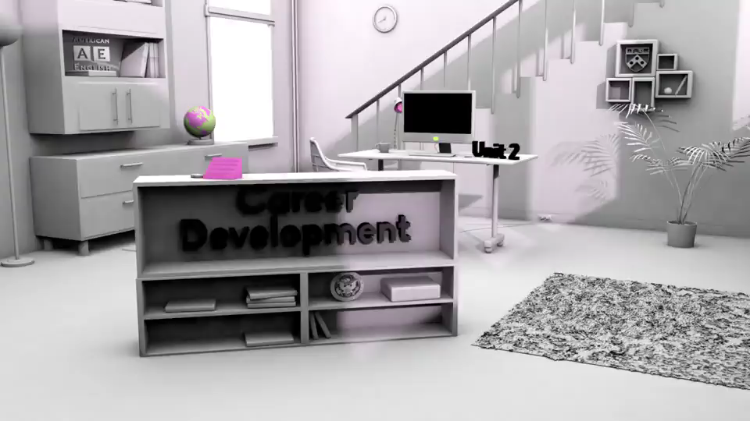
Video (Parts of a Resume)

Slide 15
There are various layouts of CV,
but the following one
is the most common.

Slide 16
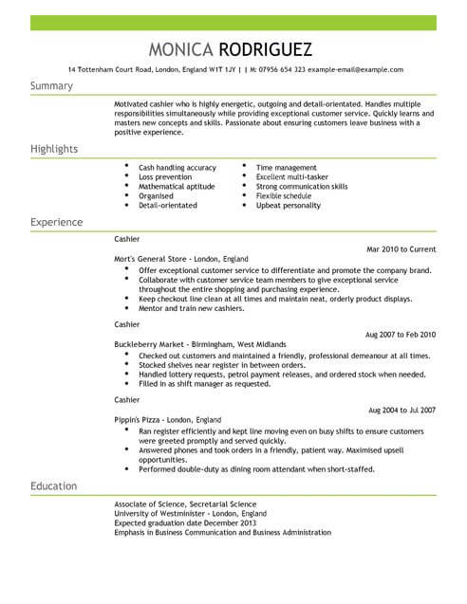

Slide 17
A. What to write in the Header
It informs the reader about your name & how to get in touch with you.
Name
Full Street address
Professional E-mail address
LinkedIn profile link (leave this off if you don’t have one, or if incomplete)
Cell phone number

Slide 18
B. What to write in the
Headline / Summary
It is a quick overview of your soft and hard skills. So, it sums up your professional characteristics & your skills.
It shows the reader why you are the right person for the job. [about 5 lines]
It contains a list of your skills [use bullets]

Slide 19
HARD SKILLS: JOB RELATED
- Often listed in the CV / Cover letter
- Easy to recognise and
evaluate.
Three Basic Hard Skills
√ English (or other foreign
languages);
√ Computer literacy
√ Skills specific to the job
position

Slide 20

SOFT SKILLS : ATTITUDE
They show if the employee:
1. can adapt to the working environment;
2. will be able to listen to a customer and provide them with helpful and polite service.

Slide 21
SOFT SKILLS : ATTITUDE
1. Communication skills
2. Teamwork
3. Time management
4. Active listening &
Problem-solving
5. Creative thinking &
Critical thinking
6. Work ethic
7. Positivity
8. Motivation

Slide 22
Headline / Summary: Example (a)
Marketing and communications leader with extensive experience in sales. Marketing and strategic planning for national and international businesses, including Novanym and Kinecta Ltd. Strong track record in new product introductions and product rebranding, increasing market share for established products, while managing a range of key stakeholders.
AREAS OF EXPERTISE
- Strategic planning and Leadership - Problem Solving
- Organisational Design and Development - Negotiation and Persuasion
- Productivity and Efficiency Improvement - Customer Satisfaction

Slide 23
Headline / Summary: Example (b)
Senior entrepreneurial executive with more than 7 years of experience managing sales, marketing, operations, personnel and merchandising at district, regional, and corporate level for both start-up and established retail and manufacturing companies. Strong leader with motivational management style and reputation for building and retaining highly motivated sales teams. Results-oriented achiever with excellent track record for identifying opportunities for accelerated growth.
HIGHLIGHTS
Operational Process Analysis - Financial Plan Development
Cross-Functional Team Leadership* - Mastery of Microsoft Office Programmes
Project Planning and Execution - Ability to handle multiple priorities
*[A cross-functional team is a group of people with different functional expertise working toward a common goal, διαλειτουργικός, διατμηματικός]

Slide 24

C. What to write in the
Skills & Highlights section (soft skills)
Analyze and diagnose complex situations
Break down a project into manageable pieces
Broad and Creative thinking
Committed to achieving company goals
Stress Management & Conflict resolution
Prioritization & Critical thinking
Define strategies for reaching goals
Strategic planning
Decision making
Promote frequent guest programs

Slide 25

C. What to write in the
Skills & Highlights section (hard skills)
Database management, such as Colleague
Content Management Systems (CMS), such as WordPress
Project Management Software, such as Trello and Zoho
Cloud Applications, such as JSON, Rest, and RPC
Marketing Campaign Management
Foreign languages: English (Proficient), French (Good)
Front Desk Operations
Screening and Directing Calls
Travel Arrangements

Slide 26
Headline/Summary & Skills/Highlights:
TIPS
1. FOCUS on the JOB LISTING
2. Use ACTIVE verbs
Try to FOCUS on the
skills & qualifications
that relate to the specific job
Try to use ACTIVE verbs
that show initiative / action and
explain precisely what you achieved in your previous job

Slide 27
Headline/Summary & Skills/Highlights:
TIPS
1. FOCUS on the JOB LISTING
Show how you can help the employer, by using the right key-words & sentences:
Is a sales director position looking for a person who can improve the company’s sales?
You may write: "Accomplished sales director with success in developing strategies that have generated 6- and 7-figure revenue growth."
Explain what you did in your previous job, as a way of showing the reader what you can and will do should they hire you.

Slide 28
Headline/Summary & Skills/Highlights:
TIPS
2. Use ACTIVE VERBS
Avoid general words / verbs (team player)
And say specifically what you achieved in your previous job
Active Verbs show confidence & clearly inform the reader about your achievements and skills (contrary to general verbs/words)
NO:‘’I worked at ‘’Halkiadakis’’, or ‘’I did sales at ‘’Kotsovolos’’ (unspecific & don’t show my contribution to the previous company).
YES ‘’I worked to develop a fundraising project at ‘’Halkiadakis’’ or ‘’I increased the sales by 5%’’ (an active role rather than a passive one).

Slide 29
Active Verbs: instead of ‘’Did’’ when you led a Project
Controlled / Coordinated / Administered
Executed / Operated / Organized
Planned / Produced / Programmed
Created / Designed / Developed
Devised / Founded / Established
Implemented / Incorporated

Slide 30

Active Verbs: instead of ‘’Did’’ when you changed sth
Improved
Customized
Redesigned
Modified
Remodelled
Reorganized
Replaced
Restructured
Updated
Upgraded
Transformed

Slide 31
Active Verbs: instead of ‘’increased’’ sales, customer satisfaction etc. // ‘’reduced’’ costs
increased
reduced
Achieved
Advanced
Enhanced
Expanded
Expedited
Furthered
Gained
Generated
Improved
Maximized
Deducted
Lessened
Consolidated
Decreased

Slide 32
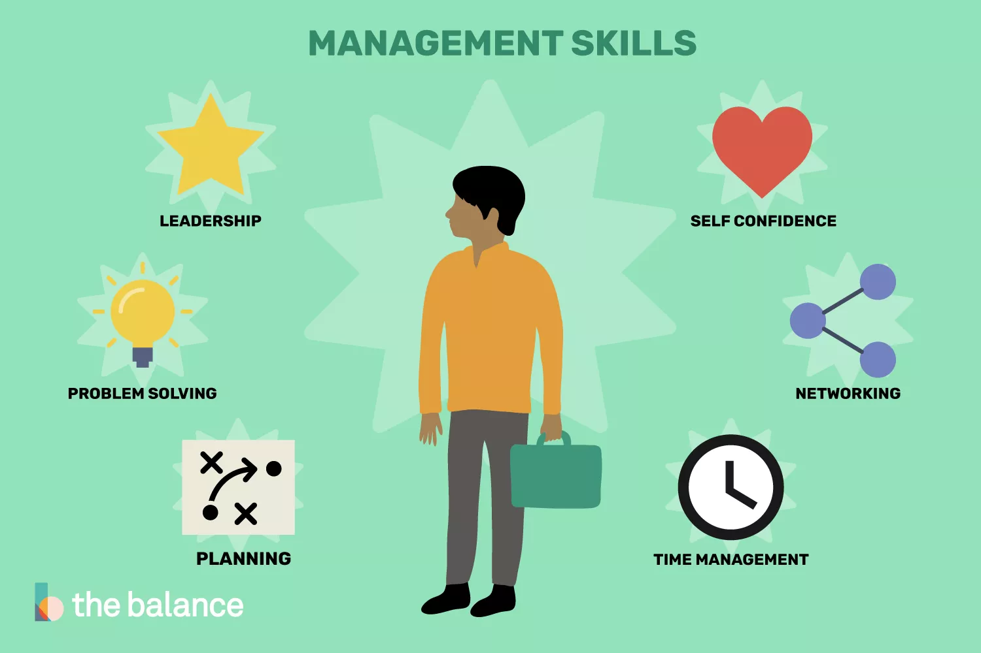

Slide 33
D. Work Experience
In reverse chronological order
Be precise

Slide 34
D. What to write in the
Work Experience section
District Sales Manager, The Computer Store, Athens, 2015 - 2017
Oversaw seven stores in two states and nine stores in Arizona; held full P & L responsibility.
Managed more than 75 employees and $2 million in revenue.
Controlled and directed operations and budget for regional office.
Front Desk assistant, Creta Beach, Hersonissos, Crete, 2014 – 2015
Responsible for maintaining records of checking in & out of guests, handling customer
requests and reservations.
Customer Service Agent, Candia Maris Hotel, Crete, 2012 - 2014
Handled a variety of customer needs and concerns.
Responsible for clients’ transportation to and from the hotel.

Slide 35
Some ideas for the
Work Experience section (a)
Effectively managing the hotel daily operations.
Making sure that customers have a good first and last impression of the hotel.
Setting goals for staff and monitoring them to ensure that they are met.
Recruiting staff, training them and monitoring their overall performance.
Managing and setting room rates.

Slide 36
Some ideas for the
Work Experience section (b)
Prepared weekly employee schedules.
Assisted with new hire training sessions.
Reviewed guest feedback online and on hotel website.
Prepared daily financial reports.
Responded to guest complaints.
Supervised hotel staff and worked to resolve staff issues.
Launching of an advertising campaign for the hotel.

Slide 37
Some ideas for the
Work Experience section (c)
In overall charge of the hotel restaurant, cafeteria and pool bar.
Encouraging and motivating staff to do better.
Assisted hotel manager with front desk operations.
Assisted in the hiring of new staff.
Constant focus on profitability and growth.
Striving to create a welcoming and relaxing atmosphere for clients.
Organising conferences, wedding receptions and other events.

Slide 38
Some ideas for the
Work Experience section (d)
Frequently interacted with guests and sought feedback.
Replied to guests’ feedback online and responded to their eventual complaints.
Processed invoices and assisted with guest payment issues.
Answered phones, booked rooms and responded to email inquiries or comments.
Striving to resolve conflicts in a professional and courteous manner.

Slide 39
D. Internship: Example
Hotel Management, BlueSky, Samos, 2014 - 2015
Served as a Hotel Management Trainee under the supervision of the
General Manager.
-Successfully supervising staff;
-Providing day-to-day administration of hotel;
-Analyzing profits and making recommendations for improvements;
-Dealing with accounting procedures;
-Implementing time management strategies to ensure that projects
reach the finish line on time;
- Managing client files and dealing with various problems.

Slide 40
E. What to write in the
Education section (a)
2012 – 2016 Technological Educational Institute of Crete, Heraklion
BA (Hons) in Business Administration.
May 2016 (anticipated graduation)
Thesis: ‘’How organisational culture can reinvent an organisation’’
Related Coursework: Advertising, Mathematics, Media Plans in Advertising, Marketing, Public Relations, Sustainable Tourism,
Business English

Slide 41
E. What to write in the
Education section (b)
2015-2017 Master’s Degree in Computer Science
Kapodistrian University of Athens, Grade: 9,5/10
2010-2014 Bachelor (Hons) in Business Administration
Technological Educational Institute of Crete, Grade: 7,5/10
2003 Secondary School Leaving Certificate, Grade: 18/10
3rd High School of Heraklion

Slide 42
C. FUNCTIONAL CV
Emphasis on skills and capabilities (rather than on working experience & historical development)
Applicable when:
you have gaps in your career, ex. bringing up children, illness;
you wish to change career field;
you have little experience, ex. just graduated;
you want to show a prospective employer that you possess the right skills for the job although you do not have much experience in that specific field;
you are a more mature candidate - this CV highlights your skills & takes the spotlight away from your age;

Slide 43
Functional CV – Sample(a)
Alex Kent
alex.kent@email.com
+44 499 513 975
Linkedin.com/in/alexkent/
Career Profile
Marketing and communications leader with extensive experience in sales, marketing and communications with national and international businesses including Novanym and Kinecta Ltd. Strong track record in new product introductions and product rebranding, increasing market share for established products and delivering strategic marketing initiatives while managing a range of key stakeholders.

Slide 44
Functional CV – Sample(b)
Achievements
Management
Presently leading a marketing consulting firm generating over $10 million in consulting revenue. Established the firm as one of the leading innovators in consumer brand marketing.
Manage six teams across Europe ensuring alignment with business goals and objectives.
Sales/Marketing
Led a national marketing campaign for Novanym, resulting in acquisition of 20 new clients.
Public relations
Manage Smithsons’ public relations activities including regular updates and press releases to media and industry associations.

Slide 45
Functional CV – Sample(c)
Employment History
2016 to present Managing Director
Novanym
Consumer goods marketing consulting firm
2013 to 2015 General Manager, Sales and Marketing
Tastemaker
Major breakfast food manufacturer
Education and Qualifications
Master’s Degree in Marketing, University of Bristol, 2004
Bachelor of Commerce majoring in Marketing, University of Kent, 2001
References
Available upon request.

Slide 46
D. VIDEO VC
First introduced in the 1980s with little success. Nowadays video resumes have taken on new popularity.
Rarely do companies request a video resume, but if you send one along with your CV & Cover Letter it may be seen as the 1st part of an interview.
Be professional: Dress and speak as you would for an interview.
Speak slowly and confidently.
Background of shots: Carefully decorated and tidy.
Script: Prepare it beforehand, but make it sound natural. Highlight your major goals, skills, accomplishments.
Duration: CV Videos should be brief, from 30 - 90 seconds. Anything longer is unlikely to be watched.
Ending: "Thank you in advance for taking the time to read my CV".

Slide 47
VIDEO CV - Sample
https://www.youtube.com/watch?v=S5RDXlRXh8c
[start from: 1’ 06’’]

Slide 48
‘’STUDY’’
YOUR CV
1. Be ready to explain ALL GAPS in your CV / professional career
2. Interviewers want to know EXACTLY what your TASKS were in your previous job/volunteer work
3. Be ready to ANALYTICALLY DESCRIBE HOW you will contribute to the company’s growth – what NEW things or ideas you will bring
4. ASK an intelligent or professional QUESTION before the end of the interview
TIPS:
Arrive ahead of time to familiarize yourself with the place
Take a copy of your CV – Cover letter with you

Slide 49
Sources:
https://www.thebalancecareers.com/what-is-a-chronological-resume-2061944
https://www.brookes.ac.uk/students/careers/students-and-graduates/cv-guide/chronological-cv/
https://www.myperfectcv.co.uk/cv-examples/chronological-cv-sample
https://www.hloom.com/resumes/chronological-format-templates/
https://www.cv-library.co.uk/career-advice/cv/cv-templates/cv-template-chronological/

