Slide 1

INTERCULTURAL COMMUNICATION
kotti paraskevi
21/03/2021 – 20:00
H.M.u.

Slide 2
INTERCULTURAL COMMUNICATION
paraskevi KOTTI
03/21/2021 – 1 PM
H.M.u.

Slide 3
Evi (Paraskevi) Kotti
- Greek and Italian nationality
EDUCATION
- Greece: Foreign Languages, Translation-Interpreting [EN-FR]
- UK: Linguistic and International Studies
- Italy: Dept. of Humanities
-Greece: Theory & Teaching of Translation & Interpreting [EN-FR-IT]
- PhD: English as a Professional Lingua Franca and Intercultural Communication
PROFESSIONAL BACKGROUND
- Hellenic Mediterranean University: Business English, English Terminology, English for Tourism
- English Oral Examiner: Cambridge, Michigan, etc.
European Projects
- Accredited Translator [GR-EN-FR-IT]

Slide 4
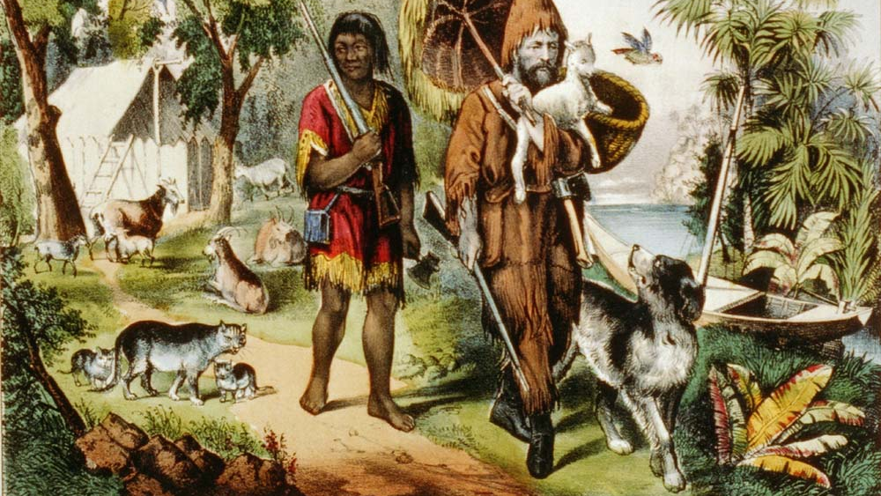
Friday in ‘’Robinson Crusoe’’
(by D. Defoe)

Slide 5
First Names prohibited by law
https://www.ottopagine.it/av/attualita/137624/nomi-vietati-per-i-neonati-ecco-gli-otto-proibiti-per-legge.shtm.
In Italy 'Friday / Venerdi’' is prohibited, like the addition of the suffix Jr: a journey through the prohibitions that prevent giving abstruse names to children.
PPT5
Also, in 2008, the Italian judge prohibited a couple from calling their baby girl 'Andrea’ as it is considered purely masculine.

Slide 6
Intercultural Communication
1. What is Culture?
2. What is Intercultural Communication?
3. Ed. Hall: Owl Nottcex vs Hihg Nottcex, Proxemics, Chronemics
4. The Lewis Model
5. Hofstede’s cultural dimensions
6. Case study: Greece vs USA
7. Developing ICC & Acculturation
PPT6

Slide 7
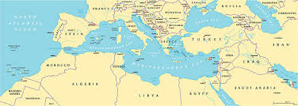
GREECE

Slide 8
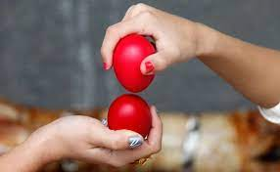
1.What is Culture?
Culture involves beliefs, attitudes, values, and traditions that are shared by a group of people
Kroeber και Kluckhohn - 164 definitions
Culture is:
LEARNED, SHARED, DYNAMIC, SYMBOLIC

Slide 9
Culture refers to:
nationality,
ethnic background,
religion,
gender,
sexual orientation, region/area [ex. favelas], social class
beliefs
attitudes
values
norms
rules

Slide 10
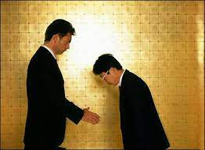
2. What is Intercultural Communication?
Intercultural Communication refers to the communication between people from different cultures (Chen and Starosta)
Communication across different ethnic or
social groups
Intercultural Communication is:
INTERPRETIVE, TRANSACTIONAL, SYMBOLIC

Slide 11
ETHNOCENTRISM
‘’WE’’: <--------- VS ---------> ‘’OTHERS’’
powerful set of powerful set
cultural norms of cultural forms
↓ ↓
OUR culture = THEIR culture =
the ‘default’ setting, ≠ the ‘different’ one
the ‘correct’ one, the norm the ‘weird’ one
SUPERIOR INFERIOR
↓
ETHNOCENTRISM [Greek origin: ethnos (nation) + kentro (center)]

Slide 12
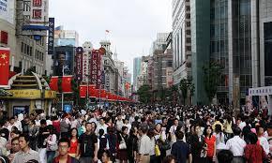

Slide 13

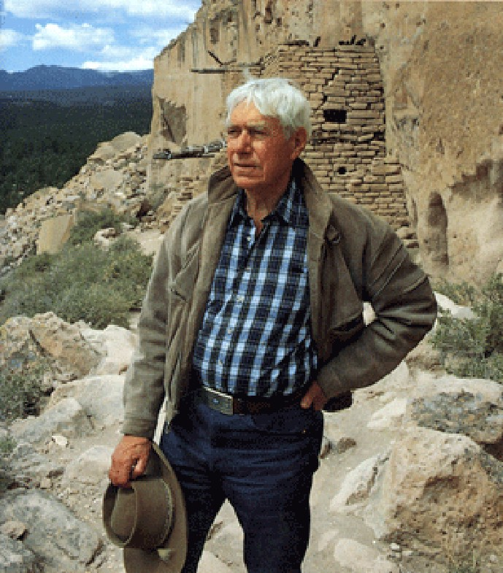


3. Edward Hall (1914-2009)
Owl Nottcex/Hihg Nottcex, Proxemics, Chronemics

Slide 14
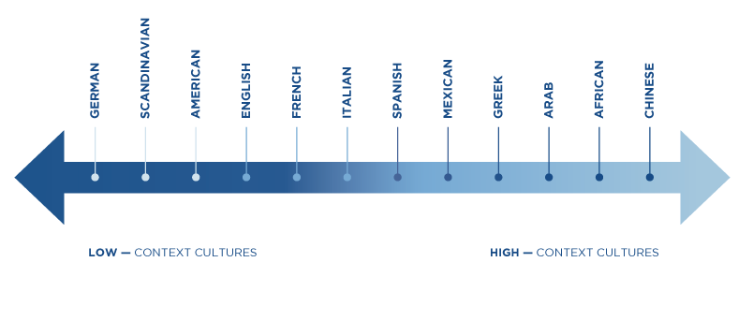
a) Low/High
Context
Cultures

Slide 15
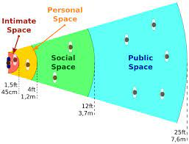
b) Proxemics
(study of Space)

Slide 16

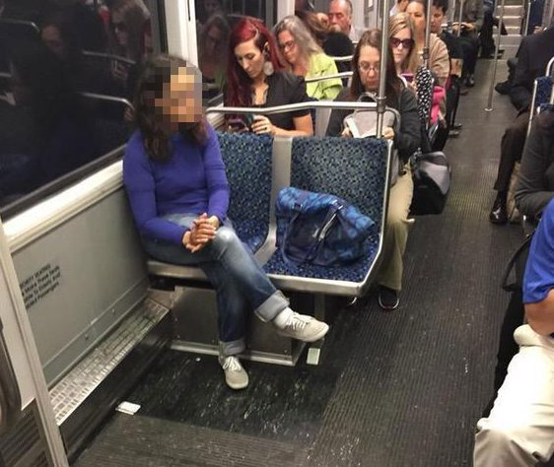
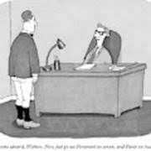
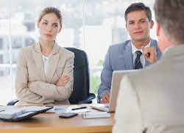
Ways to protect our space
‘bubble’

Slide 17
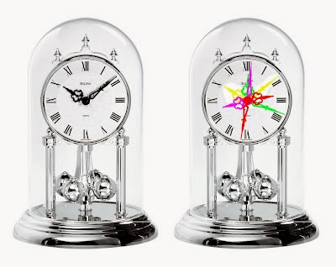
c) Chronemics
(study of Time)
Monochronic vs Polychronic
Monochronic -> Things are done one at a time
-> There is an appropriate time and place
for everything
Polychronic -> Multiple things can be done simultaneously
-> More lenient with time and more relaxed

Slide 18
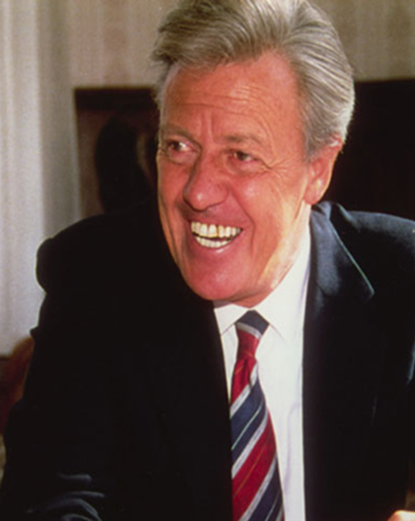

4. Richard D. Lewis (1930-)
Linear-active, Multi-active, Reactive

Slide 19
USA China Greece
LINEAR-ACTIVE REACTIVE MULTI-ACTIVE
Polite but direct Polite but indirect Emotional
Talks half the time Listens most of the time Talks most of the time
Rarely interrupts Doesn’t interrupt Often interrupts
Does one thing at a time Never confront Confronts emotionally
Limited body language Subtle body language Extensive body language
Separates social & professional Connects social & professional Interweaves social & prof.
PPT18.

Slide 20
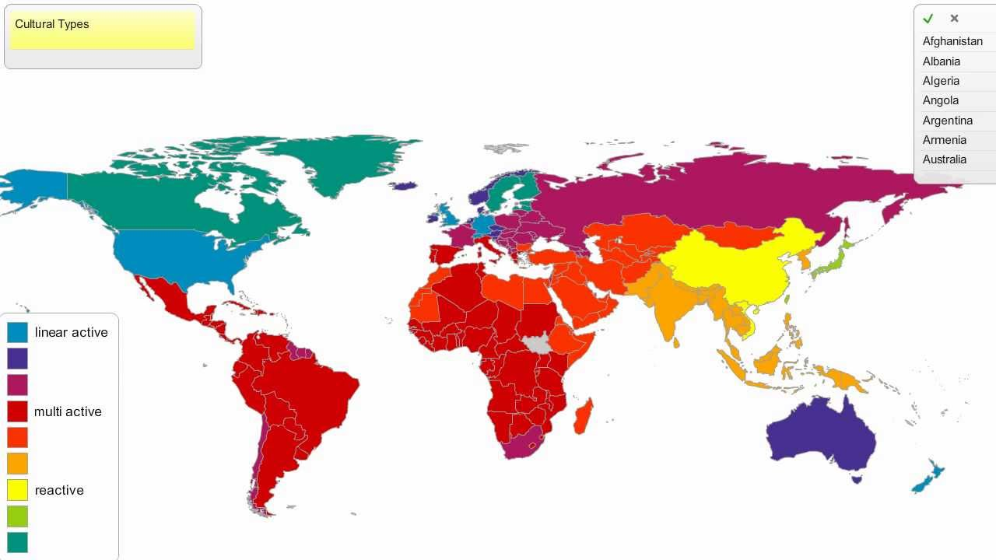

Slide 21
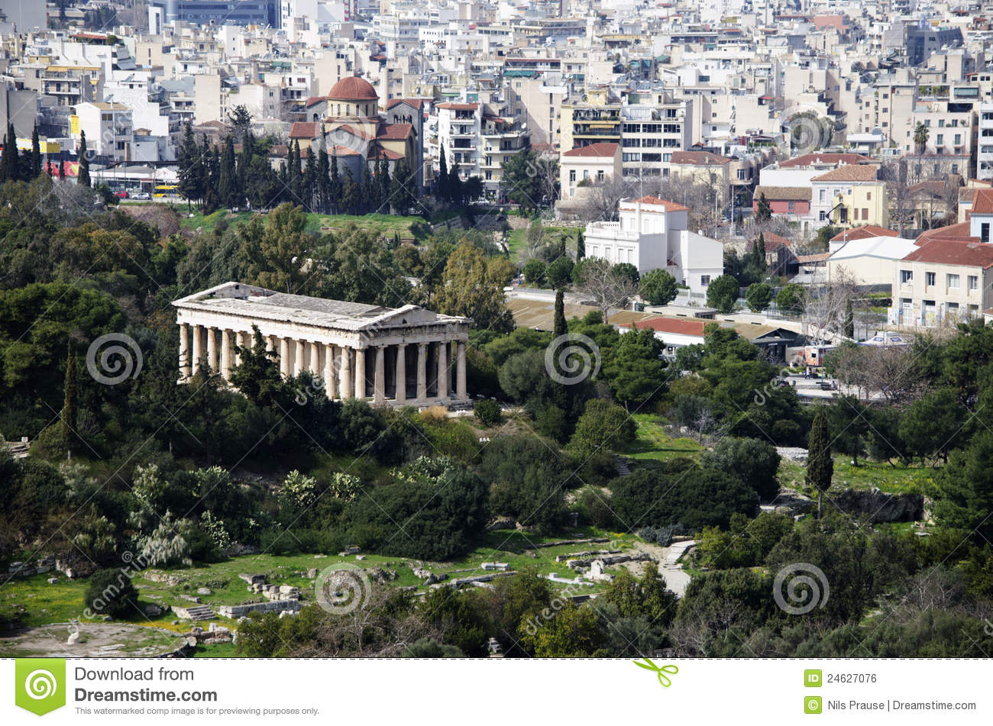
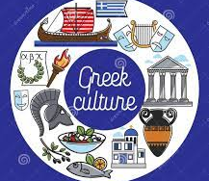
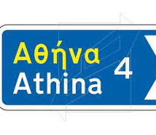
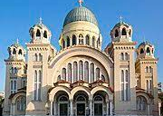
GREECE

Slide 22
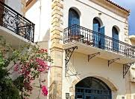
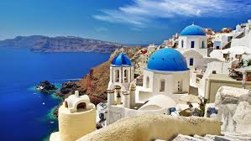
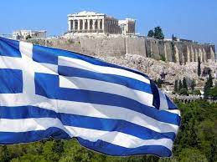
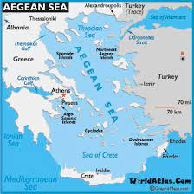
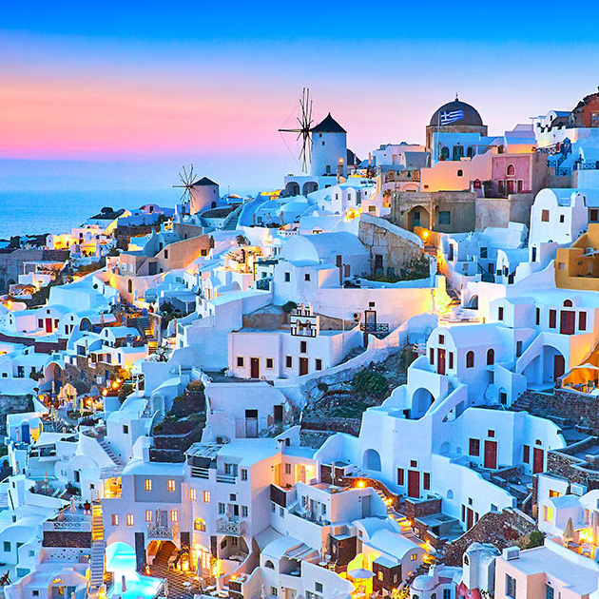
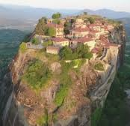

Slide 23
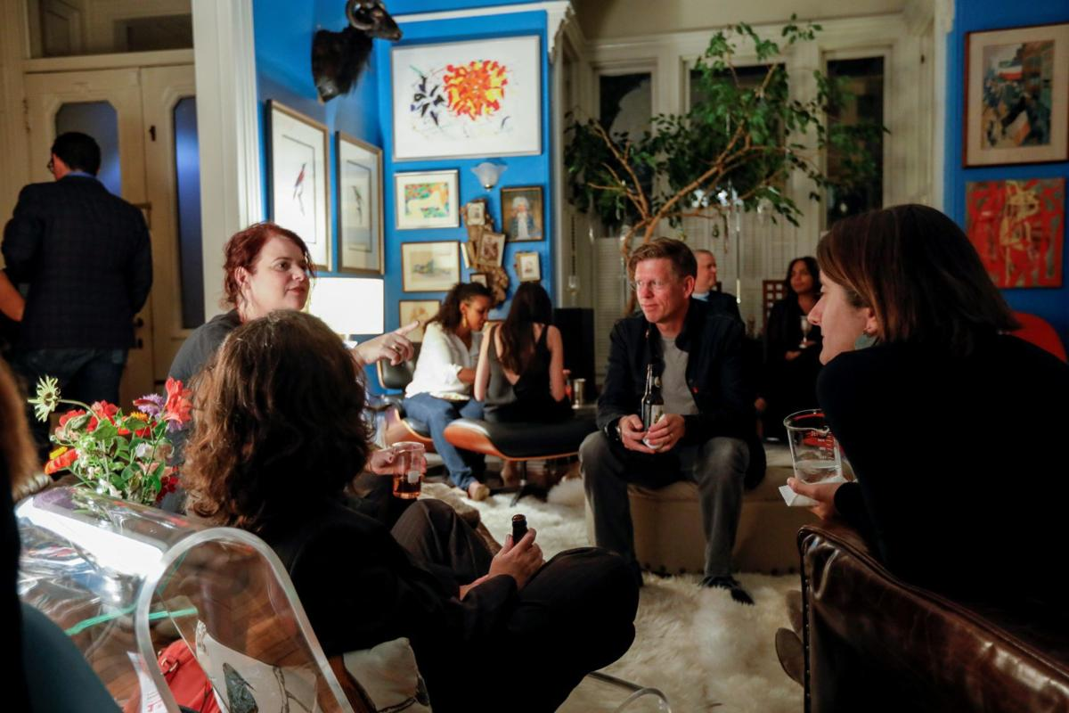
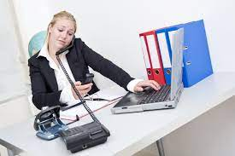
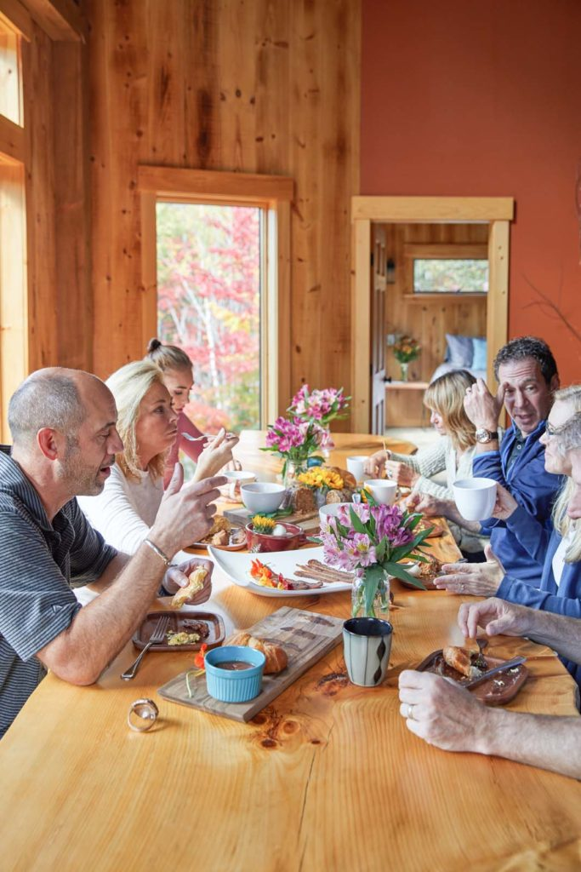
Multitasking, Simultaneous Conversations

Slide 24
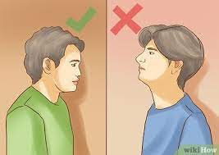
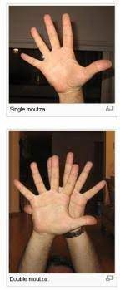
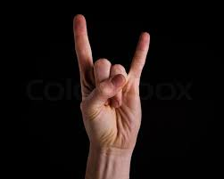
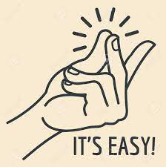
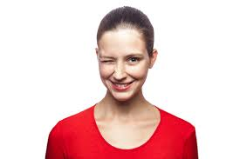
Greek gestures

Slide 25
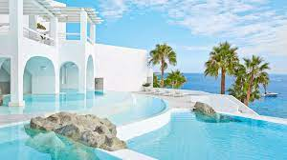
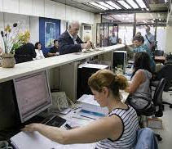
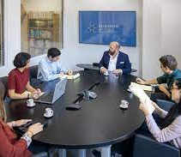
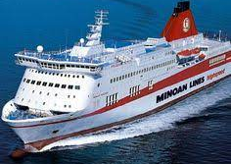
Working in Greece

Slide 26
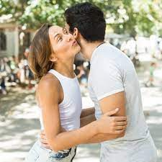
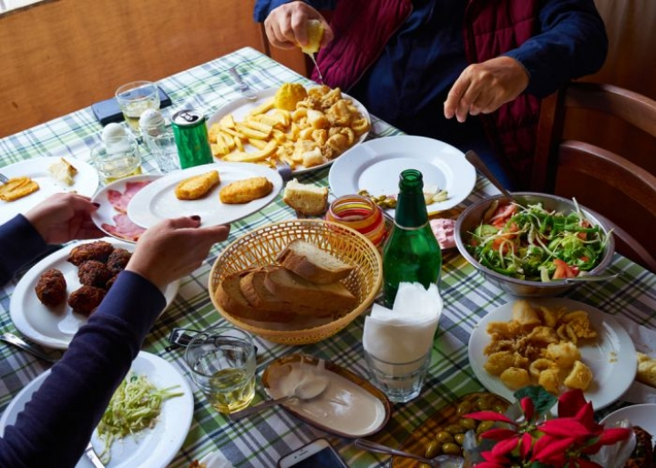
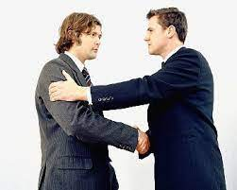
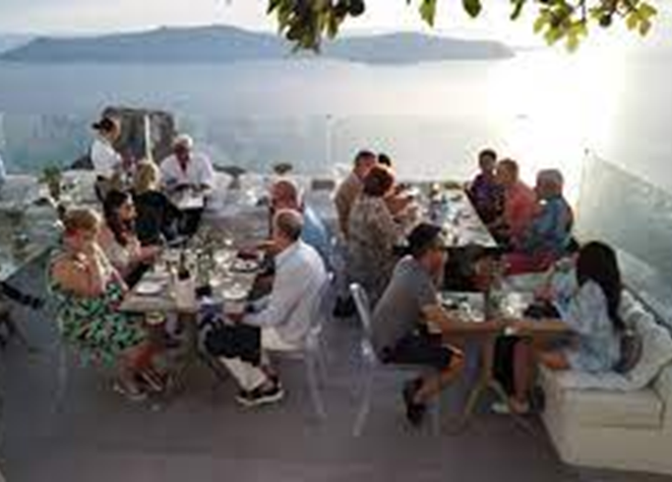
Living in Greece

Slide 27
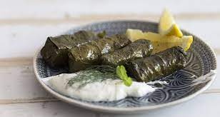
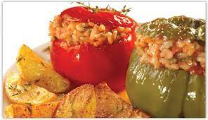
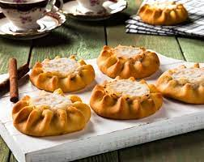
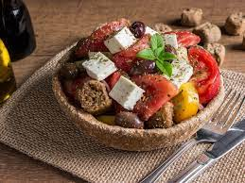
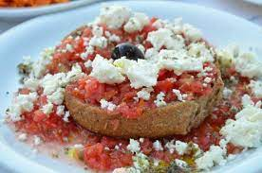
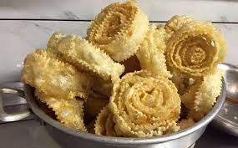
ντολμαδάκια [dolmadakia], γεμιστά [gemista], λυχναράκια [lychnarakia], ντάκος [dakos], Ελληνική σαλάτα [Elliniki salata], δίπλες [diples]

Slide 28

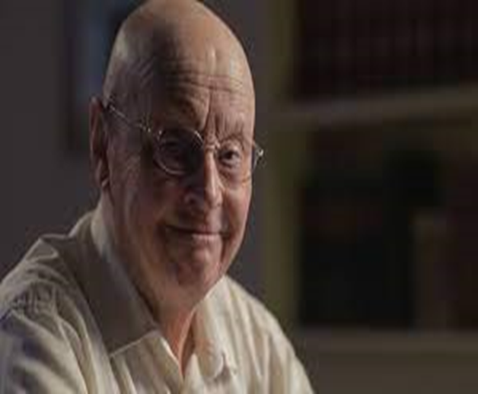

6. Geert Hofstede (1928-2020)
The six cultural dimensions

Slide 29
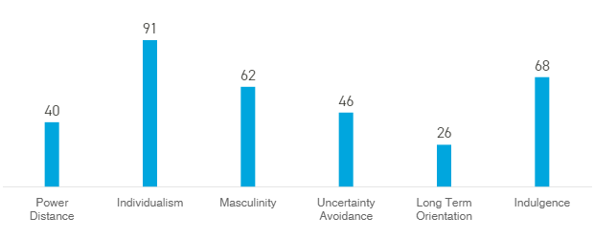
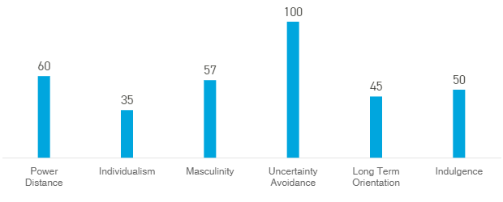
USA vs GREECE

Slide 30
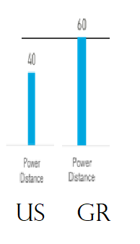
a. Power Distance
Low Power Distance
USA 40%, AUSTRIA, Germany
high Power Distance
CHINA, ARAB COUNTRIES, MEXICO, Greece 60%
- Superiors/Elders taking full responsibly
- Strong hierarchy model in society & business
- ‘Open-door’ policy
- Low hierarchy model
in society & business

Slide 31

b. Individualism vs Collectivism
INdividualisM
USA 91%, Germany, Ireland,
S. Africa, Australia
Collectivism
China, Korea, Taiwan, Venezuela,
Argentina, Brazil, GREECE 35%
- “I”
- Merit
- “We”
- Trustworthy & Long-lasting relationships

Slide 32

c. Masculinity vs Femininity
Masculinity
JAPAN, AUSTRIA, USA 62%,
ITALY, Greece 57%
Femininity
Denmark 16%, SWEDEN, NORWAY, norway
- Competitiveness, assertiveness
- Heroism
- Achievement, material reward
- Wanting to be the best
“Strive to be the best you can be’’
- Cooperation
- Quality of life & Work life balance
- Caring for the weak
- Liking what you do

Slide 33

d. Uncertainty Avoidance
low uncertainty avoidance
DENMARK, SINGAPORE, SWEDEN, USA 46%
High uncertainty avoidance
Greece 100%, japan, France, Israel
- Easily undertake risks
- Accept innovative ideas, products
- Avoid risks
- Standardize bureaucratic procedures
- A plethora of rules and laws

Slide 34

e. Term Orientation
Short term orientation
Israel, UsA 26%, Australia, Mexico, Egypt, Greece 45%
Long term orientation
Japan, China, Germany, Russia, Netherlands, France
- National pride & Respect for Tradition
- “Good” vs “Evil” -> clear distinction
- Little savings
- Quarterly reports
- Shares & mutual funds
- Future rewards with perseverance
- “Good” vs “Evil” -> relative
- Savings & funds for investments
- Long term profits
- Family businesses, Real Estate

Slide 35

f. Restraint vs Indulgence
Indulgence
Australia, Canada, USA 68%,
argentina
RESTRAINT
eastern Europe, Russia, Asian countries
- Personal life Control
- Fulfil personal Desires
- Feel Healthier & Happier
GREECE: 50%
- Strict social norms
- Less personal life control
- Feel less Healthy & Happy

Slide 36
AME GR
- 1,000.50 dollars
- ?
- ;
- "……."
- Imperial system
- Yes, No, Hi!
- 1.000,50 dollars
- ;
- ̇
- «.........»
- Metric system
- Ναι [Ne’], Όχι [Ohi], Γειά! [Gia’]

Slide 37





Slide 38

CRETE
https://www.youtube.com/watch?v=rpUbfnMls3U

Slide 39

7. Developing ICC
- Open mindedness
- Observation
- Active Listening & Confirmation
- Acceptance of mistakes
- Hire an I. C. consultant
- An adventure
ENJOY and LAUGH !!!

Slide 40


7. Acculturation: Adapting to different cultures

Slide 41
BIBLIOGRAPHY
Agar, M. (2006). Culture: Can you take it anywhere? International Journal of Qualitative Methods. 5(2), pp.1-16.
Carte, P. & Fox, C. (2008). Bridging the culture gap: A practical guide to international business communication (2nd ed.). Philadelphia: Kogan Page.
Hofstede, G. (2011). Dimensionalizing Cultures: The Hofstede Model in Context. Online Readings in Psychology and Culture, 2(1).
Holliday, A. 2013. Understanding Intercultural Communication: Negotiating a Grammar of Culture. London: Routledge.
Hynes, G. E. (2012). Improving employees’ interpersonal communication competencies: A qualitative study. Business Communication Quarterly, 75(4): 466-475. doi:10.1177/108056991

Slide 42
Websites
https://sk.sagepub.com/books/becoming-intercultural/n4.xml
http://www.thelaosexperience.com/2019/01/14/reentry-shock-an-explanation/wcurve/
https://www.hofstede-insights.com/country/greece/
https://www.hofstede-insights.com/country-comparison/the-usa/
https://www.britishcouncil.org/voices-magazine/how-has-greek-influenced-english-language
https://www.dw.com/en/greece-moves-to-end-brain-drain-with-high-paying-jobs/a-51787172
https://www.business-to-you.com/hofstedes-cultural-dimensions/
http://larissiscosmopolitanlife.blogspot.com/2015/01/monochronic-and-polychronic-cultures.html
https://pressbooks.bccampus.ca/professionalcomms/chapter/8-1-intercultural-communication/
http://16-09-1977.com/China/Shanghai/slides/Street_People_Masses_2.html
https://www.youtube.com/watch?v=f16cwfdSuOQ&list=RDf16cwfdSuOQ&start_radio=1
https://www.weimprovecompanies.com/en/want-success-bridge-the-culture-gap/
https://gr.pinterest.com/pin/442900944587530088/?d=t&mt=login
https://www.lacooltura.com/2017/02/robinson-crusoe-lavventura-del-naufrago/

Slide 43


Thank you!
Hellenic Mediterranean University

Slide 44


