Slide 1

INTERCULTURAL
COMMUNICATION
PARASKEVI kotti
05/25/2022
H.M.U.

Slide 2
INTERCULTURAL
COMMUNICATION
kotti paraskevi
25/03/2022
H.M.u.

Slide 3
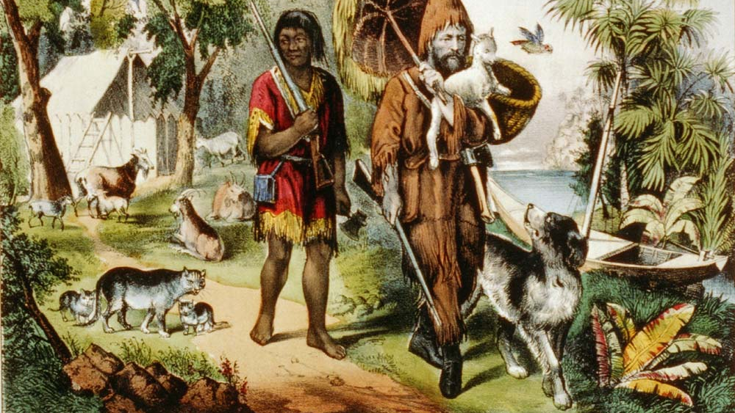
Friday in ‘’Robinson Crusoe’’
(by D. Defoe)

Slide 4
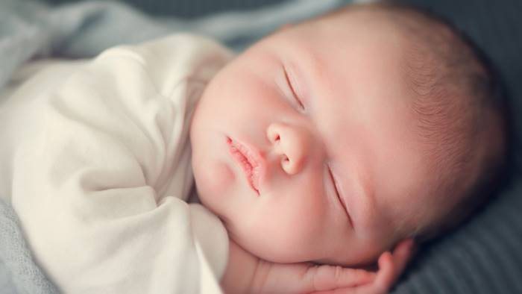
Nomi vietati per i neonati: ecco gli otto proibiti per legge
[Forbidden names for babies: here are the eight [categories] prohibited by law]
https://www.ottopagine.it/av/attualita/137624/nomi-vietati-per-i-neonati-ecco-gli-otto-proibiti-per-legge.shtml
In Italy 'Friday / Venerdi’' is prohibited, in New Zealand 'Lucifer' and in Sweden 'Ikea': a journey through the prohibitions that prevent giving abstruse names to children.
Also, in 2008, the Italian judge prohibited a couple from calling their baby girl 'Andrea’ as it is considered purely masculine.

Slide 5
Intercultural Communication
1. What is Culture?
2. What is Intercultural Communication?
3. Ed. Hall: Owl Nottcex vs Hihg Nottcex, Proxemics, Chronemics
4. The Lewis Model
5. Hofstede’s cultural dimensions
6. Case study: Greece vs USA
7. Developing ICC

Slide 6
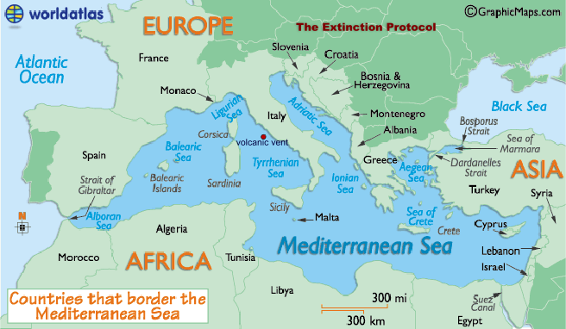

Slide 7
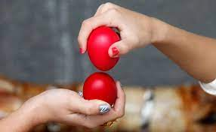
1.What is Culture?
Culture involves beliefs, attitudes, values, and traditions that are shared by a group of people
Kroeber και Kluckhohn - 164 definitions
Culture is:
LEARNED, SHARED, DYNAMIC, SYMBOLIC

Slide 8
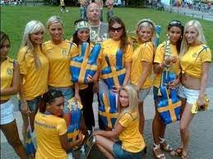
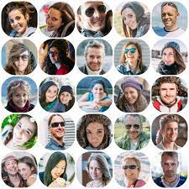
Culture: nationality and ethnic background

Slide 9
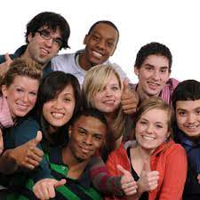
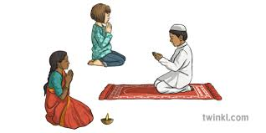

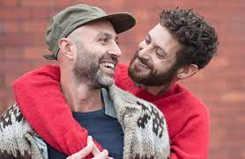
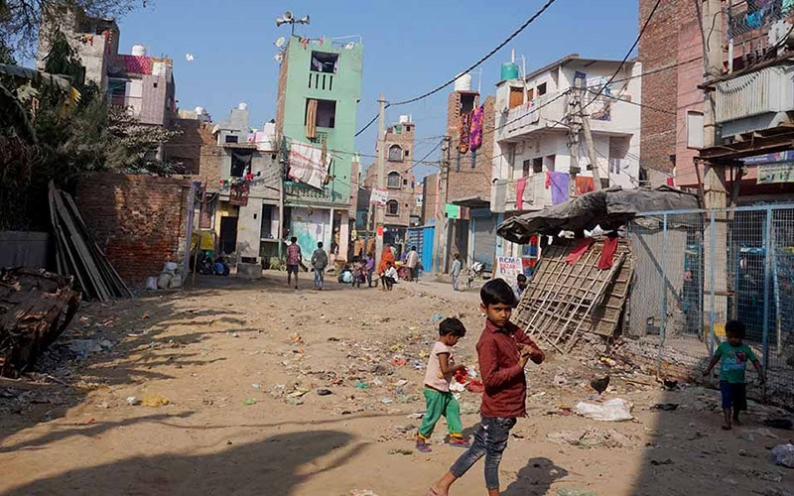

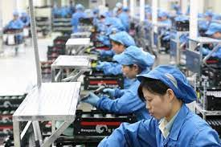
Culture: race, religion, gender, sexual orientation, region/area [ex. favelas], social class

Slide 10
These groups have COMMON:
beliefs
attitudes
values
norms
rules

Slide 11
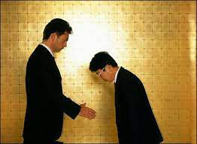
2. What is Intercultural Communication?
Intercultural Communication refers to the communication between people from different cultures
Communication across different ethnic or
social groups
Intercultural Communication is:
INTERPRETIVE, TRANSACTIONAL, SYMBOLIC

Slide 12
ETHNOCENTRISM
“WE”: <--------- VS ---------> “OTHERS”
powerful set of powerful set
cultural norms of cultural forms
↓ ↓
OUR culture = THEIR culture =
the ‘default’ setting, ≠ the ‘different’ one
the ‘correct’ one, the norm the ‘weird’ one
SUPERIOR INFERIOR
↓
ETHNOCENTRISM [Greek origin: ethnos (nation) + kentro (center)]

Slide 13
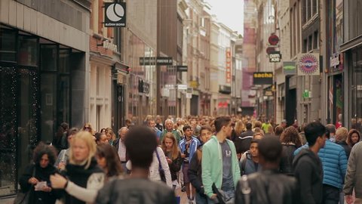
Shanghai
-more than 24,000,000 people, 40% of those foreign born
-one of the most multicultural cities in the world.

Slide 14

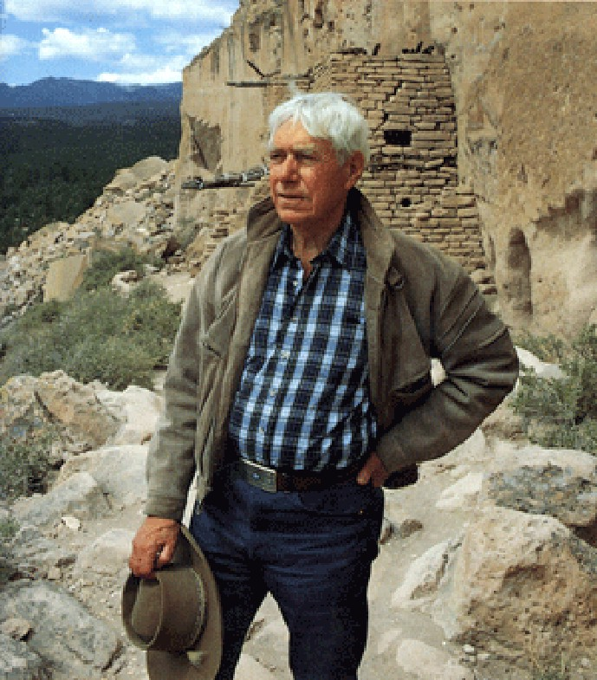


3. Edward Hall (1914-2009)
Owl Nottcex/Hihg Nottcex, Proxemics, Chronemics

Slide 15
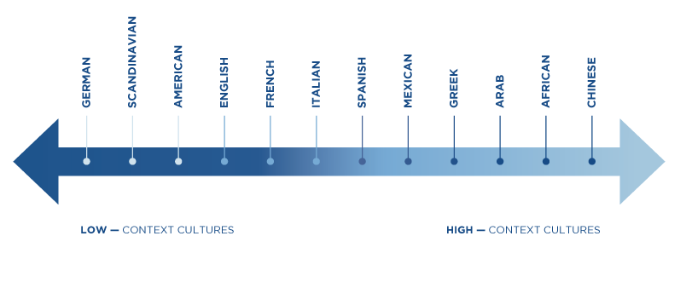
a) Low/High
Context
Cultures

Slide 16
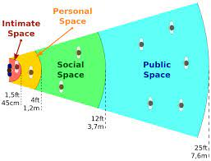
b) Proxemics
(Space)

Slide 17
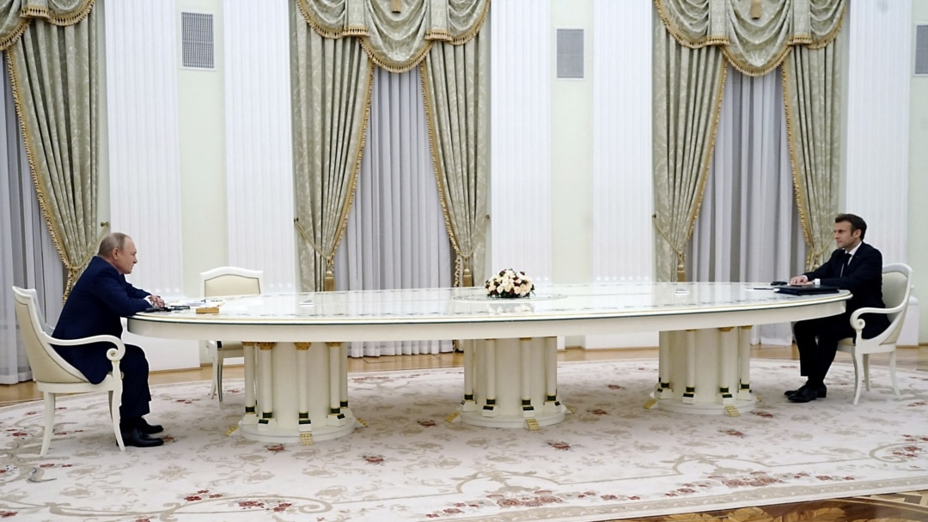

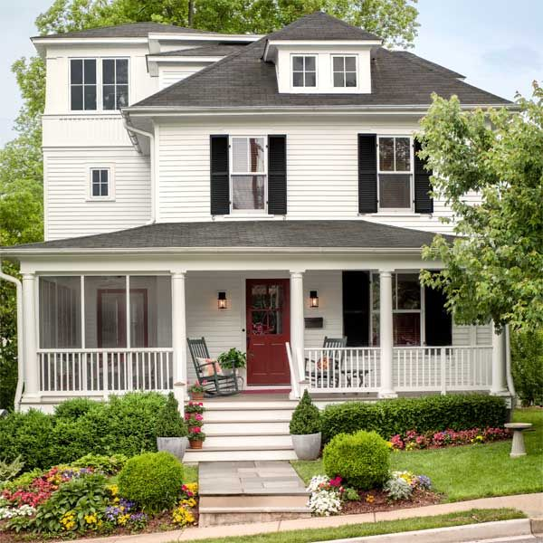
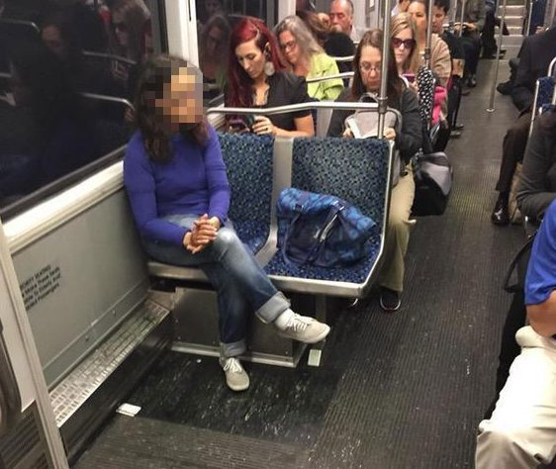
Ways to protect our space
‘bubble’

Slide 18
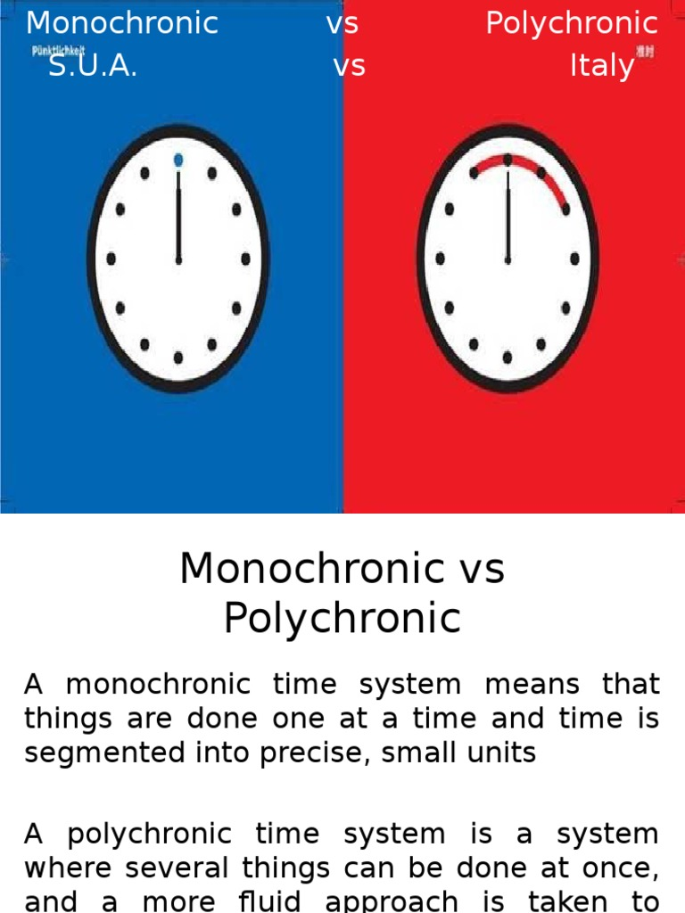
c) Chronemics
(Time)

Slide 19
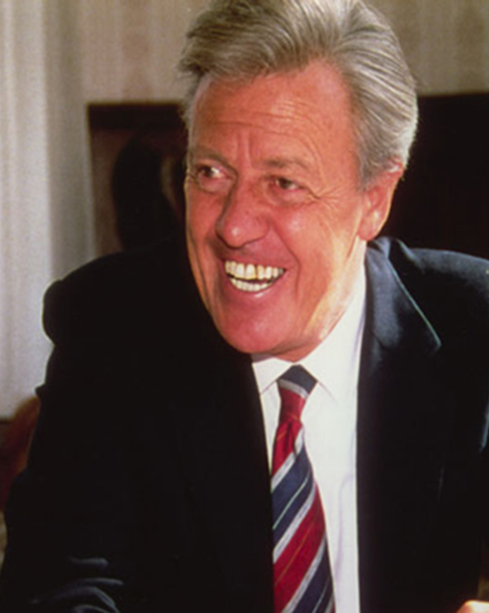
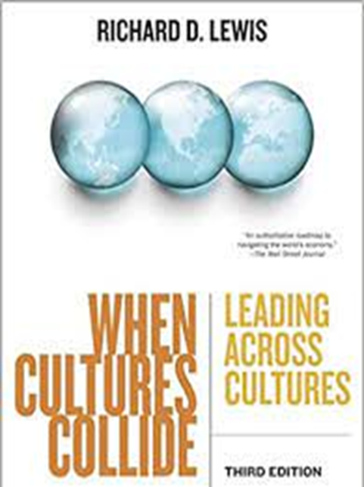
4. Richard D. Lewis (1930-)
Linear-active, Multi-active, Reactive

Slide 20
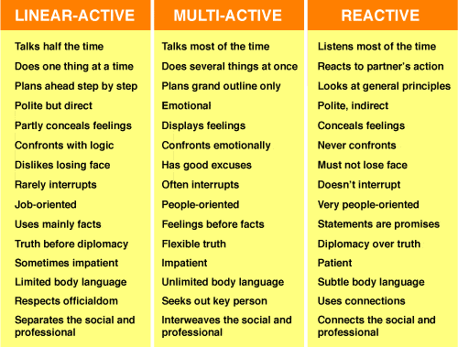

Slide 21
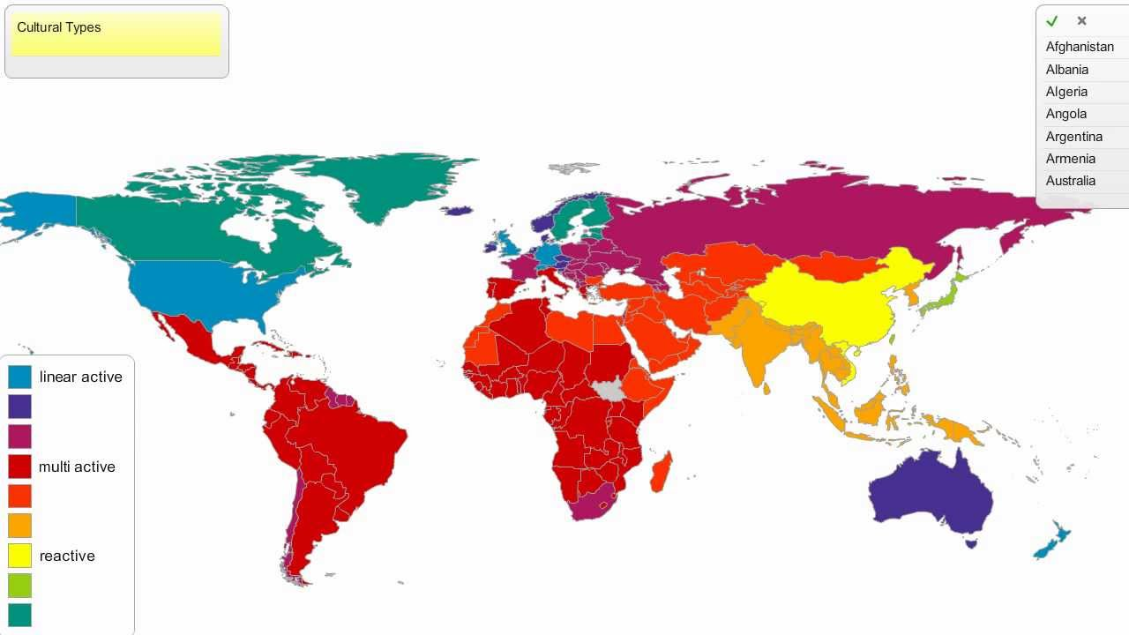

Slide 22
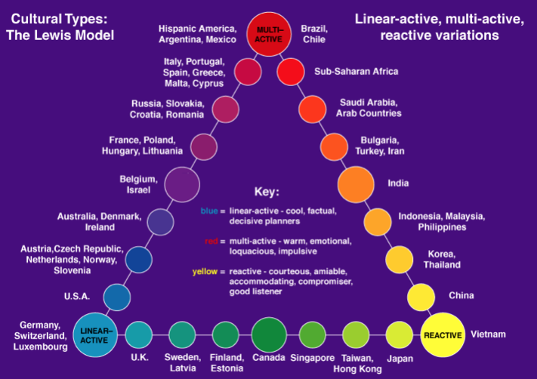
Linear Active Reactive

Slide 23
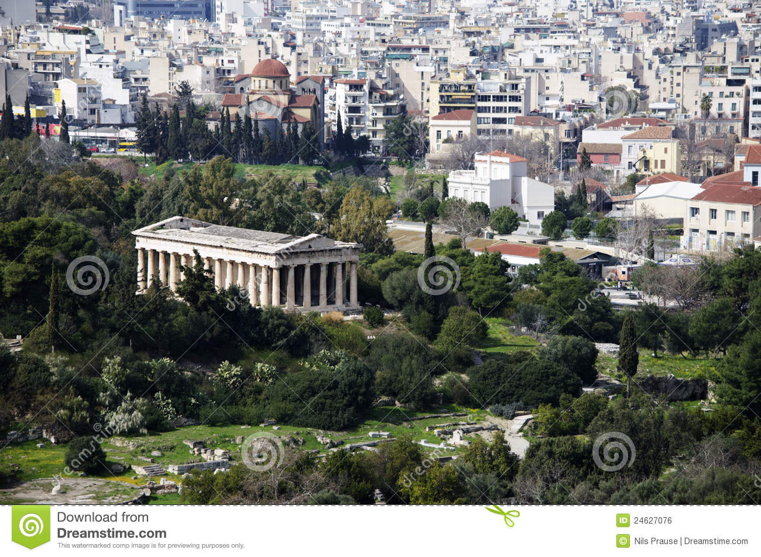
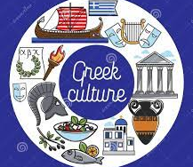
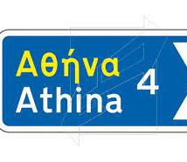
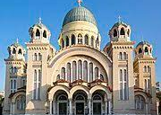
GREECE

Slide 24
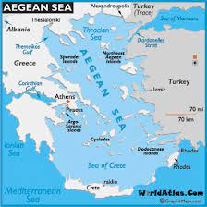
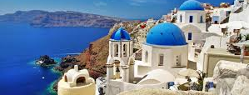
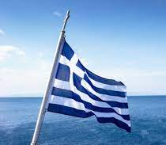
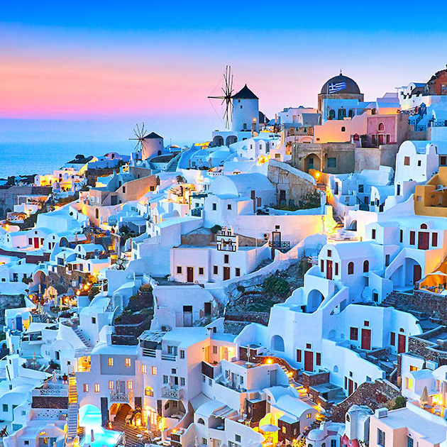
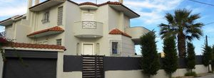

Slide 25
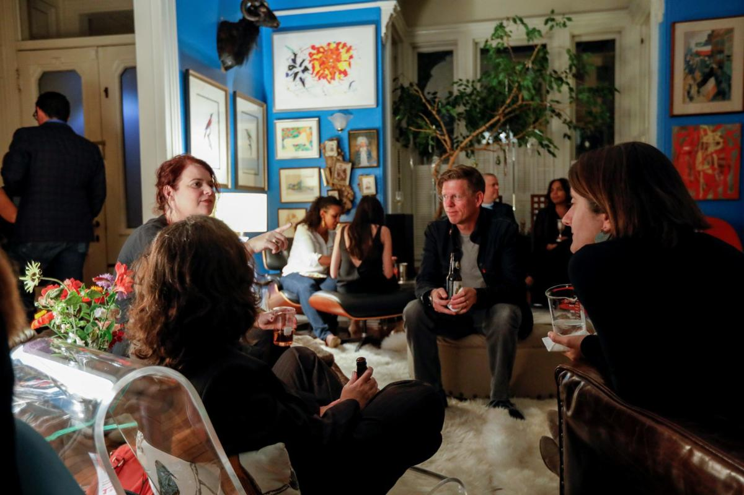
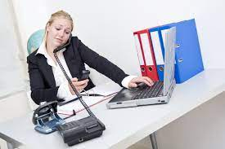
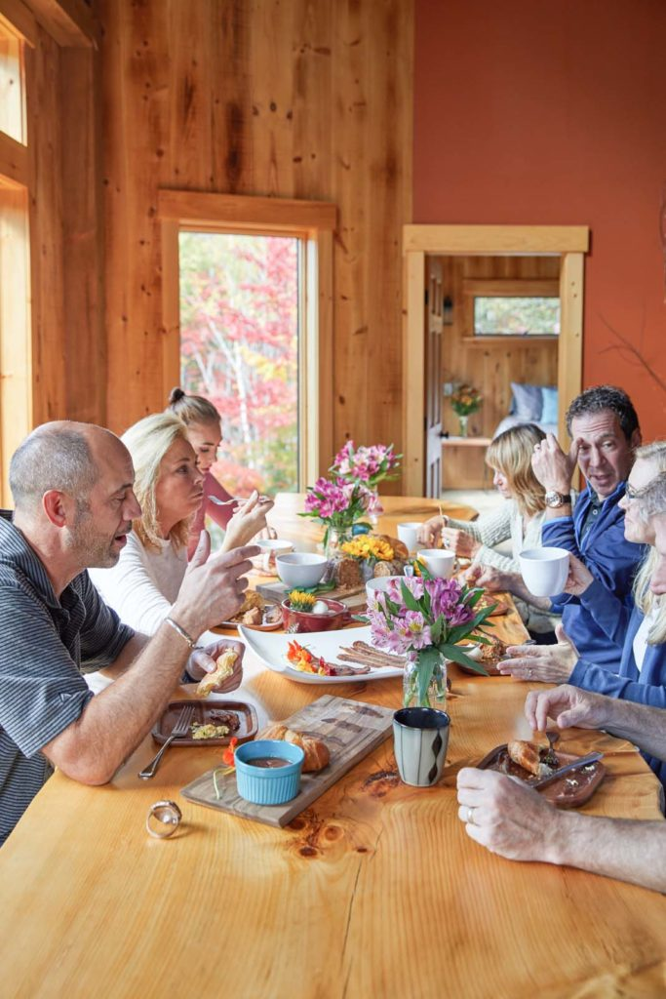
Multitasking, Simultaneous Conversations

Slide 26
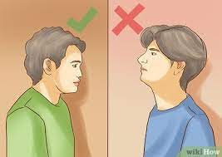
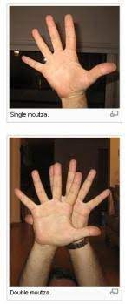
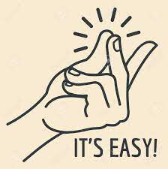
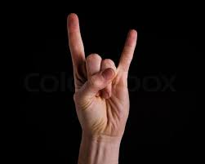
Greek gestures

Slide 27
Some gestures…
https://www.youtube.com/watch?v=qCo3wSGYRbQ

Slide 28
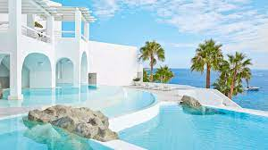
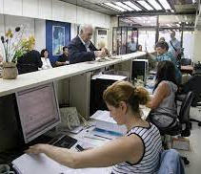
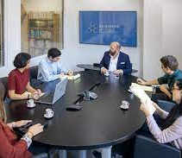
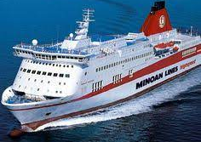
Working in Greece

Slide 29
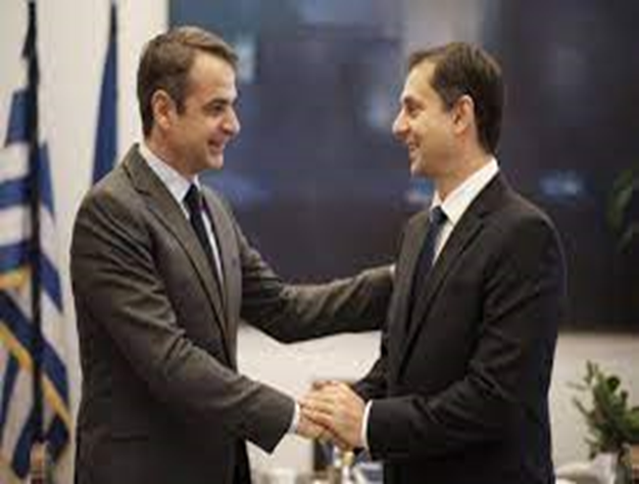
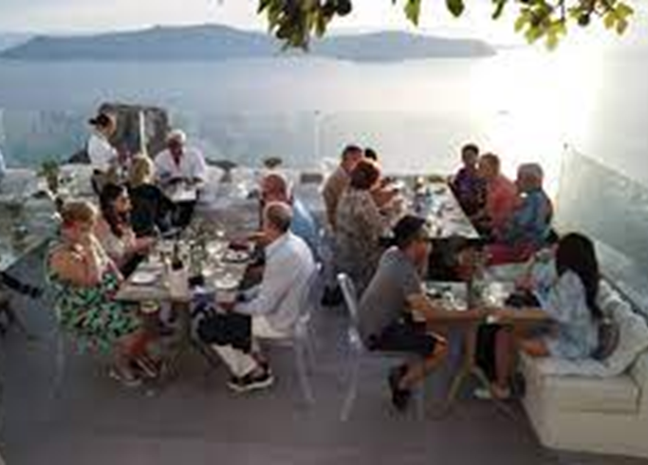
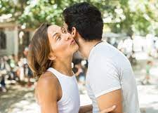
Living in Greece

Slide 30
https://www.youtube.com/watch?v=rJ4IbhXrqnc
https://www.youtube.com/watch?v=9YWFf170GVI
https://www.youtube.com/watch?v=zQvqDv4vbEg&t=50s

Slide 31
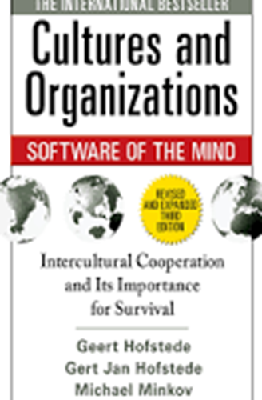


6. Geert Hofstede (1928-2020)
The six cultural dimensions

Slide 32
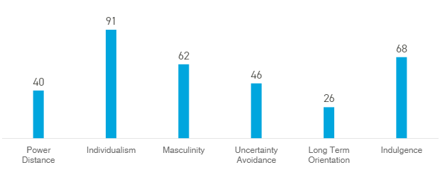

USA vs GREECE

Slide 33

a. Power Distance
Low Power Distance
USA 40%, AUSTRIA, Germany
high Power Distance
CHINA, ARAB COUNTRIES, MEXICO, Greece 60%
- Superiors/Elders taking full responsibly
- Strong hierarchy model in society & business
- ‘Open-door’ policy
- Low hierarchy model
in society & business

Slide 34

b. Individualism vs Collectivism
INdividualisM
USA 91%, Germany, Ireland,
S. Africa, Australia
Collectivism
China, Korea, Taiwan, Venezuela,
Argentina, Brazil, GREECE 35%
- “I”
- Merit
- “We”
- Trustworthy & Long-lasting relationships

Slide 35

c. Masculinity vs Femininity
Masculinity
JAPAN, AUSTRIA, USA 62%,
ITALY, Greece 57%
Femininity
SWEDEN, NORWAY, NETHERLANDS, C. RICA
- Competitiveness, assertiveness
- Heroism
- Achievement, material reward
- Wanting to be the best
“Strive to be the best you can be’’
- Cooperation
- Quality of life
- Caring for the weak
- Liking what you do

Slide 36

d. Uncertainty Avoidance
low uncertainty avoidance
DENMARK, SINGAPORE, SWEDEN, USA 46%
High uncertainty avoidance
Greece 100%, japan, France, Israel
- Easily undertake risks
- Accept innovative ideas, products
- Avoid risks
- Standardize bureaucratic procedures
- A plethora of rules and laws

Slide 37

e. Term Orientation
Short term orientation
Israel, UsA 26%, Australia, Mexico, Egypt, Greece 45%
Long term orientation
Japan, China, Germany, Russia, Netherlands, France
- National pride & Respect for Tradition
- “Good” vs “Evil” -> clear distinction
- Little savings
- Quarterly reports
- Shares & mutual funds
- Future rewards with perseverance
- “Good” vs “Evil” -> relative
- Savings & funds for investments
- Long term profits
- Family businesses, Real Estate

Slide 38

f. Restraint vs Indulgence
Indulgence
Australia, Canada, USA 68%,
argentina
RESTRAINT
eastern Europe, Russia, Asian countries
- Personal life Control
- Fulfil personal Desires
- Feel Healthier & Happier
GREECE: 50%
- Strict social norms
- Less personal life control
- Feel less Healthy & Happy

Slide 39
AME GR
- 1,000.50 dollars
- ?
- ;
- “…….”
- Imperial system
- 1.000,50 dollars
- ;
- ̇
- «.........»
- Metric system

Slide 40





Slide 41

7. Developing ICC
- Open mindedness
- Observation
- Active Listening & Confirmation
- Acceptance of mistakes
- Hire a professional
- An adventure
ENJOY and LAUGH !!!

Slide 42


7. Acculturation: Adapting to different cultures

Slide 43
https://www.youtube.com/watch?v=2xJ_hbD4TQA&t=83s

Slide 44


Thank you!

