Slide 1
WHAT IS NETWORKING?
P. KOTTI, HELLENIC MEDITERRANEAN UNIVERSITY

Slide 2
WHAT IS Networking?
why it is important in our career development?
what to say?
how to say it?

Slide 3

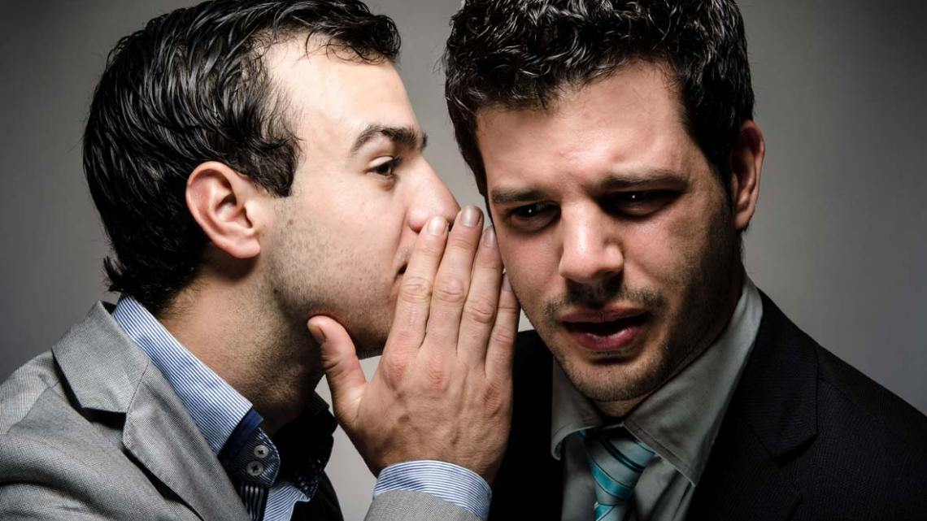
ACCORDING TO RESEARCH ONLY 30%
OF VACANCIES ARE ADVERTISED…

Slide 4
WHAT IS NETWORKING ?
connecting with people (COLLEAGUES, SUPERIORS, FRIENDS)
MUTUAL ACQUAINTANCES/INTERESTS – PROFESSIONAL NETWORK
building professional relationships
INFORMING about our job search & PROFESSIONAL goals

Slide 5
increasing professional network
join a professional organiSation, [group of people with similar JOBS or careers].
use social media websites, EX. LinkedIn, FB, Twitter.
contact College/UNIVERSITY Alumni groups [PAST STUDENTS].

Slide 6



SMALL TALK
NETWORKING ELEVATOR SPEECH

Slide 7

SMALL TALK
A polite conversation :
1ST - > ABOUT SAFE TOPICS (FAMILY, WEATHER, CAREER, FOOD, TRAVEL, FILMS, MUSIC, SPORTS, TRAVEL)
2nd -> ABOUT MORE SERIOUS PROFESSIONAL TOPICS

Slide 8

Which topics should you not talk about?

Slide 9

Avoid taboo/controversial topics
SALARY, OFFENSIVE JOKES
AGE, RELIGION,
POLITICS, PERSONAL GOSSIP,

Slide 10
Tongue tied??
SMALL TALK - Examples
How was your weeK?
Did you do SOMETHING fun or interesting OVER THE WEEKEND?
The weather WILL BE GREAT AT THE WEEKEND. Do you have any plans?
Lovely day, don't you think?
Looks like rain is in the forecast.
Did you order this beautiful weather?

Slide 11
To make it even more interesting…
WHAT STEPS DID YOU TAKE TO become a MANAGER?
What surprised you the most in your current job?
WHAT DO YOU FIND REALLY EXCITING ABOUT YOUR CURRENT JOB?
What ABOUT your first job? Did you LEARN STH INTERESTING / DID YOU like it?
What’s the best career advice you’ve ever BEEN GIVEN? I’d love some recommendations.
How about the worst ADVICE YOU HAVE EVER RECEIVED?
any good books YOU ARE READING right now?

Slide 12
MORE QUESTIONS…
any apps that you FIND IT DIFFICULT TO live without?
IS THERE A MOVIE/ SONG/ book THAT you hated BUT everyone else loved, OR vice versa?
What’s the last movie that made you REALLY laugh aloud?
ANYONE INTERESTING TO FOLlow on Instagram?
A friend of mine may come over this weekend. Any restaurants you would recommend for lunch?

Slide 13
More questions:
What are some great places or hidden gems around here?
Have you ever been on a cool road trip? I’M Thinking about travelling by car this summer.
Where’s the last place you traveLled TO? What was it like?
What’s the next trip you have planned? Do you prefer action-packed holidays or just relaxing on the beach?
What’s your favorite thing to do around here at the weekends? Any good recommendations?

Slide 14
WHERE TO NETWORK & HOW?

Slide 15
WHERE TO NETWORK & HOW?
EVERYWHERE:
LUNCH BREAKS, events, office parties, alumni GROUPS -> informally
CONFERENCES, ELEVATORS, LINKEDIN -> MORE formally

Slide 16
NETWORKING ELEVATOR SPEECH
Speech in an ‘elevator’ -> 30’’
α Brief presentation of:
ourselves
Skills
Career goals

Slide 17
ELEVATOR SPEECH SHOULD BE:
1. PREPARED
2. PRACTICED BEFOREHAND

Slide 18

How To Create Your 30 Second Elevator Pitch! | The Intern Queen
https://www.youtube.com/watch?v=Lb0Yz_5ZYzI

Slide 19
STEPS: What to say or ask
1. full name & current job title, COMPANY or employer.
2. kind of job you are looking FOR, or in which field/AREA/location.
3. a RELEVANT past job or experience.
4. a RELEVANT job skill you are very good at.
5. ask ABOUT JOB VACANCIES OR OPENINGS.

Slide 20
SAMPLE 1:
Hello. I am Evi Kotti and I have been working as an English Teacher at the Dept. of Business Administration, at the Hellenic Mediterranean University, for the last 5 years. I am currently looking for a teaching position at the University of Durham. One of the things I like most about teaching English, esp. to foreign students, is getting to know new cultures and people from all over the world as well as offering those students knowledge and help them grow in their chosen professional field. I am really good at listening to students and helping them with both academic and business English. Do you know if the University of Durham is hiring any new English teachers at the moment?

Slide 21
SAMPLE 2:
Hello. I am Mark Peterson and I am a student at the Dept. of Business Administration and Tourism, at the Hellenic Mediterranean University. I am currently looking for a position in your company as an intern /assistant manager/ receptionist/ secretary. One of the things I like most about being an administrative assistant /assistant manager/ receptionist, is that I can interact with a variety of people as well as learn the ins and outs of the work in a functioning office / team/ leading hotel. I am really good at time management, and I also have good organizational and interpersonal skills which are important in any job setting. I find the work you do both innovating and refreshing. So, I’ d love the opportunity to work for your company. Would you mind if I set up a quick call next week to talk about any upcoming opportunities on your team?

Slide 22
MOST TIMES…
Networking needs some effort & time to grow
But
It helps you find out about job openings before others!

Slide 23
Sources:
https://www.google.gr/search?hl=el&biw=1366&bih=657&tbm=isch&sa=1&ei=TLhpXJTpJMfVwAKrzanACQ&q=NETWORKING+ELEVATOR+SPEECH+IMAGES&oq=NETWORKING+ELEVATOR+SPEECH+IMAGES&gs_l=img.3...22722.25311..26048...0.0..0.130.1181.4j7......1....1..gws-wiz-img.X0Sav12iMoo
https://hr.harvard.edu/career-development
https://cardinalatwork.stanford.edu/learning-stanford/career-guidance
https://www.verywellmind.com/small-talk-topics-3024421
http://www.englishandculture.com/blog/bid/99051/4-English-Topics-to-Avoid-in-American-Small-Talk

Slide 24

THANK YOU!

