Slide 1
DEPARTMENT OF BUSINESS ADMINISTRATION
Job Interviews

Slide 2
Objectives
Employer: to find the ideal person for the job
    Can he/she do the job? (skills, abilities, qualifications)
    Will he/she stay in the job? (interest, attitude & motivation)
    How will he/she fit into the organisation? (personality)
You: to impress employer and get the job
    What does this position offer me?
    How does it fit with my career plans?

Slide 3
Your interview starts well before you enter the HR’s room!
STEP 1- PREPARATION

Slide 4
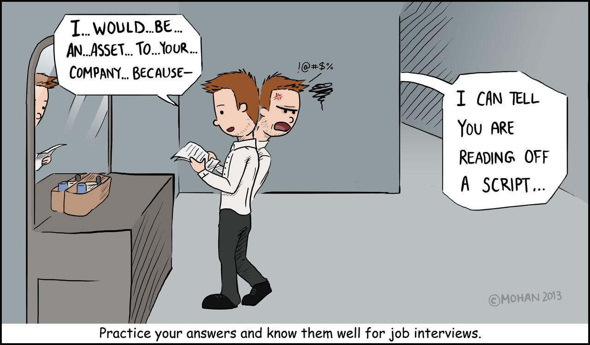

Slide 5
STEP 1a - Preparation
CV and COVER LETTER:
√ Prepare a Good CV
√ Job Oriented
√ Make sure you learn them!
√ Reference letters

Slide 6
STEP 1b - Preparation
BACKGROUND INFORMATION about:
Company name & Employer’s name
Products & services
Mission & values
Key management team
Location: Map your route to the interview site

Slide 7
STEP 1c - Preparation
WHERE TO SEARCH:
Company’s website
Search engines, ex. Google
Linkedin of the CEO, etc.
Social Media, ex. Facebook, Twitter

Slide 8
STEP 1d - Preparation
BASIC TERMS
1. Hard Skills
2. Soft Skills

Slide 9
HARD SKILLS: JOB RELATED
- Often listed in the CV /
Cover letter
- Easy to recognise and
evaluate.
Three Basic Hard Skills
√ English (or other foreign
languages);
√ Computer literacy
√ Skills specific to the job
position

Slide 10
SOFT SKILLS : ATTITUDE
They show if the employee:
1. can adapt to the working environment;
2. will be able to listen to a customer, and provide them with helpful and polite service.
Note:
- Which soft skills are needed for the job?
- Based on the job position, some soft skills are more important than others.
-They are more difficult to recognise and assess.

Slide 11
SOFT SKILLS : ATTITUDE
1. Communication skills
2. Teamwork
3. Time management
4. Active listening &
Problem-solving
5. Creative thinking &
Critical thinking
6. Work ethic
7. Positivity
8. Motivation

Slide 12
STEP 2 - DAY OF THE INTERVIEW

Slide 13
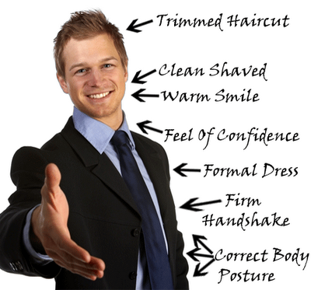

Slide 14
STEP 2a – What to TAKE or DO
DO:
√ Dress for success
√ Eat something
√ Arrive early
√ Rehearse possible
questions & answers
√ Turn off your mobile
TAKE:
√ Copy of: CV, Cover Letter, Reference Letters, Degree,
other Diplomas
√ Business Cards
√ Pen & paper
√ Water

Slide 15

STEP 2b – Interview Questions
PERSONALITY

Slide 16
Can you tell me a little about yourself?
Not too many, not too little.
A 2-part question: 1. Education - Job
        2. Personality – Interests
1. ‘’I hold a BA in Business Administration and I have worked as a receptionist for 2 years’’
2. ‘’I have good communication skills gained through my
experience as receptionist in a hotel in Hersonissos.
Also, I love playing team sports such as football and basketball’’.

Slide 17
What is your greatest strength?
Say something related to the job position.
‘’I have an extremely strong work ethic. When I'm working on a project, I want to meet deadlines or even complete it well ahead of schedule’’.
‘’I have good organisational skills gained as a secretary in an office, responsible for arranging appointments and handling correspondence’’.
‘’I pay attention to detail and I am pretty good at prioritizing tasks’’.

Slide 18
What is your greatest weakness?
√ To know your weakness = to know your boundaries
√ Show how you are dealing with your weakness
YES NO
‘’I am not very strong at public “Nothing! I'm perfect!”
speaking, so at University I “I can't meet deadlines”.
always tried to present
my projects orally’’.

Slide 19

STEP 2c – Interview Questions
EDUCATION &
WORK EXPERIENCE

Slide 20
What about your educational background?
Basic Studies
‘’I hold a degree in Business Administration from the Hellenic Mediterranean University’’
Foreign Languages
‘’I also have an English Certificate, at B2 level’’.

Slide 21
What about your educational background?
Computer Skills
‘’I have basic computer literacy skills‘’.
‘’I am very comfortable using computers and confident in my ability to learn any new programs quickly‘’.
‘’I am very experienced in word processing‘’.
‘’I am familiar with Microsoft Office programmes; that is Word, Excel, Power point. I am also familiar with using the Internet‘’.
End by saying:
‘’So, as you can see, my educational background is quite pertinent to the job position.’’

Slide 22
I see that you have no work experience.
Why should we hire you then?
Employers look favourably on any work experience, whatever this is:
volunteer experience,
internships,
presentation of projects at University, etc.
Any kind of experience gives you more common ground with the future employer, because the acquired knowledge can be as important as the work itself.

Slide 23
I see that you have no work experience.
Why should we hire you then?
Mention:
- Coursework, Class projects;
- Volunteer work;
- Extracurricular activities.
‘’This activity taught me how to do things efficiently.
‘’ // // how to work as a team.
‘’ // // to adhere to systems and procedures.
‘’ // // to put in whatever effort it takes to get the job done right.’’
Therefore, I am a candidate who is most willing to learn, work, and perform.

Slide 24
Can you describe the responsibilities you had in your previous job?
‘’I effectively managed the hotel daily operations’’.
‘’I made sure that customers had a good first and last impression of the hotel’’.
‘’I tried to create a welcoming and relaxing atmosphere for clients’’.
‘’I answered phones, booked rooms and responded to email inquiries or comments’’.
‘’I assisted the hotel manager with front desk operations’’.

Slide 25
Why did you leave / are you leaving your job?
√ Don’t lie.
√ Don’t badmouth former employers (even if they deserve it!)
√ Don’t victimise yourself.
If you lost your job:
‘’I managed to survive two rounds of corporate downsizing, but
the third round was a 20% reduction in the workforce, which
included me’’.

Slide 26
Why did you leave / are you leaving your job?
If you are still employed:
focus on what you want in your next job
‘’After two years, I made the decision to look for a company that is team-focused, where I can add my experience’’.
‘’Although I liked my job, I felt the need to quit as I wanted to pursue new opportunities and take a new step in my career’’.

Slide 27
What is your greatest professional achievement?
√ Be precise.
‘’In one month, I streamlined the process, which saved my group 10 man-hours each month and reduced errors on invoices by 25%’’.

Slide 28
Tell me about a challenge or conflict you've faced at work, and how you dealt with it.
STAR response
  S: Describe the situation
  T: Explain the task/problem that arose
  A: What action did you take?
  R: What was the result or outcome?
  What did you learn from this experience?

Slide 29
How do you handle stress and pressure?
‘’Of course, there are times at work when a lot of tasks need to be done at the same time, but I am pretty good at time management skills.
So, I immediately break down each project into small assignments, and I may delegate a part of it to the right employee, if necessary’’.

Slide 30

STEP 2d – Interview Questions
SPECIFIC JOB

Slide 31
Why do you want this job?
√ Show passion about the job
√ Identify a couple of key factors that make the role a great fit for you.
“I love customer support because I love the constant human interaction and the satisfaction that comes from helping someone solve a problem“.
‘’I’ve always been passionate about education, and I think you guys are doing great things, so I want to be a part of it”.

Slide 32
What can you do for us that other candidates can’t?
Why should I hire you?
√ Emphasize what makes you unique.
‘’I have a unique combination of strong technical skills, and the
ability to build strong customer relationships. This allows me to
be more ‘user-friendly’’.
“I believe I have exceptional organisational skills. In my last job, I
created a new system that improved productivity by 20%”.

Slide 33
What are your goals?
Short-term goal
‘’My immediate goal is to get a job in a growth-oriented company’’.
Long-term goal
‘’My long-term goal will depend on where the company goes. I hope to eventually grow into a position of responsibility’’.

Slide 34
How do you explain a gap in your CV?
Travelling?
N O
‘’I spent 5 months travelling because I didn’t feel like settling down’’.
Y E S
‘’I took 5 months in order to improve my foreign language skills and to immerse myself in a different culture. This helped me become more open minded and see life in a new perspective and leant some valuable lessons. Now, I’m ready to start focusing on my career’’.

Slide 35
How do you explain a gap in your CV?
Family Issues?
N O
‘‘I had constant fights with my parents so I left home to live with my girlfriend/boyfriend’’.
Y E S
‘’I’ve spent the last year caring
for a sick relative. Their health has now recovered and I’m ready to re-enter the workforce’’.

Slide 36
How do you explain a gap in your CV?
Redundancy?
N O
‘‘My previous boss had it in for me from day one’’.
Y E S
‘’My previous employer was forced to cut down on personnel due to serious budget cuts. They had a ‘first-in, last-out’ policy and, unfortunately I was relatively new to the company. However, I am really proud of what I achieved while working there’’.

Slide 37
How do you explain a gap in your CV?
Disease?
N O
‘’I have a recurring health problem which has made it difficult for me to have a stable job’’.
Y E S
‘’Due to a recurring medical condition I felt unable to continue in my previous job position. Nonetheless, I have fully recovered and now I feel ready to take on my next challenge’’.

Slide 38
LONG GAPS IN CVs
√ List only the years of employment/education, not the
months: the gap won’t be so obvious.
So, instead of:
Smith Company, March 2012 – January 2014
Company DEX, September 2014 – December 2016
Write:
Smith Company, 2012 – 2014
Company DEX, 2014 – 2016

Slide 39
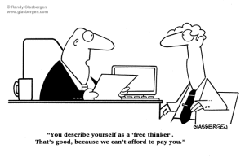
STEP 2e – Interview Questions
TRICKY QUESTIONS

Slide 40
What salary are you seeking?
‘’I am sure when the time comes, we can agree on a reasonable amount. In what range do you typically pay someone with my background?’’

Slide 41
How long do you plan on staying with us?
NO: ‘’As long as you need me’’
YES:
‘’I think this role is a great match for my skills and experience and offers me a chance to grow professionally. So, I guess that I will stay as long as we are both satisfied’’.
‘’I would like to stay for as long as I can be of help and for as long as there are growth opportunities’’.

Slide 42

STEP 2f – Interview Questions
QUESTIONS TO
THE HR RECRUITER

Slide 43
Questions to the HR
- How has this position evolved?
The answer will let you know whether this job is a dead end or a stepping-stone.
- Can you give me example of how I would collaborate with my manager?
Knowing how managers use their employees is important so you can decide whether they are the type of boss that will let you use your strengths to help the company succeed.
- Is there something else I should know about the job position?
- Will I have to attend seminars? Will you provide me with some specific training?

Slide 44
STEP 3 - AFTER THE INTERVIEW

Slide 45
After the interview
1. Get contact information.
At the end of the meeting, candidates should ask for business cards with contact information of those they interviewed with, whether it was just one person or a group. It's important to send the signal after the end of the interview that the candidate is still interested and that his efforts to secure the position won't end when he exits the interview room.

Slide 46
After the interview
2. Ask about the next steps.
Not only will asking about what the next steps are in the hiring process send the interviewer the message that the candidate is committed and truly wants the position, but it may make the applicant feel less stressed after the meeting about whether or not he'll receive a call back.

Slide 47
After the interview
3. Send a thank-you note.
This is one of the most important steps to take after an interview, and it's crucial that the applicant doesn't skip it. A recent survey indicates that more than one in five hiring managers will be less likely to offer a job to someone who doesn't send a thank you note, and many report that they interpret failing to do so as indicative of a lack of follow-through and commitment to the opportunity.

Slide 48
After the interview
4. Follow up.
If the candidate hasn't heard back from the company by the time the hiring manager said he would make his decision, he should follow up. The contact information acquired from the business cards the candidate requested at the end of the interview will be useful in this case.
Even if the candidate was rejected, they should ask feedback about why he/she was not selected, which will surely prove helpful when he pursues other opportunities in the future.

Slide 49
So, what creates a bad impression?
- Poor personal appearance
- Negative attitude – evasive, using excuses
- Lack of interest and enthusiasm
- Lack of preparation
- Poor knowledge of role
- Failure to give concrete examples of skills
- Over emphasis on money or rewards
- Lack of career plan

Slide 50
Sources:
http://www.vault.com/blog/interviewing/4-things-to-do-at-the-end-of-a-job-interview
https://graduateland.com/article/questions-to-ask-end-interview
https://www.thebalance.com/top-interview-questions-and-best-answers-2061225
https://www.theguardian.com/careers/interview-help
https://www.ucas.com/ucas/undergraduate/apply-and-track/track-your-application/undergraduate-interview-invitations
https://jobs.theguardian.com/careers/interview-advice/
https://www.forbes.com/forbes/welcome/?toURL=https://www.forbes.com/sites/dailymuse/2013/09/20/are-you-over-preparing-for-your-interview/&refURL=https://www.google.gr/&referrer=https://www.google.gr/

Slide 51
Job Interviews
Thank you for your attention!

