Slide 1

How to describe Charts & Graphs in a presentation (2nd Part)
Evi (Paraskevi) Kotti,
Dept. of Business Administration, TEI of Crete

Slide 2
Assessment:
Task Achievement (25%)
Coherence and Cohesion (25%)
Lexical Resource (25%)
Grammatical Range and Accuracy (25%)

Slide 3
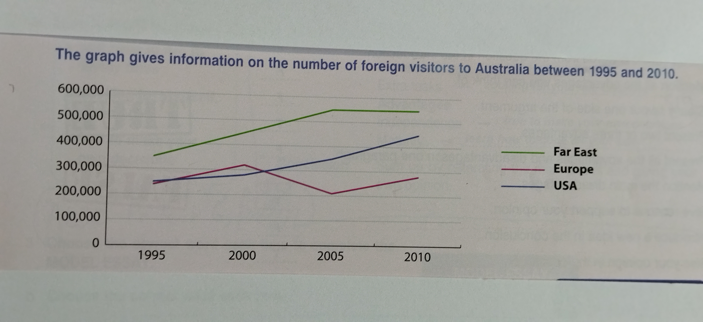
Foreign Visitors to Australia 1995 - 2010

Slide 4
Sample Writing (Introduction, Overview)
FOREIGN VISITORS TO AUSTRALIA BETWEEN 1995 AND 2010.
The graph shows how many tourists from the USA, Europe and the Far East visited Australia between the years 1995 and 2010.
Overall, the graph indicates an increase in visitors from the Far East, who represent the highest proportion, as well as a rise in the number of American tourists. The number of visitors from Europe was initially similar to that of American visitors, but plunged between 2000 and 2005.

Slide 5
Sample Writing (Main Details)
Specifically, over 350,000 visitors came from the Far East in 1995, which grew considerably to 450,000 in 2000 and 550,000 in 2005. This figure remained the same until 2010. The number of visitors from both the USA and Europe in 1995 was approximately 250,000. Tourism from these areas increased steadily up to 2000, when there were slightly more European than American visitors.
However there was a slight decline in the number of European tourists, which fell to just over 200,000 by 2005. In 2010 European visitor numbers recovered to approach 300,000. In contrast, the number of American visitors in this period rose to around 350,000 in 2005 and peaked at 450,000 in 2010.

Slide 6
INTRODUCTION
Paragraph 1

Slide 7
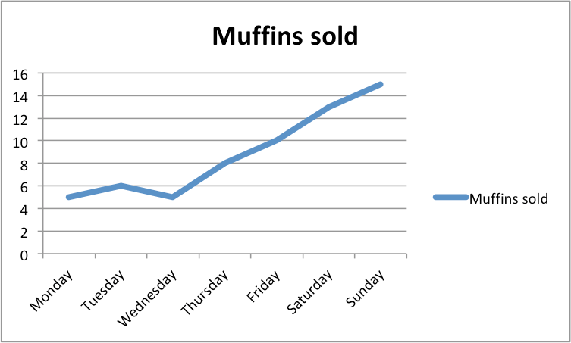
Muffins sold in Italy over the week
When = from 2001 to 2005...
So, what I’m going to show you now is an easy introductory sentence that you can use in order to explain your graph.

Slide 8
Line Graph
VERTICAL AXIS
Y-axis
ex. Money, Products sold, etc.
HORIZONTAL AXIS
X-axis
ex. Years, Categories, etc.

Slide 9
This line graph shows the changes in sales in Italy from Monday to Sunday
graphs
shows
from … to
line graph
bar chart
pie chart
table
represents
demonstrates
depicts
illustrates
lists (table)
illustrates the
breakdown of (sales)
outlines
delineates
from 2000 to 2010
between 2000 and 2010
over a ten-year period
over a 10-year period
over a period of 9 years
throughout the period of study
throughout the period in question

Slide 10
You can also add:
The given line graph
The supplied line graph
The presented line graph
The provided line graph
Ex. The provided line graphs presents ….
The supplied bar chart represents ….
The presented line graph illustrates …
The given bar chart shows …

Slide 11
Introduction = a mathematical formula !
Graph + Shows + Topic + Place + Time
(What Where When)
The provided line graph shows the changes in sales in Italy from Monday to Sunday.

Slide 12
OVERVIEW
Paragraph 2

Slide 13
WHAT is an Overview?
The 2nd paragraph
The most important paragraph of the Writing
Influences the ‘Main Details’ paragraph

Slide 14
DO DON’T
Mention: 2-4 main points from the Graph
Lenth: 2-3 sentences
Describe Trends clearly
X Include Data or Percentages
X Include Personal opinion
X Draw Conclusions

Slide 15
Overall, the graph indicates an increase in visitors from the Far East, who represent the highest proportion, as well as a rise in the number of American tourists. The number of visitors from Europe was initially similar to that of American visitors, but plunged between 2000 and 2005.
Overview

Slide 16
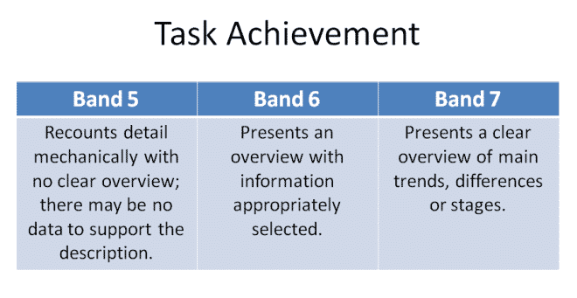
Importance of Overview in IELTS

Slide 17
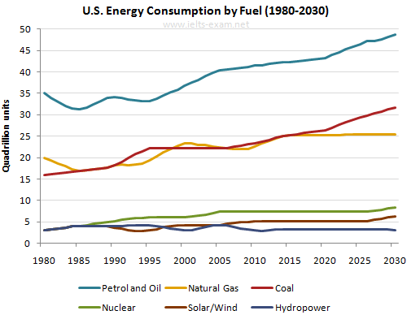
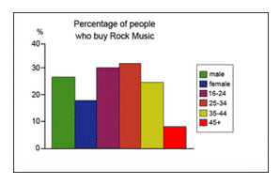
Dynamic Static/Fixed

Slide 18
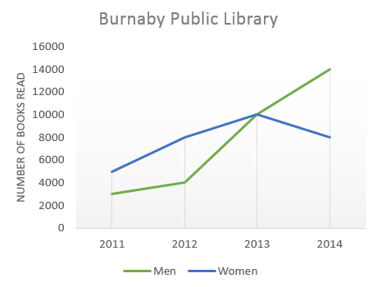
Dynamic Graph -> shows data over Time
What does the data do from the
START to FINISH?
Do they generally go up, go down, fluctuate?
Any significant difference from the general trend?
Any peaks or lows?

Slide 19
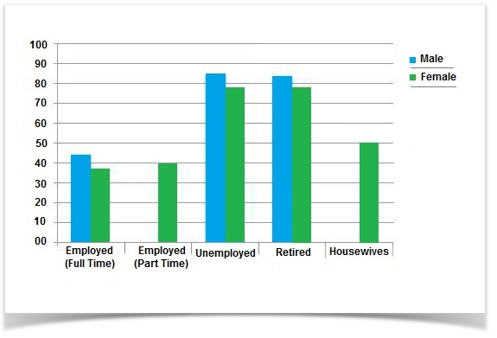
Static graph -> data at just 1 point in time
What are the HIGHEST and LOWEST
values?
The most significant Differences?
Are there any Similarities?
Are there any Exceptions?

Slide 20
How to start & Linking words
Overall, it is evident that …
Overall, the data suggests that …
Overall, it is clear that …
In general, it is apparent that …
In general, the graph indicates that…
While
Whereas
In contrast,

Slide 21
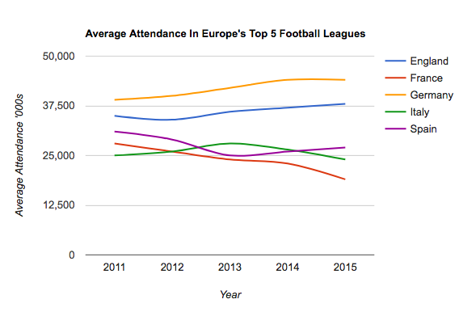
Example 1 - Overview
NOTES:
GERMANY: Highest attendance – Upward
ENGLAND: 2nd Highest – Upward
SPAIN: 3rd Highest – overall Downward
FRANCE: 4th Lowest – Downward
ITALY: Last (at first), 2nd Lowest (later) – Downward
http://all4ielts.com/ielts-academic/writing/how-to-write-a-clear-overview-%E2%80%93-dynamic-graph-(academic-writing-task-1).html

Slide 22
Clear Overview - 1
Overall, it is noticeable that the football match attendance had an
upward trend in Germany, which had the highest figures, while the trend was downward in Italy, Spain and France, which had the lowest attendance figures.

Slide 23
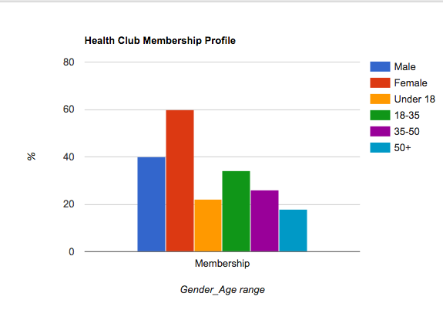
Example 2 - Overview
NOTES:
More WOMEN than Men
Age: 18-35 more popular
Age: 50+ least popular
http://all4ielts.com/ielts-academic/writing/how-to-write-a-clear-overview-%E2%80%93-static-graph-(academic-writing-task-1).html
relevant. Write at least 150 words.

Slide 24
Clear Overview - 2
(Both women and men + all age groups -> go to the health club)
Overall, it is evident that more women than men are members of the health club. It can also be seen that health club membership is most popular with the 18-35 age group and least popular with the over-50s.

Slide 25
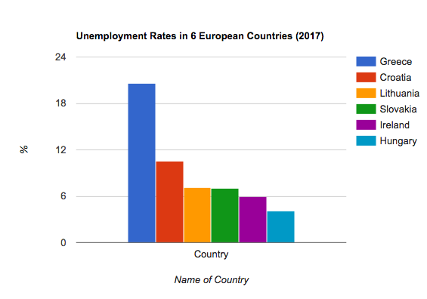
Example 3 - Overview
NOTES:
HIGHEST: Greece
LOWEST: Hungary
SAME: Slovakia, Lithuania
Write at least 150 words.

Slide 26
Clear Overview - 3
(The graph indicates that there are more unemployed people in Greece than in other countries, the least being in Hungary)
Overall, it is evident that Greece has the highest rate of unemployment of the six countries, while Hungary has the lowest rate. Lithuania and Slovakia have the same rate of jobless citizens.

Slide 27
FURTHER PRACTICE
INTRODUCTION / OVERVIEW

Slide 28
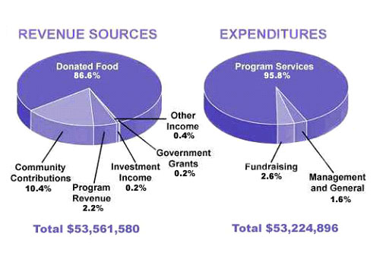
Summarize the information by selecting and reporting the main features and make comparisons where relevant.
The pie chart shows the amount of money that a children's charity located in the USA spent and received in one year, 2016. (150 wds)
https://www.ieltsbuddy.com/line-graph-examples.html

Slide 29
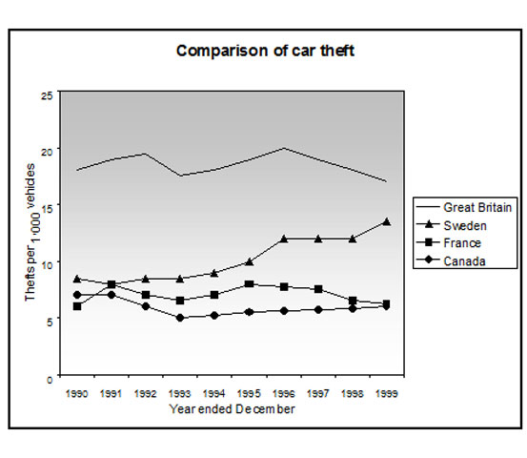
Summarize the information
The line graph shows thefts
per thousand vehicles in four
countries between 1990 and
1999. (150 wds)
https://www.ieltsbuddy.com/line-graph-examples.html

Slide 30
MAIN DETAILS
Paragraphs 3 - 4

Slide 31
How to start the ‘Main Details’ /
Linking words
More specifically, it is crystal clear that …
it is worth noticing that…
the data suggest that….
it can be clearly observed that …
the chart/graph indicates / shows / illustrates / represents
As is shown by the graph / chart, ….
As can be seen from the graph / chart, …
It is clear from the graph / chart that …

Slide 32
Linking words for the ‘Main Details’
while
whereas
in contrast,
however,
although
even though

Slide 33
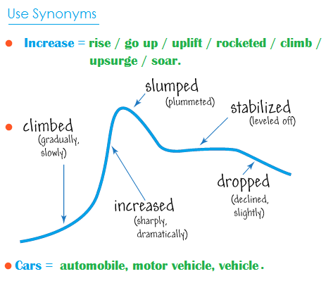
Trends

Slide 34
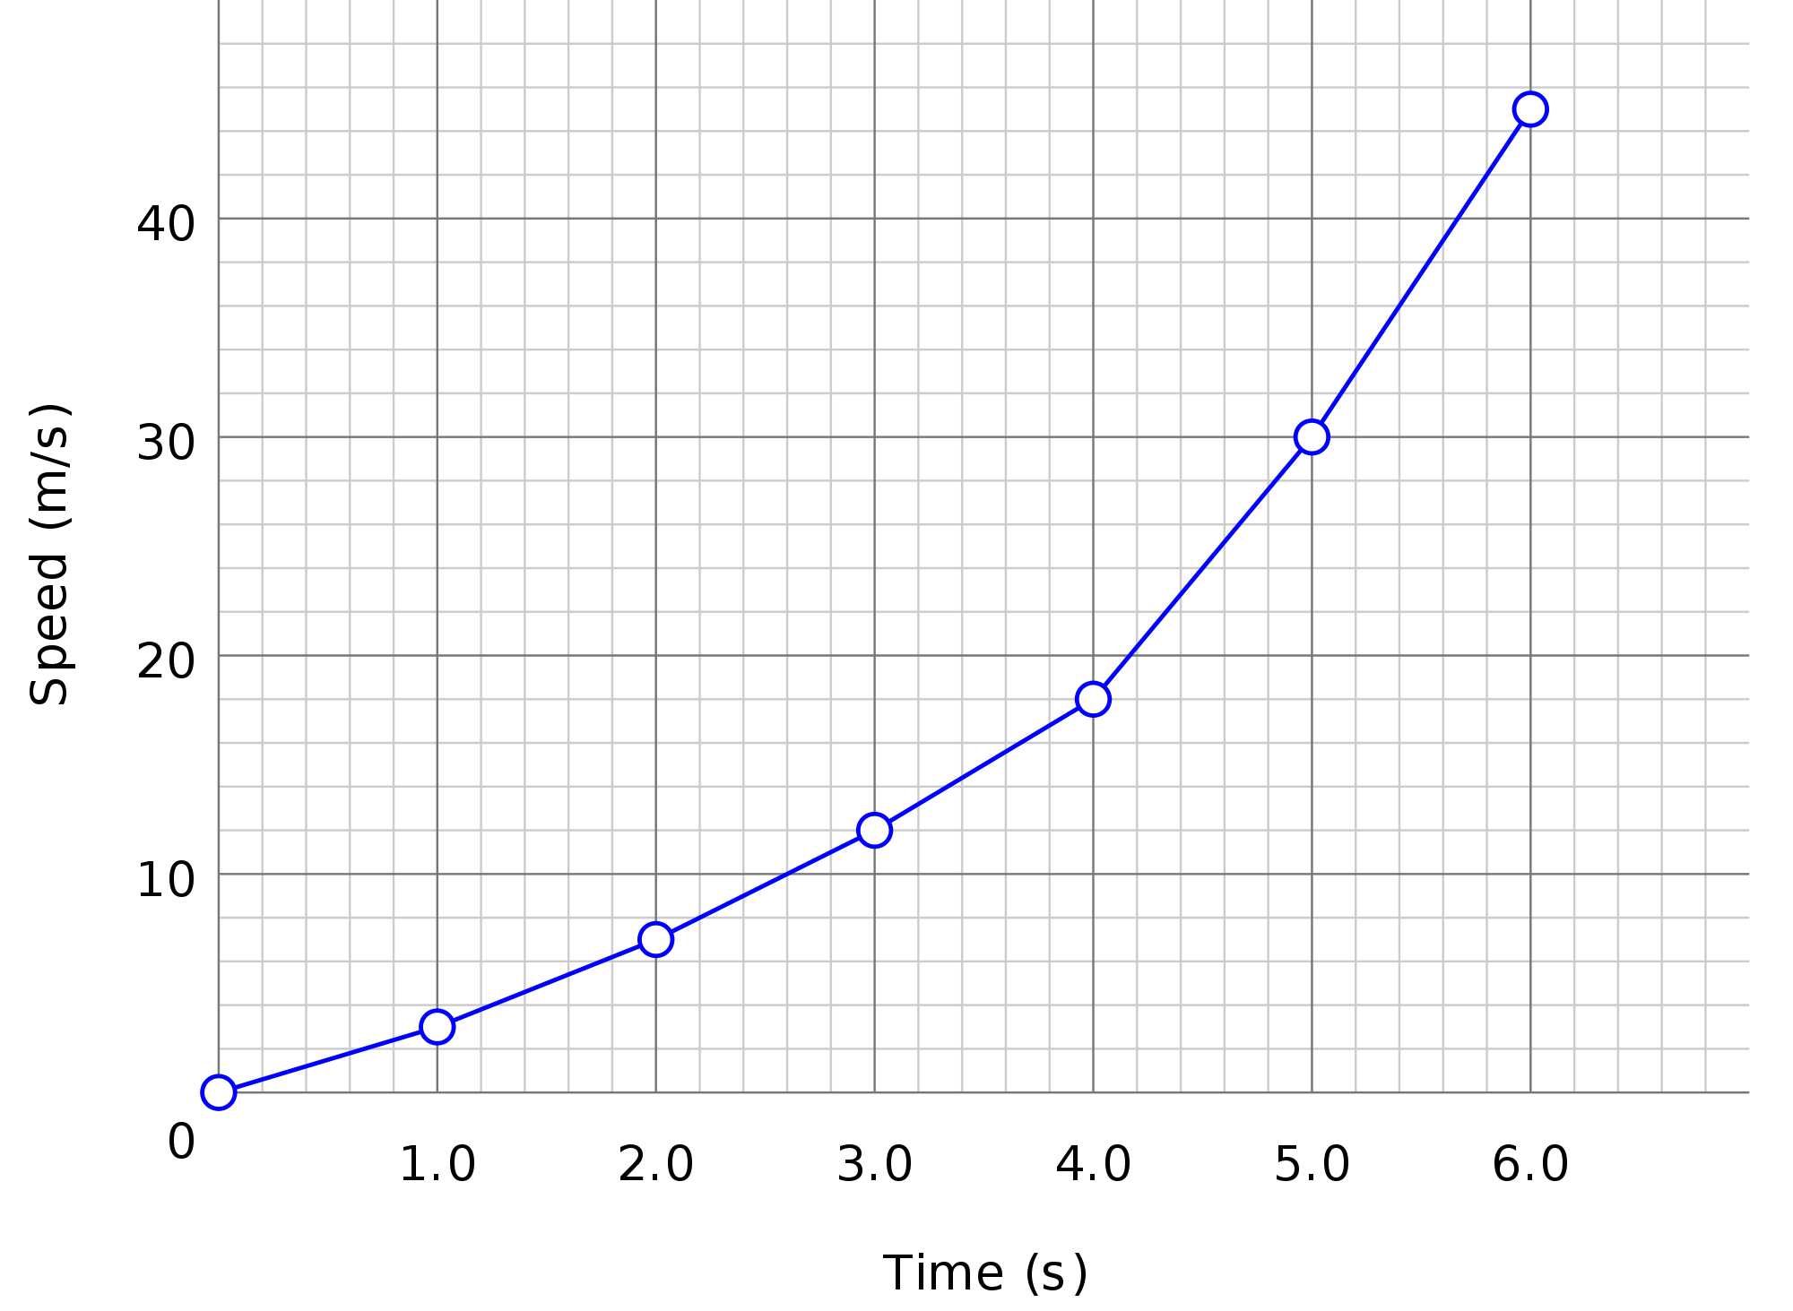
GOING UP…
VERBS
NOUNS
Go up – went up – has gone up
Increase
Rise – rose –risen
Improve
Double
Triple
Climb
Soar
Surge
Shoot up – shot up – shot up
(an) upward trend in
(an) increase in
rise in
(an) improvement in
growth in
(a) boom in
(a) surge in
-

Slide 35
GOING UP…
- Exports rose / improved / climbed / shot up / surged / doubled / tripled / soared / increased / went up in 2015.
- There is a(n) rise / improvement / growth / boom / surge/ an upward trend in exports in 2015.

Slide 36
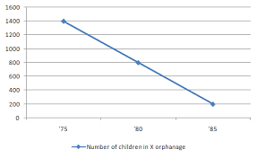
GOING DOWN…
VERB
NOUN
Go down – went down – has gone down
Decline
Decrease
Drop
Deteriorate
Reduce
Fall – fell –fallen
Plunge
Slump
Downward trend in
(a) Decline in
Decrease in
(a) Drop in
(a) Deterioration in
Reduction in
(a) Fall in
Plunge in
(a) Slump in

Slide 37
GOING DOWN…
- Exports declined / fell / went down / dropped / were reduced / slumped / deteriorated /decreased / plunged in 2015.
- There was a decline / fall / drop / reduction / slump / deterioration / decrease / plunge / downward trend in exports
in 2015.

Slide 38

STABLE / STEADY
EXPRESSIONS
Remain stable
Remain unchanged
Remain steady
Remain invariable
Stay constant
Be frozen
Be at the same level
Maintain the same level

Slide 39
Exports remained stable / remained unchanged / remained steady / remained invariable / stayed constant / were at the same level / maintained the same level in 2015.
STABLE / STEADY

Slide 40
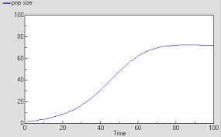
STABILISED…
VERBS/EXPRESSIONS
Level off
Stabilise
Reach a plateau
Exports leveled off / stabilized / reached a plateau in 2015.

Slide 41
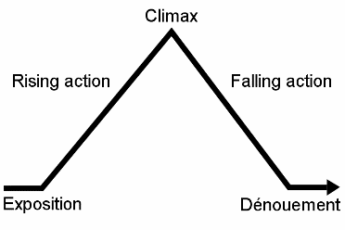
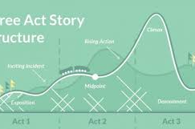
PEAK
VERB / EXPRESSION
Peak (at)
Climax
Reach a peak (of)
Reach a climax
Exports climaxed / peaked /reached a peak/ reached a climax in 2015.

Slide 42
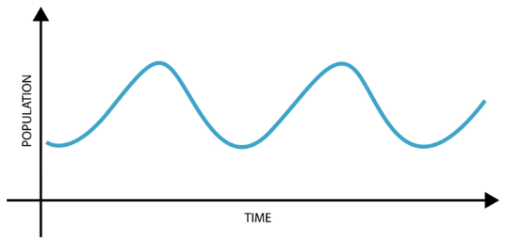
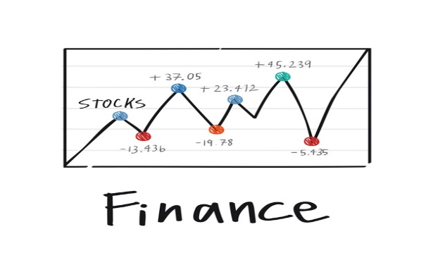
FLUCTUATE

Slide 43
FLUCTUATE
VERBS
NOUNS
EXAMPLES
Fluctuate
Go up and down
Rise and fall
Fluctuation
Exports fluctuated / went up and down / rose and fell in 2015.
There was a fluctuation in exports in 2015.
There was some fluctuation in exports in 2015.

Slide 44
How to describe Degree of Change

Slide 45
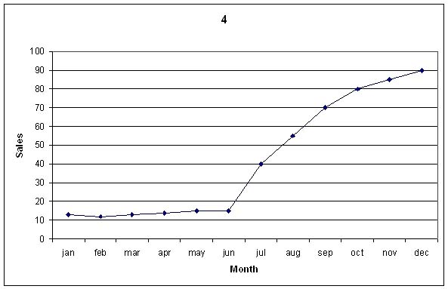
CONSIDERABLE CHANGE
Considerable – considerably
Dramatic – dramatically
Enormous - enormously
Rapid - rapidly
Sharp - sharply
Significant – significantly
Steep – steeply
Sudden - suddenly

Slide 46
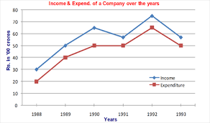
MODERATE CHANGE
Continuous – continuously
Moderate - moderately
Relative – relatively
Steady - steadily

Slide 47
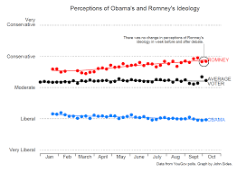
SLIGHT CHANGE
Gradual – gradually
Marginal – marginally
Negligible – negligibly
Slow - slowly

Slide 48
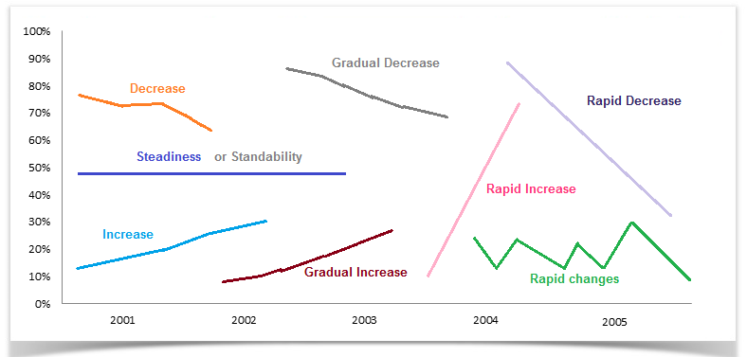
Examples:

Slide 49
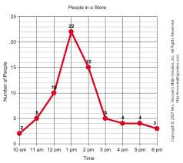
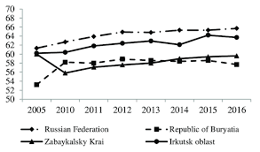
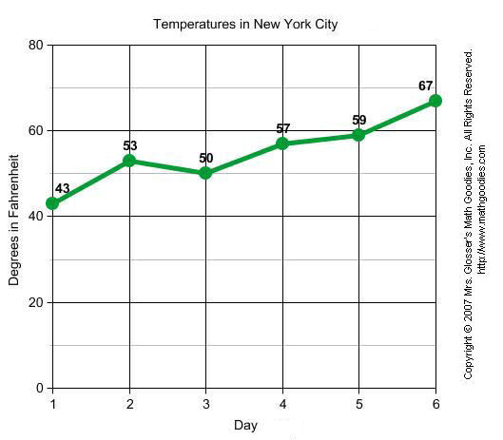
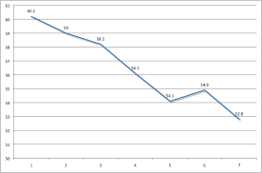
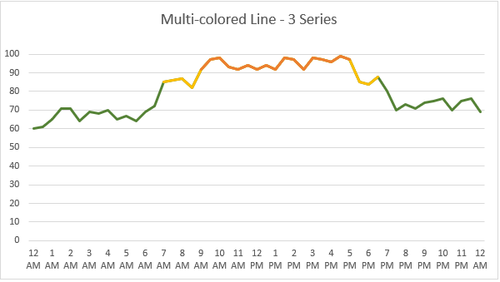
continuous decline, fluctuation, gradual increase, peak, fairly invariable, steep decline ???

Slide 50
Expressing Approximation

Slide 51
Expressing Approximation
More / Much more
About the same
Less / Much less
Just over
Much more than
Well over
Around
About
Approximately
Nearly
Roughly
Just under
Well under

Slide 52
Fractions
3% = a tiny fraction
23% = almost a quarter
25% = exactly a quarter
26% = roughly a quarter
32% = nearly one-third,
nearly a third
48% = around a half
52% = just over a half
73% = nearly three quarters
79% = well over three quarters
https://www.easy-ielts.com/most-useful-vocabulary-for-writing-task-1/

Slide 53
Number / Amount / Proportion / Figure
number
- Use "the number of + plural noun" e.g. the number of visitors.
- Don't use it to describe percentages or uncountable nouns e.g. money.
amount
- Use "the amount of + uncountable noun" e.g. the amount of money.
- Don't use it with countable nouns e.g. the amount of person/people.
proportion
- Use "the proportion of + plural noun" e.g. the proportion of people.
figure
- Use "the figure for + plural noun" e.g. the figure for visitors to the UK.
- Use it with uncountable nouns e.g. the figure for unemployment.
- Use it with countries e.g. the figure for Canada.
- Use it with percentages e.g. the figure (for...) rose to 10%.
https://ielts-simon.com/ielts-help-and-english-pr/2011/12/ielts-grammar-number-amount-proportion-figure.html

Slide 54
Prepositions

Slide 55
Prepositions (in, from-to)
NOUN+IN+NOUN
FROM - TO
The increase in the university graduates …
The decrease in salaries …
The rise in the number of people who …
Sales increased from 15% to 23%
His salary rose from €900 to €1000

Slide 56
Prepositions (of, by)
NOUN+OF+FIGURE
VERB+BY+FIGURE
There was an increase of 10% in the college dropout …
There is a rise of 80% in TV sales…
There is a decrease of 2% in exports.
College dropout increased by 10%
TV sales rose by 80%
Exports decreased by 2%

Slide 57
Prepositions (at, between-and)
Start, remain stable, level off, peak+AT+Figure
Fluctuate BETWEEN-AND
Interest rates started at 2% and peaked at 6%
The college dropout rate started at 8% in 2000 and levelled off at 12% in 2010.
Interest rates fluctuated between 2% and 6%
College dropout rate fluctuated between 2% and 6%

Slide 58
Some practice..
There is a rise ……. 45% …….. car sales in the second quarter of 2016.
The total number of graduate employees in my company remained stable ….65%.
Exports increased ….. 9% over the last two years.
The number of American tourists rose … 300,000 in 2010 and peaked … around 400,000 in 2013.
House prices fluctuate ….. €150,000 … €280,000 in this district.
The percentage of customers who complain regularly dropped … 5% last year.

Slide 59
Sources:
https://www.ielts-exam.net/academic_writing_samples_task_1/
https://www.ielts-mentor.com/writing-sample/academic-writing-task-1
https://takeielts.britishcouncil.org/prepare-test/free-sample-tests/writing-sample-test-1-academic/writing-task-1
https://www.ecenglish.com/learnenglish/lessons/describing-graphs

