Slide 1

Work values as projections of personal values at work:
Evidence from tourism and hospitality students

Slide 2
Content of presentation
Aim of the study
Prior work in H&T
Sample & data collection
Results
Discussion

Slide 3
Aim of the study
Provide evidence of conceptual validity for the conceptualization of students work values as projections of their personal values at the context of work in H&T

Slide 4
Prior work in H&T

Slide 5
Sample
201 Millennial-aged students enrolled in undergraduate H&T programmes offered in English in Switzerland and Malaysia.
The gender distribution was almost equal
- Cultural origins: China and Hong Kong (12%), Malaysia (31%), Indonesia (22%), Singapore (18%), South Korea and (5%) Thailand (11%).

Slide 6
Collection of data
Participation was voluntary and anonymous and the language of the questionnaire was English, as was the instruction language of the programme.
Work values were assessed using a modified 20-items version of Lyons Work Values Survey (LWVS; Lyons, 2003).

Slide 7
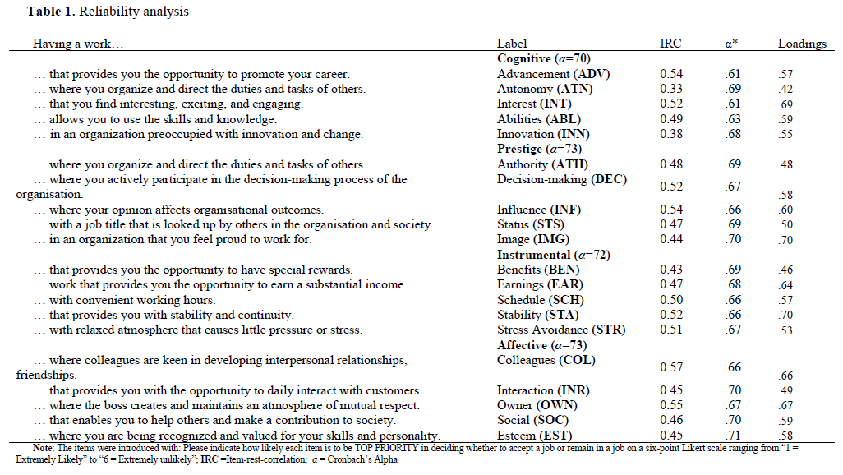
Results (1)

Slide 8
Results (2)

Slide 9
Graphical representation

Slide 10
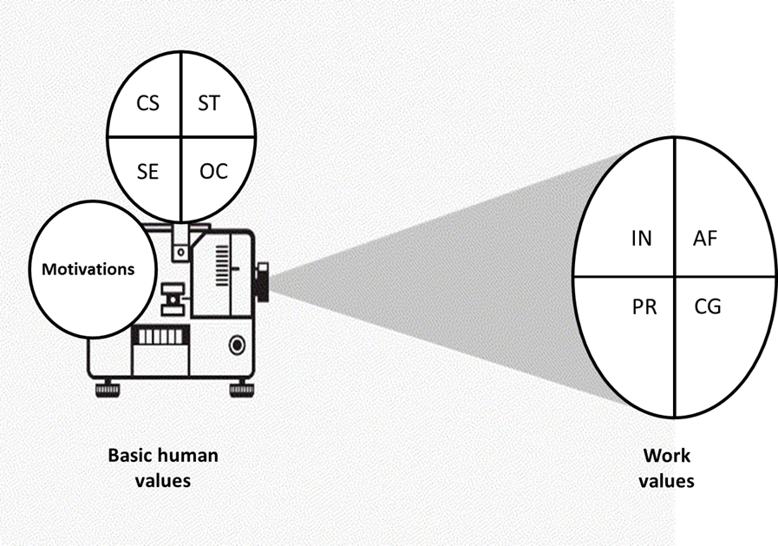
Proposed model

Slide 11

Questions

