Slide 1
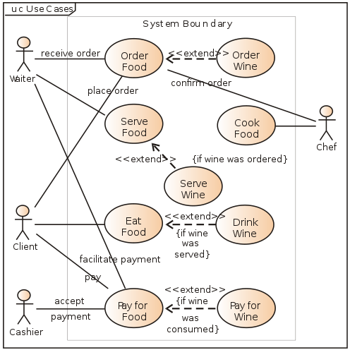

Slide 2
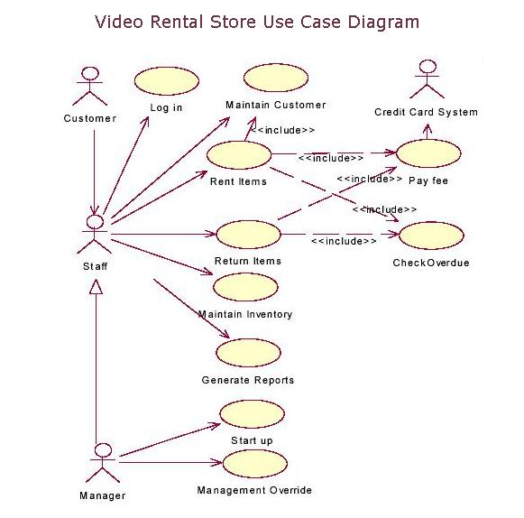

Slide 3
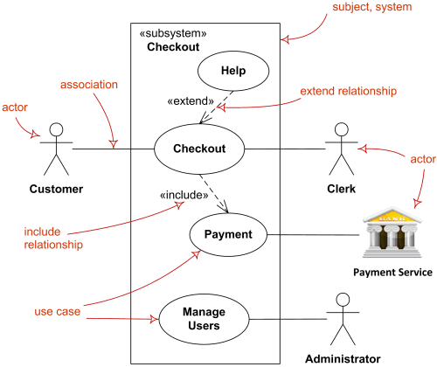

Slide 4
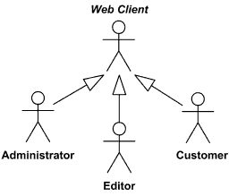
Relationships Between Actors
We can define abstract or concrete actors and specialize them using generalization relationship.
Generalization between actors is rendered as a solid directed line with a large arrowhead (same as for generalization between classes).
Web Client actor is abstract superclass for Administrator, Editor and Customer

Slide 5
Relationships Between Use Cases
Use cases could be organized using following relationships:
generalization
association
extend
include

Slide 6
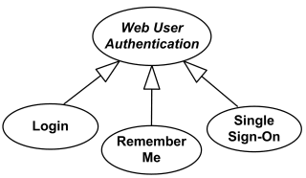
Generalization Between Use Cases
Generalization between use cases is similar to generalization between classes – child use case inherits properties and behavior of the parent use case and may override the behavior of the parent.
Generalization is shown as a solid directed line with a large hollow triangle arrowhead, the same as for generalization between classifiers, directed from the more specific use case to the general use case.
Web User Authentication use case is abstract use case specialized by Login, Remember Me and Single Sign-On use cases.

Slide 7
Association Between Use Cases
Use cases can only be involved in binary associations.

Slide 8

Extend Relationship
Extend is a directed relationship that specifies how and when the behavior defined in usually supplementary (optional) extending use case can be inserted into the behavior defined in the extended use case.
Extended use case is meaningful on its own, it is independent of the extending use case. Extending use case typically defines optional behavior that is not necessarily meaningful by itself. The extend relationship is owned by the extending use case. The same extending use case can extend more than one use case, and extending use case may itself be extended.
The extension takes place at one or more extension points defined in the extended use case.
Extend relationship is shown as a dashed line with an open arrowhead directed from the extending use case to the extended (base) use case. The arrow is labeled with the keyword «extend».
Registration use case is meaningful on its own. It could be extended with optional Get Help On Registration use case

Slide 9
Include Relationship
An include relationship is a directed relationship between two use cases when required, not optional behavior of the included use case is inserted into the behavior of the including (base) use case. Including use case depends on the addition of the included use case.
Including use cases are usually not complete by themselves and require the included use cases. For whatever reasons, UML 2.4 does not refer to those as abstract use cases which seems very appropriate. Many other sources define abstract use case as including use case, while in fact it has to be expressed the other way around: including use case is abstract use case. See discussion of the definition of abstract use cases.
The include relationship could be used:
when there are common parts of the behavior of two or more use cases,
to simplify large use case by splitting it into several use cases.
Included use cases are required, not optional for the inclusion. Execution of the included use case is analogous to a subroutine call or macro command in programming. All of the behavior of the included use case is executed at a single location in the including use case before execution of the including use case is resumed.
Note, while UML 2.4 defines extension points for the extend relationship, there are no "inclusion points" to specify location or condition of inclusion for the include.
Include relationship between use cases is shown by a dashed arrow with an open arrowhead from the including (base) use case to the included (common part) use case. The arrow is labeled with the keyword «include».
When two or more use cases have some common behavior, this common part could be extracted into a separate use case to be included back by the use cases with include.

Slide 10
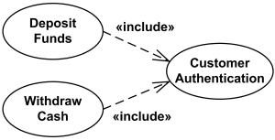
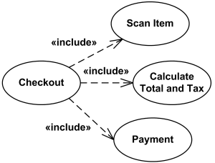
Both Deposit Funds and Withdraw Cash use cases require (include) Customer Authentication use case.
Large and complex use case could be simplified by splitting it into several use cases each describing some logical unit of behavior. Note, that including use case becomes incomplete by itself and requires included use cases to be complete.
Checkout use case includes (possibly several) Scan Item, Calculate Total and Tax, and Payment use cases

Slide 11
