Slide 1
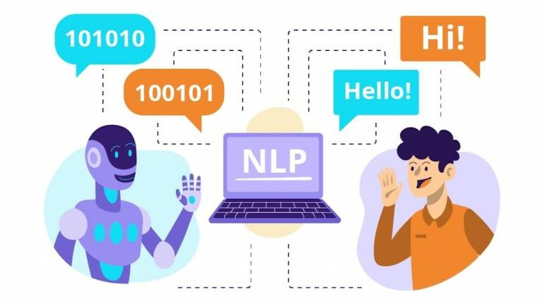
Επεξεργασια Φωνης και Φυσικης Γλωσσας
Χατζημηνα Μαρια Ευαγγελια, Τσικνακησ Μανωλησ
Email: ddk8@edu.hmu.gr

Slide 2
Εισαγωγη στην επεξεργασια φυσικησ γλωσσας (NLP)
Definition:
Natural Language Processing (NLP) is a subfield of Artificial Intelligence (AI) focused on the interaction between computers and humans through natural language.
It involves computational techniques that enable machines to understand, interpret, and generate human language in a meaningful way.
Goal:
To allow computers to comprehend and respond to human language similarly to how people communicate with each other.
Importance:
Language understanding and processing are essential for many AI applications.

Slide 3
Key Concepts
Tokenization
Part-of-speech tagging – identifying parts of speech
Named entity recognition – recognizing entities like people, places, or organizations
Word embeddings
Syntax and semantics – grammatical structure and meaning
Lemmatization

Slide 4
Εφαρμογες επεξεργασιασ φυσικησ γλωσσασ
Some of the main applications include:
Language Understanding: analyzing text to extract meaning and relationships.
Language Generation: producing natural language text from data.
Machine Translation: automatically translating text between languages.
Named Entity Recognition: identifying entities like names, locations, or dates.
Sentiment Analysis: detecting and interpreting emotions in text (covered in the next lecture).
Question Answering: automatically generating answers to user questions.
Chatbots
Speech Recognition
Information Extraction
Text Summarization
NLP applications appear across many domains such as digital assistants, social media analysis, search engines, robotics, and healthcare — enabling more natural human–machine interaction.

Slide 5
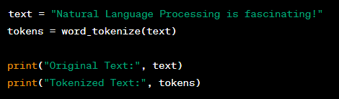
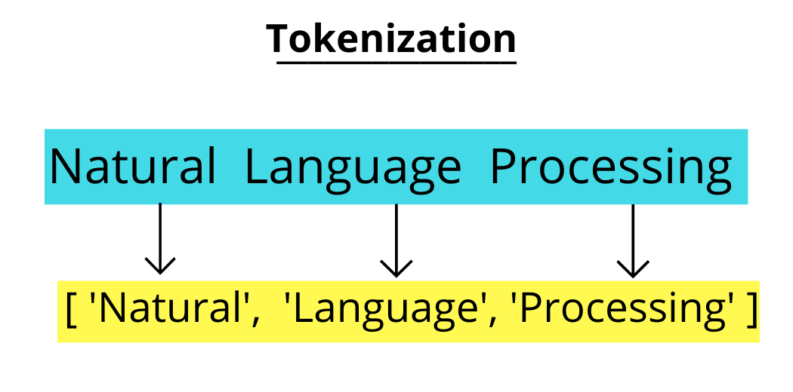
Tokenization
Definition: Breaking text into smaller units called tokens (words or punctuation marks).
Example: Original sentence:
"Natural Language Processing is fascinating!"
Python Example:
Output:
Original Text: Natural Language Processing is fascinating!
Tokenized Text: ['Natural', 'Language', 'Processing', 'is', 'fascinating', '!']

Slide 6
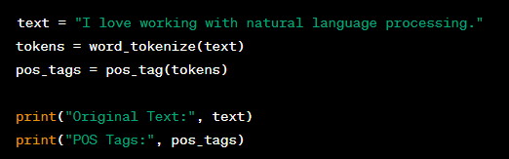
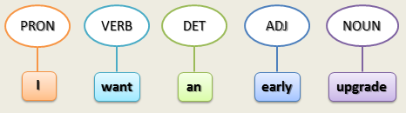
Part-of-speech Tagging (POS) - Επισhμανση μEρων του λoγου
Definition: Assigning grammatical categories (e.g., noun, verb, adjective) to each word in a sentence.
Explanation: POS tagging helps determine the grammatical role of each word, which is useful for parsing and understanding meaning.
Python Example:
Output:
Original Text: I love working with natural language processing. POS Tags: [('I', 'PRP'), ('love', 'VBP'), ('working', 'VBG'), ('with', 'IN'), ('natural', 'JJ'), ('language', 'NN'), ('processing', 'NN'), ('.', '.')]

Slide 7
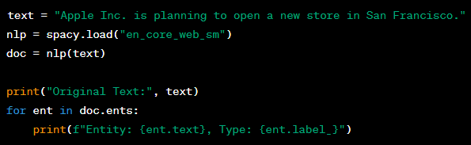
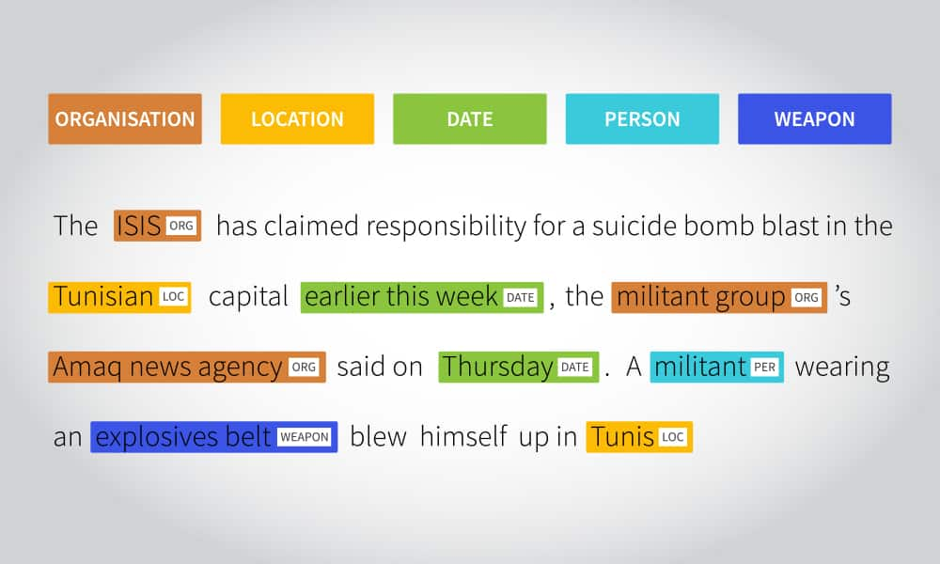
Named Entity Recognition
Definition: Identifying entities such as names, locations, organizations, or dates within a text..
Explanation: NER systems detect and classify key information into predefined categories (e.g., people, places, companies).
Python Example:
Output:
Original Text: Apple Inc. is planning to open a new store in San Francisco. Entity: Apple Inc., Type: ORG Entity: San Francisco, Type: GPE

Slide 8
Word Embeddings
Python Example:
Definition: Representation of words as numerical vectors in a multidimensional space.
Explanation: Word embeddings capture semantic meaning words with similar meanings are represented by vectors that are close to each other.
sentences = [ "Natural Language Processing is fun.", "Word embeddings capture semantic meanings." ]
tokenized_sentences = [word_tokenize(sentence.lower()) for sentence in sentences]
model = Word2Vec(tokenized_sentences, vector_size=100, window=5, min_count=1, workers=4)
word_vector = model.wv['natural’]
print("Word Vector for 'natural':", word_vector)
Output:
Word Vector for 'natural': [ 0.0023123 0.00429537 -0.00093116 ...]

Slide 9
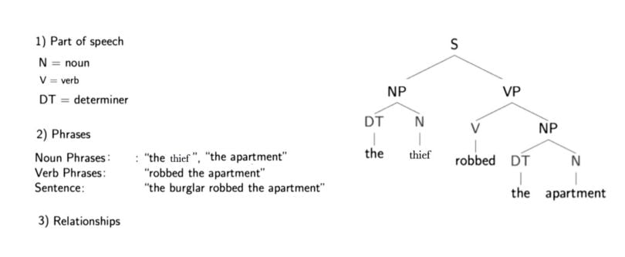
Syntax and Semantics
Python Example (Syntax):
text = "The quick brown fox jumps over the lazy dog." nlp = spacy.load("en_core_web_sm") doc = nlp(text) print("Original Text:", text) for token in doc: print(f"Token: {token.text}, Dependency: {token.dep_}")
Definition:
Syntax deals with sentence structure and grammatical rules.
Semantics focuses on the meaning of words and phrases.
Explanation: Syntax determines how words are arranged; semantics determines what they mean.
Output:
Original Text: The quick brown fox jumps over the lazy dog.
Token: The, Dependency: det
Token: quick, Dependency: amod
Token: brown, Dependency: amod
Token: fox, Dependency: nsubj
Token: jumps, Dependency: ROOT
Token: over, Dependency: prep
Token: the, Dependency: det
Token: lazy, Dependency: amod
Token: dog, Dependency: pobj
Token: ., Dependency: punct
Python Example (Semantics):
synonyms = wordnet.synsets('happy') print("Synonyms for 'happy':", [synonym.lemmas()[0].name() for synonym in synonyms])
Output
Synonyms for 'happy': ['happy', 'felicitous']

Slide 10
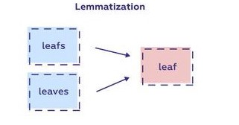
Lemmatization
Python Example:
Definition: Reducing words to their base or root form (lemma)..
Explanation: Lemmatization groups words with the same core meaning
For example, “running” → “run”, “better” → “good”.
from nltk.stem import WordNetLemmatizer
lemmatizer = WordNetLemmatizer()
words = ["running", "better", "cats"]
lemmatized_words = [lemmatizer.lemmatize(word) for word in words]
print("Original Words:", words)
print("Lemmatized Words:", lemmatized_words)
Output:
Original Words: ['running', 'better', 'cats’]
Lemmatized Words: ['run', 'better', 'cat']

Slide 11
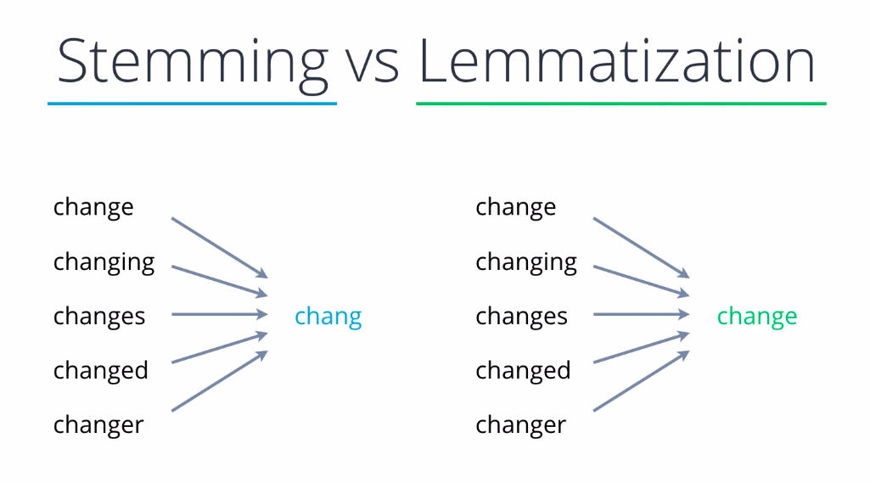
Stemming
A text normalization technique that trims words down to their stem or root form.
Goal
Simplifies word variations (e.g., connected, connecting → connect).
Reduces storage and improves search and indexing.
Applications
Information retrieval
Text mining
Search engines.

Slide 12
NLP Challenges
Ασάφεια – Ambiguity – Words or phrases with multiple meanings
Κατανόηση του πλαισίου – Context understanding – Sentences depend on previous context
Σαρκασμός και ειρωνεία – Sarcasm and irony – Difficult for models to interpret
Χειρισμός πολλαπλών γλωσσών – Multilingual handling – Managing multiple languages
Δεοντολογικά ζητήματα – Ethical issues – Bias, misinformation, and data privacy

Slide 13
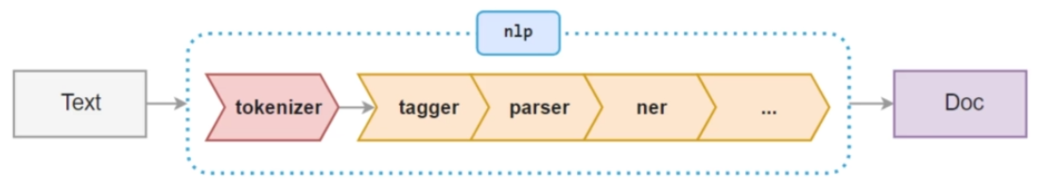
Spacy
spaCy uses a pipeline to process text efficiently.
The nlp() function performs several steps such as tokenization, tagging, parsing, and lemmatization automatically.
Features:
Fast and industrial-strength NLP library
Supports multiple languages
Ideal for production-level NLP systems

Slide 14
NLTK
Open-source NLP library released in 2001
Provides many NLP functionalities (tokenization, tagging, parsing, etc.)
Educational and research-oriented
Easier to use but slower compared to spaCy
designed for speed and efficiency, optimized for modern NLP pipelines.

Slide 15
Spacy vs nltk
Feature | spaCy | NLTK
Speed | Faster and optimized | Slower
Flexibility | Less customizable | More algorithm options
Ease of Use | Suitable for production | Better for teaching/research
Sentiment Analysis | Not built-in | Supported
spaCy is faster and better for applied NLP tasks, while NLTK offers broader educational coverage and built-in sentiment analysis.

Slide 16
GOOGLE COLAB
https://colab.research.google.com/drive/1AAtdv9IunNzejUfG0-BJVL7RIBEdN3f3?usp=sharing
New google colab: https://colab.google/

Slide 17
Evolution of NLP
Early Methods:
Rule-based systems
Bag-of-Words representations : Represents text as a collection of words without considering order or grammar — only word frequency matters.
Statistical Models: Use probability and word occurrence patterns (like n-grams) to predict or analyze language.
N-grams
Hidden Markov Models (HMMs)
Neural Networks: Learn deeper relationships between words by recognizing context and meaning through layers of interconnected nodes.
RNN, LSTM, GRU architectures
Transformers – The Game Changer: Modern models that use attention mechanisms to understand relationships between all words in a sentence simultaneously, enabling faster and more accurate language understanding.
Enabled large-scale parallel processing and context awareness
Emergence of LLMs (Large Language Models):
GPT, BERT, T5, LLaMA, Gemini.

Slide 18
How Transformers Work
Key idea: Attention mechanism to focus on relevant words
They replaced older models like RNNs and LSTMs, which struggled with large sentences and required sequential data processing.
Architecture:
Encoder: converts input text into internal representations.
Decoder: uses those representations to generate output text.
Self-Attention: identifies relationships between words regardless of their distance in the sentence.
Example:
“The cat that the dog chased was black.”
The model learns that cat is the subject of was black, even with the intervening phrase.
Benefits:
Parallel processing of text (faster training)
Better handling of long-range dependencies
Scalable and adaptable to huge datasets

Slide 19
Pretrained vs. Fine-tuned Models
Pretrained Models:
Trained on massive text corpora for general language understanding
Examples: GPT, BERT, T5
Models like ChatGPT and BERT are large-scale implementations of Transformers that have been trained on huge datasets.
BERT: focuses on understanding and analysis tasks (e.g., QA, sentiment analysis).
GPT (ChatGPT): specializes in text generation and creative responses.
Fine-tuned Models:
Adapt pretrained models to specific domains or tasks.
Examples: Sentiment analysis, NER, QA systems

Slide 20
Overview of Large Language Models (LLMs)
Examples LLMs: GPT, BERT, T5, LLaMA, Gemini
Capabilities:
Text generation
Text classification
Question answering
Summarization
Applications in healthcare, finance, customer service, etc.

Slide 21
Hands-on Exercises
Load a GPT-2 model using Hugging Face
Generate text
https://colab.research.google.com/drive/1BPJRo2O1IM6wOxyZOt2E84ytQQv1j8is?usp=sharing

Slide 22
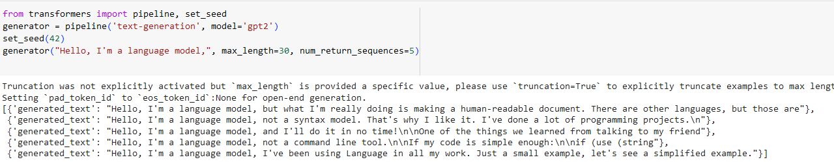
GPT-2 Example
Simplified Workflow:
Provides an easy interface for common NLP tasks (e.g., text generation).
Handles tokenization, model execution, and decoding automatically..
Built-in Decoding Strategies:
Temperature, Top-k, Top-p sampling, Repetition penalty.
Produces coherent and creative results with minimal tuning.
Features:
Reproducible outputs using random seed.
Multiple output generations via num_return_sequences.

Slide 23
Αναλυση παραμετρων
Temperature:
Controls how “creative” or “stable” the output is.
Low (0.2): predictable responses
High (1.2): more diverse or imaginative text.
Top-k Sampling:
Restricts choices to the k most likely words (e.g., k = 5 → selects from top 5 candidates)..
Top-p Sampling:
Chooses words from a dynamic set that covers a total probability mass p (e.g., p = 0.9). 90%.
Example:
A sentence starts with «The dog...» and the model has to generate the rest of the sentence:
Temperature = 0.2 → “runs in the garden.”
Temperature = 1.2 → “plays with a blue unicorn.”
Top-k = 3 → chooses among “runs,” “plays,” “sleeps.”
Top-p = 0.9 → includes slightly less obvious but plausible options..

Slide 24
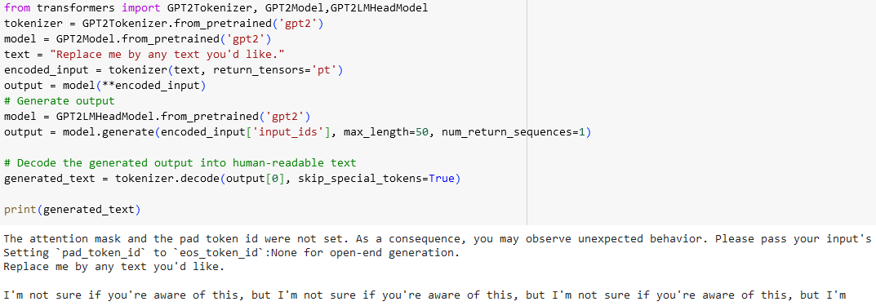
GPT-2 Example
Characteristics:
Requires manual tokenization and decoding.
Uses GPT2LMHeadModel for text generation.
Offers full control over parameters (temperature, top-k, top-p).
Use Case: Ideal for advanced users who need fine-grained customization or research-level control. Requires more setup compared to the high-level pipeline.

Slide 25
Συγκριση
Aspect | High-Level Pipeline | Low-Level API
Ease of Use | Beginner-friendly | Requires coding knowledge
Speed | Fast setup | More flexible
Parameter Control | Limited | Full control
Best For | Quick demos, teaching | Research, custom applications
The pipeline method is ideal for quick experimentation, while the low-level API is better for customized workflows and fine-tuning.

Slide 26
Warnings
Truncation Warning
Occurs when input text exceeds the model’s maximum sequence length (e.g., 1024 tokens for GPT-2).
Solution: enable truncation=True to cut text automatically.
If the input text is large, it could exceed the capacity of the model, which for GPT-2 is typically 1024.
The tokenizer truncates the input to fit the boundary. Without truncation=True, it defaults to longest_first. It is better to set it.
pad_token_id Warning
is used to make all text sequences in a batch have the same length so they can be processed together efficiently by the model..
Example Padding:
"Hello, world!“
"Hi!“
Sequence 1: [Hello, world, !]
Sequence 2: [Hi, <PAD>, <PAD>] → <PAD> is the padding token.
Example EOS
Input text: "Hello, world!”
Encoded with EOS: [Hello, world, !, <EOS>]
Feature | Padding (<PAD>) | End-of-Sequence (<EOS>)
Purpose | Fills the empty spaces in shorter sequences (sentences).Indicates the end of a sequence. | Fills the empty spaces in shorter sequences (sentences).Indicates the end of a sequence.
Used in | Batch processing | Sequence generation and decoding.
Effect on Model | Ignored during computations (masked) | Tells the model to stop processing a sequence during generation
Example in Sentence | [Hi, <PAD>, <PAD>] | [Hello, world, <EOS>]

