Slide 1
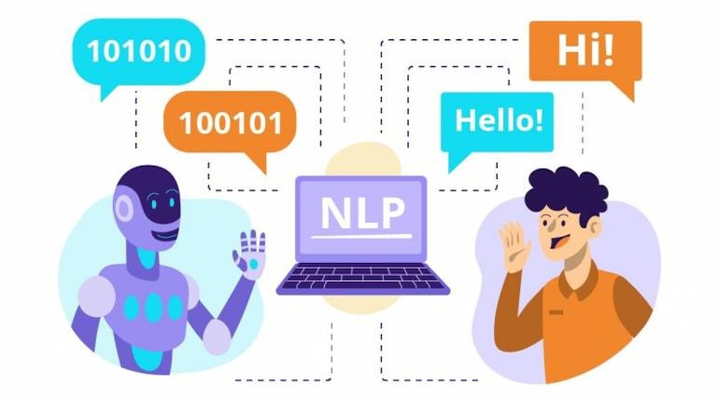
Voice and Natural Language Processing
CHATZIMINA MARIA, Tsiknakis manolis
Email: ddk8@edu.hmu.gr

Slide 2
Learning Objectives
After completing the course, participants will be able to:
Understand the difference between fine-tuning and prompt engineering for large language models.
Adapt pre-trained models to text classification applications.
Apply fine-tuning to pre-trained models for sentiment analysis.
Experiment with creative text generation through prompt engineering..

Slide 3
WHAT ARE GENERATIVES MODELS
LLMs are trained on massive datasets of text data, often from the internet. This can include books, Wikipedia, news articles, blogs, and more.
The model learns the statistical patterns and relationships between words in this huge dataset. It builds an understanding of the syntax, semantics, and context of human language.
The encoder takes in an input text prompt and converts it into an embedded numerical representation.
This embedded input passes through multiple layers in the neural network. Each layer looks at the text from a different perspective and learns different aspects of the language.
The decoder takes this encoded representation and generates predicted output text. It predicts the most likely next word in a sequence given the context.
Generation is done word-by-word. As the model generates each word, it is fed back into the model to predict the next word. This continues until the output is complete.

Slide 4
How transformers work
What Are Transformers?
  Transformers are AI models used in tools like ChatGPT, DALL-E, and Google Translate.
  They read text by breaking it into small pieces (tokens).
  Each token is turned into a vector (a list of numbers) that represents its meaning.
  The model uses attention to decide which words are most important in a sentence.
  It then predicts the next word based on all the previous ones
How They Learn
  Transformers have millions of weights (numbers) that the model adjusts during training.
  Training means showing lots of examples and updating these weights to make better predictions.
  The model learns by comparing its guesses to the correct answers a process called backpropagation.

Slide 5
How transformers work
How Meaning Is Represented
  Words with similar meanings get similar vectors in a high-dimensional space.
  The model learns relationships between words, like king – man + woman ≈ queen.
How Text Is Generated
  After processing the input, the model gives scores (logits) for every possible next token.
  These scores are turned into probabilities using a softmax function.
  A temperature setting controls how random or creative the next word choice is.

Slide 6
What Is Attention in Transformers?
Attention helps the model focus on the most important words when understanding meaning.
For example, the word “mole” can mean an animal, a spy, or something in chemistry. Attention helps the model figure out which one fits the sentence.
Each word looks at other words in the sentence and decides which ones matter most for understanding the context.
The model combines this information to update its understanding of every word.

Slide 7
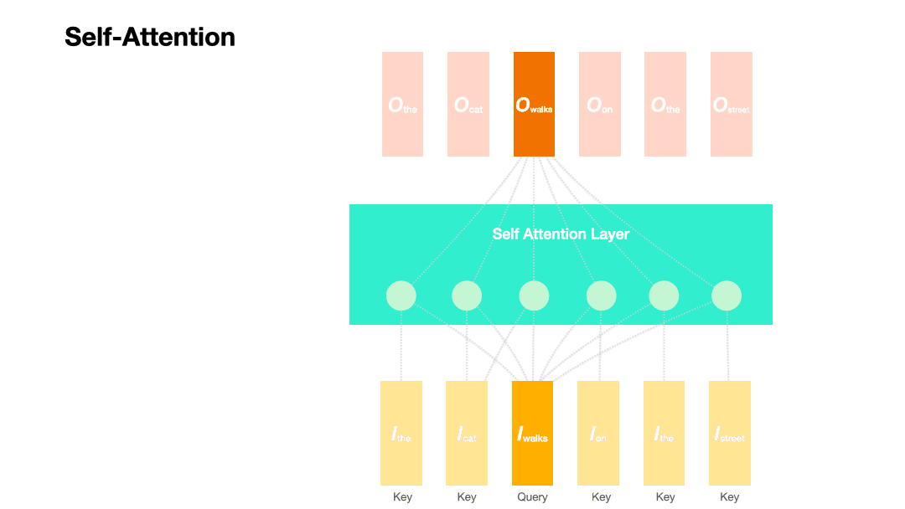
Each word becomes a vector (the yellow boxes at the bottom)
  These are the model’s “representations”, what it knows about each word.
The model picks one word to focus on (the orange one: “walks”)
  That’s the query, the word we want to understand in context.
The model looks at all the other words (the “keys”)It checks how much each of them is related to “walks.”
  For example, “cat” is important (who walks), while “the” is less important.
It calculates “attention scores”
  These scores say how much attention “walks” should pay to each other word.
It mixes the information
  The model combines what it learned from the other words (the green circles).
  The output (top boxes) is a richer version of “walks,” now aware of context.

Slide 8
Fine-tuning vs. Prompt Engineering
Fine-tuning:
  Fine-tuning only unfreezes a small part of the model. It does not retrain the whole model.
  Fine-tuning does not override hallucination. The model can still make up answers.
  Fine-tuning is like transfer learning you learn how to tie shoes, then you can tie other things. Not learning new info.
  Fine-tuning needs gathering and labeling many examples to tune the model.
  It creates a model to be slightly better at a specific task.
  Example: Finetuning BERT model for sentiment analysis from IMDb reviews.
Prompt Engineering:
  Using carefully designed text inputs (prompts) to make the most of a pre-trained model.
  Does not change or retrain the model itself.
  Fast and flexible, ideal for low-resource or quick experiments.
  Example: Using ChatGPT or OpenAI GPT to classify emotions from sentences by phrasing the question in natural language.
Characteristic | Fine-tuning | Prompt Engineering
Data Requirement | Requires labeled data | Minimal or none
Speed | Slow, needs training | Instant responses
Flexibility | Task-specific | General-purpose

Slide 9
WHY FINE-TUNING OR PROMPT ENGINEERING?
Fine-tuning:
  Suitable for customized, specialized tasks (e.g., medical diagnoses, emotion analysis).
  Produces high-accuracy models.
Prompt Engineering:
  Ideal for quick experiments or when labeled data is not available.
  Works great for general-purpose tasks (e.g., summarization, translation).
Data
Fine-tuning
Specialized Model
Text Input
Output

Slide 10
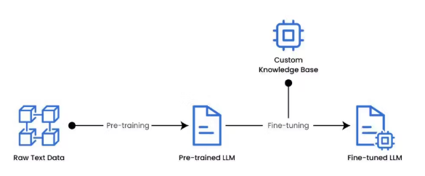
FINETUNING
Fine-tuning is the process where an already pre-trained model (e.g., BERT, GPT) is adapted for a specific task or application. The process includes:
Input Representation:
  Cleaning data and converting text into smaller units (tokens).
  Representing tokens as embeddings (numerical vectors)..
Model Processing:
  Feeding embeddings into a pre-trained model (e.g., BERT, GPT).
  Extracting meaningful features.
Adding a Classification Layer:
  Adding a new output layer (e.g., softmax) for binary or multi-class classification.
Fine-tuning:
  Training the model further on labeled data.
  The model updates its parameters to perform well on the new task.
Model Evaluation:
  Measuring performance on a test dataset.

Slide 11
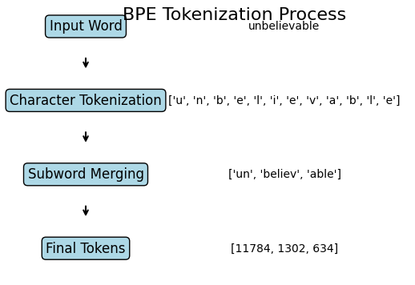
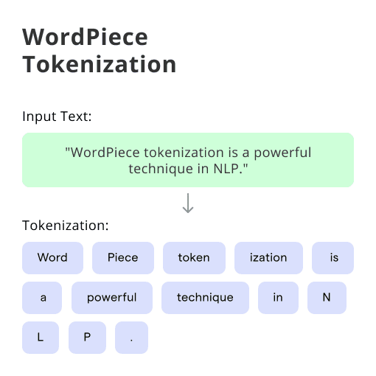
HANDLING LONG INPUT SEQUENCES
Τοκενισμός (Tokenization):
  Converting text into smaller units called tokens.
  Common methods:
    Byte-Pair Encoding (BPE)
    WordPiece or SentencePiece.
Managing Long Inputs:
  Αποκοπή (Truncation): Keeping only the first or last tokens when the input is too long.
  Συρόμενο Παράθυρο/ Sliding Window: Processing text in overlapping segments to avoid losing context.
  Σύνοψη/ Summarization: Using summarization techniques to reduce input length.

Slide 12
TRAINING BERT ON IMDB DATA FOR SENTIMENT ANALYSIS
Data Preparation:
  Load the IMDB dataset (positive and negative reviews).
  Tokenize the data using BERT’s tokenizer.
Model Adaptation:
  Add a classification layer on top of BERT.
Model Training:
  Train the model using labeled data.
  Adjust hyperparameters (e.g., learning rate, epochs, batch size).
Model Evaluation:
  Calculate accuracy, precision, and recall.

Slide 13
Finetuning BERT
Step 1: Install Libraries
Step 2: Data Preparation
  The simplest approach is to use the IMDB dataset, which is easily accessible through the Hugging Face datasets library
Step 3: Model and Tokenizer Setup. For fine-tuning, we use the pre-trained BERT model..
!pip install transformers datasets torch
from datasets import load_dataset
# Load IMDb dataset
dataset dataset = load_dataset("imdb")
from transformers import BertTokenizer, BertForSequenceClassification, Trainer, TrainingArguments
# Φορτώνουμε το BERT tokenizer και το BERT μοντέλο για ταξινόμηση
tokenizer = BertTokenizer.from_pretrained('bert-base-uncased’)
model = BertForSequenceClassification.from_pretrained('bert-base-uncased', num_labels=2)

Slide 14
Finetuning BERT
Step 4: Προετοιμασία των Δεδομένων για Εκπαίδευση. The IMDB reviews are in text form, so we need to convert them into numerical data (tokenized input) before feeding them to the model.
Step 5: Defining Hyperparameters for Fine-tuning
def tokenize_function(examples):
return tokenizer(examples['text'], padding="max_length", truncation=True)
# Εφαρμόζουμε το tokenization στο dataset
tokenized_datasets = dataset.map(tokenize_function, batched=True)
Batch size: The number of samples processed before the model updates its weights. Larger batch sizes speed up training but require more memory.
Warmup steps: The number of steps where the learning rate gradually increases from low to normal to stabilize training.
Ο όρος batch size αναφέρεται στον αριθμό των δειγμάτων (ή παραδειγμάτων) που επεξεργάζεται το μοντέλο σε κάθε βήμα κατά την εκπαίδευση ή την αξιολόγηση. Αντί να επεξεργάζεται το μοντέλο ένα δείγμα τη φορά, επεξεργάζεται ένα σύνολο δειγμάτων (ένα "batch") ταυτόχρονα. Αυτό επιταχύνει τη διαδικασία εκπαίδευσης, καθώς εκμεταλλεύεται τη δυνατότητα παράλληλης επεξεργασίας των δεδομένων από την GPU ή την CPU.
training_args = TrainingArguments(
output_dir='./results', # φάκελος για τα αποτελέσματα
num_train_epochs=3, # αριθμός εποχών
per_device_train_batch_size=8, # μέγεθος batch για εκπαίδευση
per_device_eval_batch_size=16, # μέγεθος batch για αξιολόγηση
warmup_steps=500, # αριθμός βημάτων warm-up
weight_decay=0.01, # L2 regularization
logging_dir='./logs', # φάκελος για τα logs
logging_steps=10,)
trainer = Trainer(
model=model, # το μοντέλο BERT
args=training_args, # υπερπαραμέτρους
train_dataset=tokenized_datasets['train'], # το training dataset
eval_dataset=tokenized_datasets['test'], # το evaluation dataset
)
Το warmup steps καθορίζει πόσα βήματα θα χρησιμοποιήσεις ένα πολύ χαμηλό learning rate (warmup). Αρχικά, το learning rate ξεκινά πολύ χαμηλά και αυξάνεται σταδιακά, μέχρι να φτάσει στο κανονικό learning rate που θα χρησιμοποιείς για το υπόλοιπο της εκπαίδευσης.

Slide 15
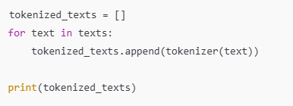
FUNCTION MAP()
tokenized_datasets = dataset.map(tokenize_function, batched=True)
What does map() do?
  Takes the function you give as input (here is tokenize_function).
  Applies that function to every item in your dataset.
  Returns a new dataset with the processed results.
Είναι σαν να κάνετε ένα for:
Why is it useful?
  Efficient: map() doesn’t load the whole dataset into memory at once it processes data on demand.
    Το Lazy Evaluation (Τεμπέλικη Αξιολόγηση) The results are generated only when needed, saving memory and time.
  Automatic batching: When you set batched=True, it processes many samples together, making it faster.
  Cleaner code: Shorter, easier to read, and less error-prone.

Slide 16
Finetuning BERT
Step 6: Training Model
Step 7: Model evaluation. After training is complete, we can test how well the model performs on the test set.
Βήμα 8: Comparison with Zero-shot Classification
In the second part of the exercise, we compare the fine-tuned model with a zero-shot classification approach
trainer.train()
trainer.evaluate()
from transformers import pipeline
# Χρησιμοποιούμε το
zero-shot classification pipeline
zero_shot_classifier = pipeline("zero-shot-classification", model="facebook/bart-large-mnli")
# Παράδειγμα με zero-shot
sequence = "The movie was great, I really enjoyed it!“
labels = ["positive", "negative"]
result = zero_shot_classifier(sequence, candidate_labels=labels)
print(result)

Slide 17
What is Zero-shot Classification (explained simply)
It means the model can classify text into categories it was never trained on.
You just tell it the possible labels in words, and it uses its general knowledge to decide.
Example:
  You ask, “Is this review positive or negative?” even though the model was never trained on movie reviews.
It’s like asking a very smart person to guess the answer using logic and general language understanding, instead of prior examples.

Slide 18
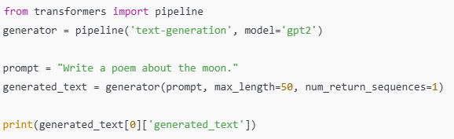
EXERCISE – MODIFYING PROMPTS IN GPT-2 FOR CREATIVE TEXT GENERATION
Get familiar with the technique of prompt engineering for creating high-quality outputs.
Modifying the Prompt:
  Examples of prompts you can try:
  "Write a poem about the sea.“→ “Write a short poem about the sea during a storm.”
  “Complete the following story: Once upon a time, in a small village, there was a mysterious creature.”
Adjusting Parameters:
  You can change a few settings to control how the text is generated:
    max_length: Maximum number of tokens (text length) to generate.
    num_return_sequences: umber of different outputs to generate.
    temperature: Controls creativity.
      Lower values → more predictable text.
      Higher values → more imaginative and creative text.

Slide 19
BERT FINETUNING COLAB NOTEBOOK
https://colab.research.google.com/drive/1p4XeUDWA11jbZ-SY-g_WDeEmROxD96nS?usp=sharing

