Slide 1
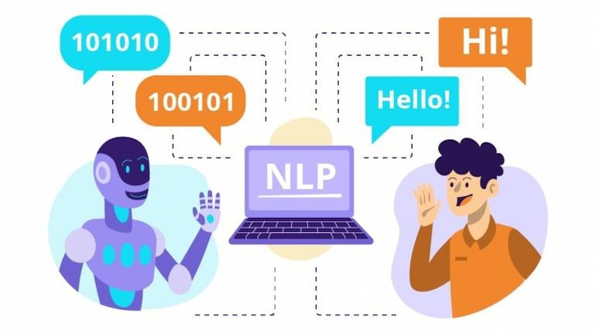
Voice and Natural Language Processing
Χατζημηνα Μαρια Ευαγγελια, Τσικνακησ Μανωλησ
Email: ddk8@edu.hmu.gr

Slide 2
Introduction to RAG
What is Retrieval-Augmented Generation (RAG)?
A method that combines:
Retrieval (finding relevant information)
Generation (producing text with an LLM)
Uses external knowledge to create answers.
Architecture:
Retriever: Finds relevant documents or passages using embeddings
Generator: Uses the retrieved documents to produce a full answer
Advantages:
Works with large external datasets
Produces updated and more accurate answers
Limitations:
Depends on document quality
More complex architecture

Slide 3
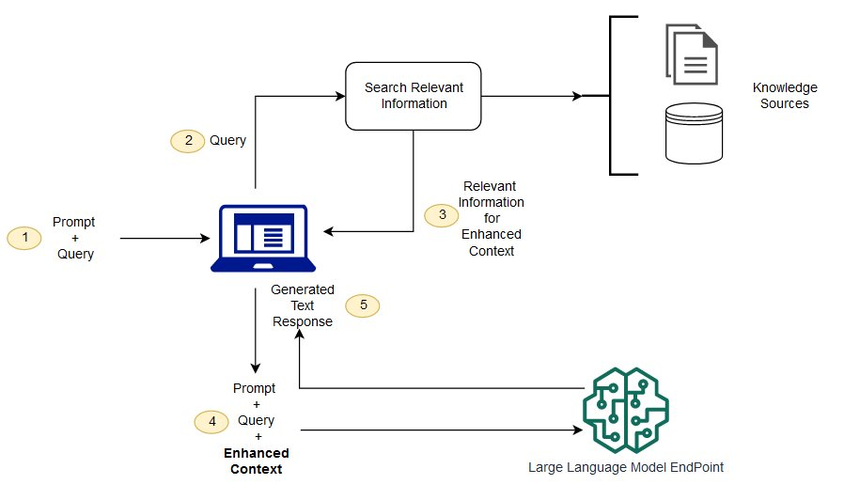
RAG vs Traditional QA Systems
Comparison with extractive / generative QA:
RAG: Uses an external database and generates answers.
Generative QA: Does not rely on external knowledge (risk of hallucinations)
Extractive QA: Restricted to exact text spans.
Practical uses of RAG:
Chatbots.
Information retrieval applications
Dynamic answer generation from large data collections.

Slide 4
RAG Approaches: Embeddings vs Finetuning
Embeddings Approach
Uses models such as BERT/RoBERTa to generate embeddings
Retrieves information from pre-computed embeddings
Process:
Create embeddings for the database
Search using similarity (e.g., cosine similarity)
Feed retrieved texts into the generator
Pros:
Flexible for large datasets
No need to train the generator
Cons:
Quality depends on embedding model

Slide 5
Vector Embedding
Vector embeddings are a technique used in NLP to represent words or phrases in a continuous vector space.
Each word is assigned a vector (a list of numerical values)
Semantically similar words lie close to each other
Embeddings are produced by neural networks trained on large text datasetsWord vectors capture syntactic and semantic information
Example of vector arithmetic:
vector("King") – vector("Man") + vector("Woman") ≈ vector("Queen")

Slide 6
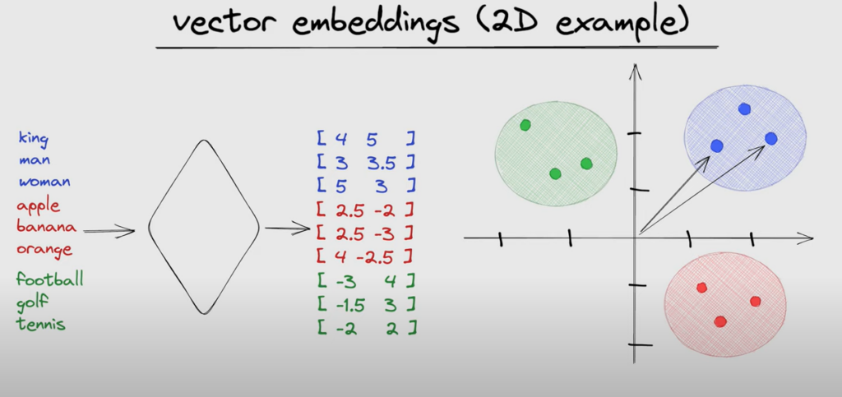
Vector Embedding

Slide 7
RAG Approach: Finetuning
Finetuning
Training a whole RAG pipeline with task-specific data.
Pros:
More coherent answers
Captures domain-specific knowledge
Cons:
Time-consuming
Less flexible for new data

Slide 8
What Are Embeddings?
Embeddings are numerical representations of text (words, phrases, or sentences) in a multi-dimensional space.
Similar meanings → vectors close together
Different meanings → vectors far apart
They act like a “map” of semantic relationships
How they work in RAG:
The database context is converted into embeddings
The query is also converted
Similarity metrics (cosine, L2) find the closest context
Why are they useful?
Can find relevant context even without exact word matching

Slide 9
Evaluating Embedding Quality
How do we know if embeddings are good?
Analytical approach:
They should preserve semantic similarity
Empirical approach:
Test whether the system retrieves the correct context
Factors affecting embedding quality
Embedding model (e.g., Sentence Transformers like all-mpnet-base-v2 perform very well)
Training dataset Similarity between training data and our domain improves quality
Similarity metric (cosine similarity vs L2 distance)

Slide 10
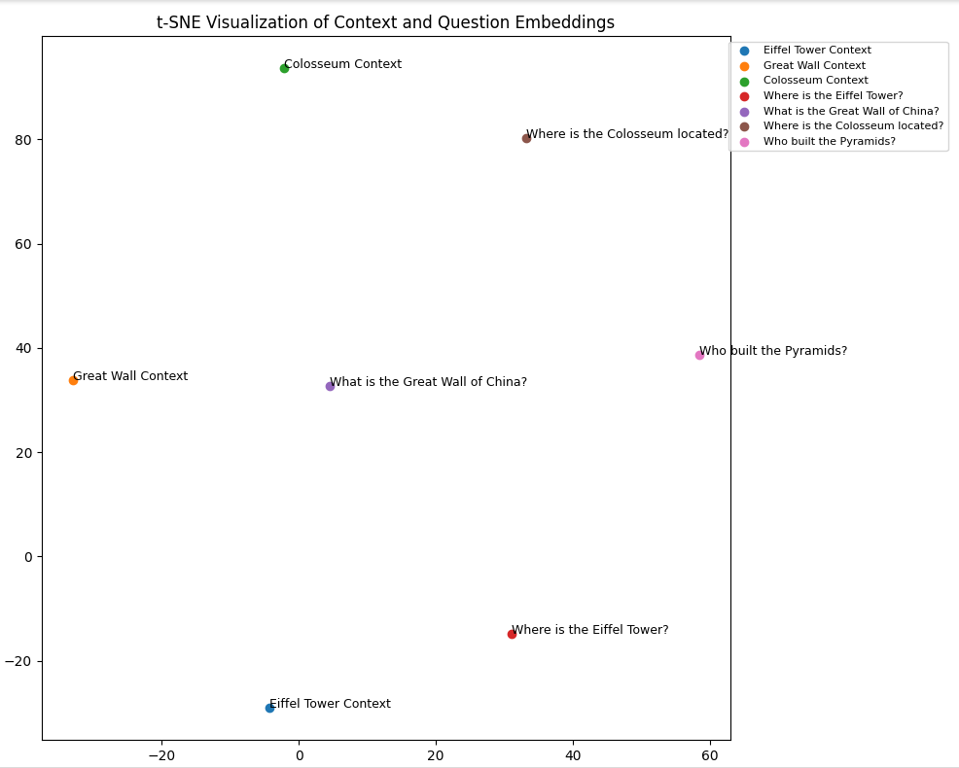
Embeddings Example
https://colab.research.google.com/drive/1MnDZzsunA8755CNNIPtmJYhG1ltg6y6u?usp=sharing

Slide 11

VECTOR DB
ChromaDB is a vector database optimized for storing and retrieving embeddings.
Main features:
Fast similarity search
Native embedding support
Scalable collections
Simple API for insertion and retrieval
Used in:
Recommendation systems
QA and RAG systems
Applications needing similarity-based search

Slide 12
Evaluation Metrics
Exact Match (EM) – literal overlap
NER Overlap – correct medical entities
ROUGE-L – actual overlap (longest common subsequence) between the model’s answer and the reference answer.
F1 / BERT Score – semantic similarity
Recall@K – retrieval coverage
Semantic and retrieval metrics

Slide 13
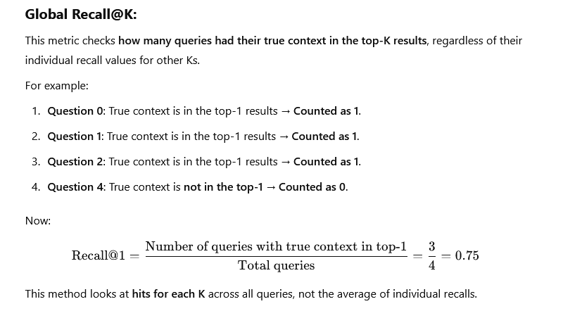
Evaluation Metrics
Recall@K: Measures whether the relevant context/content appears in the top-k retrieved documents.
Example: Recall@3 = 80% means the correct context appears in the top-3 retrieved documents in 80% of the cases.
Precision: The ratio of relevant contents among the retrieved ones.

Slide 14
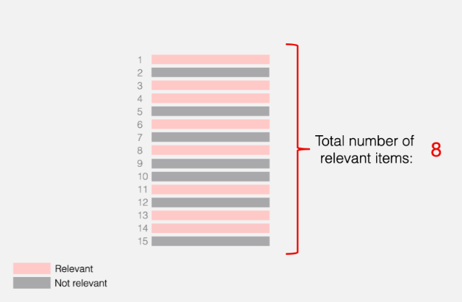
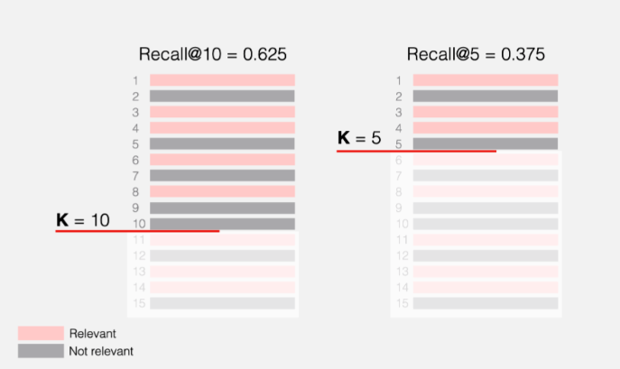
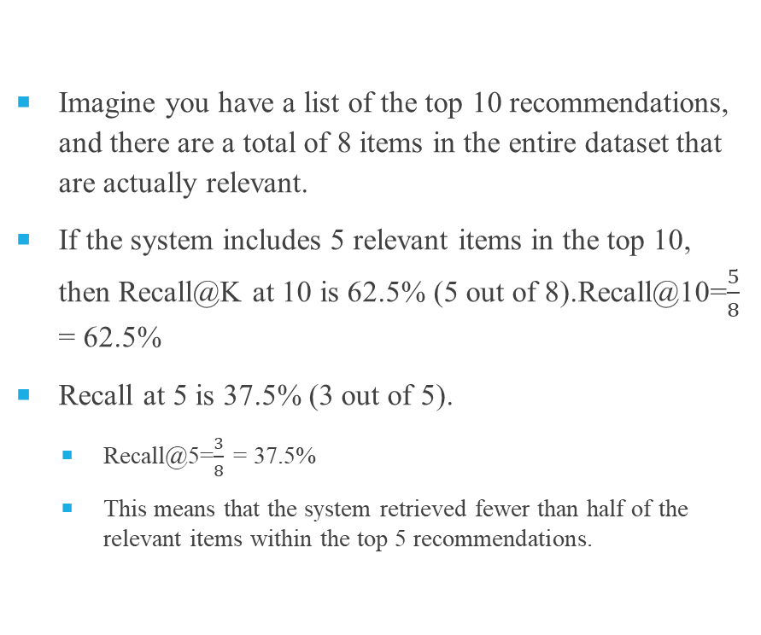
Recall@K
Imagine you have a list of the top 10 recommendations, and there are a total of 8 items in the entire dataset that are actually relevant.
If the system includes 5 relevant items in the top 10, then Recall@K at 10 is 62.5% (5 out of 8).Recall@10=$\frac{5}{8}$ = 62.5%
Recall at 5 is 37.5% (3 out of 5).
Recall@5=$\frac{3}{8}$ = 37.5%
This means that the system retrieved fewer than half of the relevant items within the top 5 recommendations.

Slide 15
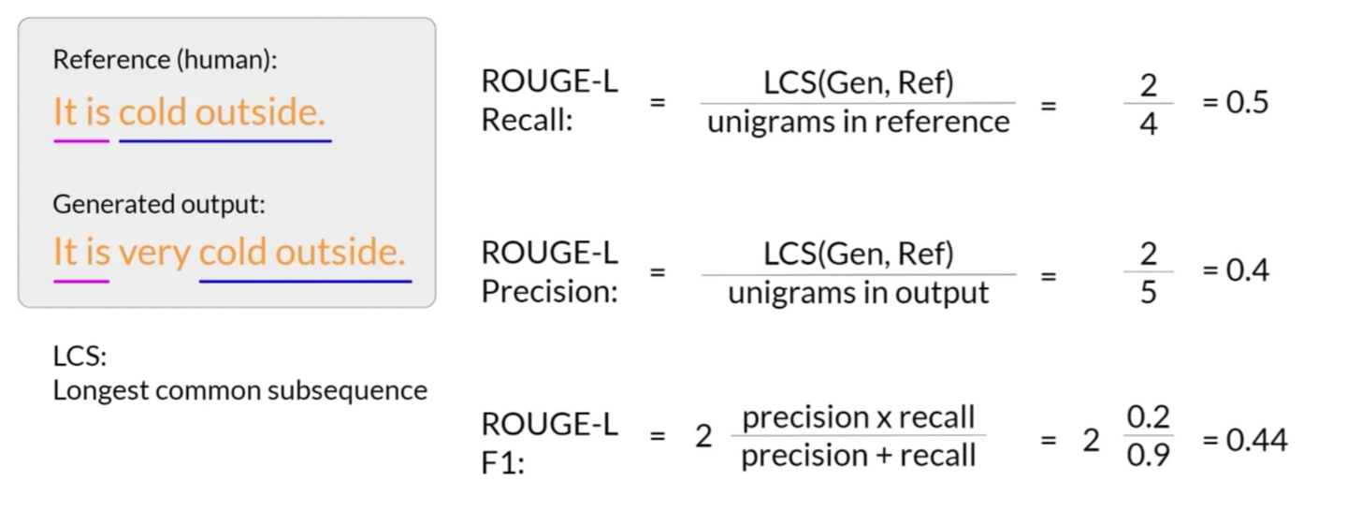
Evaluation Metrics
BLEU Score: It is a measure of the accuracy of n-grams in the model’s output compared to the reference text created by a human. It was originally designed for machine translation tasks but has since been widely adopted across NLP tasks. BLEU stands for Bilingual Evaluation Understudy.
ROUGE Score:It focuses more on recall. It compares overlapping units such as n-grams, word sequences, and word pairs between the generated text and the reference text. ROUGE scores are commonly used for NLP tasks like text summarization.ROUGE stands for Recall-Oriented Understudy for Gisting Evaluation.
ROUGE-L:
It uses the longest common subsequences (LCS), which capture structural similarity between the generated text and the reference.

Slide 16
LitQA2: What It Is and Why We Use It
Not simple questions from abstracts
Answers require full-text documents
Measures whether RAG retrieves the correct paper and answers accurately
If the index contains only abstracts → Recall drops

Slide 17
LitQA2 Example
https://colab.research.google.com/drive/1vlcb2HGYwinojG_kR-Kt94NpHsmr_wLY?usp=sharing

Slide 18
Model Selection Guidelines
Embeddings Models
Hugging Face Models: https://huggingface.co/models
Filter: Task = Sentence Similarity / Embeddings
Sentence Transformers Models: https://www.sbert.net/docs/pretrained_models.html
LLMs (Generative Models)
Hugging Face Models: https://huggingface.co/models
Filter: Task = Text Generation
Model examples: gpt2, gpt2-medium (λίγο μεγαλύτερο, αλλά διαχειρίσιμο με GPU στο Colab)

Slide 19
How to select models
Model Size:
Prefer lightweight models (based on number of parameters).
GPU Limitations:
Free Google Colab environments have limited GPU memory (8–12 GB).
A smaller model reduces loading time and memory usage.
CPU Usage (fallback):
If no GPU is available, you should choose very lightweight models.
Language Coverage:
Make sure the model supports English (or any other language you plan to use).

Slide 20
Useful Links & Tools
Chroma (Vector DB): https://docs.trychroma.com/
Google Colab Tips: https://colab.research.google.com/notebooks/

Slide 21
Example Code – Embeddings
from sentence_transformers import SentenceTransformer
model = SentenceTransformer("all-mpnet-base-v2") #βρειτε καποιο άλλο μοντελο
contexts = ["Example context 1", "Example context 2"]
embeddings = model.encode(contexts)

Slide 22
Example Code – Vector DB
import chromadb
collection.add(
ids=["id1"],
documents=["context"],
embeddings=[embedding]
)
results = collection.query(query_embeddings=embedding, n_results=1)

Slide 23
Example Code – LLM Answers
from transformers import pipeline
generator = pipeline("text-generation", model=“your_model") #try different llms
response = generator(prompt, max_length=50)

Slide 24
Ethics, AI and LLMs in Biomedicine
What is AI Ethics?
Ensuring algorithms are fair, transparent, and beneficial.
Why important in biomedical LLMs?
Risk of inaccurate or harmful answers
Data bias
Patient safety

Slide 25
Ethical Considerations
Accuracy & Validity
Risk of generating incorrect medical information
Privacy & Security
Protect sensitive health data
GDPR compliance
Fairness & Inclusion
Avoid discrimination against minorities
Trust
Clinicians and patients must trust the system

Slide 26
Regulations and Frameworks
GDPR: How it affects patient-data use in LLMs
EU AI Act: Framework for developing and deploying AI in the EU
Biomedical ethics: Importance of consent and transparency

