Slide 1
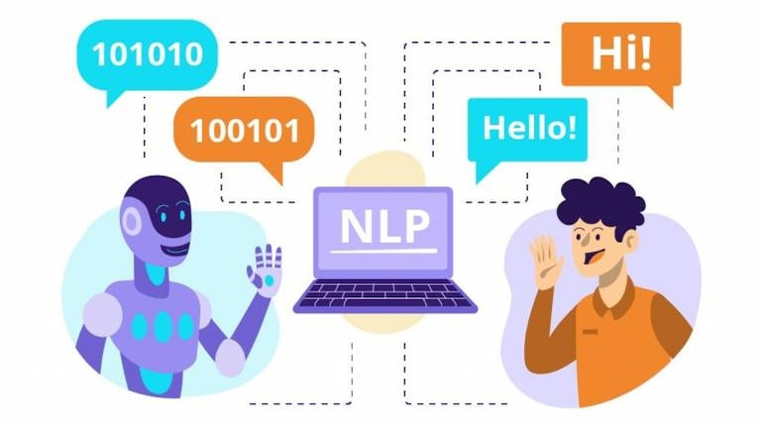
Voice and Natural Language Processing
Chatzimina Maria, Tsiknakis manolis
Email: ddk8@edu.hmu.gr

Slide 2
CHATBOTS
What is a Chatbot?
A chatbot is a software system that simulates conversation with humans using natural language.
It may be based on:
  simple rules,
  predefined responses, or
  Artificial Intelligence (AI) and machine learning.
Examples of chatbots around us
  Customer support in e-shops
  Assistants in banks, airlines, mobile apps
  Educational or psychological chatbots (e.g., Woebot)

Slide 3
Types of Chatbots
1. Rule-based chatbots
  “If the user says X → reply Y”
2. NLU-based chatbots with dialogue management
  (e.g., Rasa, DialogFlow)
3. LLM-based chatbots
  (e.g., ChatGPT API)

Slide 4
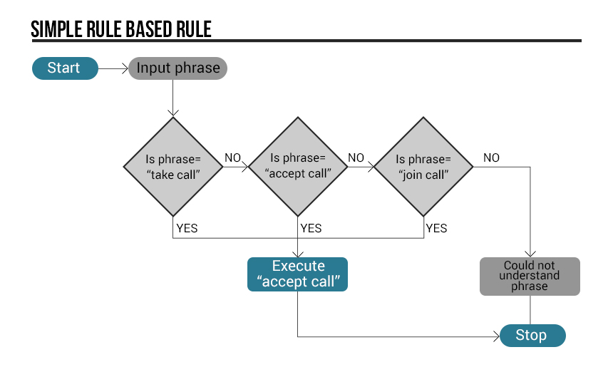
How a Simple Rule-Based CHATBot Works
Detects keywords
Uses predefined patterns (regex)
Responds without real understanding of context

Slide 5
Rule-based Bot
Advantages
  Easy to implement
  Predictable behavior
  Fully controllable dialogue
Disadvantages
  No contextual understanding
  Cannot handle spontaneous language
  Very limited scenarios

Slide 6
What is NLU (Natural Language Understanding)?
Utterance
  A user message (sentence or phrase with meaning).
Intent Extraction
  “What does the user want?”
  Examples: “order food”, “check balance”, “book a ticket”
Entity Extraction
  Specific pieces of information inside the intent.
  Examples: pizza, size, date, address
Summary
NLU identifies:
  intent (the user’s goal)
  entities (supporting details)
  to help the system understand what the user wants

Slide 7
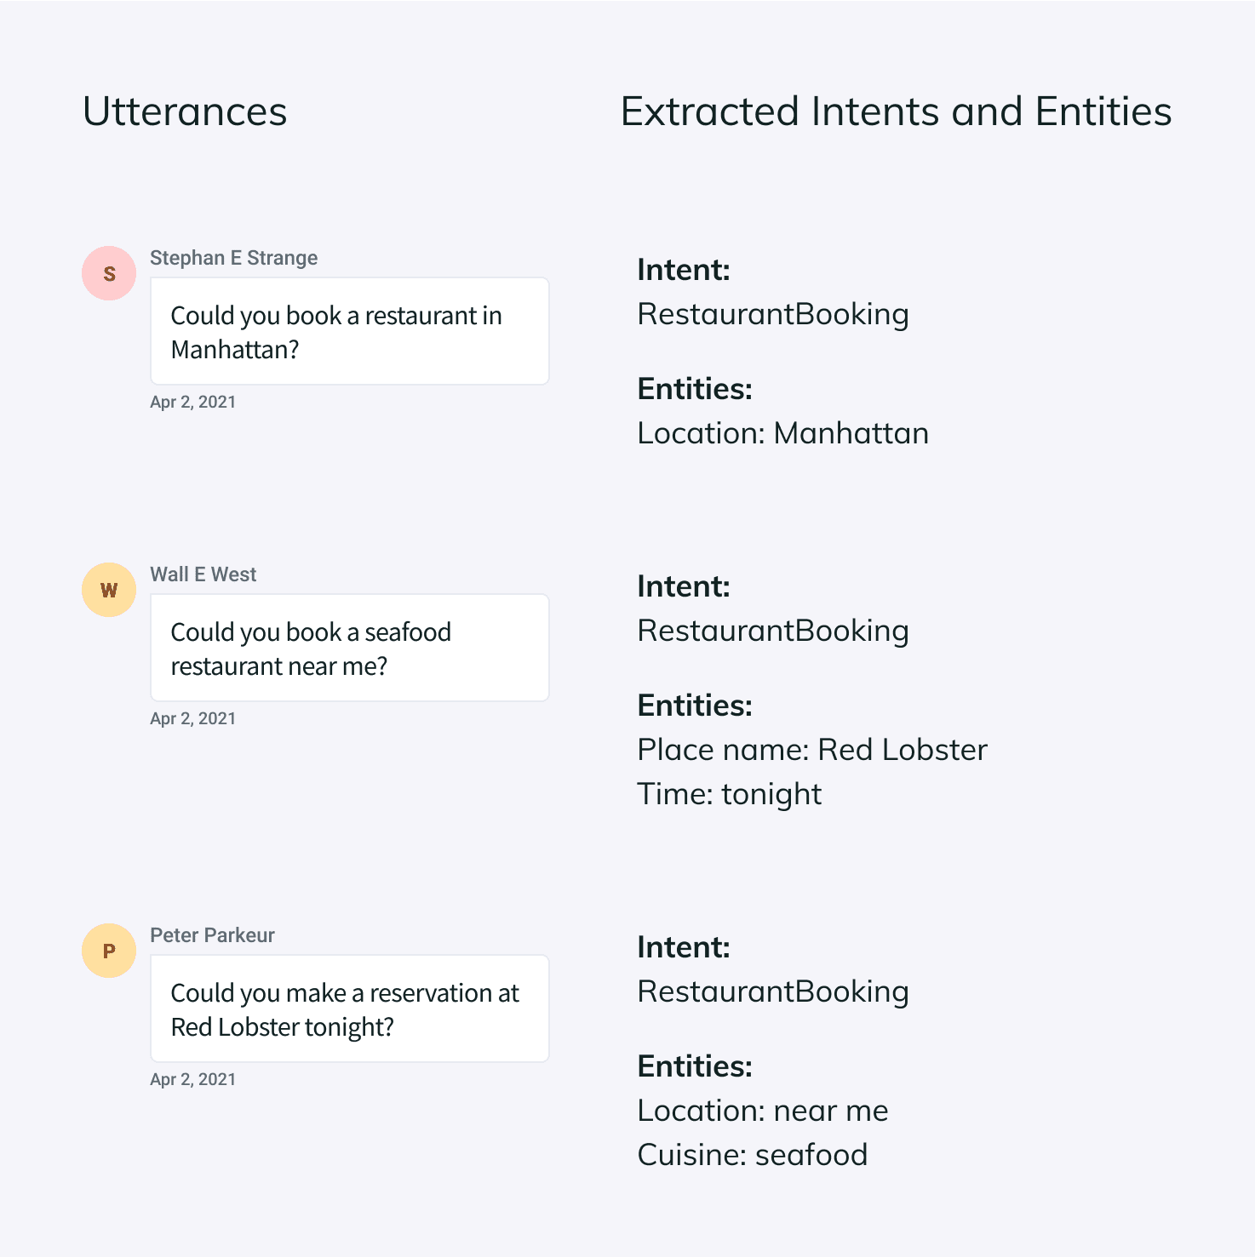
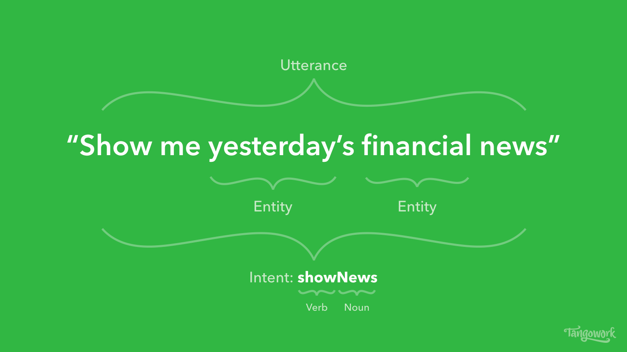
Utterances – Intents- Entities

Slide 8
Dialogue Management
Dialogue management controls the flow of the conversation.
defines dialogue flow
manages context and slots
selects the correct action and response

Slide 9
Dialogue Management
1. System-Directed Dialogue
The system leads the conversation. Example:
  System: “Where do you want to travel?”
  User: “London”
  System: “What date?”
2. User-Directed Dialogue
The user controls the flow. Example:
  User: “How many workers in London earn over 50,000?”
  System: “Fifty-four.”
3. Rule-Based Dialogue Management
The system follows fixed rules to decide the next action. Example:
  Computer: “What force acts on the electron?”
  Human: “Electric force.”
  Computer: “Correct.”

Slide 10
Dialogue Management
4. Example-Based Dialogue Management
The system learns from past dialogues and selects appropriate responses based on similarities.
Example: If a user previously asked for “a movie” and the system asked “what genre do you prefer?”, this is reused.
5. State-Based Dialogue Management
The system maintains a state with information about the dialogue, and uses it for subsequent responses.
Example: In a travel booking, it tracks: origin, destination, and travel date to guide the user correctly.
6. Dialogue Management in Chatbots
Chatbots use dialogue mechanisms to understand what the user is saying, select a response, and maintain coherence in the conversation.
Example: If a request is not understood, the bot can ask for clarification or suggest options to the user.

Slide 11

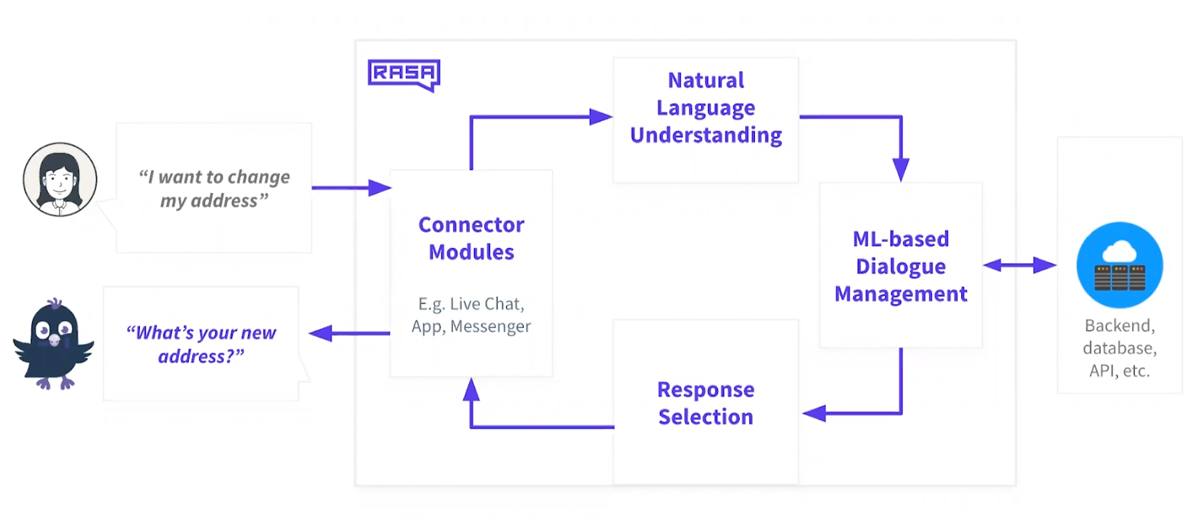
Rasa – NLU and Dialogue Tool
Open-source platform for NLU + dialogue
Trains intents/entities
Uses policies to decide actions
Typical pipeline:
  User → Message
  NLU → intent/entity
  Dialogue policy → decision
  Response → User
Link: https://rasa.com/

Slide 12
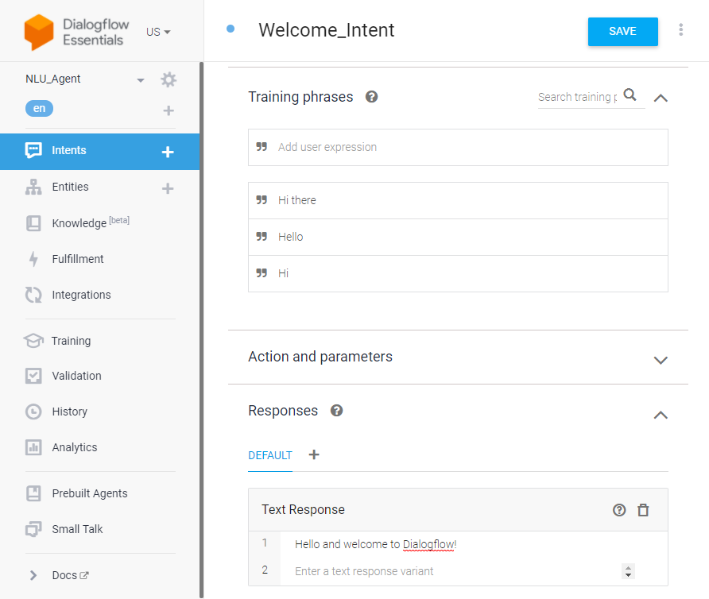
Dialogflow – NLU Tool
Google platform
Visual interface
Easy integration with apps and Google Assistant

Slide 13
NLU-based Bots
Advantages
  Better understanding
  More natural dialogue
  Customizable
Limitations
  Require training data
  Limited generalization

Slide 14
NLU Chatbots
Since 2023–2025, developers increasingly prefer:
  LLM-based chatbots
  RAG systems
  Custom agents built with OpenAI, Gemini, Claude APIs
  Python frameworks (LangChain, Rasa 3, Haystack)
  Flowise / Botpress (modern low-code)
Dialogflow is falling behind because it is:
  intent-based (old paradigm)
  not optimized for LLM interactions
  expensive for large-scale use
  less flexible than modern frameworks

Slide 15
LLM-based Chatbots
Use Large Language Models (LLMs) such as GPT-4/5/Gemini to respond dynamically, without intents or flows.
Examples
  ChatGPT
  Claude
  Custom chatbots using OpenAI API
  Internal company chatbots

Slide 16
LLM-based Chatbots
Advantages
  No manual intent creation
  Very flexible
  Natural, open-ended dialogue
Challenges
  Hallucinations
  No memory unless implemented
  May answer out-of-scope questions

Slide 17
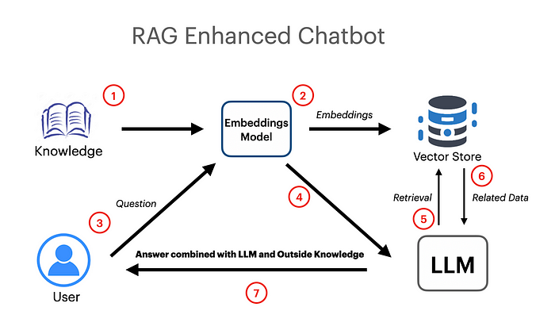
RAG + LLM
RAG + LLM = an informed agent
The system retrieves information and injects it into the prompt.
Example:
A chatbot that answers based on PDF documents.

Slide 18
Prompt Engineering σε Chatbots
Role / Instructions / Goal
  Role: “You act as a medical assistant.”
  Instructions: “Be short, simple, and clear.”
  Goal: Guide the model into the correct style and purpose.
Understanding the LLM Model: Chatbots, especially those powered by Large Language Models (LLM), respond based on the data they receive. Direct Engineering aims to shape this data to elicit the desired outcome.
Clarity and Context: Well-designed prompts provide the chatbot with clear instructions and relevant content, helping it understand the user’s intent and the overall conversation.
Improving Output Quality: By optimizing prompts, you can reduce ambiguity, improve the accuracy of responses, and minimize the chatbot’s generation of illusions or misinformation.
Improving User Experience: Direct Engineering contributes to a more natural and engaging chatbot experience, making it easier for users to interact and satisfy their needs.

Slide 19
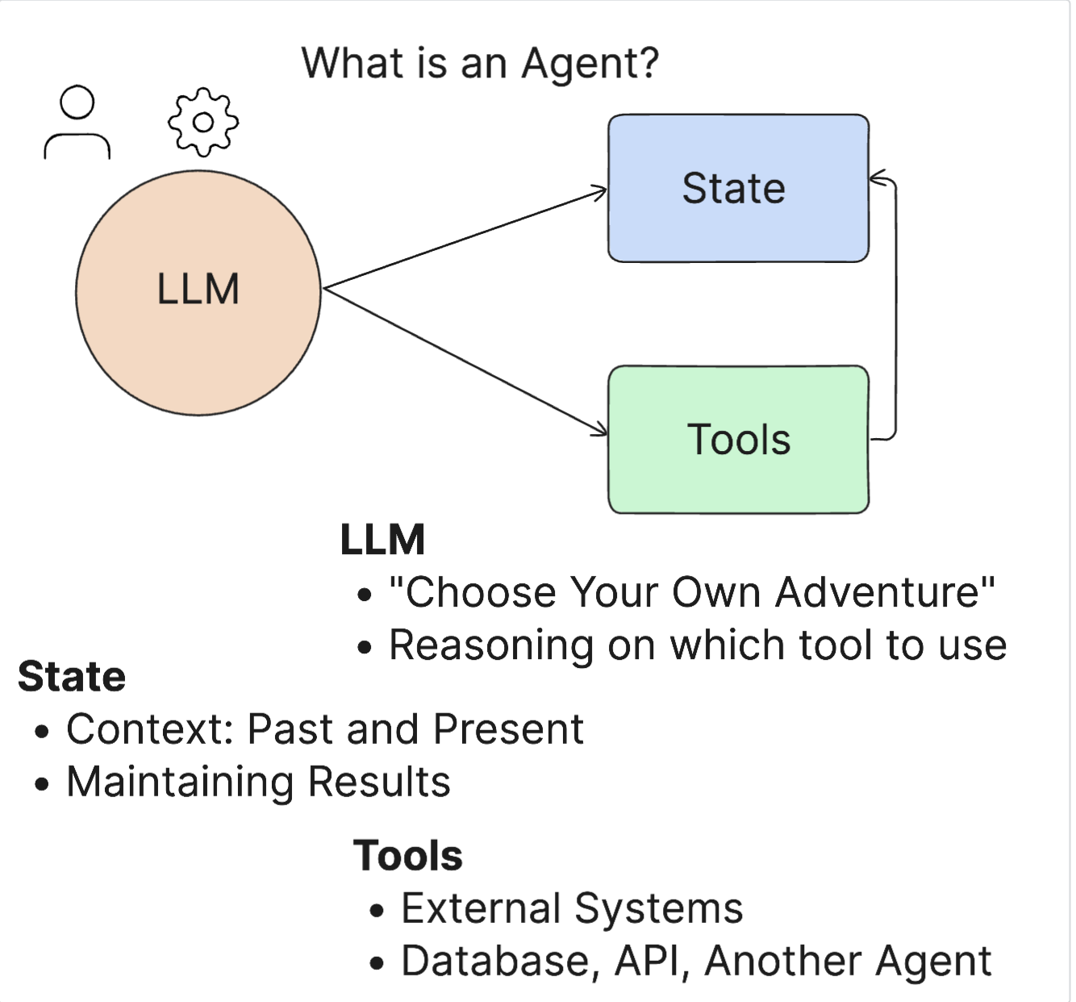
AI AGENTS
An agent is a system that:
  understands its environment
  makes decisions
  takes actions to achieve goals
State - This refers to the context in which the LLM is working. The LLM uses the context of its previous actions and the current context to guide its decision-making for subsequent actions. AI agent frameworks allow developers to maintain this context more easily.
Tools - To complete the task requested by the user and designed by the LLM, the LLM needs access to tools. Some examples of tools might be a database, an API, an external application, or even another LLM.

Slide 20
Chatbot vs AI Agent
Feature | Chatbot | AI Agent
Initiation | Responds to user | Works after initial goal
Autonomy | Low | High
Tool Use | Uses tools only when asked | Chooses tools independently
Memory | Limited | Long-term, adaptive
Goal Handling | Answers questions | Completes tasks
Reasoning | Local, per-question | Multi-step planning
Examples | ChatGPT, Copilot | AutoGPT-like agents
Σκοπός (goal)
Μνήμη (memory)
Στρατηγική / Λογική (planning)
Εργαλεία (tool use)
LLM (για γλώσσα και απόφαση)

Slide 21
Chatbot vs AI Agent
Examples
Chatbot
User: “What’s the temperature in Athens?”
→ Calls weather API
→ “29°C”
AI Agent
User: “I’m traveling to Athens tomorrow. What should I wear?”
→ Retrieves weather
→ Reasons
→ “It will be 29°C. Dress lightly.”

Slide 22
AI assistants
Conversational AI: AI assistants powered by LLMs use Natural Language Processing (NLP) to communicate with users through a chatbot interface.
  Examples include Microsoft Copilot, ChatGPT, and IBM watsonx™ Assistant.
  These assistants integrate with APIs to extend their capabilities.
Prompts: AI assistants need a clearly defined problem or question to begin.
They rely on continuous user input to move the conversation forward.
Recommendations: An AI assistant can suggest information or actions based on the data it has access to.
Users should always verify the results for accuracy.
Tuning: Users can adapt AI models to more specific tasks through fine-tuning, which avoids retraining from scratch.
With optimization, labelled examples can be provided so the model adapts to a target task.
Through prompt tuning, professionals can give the model a specific context or role for the task.

Slide 23
AI agentS : Taking Initiative
Greater Autonomy: After an initial prompt, AI agents can continue working without further user input, reducing the need for human supervision.
Unlike assistants, which suggest actions for user approval, agents use multi-step reasoning and autonomy to:
  plan
  decide
  solve problems
  using external tools and data sources.
Connectivity
  Agents integrate seamlessly with:
  external applications
  databases
  APIs
  other AI models
They can combine multiple tools to complete complex workflows.
Decision-Making and Action
Simply having access to tools does not make an LLM an agent.
AI agents can independently decide:
  which tools to use
  when to use them
  how to execute multi-step tasks
Driven by foundation models, agents go beyond conversation to complete real tasks from end to end.
Memory and Adaptive Learning
Compared to AI assistants, AI agents have stronger learning capabilities.
They store:
  previous actions
  past conversations
  contextual knowledge
  user preferences
Over time, this allows them to improve their behaviour, adapt, and become more effective.

Slide 24
AI agents
Tools used by AI agents
  Google Search
  Calculator
  File System
  Database queries
  APIs
Where AI Agents are used:
  Data analysis
  SEO / Marketing
  Customer support
  Personal Assistants

Slide 25
AI agents
Advantages of AI Agents
Autonomous operation
Can continue working after the initial instruction without constant user input.
Tool orchestration
Can combine multiple tools (APIs, databases, external models) to complete tasks.
Personalization & memory
Maintain long-term user preferences, past actions, and context.
Challenges of AI Agents
Safety risks
(e.g., executing dangerous or unintended actions if not restricted)
Performance issues
Latency, computational cost, API costs, and reliability.
Excessive autonomy
Agents may take unwanted actions without user supervision if not carefully controlled.

Slide 26
OPENAI Simple conversational agent/chatbot
!pip install openai -q import openai openai.api_key = "sk-..." # Βάλε το δικό σου API key εδώ def ask_agent(system_prompt, user_input): response = openai.ChatCompletion.create( model="gpt-3.5-turbo", messages=[ {"role": "system", "content": system_prompt}, {"role": "user", "content": user_input} ] ) return response.choices[0].message["content"] prompt = "Είσαι ένας φιλικός διατροφολόγος που δίνει συμβουλές για υγιεινή διατροφή σε φοιτητές." user_input = "Τι μπορώ να φάω το βράδυ χωρίς πολλές θερμίδες;" print(ask_agent(prompt, user_input))

Slide 27
Simple example chatbot with memory
https://colab.research.google.com/drive/13ySGjsjHBpYRIjKa60e6rH67bvT9L27U?usp=sharing

Slide 28
Simple example chatbot with memory
Chatbot with temporary memory (using dictionary).
Search for phrases like "my name is Maria".
The regex finds the name or age accurately..
The bot remembers and answers the question "What’s my name?".
If nothing is stored, it asks the user to provide it..
user_info = { "name": "", "age": "" }
re.search(r'my name is (\w+)', user_input, re.IGNORECASE)
if re.search(r"what('s| is) my name", user_input)

Slide 29
RAG Semester Project Overview
End-to-end RAG system with biomedical MCQ evaluation
  Compare 3 retrievers and 3 LLMs
  Implement retrieval → generation → evaluation
  Deliverables: Notebook + PDF report
Goal of the Assignment
  Learn retrieval methods (BM25, MiniLM, BGE-small)
  Generate answers using small LLMs
  Evaluate with Recall@K and Accuracy

Slide 30
Datasets:
LitQA2-Style MCQ
  30–50 biomedical multiple-choice questions
    Includes question, options, correct answer
  Gold paper ID used for retrieval evaluation
Biomedical Corpus
≈ 1,000 abstracts included in the ZIP
  Topics: oncology, hematology, palliative care
  Retrieval runs ONLY on this corpus

Slide 31
Retrievers & Models
Retrievers:
  BM25 – sparse baseline
  MiniLM (all-MiniLM-L6-v2) – fast semantic model
  BGE-small-en – strong dense model for biomedical tasks
Possible models:
  Flan‑T5‑small – lightweight
  Flan‑T5‑base – stronger reasoning
  Mistral‑7B‑Instruct (or quantized alternative)

Slide 32
Evaluation Metrics
Retrieval: Recall@1, Recall@5, Recall@10
  QA: Accuracy (%)
  Error analysis on 5 failed questions

Slide 33
What You Will Build
Compute embeddings for corpus
  Run all 3 retrievers
  Feed top‑k contexts to each LLM
  Model outputs A/B/C/D
  Compute metrics + tables
Deliverables:
  Notebook (.ipynb) – retrieval, generation, evaluation
  PDF Report (2–3 pages): tables + conclusions

Slide 34
Good Luck!
A real research-style project
Ask questions early if needed

