Slide 1
Biomedical Informatics
Koumakis Lefteris, Maria Chatzimina

Slide 2
What is MaterialApp?
MaterialApp is a core component that provides all the other elements (widgets) offered by the Flutter SDK, such as:
Scaffold
AppBar
Text widget
DropdownButton widget
It is the entry point of the application and informs Flutter that the application will follow the Material Design guidelines.
Basic Attributes
title: Text that appears as the application title
home: The first screen that will be shown to the user

Slide 3
Scaffold and Container Widgets
Scaffold widget
The Scaffold widget provides several built-in properties such as:
AppBar – the bar displayed at the top of the application
Body
Bottom Navigation
Scaffold provides a basic structure for the application that follows the Material Design guidelines created by Google.
Scaffold Class: https://api.flutter.dev/flutter/material/Scaffold-class.html
App Samples: https://flutter.dev/docs/catalog/samples/Scaffold
Container widget:
The Container widget is a basic widget that can contain other widgets.
It is used to decorate its child widgets using properties such as:
borders
padding
alignment
height
width
Container Class: https://api.flutter.dev/flutter/widgets/Container-class.html

Slide 4
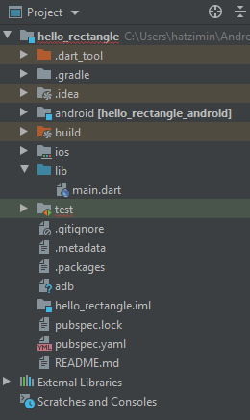
Folders and Files
android folder An Android project containing the compiled Flutter code (we do not modify or use this folder directly).
build folder Contains the output of the Flutter project. It is generated and managed by the Flutter SDK (we do not modify or use this folder).
iOS folder Similar to the Android folder (we do not modify or use this folder).
lib folder The folder where we create and add all Dart files.
test folder The folder used for creating tests for the application (it will not be used in this course).

Slide 5
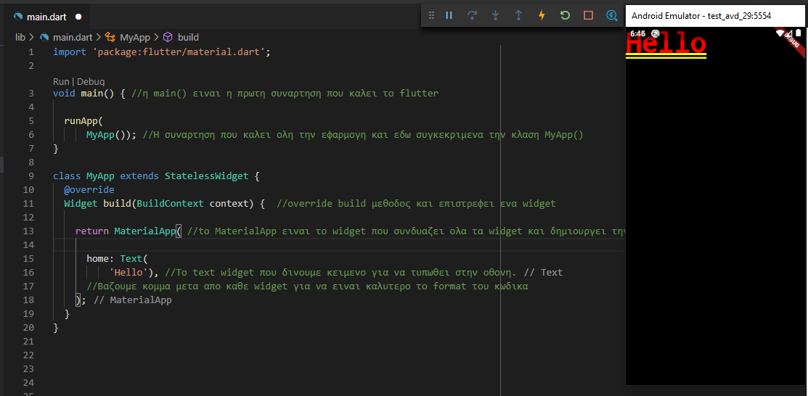
Simple App

Slide 6
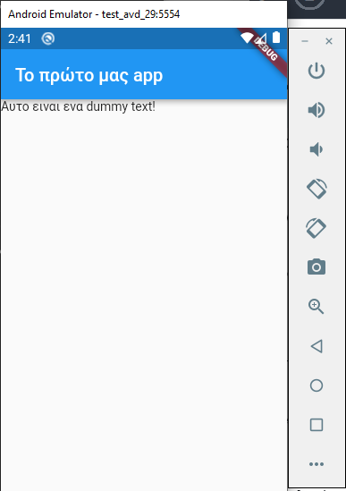
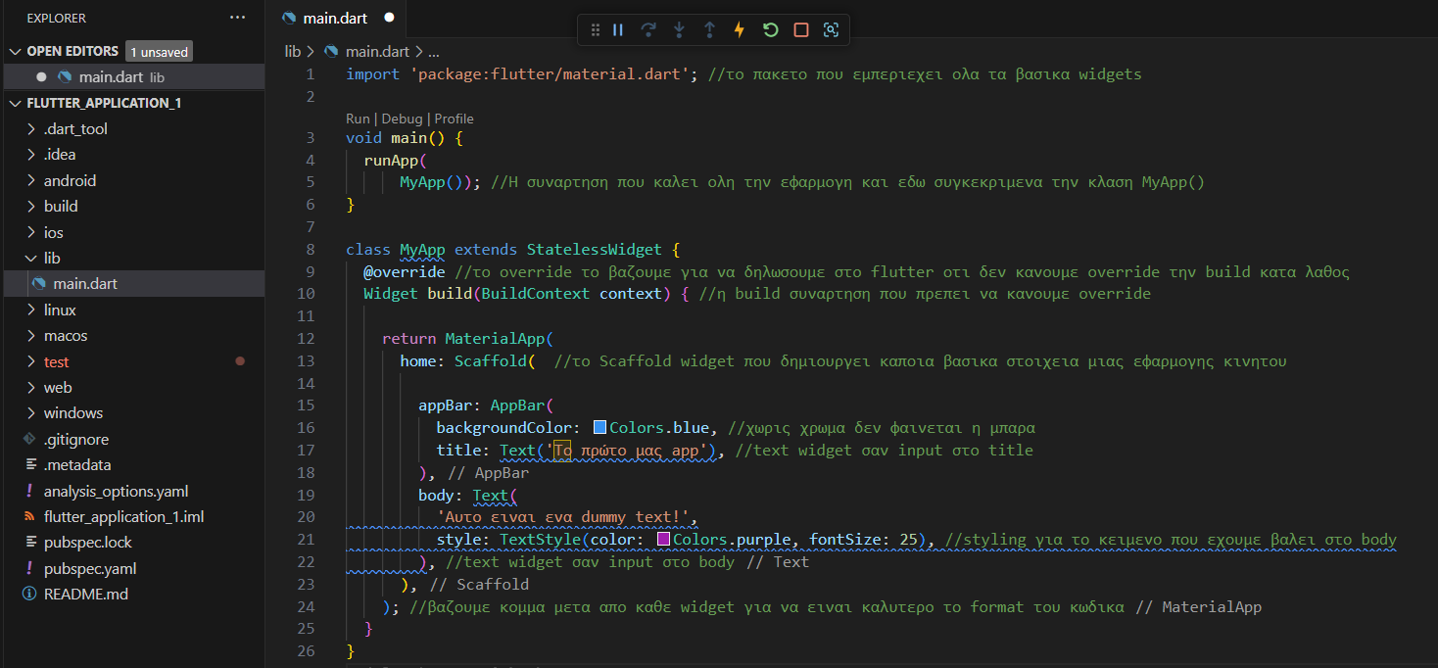
App with styling

Slide 7
Questions
What is the role of runApp()?
This function creates the main widget and calls the build() function of the widget.
What does the build() method do?
It returns the widget tree that should be displayed on the mobile screen.
What are Widgets?
They are the basic building blocks of Flutter used to create the user interface.

Slide 8
Ερωτήσεις
What is the role of a Widget?
The user interface (UI) of your application is built using widgets.
What does the term "Widget tree" describe?
The widget tree means that the UI is built by combining nested widgets.
Why do we need Widgets?
Widgets are the fundamental components used to build rich user interfaces in Flutter.
How are Widgets combined?
Widgets are passed into the constructors of other widgets to achieve the desired result.
How does a Dart object become a Widget?
By extending StatelessWidget or StatefulWidget and implementing a build() method.

Slide 9
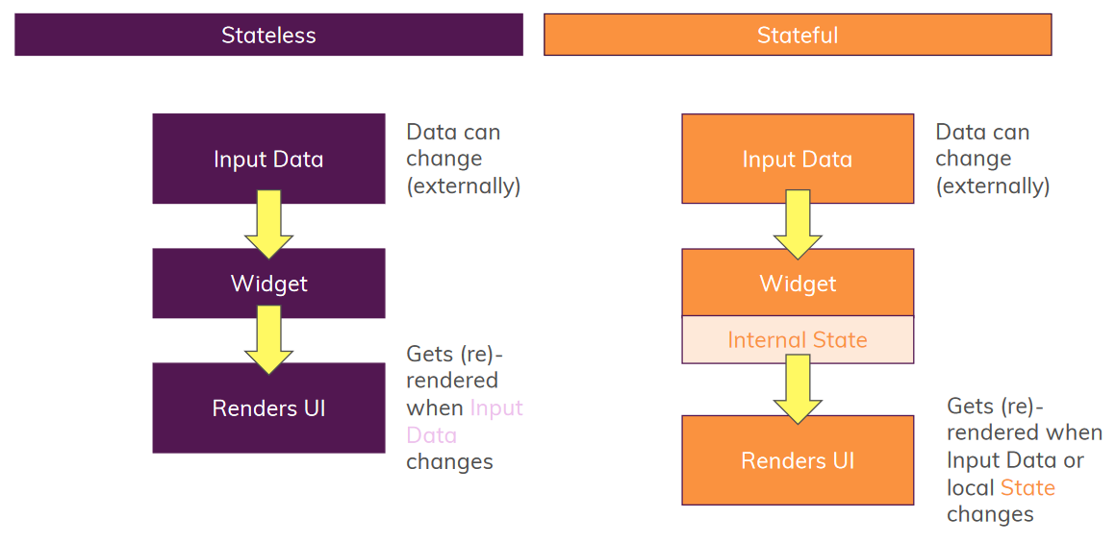
Stateless vs Stateful

Slide 10
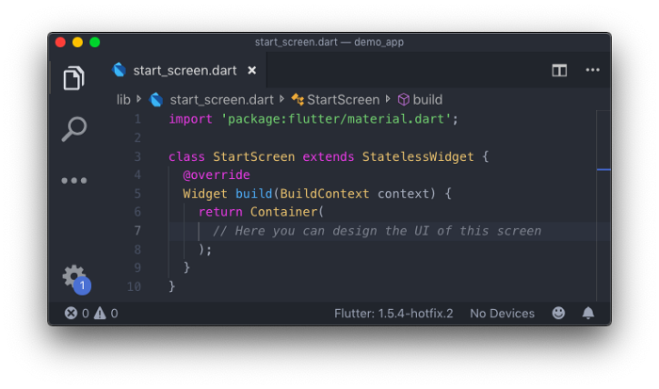
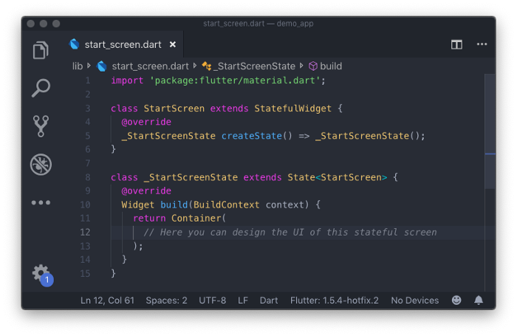
Stateless vs Stateful

Slide 11
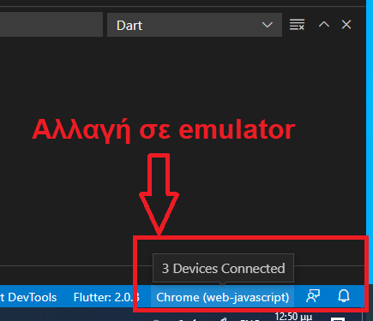
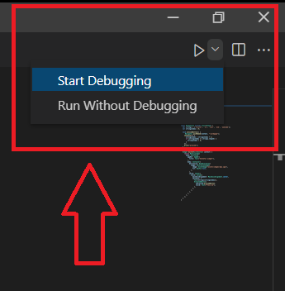
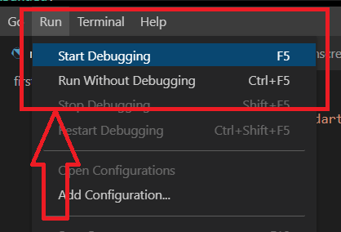
Run project
1 βήμα – Select an emulator
2 βήμα – Run code
ή

Slide 12
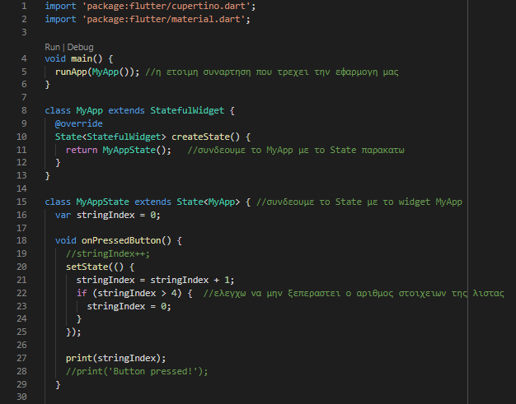
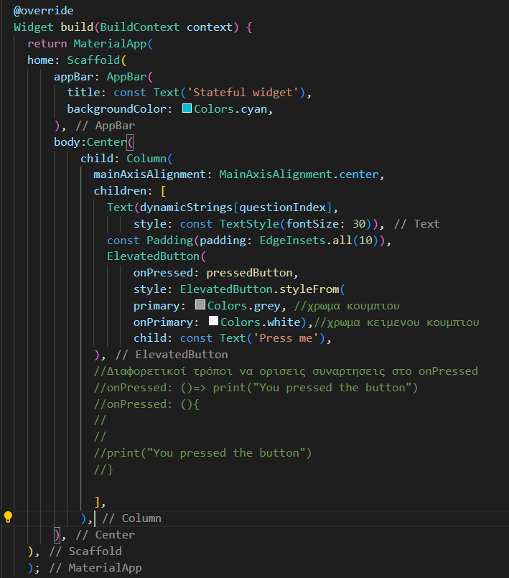
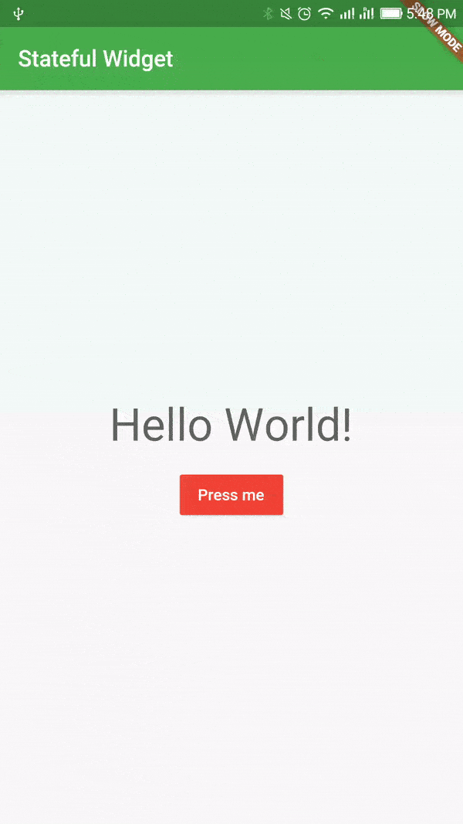
Flutter Examples

Slide 13
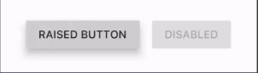
Widget lifecycle
Rebuilding the widget and refreshing the UI based on the state change.
UI
New State
User input
State Change
Example: button press
Αλλαγή
κατάστασης
Updated
State

Slide 14
Stateless vs Stateful
Stateless Widgets
Do not have a method to re-render themselves when their internal data changes.
They do not have an internal state, as the name suggests.
If a Stateless Widget is rebuilt, the entire widget is rebuilt.
Stateful Widgets
Can be rebuilt when their internal or external data changes.
The setState() method triggers the rebuilding of elements affected by the state change.
It does not rebuild the entire widget, only the necessary parts.

Slide 15
Stateful Widgets
https://flutter.io/tutorials/interactive/#stateful-stateless
setState() is a special function available only in Stateful Widgets.
It updates the state of the widget and rebuilds the UI elements affected by the state change.
We define the data that needs to be updated inside the setState() block(in our example we used stringIndex).
Only the Text() widget will be rebuilt because it interacts with the change of the stringIndex value.

Slide 16
Questions
What is the difference between StatelessWidget and StatefulWidget?
A StatelessWidget cannot re-run the build() method during the execution of the application.
Why do you need to call setState(() { ... }) in a StatefulWidget when data changes?
Without calling setState, the widget will not re-run the build() method, and the changes will not appear on the screen.

Slide 17
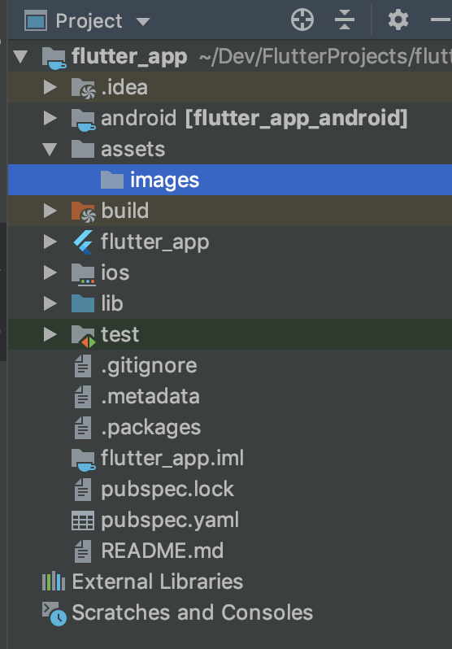
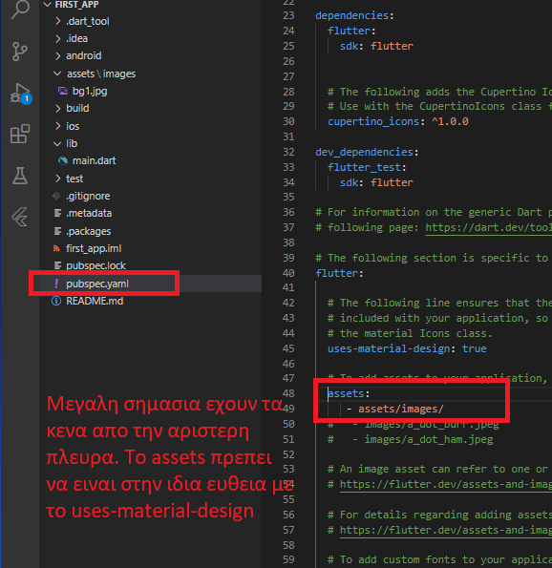
Flutter Examples
Adding a Background Image
Create a folder assets/images
Use any folder names you want
Save the image inside the images folder
Declare the assets in pubspec.yaml
Open the file pubspec.yaml
Add an assets subcategory inside the flutter section like this::
flutter:
assets:
- assets/images/
⚠ Important: indentation (spaces on the left) is important in this file.
Insert the image in main.dart:
Image.asset('assets/images/bg1.jpg')

Slide 18
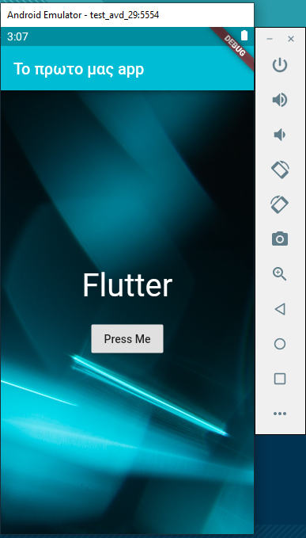
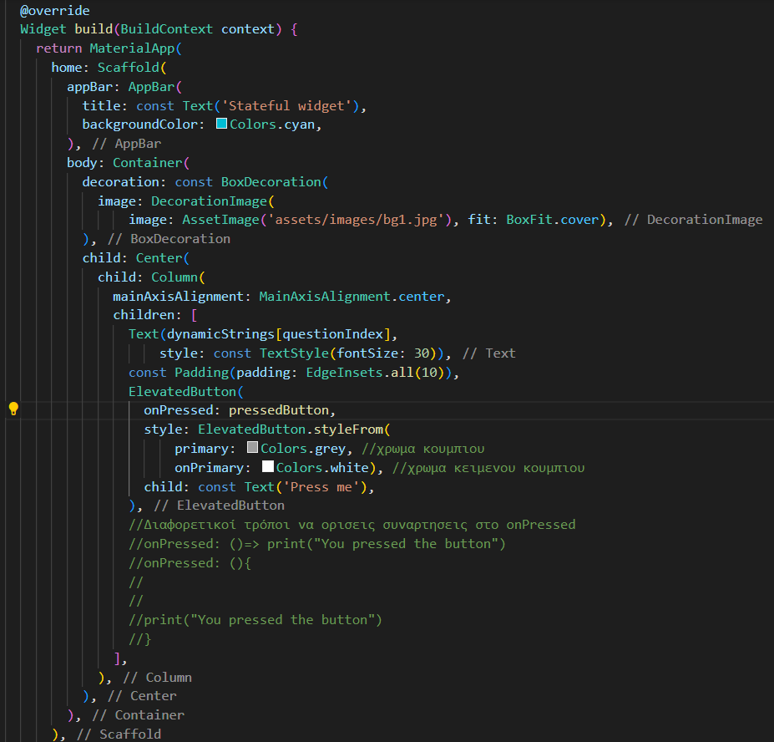
Background Example

Slide 19
Flutter Navigation
We use the Navigator class.
Navigator allows navigation from one screen to another.
It is connected to the context variable.
The context variable contains information about the widget class that is called and its position in the Widget Tree.
Screens are managed as a stack.
The top-most page is visible.

Slide 20
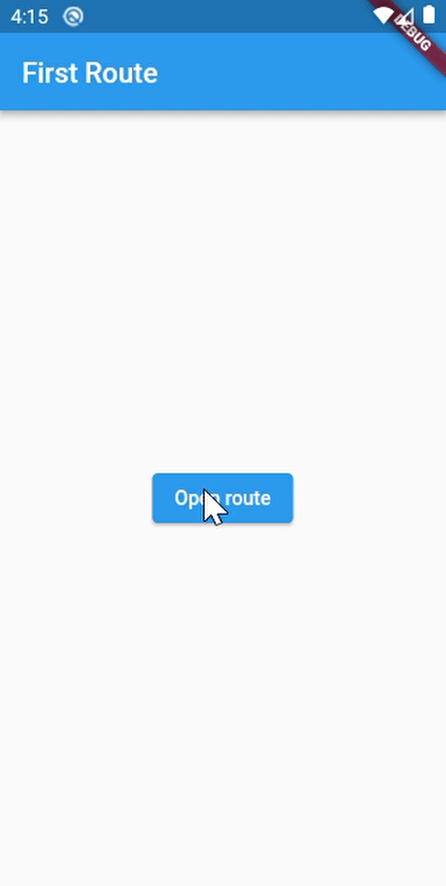
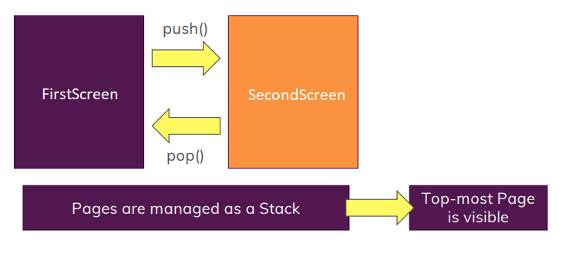
Flutter Navigation

Slide 21
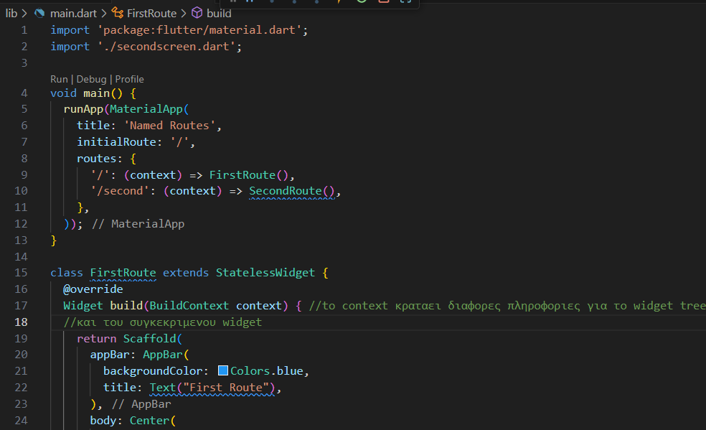
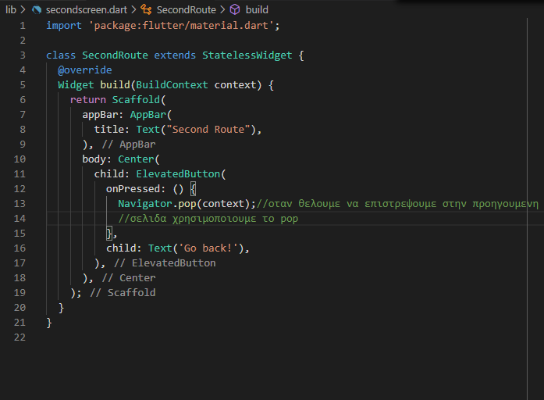
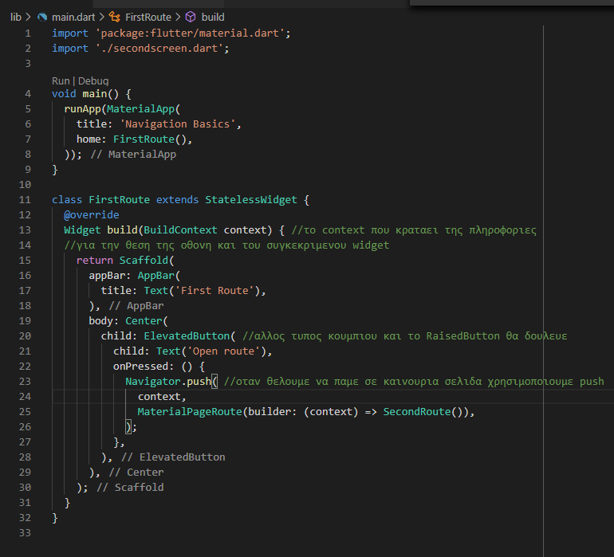
Flutter Navigation Code
main.dart
secondscreen.dart

Slide 22
Named Routes
In Flutter, screens and pages are called routes.
A route is an abstraction for a screen or page of an application.
The Navigator is a widget that manages routes.

Slide 23
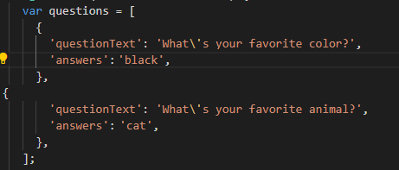
Map Class
The Map is a class in Dart.
It uses a key-value structure.
It is declared using { }
Example:

Slide 24
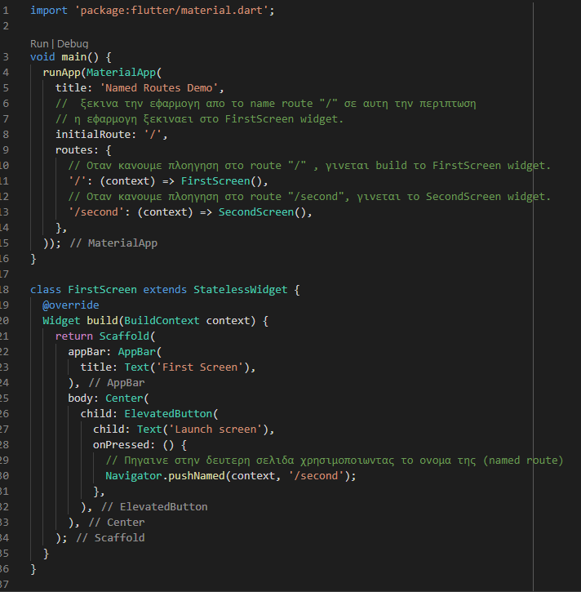
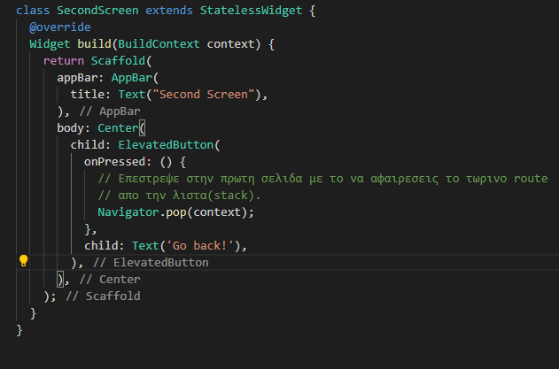
Navigation Code with Named Routes
main.dart
secondscreen.dart

Slide 25
Navigator
Different ways to navigate to a new page
Using a dynamic route name declared in main.dart (named routes):
Navigator.pushNamed(context, routePage);
Using widget initialization:
Navigator.of(context).push(MaterialPageRoute(builder:(context)=>CardPage()));
Removing the current page from the stack:
Navigator.of(context).pushReplacement(MaterialPageRoute(builder:(context)=>CardPage()));
When pressing back, it goes to the previous page from the homepage (SplashScreen).
Using named routes to remove the page:
Navigator.of(context).pushReplacementNamed(routePage);

Slide 26
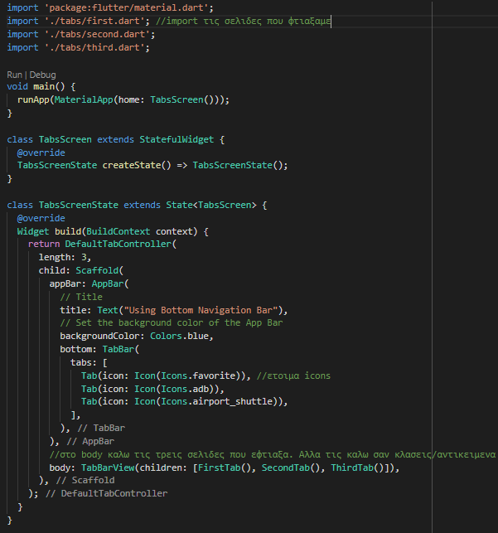
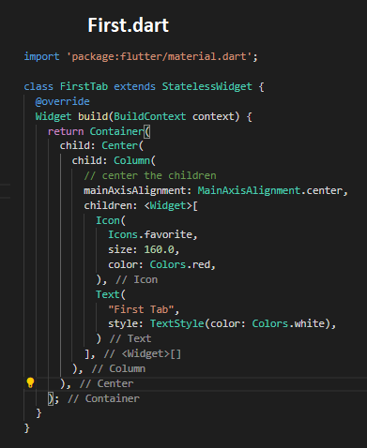
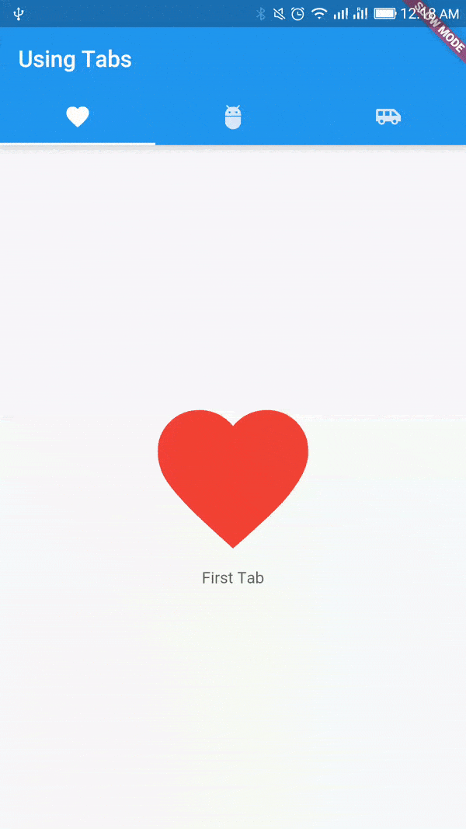
Tabs example
Icons: https://api.flutter.dev/flutter/material/Icons-class.html

Slide 27
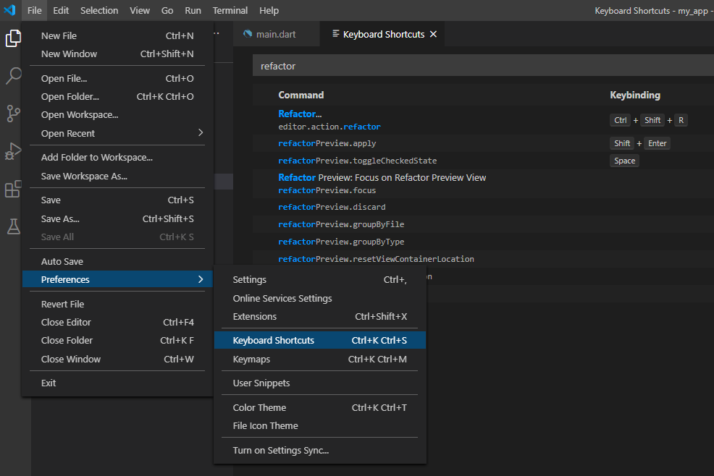
Refactor code – VS Code steps
Refactor StatelessWidget class σε StatefulWidget class
File→Preferences→Keyboard Shortcuts→Γράφουμε refactor

Slide 28
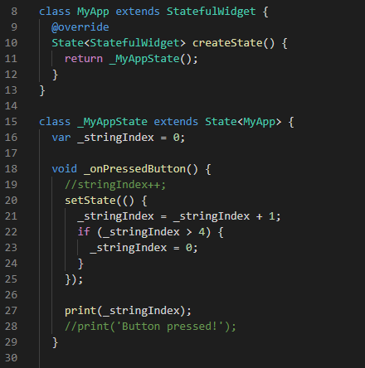
Private Properties
Each Dart file can be considered a closed ecosystem.
Different files can work together through import.
If we add _ (underscore) before a class, function, or variable, it becomes private and can only be used within that file.

