Slide 1
Bioinformatics
Lefteris Koumakis, Maria Chatzimina

Slide 2
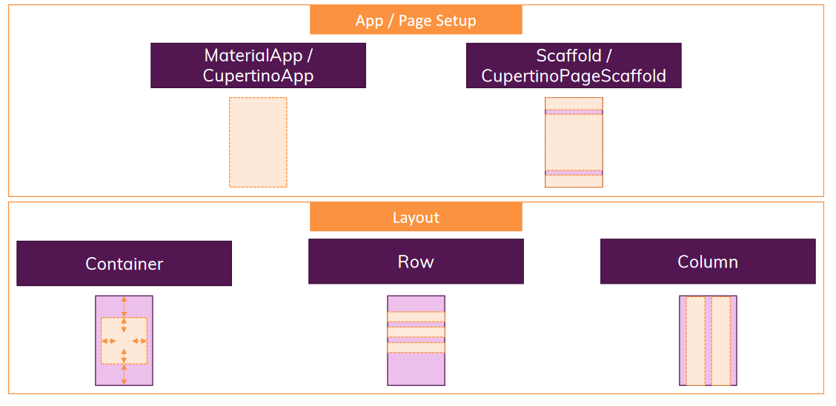
Overview Flutter Widgets
Flutter Widgets Catalog: https://flutter.dev/docs/development/ui/widgets

Slide 3
Overview Flutter Widgets
Container:
Extremely flexible widget
Can be transformed based on size (width, height, max-width, max-height), style (border, color, shape, ...) and more
It can take a child (not necessarily) which you can also align in different ways
You will be using this widget quite often
Row / Column:
You should use it if you need multiple widgets next to each other horizontally or vertically
Limited style options => Use with Container to apply styles
Its children can be aligned along the vertical and horizontal axis

Slide 4
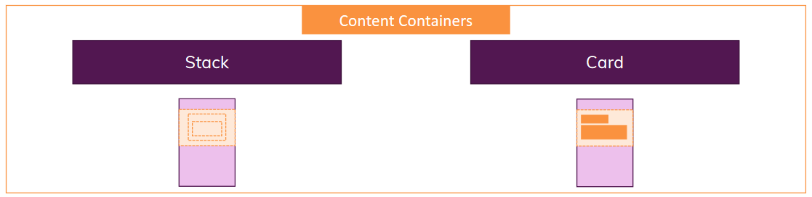
Overview Flutter Widgets
Stack:
Used to stack objects on top of each other (along the Z axis)Widgets can overlap
Card:
A Container with some ready-made styling (shadow, background color, rounded corners)
Can take a child (can be anything)

Slide 5
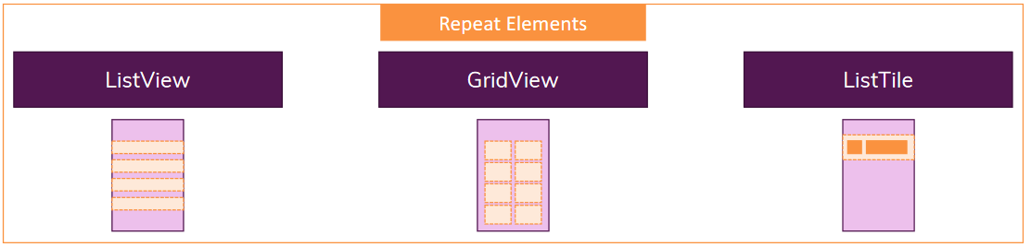
Overview Flutter Widgets
ListView/ GridView:
Used to display lists (or grids) of objects
Like Column() but scrollable (column doesn’t scroll)
ListTile:
A pre-styled container / Row() that gives you a standard “list-item look”
Offers various widget slots (e.g. at the beginning, a title, at the end)

Slide 6
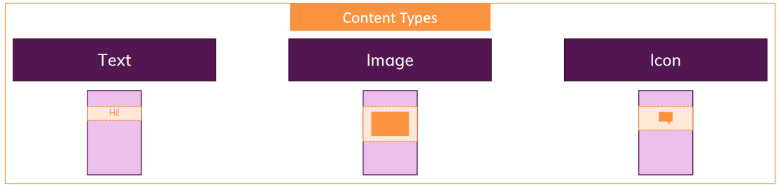
Overview Flutter Widgets
Text:
A widget that just prints some text on the screen
Text can acquire styling (font family, font weight, font size etc.)
Image:
It is used to display an image on the screen
Supports different sources (in-app, online, ...)
It can be shaped to the specific size in different ways
Icon:
Displays an icon on the screen
Flutter gives many ready-made Android and iOS icons that you can use

Slide 7
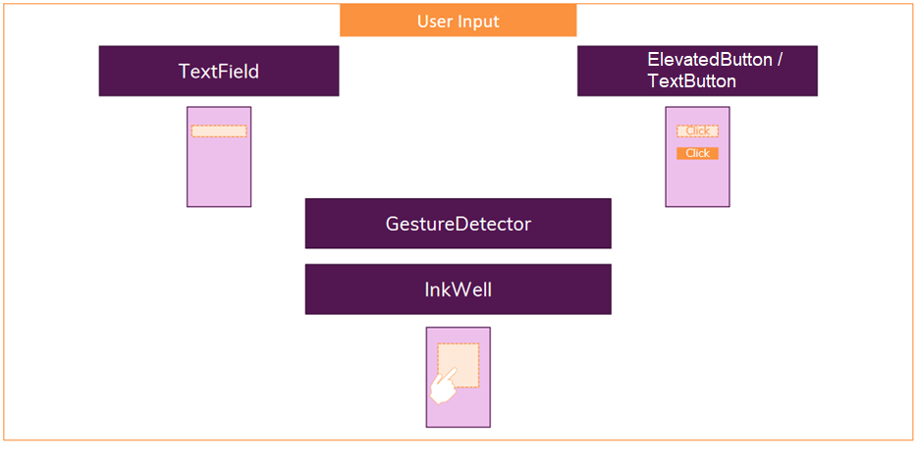
Overview Flutter Widgets

Slide 8
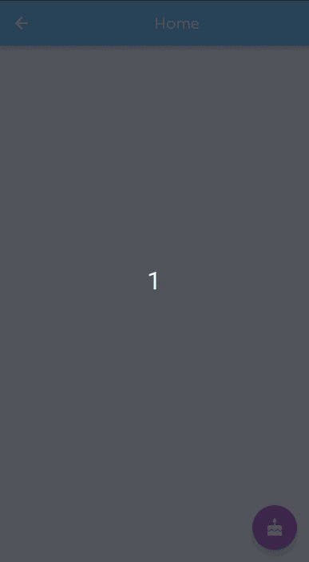
Overview Flutter Widgets
TextField:
Displays an editable text field where the user can enter (type) information
Lots of configuration options (e.g. autocorrect, error messages, labels, styles)
It supports different types (email, number, regular text, ...)
ElevatedButton/ TextButton/ IconButton:
Differently styled buttons that handle the user's touch on the screen
A function will be executed when the user taps/touches them
It can be configured / customized in appearance
GestureDetector/ InkWell:
GestureDetector allows you to wrap any widget with touch listeners (e.g. double tap, long tap)
InkWell does the same, but adds a visual ripple effect to the touch (the effect can be configured)

Slide 9
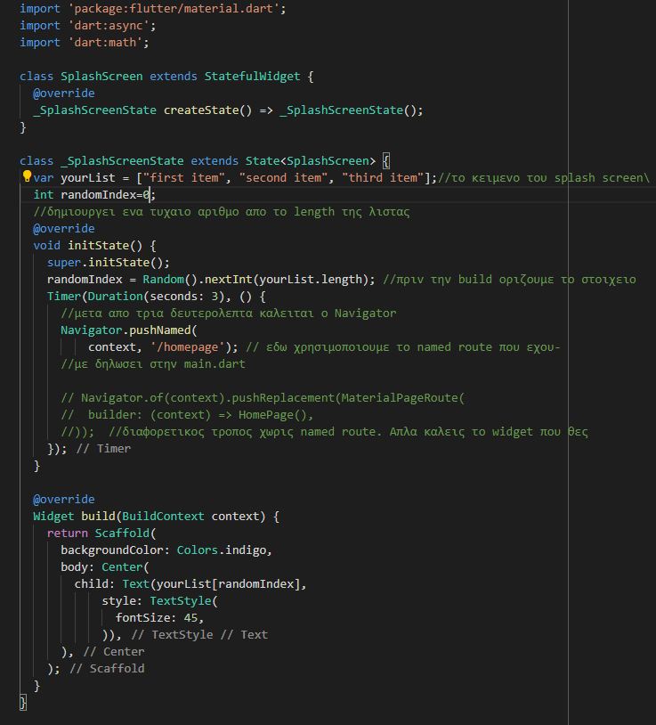
Splash Screen
The page that will open when we run the application
Change text in Random way
import 'dart:math’;
We override init.State
You call init.State only once even in statefulWidgets
We override init.State when we want to do initialization before the build method runs

Slide 10
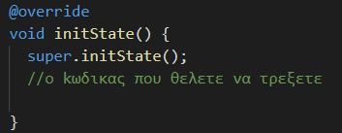
setState - initState
setState
Calling setState notifies the framework that the internal state of this object has changed in a way that may affect the user interface in this subtree, which causes the framework to run build to change the state of that object.
initState
We override this method if we need to do some kind of initialization because unlike build() this method is called once

Slide 11
Code Stateless και Stateful
Stateless
Stateful
class MyWidget extends StatelessWidget {
const MyWidget({Key? key}) : super(key: key);
@override
Widget build(BuildContext context) {
}
}
class MyWidget extends StatefulWidget {
const MyWidget({Key? key}) : super(key: key);
@override
State<MyWidget> createState() => _MyWidgetState();
}
class _MyWidgetState extends State<MyWidget> {
@override
Widget build(BuildContext context) {
}
}

Slide 12
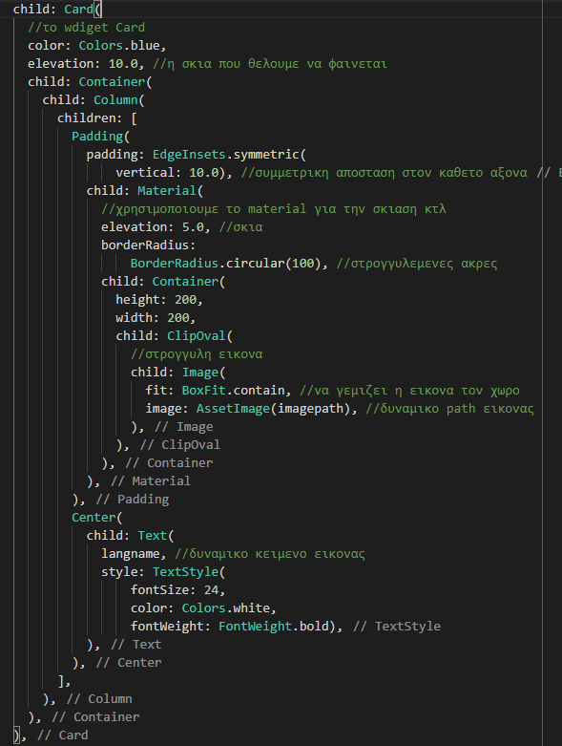
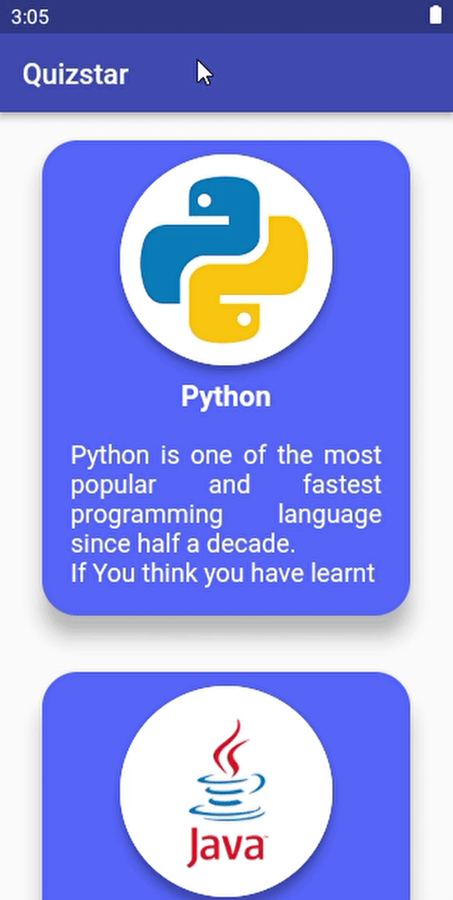
Card Widget
Card Widget:
We use the named argument “elevation” for shading
Material Widget:
elevation: shade
borderRadius: Rounded edges according to the number in parentheses
ClipΟval Widget:
We use it to wrap an image that we want to make it round

Slide 13
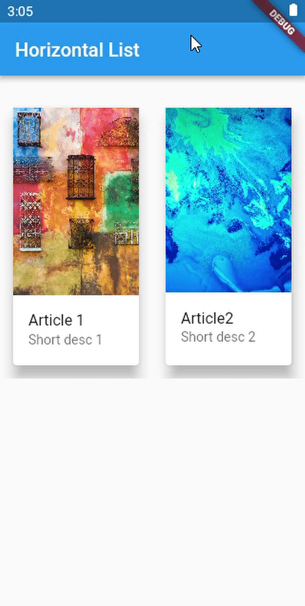
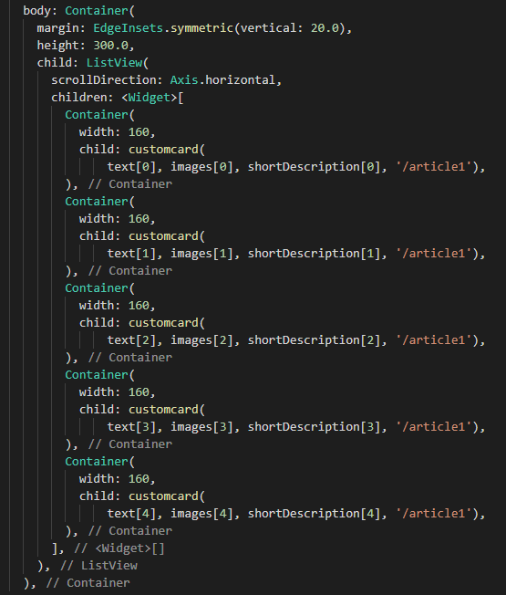
Horizontal List View
ListView
To have horizontal scrolling we add
scrollDirection: Axis horizontal
SizedBox()
You can add space between widgets depending on the width and height you declare in Sizedbox()
E.g. SizedBox(width:50)

Slide 14
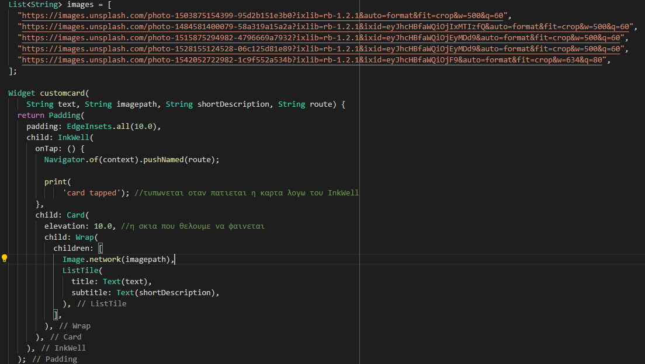
Card and Image Widget
Image()
We can use an online image:
Image.network(URL)
Card()
We can use Wrap() Widget to add more than widgets since Card has one “child”

Slide 15
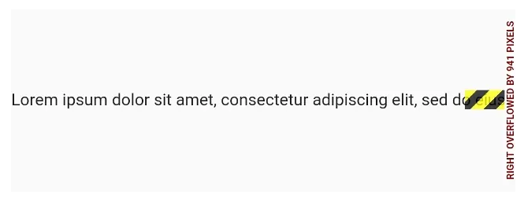
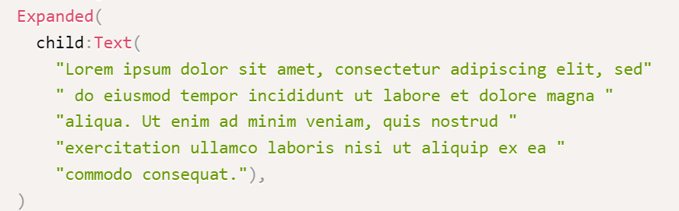
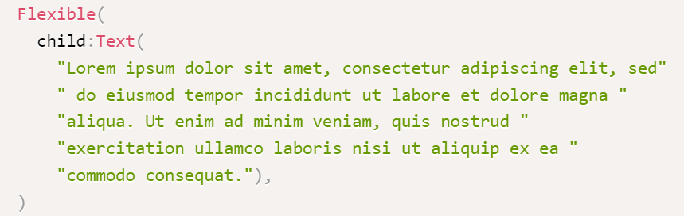
Overflow error
MediaQuery.of(context).size.width - It gives us the width of the device
MediaQuery.of(context).size.height - It gives us the height of the device
We can divide or multiply them depending on what size we want to transform the widget
Other widgets that can help with overflow:
Flexible()
Expanded()

Slide 16
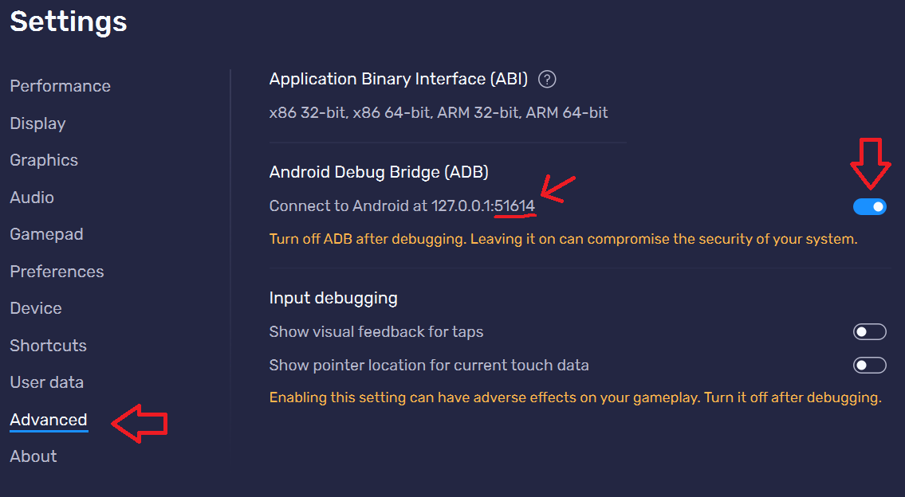
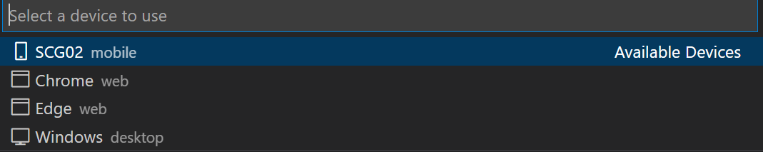
Connect BlueStacks emulator VSCode
In bluestacks emulator got to Settings→ Advanced
Depending on the port(in the example is 51614) but the number may change everytime
Type in command line to “platform-tools” path:
The emulator will show on VSCode

