Slide 1
Biomedical Informatics
Lefteris Koumakis,
Maria Chatzimina

Slide 2
Lecture 4

Slide 3
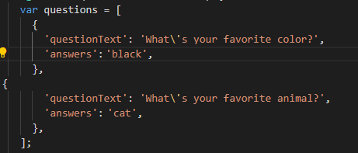
Class Map
Map is a class of dart
Uses key-value structure
We declare it with { }
Example:

Slide 4
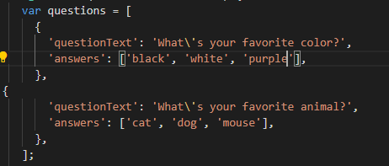
Questions
What is the difference between a list ([]) and a map ({}) in Dart / Flutter?
  Lists give you an ordered list of individual values, identified by an index.
  The map uses key-value pairs where we get the values based on their key.
  Example:
  print(questions[0]['questionText’]) prints “What’s your favorite color”

Slide 5
Final vs Const
“Final“:
  means that the variable is assigned once:
  a final variable must be initialized. Once a value is assigned, the value of a final variable cannot be changed.
  We know before the program runs that the value of this variable will not change but we still don't know the exact value. The value is assigned when the program is run
  final birthday = getBirthDateFromDB()
“Const”:
  The value must be known at compile time,
    const birthday = "2008/12/25“
  Cannot be changed after initialization.
“Static”:
  static is used for a class-level variable that is the same for every instance of the class, this means that if the data is static, it can be accessed without creating an object.
    Example the Colors class where we use the colors without creating an object:
    static const MaterialColor deepPurple = MaterialColor(…..
    color: Colors.deepPurple

Slide 6
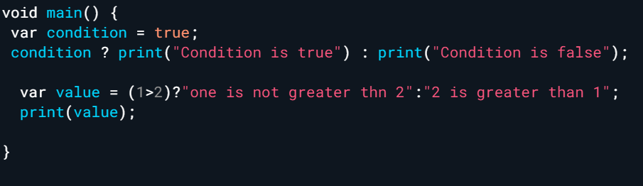
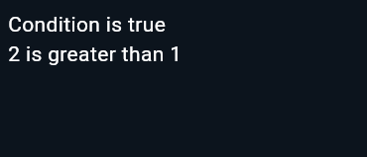
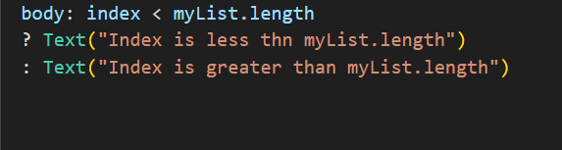
One Line If statements
If the condition we check is true, the code after the “?” is executed. while if it is false the code after the “:” is executed
Example with widgets:

Slide 7
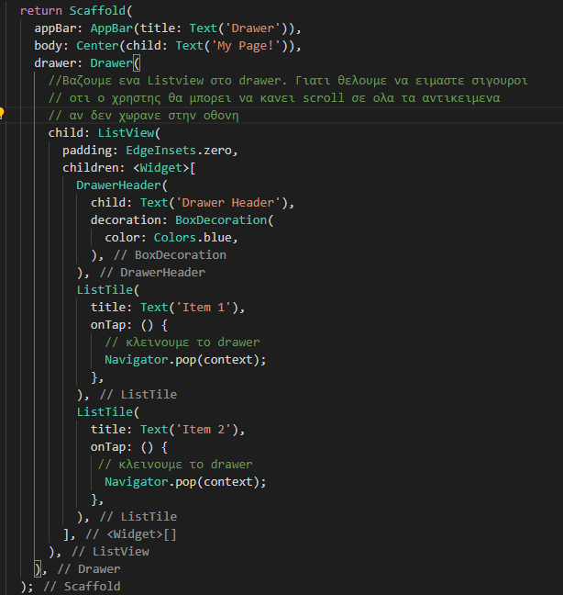
Drawer Widget
Video and Details: https://api.flutter.dev/flutter/material/Drawer-class.html
Example :

Slide 8
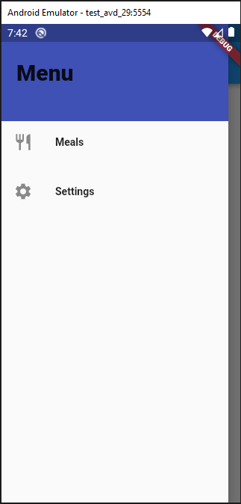
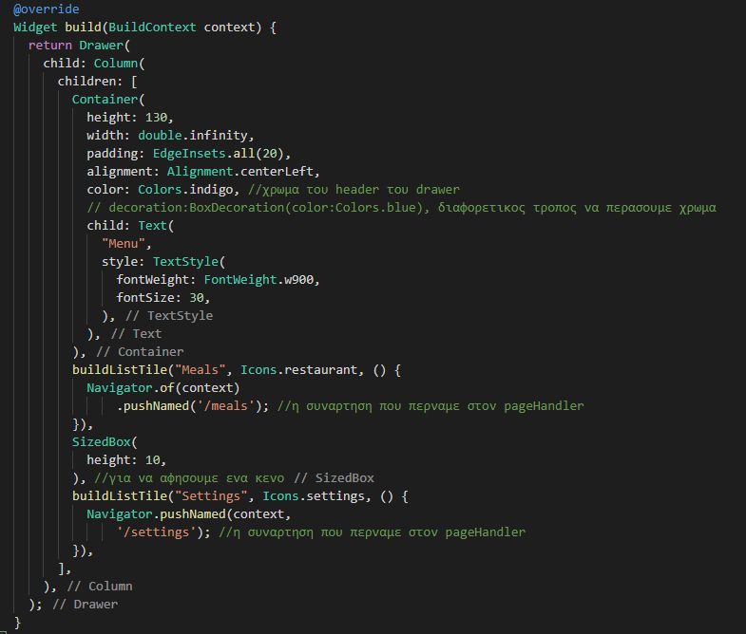
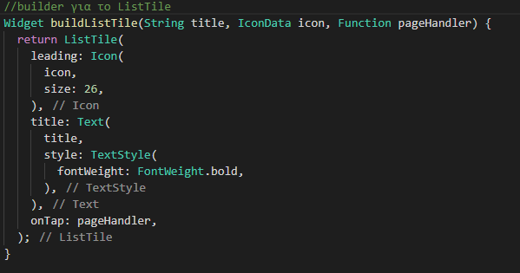
Custom Drawer
ListTile builder

Slide 9
Exercise 1: Drawer & Navigation
Create a Drawer menu and navigate between screens
  Add a ListTile for Home
  Add a ListTile for Settings
  Navigate to /settings when clicked
Hints
  Navigator.of(context).pushNamed('/settings’)
  Use onTap
  Add an Icon

Slide 10
Questions
What about "Screens" and "regular Widgets"?
  Both are regular widgets at the end, the only difference is how the widgets are used and what role they play.
What is the difference between push() and pushNamed();
  push() navigates to a new screen by creating it "on the fly", pushNamed() can only load screens that are registered in advance.
What exactly is a “route”?
  An object managed by a Navigator that represents a screen, typically implemented by classes like MaterialPageRoute
  A route registered in the routes table - receives a "name" (key) with which it can be loaded.
What is a "Stack of Pages" (or "Stack of Screens")?
  New pages are usually promoted on top of the "Stack of Pages/Screens". The top (the last) page / screen is the visible screen. Removing the last screen (Popping) returns to an older screen.

Slide 11
Questions
What is the difference between using Tabs (regardless of which tabs) and using push() / pushNamed();
  Tabs replace the current screen (or part of it) with a new one, push() / pushNamed() add a new screen to the stack.
Which widget is important for both Tabs and Drawers?
  The Scaffold widget - both are inserted there.

Slide 12
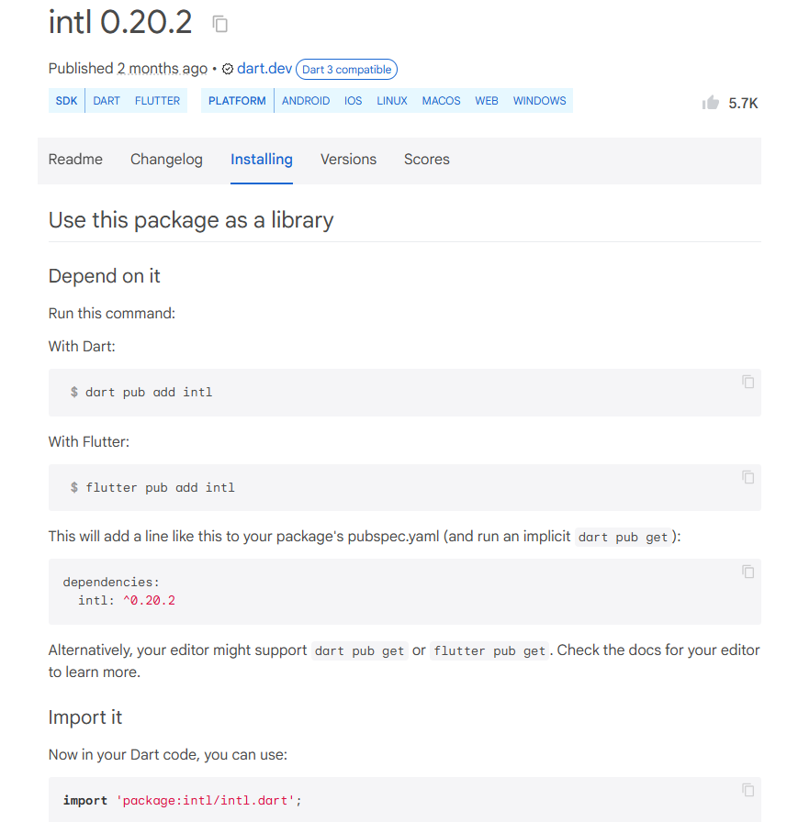
Installing External Packages
Example: Format Date
  Intl package → https://pub.dev/packages/intl
  Pub.dev: Website with many packages that you can use in Flutter projects
  Select “Installing” in the page which provides instructions
  We copy what is written under dependencies and add it to pubspec.yaml just below the word flutter in the same level
  dependencies:
      flutter
      intl: ^0.20.0
  Save the file and flutter will install it automatically
  We import it based on the instructions on the “Installing” page
  If the package is not installed automatically, open the terminal and run
    flutter packages get

Slide 13
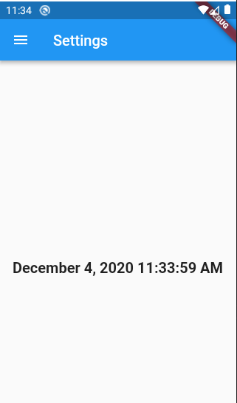
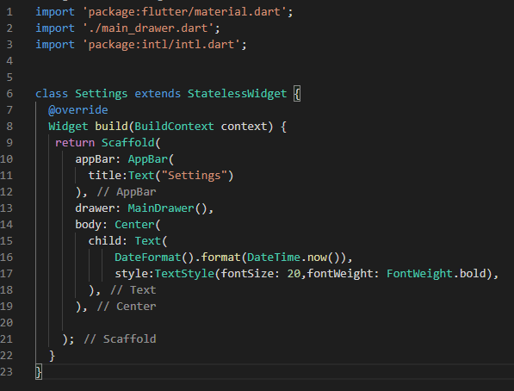
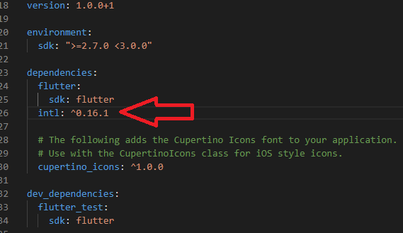
Date Format
pubspec.yaml
settings.dart

Slide 14
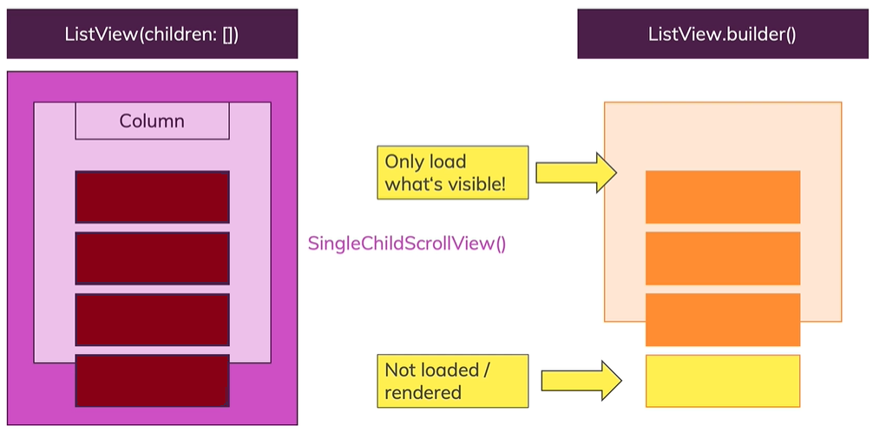
ListView Class
ListView:
  Infinity height
  If it is inside a container we can define the height
  Two ways to create it:
    With named parameter children
      Renders all τα widgets (visual and non-visual)
    With a constructor .builder()
      When we do not know the amount of objects we will have in the list or the number of objects is too large
      Renders only visual widgets

Slide 15
Future Class
Url: https://api.flutter.dev/flutter/dart-async/Future-class.html
A Future is used to represent a potential value, or error, that will be available at some time in the future.
It allows the creation of objects that will be given a value in the future
We use it when we want to make HttpRequests, read json files etc.
The Future class represents a future result of an asynchronous computation. This result will eventually appear in the Future after the processing is complete.
The program will not wait for the value assignment to the future to complete but will execute normally
FutureBuilder: Takes a named parameter “builder” that contains the current state of the future

Slide 16
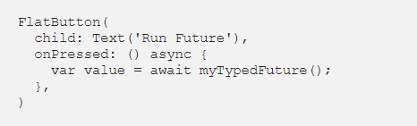
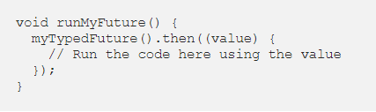
Futures
There are two ways to execute a “Future” and use the value it returns (If it returns anything). The most common way is to wait for the “Future” to return data. For this to work the function calling the code must be marked with “async”.
  Example:
The other way to handle a “future” is to use the .then() function which is a callback that's called when future completes successfully(with a value).
  Example:

Slide 17
Synchronous and Asynchronous programming
Synchronous programming is a type of programming where the program executes in a sequential manner, with each line of code being executed one after the other. The program must wait for each operation to complete before moving on to the next one. This can sometimes result in slower program execution.
Asynchronous programming is a type of programming where tasks are executed independently and concurrently without waiting for each other to complete. It allows for better utilization of system resources and can improve performance. An asynchronous programming model allows multiple things to happen simultaneously. When an action/task starts, your program continues to run. When the action completes, the program is updated and accesses the result.

Slide 18
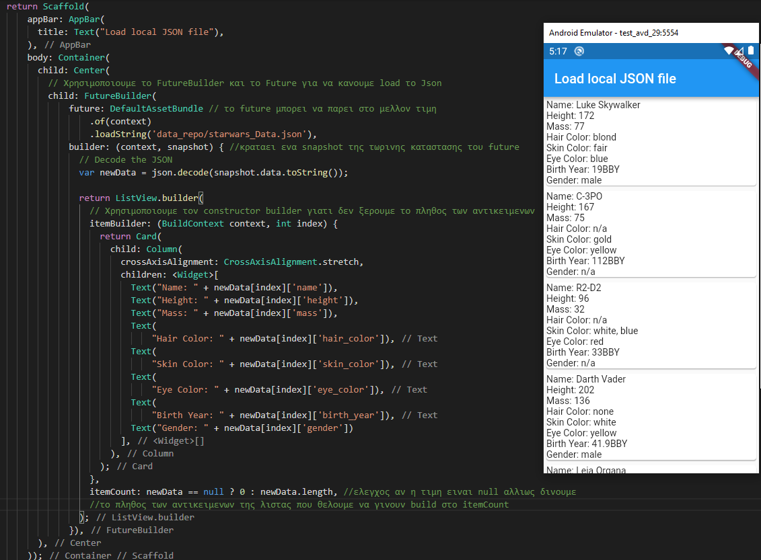
Read Local JSON file
WE use DefaultAssetBundle to read the JSON file
We use ListView.builder() because we don’t know the number of objects to be created
The named parameter “builder” in FutureBuilder has a snapshot of the future’s current state.
  snapshot.data : The data (if there are any)
  snapshot.hasData : returns true/false if the snapshot has data or not
  etc.

Slide 19
Exercise 2: JSON & FutureBuilder
Load data from the JSON file in the folder and display it in a list
  Load JSON using Future
  Use FutureBuilder
  Display name and age using ListView.builder
Hints
  snapshot.hasData
  snapshot.data
  data[index]['name']

