Slide 1
Bioinformatics
Koumakis Lefteris,
ChatziminaMaria

Slide 2
Lecture 5

Slide 3
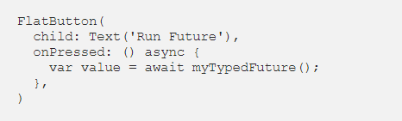
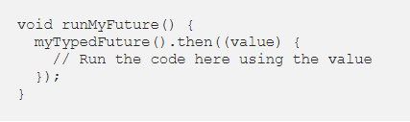
Futures
There are two ways to execute a “Future” and use the value it returns (If it returns anything). The most common way is to wait for the “Future” to return data. For this to work the function calling the code must be marked with “async”.
  Example:
The other way to handle a “future” is to use the .then() function which is a callback that's called when future completes successfully(with a value).
  Example:

Slide 4
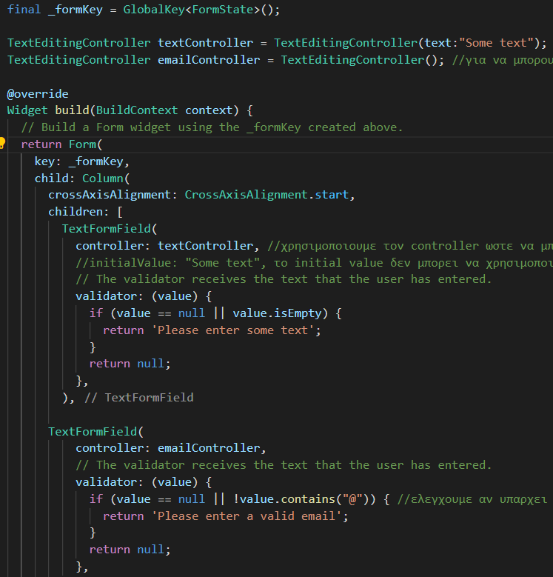
Forms
GlobalKey<FormState>: We create a global
key that uniquely characterizes the form and
allows us to validate it.
TextFormField
  validator: Function that checks the value of the field.
  controller: It is used so that we can manage the
values outside the form
  The initial value of the field can be given when the controller is created.
  initialValue: we declare initial value of the field
    Cannot be used at the same time as the controller.
  onTap: can be used when we want to add some
action when the field is clicked (like showing a datepicker)
  keyboardType: keyboard type displayed

Slide 5
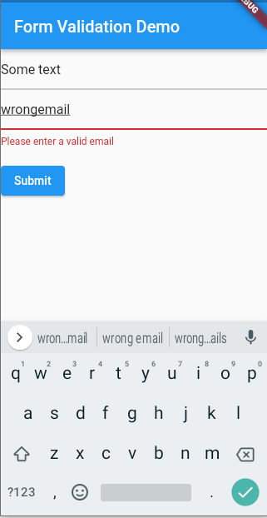
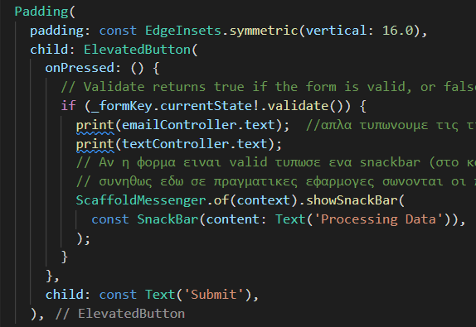
Forms
When validate() is called it runs the functions for each field validator. If there are no errors it returns true. Otherwise it prints the error messages and returns false.

Slide 6
Exercise – Form Validation (20 minutes)
Task 1: Add a Username Field
Add a new TextFormField for the username. The field must not be empty.
Task 2: Add a Password Field
Add a password field. The password must contain at least 6 characters.
Task 3: Add a Confirm Password Field
Add a confirm password field. Its value must match the password.
Task 4: Improve Email Validation
Check if the email has a valid format, e.g. it contains @ and a dot.

Slide 7
Exercise – Form Validation
TASK 1
TASK 3
if (value == null || value.isEmpty) { return 'Please enter username'; }
final passwordController = TextEditingController(); TextFormField( controller: passwordController, obscureText: true, decoration: InputDecoration(labelText: 'Password'), ) TextFormField( obscureText: true, decoration: InputDecoration(labelText: 'Confirm Password'), validator: (value) { if (value != passwordController.text) { return 'Passwords do not match'; } return null; }, )
TASK 2
if (value!.length < 6) { return 'Password too short'; }
TASK 4
if (!RegExp(r'\S+@\S+\.\S+').hasMatch(value!)) { return 'Enter valid email'; }

Slide 8
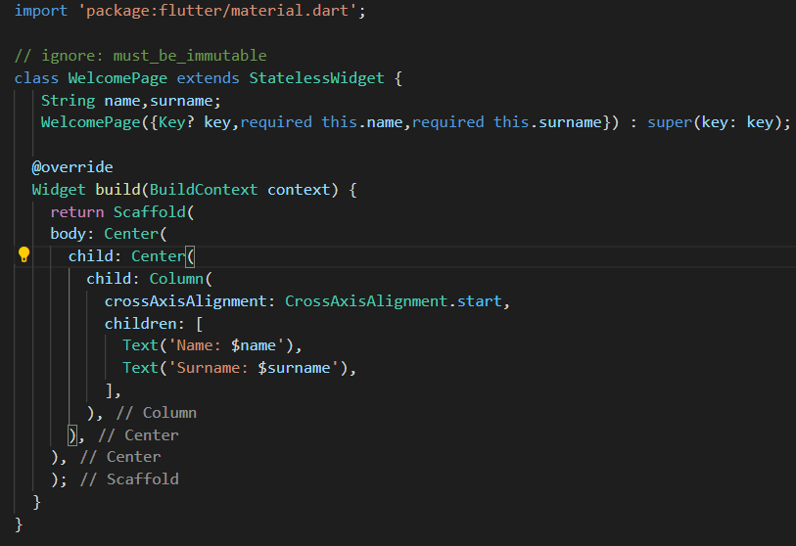
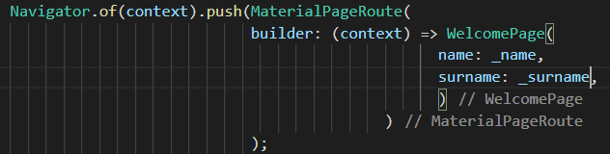
Constructors
Warning: Use key in widget constructors.dart
A Key is an identifier for Widgets, Elements
When the widget tree is redrawn flutter needs to know:
  Which widgets are completely new and which already have state, and this is where the key helps
It is not mandatory but is considered good practice

Slide 9



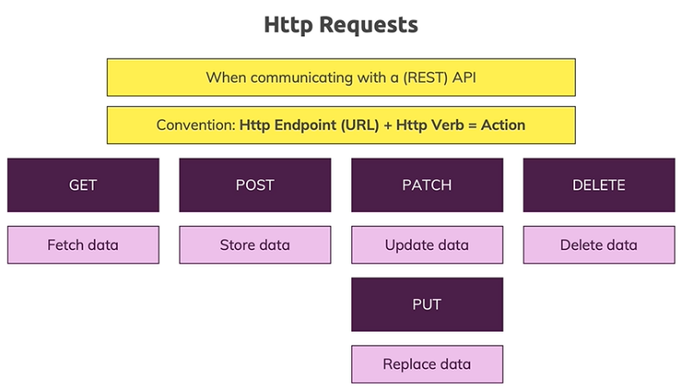

Http requests

Slide 10
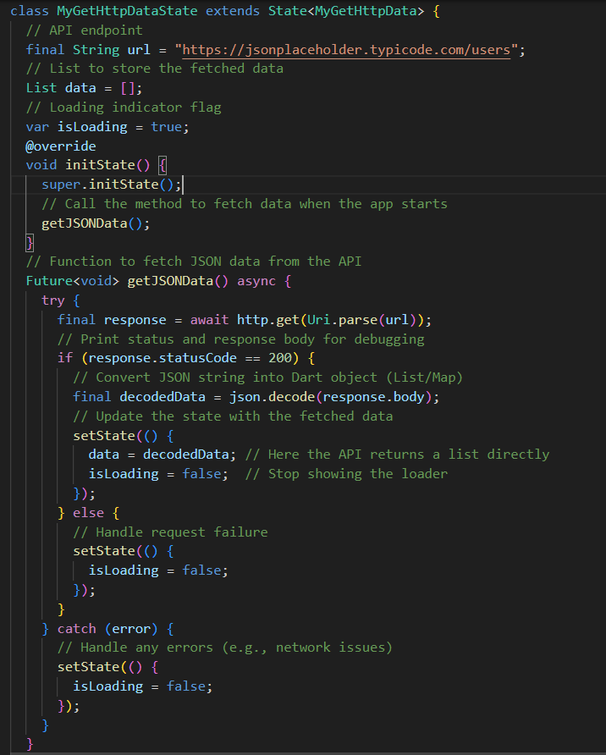
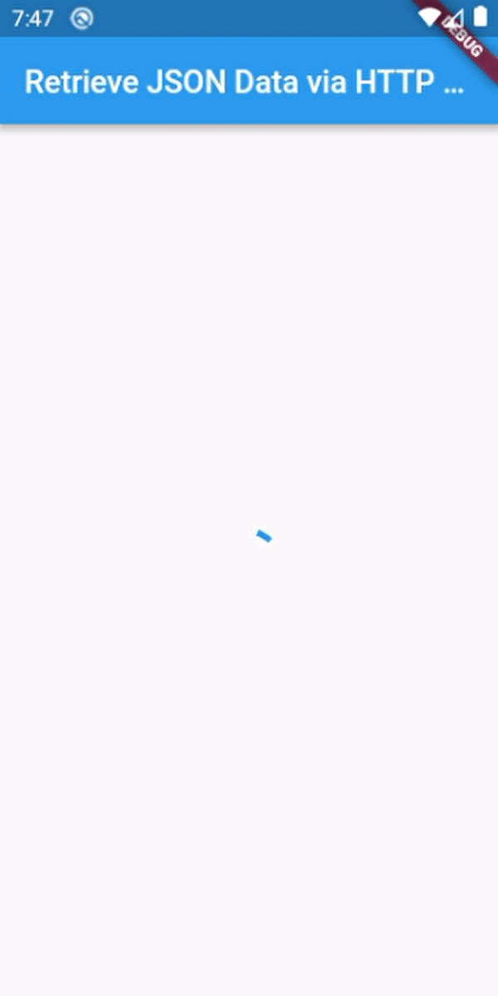
HTTP Request
http.get returns a future object
We use the
.then((value){}) method
on a future when we
want to execute code
after data has been assigned to the future.
We use async/await to handle asynchronous operations The await keyword pauses execution until the Future returns a value
In this example, we show a loader while data is being fetched
The loader remains visible until the isLoading variable changes from true to false

Slide 11
GestureDetector vs InkWell
Both provide many common functions like onTap, onLongPress etc. The main difference is that GestureDetector provides more controls like dragging etc. while it does not include the ripple effect, which InkWell does.
You can use either of the two according to your needs,
  if you want the ripple effect, choose InkWell,
  if you need more controls choose GestureDetector
  or you can combine both.

Slide 12
StaggeredGridView
Package: https://pub.dev/packages/flutter_staggered_grid_view
  Installation steps on tab“Installing”
Insert in pubspec.yaml :
  flutter_staggered_grid_view:
If it is not installed automatically when the file is saved, we run:
  flutter pub get
We import it into the file we want to use:
  import 'package:flutter_staggered_grid_view/flutter_staggered_grid_view.dart';

Slide 13
StaggeredGridView
StaggeredGridView.count the constructor
crossAxisCount:
  The number of columns we want the grid view to cover
crossAxisSpacing:
  The space between boxes/tiles on the horizontal axis
mainAxisSpacing:
  The space between the boxes/tiles on the vertical axis

Slide 14
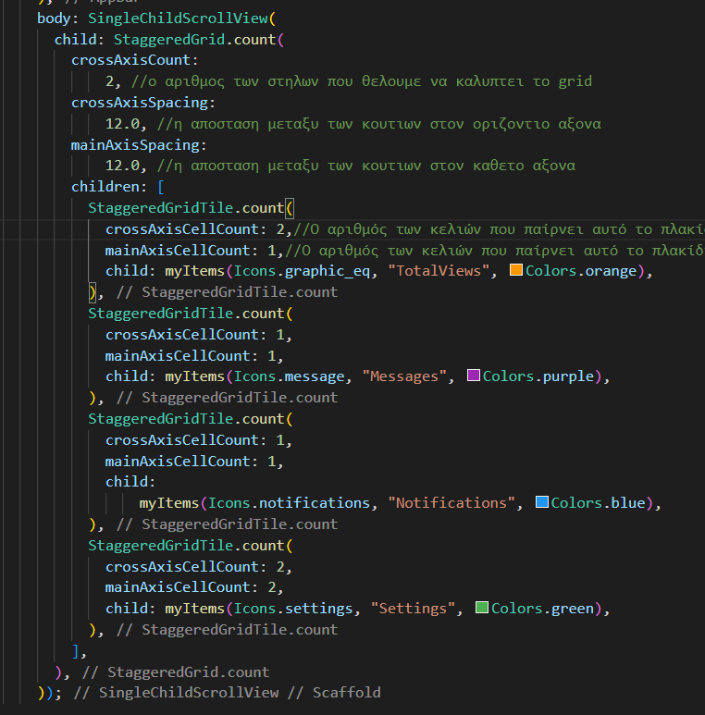
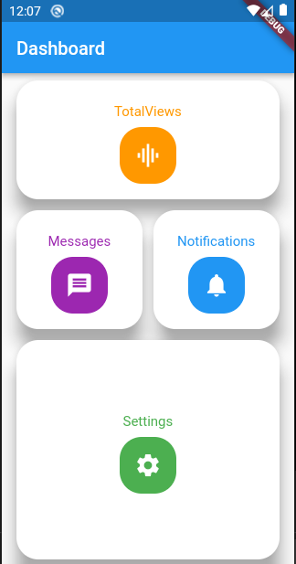
StaggeredGridView
The “TotalViews”
covers both columns
that we have declared
in crossAxisCount and
has a smaller height
than “Settings” because
in mainAxisCellCount we have the value 1
“messages” and
“notifications” have 1
crossAxisCellCount so
each one of them
covers one column and
are shown next to each other

Slide 15
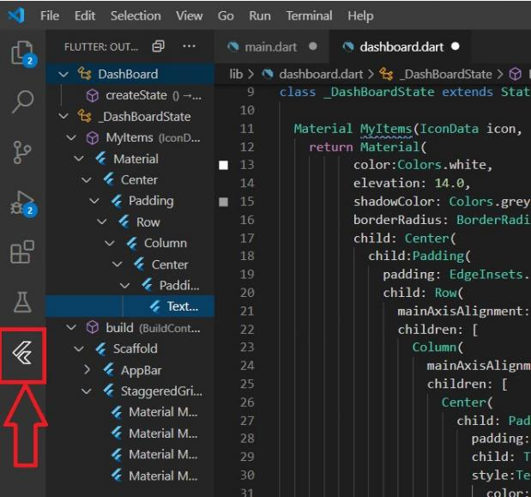
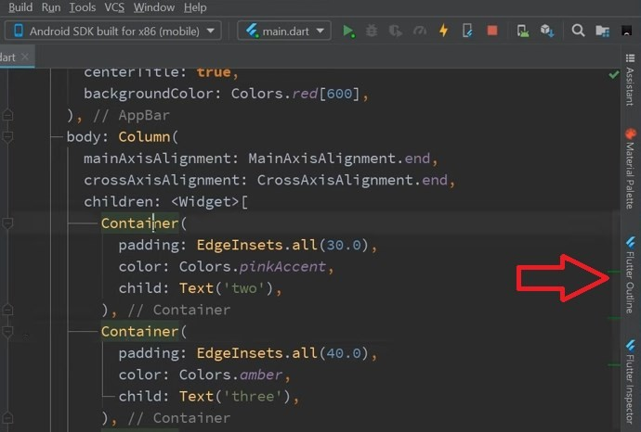
Flutter outline
Command Pallete → write outline view → choose outline view

Slide 16
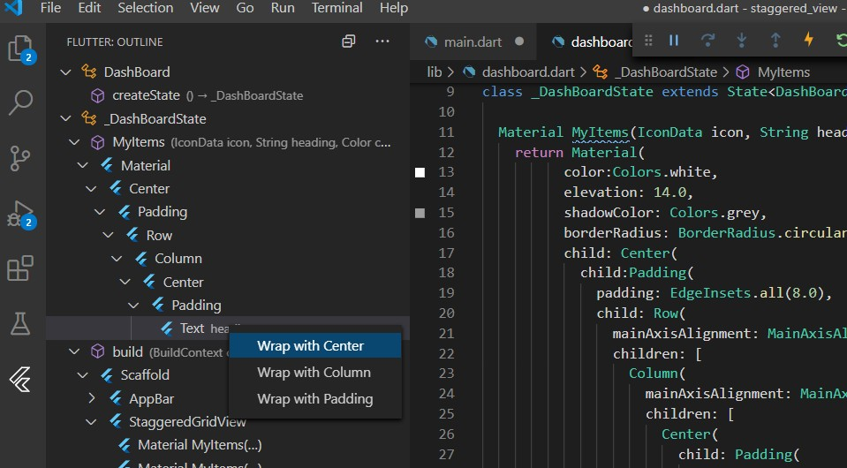
Flutter outline
We select the widget we want (it is highlighted in the code)
In the widget tree of the outline view, we right-click on the widget we want and we can wrap it with other widgets such as padding, center, etc.

Slide 17
Questions
How does sending HTTP requests to a (REST) API work?
  The Flutter application sends requests with specific Http Verbs and endpoints (paths) to the web server (= the API).
What is "future" in Dart?
  An object that waits for an asynchronous operation to complete and then (possibly) uses the data.
What is "asynchronous" (or "async") code?
  Code that is not executed immediately but is executed at some point in the future. The rest of the code continues execution without waiting for the async code to complete.

Slide 18

Const warning
Prefer const with constant constructors.dart (prefer_const_constructors)
Solution:
  We use const in as many constructors as we can
  Insert at the beginning of the file: // ignore_for_file: prefer_const_constructors
  Insert in file analysis_options.yaml under rules
    prefer_const_constructors : false

Slide 19


Variable late
When the compiler considers that a variable should not be null we use late
  The compiler with late "trusts" us to initialize the non-nullable variable after initializing it
Lazily initializing a variable
  The variable may not be needed and its initialization may be "expensive".
  In the example below if result is never used the "expensive" function _getResult is never called

Slide 20
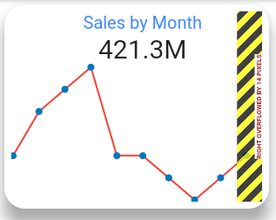
Common Overflow Error
In the example, the column tries cover more space than the space that can be allocated inside the row, causing an overflow error. The row in the example is the Parent of the Column. Solution:
child: Row( children: [ Flexible(
child: Column(
// code
),
),
]
)

Slide 21
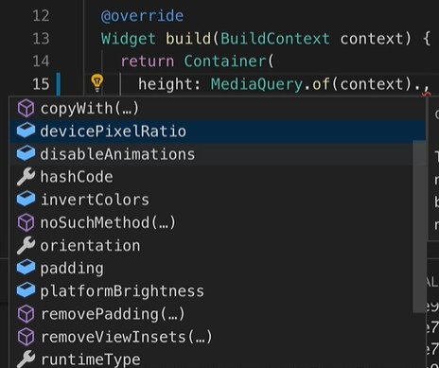

Get Dynamically Device Size
With the MediaQuery class we have several options:
The size option gives us the height and width.
  We can use the percentage of these values by multiplying the height/width with the percentage (60% -> 0.6).

Slide 22
SQFlite
Supported by Android and iOS
Used to keep data saved locally
SQFlite plugin : https://pub.dev/packages/sqflite
CRUD operations
  create, read, update, and delete (CRUD) the four basic functions

Slide 23
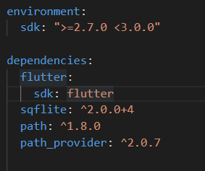

Steps
Setup SQFlite
  We import the following packages into the pubspec.yaml file under flutter sdk with this exact alignment/spaces.
    sqflite: appropriate version
    path: appropriate version
    path_provider: appropriate version
Open database
  Create database
Create tables
Perform CRUD
Flutter Packages versions:
  any : update to the latest version even if it is not compatible
  κενό: update to the latest version but takes compatibility into account

Slide 24
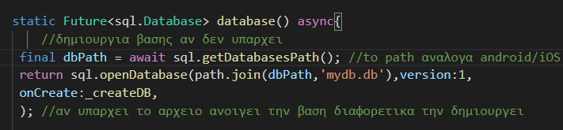
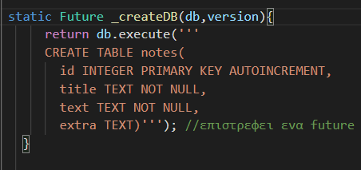
Create database
Creating a database returns a future.
getDatabasesPath() returns the path stored on the device depending on whether it is android/iOS
path.join: joins the storage path with the name we give to our database e.g. 'mydb.db'
openDatabase(): if the database exists in the given path it opens it otherwise it creates it
In onCreate we give the command to create the table
Follows SQL rules

Slide 25
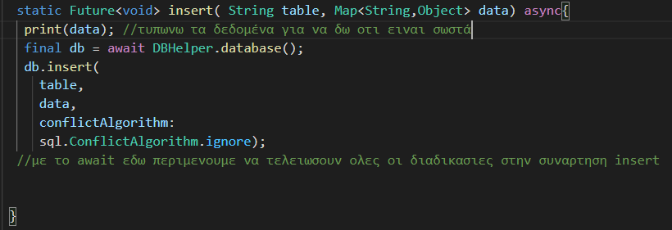
Insert in database
db.insert(): data entry in the corresponding table
confilictAlgorithm: choose what happens if the id (PRIMARY KEY) already exists, e.g. to be replaced or no action

Slide 26
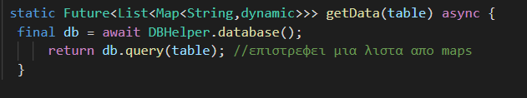

Return data
dq.query: When only the table name is given (as here) it returns what the table contains
  Named parameter where: executes the WHERE in the SELECT statement
It returns a future and more specifically a map list that contains String and dynamic

