Slide 1
Bioinformatics
Lefteris Koumakis,
Maria Chatzimina

Slide 2
Lecture 6

Slide 3
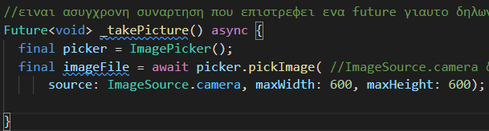
Use Mobile Camera
Package:
  Image_picker
    url: https://pub.dev/packages/image_picker/install
imageSource can be either one:
  Gallery
  Camera
If in the emulator camera is not working we are running in folder “emulator (in Android SDK path) the command line:
  emulator -camera-front webcam0 -avd το_ονομα_του_emulator

Slide 4
Use Mobile Camera
In packages that are using native parts of the mobile such as microphone, camera etc. we read the “Read me” section to find the permissions needed
Camera permission for example :
  Android:
    No configuration required - the plugin should work out of the box.
  iOS:
    Add the following keys to your Info.plist file, located in <project root>/ios/Runner/Info.plist:
      NSPhotoLibraryUsageDescription - describe why your app needs permission for the photo library. This is called Privacy - Photo Library Usage Description in the visual editor.
      NSCameraUsageDescription - describe why your app needs access to the camera. This is called Privacy - Camera Usage Description in the visual editor.
      NSMicrophoneUsageDescription - describe why your app needs access to the microphone, if you intend to record videos. This is called Privacy - Microphone Usage Description in the visual editor.

Slide 5
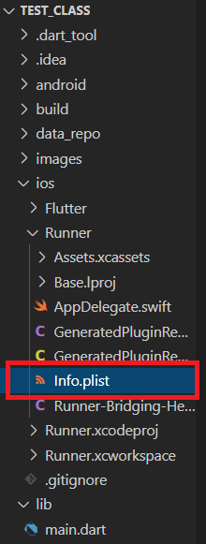
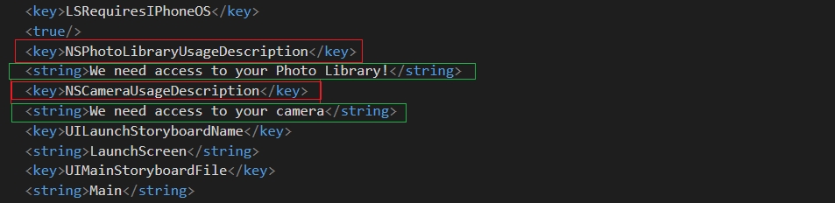
Use Mobile Camera - iOS
In info.plist we add information such as:
  App version
  permissions needed
  The text to be shown when the user is informed about the permissions needed
Permissions needed
Displayed text to the user
Permissions needed
Displayed text to the user

Slide 6
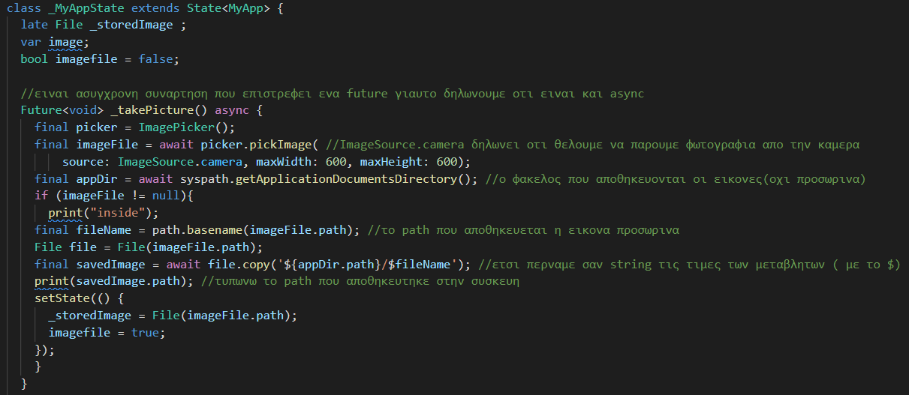
Save Image to Mobile
Packages:
  path_provider : provides mobile paths
    https://pub.dev/packages/path_provider
  path : creates paths
    https://pub.dev/packages/path

Slide 7
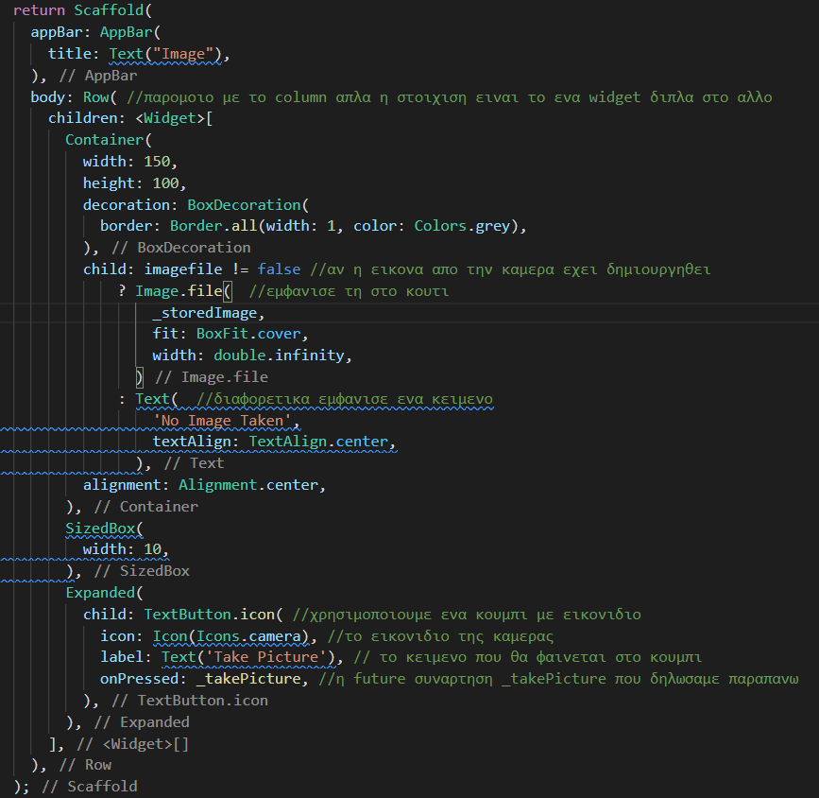
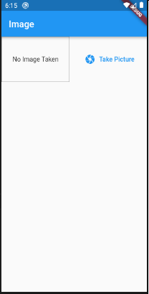
Save Image to Mobile
FlatButton.icon
  Creates a button with an icon
Expanded:
  Using an expanded widget on the child of a Row or Column causes it to expand to fill the available space along the main axis (eg horizontally for Row or vertically for Column).

Slide 8
Useful Links
Icons list: https://api.flutter.dev/flutter/material/Icons-class.html
Charts package: https://pub.dev/packages/charts_flutter#-readme-tab-
Available charts: https://google.github.io/charts/flutter/gallery.html

Slide 9
UI Design
How do we know that a UI Design is good?
  Learnability: How easily can users complete their tasks?
  Efficiency: The interface allows the user to complete tasks promptly/on time?
  Memorability: After leaving the website, how likely are users to remember how to use it when they return?
  Errors: What steps does the interface take to minimize user errors, and how does it support users in correcting errors?
  Satisfaction: Do users enjoy interacting with the website?

Slide 10
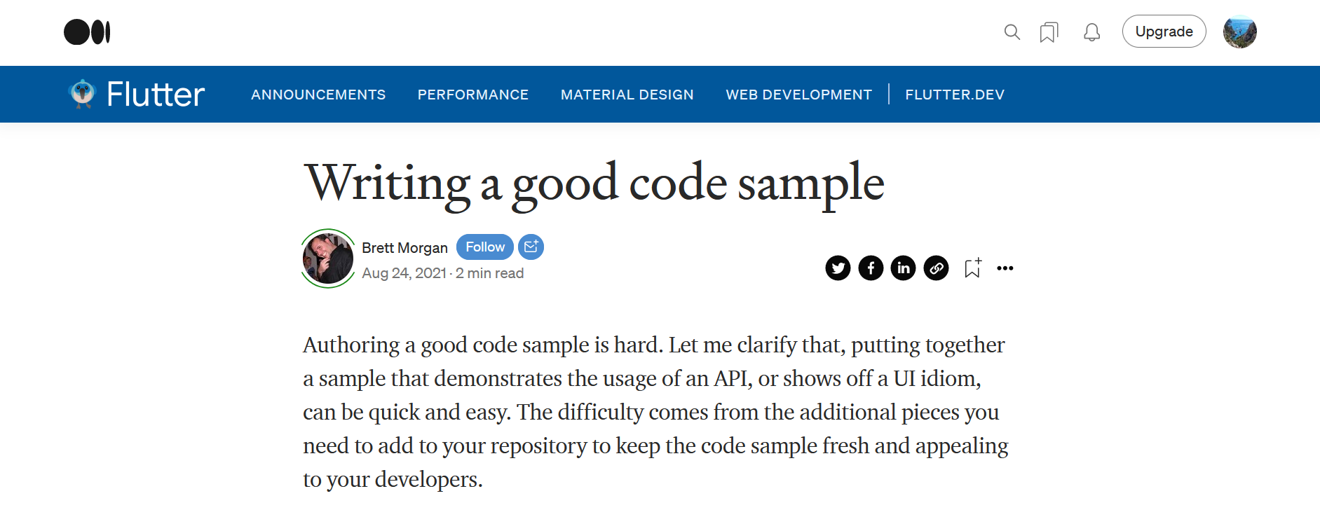
Successful Examples: Medium
Online reading and publishing platform → Medium
  Minimal use of color
  Generous line spacing
  Well chosen combination of typography
  The articles are in a single column format which makes it easy to read
  Estimated reading time
  Direct commenting on specific parts of the articles

Slide 11
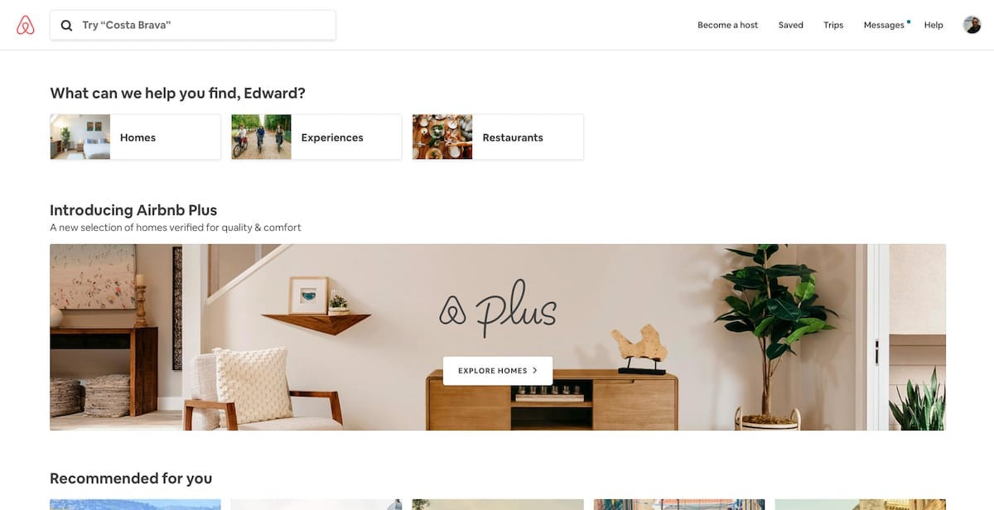
Successful Examples: Airbnb
It accomplishes two things
  Book a place to stay
  Building trust between two complete strangers.
Simple process of finding accommodation
Clean design
Helpful hint text
  "What can we help you find, Edward?"

Slide 12
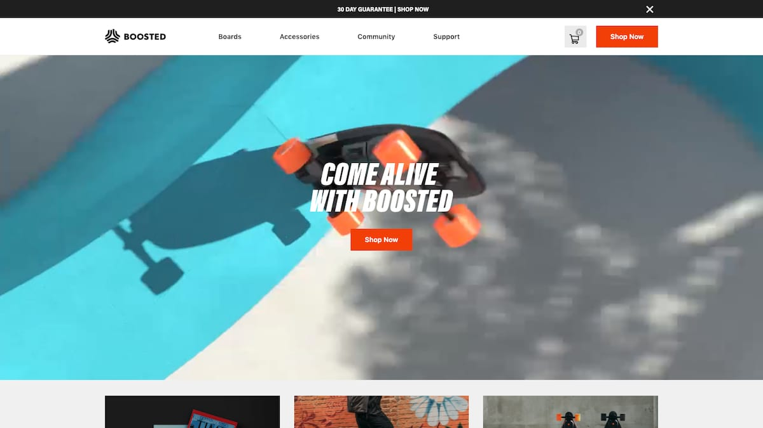
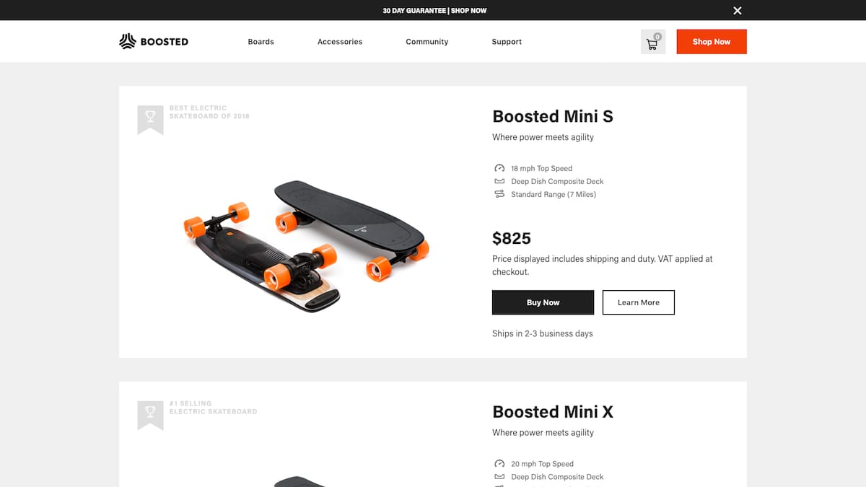
Successful Examples: Boosted Boards
Users are immediately welcomed with a dynamic product video.
The interface is free of color
Only the most relevant information is provided: image, maximum speed, range, price, shipping time and, of course, "Buy Now".

Slide 13
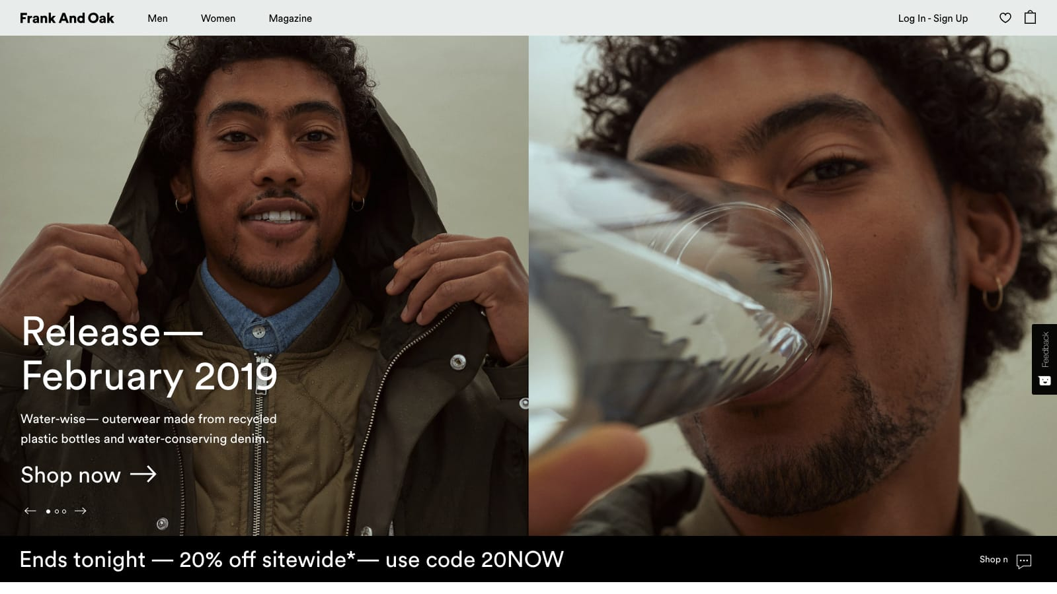
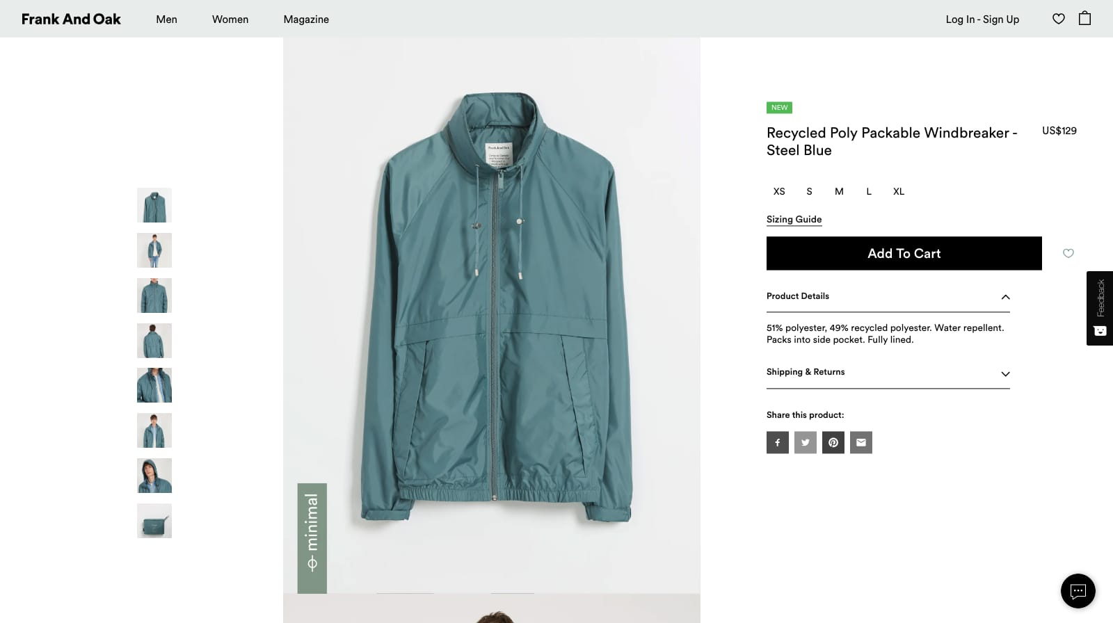
Successful Examples : Frank and Oak
It uses the user interface to grab users' attention
The company uses bold photography and clean, sans-serif typography
After clicking on an item, the product page focuses on two things: the product photo and the buy button, as they are essentially the only colored elements on the page.

Slide 14
Best Practices for Designing an Interface
Keep the interface simple. The best interfaces are almost invisible to the user. They avoid unnecessary elements and are clear in the language they use in labels and messages.
Use color and texture strategically. You can direct attention or redirect attention away from objects by using color, light, contrast and texture to your advantage.
Use typography to create hierarchy and clarity. Consider carefully how you use the font. Different sizes, fonts and layout of text to help increase legibility and readability.

Slide 15
Best Practices for Designing an Interface
Be intentional about your page layout. Consider the spatial relationships between elements on the page and structure the page based on their importance. Careful placement of items can help draw attention to the most important information and can aid readability.
Make sure the system communicates what is happening. Always keep your users informed of actions, status changes, or errors. Using various user interface elements to communicate the status and, if necessary, next steps can reduce user frustration.

Slide 16
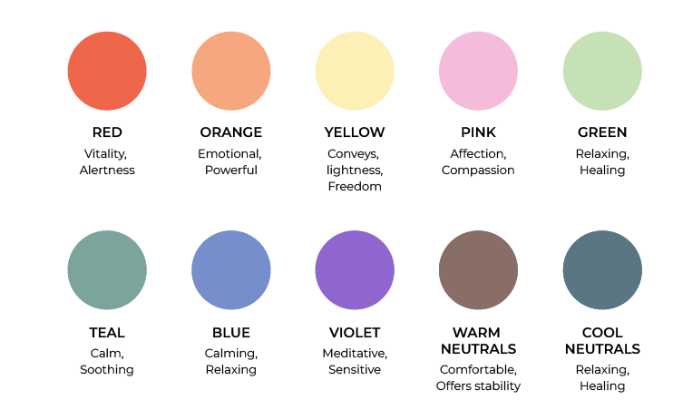
Best Practices for Medical and Healthcare Apps
Consider the importance of color combinations
The medical color palette is quite limited. It’s difficult to imagine a healthcare organization where neon yellow is the leading color. This is due to the influence of color on the mood and wellbeing of patients.
Flashy and vibrant colors can lead to feelings of aggression. A medical application should convey a friendly attitude and be therapeutic and calm. Therefore, it’s best to use cold or pastel shades.

Slide 17
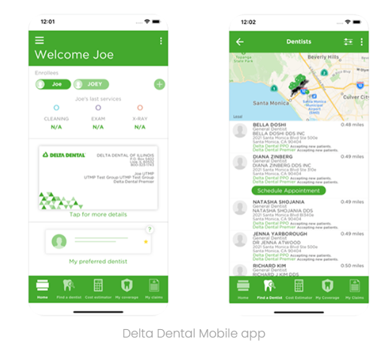
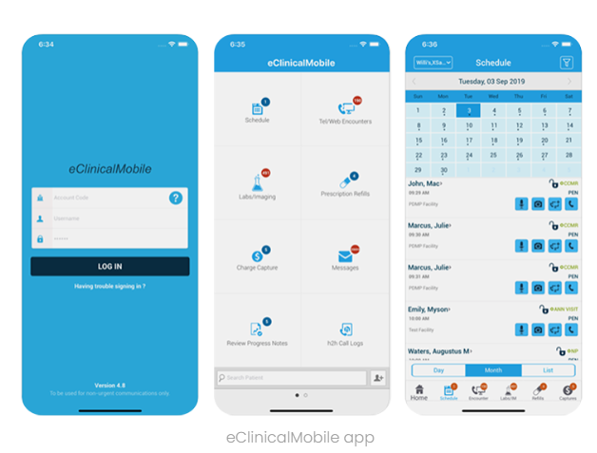
Colors
Blue
Blue is a natural color, and you can often find it in the sky and in water. Perhaps that’s why blue is associated with calm and serenity.
Green
Green symbolizes the world of nature. It’s believed that green removes stress and improves wellbeing.

Slide 18
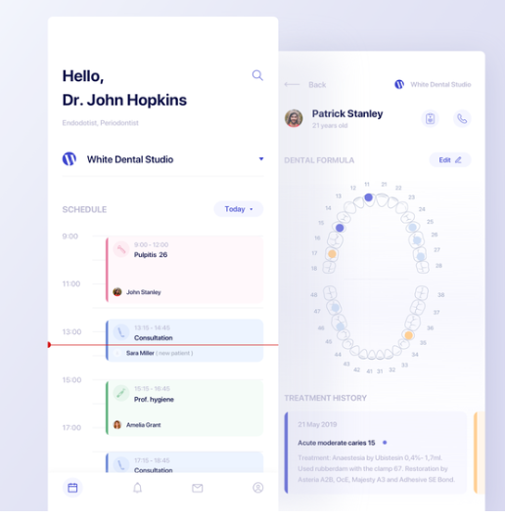
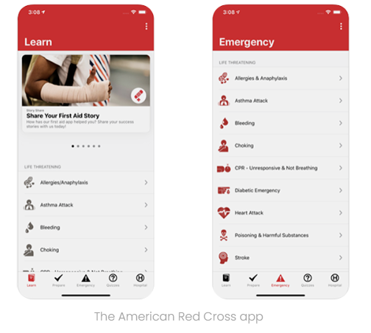
Colors
White
White is often used to convey a sense of purity and peace. It evokes positive emotions and calms users.
Red
Red is risky because this color may evoke an aggressive mood. But in some cases, red can serve as a great tool.

Slide 19
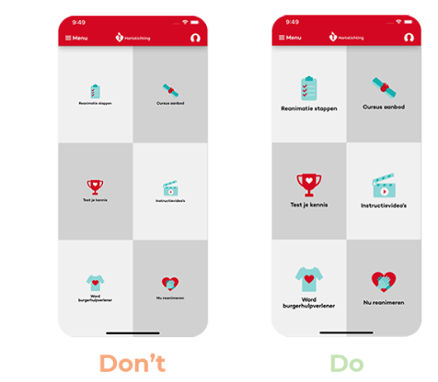
Buttons
Be attentive to buttons
The size and placement of buttons is an important part of a medical app’s UI design since it helps users navigate and perform their desired actions. All buttons should be large enough and located at such a distance that users can interact with them without accidental taps. But avoid making buttons huge, as this will violate the integrity of the layout.

Slide 20
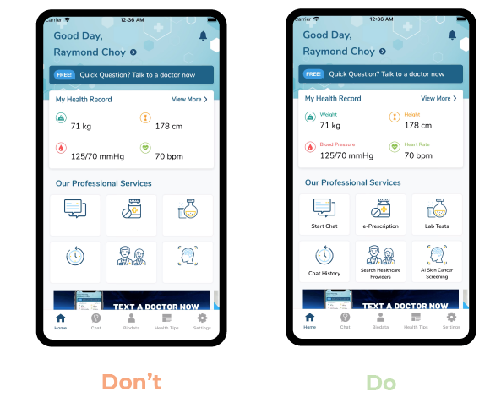
Icons
Use responsive icons
Icons should be intuitive so that users can understand what stands behind them. Although icons are a great graphical element, you shouldn’t use them on each screen, however. Don’t mislead users, and accompany each icon with text.

Slide 21
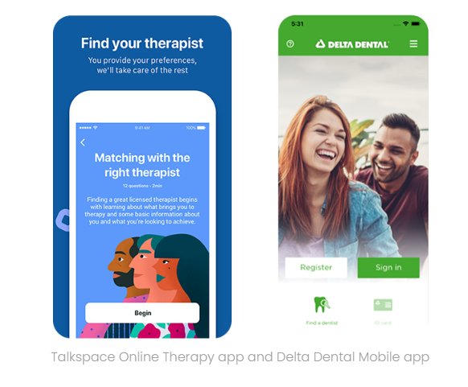
Images and photos
Illustrations and photos can also create a pleasant impression when using a medical application. Use high-resolution images to be visually pleasing. Flat illustrations and photos of people can also create a positive vibe.

Slide 22
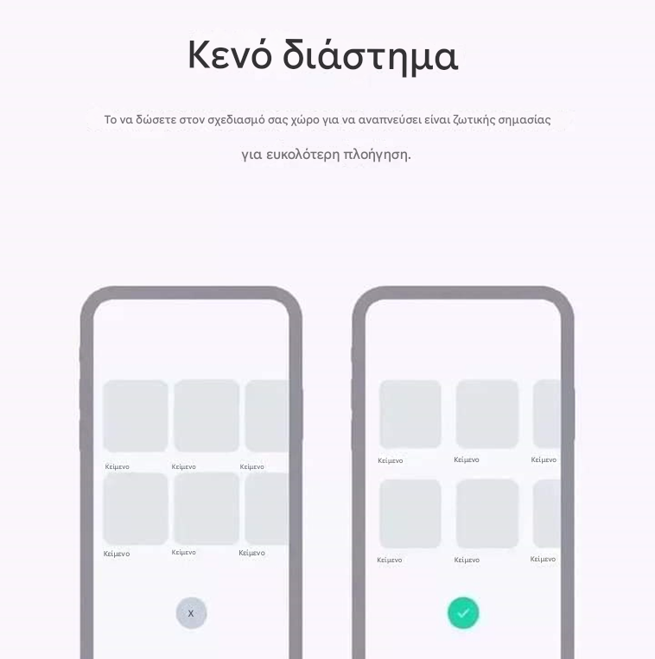
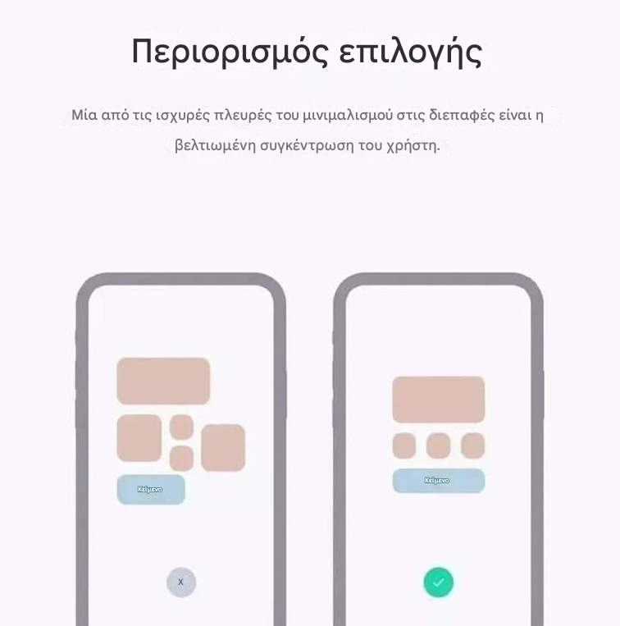
User Interface Design
Whitespace
Giving your design space to breathe is essential for easier navigation.
Limiting Choices
One of the strongest aspects of minimalism in interfaces is improved user focus.

Slide 23
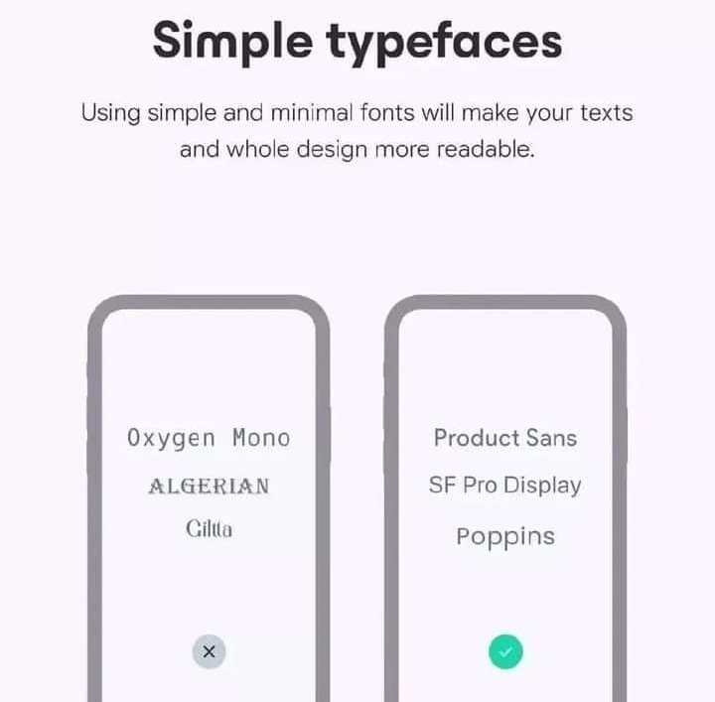

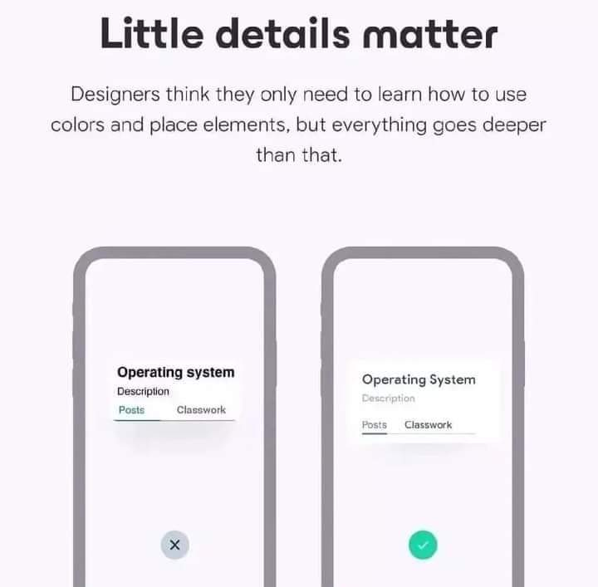
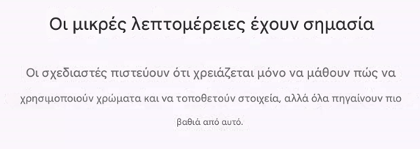
User Interface Design
Simple Fonts
Using simple and minimal fonts will make your text — and your overall design — more readable.
Small Details Matter
Designers often believe they only need to learn how to use colors and place elements, but it goes much deeper than that.

Slide 24
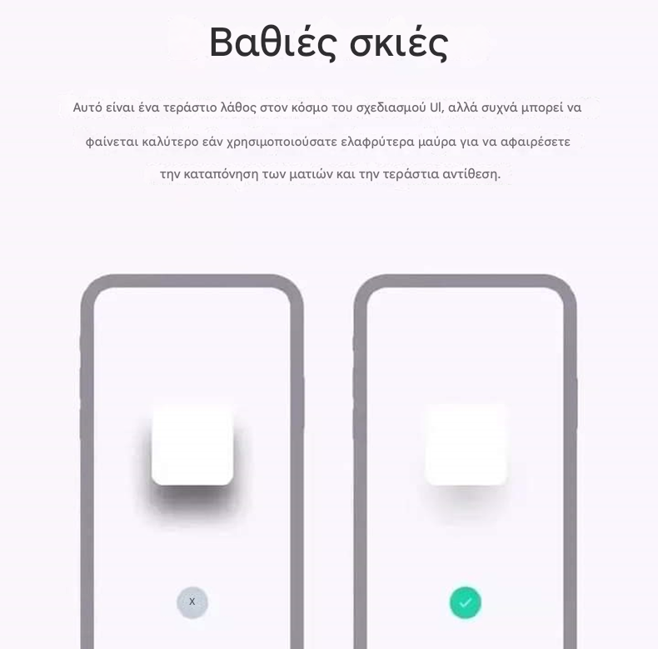
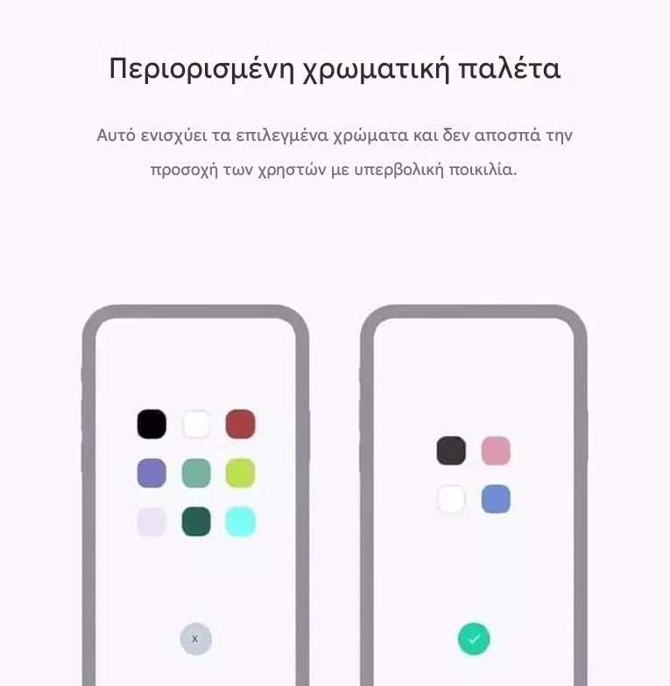
User Interface Design
Heavy Shadows
This is a common mistake in UI design, but it often looks better if you use lighter blacks to reduce eye strain and excessive contrast.
Limited Color Palette
This strengthens the selected colors and prevents distracting users with excessive variety.
μειώσετε

Slide 25
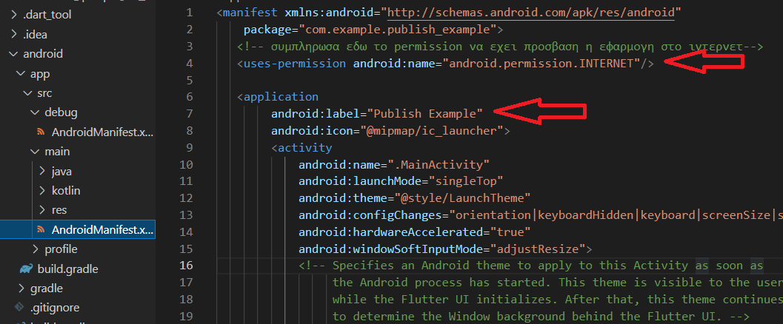
Publish app to Android και iOS store
Android:
  Φάκελος android → app → src→ main → AndroidManifest.xml
Android:label : apps title
Be sure that you have declared correctly the permissions
There is also an AndroidManifest.xml in debug folder but this is a different file

Slide 26
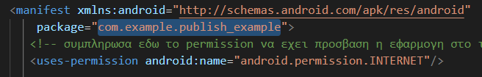
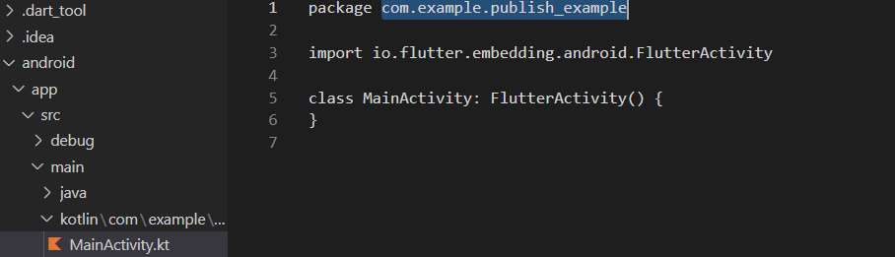
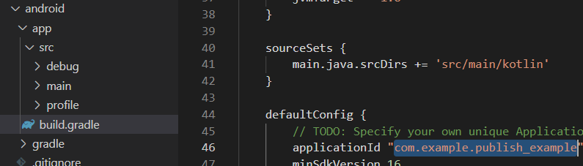
Android
Package identifier: it should be unique in App Store
If you change it in AndroidManifest.xml you should change it in all other files such as:
  android→src→debug→ AndroidManifest.xml
  android→app→main→kotlin→com→example→publish_example→MainActivity.kt
  android→app→build.grandle

Slide 27
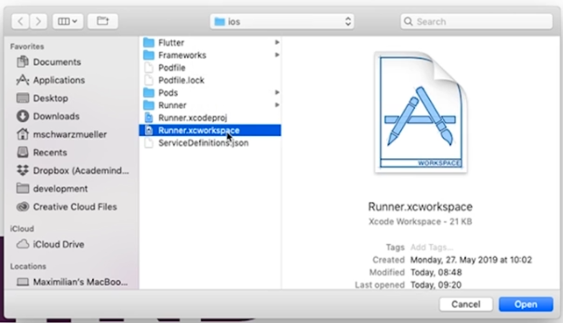
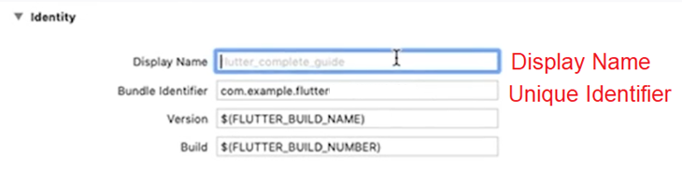
iOS
ios→Runner→Info.plist : we check if all the permissions the app needs are correct
Package identifier and app title are inserted in XCode
  open folder: ios→Runner.xcworkspace

Slide 28
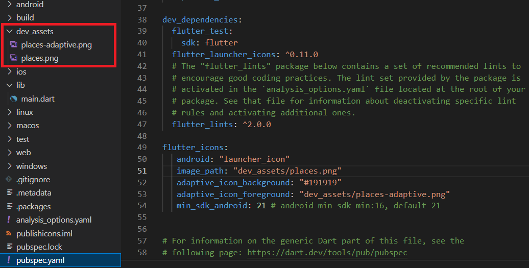
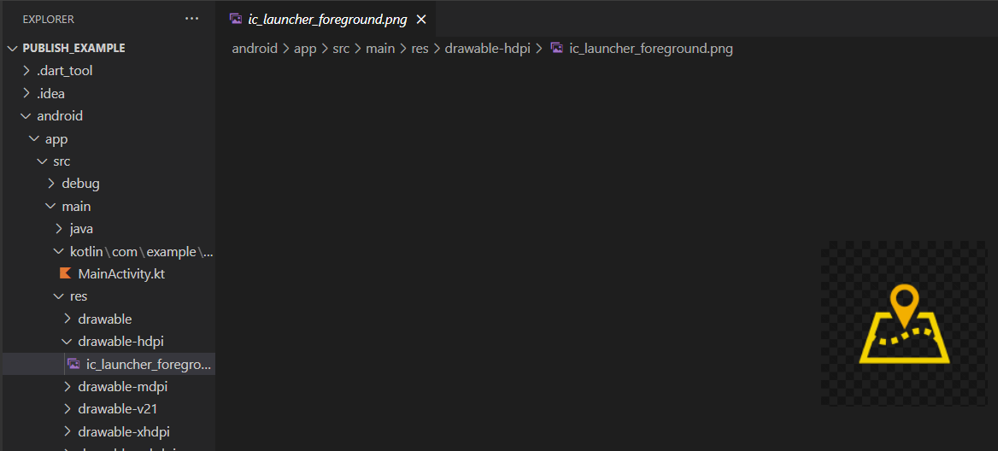
Adding Icons
flutter_launcher_icons
  We use this package to automatically generate all the images needed
  We add it in “dev_dependencies” in pubspec.yaml because we don't want it to be part of the final application
Image_path: icons path
Adaptive icon : round icons used in apps
  Adaptive background : color
  Adaptive foreground : icon
Creates icons for each different mobile version the user is using for both Android and iOS
Run the command that the package has in the Readme file : flutter pub run flutter_launcher_icons:main

Slide 29
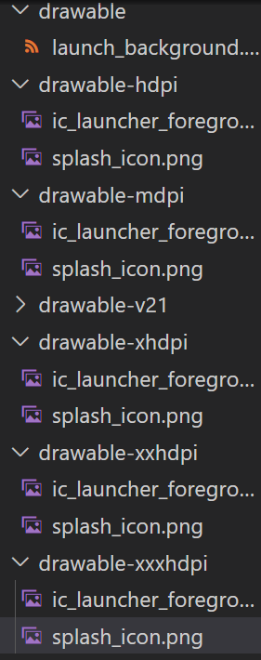
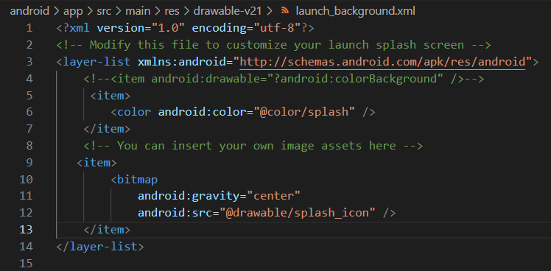
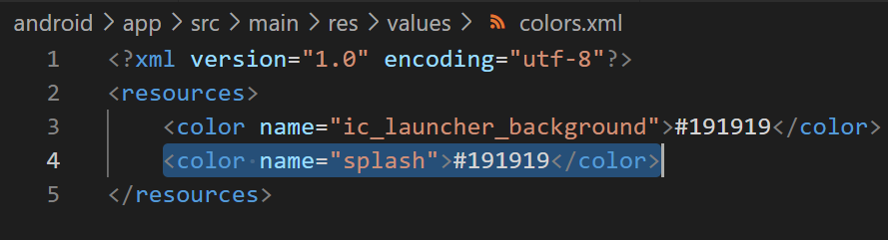
Adding Splash Screen - Android
1)
Android→app→res→launch_background.xml: loading screen
1) In all drawable_hdpi etc. folders we add the icons and splash screen icons such as splash_icon.png
2) values→colors.xml add the splash color
3) drawable→launch_background.xml and drawable-v21→launch_background.xml add color title add in colors.xml for example @color/splash
2)
3)

Slide 30
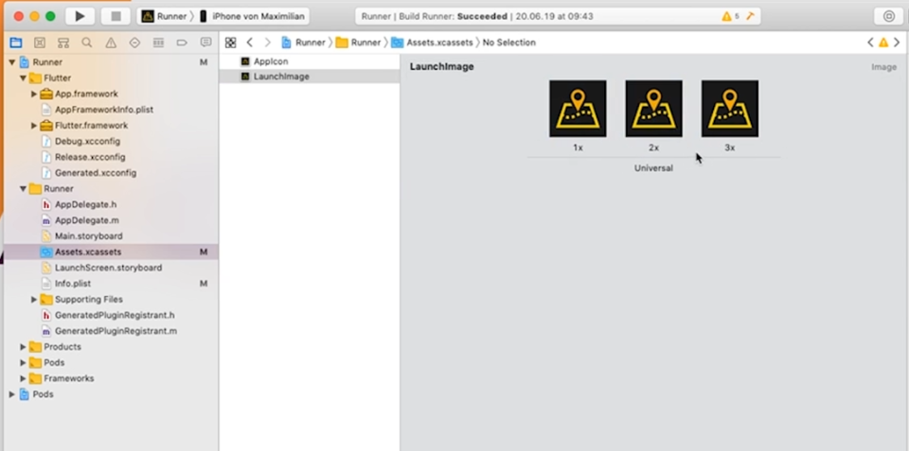
Adding SplashScreen - iOS

