Slide 1
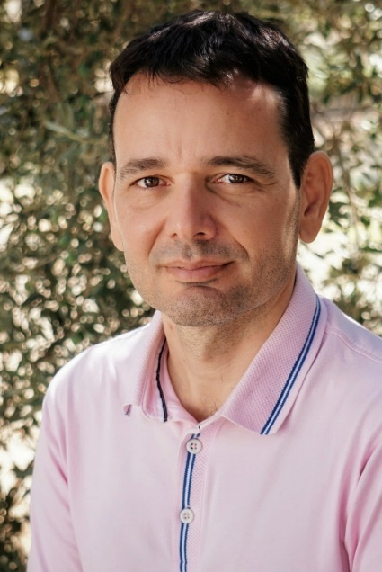
Radiomics Extraction Unlocking the Power of Medical Imaging
Kostas Marias Dipl.Eng, M.Sc , Ph.D
Head Computational Biomedicine Laboratory at FORTH-ICS Professor in Medical Image Processing at the Electrical and Computer Eng. Department of the Hellenic Mediterranean University
http://kostasmarias.eu/

Slide 2
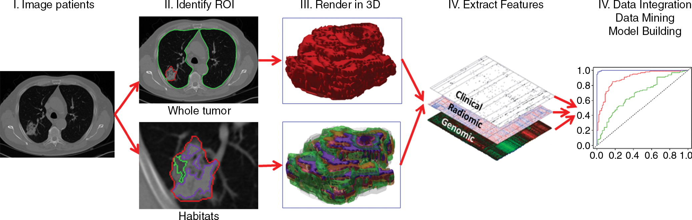
Introduction: What is Radiomics?
Radiomics is a wide term referring to the high throughput extraction of quantitative features from medical images.
These Radiomic features have the potential to enhance diagnostic accuracy and treatment planning via AI driven modelling techniques (including integrative multi-omics ML)
Gillies, Robert J et al. “Radiomics: Images Are More than Pictures, They Are Data.” Radiology vol. 278,2 (2016): 563-77. doi:10.1148/radiol.2015151169

Slide 3
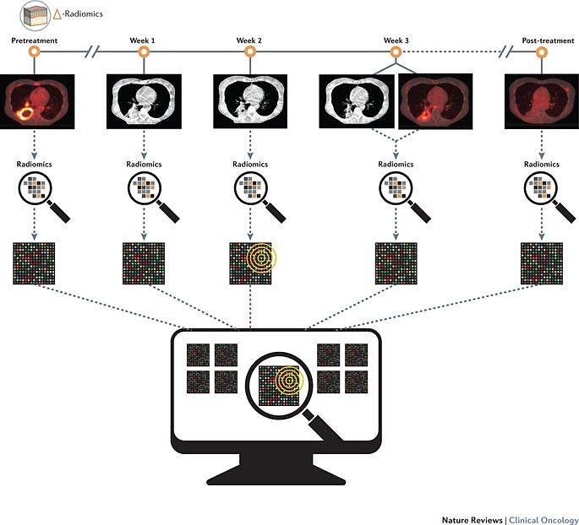
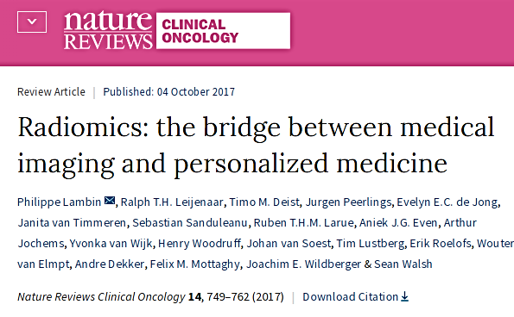
Radiomics
From simple texture features to high-throughput feature extraction-> Radiomics
The term radiomics refer to the high-throughput feature extraction from medical images using advanced multi-resolution image processing feature extraction techniques.
This offers massive opportunities for discovering more correlations with pathophysiology.

Slide 4
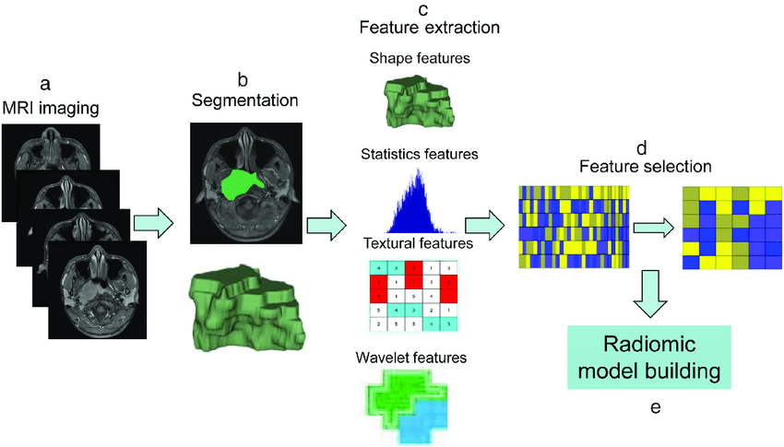
The Radiomics Workflow: Steps in Radiomics
Image Acquisition
Image Preprocessing
Segmentation
Feature Extraction
Data Analysis and Modeling
Zhang, Bin et al. “Advanced nasopharyngeal carcinoma: pre-treatment prediction of progression based on multi-parametric MRI radiomics.” Oncotarget vol. 8,42 72457-72465. 2 Aug. 2017, doi:10.18632/oncotarget.19799

Slide 5
Radiomics Feature Extraction
Texture Radiomics extraction
Shape Radiomics extraction

Slide 6
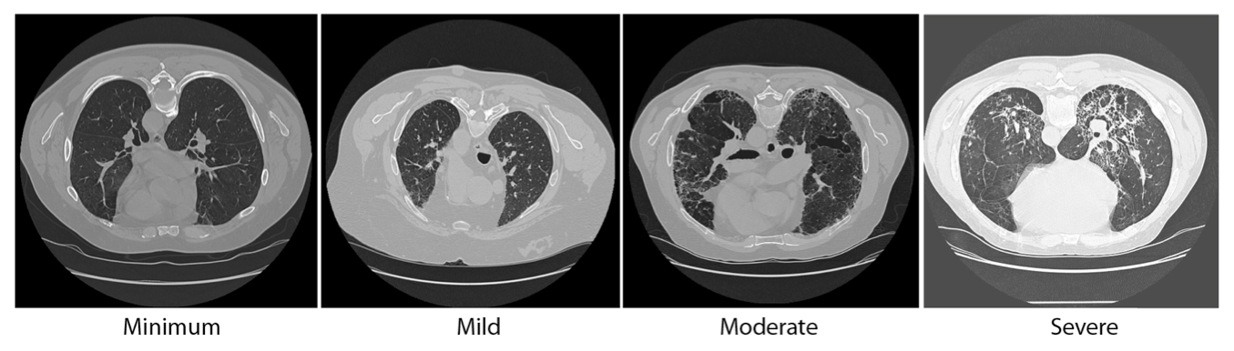
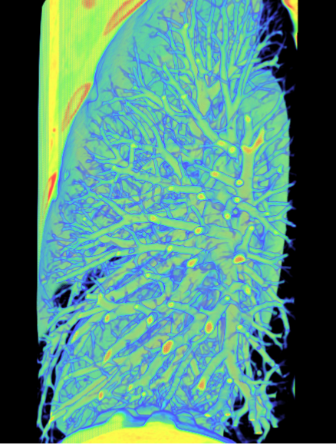
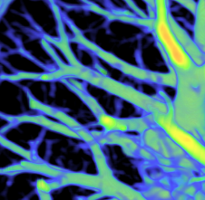
What to Measure in PET/SPECT/.. Images?
Texture in Medical Images
Texture information of lesion (heterogeneous vs homogeneous)
A spatial arrangement of a predefined number of voxels allowing the extraction of complex image patterns/ properties.
Credit to:
Bagci EMBC 2011, RSNA 2011, 2012, ISBI 2012, PlosOne 2013.

Slide 7
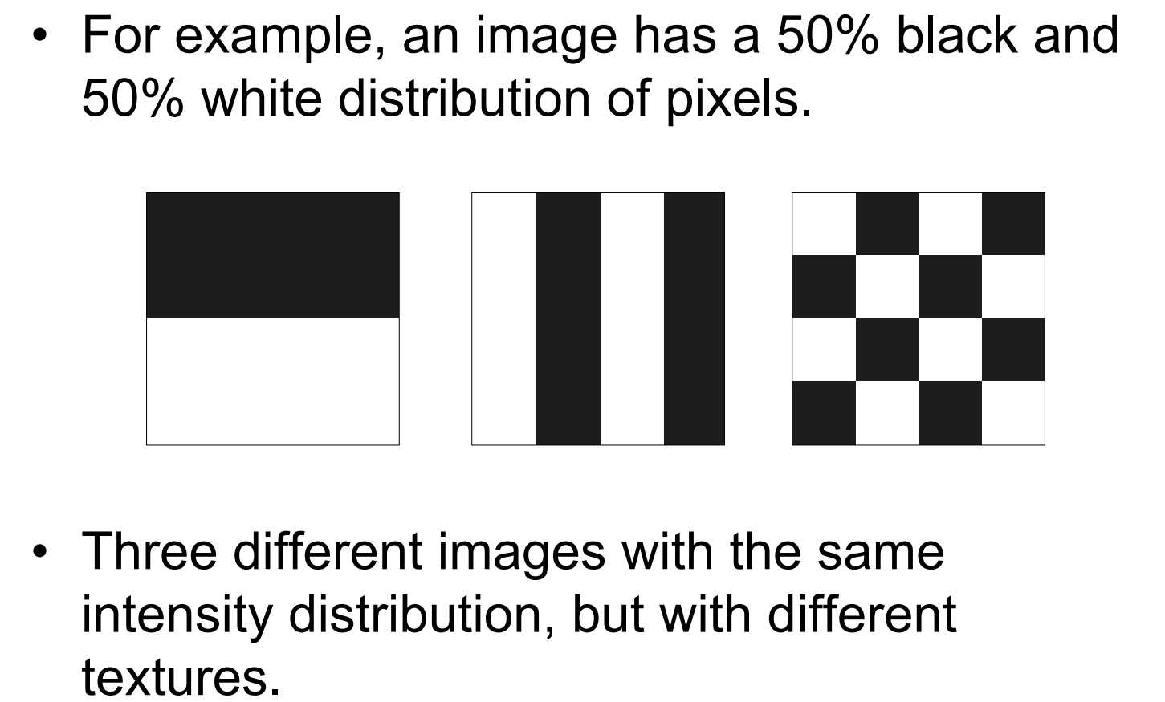
Simple Histogram can’t tell the whole story
Credit to: Michael A. Wurth from Purdue University

Slide 8
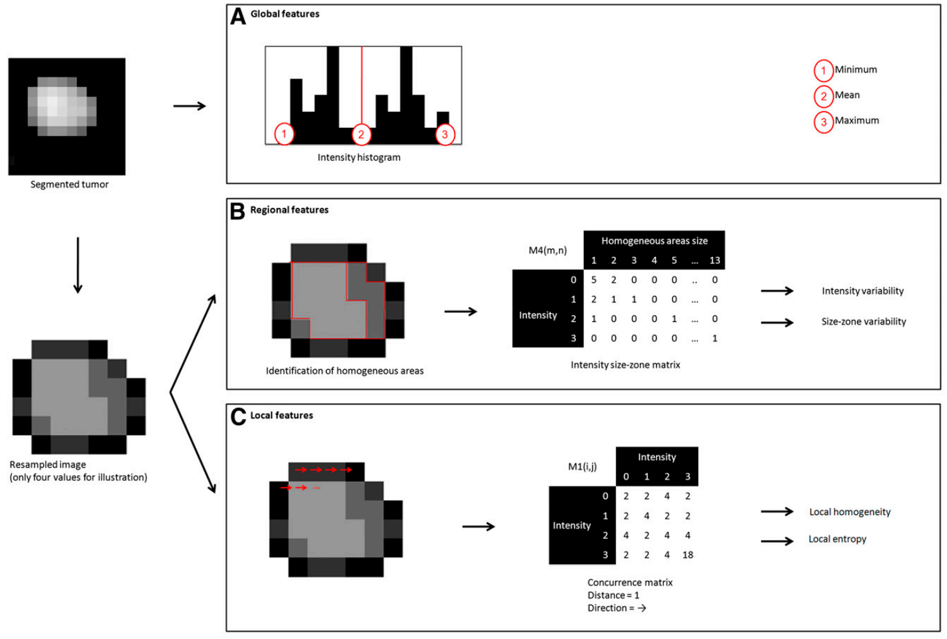
Example Texture Analysis Strategy
Why computer measures of tissue appearance are so important?
Credit to: M. Hatt, JNM

Slide 9
Texture Feature Maps
A technical view on texture analysis
Custom code in Octave/Matlab to implement texture analysis (TA) methods:
Haralick [1973 Haralick Robert M., Shanmugam K., Dinstein]

Slide 10
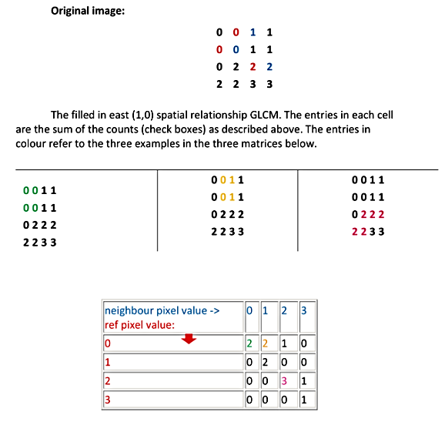
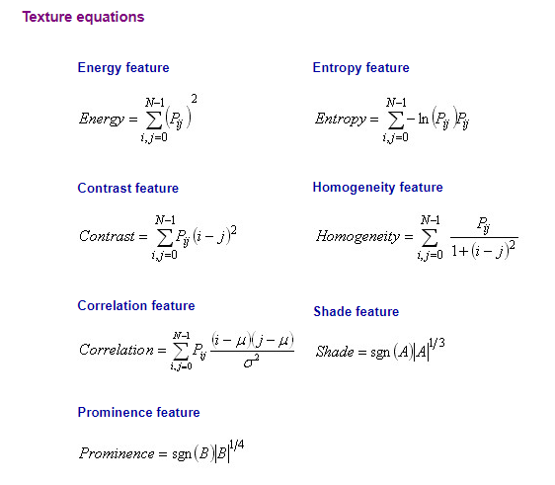
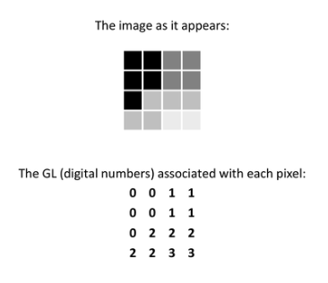
Gray-level Co-occurrence Matrix Texture
A technical view on texture analysis
aka second order statistics
The computation of large number of texture features lead to the advancement of Radiomics approaches
https://prism.ucalgary.ca/handle/1880/51900

Slide 11
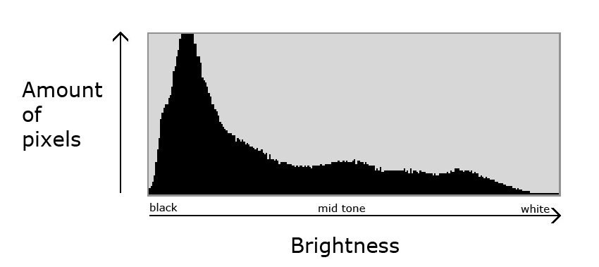
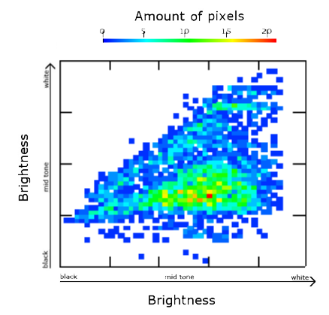
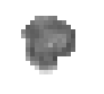
Method 1: Haralick features and feature maps.
A technical view on texture analysis
Gray Level Histogram
Gray Level Coocurence Matrix (GLCM)

Slide 12
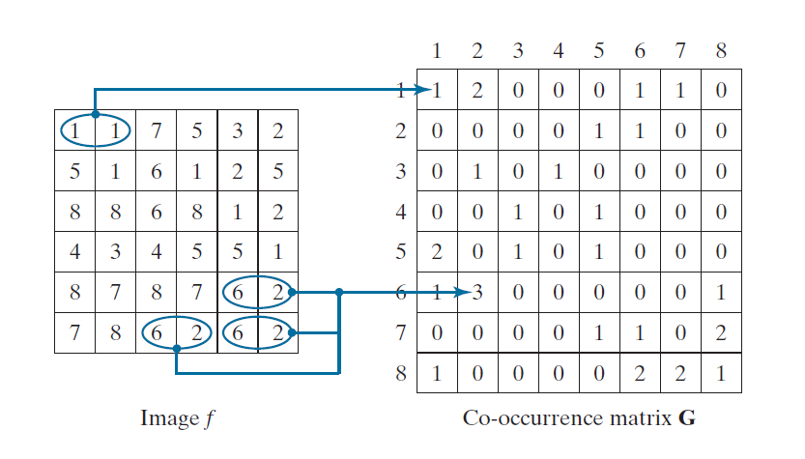
A technical view on texture analysis
0°, distance=1
g_{ij} = 3 είναι η συχνότητα συν-εμφάνισης των τιμών εικόνας 6,2 δηλ έχουμε το g_{6,2}. Για να υπολογιστεί η πιθανότητα συν-εμφάνισης p6,2 πρέπει να το διαιρέσω με των συνολικό αριθμό συν-εμφανήσεων δηλ. το 30. Άρα p_{6,2}=g_{6,2}/30
Gonzalez, R.C. and Woods, R.E. (2018) Digital Image Processing. 4th Edition, Pearson Education, New York
Let G be a matrix whose element gij is the number of times that pixel pairs with intensities zi and zj occur in image f in the position specified by Q, where 1 < i, j < L.
A matrix formed in this manner is referred to as a graylevel (or intensity) co-occurrence matrix. When the meaning is clear, G is referred to simply as a co-occurrence matrix.

Slide 13
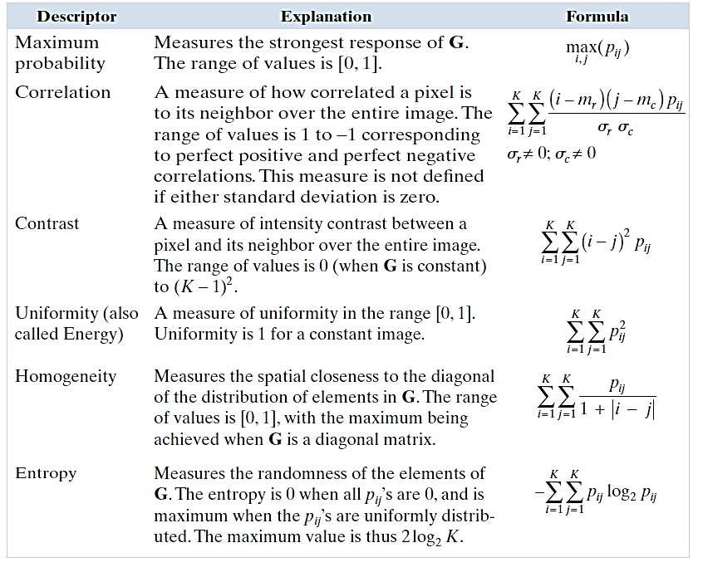
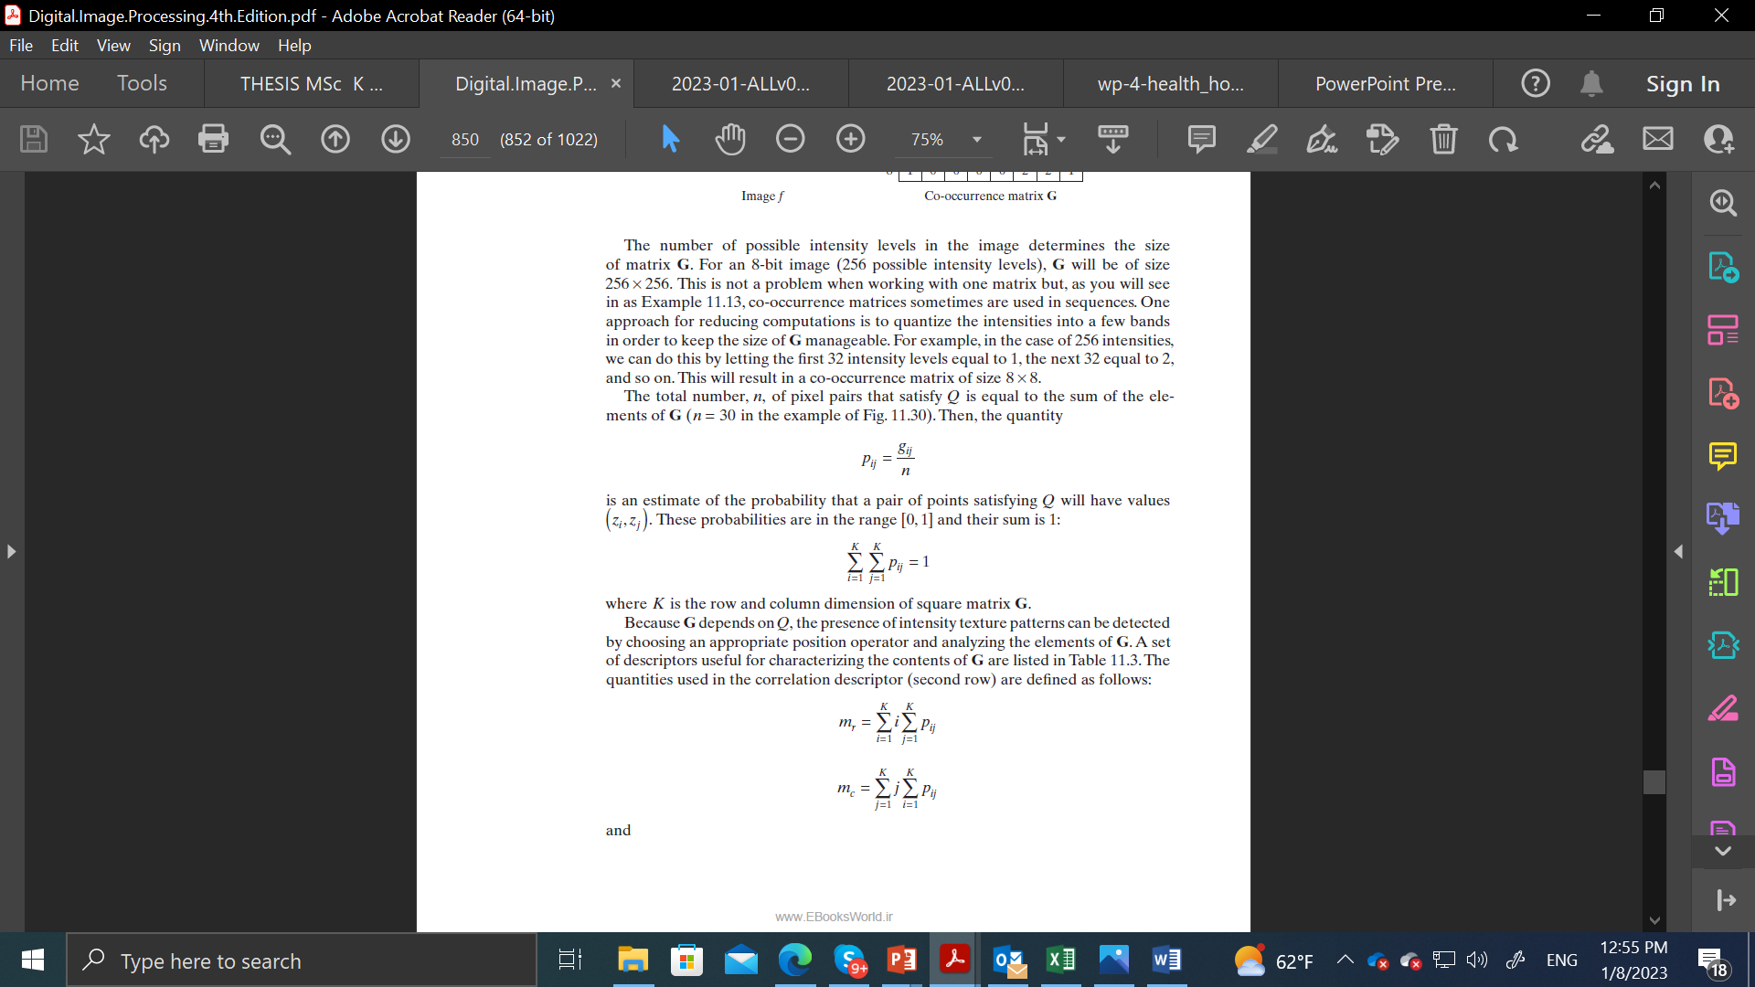
GLCM tips
A technical view on texture analysis
Reduce gray levels to save time
Devide with sum of event to compute probabilities
Compute texture measures
Gonzalez, R.C. and Woods, R.E. (2018) Digital Image Processing. 4th Edition, Pearson Education, New York

Slide 14
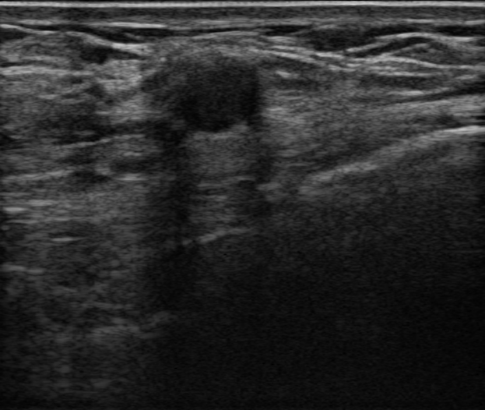

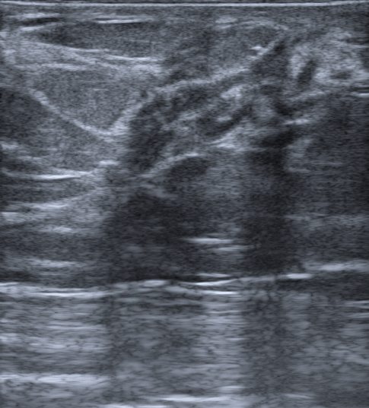

A technical view on texture analysis
A=imread(‘US.jpeg');%A=double(A(:,:,1));
maximum=max(max(A)); minimum=min(min(A));
[rm,cm]=size(A);
%Co-occurence matrix computation
CM=zeros(maximum-minimum+1);
for i=1:rm
for j=1:cm-1
x=A(i,j);
y=A(i,j+1);
CM(x-minimum+1,y-minimum+1)=CM(x-minimum+1,y-minimum+1)+1;
CM(y-minimum+1,x-minimum+1)=CM(y-minimum+1,x-minimum+1)+1;
end
end
%Co-occurence matrix normalisation
CM=CM/(sum(sum(CM)));
%Image A rows summation to ----> px
px=sum(CM');
py=sum(CM);
% Initialize feature vector
features = struct('Entropy', [], 'Homogeneity', [], 'Contrast', []);
%Compute the Entropies Hx and Hy!
Hx=0;Hy=0;
for k=1:(maximum-minimum+1)
if px(k)>0
Hx=Hx-px(k)*log2(px(k));
end
if py(k)>0
Hy=Hy-py(k)*log2(py(k));
end
end
%And the joint entropy Hxy
i=0;j=0;Hxy=0;Hom=0;Contr=0;
for i=1:(maximum-minimum+1)
for j=1:(maximum-minimum+1),
if CM(i,j)>0
Hxy=Hxy-(CM(i,j))*log2(CM(i,j));
Hom=Hom+CM(i,j)/(1+abs(i-j));
Contr=Contr+((i-j)^2)*CM(i,j);
end
end
end
% Store the features
features.Entropy = Hxy;
features.Homogeneity = Hom;
features.Contrast = Contr;
% Display the features
display(features)
Benign mammary dysplasia confirmed by biopsy
Entropy = 0.4414
Homogeneity = 0.9842
Contrast = 1.5525
Entropy = 1.4541
Homogeneity = 0.9358
Contrast = 22.784
Encapsulated papillary carcinoma&Ductal carcinoma in situ (DCIS)
https://www.cancerimagingarchive.net/collection/breast-lesions-usg/

Slide 15
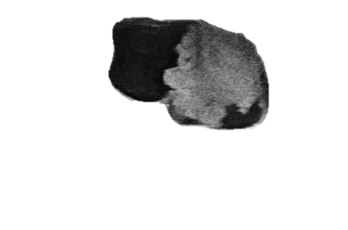
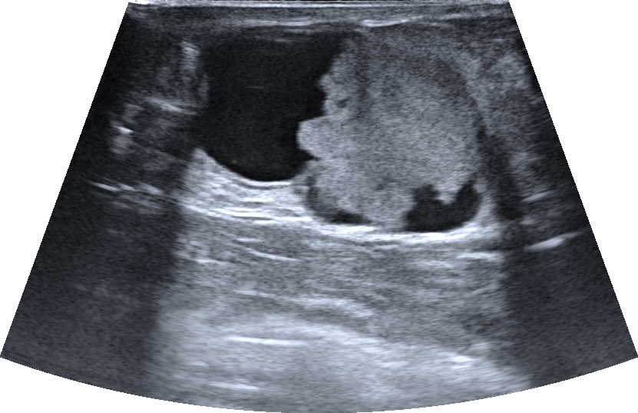

A technical view on texture analysis
A=imread(‘US.jpeg');%A=double(A(:,:,1));
maximum=max(max(A)); minimum=min(min(A));
[rm,cm]=size(A);
%Co-occurence matrix computation
CM=zeros(maximum-minimum+1);
for i=1:rm
for j=1:cm-1
x=A(i,j);
y=A(i,j+1);
CM(x-minimum+1,y-minimum+1)=CM(x-minimum+1,y-minimum+1)+1;
CM(y-minimum+1,x-minimum+1)=CM(y-minimum+1,x-minimum+1)+1;
end
end
%Co-occurence matrix normalisation
CM=CM/(sum(sum(CM)));
%Image A rows summation to ----> px
px=sum(CM');
py=sum(CM);
% Initialize feature vector
features = struct('Entropy', [], 'Homogeneity', [], 'Contrast', []);
%Compute the Entropies Hx and Hy!
Hx=0;Hy=0;
for k=1:(maximum-minimum+1)
if px(k)>0
Hx=Hx-px(k)*log2(px(k));
end
if py(k)>0
Hy=Hy-py(k)*log2(py(k));
end
end
%And the joint entropy Hxy
i=0;j=0;Hxy=0;Hom=0;Contr=0;
for i=1:(maximum-minimum+1)
for j=1:(maximum-minimum+1),
if CM(i,j)>0
Hxy=Hxy-(CM(i,j))*log2(CM(i,j));
Hom=Hom+CM(i,j)/(1+abs(i-j));
Contr=Contr+((i-j)^2)*CM(i,j);
end
end
end
% Store the features
features.Entropy = Hxy;
features.Homogeneity = Hom;
features.Contrast = Contr;
% Display the features
display(features)
Entropy = 2.6201
Homogeneity = 0.8895
Contrast = 11.517
Cyst filled with thick fluid

Slide 16
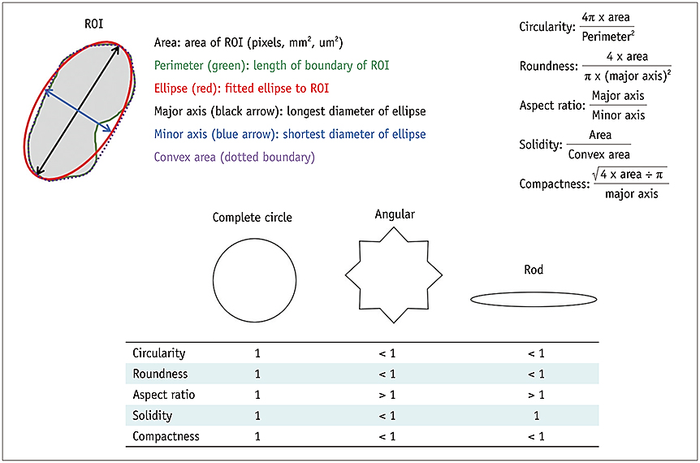
Shape Radiomics extraction
A technical view on shape Radiomics
Park HJ, Park B, Lee SS. Radiomics and Deep Learning: Hepatic Applications. Korean J Radiol. 2020 Apr;21(4):387-401. https://doi.org/10.3348/kjr.2019.0752

Slide 17
A technical view on shape Radiomics
function shapeFeatures = computeShapeRadiomics(binaryImage)
% Ensure the input is a binary image
if !islogical(binaryImage)
error('Input must be a binary image.');
end
% Label the connected components in the binary image
[labeledImage, numObjects] = bwlabel(binaryImage);
% Get properties of the labeled regions
stats = regionprops(labeledImage, 'Area', 'Perimeter', 'BoundingBox', 'MajorAxisLength', 'MinorAxisLength');
% Initialize feature structure
shapeFeatures = struct('Area', [], 'Perimeter', [], 'Circularity', [], 'AspectRatio', []);
% Compute features for each labeled region
for i = 1:numObjects
area = stats(i).Area;
perimeter = stats(i).Perimeter;
boundingBox = stats(i).BoundingBox;
majorAxisLength = stats(i).MajorAxisLength;
minorAxisLength = stats(i).MinorAxisLength;
% Circularity: 4*pi*Area / Perimeter^2
circularity = 4 * pi * area / (perimeter^2);
% Aspect Ratio: Width / Height of the bounding box
aspectRatio = boundingBox(3) / boundingBox(4);
% Store the features
shapeFeatures(i).Area = area;
shapeFeatures(i).Perimeter = perimeter;
shapeFeatures(i).Circularity = circularity;
shapeFeatures(i).AspectRatio = aspectRatio;
end
end
image = imread('case016_tumor.png'); A=uint8(image(:,:,3));
% Convert the grayscale image to a binary image using 0 as threshold
binaryImage = im2bw(A, 0);
% Compute shape radiomics features
features = computeShapeRadiomics(binaryImage);
% Display the features
disp(features);
Benign mammary dysplasia confirmed by biopsy
Area = 9223
Perimeter = 370.28
Circularity = 0.8453
AspectRatio = 1.1700
Area = 23534
Perimeter = 812.37
Circularity = 0.4481
AspectRatio = 1.3889
Encapsulated papillary carcinoma&Ductal carcinoma in situ (DCIS)
https://www.cancerimagingarchive.net/collection/breast-lesions-usg/

Slide 18

PyRadiomics is an open-source Python package for extracting radiomics features from medical images.
It aims to set a reference standard for radiomics analysis.
Provides a tested and maintained platform for easy and reproducible feature extraction.
Developers aim to raise awareness of radiomics and grow the community.
Supports feature extraction in both 2D and 3D.
Can calculate single values per feature for a region of interest (segment-based) or generate feature maps (voxel-based).
Not intended for clinical use.

Slide 19
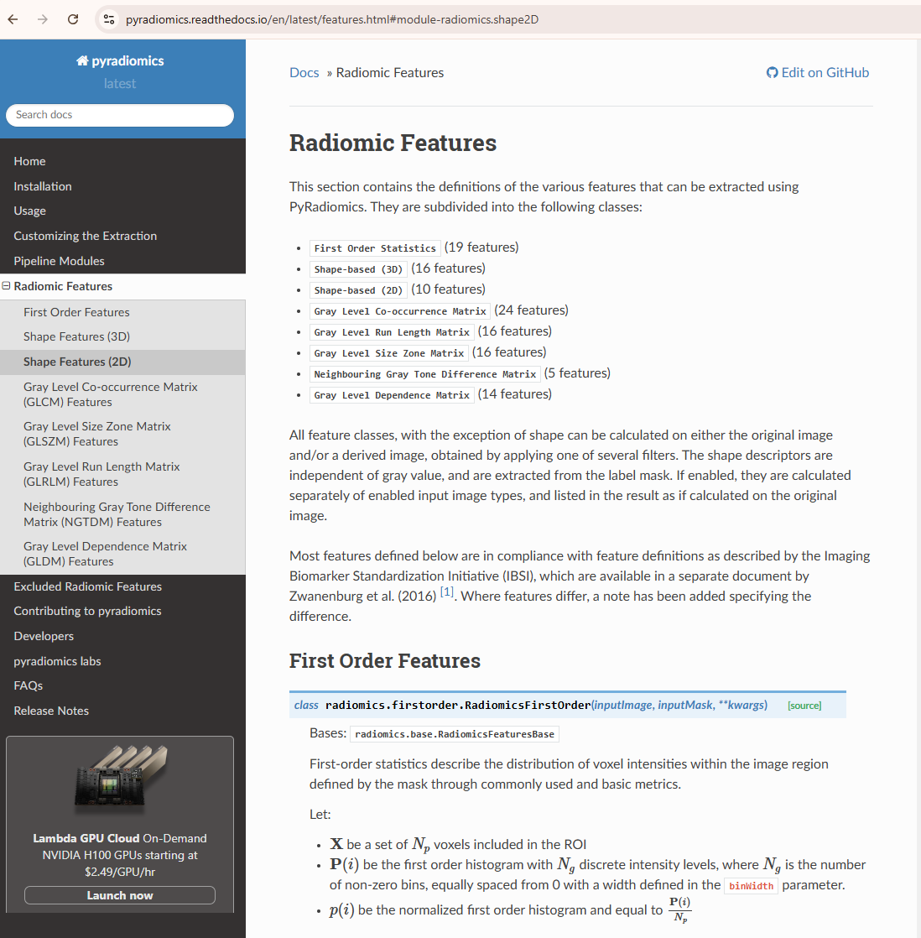
Issues
Image Segmentation
Preprocessing
Noise Reduction
Normalization
Resampling
Standardization/Reproducibility
ML model training, validation, deployment and translation
… see next presentations

Slide 20
Applications of Radiomics
Oncology:
Tumor Characterization
Treatment Response Prediction
Cardiology
Neurology

