Slide 1

Advanced Topics in Databases
Assignment III.
Dániel Bertók

Slide 2

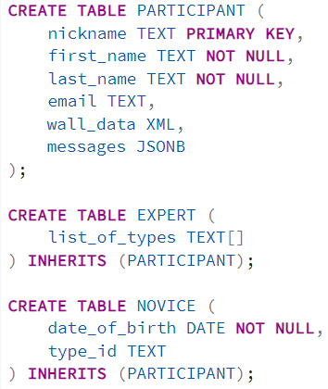
New tables, inheritance
The assignment required to introduce 3 new tables:
Participant: represents people who have participated in auctions. There were no exact columns given in the task, the ones I have given are implications from the demanded queries
Expert: Inherits from the Participant table. Has one additional field, which is a multivalued type attribute consisting of the type of artwork they are expert at
Novice: Inherits from the Participant table. Adds a date of birth column, as well as a type_id field which can act as a foreign key for the TypeOfWork table

Slide 3
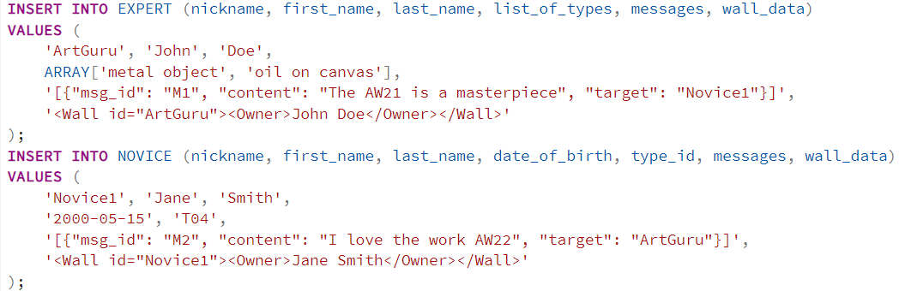
XML, JSONB fields
The assignment mentioned two queries, which imply that every Participant should be able to store message walls, and messages sent through these walls.
Messages might not have the same structure each time, and they have to be stored fastly in real time, so they are stored as JSONB -> Don’t have to split it up on insert, but still can be queried efficiently
Walls consist of data structured within each other, therefore the XML type is the most suitable choice
They are filled with test data to try them out with the queries

Slide 4
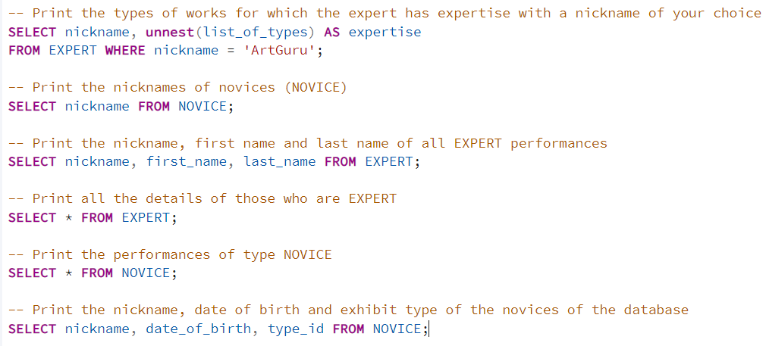
Queries I. – Testing inheritance
The following queries test if the previously added tables properly inherit the fields from the Participant table
The result set also contains data stored in the Participant table
Unnesting the multivalued type results a record for each element stored in the list_of_types field
Result of query no. 4:

Slide 5
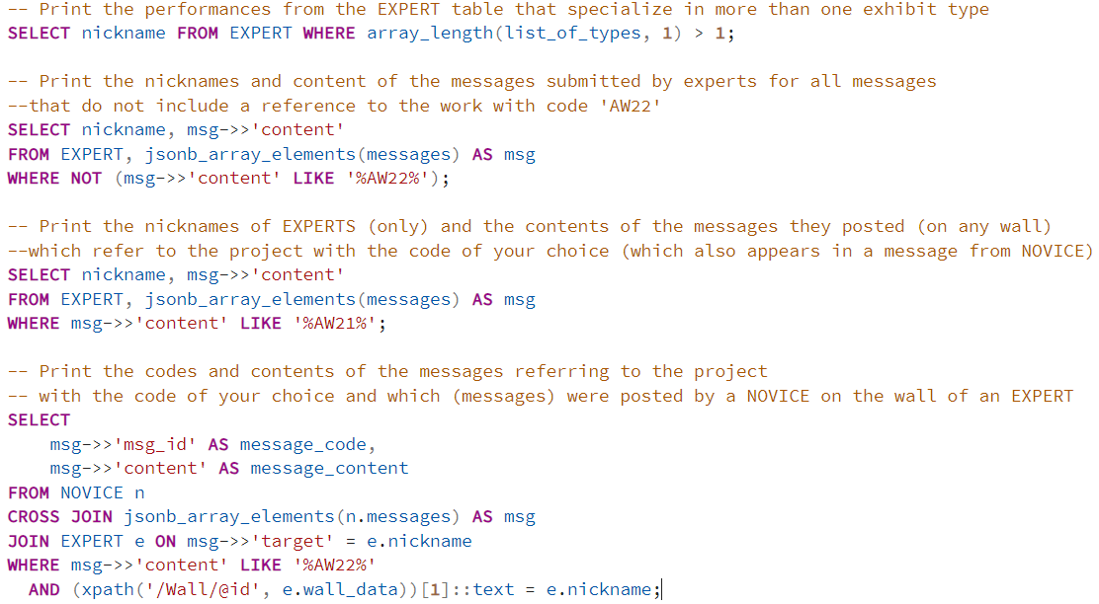
Queries II. – Testing XMl and JSONB fields
The following queries mainly focus on methods used to query XML and JSONB type fields
jsonb_array_elements(): Used to expand the JSON array of messages so each message can be filtered individually
->>: Extracts the JSON content as text
xpath('/Wall/@id', e.wall_data): This extracts the ID from the XML column, than the [1] refers to the first field of the XML, which is wall’s ID, which we filter by the experts’ nicknames (That is what I have used as an ID in the XML)

