Slide 1
ClassNet Assignment 3
Fanni Farkas

Slide 2
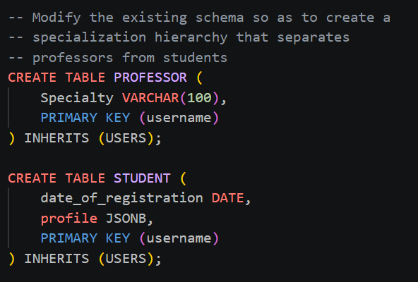
Database Hierarchy
PostgreSQL INHERITS mechanism
Base table: USERS
Common attributes: Name, Gender, City, Country, Description
Subclasses:
        Professors: Added Specialty attribute
              Students: Date of registration, JSONB Profile (Flexible academic data storage)

Slide 3
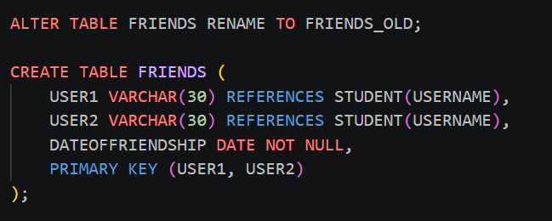
Relationship Constraints
Friendship restricted to Students only
FRIENDS table recreated
Foreign Key enforcement against Student subclass

Slide 4
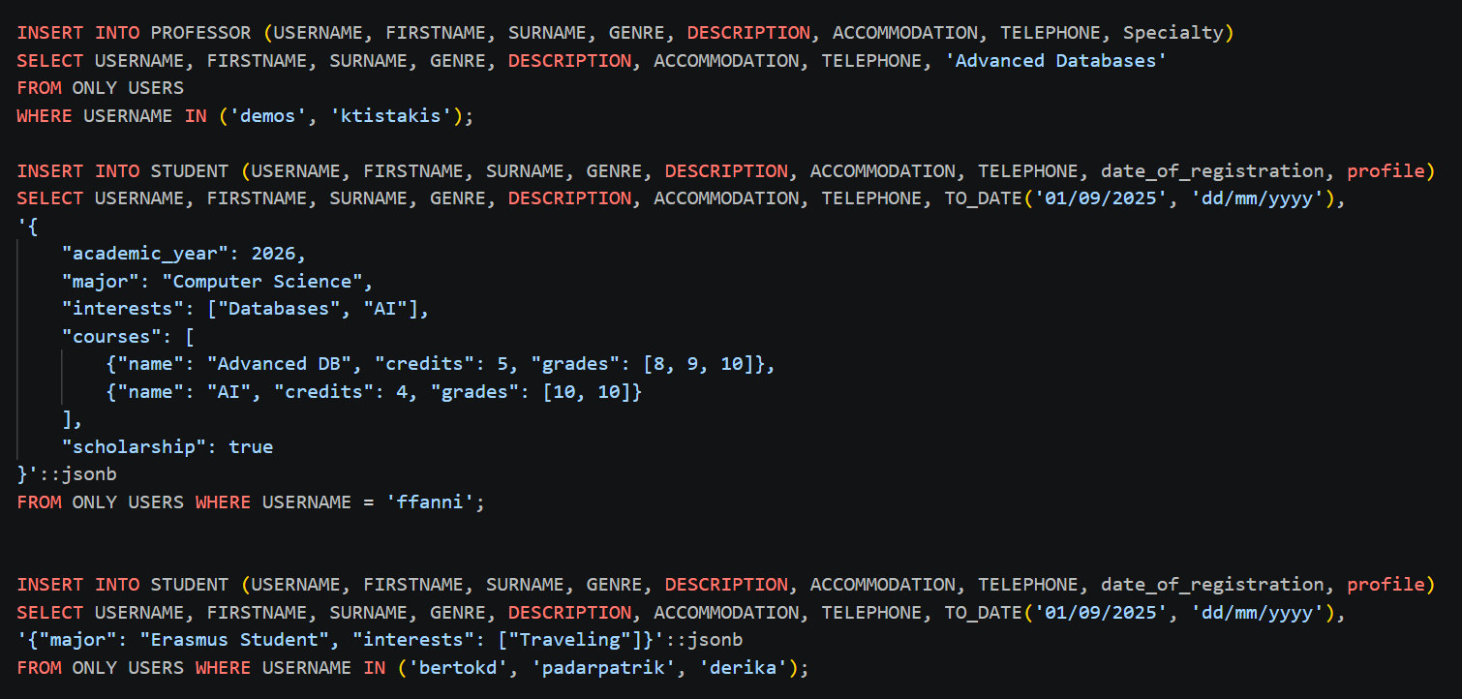
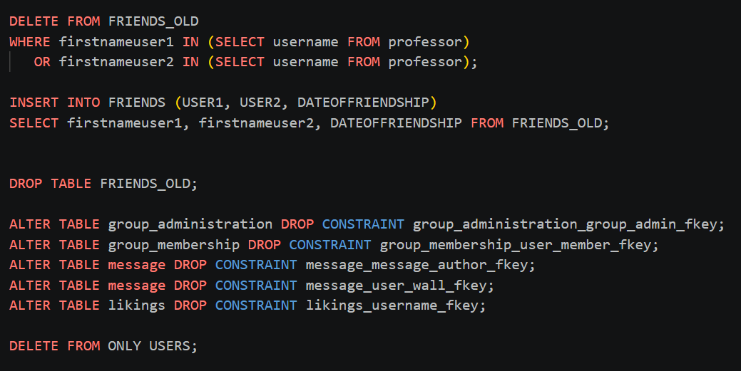
Schema Transition
Records migrated from parent to subclasses
Example 'ffanni' profile: Nested arrays
Complex storage: Academic years, Majors, Courses
Multi-level data: Nested grades [8, 9, 10]

Slide 5
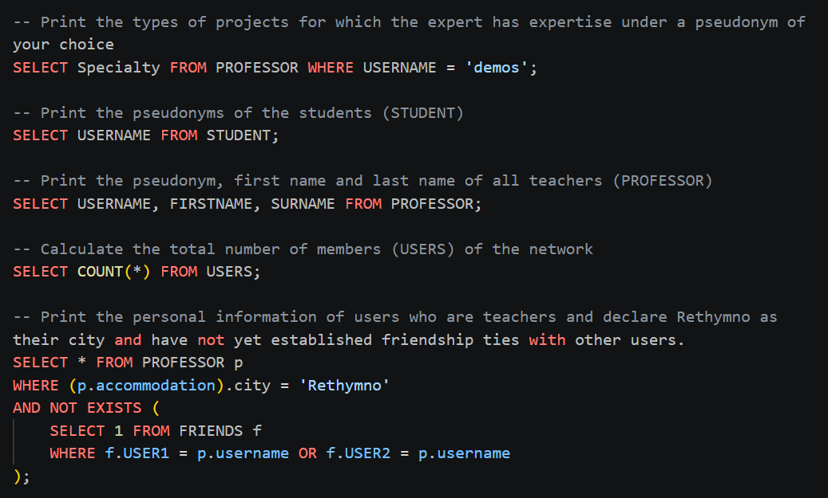
Queries

Slide 6
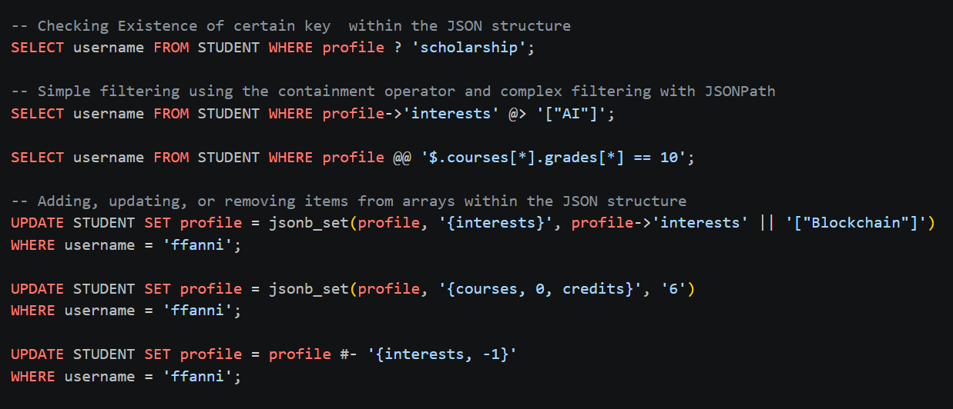
JSONB Operators
? operator: Key existence (e.g., "scholarship")
@> operator: Simple containment (e.g., "AI")
@@ JSONPath: Complex logic (e.g., specific grades)

Slide 7
Data Manipulation
jsonb_set: Update specific nested values
|| operator: Concatenate new interests/data
#- operator: Remove array elements or keys

