Slide 1
Starting with React

Slide 2
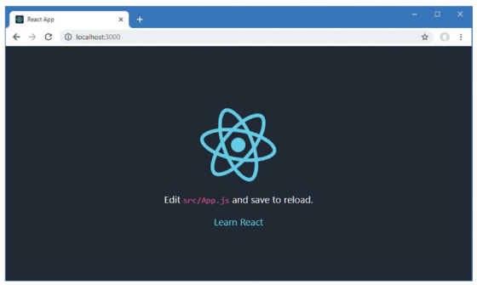
Node.js Creat React App Git
Download and install Node Js
Install create-react-app
npx create-react-app <The name of app you want to develop>
npm start
Compiled successfully!
You can now view my-testapp in the browser.
Local: http://localhost:3000
On Your Network: http://192.168.181.1:3000
Note that the development build is not optimized.
To create a production build, use npm run build.
webpack compiled successfully
The app will run on http://localhost:3000

Slide 3
First app
public/index.html
This is the HTML file that is loaded by the browser. It contains an element
in which the application is displayed and a script element that loads the
application’s JavaScript files.
src/index.js
This is the JavaScript file that is responsible for configuring and starting the React
application. We use this file to add the Bootstrap CSS framework, etc.
src/App.js
This is the React component, which contains the HTML content that will
be displayed to the user and the JavaScript code required by the HTML.

Slide 4
What is react
React isn’t the solution to every problem, and it is important to know when you should use React and when
you should seek an alternative. React delivers the kind of functionality that used to be available only to
server-side developers but is delivered entirely in the browser.
Internet applications use a standard round trip, users requests, server creates, server delivers, browser renders
Drawbacks to round-trip applications:
they make the user wait while the next HTML document is requested and loaded
they require a large server-side infrastructure to process all the requests and manage all the application state,
they can require more bandwidth because each HTML document has to be self-contained, which can lead to the same content being included in each response from the server.
In React,
an initial HTML document is sent to the browser
user interactions lead to HTTP requests for small fragments of HTML or data inserted into the existing set of elements being displayed to the user
the initial HTML document is never reloaded or replaced

Slide 5
Why react
React is necessary in large applications, where there are complex workflows to implement, different types of users to deal with, and substantial volumes of data to be processed. In these situations, you can work directly with the browser APIs, but it becomes difficult to manage the code and hard to scale up the application. The features provided by React make it easier to build large and complex applications.

Slide 6
Rendering Elements
In order to render any element into the Browser DOM, we need to have a container or root DOM element. It is almost a convention to have a div element with the id=”root” or id=”app” to be used as the root DOM element.
Assume that our index.html file has the following statement inside it.
<div id="root"></div>
Now, in order to render a simple React Element to the root node, we must write the following in the App.js file.
import React,{ Component } from 'react';
class App extends Component {
render() {
return (
<div>
<h1>Hello World!</h1>
</div>
);
}
}
export default App;

Slide 7
Updating an Element
React Elements are immutable i.e. once an element is created it is impossible to update its children or attribute. Thus, in order to update an element, we must use the render() method several times to update the value over time
import React from 'react';
import ReactDOM from 'react-dom';
function showTime()
{
const myElement = (
<div>
<h1>Hello World! </h1>
<h2>{new Date().toLocaleTimeString()}</h2>
</div>
);
ReactDOM.render(
myElement,
document.getElementById("root")
);
}
setInterval(showTime, 1000);

Slide 8
Important notices
Calling the render() method multiple times may serve our purpose for this example, but in general, it is never used instead a stateful component is used.
A React Element is almost never used isolated, we can use elements as the building blocks of creating a component in React.

Slide 9
Functional Components
Components in React basically return a piece of JSX code that tells what should be rendered on the screen. In React, we mainly have two types of components, functional and class components:
Functional Components: Functional components are simply javascript functions. We can create a functional component in React by writing a javascript function. These functions may or may not receive data as parameters, we will discuss this later in the tutorial. Below example shows a valid functional component in React:
const Democomponent=()=>
{
return <h1>Welcome Message!</h1>;
}
we will use functional component only when we are sure that our component does not require interacting or work with any other component

Slide 10
Class components
Class Components: The class components are a little more complex than the functional components. The functional components are not aware of the other components in your program whereas the class components can work with each other. We can pass data from one class component to other class components. We can use JavaScript ES6 classes to create class-based components in React. Below example shows a valid class-based component in React:
class Democomponent extends React.Component
{
render(){
return <h1>Welcome Message!</h1>;
}
}

Slide 11
Import and Export modules
React Apps are a collection of interactive Components
to create collections of Components -> re-use components
To deal with reusable components we need to Import and Export modules

Slide 12
Importing
Importing default export: Every module have one default export.
In order to import the default export from a file (.js library for example), we use the relative path and the keyword “import” before it. Same way we import one or more parameters from a file
import Component_name from module_path
import { PARA_NAME } from module_path
import Component_name , { PARA_NAME, ... } from module_path

Slide 13
Exporting
Exporting default export: export default Component_name
Exporting named values: export { PARA_NAME }

Slide 14
Example
change-style.js
import React, {Component} from 'react';
class ChangeStyle extends Component {
constructor(props)
{ super(props);
this.state = { color : '#000000' };
}
getClick()
{
if (this.state.color === '#ff0000')
this.setState({ color : '#00ff00' });
else
this.setState({ color : '#ff0000' });
}
render()
{
return <h1 style = { this.state }
onClick = {this.getClick.bind(this)}>
{this.props.title} < /h1>
}
}
export default ChangeStyle;
index.js
// Importing combination
import React, {Component} from 'react';
// Importing Module
import ReactDOM from 'react-dom';
import ChangeStyle from './change-style.js';
// Importing CSS
import './index.css';
class App extends Component {
render()
{
return (<div><h2>Welcome to</h2>
<ChangeStyle title=“I change my style" /></div>);
}
}
ReactDOM.render(
<App/>,
document.getElementById('root')
);

Slide 15
JavaScript Hoisting
Hoisting is a concept that enables us to extract values of variables and functions before initializing/assigning value without getting errors
In JavaScript, Hoisting is done by moving all the declarations at the top of the scope before code no matter if scope is global or local.
JavaScript allocates memory for all variables and functions defined in the program before execution.
Declaration –> Initialisation/Assignment –> Usage
// Variable lifecycle
let a; // Declaration
a = 100; // Assignment
console.log(a); // Usage
However, since JavaScript allows us to both declare and initialize our variables simultaneously, this is the most used pattern:
let a = 100;

Slide 16
JavaScript Hoisting…..
Always remember that in the background the Javascript is first declaring the variable and then initializing them. It is also good to know that variable declarations are processed before any code is executed.
However, in javascript, undeclared variables do not exist until code assigning them is executed. Therefore, assigning a value to an undeclared variable implicitly creates it as a global variable when the assignment is executed. This means that all undeclared variables are global variables.
Undeclared variables=global variables
Var: variables declared with var are function scoped
Let: variables declared with “let” keyword are block scoped not function scoped and hence it is not any kind of problem when it comes to hoisting.

Slide 17
Static Variable vs Const vs freeze
A static variable in JavaScript is a property of a class which is used inside the class.
A const variable is used for declaring a constant value that cannot be modified.
The const keyword creates a read-only reference to a value
Object.freeze() which is used to freeze an object: does not allow new properties to be added and no removing or altering the existing ones

Slide 18
Strict mode programming
JavaScript has the feature of strict-mode, which is supposed to disallow certain behaviors of the language to decrease the random behavior and increase the detectability of poorly written code. This set of restrictions made the code much more secure and maintained a high standard of coding in general. JavaScript codes are optimized before execution by the engine, using the strict mode it was seen that developers could now write highly optimized programs. It is not only recommended by developers but also a mandatory inclusion of industrial coding standards.
"use strict"; // Turn on strict mode.

Slide 19
this
“this” in javascript always holds the reference to a single object, that defines the current line of code’s execution context. Functions, in JavaScript, are essentially objects. Like objects, they can be assigned to variables, passed to other functions, and returned from functions. And much like objects, they have their own properties. One of these properties is this.
The value that this store is the current execution context of the JavaScript program. Thus, when used inside a function “this” has the value of the global object, which is the window object in the browser environment:
<!DOCTYPE html>
<html>
<body>
<script>
function doSomething(a, b) {
// adds a propone property to the Window object
this.propone = "test value";
}
// function invocation
doSomething();
document.write(window.propone);
</script>
</body>
</html>
Source: https://www.geeksforgeeks.org

Slide 20
<!DOCTYPE html>
<html>
<body>
<script>
let person = {
name : "John",
age : 31,
logInfo : function() {
document.write(this.name + " is " + this.age + " years old ");
}
}
// logs John is 31 years old
person.logInfo()
</script>
</body>
</html>
Functions, when defined as fields or properties of objects, are referred to as methods.
Source: https://www.geeksforgeeks.org

Slide 21
<script>
let people = function(name, age) {
this.name = name;
this.age = age;
this.displayInfo = function() {
document.write(this.name + " is " + this.age + " years old");
}
}
let person1
= new people('John', 21);
// logs John is 21 years old
person1.displayInfo();
</script>
Source: https://www.geeksforgeeks.org

Slide 22
Javascript functions
this.publicInstanceMethod = function() {
// has access to all vars
// also known as a privileged method
};
}
MyObj.prototype.publicSharedVar = 'quux';
MyObj.prototype.publicSharedMethod = function() {
// has access to shared and public vars
// canonical way for method creation:
// try to use this as much as possible
};
return MyObj;
})();
var MyObj = (function() { // scoping
var privateSharedVar = 'foo';
function privateSharedFunction() {
// has access to privateSharedVar
// may also access publicSharedVar via explicit MyObj.prototype
// can't be called via this
}
function MyObj() { // constructor
var privateInstanceVar = 'bar';
this.publicInstanceVar = 'baz';
function privateInstanceFunction() {
// has access to all vars
// can't be called via this
};
Source: https://stackoverflow.com/

Slide 23
Insert computational expressions
import React, { Component } from "react";
const count = 4
export default class App extends Component {
render = () =>
<h4 className="bg-primary text-white text-center p-2 m-1">
Number of things: { count % 2 === 0 ? "Even" : "Odd" }
</h4>
}
import React, { Component } from "react";
const count = 4
function isEven() {
return count % 2 === 0 ? "Even" : "Odd";
}
export default class App extends Component {
render = () =>
<h4 className="bg-primary text-white text-center p-2 m-1">
Number of things: { isEven() }
</h4>
}

Slide 24
JavaScript JSON
JSON or JavaScript Object Notation is a format for structuring data
{ “name”:”Thanos” }
Types of Values:
Array: An associative array of values.
Boolean: True or false.
Number: An integer.
Object: An associative array of key/value pairs.
String: Several plain text characters which usually form a word.
Many data -> separated by comma
{ “name”:”Thanos”, “Occupation”:”Professor” }
As a functional data object
var person={ “name”:”Thanos”, “Occupation”:”Destroying half of humanity” }

Slide 25
JSON….
{
“Books": [
{
"Name" : “Les Misarables",
“author" : “Victor Hugo",
“Keywords" : [ “France", “Paris“, “French revolution“, “1879” ]
},
{
"Name" : “Art of Electronics",
"author" : “Horovitz",
“Keywords" : [ “Amplifiers", “Transistors" ]
}
]
}

Slide 26
JSX
JSX is basically a syntax extension of regular JavaScript and is used to create React elements. These elements are then rendered to the React DOM
In React we are allowed to use normal JavaScript expressions with JSX. To embed any JavaScript expression in a piece of code written in JSX we will have to wrap that expression in curly braces {}. Consider the below program, written in the index.js file
import React from 'react';
import ReactDOM from 'react-dom';
const name = “Thanos";
const element = <h1>Hello,{ name }.Welcome to my page.< /h1>;
ReactDOM.render(
element,
document.getElementById("root")
);

Slide 27
JSX
import React from 'react';
import ReactDOM from 'react-dom';
let i = 1;
const element = <h1>{ (i == 1) ? 'Hello World!' : 'False!' } < /h1>;
ReactDOM.render(
element,
document.getElementById("root")
);
If i=1 then ‘Hello world!’ else ‘False’
class in HTML becomes className in JSX
For custom attributes, the names of such attributes should be prefixed by data-.
<h2 data-sampleAttribute="sample">Custom attribute</h2>

Slide 28
Grouping elements in JSX
Consider that you want to render multiple tags at the same time. You should group all the tags under a parent tag and then render this parent element to the HTML.
import React from 'react';
import ReactDOM from 'react-dom';
const element = <div>
<h1>This is Heading 1 < /h1>
<h2>This is Heading 2</h2 >
<h3>This is Heading 3 < /h3>
</div > ;
ReactDOM.render(element, document.getElementById("root"));

Slide 29
Comments in JSX
import React from 'react';
import ReactDOM from 'react-dom';
const element = <div><h1>Hello World !</h1>
{/ * This is a comment in JSX * /}
</div>;
ReactDOM.render(
element,
document.getElementById("root"));

Slide 30
JSX vs createElement
const NewComponent = (<Component className=‘test’>
<div> Hello World </div>
</Component>
);
ReactDOM.render(NewComponent, document.querySelector("#root"));
React.createElement(
Component,
{className=‘test’},
React.createElement(
‘div’,
null,
‘Hello world’
)
);

Slide 31
Mix programming….
const names = [“Apple", “Banana", “Mango", “Cherry"]
const Command = (
<h4>
{
names.map( function creatNameElement(name){
return <li key={ name }> { name } </li>
})
}
</h4>
);
ReactDOM.render(Command, document.querySelector('#root'))

Slide 32
React + db
const mariadb = require('mariadb');
const pool = mariadb.createPool({
host: 'mydb.com',
user:'myUser',
password: 'myPassword',
connectionLimit: 5
});
pool.getConnection()
.then(conn => {
conn.query("SELECT 1 as val")
.then((rows) => {
console.log(rows); //[ {val: 1}, meta: ... ]
//Table must have been created before
// " CREATE TABLE myTable (id int, val varchar(255)) "
return conn.query("INSERT INTO myTable value (?, ?)", [1, "mariadb"]);
})
.then((res) => {
console.log(res); // { affectedRows: 1, insertId: 1, warningStatus: 0 }
conn.end();
})
.catch(err => {
//handle error
console.log(err);
conn.end();
})
}).catch(err => {
//not connected
});
$ npm install mariadb

Slide 33
Ecma script 2017
const mariadb = require('mariadb');
const pool = mariadb.createPool({
host: 'mydb.com',
user:'myUser',
password: 'myPassword',
connectionLimit: 5
});
async function asyncFunction() {
let conn;
try {
conn = await pool.getConnection();
const rows = await conn.query("SELECT 1 as val");
console.log(rows); //[ {val: 1}, meta: ... ]
const res = await conn.query("INSERT INTO myTable value (?, ?)", [1, "mariadb"]);
console.log(res); // { affectedRows: 1, insertId: 1, warningStatus: 0 }
} catch (err) {
throw err;
} finally {
if (conn) return conn.end();
}
}

Slide 34
Security consideration
Connection details such as URL, username, and password are better hidden into environment variables. using code like :
const mariadb = require('mariadb');
mariadb.createConnection({host: process.env.DB_HOST, user: process.env.DB_USER, password: process.env.DB_PWD})
.then(conn => {
...
});
Then for example, run node.js setting those environment variable :
$ DB_HOST=localhost DB_USER=test DB_PASSWORD=secretPasswrd node my-app.js

Slide 35
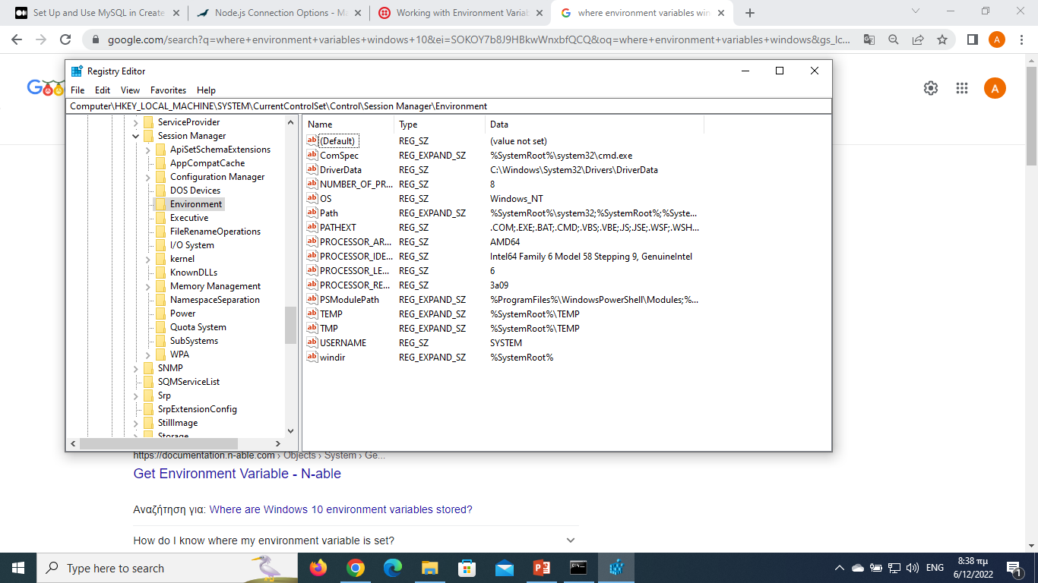

Slide 36
A full DB project architecture
React + Express + Node.js + Database (MariaDB, MySQL,…)

Slide 37
Basic steps
Install Database
Create the reactjs app environment
React is needed to build a UI, which is part of our project.
Create React App includes the Express server that is needed for the project.
As we know the following command creates a React project:
npx create-react-app my-app
Setup database in nodejs
Set up mysql
$ npm install mysql
Set up mariaDB
$ npm install mariadb

Slide 38
Mysql example
import mysql from 'mysql';
const mysql_user = {
host: 'localhost',
user: 'root',
password: 'password',
};
const connection = mysql.createConnection(mysql_user, {
multipleStatements: true,
});
function query(query) {
connection.query(query, (error, result) => {
if (error) {
console.log(error);
} else {
console.log(result);
}
});
}
function connect() {
connection.connect((error) => {
if (error) {
console.log(error);
} else {
console.log('Connected to SQL');
inquire();
} });
}
connect();

Slide 39
Setup express
const express = require("express");
const cors = require("cors");
const app = express();
var corsOptions = {
origin: "http://localhost:8081"
};
app.use(cors(corsOptions));
// parse requests of content-type - application/json
app.use(express.json());
// parse requests of content-type - application/x-www-form-urlencoded
app.use(express.urlencoded({ extended: true }));
// simple route
app.get("/", (req, res) => {
res.json({ message: "Welcome to bezkoder application." });
});
// set port, listen for requests
const PORT = process.env.PORT || 8080;
app.listen(PORT, () => {
console.log(`Server is running on port ${PORT}.`);
});
In the root folder, let’s create a new server.js file:

Slide 40
In the app folder, we create a separate config folder for configuration with db.config.js file like this:
module.exports = {
HOST: "localhost",
USER: "root",
PASSWORD: "123456",
DB: "testdb",
dialect: "mysql",
pool: {
max: 5,
min: 0,
acquire: 30000,
idle: 10000
}
};

Slide 41
const dbConfig = require("../config/db.config.js");
const Sequelize = require("sequelize");
const sequelize = new Sequelize(dbConfig.DB, dbConfig.USER, dbConfig.PASSWORD, {
host: dbConfig.HOST,
dialect: dbConfig.dialect,
operatorsAliases: false,
pool: {
max: dbConfig.pool.max,
min: dbConfig.pool.min,
acquire: dbConfig.pool.acquire,
idle: dbConfig.pool.idle
}
});
const db = {};
db.Sequelize = Sequelize;
db.sequelize = sequelize;
db.tutorials = require("./tutorial.model.js")(sequelize, Sequelize);
module.exports = db;
Initialize Sequelize
We’re gonna initialize Sequelize in app/models folder that will contain model in the next step.
Now create app/models/index.js with the following code:
Sequelize is a Node. js-based Object Relational Mapper that makes it easy to work with MySQL, MariaDB, SQLite, PostgreSQL databases, and more. An Object Relational Mapper performs functions like handling database records by representing the data as objects.

Slide 42
Don’t forget to call sync() method in server.js:
...
const app = express();
app.use(...);
const db = require("./app/models");
db.sequelize.sync();
...
In development, you may need to drop existing tables and re-sync database. Just use force: true as following code:
db.sequelize.sync({ force: true }).then(() => {
console.log("Drop and re-sync db.");

Slide 43
module.exports = (sequelize, Sequelize) => {
const Tutorial = sequelize.define("tutorial", {
title: {
type: Sequelize.STRING
},
description: {
type: Sequelize.STRING
},
published: {
type: Sequelize.BOOLEAN
}
});
return Tutorial;
};
Define the Sequelize Model
In models folder, create tutorial.model.js file like this:
This Sequelize Model represents tutorials table in MySQL database. These columns will be generated automatically: id, title, description, published, createdAt, updatedAt.

Slide 44
Run the Node.js Express Server
Run our Node.js application with command: node server.js.

Slide 45
UIX
Setup React.js Project
Open cmd at the folder you want to save Project folder, run command:
npx create-react-app react-crud
Technology
React
react-router-dom
axios
bootstrap ?

Slide 46
Import Bootstrap to React CRUD App
Run command: npm install bootstrap.
Open src/App.js and modify the code inside it as following-
import React, { Component } from "react";
import "bootstrap/dist/css/bootstrap.min.css";
class App extends Component {
render() {
// ...
}
}

Slide 47
export default App;
Add React Router to React CRUD App
– Run the command: npm install react-router-dom.
– Open src/index.js and wrap App component by BrowserRouter object.
import React from "react";
import { createRoot } from "react-dom/client";
import { BrowserRouter } from "react-router-dom";
import App from "./App";
const container = document.getElementById("root");
const root = createRoot(container);
root.render(
<BrowserRouter>
<App />
</BrowserRouter>
);

Slide 48
Open src/App.js, this App component is the root container for our application, it will contain a navbar, and also, a Routes object with several Route. Each Route points to a React Component.
import React, { Component } from "react";
...
class App extends Component {
render() {
return (
<div>
<nav className="navbar navbar-expand navbar-dark bg-dark">
<a href="/tutorials" className="navbar-brand">
bezKoder
</a>
<div className="navbar-nav mr-auto">
<li className="nav-item">
<Link to={"/tutorials"} className="nav-link">
Tutorials
</Link>
</li>
<li className="nav-item">
<Link to={"/add"} className="nav-link">
Add
</Link>
</li>
</div>
</nav>
<div className="container mt-3">
<Routes>
<Route path="/" element={<TutorialsList/>} />
<Route path="/tutorials" element={<TutorialsList/>} />
<Route path="/add" element={<AddTutorial/>} />
<Route path="/tutorials/:id" element={<Tutorial/>} />
</Routes>
</div>
</div>
);
}
}
export default App;

Slide 49
Initialize Axios for React CRUD HTTP Client
Let’s install axios with command: npm install axios.
Under src folder, we create http-common.js file with following code:
import axios from "axios";
export default axios.create({
baseURL: "http://localhost:8080/api",
headers: {
"Content-type": "application/json"
}
});
You can change the baseURL that depends on REST APIs url that your Server configures.
Create Data Service
In this step, we’re gonna create a service that uses axios object above to send HTTP requests.
services/tutorial.service.js
import http from "../http-common";
class TutorialDataService {
getAll() {
return http.get("/tutorials");
}
get(id) {
return http.get(`/tutorials/${id}`);
}

Slide 50
create(data) {
return http.post("/tutorials", data);
}
update(id, data) {
return http.put(`/tutorials/${id}`, data);
}
delete(id) {
return http.delete(`/tutorials/${id}`);
}
deleteAll() {
return http.delete(`/tutorials`);
}
findByTitle(title) {
return http.get(`/tutorials?title=${title}`);
}
}
export default new TutorialDataService();
We call axios get, post, put, delete method corresponding to HTTP Requests: GET, POST, PUT, DELETE to make CRUD Operations.

