Slide 1
Advanced Programming

Slide 2
Design Patterns
In software engineering, a software design pattern is a general, reusable solution to a commonly occurring problem within a given context in software design. It is a description or template for how to solve a problem that can be used in many different situations. Design patterns are formalized best practices that the programmer can use to solve common problems when designing an application or system.
Object-oriented design patterns typically show relationships and interactions between classes or objects, without specifying the final application classes or objects that are involved. Some patterns can be rendered unnecessary in languages that have built-in support for solving the problem they are trying to solve, and object-oriented patterns are not necessarily suitable for non-object-oriented languages.
Design patterns may be viewed as a structured approach to computer programming intermediate between the levels of a programming paradigm and a concrete algorithm.
https://en.wikipedia.org/wiki/Software_design_pattern

Slide 3
Creational Design Patterns
Singleton
Builder
Factory
Abstract Factory
Dependency Inversion

Slide 4
Ensure they only have one instance
Provide easy access to that instance
Control their instantiation (for example, hiding the constructors of a class)
Singleton

Slide 5
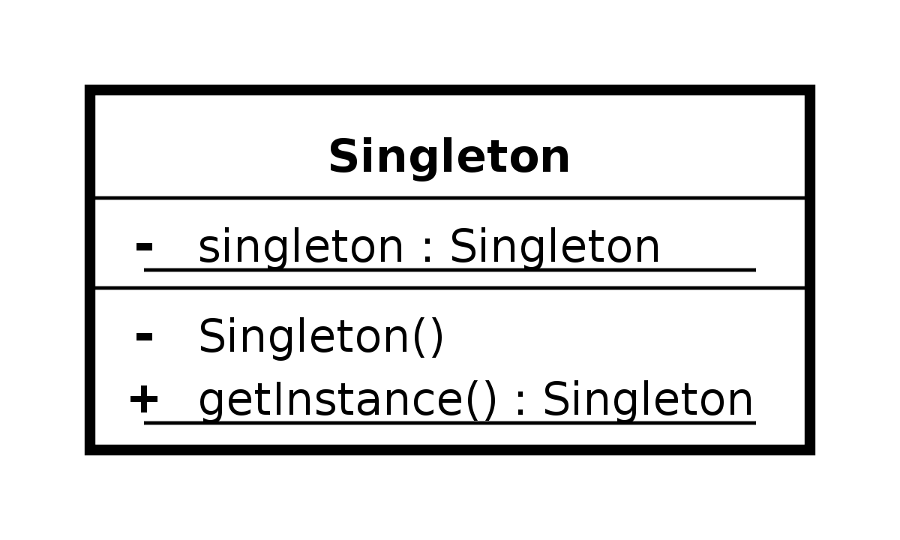
Singleton UML

Slide 6
object Singleton { val sampleVar: Int = 5 fun sampleFun() { print("Sample print") } }
Singleton Example in Kotlin

Slide 7
How can a class (the same construction process) create different representations of a complex object?
How can a class that includes creating a complex object be simplified?
Builder

Slide 8
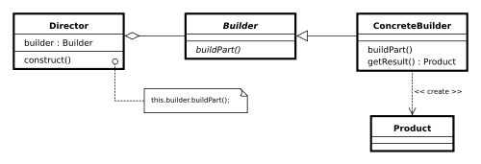
Builder UML

Slide 9
data class AppRec(var ui: String, var logic: String, var db: String) { class Builder { private lateinit var ui: String private lateinit var logic: String private lateinit var db: String fun setUI(ui: String): Builder { this.ui = ui return this }
fun build(): AppRec { return AppRec(ui, logic, db) } } }
Builder Example in Kotlin 1/2

Slide 10
Usage
var app = AppRec .Builder() .setUI("Demo UI") .setLogic("Demo Logic") .setDB("Demo DB").build()
Builder Example in Kotlin 1/2

Slide 11
Factory
How can an object be created so that subclasses can redefine which class to instantiate?
How can a class defer instantiation to subclasses?

Slide 12
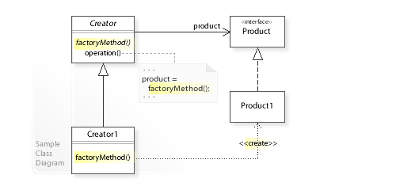
Factory UML

Slide 13
fun appInit(appType: String): AppRec { return when (appType) { "DemoApp" -> demoApp() "AlphaApp" -> alphaApp() "betaApp" -> betaApp() "productionApp" -> productionApp() else -> betaApp() } }
Factory Example in Kotlin

Slide 14
How can an application be independent of how its objects are created?
How can a class be independent of how the objects it requires are created?
How can families of related or dependent objects be created?
Abstract Factory

Slide 15
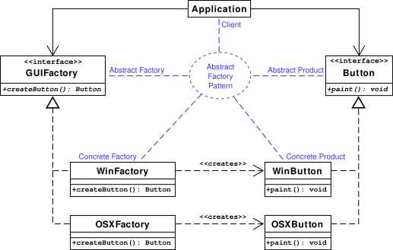
Abstract Factory UML

Slide 16
How can a class be independent from the creation of the objects it depends on?
How can an application, and the objects it uses support different configurations?
How can the behavior of a piece of code be changed without editing it directly?
Dependency Injection

Slide 17
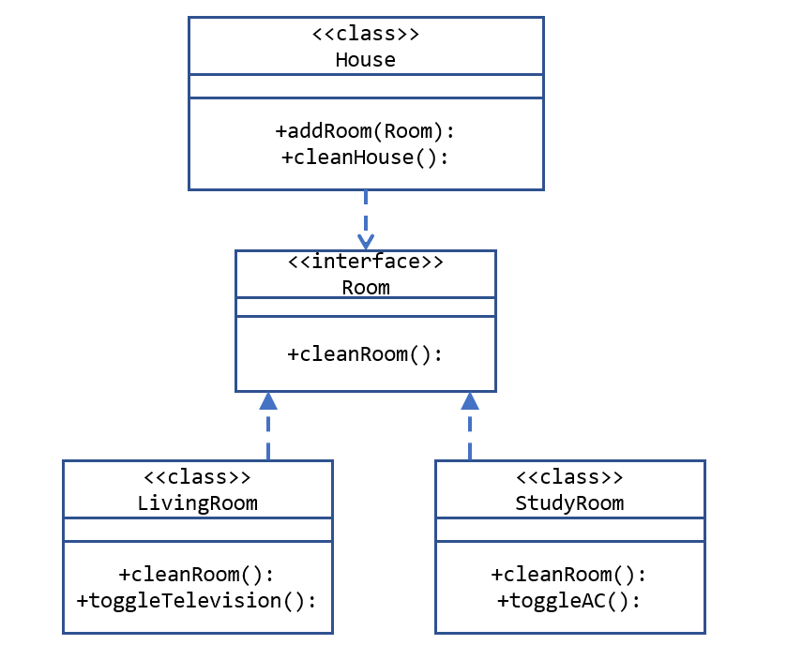
Dependency Injection UML

Slide 18
Extra Creational Design Patterns
Multiton
Prototype
Object Pool
Lazy Initialization
Resource Acquisition Is Initialization

