Slide 1
Introduction to Advanced topics in Biomedical Informatics
Ioannis Kyprakis
ikyprakis@ics.forth.gr

Slide 2

Agenda
Biomedical ML: problems & data types
Machine learning & Deep Learning
ML workflow: from data to evaluation
Splits & validation: K-Fold, GroupKFold, LOSO
Metrics that matter in healthcare
Classical ML baselines (linear models, trees, boosting)
Deep learning families: CNNs, RNN/LSTM, Encoders, Transformers
Medical imaging focus
Common pitfalls Code demos & Q/A

Slide 3
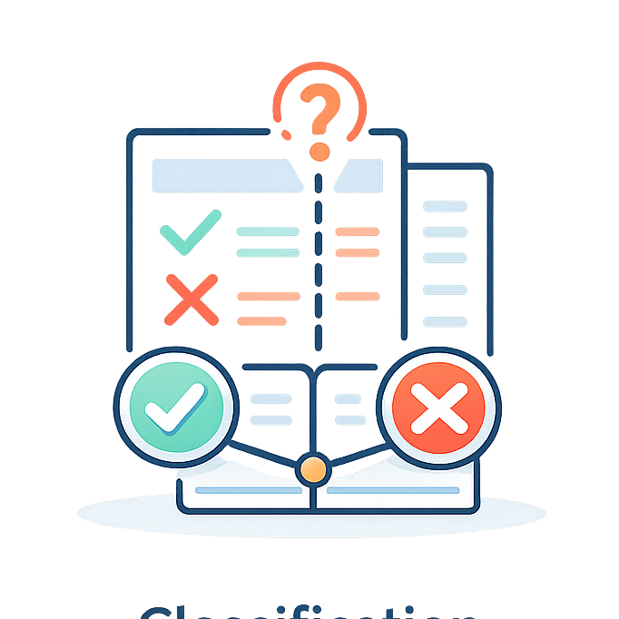
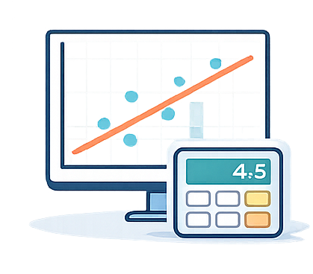
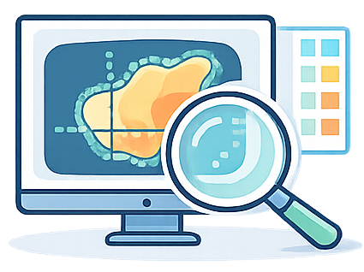
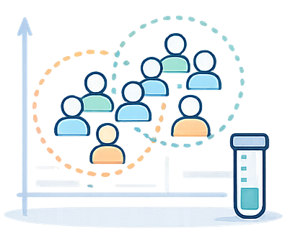
Biomedical ML: problems
Why ML and DL matter in biomedical research
Classification
Regression
Segmentation
Discovery
disease / no disease
arrhythmia, cancer, sepsis
continuous outputs
stress score, length of stay
pixel-wise masks
tumor, organ, lesion
subtypes and phenotypes
cluster patients

Slide 4
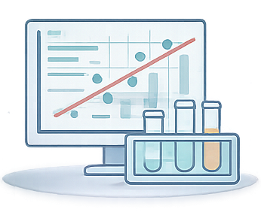
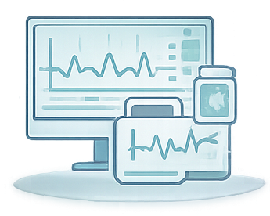
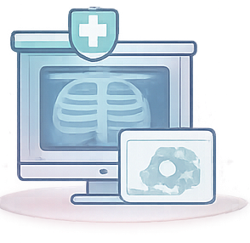

Biomedical ML: data types
Biomedical data come in very different forms
Tabular
Time-series
Imaging
Text
Demographics, lab values, vitals, omics summaries
Typical starting models:
linear models, random forest, gradient boosting
ECG, EEG, PPG, accelerometry, wearables
Typical starting models:
1D-CNN, LSTM/GRU, transformers
X-ray, CT, MRI, histopathology, ultrasound
Typical starting models:
CNN, U-Net, vision transformers
Clinical notes, reports, literature
Typical starting models:
embeddings + transformers

Slide 5
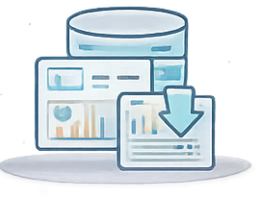

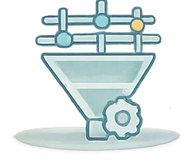
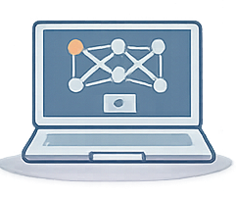

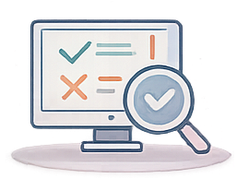
Pipelines
The end-to-end pipeline
Data Collection
Splits
Preprocessing
Training
Validation
Testing

Slide 6
Preprocessing and Feature Extraction
Raw Data
Preprocessing
Feature Extraction
Feature Selection
Examples of biomedical inputs
ECG / EEG / PPG
Medical images
Clinical tabular data
Wearables
Questionnaires
Clean and standardize the data
Noise / artifact removal
Missing value handling
Normalization / scaling
Resampling / alignment / segmentation
Transform data into informative representations
Statistical Features
Time / Frequency features
Texture / shape descriptors
Deep Learned representations
Keep the most relevant information
Remove redundancy
Select discriminative features
Reduce dimensionality
Improve generalization
High-quality preprocessing and feature engineering often matter as much as model choice, because noisy or irrelevant inputs lead to weak and unreliable predictions.

Slide 7
Validation splits
Validation strategy vocabulary
Hold-out split
K-fold CV
Stratified K-fold
Group K-fold
LOSO
Temporal
One train/validation/test division
Fast but noisy
Best for very large datasets
Split into K folds
Train K times
Report mean ± variability
Keeps class balance similar in each fold
Important for imbalanced classes
Keeps all samples from one group together
Use patient_id or hospital_id
Leave one subject out
Strong subject generalization test
Leave future time periods out
Strong temporal generalization test
Will the model work on a new patient?
GroupKFold by patient or LOSO
Will it work at a new hospital?
Leave-one-site-out / GroupKFold by site
Will it work on future data?
Temporal split

Slide 8
Validation examples
K-fold and LOSO in pictures
K-fold cross-validation
LOSO / Leave-One-Subject-Out
run 1
test subj 1
• Use LOSO when the goal is a new patient • Use GroupKFold when groups are subjects or sites
run 2
test subj 2
run 3
test subj 3
run 4
test subj 4
run 5
test subj 5
Orange = validation fold; blue = training folds

Slide 9
Data leakage
When train-test separation breaks down
Definition: Data leakage occurs when information from the test set, future data, labels, or correlated duplicates inadvertently influences training, feature construction, model selection, or preprocessing, leading to overly optimistic estimates of generalization.
Common leakage patterns
Safer practice
Normalize before splitting Randomly split windows from the same patient Tune on the test set “just once”
Split at the patient / site / session level Fit scalers and imputers only on train data Use validation for tuning and keep test untouched
A suspicious sign: near-perfect performance on a tiny biomedical dataset.

Slide 10
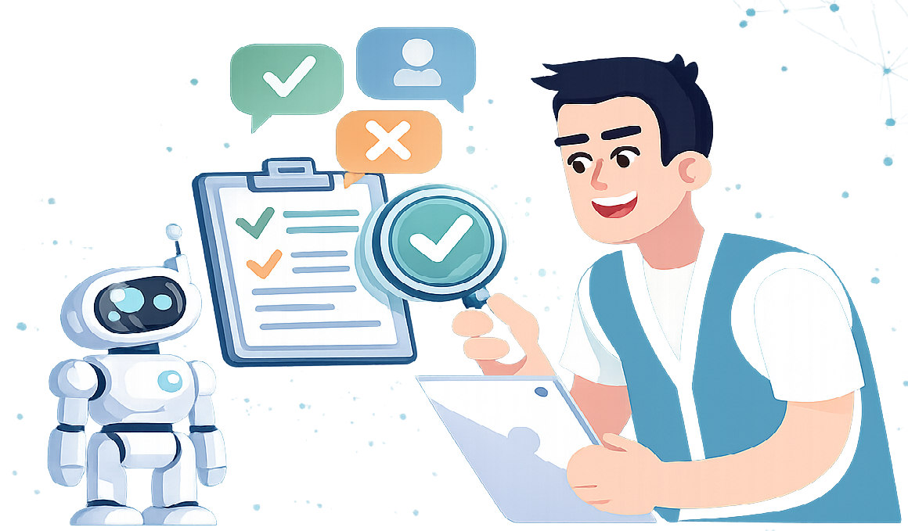

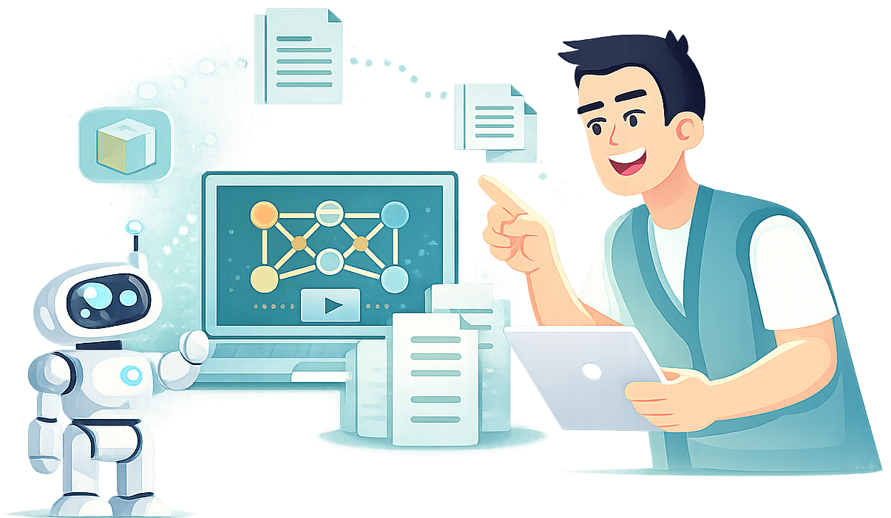
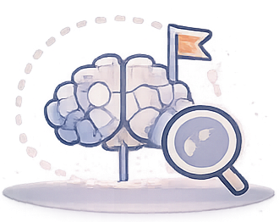
Model learning settings
Four learning settings you will usually see in papers
The label situation determines the formulation
Supervised
Unsupervised
Semi-supervised
Self-supervised
Every training sample has a target
Example: disease yes/no
No labels
Example: patient phenotypes
Few labels + many unlabeled samples
Common in medical imaging
Learn useful representations first
Fine-tune later on labels

Slide 11
Classification metrics
Confusion matrix intuition
predicted
Sensitivity
Specificity
Precision
TP
FN
How many real positives are found?
TP / (TP + FN)
How many real negatives are rejected?
TN / (TN + FP)
Of predicted positives, how many are correct?
TP / (TP + FP)
actual
FP
TN
• ROC-AUC: ranking quality across thresholds • PR-AUC: often more informative when positives are rare • F1: balances precision and recall

Slide 12
Regression Metrics
Mean Absolute Error (MAE)
Root mean squared error (RMSE)
R²
Average absolute error
Easy to explain in original units
Penalizes large mistakes more strongly
Useful when big errors really matter
How much variance is explained
Do not treat it as a clinical metric
Calibration
• Good ranking is not the same as good probability estimates • In medicine, calibration can matter as much as discrimination
If a model predicts 0.8 risk, about 80% of similar cases should truly be positive.

Slide 13
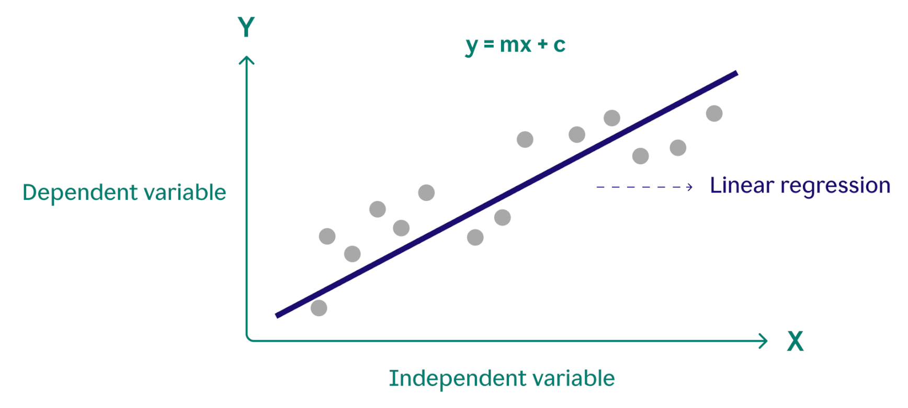
Strong classic ML baselines: Linear Regression
Fast, interpretable, and a strong first baseline
Functionality:
Models a linear relationship between inputs and the outcome.
Use linear regression for continuous targets and logistic regression for binary classification.
Why to use it:
Easy to train and explain.
Works well when effects are approximately linear.
Good benchmark before trying more complex models.
Strengths
Interpretable coefficients
Fast training
Low risk of overfitting on small datasets
Limitations
May underperform on complex nonlinear patterns Sensitive to feature scaling and collinearity

Slide 14
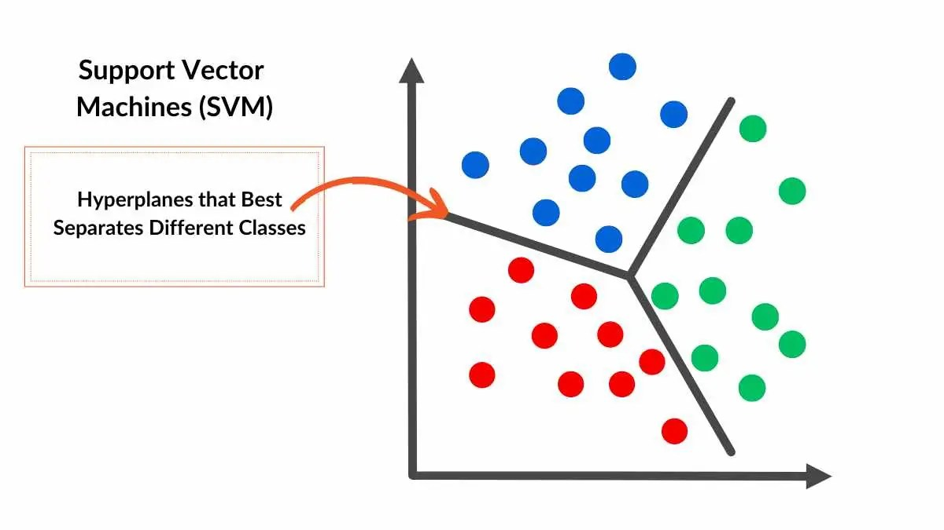
Strong classic ML baselines: Support Vector Machine
Effective for smaller datasets and complex decision boundaries
Functionality:
Finds a boundary that best separates classes.
With kernels, it can model nonlinear patterns.
Why to use it:
Often performs well in high-dimensional settings.
Useful when the dataset is not huge but the boundary is complex.
Strengths
Strong performance on small to medium datasets
Can handle nonlinear decision boundaries
Effective in high-dimensional feature spaces
Limitations
Can be slower on large datasets
Requires tuning of kernel and regularization parameters
Less interpretable than linear models

Slide 15
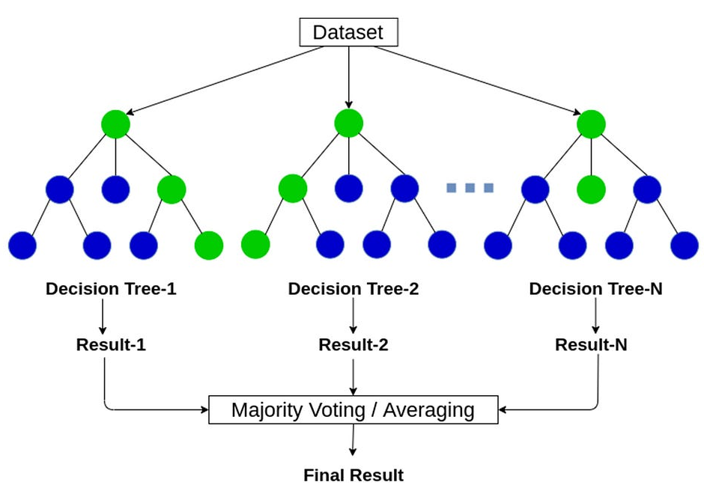
Strong classic ML baselines: Random Forest
Robust nonlinear model with strong default performance
Functionality:
Builds many decision trees and combines their predictions.
Reduces variance by averaging across trees.
Why to use it:
Handles nonlinear effects and feature interactions well.
Usually works reliably with limited preprocessing.
Strengths
Robust to noise and overfitting
Captures nonlinear relationships
Works well with mixed feature types
Little tuning required
Limitations
Less interpretable than simple models
Can be less accurate than boosting methods
Larger models can be slower at inference

Slide 16
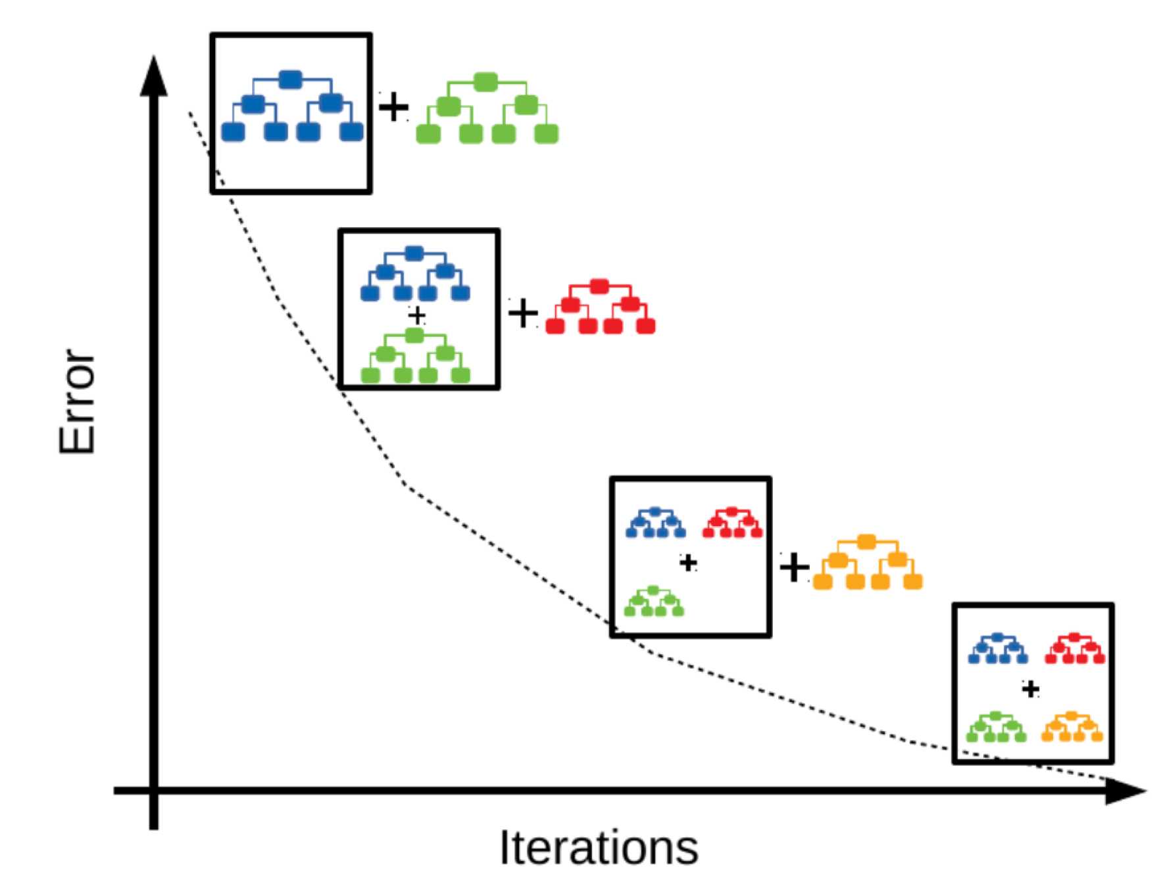
Strong classic ML baselines: Gradient Boosting
Often the strongest model for structured tabular data
Functionality:
Builds trees sequentially, with each new tree correcting previous errors.
Why to use it:
Frequently delivers top predictive performance on tabular datasets.
Captures complex nonlinear patterns and interactions.
Strengths
High accuracy on tabular data
Handles nonlinearities and interactions well
Flexible and widely used in practice
Limitations
More sensitive to hyperparameter tuning
Can overfit if not regularized properly
Training is usually slower than random forest

Slide 17

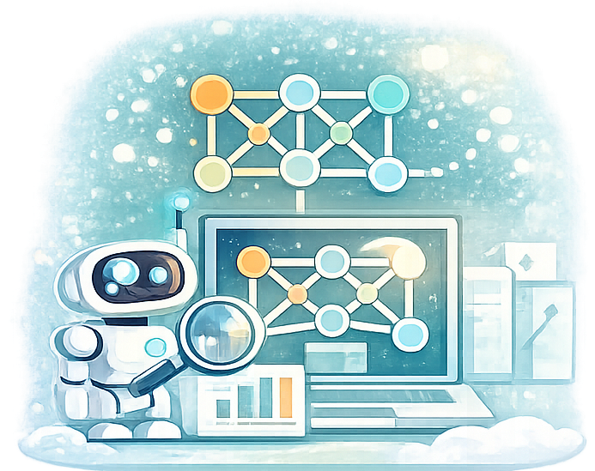

Biomedical ML: metrics for regression
Classic ML
Deep learning
What is a representation?
We design the features
mean, variance, HRV, texture, radiomics
The network learns features and decision boundaries together
A compact embedding that preserves useful structure for the task

Slide 18
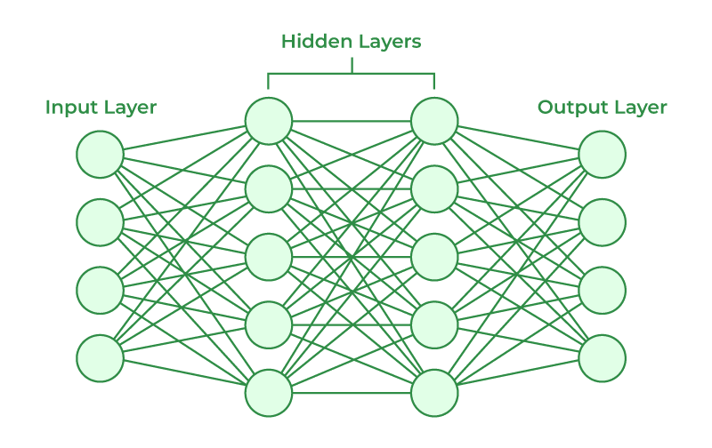
Strong DL baselines: Neural Networks
Flexible function approximators for complex nonlinear relationships
Functionality:
Learns layered representations by combining multiple transformations of the input data.
When to use it:
Useful when relationships between features and outcomes are highly nonlinear and hard to specify manually.
Strengths
Captures complex nonlinear patterns
Highly flexible architecture
Applicable to many data modalities
Limitations
Requires more data (data hungry) and tuning
Less interpretable than simpler models
Can overfit without regularization

Slide 19
Strong DL baselines: Neural Networks
Flexible function approximators for complex nonlinear relationships
Example ECG arrhythmia detection
Input: raw ECG signal or extracted features
Neural network learns complex temporal patterns
Output: normal vs arrhythmia classification

Slide 20
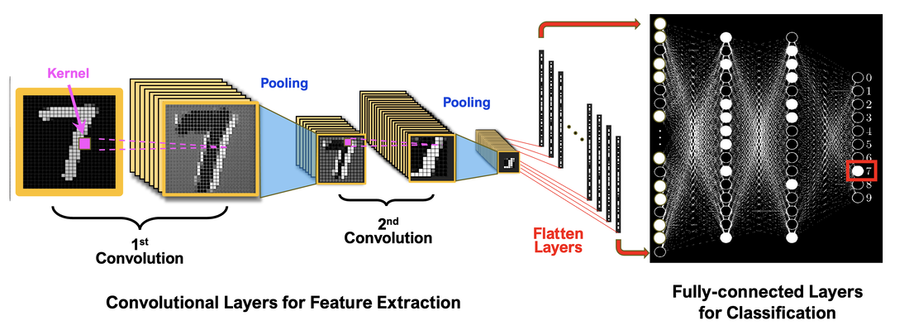
Strong DL baselines: Convolutional Neural Networks
Specialized neural networks for images and spatially structured data
Functionality:
Uses convolutional filters to learn local spatial patterns such as edges, shapes, and textures.
When to use it:
Well suited for imaging tasks, including classification, detection, and segmentation.
Strengths
Excellent for image and signal data
Learns spatial hierarchies automatically
Parameter-efficient compared with fully connected networks
Limitations
Needs substantial data or pretraining
Less suited to non-spatial tabular data
Training can be computationally expensive

Slide 21
Strong DL baselines: Convolutional Neural Networks
Specialized neural networks for images and spatially structured data
Example Chest X-ray classification
Input: chest X-ray image
CNN learns spatial patterns in lung regions
Output: pneumonia vs normal

Slide 22
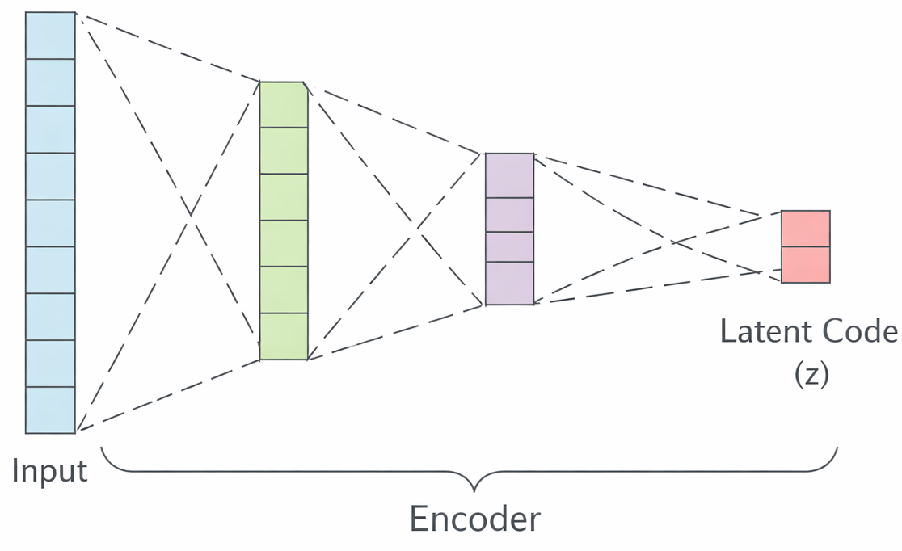
Strong DL baselines: Encoders
Learn compact feature representations from complex input data
Functionality:
Maps high-dimensional inputs into lower-dimensional latent embeddings that preserve useful information.
When to use it:
Helpful for representation learning, dimensionality reduction, multimodal learning, and transfer learning.
Strengths
Produces informative latent features
Useful as a preprocessing or backbone model
Can support downstream prediction tasks
Limitations
Learned representations may be hard to interpret
Quality depends strongly on training objective
May require large datasets for strong embeddings

Slide 23
Strong DL baselines: Encoders
Learn compact feature representations from complex input data
Example ECG representation learning
an encoder compresses a raw ECG signal into a compact latent vector capturing heart rhythm patterns.
The learned embedding can then be used for arrhythmia classification, or anomaly detection.

Slide 24
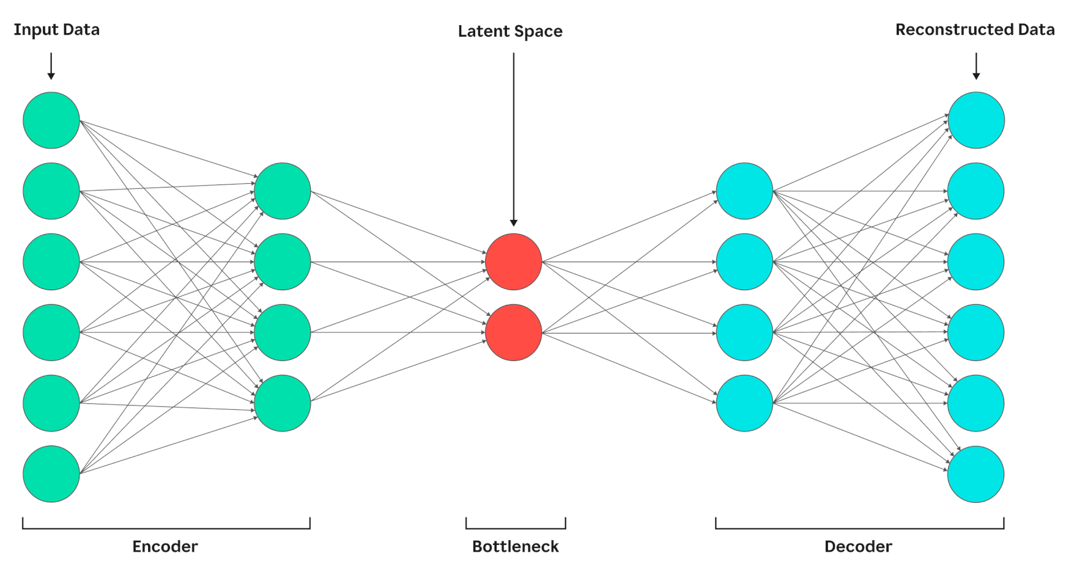
Strong DL baselines: Autoencoders
Unsupervised models for compression and representation learning
Functionality:
Learns to reconstruct the input from a compressed latent representation.
When to use it:
Useful for dimensionality reduction, denoising, anomaly detection, and feature extraction.
Strengths
Does not require labels
Learns compact representations
Can remove noise and redundancy
Limitations
May learn trivial reconstructions without useful features
Latent space can be difficult to interpret
Not always optimal for predictive tasks by itself

Slide 25
Strong DL baselines: Autoencoders
Unsupervised models for compression and representation learning
Example:
Train an autoencoder on normal ECG signals
The encoder compresses the signal into a latent representation
The decoder reconstructs the clean ECG
Useful for noise removal and abnormal heartbeat detection

Slide 26
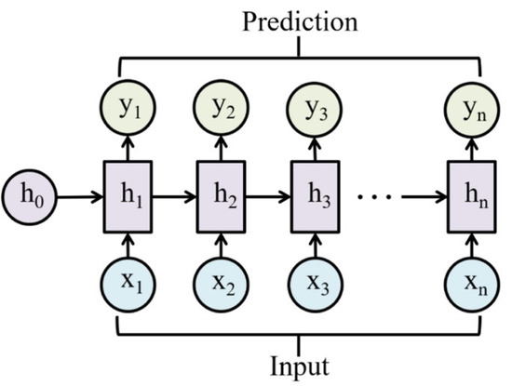
Strong DL baselines: Recurrent Neural Networks
Sequence models for temporal and ordered data
Functionality:
Processes inputs step by step while maintaining a hidden state that summarizes previous information.
When to use it:
Designed for sequential data such as time series, text, longitudinal records, or physiological signals.
Strengths
Handles ordered and variable-length sequences
Captures temporal dependencies
Natural fit for sequence prediction tasks
Limitations
Can struggle with long-range dependencies
Training may be unstable or slow
Often outperformed by newer architectures such as transformers

Slide 27
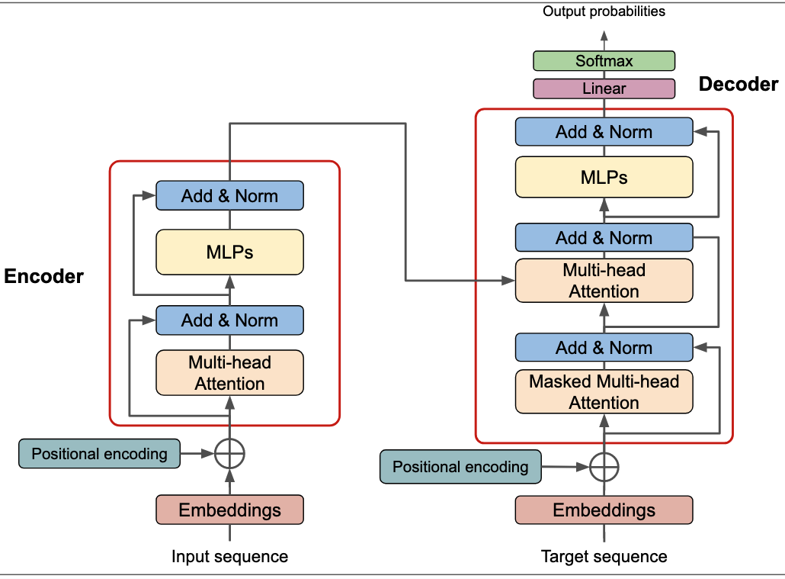
Strong DL baselines: Transformers
Sequence models based on attention for long-range dependencies
Functionality:
Processes the full sequence in parallel using self-attention
Learns which parts of the input are most important for each prediction
Builds contextual representations without relying on step-by-step recurrence
When to use it:
Ideal for sequential or structured data where long-range relationships matter
Useful for text, signals, multivariate time series, and increasingly biomedical data
Preferred when enough data and computational resources are available

Slide 28
Strong DL baselines: Transformers
Sequence models based on attention for long-range dependencies
Strengths
Captures both short- and long-range dependencies effectively
Parallel computation makes training faster than RNNs/LSTMs
Scales well to large datasets and complex tasks
Flexible backbone for classification, forecasting, representation learning, and multimodal fusion
Limitations
Requires more data than simpler models to generalize well
Computationally expensive, especially for long sequences
Can be harder to interpret and tune
May be excessive for small datasets or simple prediction problems

Slide 29
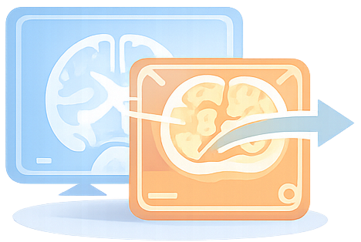
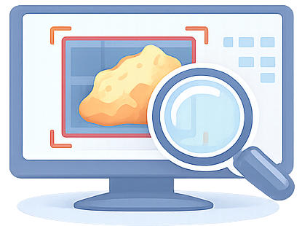
Medical imaging tasks and model choices
Classification
Detection
Segmentation
Registration
one label for the whole image
box around an object or lesion
mask every relevant pixel
align one image to another

Slide 30
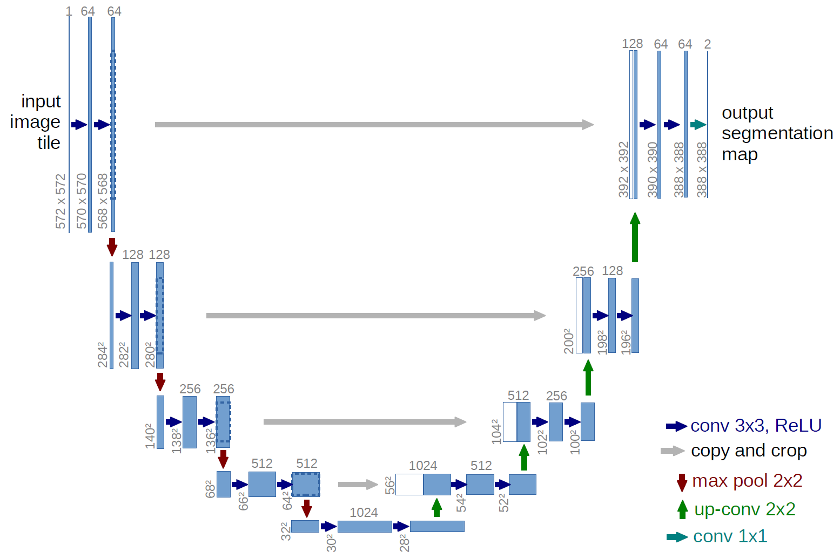
Strong Medical Imaging baseline: U-Net
Encoder–decoder architecture for image segmentation
Functionality
Extracts features through a contracting path (encoder) and reconstructs spatial detail through an expanding path (decoder)
Produces a pixel-wise prediction map, assigning a class label to each pixel
When to use it
Designed for segmentation tasks, especially in medical imaging
Useful when precise localization is needed, such as tumors, organs, lesions, or anatomical regions
Appropriate for CT, MRI, ultrasound, microscopy, retinal.

Slide 31
Strong Medical Imaging baseline: U-Net
Encoder–decoder architecture for image segmentation
Strengths
Excellent for pixel-level prediction and boundary localization
Strong baseline for many medical image segmentation problems
Limitations
Primarily designed for segmentation, not general classification tasks
Performance depends on annotation quality and class balance
High-resolution 2D or 3D variants can be computationally expensive

Slide 32
Failures you must be aware
Data & cohort
Labels & ground of truth
Splits & methodology
Generalization & deployment
Small datasets / low effective N
Overfitting, high variance, unstable results
Class Imbalance
Misleading accuracy
Selection bias / cohort shift
training population ≠ target population
Missingness & artefacts
sensor dropouts, motion noise, inconsistent acquisition
Label noise / inter-rater variability
experts disagree, weak supervision
Ambiguous endpoints / proxy labels
label doesn’t match what you actually care about clinically
Data leakage (very common)
patient overlap, window-level splits, preprocessing before split
Train/validation mismatch
tuning on test set, repeated peeking, non-nested CV
Confounding
age/site/device drives prediction instead of pathology
Domain shift (scanner/hospital/device)
performance drops out-of-distribution
Spurious cues
site marks, padding, compression, text overlays, artifacts
Poor calibration / overconfidence
probabilities don’t reflect true risk → unsafe decisions
Fairness gaps
performance differs across sex/age/skin tone/site

Slide 33
Trustworthiness
Interpretability
Reproducibility
Generalization
Reliability
Helps you understand what the model “looks at”
Tabular: feature importance / SHAP
Images: Grad-CAM heatmaps
Can be use to catch mistakes
Important: explanations ≠ proof of cause (“why”) — only what the model used
Same inputs → same outputs
Deterministic setup
Split first, preprocess later
Do not tune on the test set
Report average performance across splits
Save basics: data version, code version, hyperparameters
Helps you understand if it will work in new data
Test on new patients / new hospital / new device
Use GroupKFold / LOSO when you have repeated measures
Expect performance to drop outside the training settings
Handles noise, missing values, artefacts
Performance is stable across folds, not random
Flag uncertainty when the model is unsure
Clinical usefulness
Define the use case & workflow (who uses it, when, what action follows)
Compare to a baseline standard (clinician / simple rule / existing score)
Decision threshold matters (trade-offs: false alarms vs missed cases)
Actionability: prediction should lead to a clear next step Time-to-decision & burden (faster? fewer tests? lower workload?)
Safety net: use uncertainty score
Prospective / real-world evaluation (retrospective accuracy isn’t the end goal)

Slide 34
Vocabulary
Accuracy: fraction of all predictions that are correct
Baseline (model): a simple/standard model used as a reference
Bias (in data): systematic differences between the training data and the real target population that can distort performance.
Classification: predicting a category (e.g., disease vs no disease).
Clinical usefulness: whether the model improves decisions/workflow safely
Confounding: when the model learns shortcuts correlated with the label (e.g., age) rather than the underlying physiology.
Confusion matrix: table of TP/FN/FP/TN that explains classification outcomes.
Data leakage: test/future/label information accidentally influences training
Deep learning (DL): neural networks that learn representations and prediction.
Domain shift: performance drop when moving to a new scanner/hospital/device/protocol
Embedding / representation: a compact vector that captures useful structure in the data for prediction or clustering.
Feature (X): an input variable used by a model (e.g., HRV metrics, lab values, pixels).
F1 score: harmonic mean of precision and recall; useful when classes are imbalanced.
False negative (FN): actual positive predicted as negative (missed case).
False positive (FP): actual negative predicted as positive (false alarm).
Generalization: ability to work on new data (new patients/sites/devices/time periods).

Slide 35
Vocabulary
Hold-out split: one train/validation/test split.
Imbalanced classes: when one class is rare (common in healthcare); requires careful metrics and splitting.
Interpretability: tools to understand what the model relied on (feature importance/SHAP; Grad-CAM/
K-fold cross-validation (K-fold CV): split data into K folds; train K times; report mean and variability across folds.
Label / target (y): the outcome to predict (diagnosis, score, mask).
Label noise: incorrect/inconsistent labels.
Latent space / latent representation: the compressed internal representation learned by an encoder/autoencoder.
Linear regression: classic model for continuous targets assuming a linear relationship.
Logistic regression: classic model for binary classification producing probabilities.
LOSO (Leave-One-Subject-Out): validation where each subject is held out once; strong test of new-patient generalization.
Overfitting: model fits noise in training data; performs poorly on unseen data.
Metric: a quantitative measure of performance (choose based on clinical goal).
Precision: among predicted positives, how many are truly positive?
Preprocessing: transformations before training (scaling, filtering, imputation); must be fit on train only to avoid leakage.
Recall / sensitivity: among actual positives, how many are detected?
Segmentation (imaging): pixel-wise classification producing a mask (tumor/organ/lesion).
Specificity: among actual negatives, how many are correctly rejected?

Slide 36
Useful Links
Beginner courses
Machine Learning (Andrew Ng)
Machine Learning Specialization (Coursera)
Stanford Machine Learning (CS229)
Stanford CS229 Course Page
AI for Everyone
AI for Everyone (Andrew Ng)
Deep learning courses
Stanford Deep Learning
Stanford CS230 Deep Learning Course
Deep Learning Specialization
Deep Learning Specialization (Coursera)
Hands-on practice
Kaggle (datasets, competitions, mini-courses)
TensorFlow Learning Hub
Biomedical Machine Learning resources
Machine Learning for Healthcare Course
Books
The Hundred-Page Machine Learning Book – Andriy Burkov
Machine Learning for Absolute Beginners – Oliver Theobald

Slide 37


