Slide 1
Introduction Physiological Signals
PhD(c) Ioannis Kyprakis
ikyprakis@ics.forth.gr

Slide 2

Agenda
Why physiological signals matter
Different types of physiological signals
Pipelines
Preprocessing, segmentation and feature extraction.
Problems
Imputation Techniques
Synthetic Data Generation
ML-DL pipelines
Key Messages

Slide 3
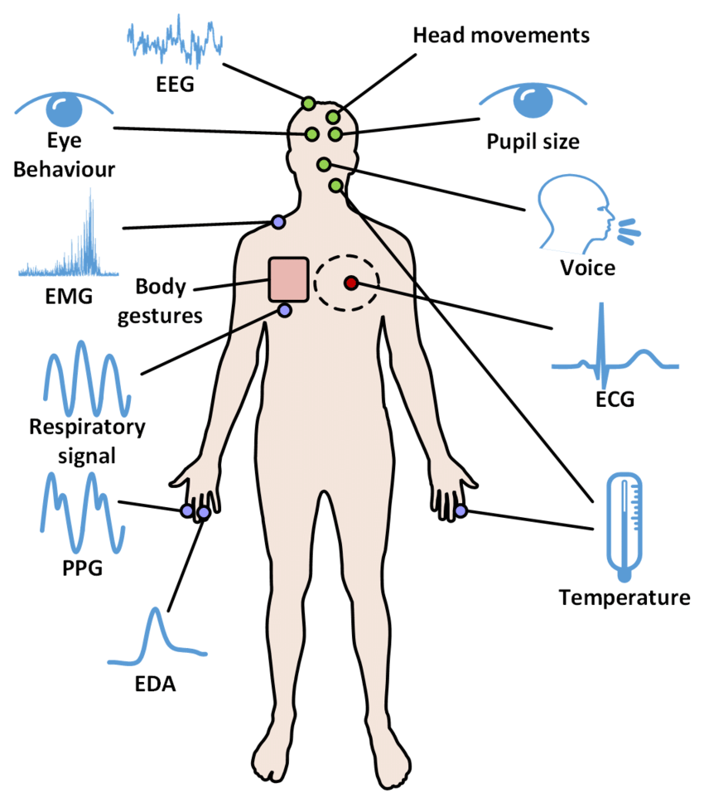
Physiological Signals
Why Physiological Signals matter?
They are objective and time-resolved: we can observe what changes, when it changes, and how fast it changes.
They capture mechanisms that questionnaires or static clinical snapshots often miss, such as autonomic reactivity, recovery, coupling, and instability.
They can be recorded continuously, repeatedly, and increasingly non-invasively with bedside monitors, wearables, and smartphones.
In biomedical informatics, they support monitoring, early warning, phenotyping, digital biomarkers, and closed-loop decision support.

Slide 4
Autonomic Regulation
The first lens for reading biosignals
Sympathetic branch (SNS)
Parasympathetic branch (PNS / vagal)
Importance
Many “stress”, “fatigue”, or “engagement” models are really modelling patterns of autonomic regulation and dysregulation.
Interpretation should be physiological first, algorithmic second: the same model output means little if the signal-to-physiology link is unclear.
Strictly speaking, SNS and PNS are branches of the autonomic nervous system, not literal “parts of the brain”; brain networks regulate them.
Mobilisation, vigilance, effort, and stress readiness
Typical effects: faster heart rate, higher contractility, vasoconstriction, sweating, pupil dilation
In signals, stronger sympathetic drive often appears as reduced HRV, increased EDA, and altered peripheral pulse patterns
Recovery, energy conservation, digestion, and flexible regulation
Typical effects: slower heart rate, vagal braking, stronger respiratory coupling, greater beat-to-beat variability
In signals, stronger vagal influence is often reflected by higher RMSSD / HF-HRV and more adaptive recovery after challenge

Slide 5
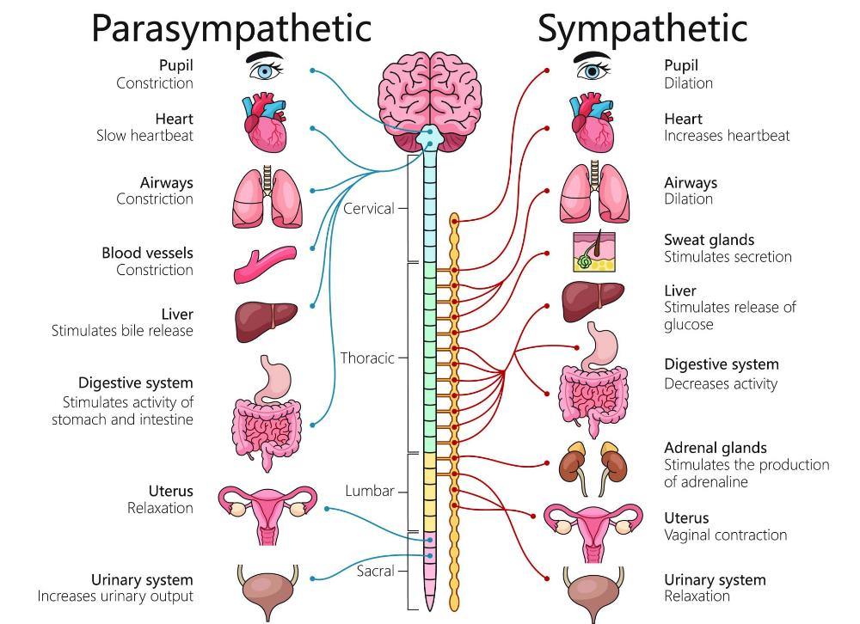
Autonomic Regulation
The first lens for reading biosignals
https://www.simplypsychology.org/wp-content/uploads/Sympathetic-Parasympathetic-Nervous-System.jpg

Slide 6
Strengths and weaknesses
Strengths
Objective measurements rather than retrospective self-report only
High temporal resolution, especially for ECG, EEG, EMG, EDA, and PPG
Rich multimodality: electrical, haemodynamic, mechanical, and neural information
Potential for remote monitoring and digital biomarker development
Useful for detecting both reactivity and recovery
Weaknesses
Motion artefacts, electrode issues, baseline drift, and sensor dropout
High inter-subject variability and context dependence
Labels are often weak, delayed, subjective, or sparsely sampled
Missing data are not random: gaps often come from physiology, workflow, or device failure
Interpretation is easy to overclaim without physiological grounding
Physiological signals are powerful exactly because they are close to real physiology, but that is also why they are messy in real deployments.

Slide 7
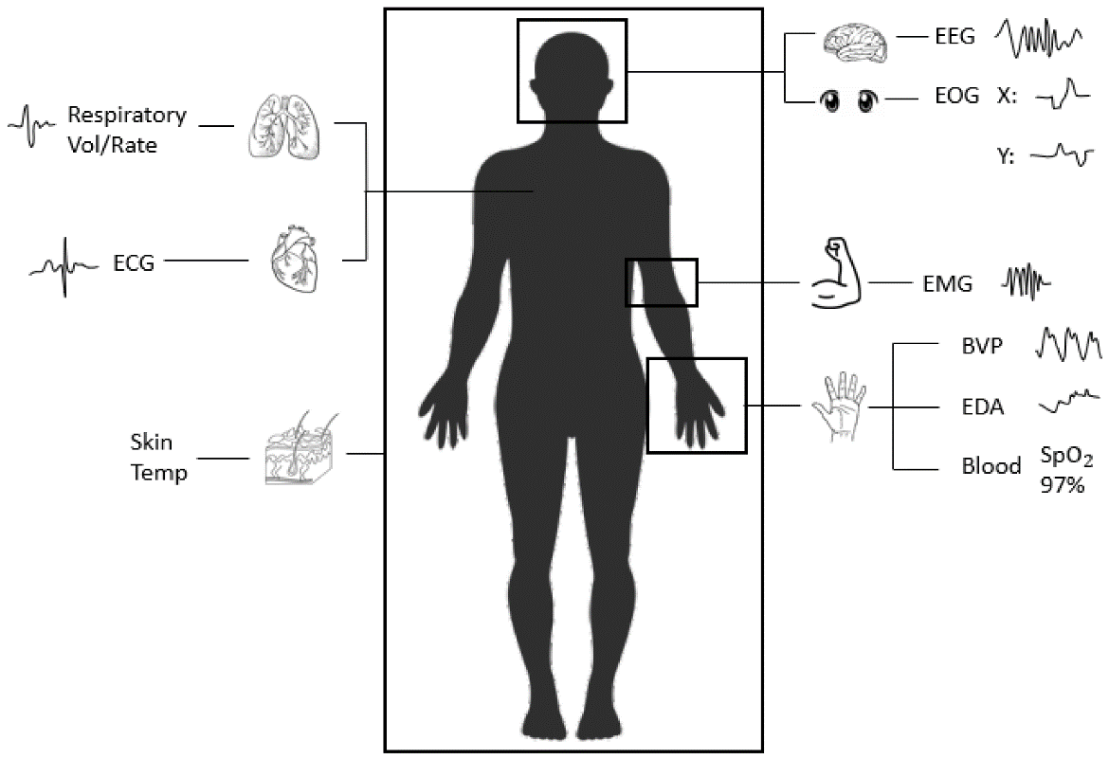
Major signal families
Electrical
ECG, EEG, EMG, EOG
Mechanical / respiratory
respiration, seismocardiography
Optical / vascular
PPG, NIRS
Electrodermal
EDA / GSR
Imaging
fMRI, ultrasound, CT, MRI
https://encyclopedia.pub/entry/40293

Slide 8
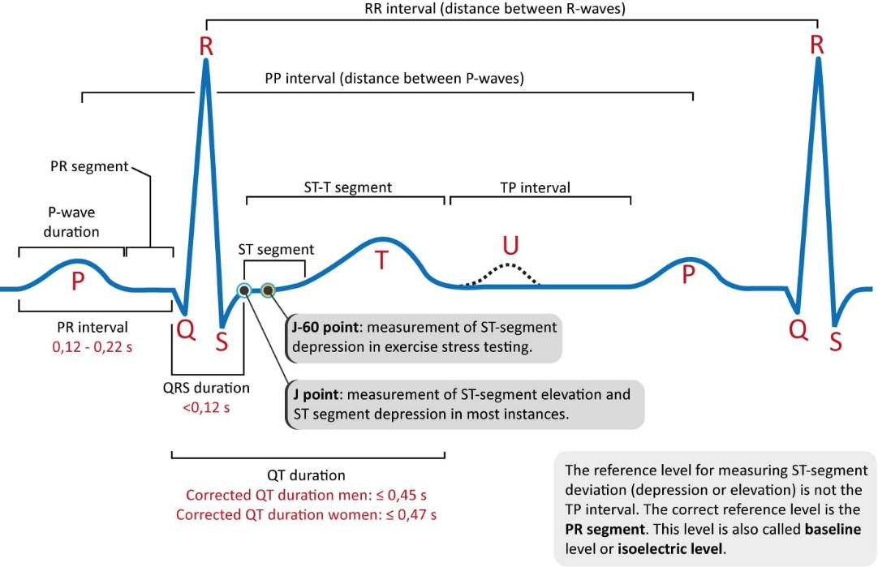
Electrocardiogram (ECG)
What it measures
Electrical activity of the heart (ion currents)
Depolarization & repolarization of cardiac muscle
Standard clinical: 12-lead recording system
Waveform Components
P wave — Atrial depolarization (sinoatrial node)
QRS complex — Ventricular depolarization (1–2 mV peak)
T wave — Ventricular repolarization
PR interval — AV node conduction delay
ST segment — Ischemia and infarction indicator
https://ecgwaves.com/topic/ecg-normal-p-wave-qrs-complex-st-segment-t-wave-j-point/

Slide 9
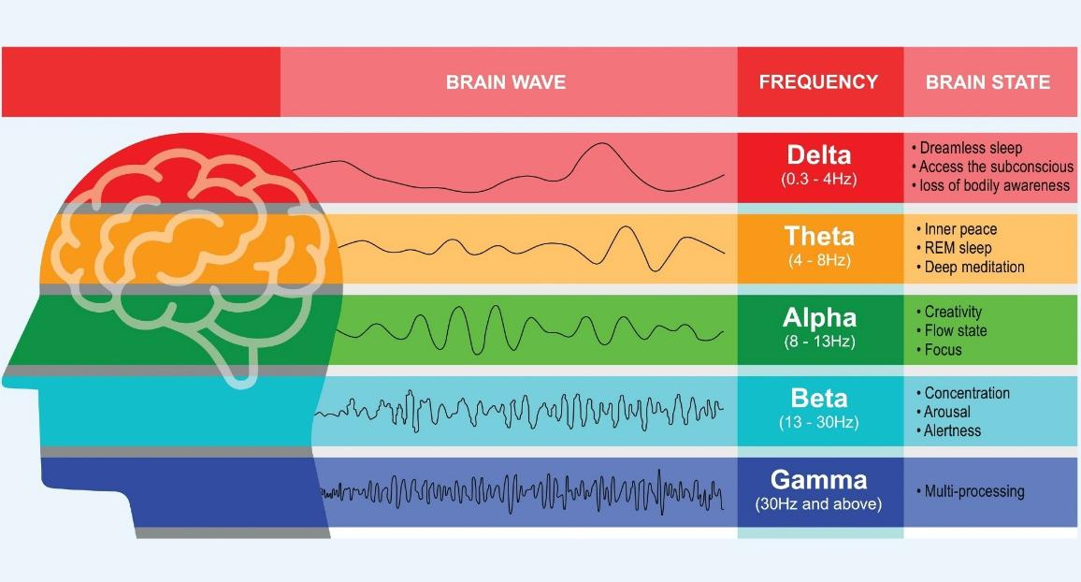
Electroencephalogram (EEG)
What it measures
Electrical activity of cortical neuron populations
10–20 international electrode placement system (32–256 ch)
Applications: epilepsy, sleep staging, BCI, anesthesia depth
Band | Freq (Hz) | State / Relevance
δ Delta | 0.5–4 | Deep sleep, anesthesia, brain injury
θ Theta | 4–8 | Drowsiness, meditation, memory encoding
α Alpha | 8–13 | Relaxed wakefulness, eyes closed
β Beta | 13–30 | Active cognition, alertness, focus
γ Gamma | 30–100 | High-level processing, perception, binding
https://www.news-medical.net/health/Electroencephalogram-%28EEG%29-Systems-Explained.aspx

Slide 10
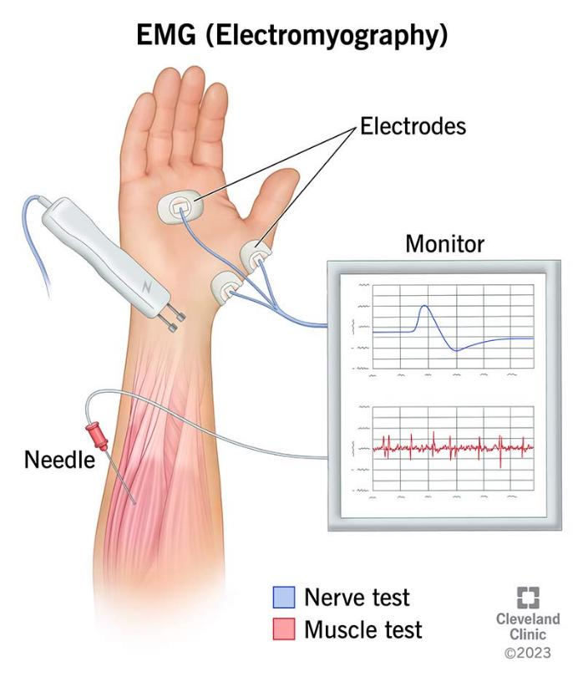
Electromyography (EMG)
What it measures
Electrical activity produced by skeletal muscles
Reflects motor unit action potentials (MUAPs)
Surface (sEMG) vs. intramuscular (iEMG/needle)
Applications
Prosthetic limb control & rehabilitation
Neuromuscular disorder diagnosis (ALS, myopathy)
Muscle fatigue assessment in sports science
Gesture recognition for HCI and robotics
Gait analysis and biomechanics
https://my.clevelandclinic.org/health/diagnostics/4825-emg-electromyography

Slide 11
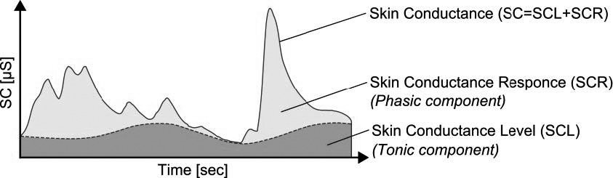
Electrodermal Activity (EDA/GSR)
What it measures
Skin conductance via eccrine sweat gland activity
Tonic (SCL: slow baseline) + phasic (SCR: fast response)
Applications
Pain and distress assessment
Stress and autonomic arousal monitoring
Sleep, vigilance, and arousal analysis
https://www.researchgate.net/figure/The-tonic-and-the-phasic-component-of-skin-conductance-Reprinted-from-An-investigation_fig3_352547906

Slide 12
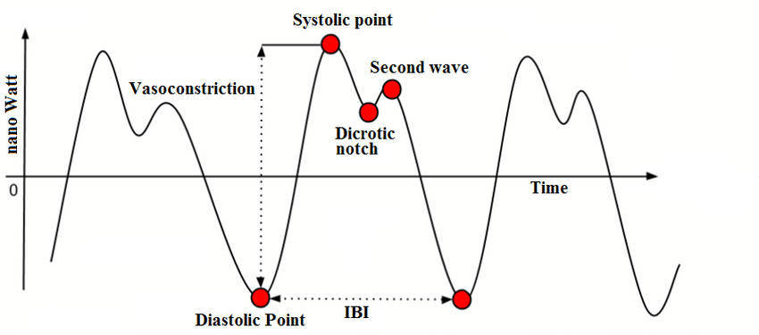
Photoplethysmography (PPG)
What it measures
Optical measurement of blood volume changes in tissue
LED (IR/red) + photodetector at skin surface
Derives HR, SpO₂, HRV, respiratory rate, PAT
Applications
Arrhythmia and atrial fibrillation detection
Cardiovascular monitoring and risk assessment
Blood pressure and vascular health estimation
Sleep and respiratory disorder screening
https://www.researchgate.net/figure/A-typical-PPG-signal-and-its-components_fig2_333348488

Slide 13
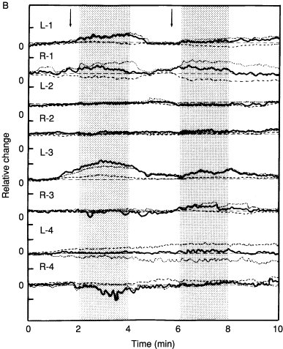
Functional Near-Infrared Spectroscopy (fNIRS)
What it measures
Measures changes in cerebral oxygenation and haemodynamics
Estimates variations in oxyhaemoglobin (HbO) and deoxyhaemoglobin (HbR)
Uses near-infrared light to probe cortical brain activity non-invasively
Reflects neurovascular coupling associated with neural activation
Primarily captures activity from superficial cortical regions
Applications
Cognitive neuroscience and task-evoked brain activity analysis
Monitoring of prefrontal activation during decision-making and workload
https://www.sciencedirect.com/science/chapter/bookseries/pii/S0074774205660084

Slide 14






Pipeline
The end-to-end pipeline
Physiology
ADC
Preprocessing
Feature Extraction
ML-DL
Real-World
Deployment

Slide 15
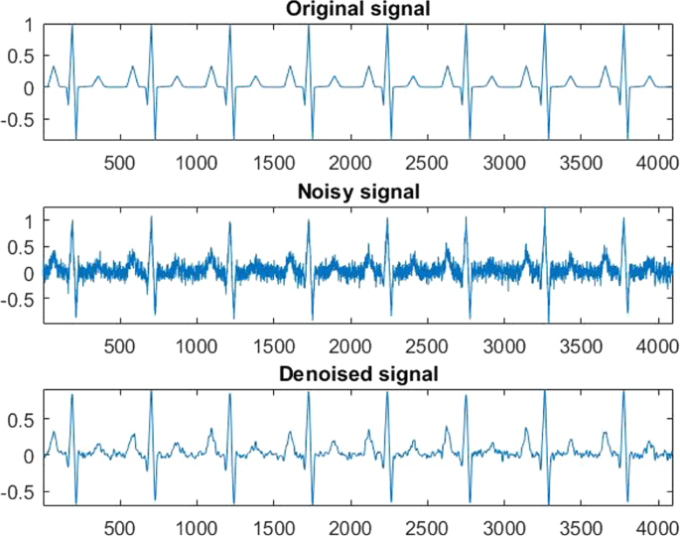
Noise & Artifact Sources
Power Line Interference
50/60 Hz from electrical environment
Motion Artifacts
Electrode–skin impedance change during movement
Baseline Wander
Low-frequency drift from respiration
Ocular Artifacts (in EEG)
Eye blinks & movements
EMG Crosstalk (in ECG)
Muscle activity near ECG electrodes
https://link.springer.com/article/10.1007/s11760-024-03453-1

Slide 16
Preprocessing
Filtering
High-Pass Filter (HPF). Removes DC offset and baseline wander
Low-Pass Filter (LPF). Suppresses high-frequency noise & anti-alias
Band-Pass Filter (BPF). Retain signal band, reject out-of-band noise
Notch / Band-Stop Filter. Eliminate power-line interference selectively
Independent Component Analysis (ICA)
Blind source separation: finds statistically independent signals
Removes eye blinks, cardiac, and muscle artifacts from EEG
Segmentation & Epoching
Divide continuous data into fixed-length or event-locked segments
Windowing splits the signal into analysis frames, often overlapping
Common windows: rectangular, Hamming, Hann
Important for FFT/STFT
Resampling & Decimation
Downsample after low-pass filtering to reduce data volume.
Normalization & Standardization
Z-score: subtract mean, divide by std (within- or across-trial)
Min-max scaling: map to [0,1] for neural network inputs
Baseline Correction / Detrending
Removes slow drift unrelated to the physiological phenomenon
Important in EEG, EDA, PPG, and fNIRS

Slide 17
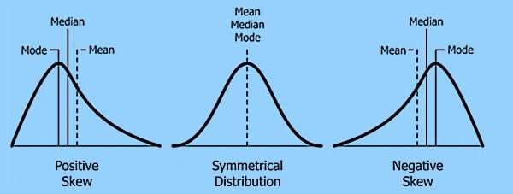
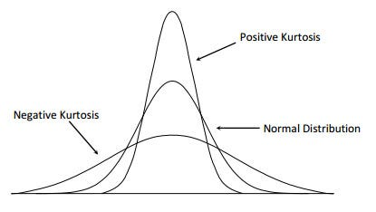
Statistical Feature Extraction
Basic numerical properties of the signal in the time domain
Features
Mean / Median
Variance / Standard Deviation
Root Mean Square (RMS)
Zero Crossing Rate
Skewness
Kurtosis
Slope Sign Changes
Applications
General signal characterization
Noise and variability assessment
EMG activity estimation
Simple feature-based classification

Slide 18
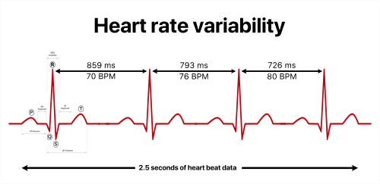
ECG & HRV Feature Extraction
Beat-to-beat timing and cardiac rhythm variability
Features
R-R interval (IBI)
SDNN
RMSSD
pNN50
QRS Delineation
Waveform Length
R-peak detection
PR / QT interval estimation
Applications
Heart rate variability analysis
Stress and autonomic function assessment
Arrhythmia screening
Cardiovascular monitoring

Slide 19
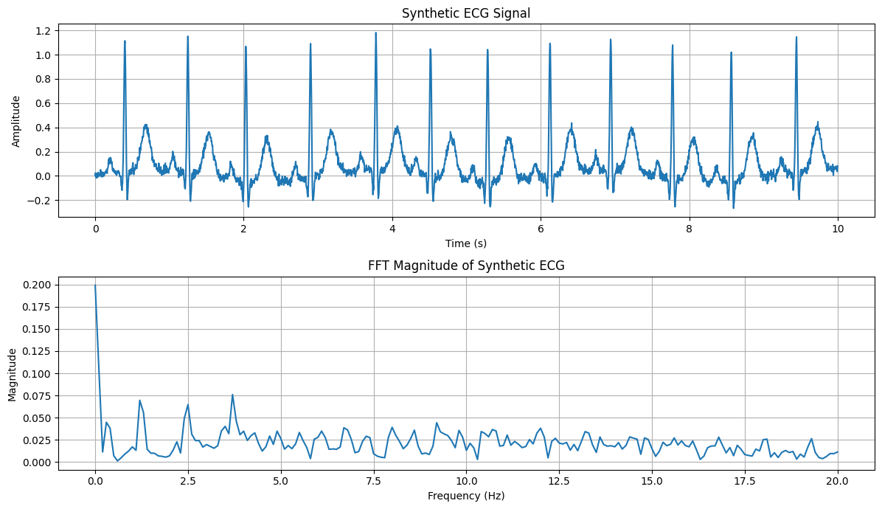
Frequency domain Feature Extraction
How signal energy is distributed across frequencies
Features
Fast Fourier Transform (FFT)
Power Spectral Density (PSD)
Peak frequency
Mean / Median frequency
Band power
Spectral entropy
Frequency ratios
Harmonic components
Applications
EEG rhythm analysis
EMG fatigue assessment
HRV spectral analysis
Oscillatory pattern detection

Slide 20
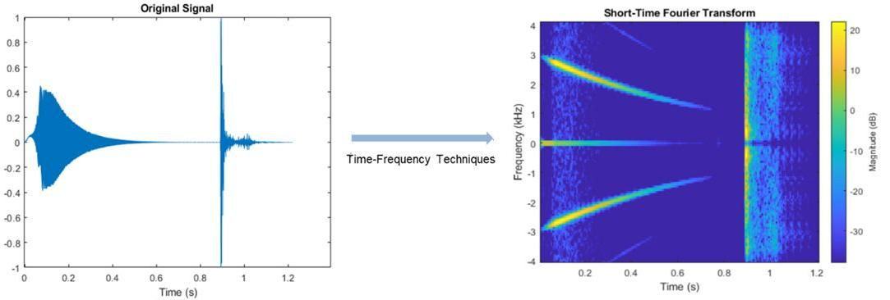
Time-Frequency domain Feature Extraction
How frequency content changes over time
Features
Short-Time Fourier Transform (STFT)
Spectrogram-derived energy
Wavelet Transform
Wavelet coefficients
Sub-band energy
Scalogram features
Instantaneous frequency
Time-localized transient descriptors
Applications
Non-stationary signal analysis
Seizure detection
Arrhythmia analysis
Event detection in wearable signals

Slide 21
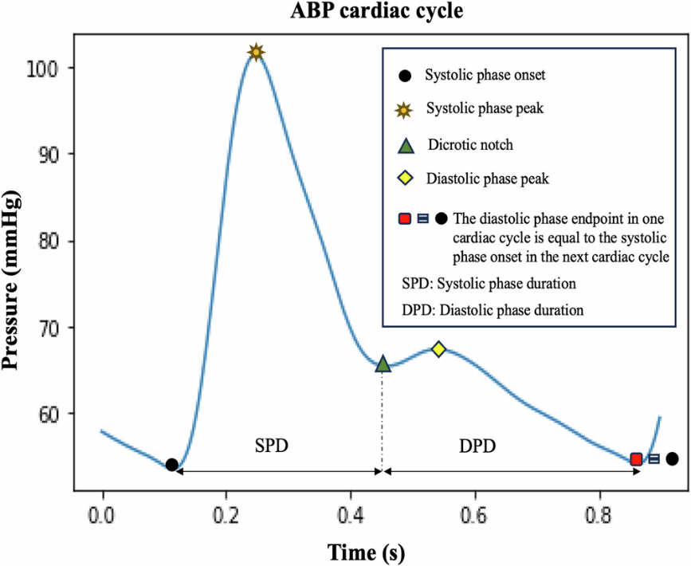
Morphological Feature Extraction
Shape-based properties of the waveform
Features
Peak amplitude
Peak width / duration
Rise time
Decay time
Area under the curve
Pulse width
Systolic / diastolic landmarks
Waveform shape descriptors
Applications
ECG waveform analysis
PPG pulse analysis
Event and peak characterization
Vascular and haemodynamic assessment
https://www.nature.com/articles/s44325-025-00096-0

Slide 22
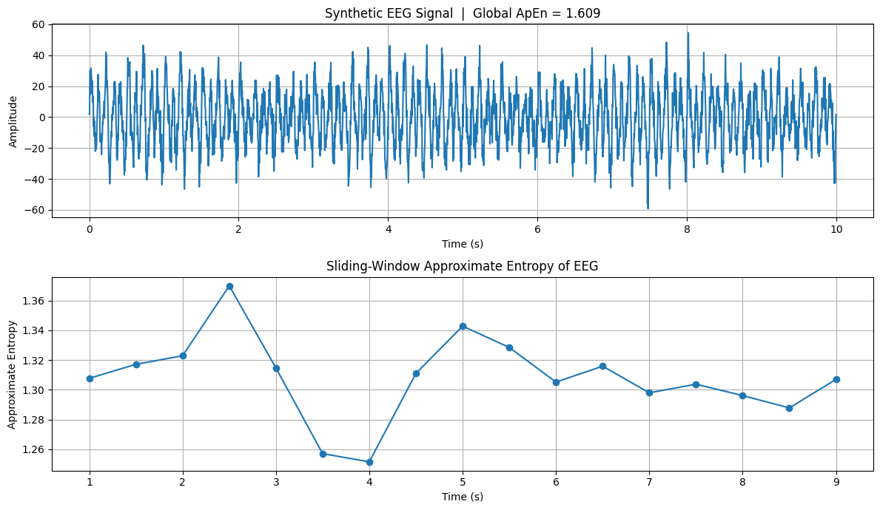
Nonlinear Feature Extraction
Complex and irregular dynamics not captured by simple linear statistics
Features
Sample entropy
Approximate entropy
Fractal dimension
Hjorth parameters
Lyapunov exponent
Detrended fluctuation analysis
Complexity indices
Applications
HRV complexity analysis
Epileptic seizure detection
Stress and autonomic regulation assessment
Nonlinear physiological dynamics modelling

Slide 23
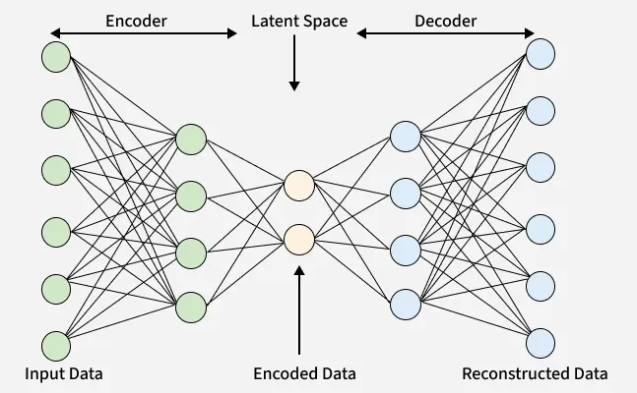
Learned / Representation Feature Extraction
Data-driven feature embeddings learned automatically from raw or transformed signals
Features
Autoencoder latent vectors
CNN-derived embeddings
Transformer-based representations
Contrastive learned embeddings
Multimodal fused representations
Pretrained feature backbones
Applications
End-to-end classification
Representation learning from raw biosignals
Transfer learning across datasets
https://www.geeksforgeeks.org/numpy/types-of-autoencoders/

Slide 24
Visual Representations of Biomedical Signals
Transforming 1D signals into 2D images for pattern discovery and deep learning
Techniques
Spectrograms
Scalograms
Recurrence Plots
Gramian Angular Fields (GAF)
Markov Transition Fields (MTF)
Poincaré Plots
Applications
Arrhythmia and seizure detection
Stress and cognitive-state estimation
Wearable signal classification
Vision-based biomedical AI
Strengths
Capture patterns not easily described by handcrafted features
Reveal time–frequency and nonlinear dynamics
Make signal structure more interpretable visually
Enable the use of computer vision and deep learning models
Support multimodal fusion across heterogeneous biosignals

Slide 25
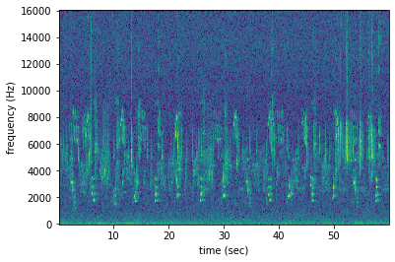
Spectrograms
A spectrogram is a 2D time–frequency representation showing how the spectral energy of a signal evolves over time.
How they are generated
Divide the signal into short overlapping windows
Apply a window function such as Hamming or Hann
Compute the FFT for each window
Stack the spectra over time and display magnitude or power as an image
What they capture
Temporal evolution of frequency components
Rhythmic activity and transient bursts
Frequency shifts, oscillatory patterns, and event-related changes
Why they are useful in biomedicine
Many physiological signals are non-stationary, so their frequency content changes over time rather than remaining constant.

Slide 26
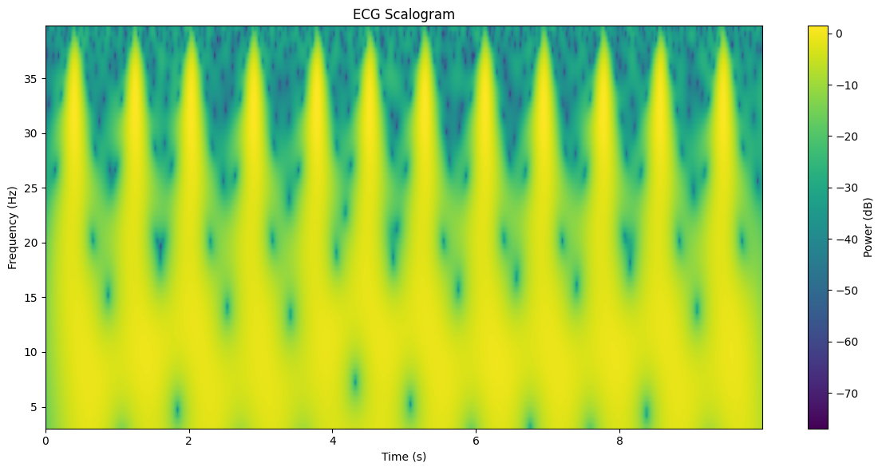
Scalograms
A scalogram is a wavelet-based time–frequency image showing the magnitude of wavelet coefficients across time and scale.
How they are generated
Apply the Continuous Wavelet Transform (CWT)
Use a selected mother wavelet such as Morlet or Mexican hat
Map coefficient energy to a 2D image over time and scale
What they capture
Transient events
Localized signal irregularities
Multi-scale structure and short-duration oscillatory changes
Why they are useful in biomedicine
Biomedical signals often contain both slow and fast components, so a multi-resolution analysis is often more appropriate than a fixed-window FFT.

Slide 27
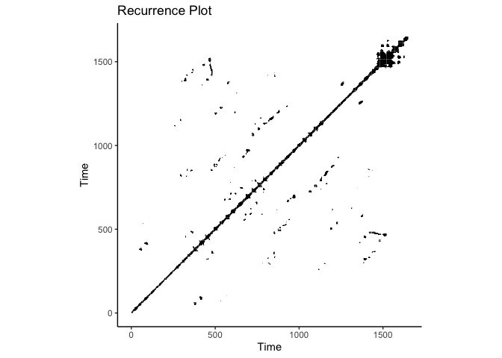
Recurrence Plot
A recurrence plot is a 2D visualization showing when a dynamical system returns to similar states over time.
How they are generated
Reconstruct the signal in phase space using time-delay embedding
Compute distances between all state pairs
Mark recurrent states based on a threshold
What they capture
Repeated patterns and periodicity
Irregularity and dynamical transitions
Hidden nonlinear structure and complexity changes
Why they are useful in biomedicine
Physiological systems are often nonlinear and adaptive, and recurrence plots can reveal patterns that may not be visible in standard time- or frequency-domain views.

Slide 28
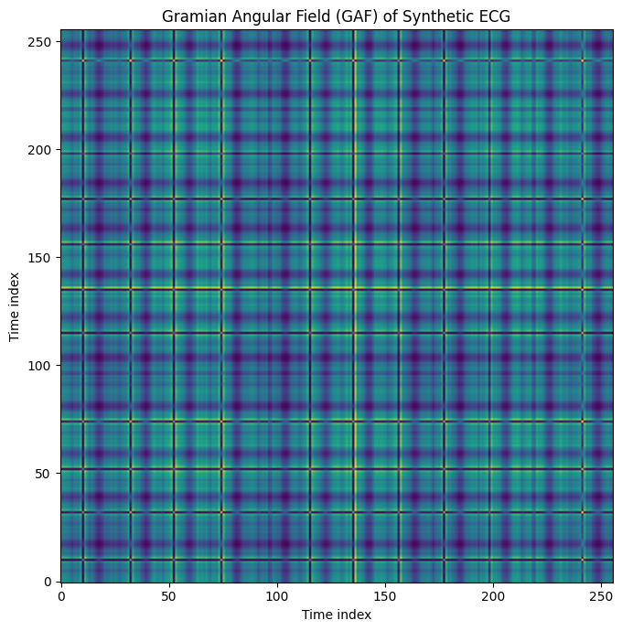
Gramian Angular Fields (GAF)
GAF converts a normalized time series into an image by encoding pairwise angular relationships between time points.
How they are generated
Normalize the signal to a bounded interval
Convert values into polar coordinates
Compute a Gramian matrix using trigonometric relationships
Represent the resulting matrix as an image
What they capture
Global temporal correlations
Relative signal evolution across time
Structured patterns suitable for image-based learning
Why they are useful in biomedicine
They are useful in biomedicine because they transform complex physiological time-series into structured patterns that can reveal subtle signal dynamics, improve discrimination of normal versus abnormal states.

Slide 29
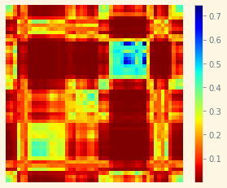
Markov Transition Fields (MTF)
MTF represents a time series as an image by encoding transition probabilities between discretized signal states over time.
How they are generated
Discretize the signal into quantized states
Estimate transition probabilities between states
Map those probabilities back across temporal positions
What they capture
State-to-state transition behavior
Temporal evolution of signal dynamics
Probabilistic structure of signal changes
Why they are useful in biomedicine
They are helpful when the signal is better understood as movement between states rather than only by amplitude or frequency content.

Slide 30
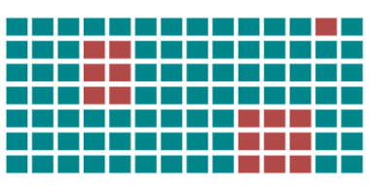
Imputation
Why missing data are unavoidable in physiological studies?
Wearable signals
device not worn
battery drain
Bluetooth sync problems
motion artefacts
sensor saturation.
Clinical data
missed visits
delayed questionnaires
incomplete EHR
protocol deviations.
Signal-level gaps
corrupted segments
bad electrodes
poor skin contact
low perfusion in PPG
noisy EEG channels
Important point:
Missing data are rarely neutral. The reason for missingness may be related to disease, fatigue, mobility, adherence, or workflow.
In short they can be part of the feature set.
Observed Data Missing Data

Slide 31
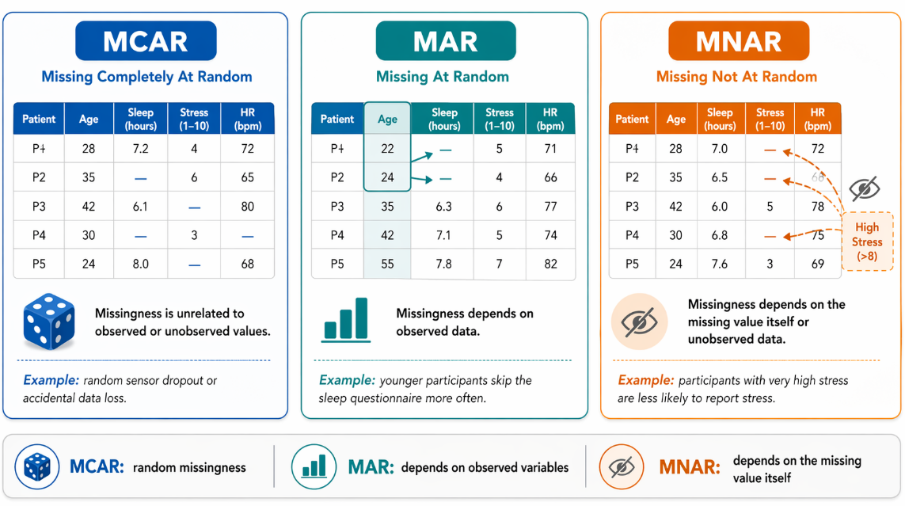
Missingness mechanisms
Classic missing-data theory, translated to biomedical informatics.
MCAR
Missing Completely At Random. The probability of missingness is unrelated to observed or unobserved values.
MAR
Missing At Random. Missingness can be explained by observed variables, e.g., age, site, device type, visit date.
MNAR
Missing Not At Random. Missingness depends on the unobserved value itself, e.g., very ill patients stop wearing the sensor.
Practical Implication
Most biomedical datasets are not MCAR. Treating them as MCAR can bias downstream models.

Slide 32
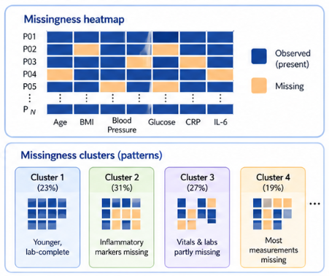

First step: map the missingness pattern
Good imputation starts with visual and statistical missingness profiling.
Create a missingness matrix
rows = patients/records, columns = variables or time windows
Check missingness by
patient, variable, hospital/site, sensor type, visit, class label, and outcome severity
Look for block missingness
entire days, entire channels, entire visits, or entire modalities missing together
Analyse whether missingness correlates with
demographics, baseline status, disease severity, device adherence, or study arm.
Create missingness indicators when absence may carry useful information.
Rule of thumb: never impute before understanding the missingness structure.

Slide 33
Common imputations
There is no universal best method; the correct choice depends on data type, mechanism, and task.
Deletion
Deletion removes incomplete rows/columns (listwise/pairwise), best for minimal or completely random data, but risks bias and low power.
Simple imputation
Mean, median, mode, forward/backward fill. Fast baseline, but uncertainty is underestimated.
Model-Based
KNN, regression, random forest, MICE. Uses relationships between variables.
Time Aware
Forward fill, interpolation, Kalman smoothing, Gaussian processes, state-space methods.
Deep Imputation
RNN/GRU-based models, autoencoders, GAIN, BRITS, transformers.
Missingness-aware learning
Pass masks and time gaps directly to the model.

Slide 34
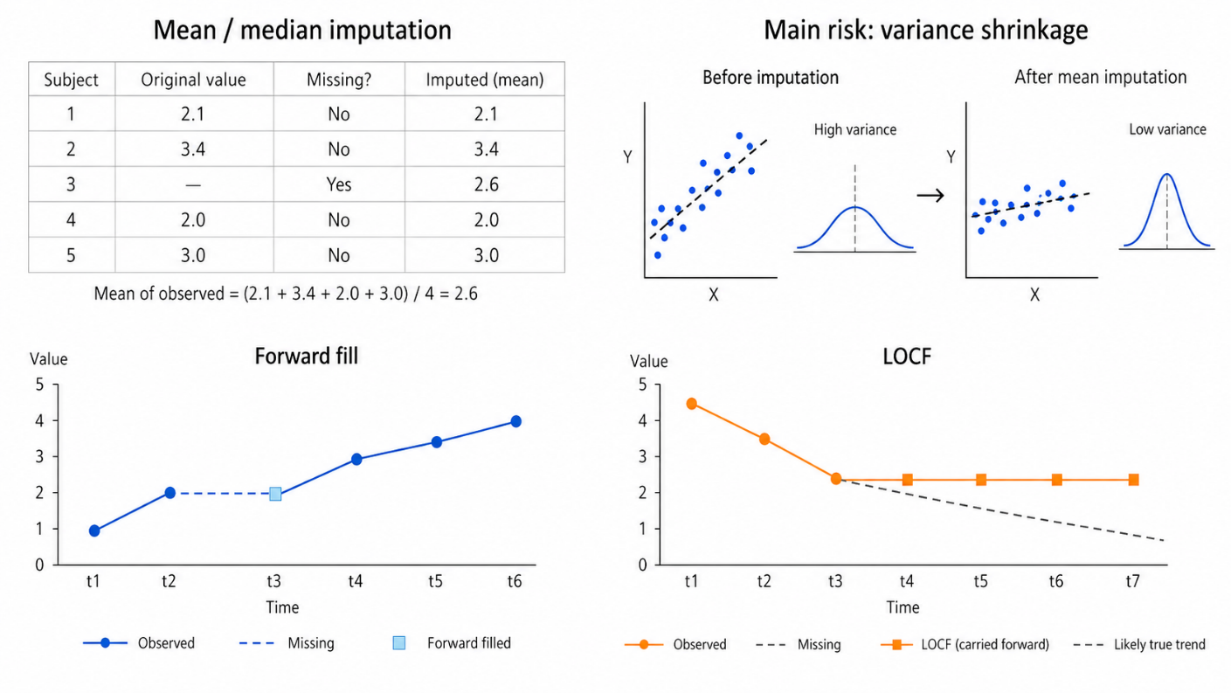
Simple Imputation

Slide 35
Interpolation and smoothing
Signal imputation must respect time, sampling rate, and physiological plausibility.
Linear Interpolation
Suitable only for short gaps and slowly varying signals.
Spline Interpolation
Smoother, but can create unrealistic oscillations around sharp physiological events.
Kalman Filtering
useful when a dynamic state-space assumption is plausible.
Gaussian Imputation
estimates missing values together with a confidence range, but it can be slow for large datasets.
For long gaps, interpolation may fabricate physiology, marking the segment as unreliable may be better.

Slide 36
Feature level imputation
Most real biomedical pipelines impute features rather than raw waveforms.
Feature imputation
Impute extracted features such as RMSSD, band power, sleep duration, step count, or questionnaire items.
Feature-level imputation is easier and more stable when raw signals are too noisy or too large.
Keep binary indicators
“feature was originally missing”, “day had low wear time”, “window failed quality control”.
Use patient-level context
Baseline value, previous week, next week, site, age group, treatment phase, sensor availability.
Do imputation inside each training fold only, otherwise validation/test information leaks into training.

Slide 37
Model-based imputation
Useful for tabular biomedical features and mixed clinical/wearable datasets.
KNN imputation
Fills missing values using similar patients/windows. Sensitive to scaling and irrelevant features.
Regression imputation
Predicts missing values from observed variables. Can be biased if model assumptions are weak.
Multivariate Imputation by Chained Equations (MICE)
Multiple imputation by chained equations; generates several plausible completed datasets.
Random Forest imputation
Handles nonlinear relationships and mixed variables, but may be harder to interpret.

Slide 38
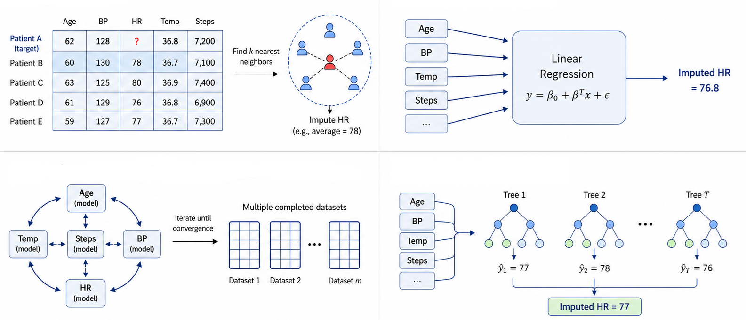
Model-based imputation

Slide 39
Deep imputation for time series
These methods are attractive when temporal dynamics and missingness patterns are predictive.
GAIN
Adversarial imputation model with a generator and discriminator.
Useful for learning realistic values rather than only smooth interpolations.
SAITS
Self-attention-based imputation model for multivariate time series.
Useful when variables have long-range temporal dependencies.
Transformer-based imputation
Uses attention masks, time encodings and self-attention to model irregular multivariate sequences.
Useful when many signals interact across longer windows.
NAOMI / E2GAN / GRUI-GAN
Generative sequence-imputation approaches.
Useful examples when discussing synthetic reconstruction of incomplete temporal trajectories.
Deep imputation is not only about filling missing values, it can learn temporal dynamics, variable interactions and missingness structure.

Slide 40
Missingness-aware learning
Modern pipelines often combine imputation, masks and quality indicators.
Inputs
Observed value: the available physiological or clinical measurement
Mask: whether the value is observed or missing
Time gap: how long since the variable was last observed
Quality indicator: whether the signal/window is reliable or artefact-prone
Strengths
Many DL models can receive the value, a mask, and the time since last observation as separate inputs.
This avoids pretending that missing values were truly observed.
The model can learn that missingness itself is predictive, for example lower adherence in sicker patients.
This approach is useful for irregular clinical time series, wearable windows, and longitudinal multimodal data.
Weakness
Still requires careful validation, because the model may learn site/device artefacts rather than physiology.

Slide 41
Evaluation of imputation
Imputation should be judged both numerically and physiologically.
Artificial masking test
hide known observed values, impute them, and measure reconstruction error
Downstream utility
do imputed values preserve mean, variance, correlation, and physiological range?
Distributional check
Still requires careful validation, because the model may learn site/device artefacts rather than physiology.
Clinical plausibility check
are imputed values possible for that patient/time window?
Sensitivity analysis
do conclusions change when using different imputation methods?

Slide 42
Synthetic Data Generation
Why generate synthetic biomedical data?
Class imbalance
rare disease, rare adverse events, rare pain states, rare arrhythmias.
Small cohorts
expensive sensors, difficult recruitment, vulnerable populations, longitudinal drop-out.
Augmentation
improve robustness to noise, shift, missingness, and device variability.
Privacy-aware sharing
create data that resemble the original distribution without directly exposing records.
Simulation
test pipelines under controlled missingness, noise, prevalence, and modality availability.

Slide 43
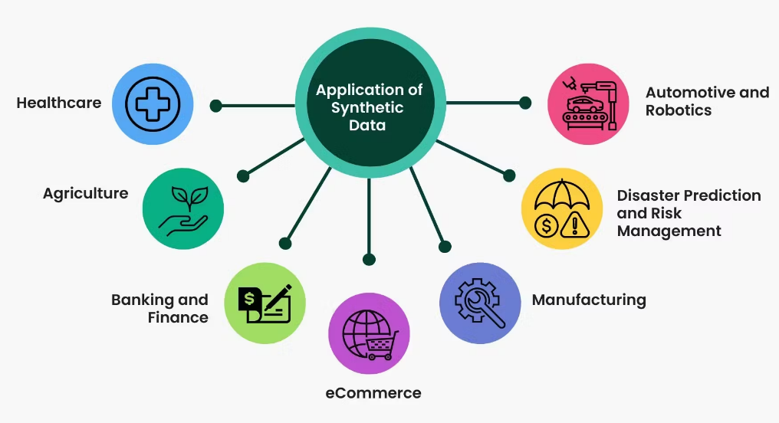
Synthetic Data Generation Techniques
Clarify which type you mean before claiming that you used synthetic data.
Oversampling
Creates extra minority examples near existing samples (e.g., SMOTE).
Augmentation
Applies transformations to existing samples (e.g., jittering, scaling, time-warping).
Generative modelling
Learns a data distribution and samples new records (e.g., VAE, GAN, diffusion, flows).
Simulation
Uses mechanistic or statistical assumptions to generate controlled artificial data.

Slide 44
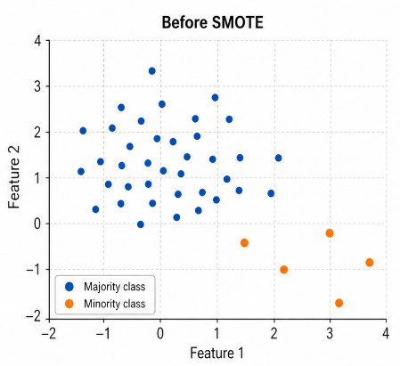
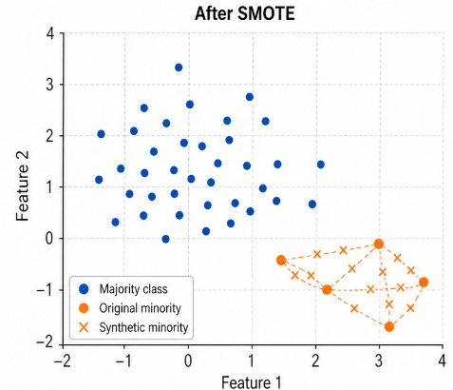
Classical Oversampling
Good for tabular features; risky for raw physiological waveforms unless adapted carefully.
SMOTE
creates synthetic minority samples by interpolating between neighbouring minority-class examples
It can improve sensitivity for minority classes, especially in low-dimensional tabular feature spaces.
SMOTE-NC
extends the idea to mixed continuous and categorical variables
ADASYN
focuses more strongly on difficult minority regions near the decision boundary.
Limitations
can create unrealistic samples, blur class boundaries, and amplify noisy labels.

Slide 45
Generative models
Good for tabular features; risky for raw physiological waveforms unless adapted carefully.
Variational Autoencoder
Encoder maps data to latent space; decoder samples realistic outputs. Often stable but may smooth details.
Generative adversarial network
Generator competes with discriminator. Can produce sharp samples, but training instability and mode collapse are common.
Diffusion
Learns to denoise from noise to data. Strong generation quality, but can be computationally heavy.
Normalising flows
Invertible transformations with exact likelihood; useful when density estimation matters.

Slide 46
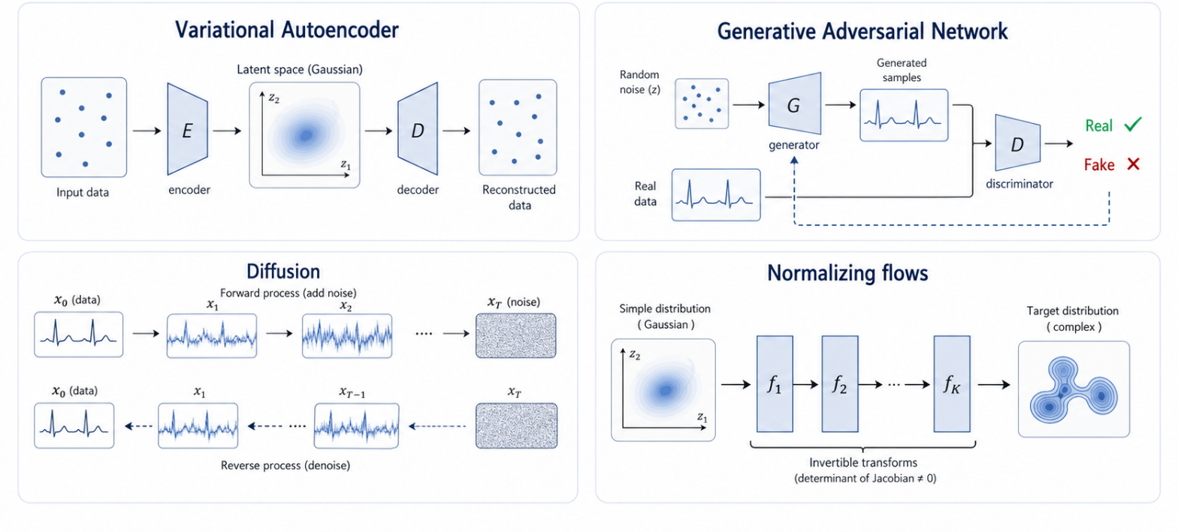
Generative models

Slide 47
Synthetic tabular clinical data
Synthetic tabular clinical data is a rapidly growing field.
Tabular Clinical Data
Are mix continuous, ordinal, binary, categorical, and missing variables.
Clinical distributions are often multimodal
Age groups, treatment pathways, comorbidity profiles, physiological, hospital sites.
CTGAN
Was designed for tabular data with mixed variable types and imbalanced categorical columns
Bayesian networks and Gaussian mixture models
Can be simpler alternatives for structured tabular data.
Evaluate
Always compare synthetic records against clinically plausible ranges and correlations.

Slide 48
Fidelity Metrics
A synthetic dataset is useful only if it preserves the important structure of the real data.
Distribution-level metrics
Kolmogorov–Smirnov test / KS statistic: Measures the maximum distance between the real and synthetic cumulative distributions.
Wasserstein distance: Measures how much “effort” is needed to transform the synthetic distribution into the real one.
Jensen–Shannon divergence: Measures similarity between probability distributions, useful for comparing feature distributions.
Chi-squared test: Compares categorical distributions between real and synthetic data.
Cramér’s V: Measures the strength of association between categorical variables.
Statistics similarity
Mean absolute difference: Difference between real and synthetic feature means.
Variance / standard deviation difference: Checks whether the synthetic data preserve spread and variability.
Skewness difference: Checks whether asymmetry of the distribution is preserved.
Kurtosis difference: Checks whether tail behaviour and extreme values are preserved.

Slide 49
Fidelity Metrics
A synthetic dataset is useful only if it preserves the important structure of the real data.
Multivariate structure metrics
Correlation matrix difference: Compares real and synthetic Pearson/Spearman correlation matrices.
Covariance matrix difference: Checks whether joint variability between variables is preserved.
Mutual information difference: Measures whether nonlinear dependencies between variables are preserved.
Maximum Mean Discrepancy: Compares real and synthetic samples in a kernel-based feature space.
Machine-learning utility metrics
Train on Synthetic, Test on Real: Train a model on synthetic data and evaluate it on real data.
Train on Real, Test on Synthetic: Tests whether synthetic data behave similarly to real test data.
Classifier Two-Sample Test: Train a classifier to distinguish real from synthetic samples; lower separability suggests better fidelity.
Synthetic data should be close enough to preserve distributions, correlations and modelling utility, but not so close that they memorise real patients.

Slide 50
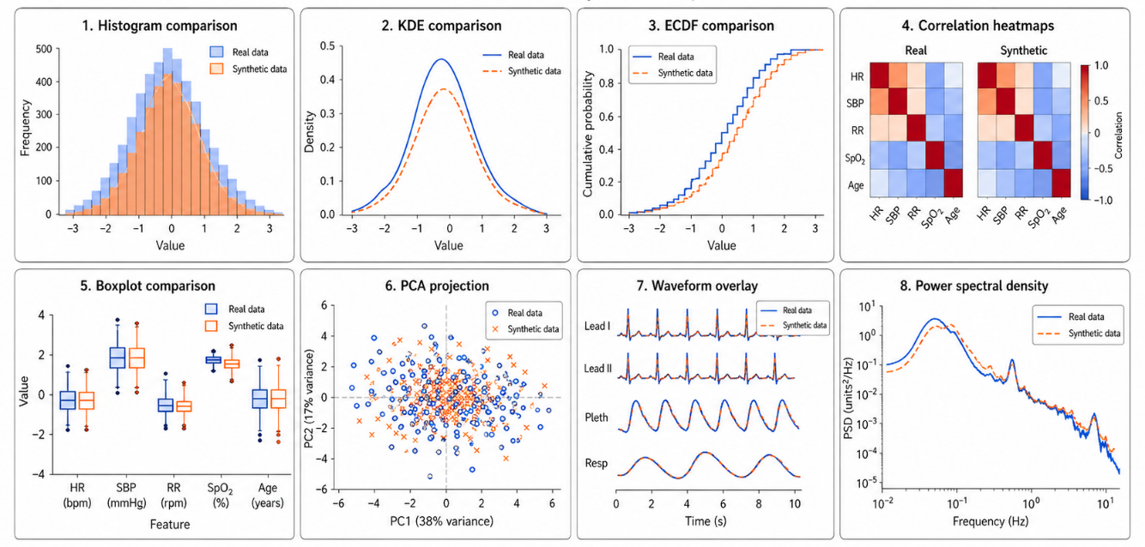
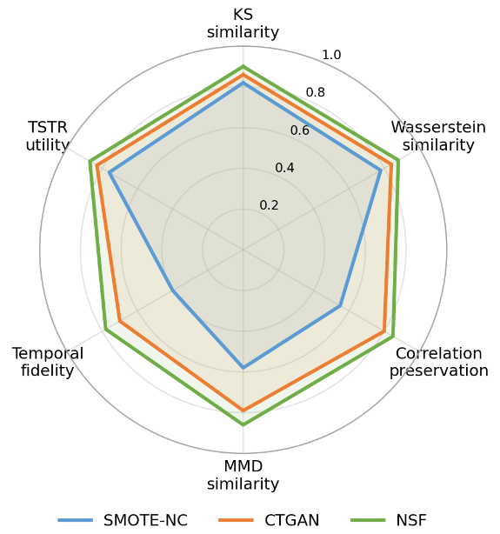
Fidelity Metrics Visualization

Slide 51
Pipeline
Define Purpose
Split Real Data
Train Generator on train set
Generate Synthetic training set
Evaluate on real test set

Slide 52
Key Messages
Missingness is information
Do not hide it: Report the amount, pattern, and likely reason for missing data.
Do not leak: Fit imputers only on training data inside each cross-validation fold.
Do not over-trust: Imputed values are estimates, not observed physiology.
Use masks: When missingness may be predictive, pass masks/time gaps to the model.
Synthetic data need proof
Purpose: Say why you generated it: balancing, augmentation, privacy, simulation, or training.
Train only: Keep synthetic data out of validation and test sets.
Evaluate: Use fidelity metrics to evaluate the synthetic data.
Pipelines determine credibility
Split correctly: Patient-level, time-aware, or site-aware validation depending on the intended use.
Match metrics to use case: Screening, diagnosis, monitoring, and forecasting require different metrics.
Keep physiology central: Model outputs must be interpretable in relation to biological mechanisms.

Slide 53


