Slide 1
Introduction Physiological Signals
PhD(c) Ioannis Kyprakis
ikyprakis@ics.forth.gr

Slide 2

Agenda
Why physiological signals matter
Different types of physiological signals
Pipelines
Preprocessing, segmentation and feature extraction.
Problems
Imputation Techniques
Synthetic Data Generation
ML-DL pipelines
Key Messages

Slide 3
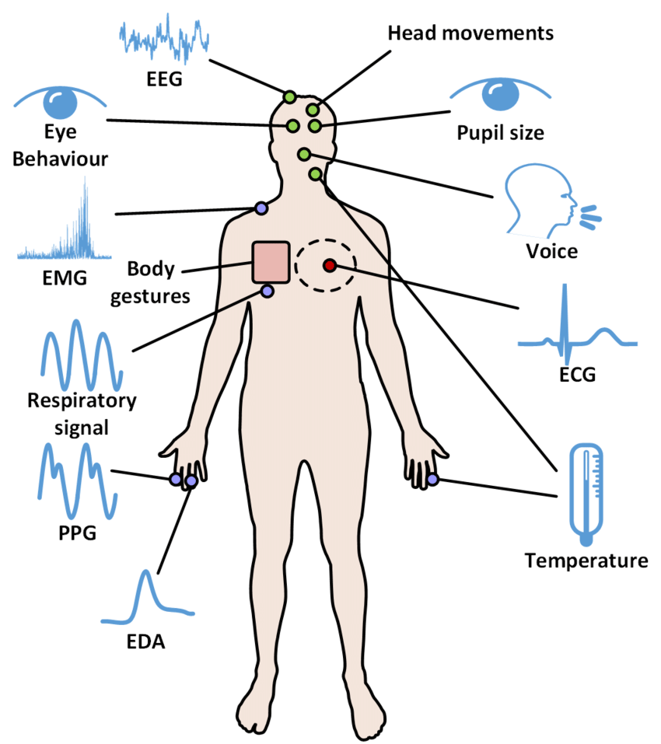
Physiological Signals
Why Physiological Signals matter?
They are objective and time-resolved: we can observe what changes, when it changes, and how fast it changes.
They capture mechanisms that questionnaires or static clinical snapshots often miss, such as autonomic reactivity, recovery, coupling, and instability.
They can be recorded continuously, repeatedly, and increasingly non-invasively with bedside monitors, wearables, and smartphones.
In biomedical informatics, they support monitoring, early warning, phenotyping, digital biomarkers, and closed-loop decision support.

Slide 4
Autonomic Regulation
The first lens for reading biosignals
Sympathetic branch (SNS)
Parasympathetic branch (PNS / vagal)
Importance
Many “stress”, “fatigue”, or “engagement” models are really modelling patterns of autonomic regulation and dysregulation.
Interpretation should be physiological first, algorithmic second: the same model output means little if the signal-to-physiology link is unclear.
Strictly speaking, SNS and PNS are branches of the autonomic nervous system, not literal “parts of the brain”; brain networks regulate them.
Mobilisation, vigilance, effort, and stress readiness
Typical effects: faster heart rate, higher contractility, vasoconstriction, sweating, pupil dilation
In signals, stronger sympathetic drive often appears as reduced HRV, increased EDA, and altered peripheral pulse patterns
Recovery, energy conservation, digestion, and flexible regulation
Typical effects: slower heart rate, vagal braking, stronger respiratory coupling, greater beat-to-beat variability
In signals, stronger vagal influence is often reflected by higher RMSSD / HF-HRV and more adaptive recovery after challenge

Slide 5
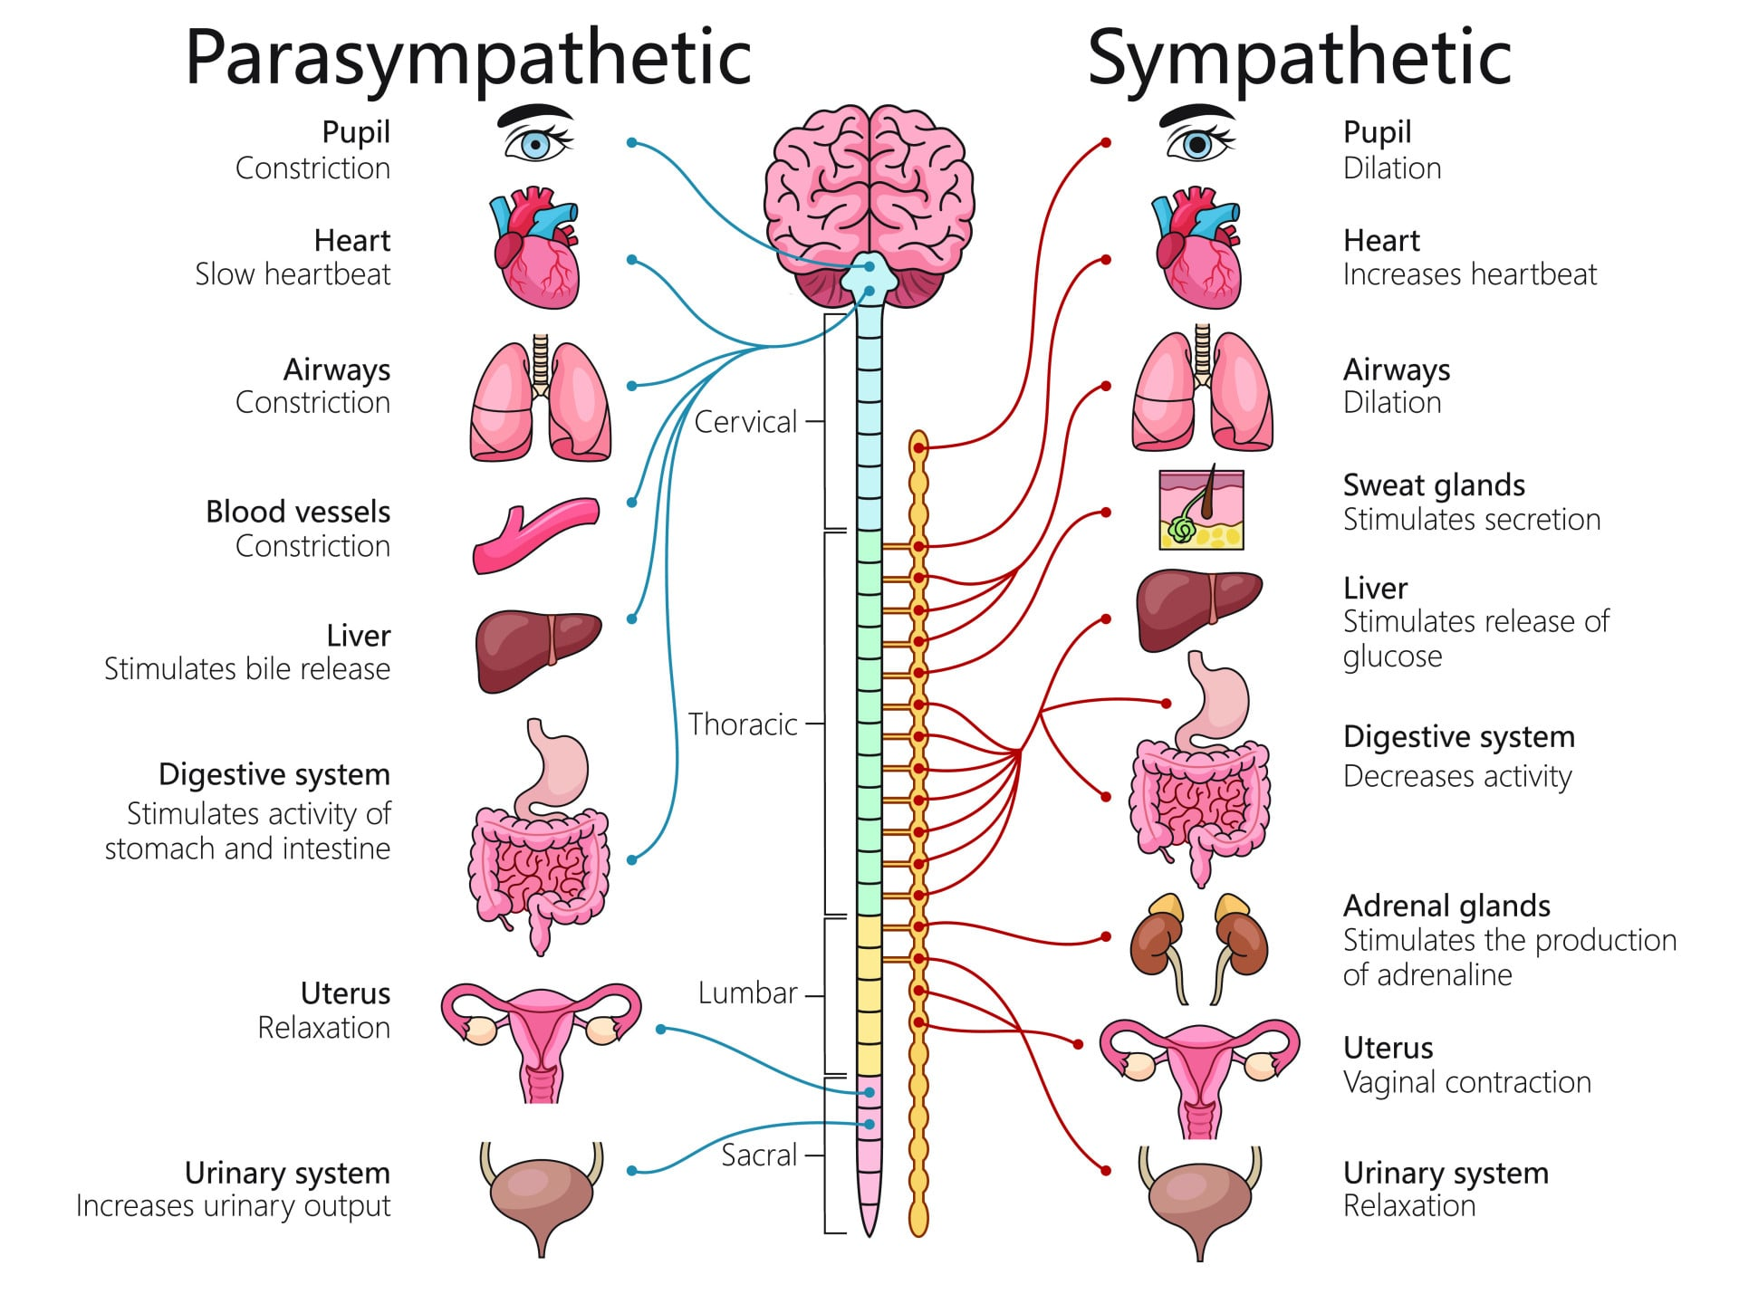
Autonomic Regulation
The first lens for reading biosignals
https://www.simplypsychology.org/wp-content/uploads/Sympathetic-Parasympathetic-Nervous-System.jpg

Slide 6
Strengths and weaknesses
Strengths
Objective measurements rather than retrospective self-report only
High temporal resolution, especially for ECG, EEG, EMG, EDA, and PPG
Rich multimodality: electrical, haemodynamic, mechanical, and neural information
Potential for remote monitoring and digital biomarker development
Useful for detecting both reactivity and recovery
Weaknesses
Motion artefacts, electrode issues, baseline drift, and sensor dropout
High inter-subject variability and context dependence
Labels are often weak, delayed, subjective, or sparsely sampled
Missing data are not random: gaps often come from physiology, workflow, or device failure
Interpretation is easy to overclaim without physiological grounding
Physiological signals are powerful exactly because they are close to real physiology, but that is also why they are messy in real deployments.

Slide 7
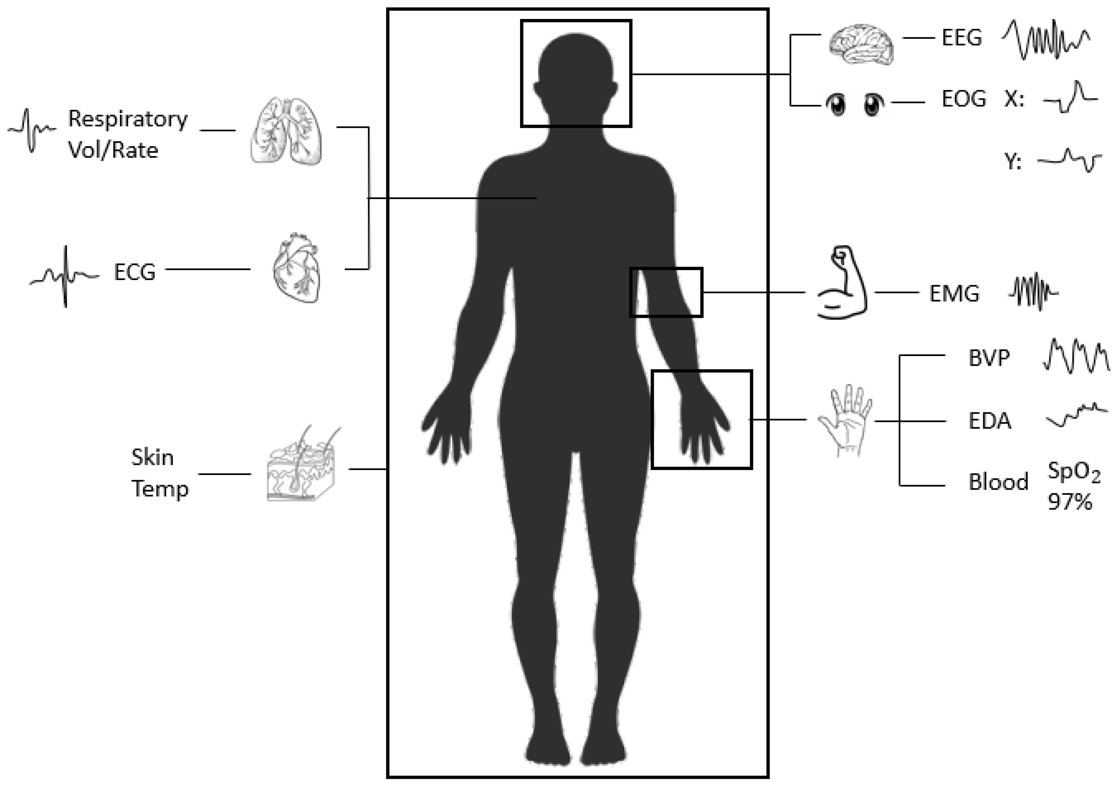
Major signal families
Electrical
ECG, EEG, EMG, EOG
Mechanical / respiratory
respiration, seismocardiography
Optical / vascular
PPG, NIRS
Electrodermal
EDA / GSR
Imaging
fMRI, ultrasound, CT, MRI
https://encyclopedia.pub/entry/40293

Slide 8
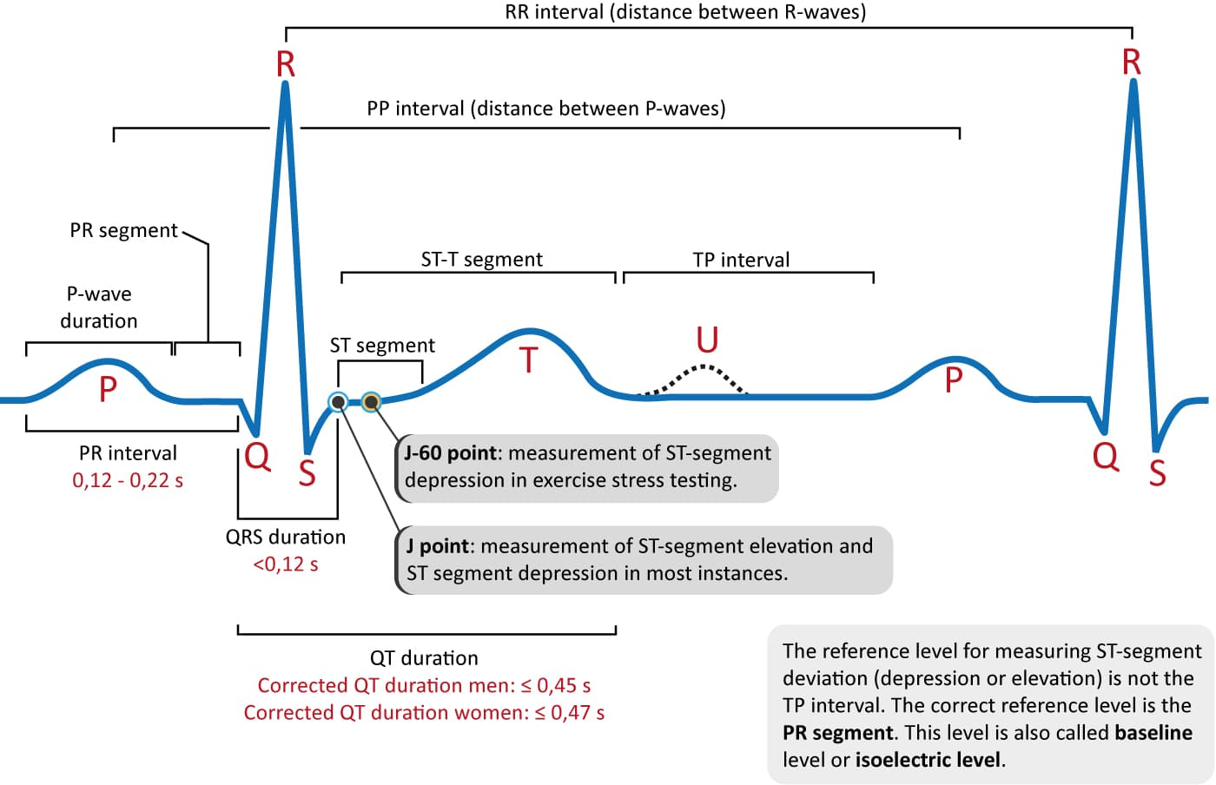
Electrocardiogram (ECG)
What it measures
Electrical activity of the heart (ion currents)
Depolarization & repolarization of cardiac muscle
Standard clinical: 12-lead recording system
Waveform Components
P wave — Atrial depolarization (sinoatrial node)
QRS complex — Ventricular depolarization (1–2 mV peak)
T wave — Ventricular repolarization
PR interval — AV node conduction delay
ST segment — Ischemia and infarction indicator
https://ecgwaves.com/topic/ecg-normal-p-wave-qrs-complex-st-segment-t-wave-j-point/

Slide 9
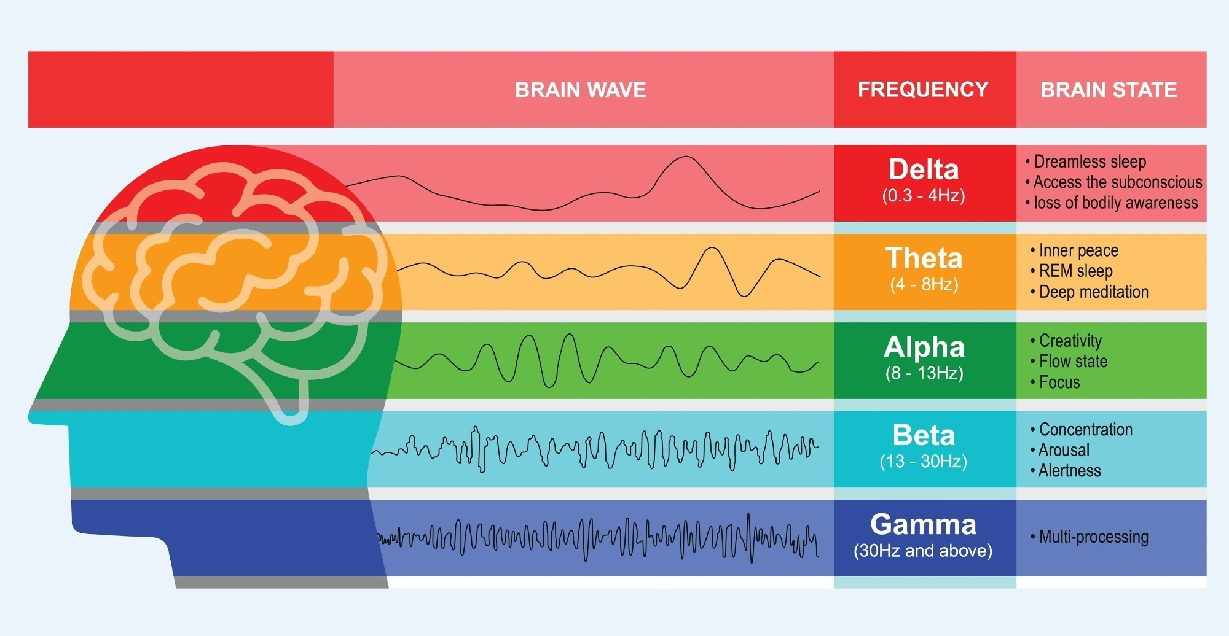
Electroencephalogram (EEG)
What it measures
Electrical activity of cortical neuron populations
10–20 international electrode placement system (32–256 ch)
Applications: epilepsy, sleep staging, BCI, anesthesia depth
Band | Freq (Hz) | State / Relevance
δ Delta | 0.5–4 | Deep sleep, anesthesia, brain injury
θ Theta | 4–8 | Drowsiness, meditation, memory encoding
α Alpha | 8–13 | Relaxed wakefulness, eyes closed
β Beta | 13–30 | Active cognition, alertness, focus
γ Gamma | 30–100 | High-level processing, perception, binding
https://www.news-medical.net/health/Electroencephalogram-%28EEG%29-Systems-Explained.aspx

Slide 10
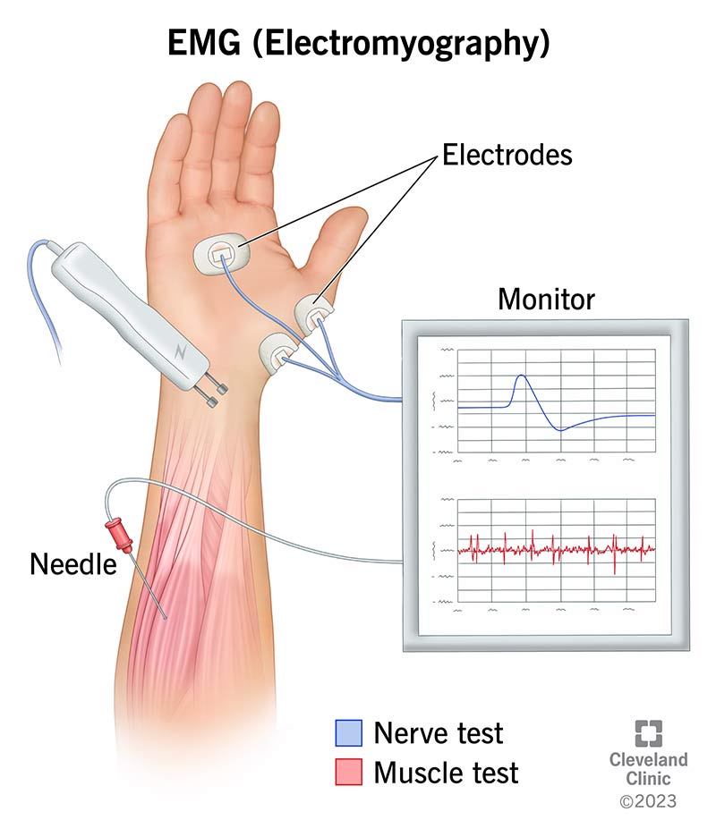
Electromyography (EMG)
What it measures
Electrical activity produced by skeletal muscles
Reflects motor unit action potentials (MUAPs)
Surface (sEMG) vs. intramuscular (iEMG/needle)
Applications
Prosthetic limb control & rehabilitation
Neuromuscular disorder diagnosis (ALS, myopathy)
Muscle fatigue assessment in sports science
Gesture recognition for HCI and robotics
Gait analysis and biomechanics
https://my.clevelandclinic.org/health/diagnostics/4825-emg-electromyography

Slide 11
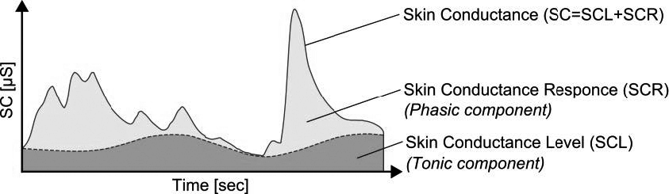
Electrodermal Activity (EDA/GSR)
What it measures
Skin conductance via eccrine sweat gland activity
Tonic (SCL: slow baseline) + phasic (SCR: fast response)
Applications
Pain and distress assessment
Stress and autonomic arousal monitoring
Sleep, vigilance, and arousal analysis
https://www.researchgate.net/figure/The-tonic-and-the-phasic-component-of-skin-conductance-Reprinted-from-An-investigation_fig3_352547906

Slide 12
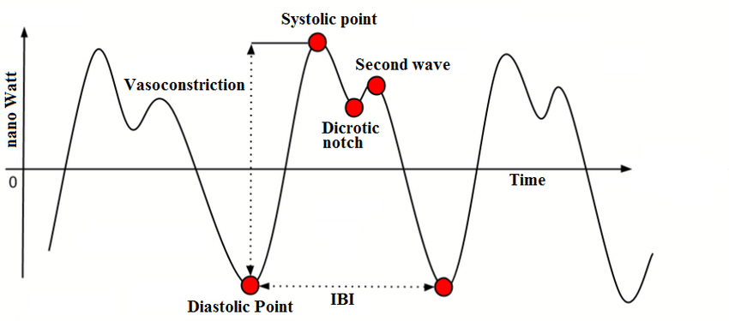
Photoplethysmography (PPG)
What it measures
Optical measurement of blood volume changes in tissue
LED (IR/red) + photodetector at skin surface
Derives HR, SpO₂, HRV, respiratory rate, PAT
Applications
Arrhythmia and atrial fibrillation detection
Cardiovascular monitoring and risk assessment
Blood pressure and vascular health estimation
Sleep and respiratory disorder screening
https://www.researchgate.net/figure/A-typical-PPG-signal-and-its-components_fig2_333348488

Slide 13
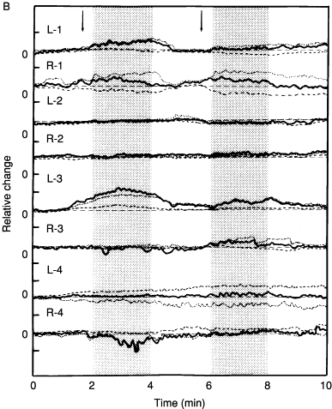
Functional Near-Infrared Spectroscopy (fNIRS)
What it measures
Measures changes in cerebral oxygenation and haemodynamics
Estimates variations in oxyhaemoglobin (HbO) and deoxyhaemoglobin (HbR)
Uses near-infrared light to probe cortical brain activity non-invasively
Reflects neurovascular coupling associated with neural activation
Primarily captures activity from superficial cortical regions
Applications
Cognitive neuroscience and task-evoked brain activity analysis
Monitoring of prefrontal activation during decision-making and workload
https://www.sciencedirect.com/science/chapter/bookseries/pii/S0074774205660084

Slide 14






Pipeline
The end-to-end pipeline
Physiology
ADC
Preprocessing
Feature Extraction
ML-DL
Real-World
Deployment

Slide 15
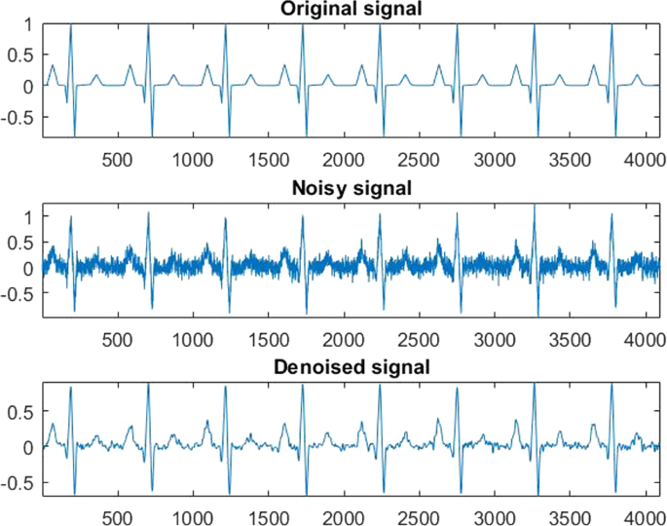
Noise & Artifact Sources
Power Line Interference
50/60 Hz from electrical environment
Motion Artifacts
Electrode–skin impedance change during movement
Baseline Wander
Low-frequency drift from respiration
Ocular Artifacts (in EEG)
Eye blinks & movements
EMG Crosstalk (in ECG)
Muscle activity near ECG electrodes
https://link.springer.com/article/10.1007/s11760-024-03453-1

Slide 16
Preprocessing
Filtering
High-Pass Filter (HPF). Removes DC offset and baseline wander
Low-Pass Filter (LPF). Suppresses high-frequency noise & anti-alias
Band-Pass Filter (BPF). Retain signal band, reject out-of-band noise
Notch / Band-Stop Filter. Eliminate power-line interference selectively
Independent Component Analysis (ICA)
Blind source separation: finds statistically independent signals
Removes eye blinks, cardiac, and muscle artifacts from EEG
Segmentation & Epoching
Divide continuous data into fixed-length or event-locked segments
Windowing splits the signal into analysis frames, often overlapping
Common windows: rectangular, Hamming, Hann
Important for FFT/STFT
Resampling & Decimation
Downsample after low-pass filtering to reduce data volume.
Normalization & Standardization
Z-score: subtract mean, divide by std (within- or across-trial)
Min-max scaling: map to [0,1] for neural network inputs
Baseline Correction / Detrending
Removes slow drift unrelated to the physiological phenomenon
Important in EEG, EDA, PPG, and fNIRS

Slide 17
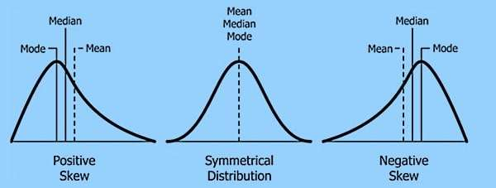
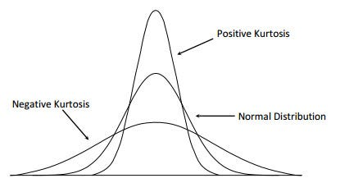
Statistical Feature Extraction
Basic numerical properties of the signal in the time domain
Features
Mean / Median
Variance / Standard Deviation
Root Mean Square (RMS)
Zero Crossing Rate
Skewness
Kurtosis
Slope Sign Changes
Applications
General signal characterization
Noise and variability assessment
EMG activity estimation
Simple feature-based classification

Slide 18
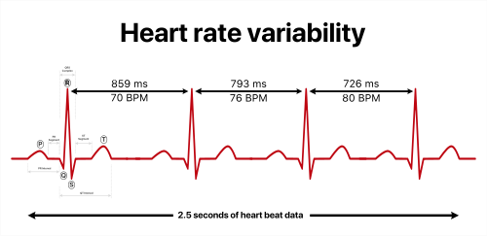
ECG & HRV Feature Extraction
Beat-to-beat timing and cardiac rhythm variability
Features
R-R interval (IBI)
SDNN
RMSSD
pNN50
QRS Delineation
Waveform Length
R-peak detection
PR / QT interval estimation
Applications
Heart rate variability analysis
Stress and autonomic function assessment
Arrhythmia screening
Cardiovascular monitoring

Slide 19
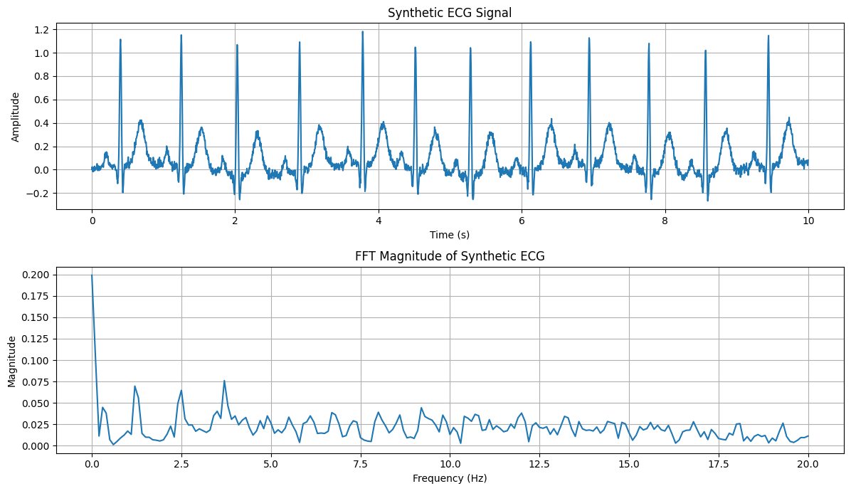
Frequency domain Feature Extraction
How signal energy is distributed across frequencies
Features
Fast Fourier Transform (FFT)
Power Spectral Density (PSD)
Peak frequency
Mean / Median frequency
Band power
Spectral entropy
Frequency ratios
Harmonic components
Applications
EEG rhythm analysis
EMG fatigue assessment
HRV spectral analysis
Oscillatory pattern detection

Slide 20
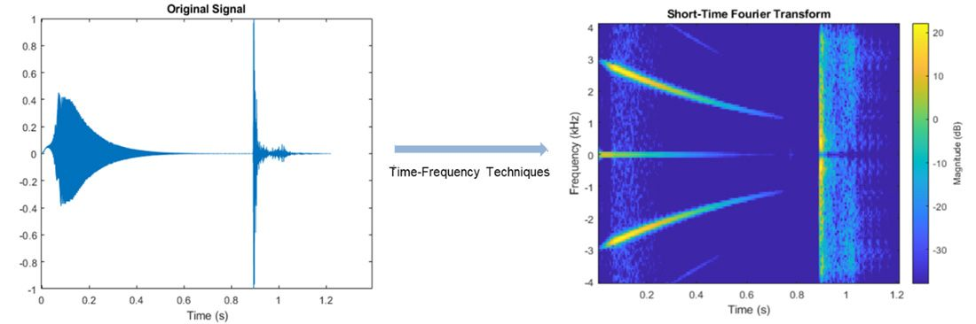
Time-Frequency domain Feature Extraction
How frequency content changes over time
Features
Short-Time Fourier Transform (STFT)
Spectrogram-derived energy
Wavelet Transform
Wavelet coefficients
Sub-band energy
Scalogram features
Instantaneous frequency
Time-localized transient descriptors
Applications
Non-stationary signal analysis
Seizure detection
Arrhythmia analysis
Event detection in wearable signals

Slide 21
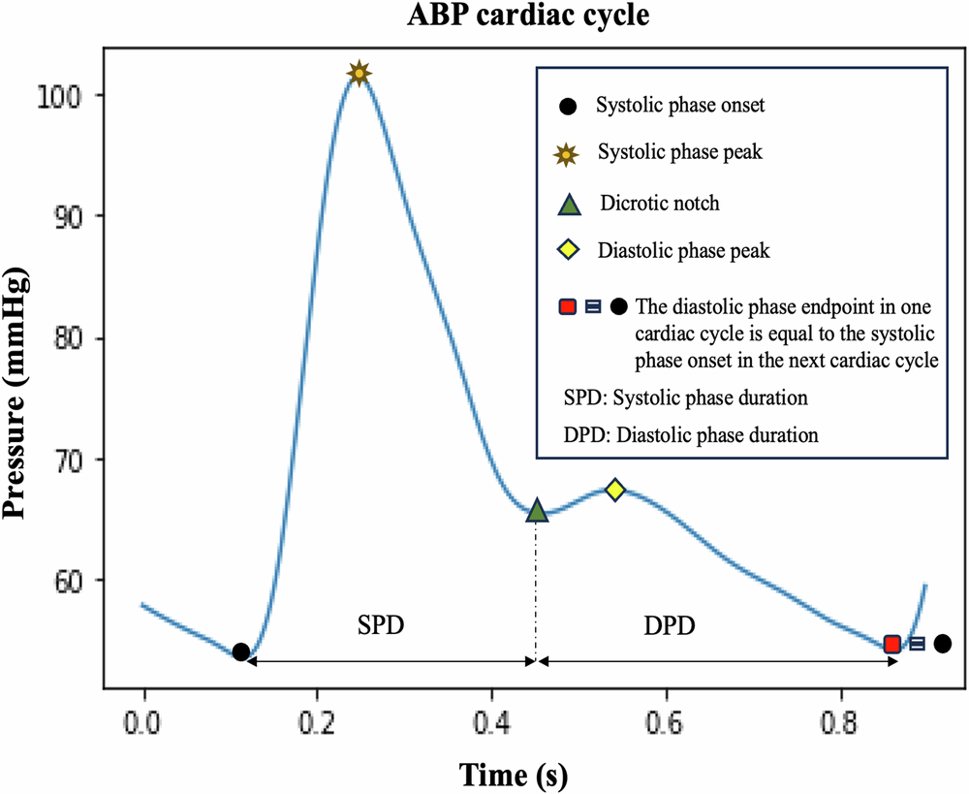
Morphological Feature Extraction
Shape-based properties of the waveform
Features
Peak amplitude
Peak width / duration
Rise time
Decay time
Area under the curve
Pulse width
Systolic / diastolic landmarks
Waveform shape descriptors
Applications
ECG waveform analysis
PPG pulse analysis
Event and peak characterization
Vascular and haemodynamic assessment
https://www.nature.com/articles/s44325-025-00096-0

Slide 22
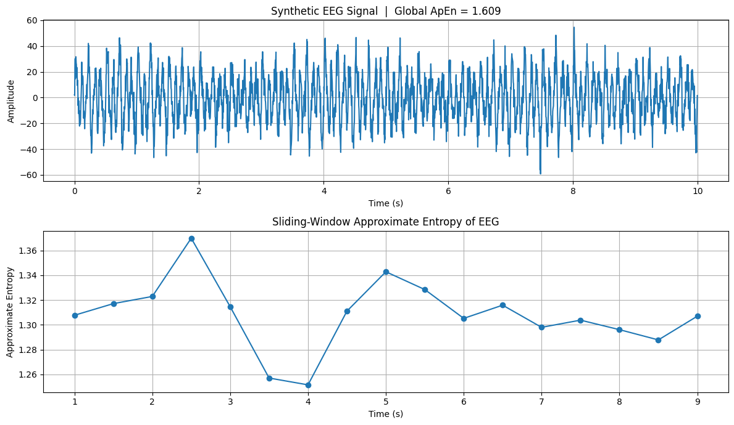
Nonlinear Feature Extraction
Complex and irregular dynamics not captured by simple linear statistics
Features
Sample entropy
Approximate entropy
Fractal dimension
Hjorth parameters
Lyapunov exponent
Detrended fluctuation analysis
Complexity indices
Applications
HRV complexity analysis
Epileptic seizure detection
Stress and autonomic regulation assessment
Nonlinear physiological dynamics modelling

Slide 23
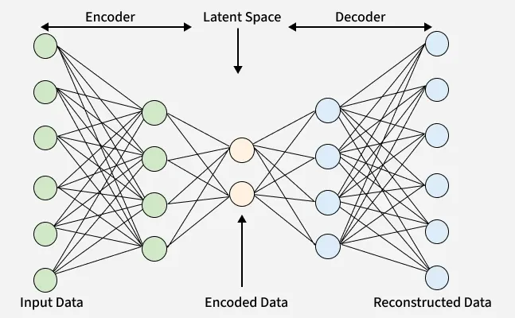
Learned / Representation Feature Extraction
Data-driven feature embeddings learned automatically from raw or transformed signals
Features
Autoencoder latent vectors
CNN-derived embeddings
Transformer-based representations
Contrastive learned embeddings
Multimodal fused representations
Pretrained feature backbones
Applications
End-to-end classification
Representation learning from raw biosignals
Transfer learning across datasets
https://www.geeksforgeeks.org/numpy/types-of-autoencoders/

Slide 24
Visual Representations of Biomedical Signals
Transforming 1D signals into 2D images for pattern discovery and deep learning
Techniques
Spectrograms
Scalograms
Recurrence Plots
Gramian Angular Fields (GAF)
Markov Transition Fields (MTF)
Poincaré Plots
Applications
Arrhythmia and seizure detection
Stress and cognitive-state estimation
Wearable signal classification
Vision-based biomedical AI
Strengths
Capture patterns not easily described by handcrafted features
Reveal time–frequency and nonlinear dynamics
Make signal structure more interpretable visually
Enable the use of computer vision and deep learning models
Support multimodal fusion across heterogeneous biosignals

Slide 25
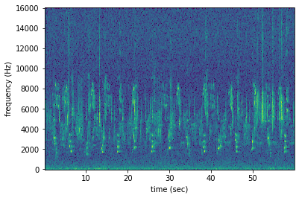
Spectrograms
A spectrogram is a 2D time–frequency representation showing how the spectral energy of a signal evolves over time.
How they are generated
Divide the signal into short overlapping windows
Apply a window function such as Hamming or Hann
Compute the FFT for each window
Stack the spectra over time and display magnitude or power as an image
What they capture
Temporal evolution of frequency components
Rhythmic activity and transient bursts
Frequency shifts, oscillatory patterns, and event-related changes
Why they are useful in biomedicine
Many physiological signals are non-stationary, so their frequency content changes over time rather than remaining constant.

Slide 26
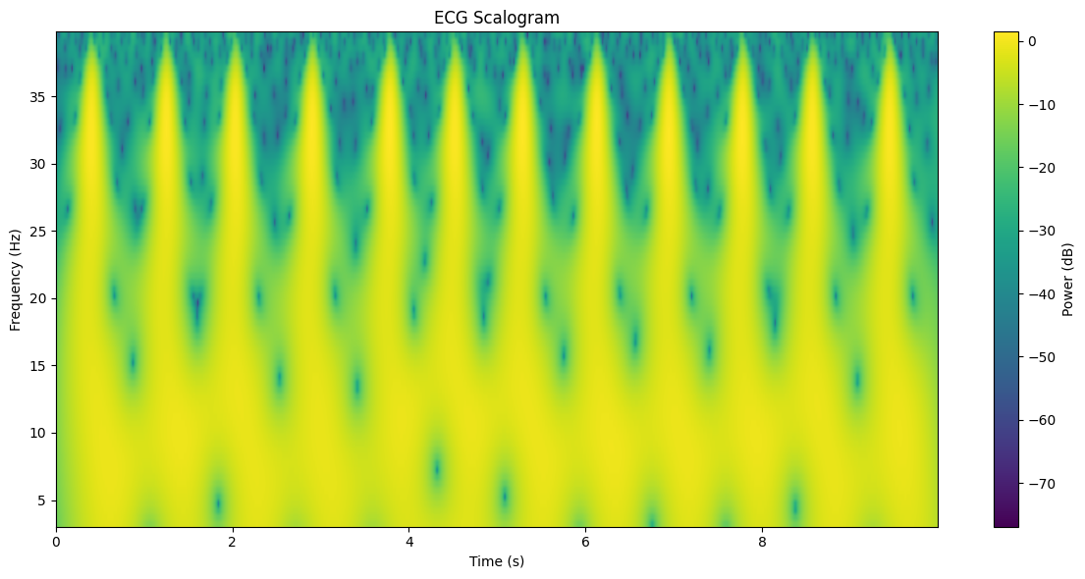
Scalograms
A scalogram is a wavelet-based time–frequency image showing the magnitude of wavelet coefficients across time and scale.
How they are generated
Apply the Continuous Wavelet Transform (CWT)
Use a selected mother wavelet such as Morlet or Mexican hat
Map coefficient energy to a 2D image over time and scale
What they capture
Transient events
Localized signal irregularities
Multi-scale structure and short-duration oscillatory changes
Why they are useful in biomedicine
Biomedical signals often contain both slow and fast components, so a multi-resolution analysis is often more appropriate than a fixed-window FFT.

Slide 27
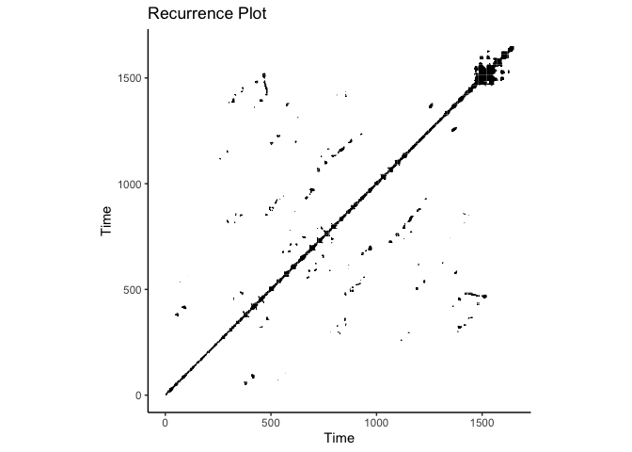
Recurrence Plot
A recurrence plot is a 2D visualization showing when a dynamical system returns to similar states over time.
How they are generated
Reconstruct the signal in phase space using time-delay embedding
Compute distances between all state pairs
Mark recurrent states based on a threshold
What they capture
Repeated patterns and periodicity
Irregularity and dynamical transitions
Hidden nonlinear structure and complexity changes
Why they are useful in biomedicine
Physiological systems are often nonlinear and adaptive, and recurrence plots can reveal patterns that may not be visible in standard time- or frequency-domain views.

Slide 28
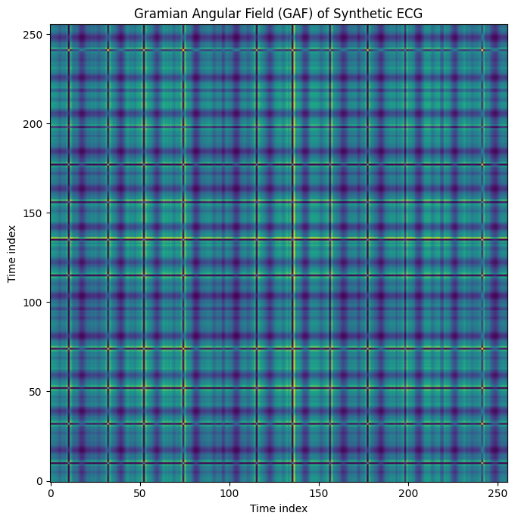
Gramian Angular Fields (GAF)
GAF converts a normalized time series into an image by encoding pairwise angular relationships between time points.
How they are generated
Normalize the signal to a bounded interval
Convert values into polar coordinates
Compute a Gramian matrix using trigonometric relationships
Represent the resulting matrix as an image
What they capture
Global temporal correlations
Relative signal evolution across time
Structured patterns suitable for image-based learning
Why they are useful in biomedicine
They are useful in biomedicine because they transform complex physiological time-series into structured patterns that can reveal subtle signal dynamics, improve discrimination of normal versus abnormal states.

Slide 29
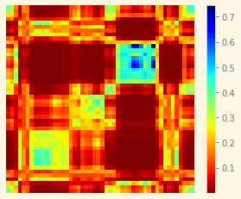
Markov Transition Fields (MTF)
MTF represents a time series as an image by encoding transition probabilities between discretized signal states over time.
How they are generated
Discretize the signal into quantized states
Estimate transition probabilities between states
Map those probabilities back across temporal positions
What they capture
State-to-state transition behavior
Temporal evolution of signal dynamics
Probabilistic structure of signal changes
Why they are useful in biomedicine
They are helpful when the signal is better understood as movement between states rather than only by amplitude or frequency content.

Slide 30
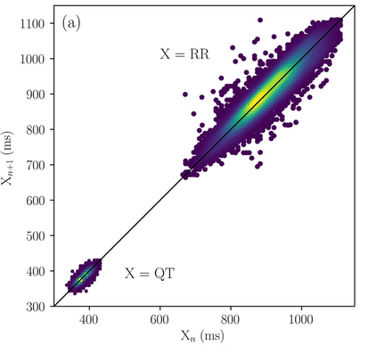
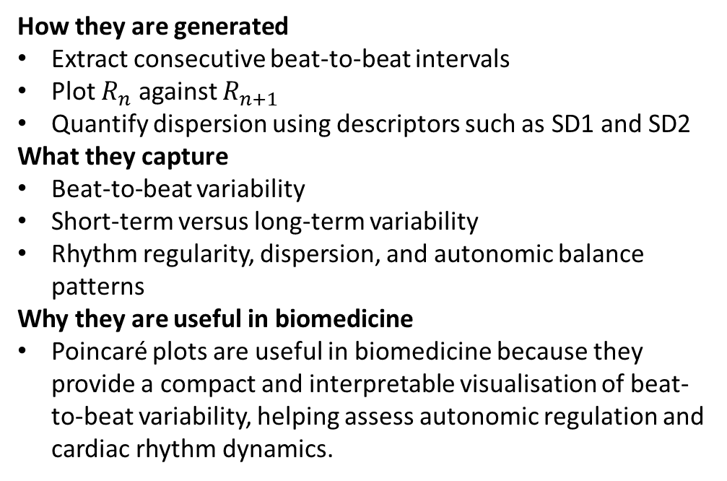
Poincaré Plots
A Poincaré plot is a scatter plot of each interval against the following interval.
How they are generated
Extract consecutive beat-to-beat intervals
Plot $R_{n}$​ against $R_{n+1}$
​Quantify dispersion using descriptors such as SD1 and SD2
What they capture
Beat-to-beat variability
Short-term versus long-term variability
Rhythm regularity, dispersion, and autonomic balance patterns
Why they are useful in biomedicine
Poincaré plots are useful in biomedicine because they provide a compact and interpretable visualisation of beat-to-beat variability, helping assess autonomic regulation and cardiac rhythm dynamics.

Slide 31


