Slide 1
Wearables
PhD(c) Ioannis Kyprakis
ddk366@edu.hmu.gr

Slide 2

Agenda
Motivation
Modalities
Signal Pathway
Data quality
Features & AI
Translation

Slide 3
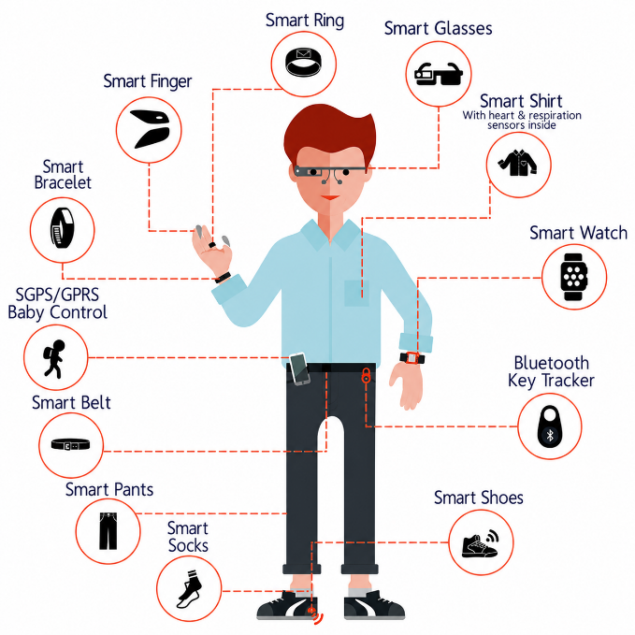
Wearable data the new era of continuous phenotyping
Why wearables matter now: long-duration, real-world, multimodal data streams can move monitoring from occasional snapshots to longitudinal digital phenotypes.
What wearable data usually include
Heart rate and HRV from ECG/PPG
Sleep timing, duration, fragmentation, and stages
Physical activity, gait, posture, and energy proxies
Respiration surrogates, skin temperature, and EDA
Context-aware, dense, longitudinal home data
Map those probabilities back across temporal positions
Evidence for a new era
Recent reviews describe state-of-the-art wearable sensing for cardiovascular health and consumer-grade monitoring.
FDA now maintains a category of authorised sensor-based digital health technologies, including wearable devices.
Digital health technologies are increasingly used to capture real-world data in drug development and trials.
Evidence examples: Nature Reviews Cardiology (2025) on consumer wearables; Nature Reviews Bioengineering (2025) on cardiovascular wearable sensors; FDA sensor-based digital health technology device list (updated 2026); FDA digital health technologies for drug development (2025).

Slide 4
Wearable data the new era of continuous phenotyping
Key shift: wearable biosignals are no longer only wellness proxies; they increasingly support remote monitoring, early warning, endpoint capture, and AI-enabled clinical decision support.
Why this is a revolution
From sparse clinic visits to continuous real-world measurement
From single markers to multimodal digital phenotypes
From retrospective review to prospective risk tracking
From population averages to personalised baselines and deviations
Cautions
Consumer wearables are not equal to gold-standard instruments.
Signal quality, adherence, motion, skin tone, placement, and firmware matter.
Use validation, uncertainty estimation, and clinical escalation rules.
Never over-interpret blood pressure or diagnostic claims without verification.
Evidence examples: Nature Reviews Cardiology (2025) on consumer wearables; Nature Reviews Bioengineering (2025) on cardiovascular wearable sensors; FDA sensor-based digital health technology device list (updated 2026); FDA digital health technologies for drug development (2025).

Slide 5
The wearable revolution: evidence, investment and clinical translation
Modern biosignal science is now shaped by sensing hardware, AI interpretation, reimbursement/regulation, and very large real-world data ecosystems.
AEI framing
The American Enterprise Institute article presents CES 2025 as an inflection point: AI is turning wearables from simple activity loggers into devices that can contextualise physiology and support more proactive care.
Moving from tracker to companion
Market money
Grand View Research estimates the global wearable medical devices market at USD 42.74B in 2024, with projected growth to USD 168.29B by 2030. Even if estimates differ by source, the scale is now clearly massive.
Capital signals
ŌURA announced over USD 900M in funding in October 2025 at an approximately USD 11B valuation. That level of capital signals strong investor confidence in wearable-centred preventive health platforms.
Regulatory momentum
The FDA now maintains a dedicated list of sensor-based digital health devices, including watches, rings, patches and bands, and launched the TEMPO pilot in 2026 to advance access to selected digital health devices.
Sources: AEI article search result/snippet (Jan 2025); Grand View Research wearable medical devices market; Reuters and ŌURA funding announcement (Oct 2025); FDA sDHT device list and Digital Health Center of Excellence (2025–2026).

Slide 6
Wearable data modalities
Common wearable data streams in biomedical research
Data stream | What it reflects | Biomedical relevance
Heart rate / HRV | Autonomic regulation | Stress, recovery, cardiovascular strain
Physical activity | Mobility and energy expenditure | Frailty, functional decline, rehabilitation
Sleep | Recovery and circadian rhythm | Fatigue, mental health, QoL
ECG / PPG | Cardiac and vascular signals | Arrhythmia, pulse dynamics, cardiovascular monitoring
Temperature / EDA | Thermoregulation and arousal | Infection, stress, sympathetic activation
Different wearable streams provide complementary information, which is why multimodal integration is usually more informative than analysing one signal alone.

Slide 7
What makes wearable signals different?
Wearable data are biomedical signals collected continuously, passively and in uncontrolled real-world contexts
Continuous
Minutes, hours and weeks instead of one clinic measurement
Capture dynamic fluctuations, daily rhythms and transient events that snapshots may miss
Contextual
Home, work, sleep and daily routines shape the data
The same signal may have different meanings depending on activity, environment and time of day
Longitudinal
Change from baseline often matters more than one value
Trends, deviations and recovery patterns can be more informative than absolute levels
Messy
Non-wear, artefacts and adherence are part of the dataset
Missingness and noise are not only technical issues, they may also reflect behaviour or health status

Slide 8
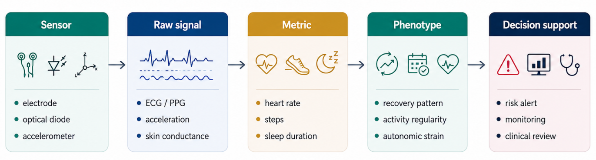
From body-worn sensors to biomedical meaning
A wearable measurement becomes clinically useful only after several interpretation layers
Key distinction
Wearables measure physical signals; “stress”, “frailty” or “QoL decline” are inferred constructs that require validation.
Practical implication
Each layer can introduce bias: sensor placement, filtering, proprietary algorithms, labels and clinical interpretation.

Slide 9
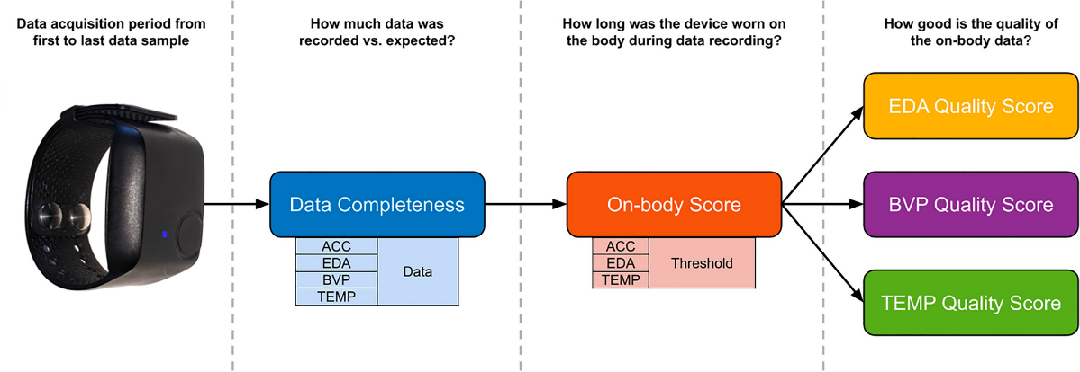
Preprocessing and signal-quality control
Quality control determines whether the model learns physiology or artefact
Synchronise
  timestamps, time zones, visits
Clean
  duplicates, impossible values, units
Detect Quality
  motion, contact, clipping, noise
Segment
  windows, days, weeks, clinical phases
Aggregate
  features by context and endpoint
Document
  wear-time, missingness, exclusions

Slide 10
Missingness and adherence
In wearable studies, missing data may reflect device issues, patient behaviour or changes in health status.
Missingness pattern | Common technical explanation | Possible clinical or behavioural meaning
Short gaps | Charging, Bluetooth dropout, temporary sensor disconnection | Temporary illness, sleep disruption, hospital visit, symptom episode
Repeated gaps | Device removed during sleep, showering or work, poor battery routine, app synchronisation problems | Poor tolerance of the device, lifestyle routine affecting adherence, night-time discomfort, reduced motivation
Long gaps | Device lost, app uninstalled, device not returned, study dropout | Fatigue, treatment burden, disengagement, functional deterioration, hospitalisation or disease progression
Report wear-time and missingness patterns as study information. Do not automatically impute away behaviour that may be clinically meaningful.

Slide 11
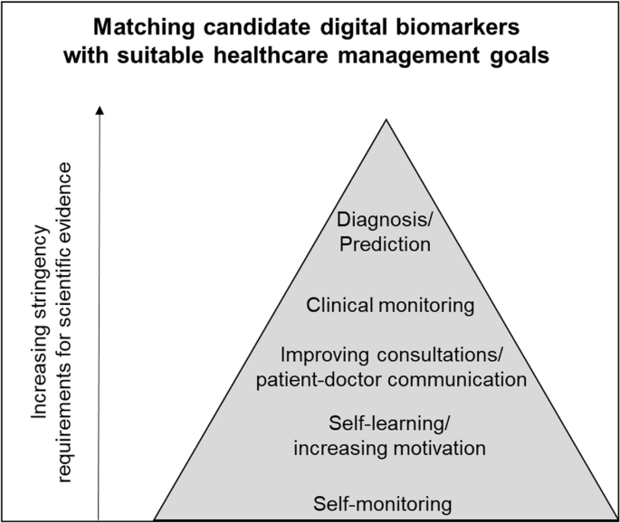
Feature extraction: from signals to digital biomarkers
Features should reflect physiology, behaviour, recovery or change over time
Time domain
mean, median, variance, peaks, slopes, activity duration, sedentary time
Frequency domain
spectral power, dominant frequency, LF/HF components, rhythms
Non linear
entropy, complexity, Poincaré descriptors, fractal or variability markers
Longitudinal
change from baseline, weekly instability, recovery delay, circadian regularity
Digital biomarkers are not just statistical summaries. They are candidate measurements that must be linked to a biological or clinical construct.
https://www.nature.com/articles/s41746-024-01151-3

Slide 12
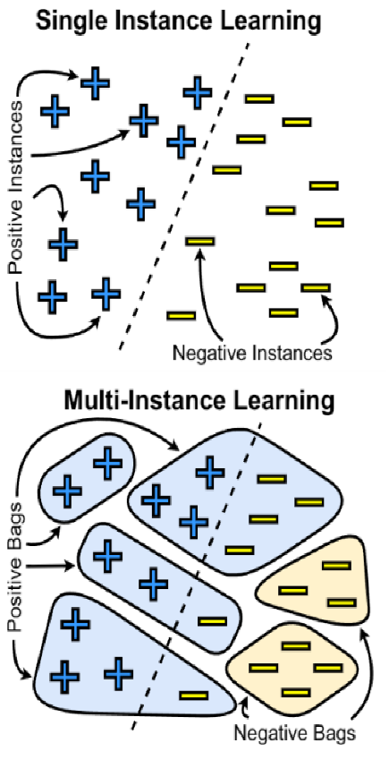
Representing wearable data for AI
The representation should match the biological question, the model and the clinical endpoint
Raw time series
Sequence models: e.g., Temporal CNN, LSTM, Transformer
Feature table
Classical ML: e.g., Random Forest, SVM, XGBoost
Image-like views
CNNs / ViTs: e.g., Spectrograms, scalograms, recurrence plots
Longitudinal bags
MIL / attention: Patient-timepoint phenotyping
Changing the representation changes what the model can see: morphology, rhythm, trend, variability or patient-level trajectory.

Slide 13
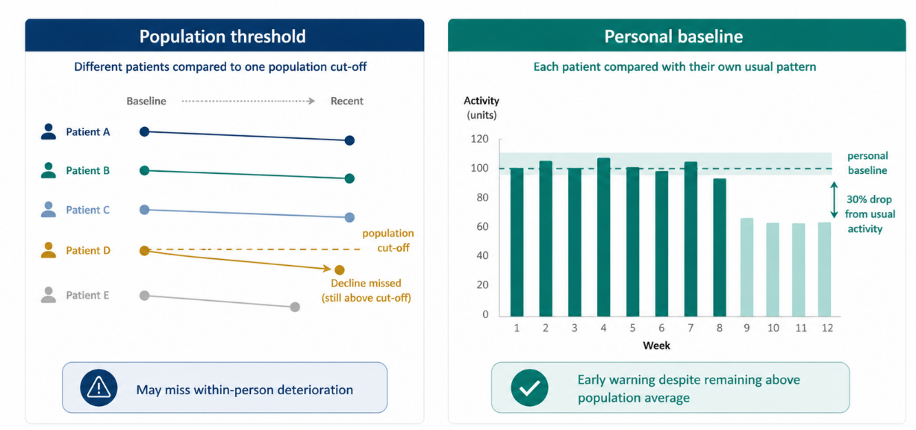
Patient-specific baselines and deviation modelling
For continuous monitoring, “normal” is often personal rather than population-wide
Population threshold
Single cut-off applied to everyone
  Useful for screening, but may miss within-person deterioration in patients with naturally high or low baselines.
Personal baseline
Each patient compared against their own usual pattern
  Useful for early warning, recovery monitoring and treatment-related deterioration.

Slide 14
Task formulations
Wearable signals can support several biomedical prediction tasks
Classification
Dyskinesia yes/no, arrhythmia detection, high vs low fatigue
Regression
stress score, QoL score, functional capacity
Forecasting
risk of deterioration, next-week recovery, future symptom burden
Anomaly Detection
deviation from personal baseline, rare events, unsafe physiological patterns
Choose the task according to the clinical decision: detect, estimate, forecast or flag unusual change.

Slide 15
Validation and Leakage
Wearables become stronger when combined with clinical context and patient-reported outcomes
Wearables
PROMs
ECG, PPG, sleep, activity
QoL, fatigue, stress
Shared patient representation
fusion + attention + uncertainty
Clinical data
Imaging / omics
diagnosis, treatment, labs
disease phenotype, biology

Slide 16
Clinical translation
A wearable AI model needs evidence, workflow fit and governance, not only good performance
Evidence
analytical validity, clinical validity, external validation
Safety
uncertainty estimates, alert fatigue control, escalation rules
Workflow
clinician dashboard, patient instructions, responsibility boundaries
Governance
Privacy, security, model monitoring, regulatory pathway

Slide 17
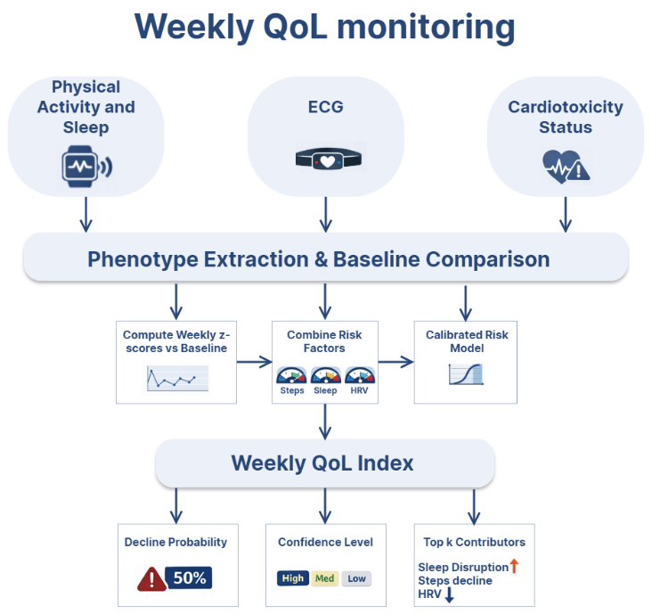
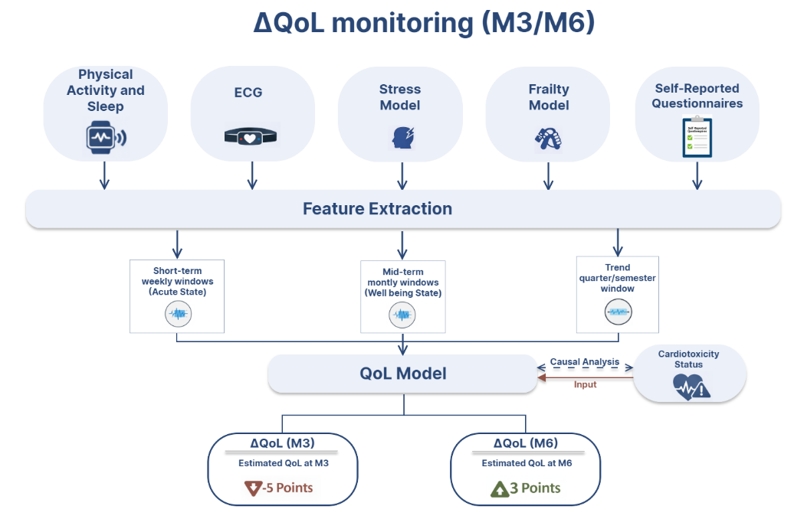
Mini case study: wearable monitoring for QoL in oncology

Slide 18
Key Messages
The strongest wearable studies combine signal knowledge, longitudinal thinking and clinical validation
Wearables enable continuous, real-world monitoring beyond the clinic.
The most valuable signal is often longitudinal change from a personal baseline.
Raw streams require preprocessing, signal-quality control and transparent missingness reporting.
Feature extraction should be biologically and clinically motivated.
AI models require patient-level validation to avoid leakage.
Clinical translation requires validation, uncertainty, escalation rules and workflow integration.

Slide 19


