Slide 1
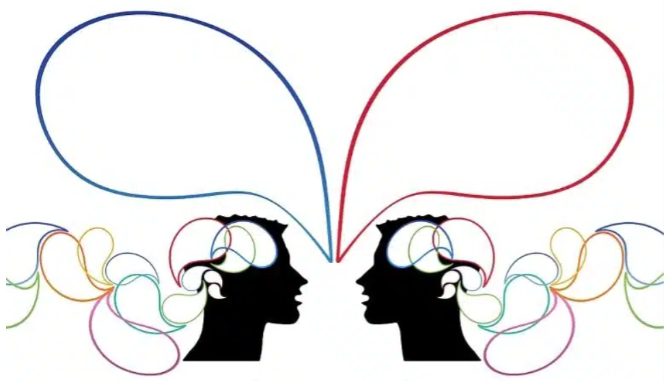


Introduction to Advanced topics in Biomedical Informatics
Speech Signal Processing
Dr. Anastasia Pentari
Email: anpentari@gmail.com

Slide 2

Dr. Anastasia Pentari: Short Biography
Education:
- 2013: Diploma, Electrical & Computer Engineering, Technical University of Crete
- 2015: MSc, Electrical & Computer Engineering, Technical University of Crete
- 2022: PhD, Computer Science, University of Crete
- 2022-Current: Postdoctoral Researcher, CBML, FORTH
Main Research Interests:
- Speech and voice processing (medical data)
- Signal processing for emotional state recognition
- Development of algorithms based on machine learning and deep learning
- Graph theory applied to signals (such as speech, EEG)

Slide 3
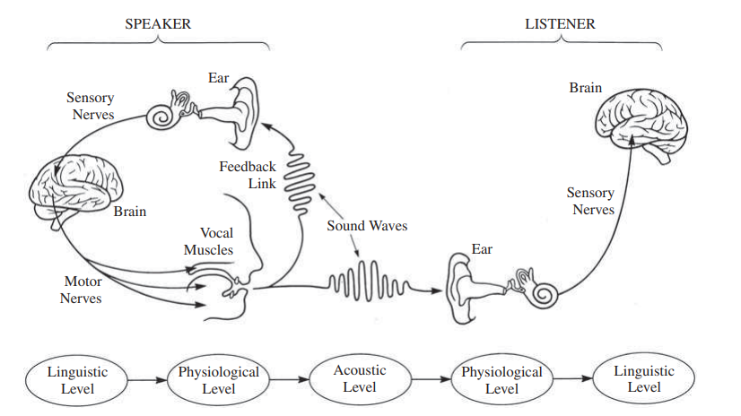
What is Speech?
Speech is the main means of communication between humans.
It is characterized by variations in tone, style, articulation, and other elements.

Slide 4
Speech Transmission (Speaker → Listener)
From a linguistic perspective, an idea is first formed in the speaker's mind
This idea is then converted into: a) words; b)phrases; c) sentences,
According to the grammatical rules of each language
During normal communication:
  The brain generates electrical signals
  These signals travel along motor nerves
  They activate muscles in the vocal tract and the vocal cords

Slide 5
Speech Transmission (continued)
Movement of the vocal tract and vocal cords produces a sound wave that exits through the lips
The sound wave propagates through space (through interactions between air particles) and vibrates the eardrum of the listener
This vibration creates electrical signals that travel through sensory nerves to the brain
Finally, the listener's brain performs:
  speech recognition
  speech understanding at a linguistic level

Slide 6
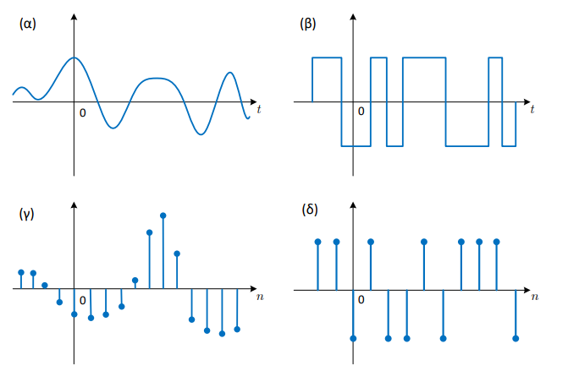
Digital Speech
Through digital technology and the conversion of analog quantities into digital form, speech can be represented as a signal.
A speech signal can be represented as a discrete-time signal, i.e., a set of samples.
(a) Analog signal, continuous time
(b) Digital signal, continuous time
(c) Analog signal, discrete time
(d) Digital signal, discrete time

Slide 7
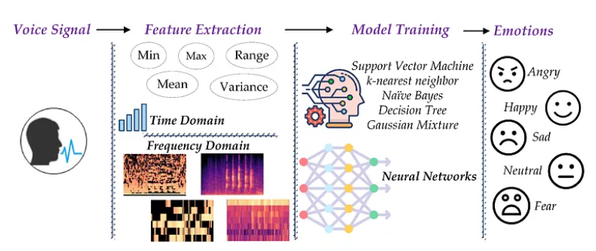
Main Applications of Speech Processing
Speech analysis can be used to recognize emotions from speech.
Speech analysis also helps in diagnosing and monitoring mental health conditions such as:
  depression
  anxiety
by analyzing:
  voice tone
  speech patterns
  vocabulary
https://medium.com/@evertongomede/speech-emotion-recognition-unveiling-the-emotional-spectrum-through-sound-2dde24273616

Slide 8
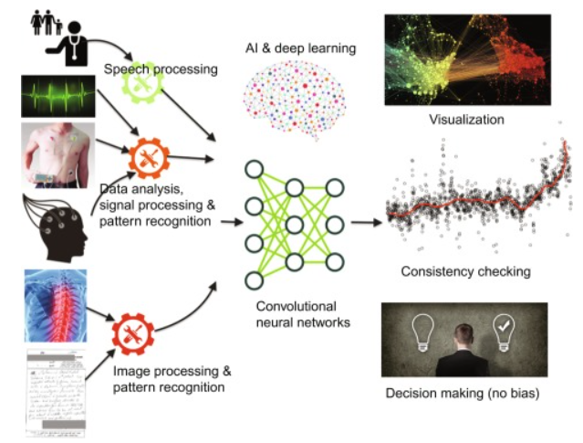
Other Applications of Speech Processing
Voice Biometrics
  Used for security and identity verification
  Analyzes unique voice characteristics to confirm identity
  Adds an extra layer of security for banking or sensitive operations
Smart Assistants
  Virtual assistants (e.g., Alexa)
  Understand user commands
  Recognize specific voices
  Provide personalized responses
https://www.sciencedirect.com/topics/computer-science/speech-analysis

Slide 9
Important Applications of Speech Analysis
Characteristics-Indices-Biomarkers: quantification of speech characteristics with the aim of disease recognition/disease progression/determination of medication
Telemedicine: Very often the collection of speech data is done through an application → Processing → Clinical evaluation → Clinical response (as in remote areas)

Slide 10

Speech Signal Processing Procedure
Denoising/Filtering: Improve signal quality
Speaker Identification
Speech Recognition:
Extraction of speech-based features
Speech Coding:
Compression processes
https://stock.adobe.com/gr_en/search?k=robot+cartoon&asset_id=559871209

Slide 11
Speech Signal Processing Procedure
Recording speech.
A common step is denoising:
  separating the signal of the speaker of interest from other speakers
  reducing environmental noise
Extracting optimal information from the speech signal:
  depends on the application
Extracting appropriate features
Representation as:
  graphs
  spectrograms.
Classification / recognition / speaker separation

Slide 12
What are the (speech) Features?
Healthy Subjects
Patients with Parkinson’s Disease (PD)
Normal
structured speech flow
wide vocal range
high speaking rate
speech with frequent pauses
limited vocal range
low/slow speaking rate
Suppose that we want to differentiate healthy subjects from PD Patients, through their speech recordings:
We will search for differences between the two groups → The quantification of these speech-based differences are the so-called FEATURES

Slide 13
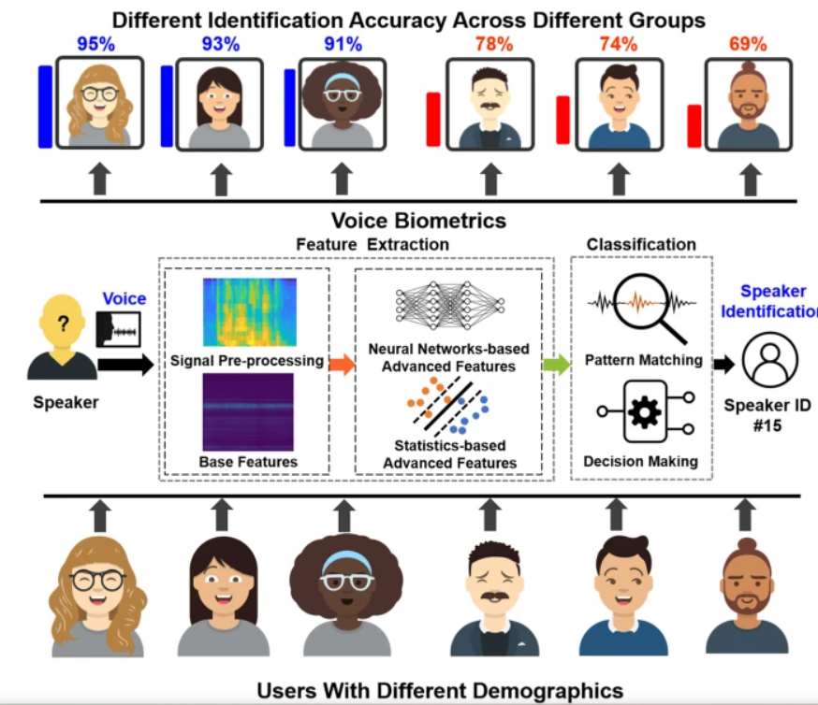
Definition of Features
Features are representative quantities of a general characteristic of a dataset
In other words, they are representations of useful information from signals in different spaces or domains, which help us quantify speech signals
https://www.nature.com/articles/s41598-022-06673-y

Slide 14
Why do we extract Features?
Speech signals usually have:
  long duration
  many samples
Although raw speech recordings contain important information (e.g., emotional state), computers cannot interpret speech the way humans do
Therefore:
  features are extracted or computed
  to help computational methods understand what humans perceive

Slide 15
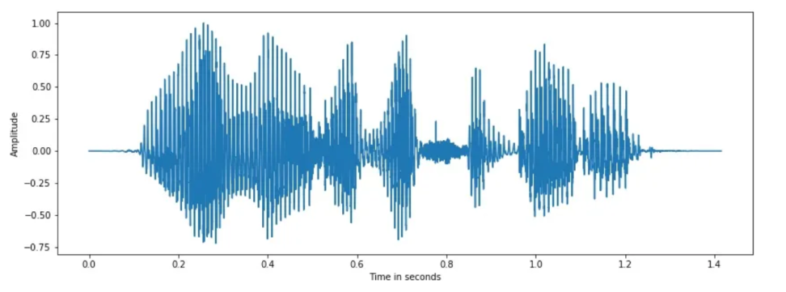
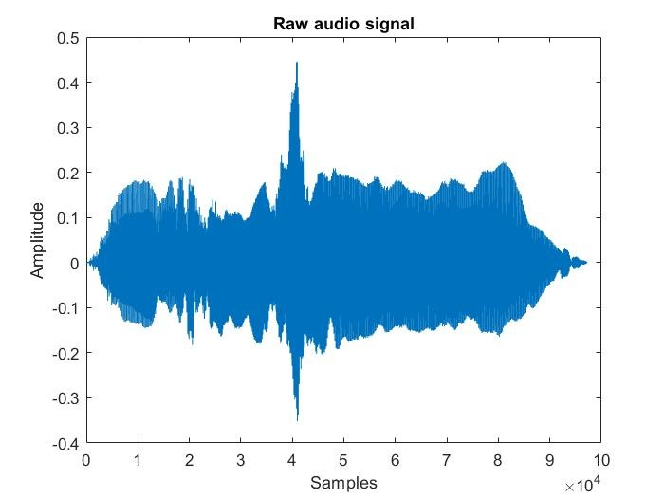
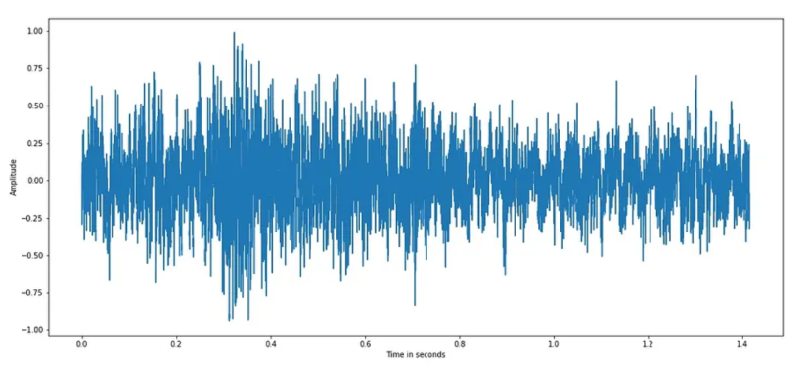
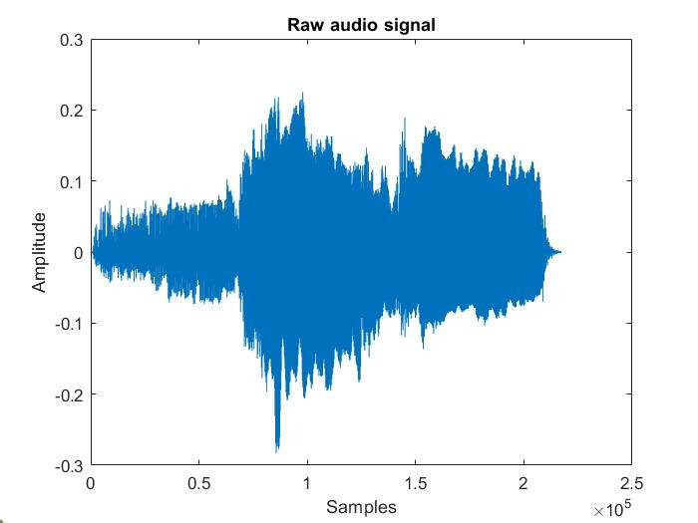
Examples of Speech Signals
Man-Woman
Healthy-PD Patient

Slide 16
Speech-based Characteristics/Features
We can extract voice and speech characteristics by representing the signals in various domains or through various mathematical processes:
Indicatively, their main processing is done
a) in the time domain,
b) in the frequency domain, including spectral representations

Slide 17
Prosody in Linguistics
Prosody refers to:
  rhythm
  tone
  intonation of speech
Through prosody we can understand characteristics of the speaker such as:
  emotional state
  type of utterance (e.g., question)
  presence of irony or sarcasm

Slide 18
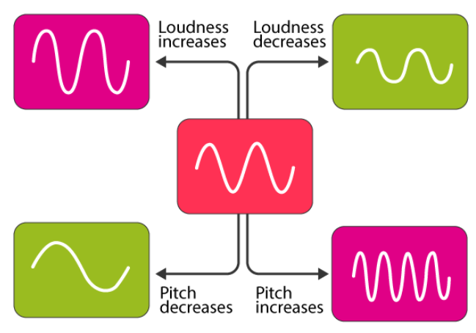
Prosodic Time Features
Pitch: perceived frequency of the speaker’s voice
Phoneme duration: short or long sounds
Voice intensity: related to signal amplitude
Voice quality
https://byjus.com/physics/loudness-of-sound/

Slide 19
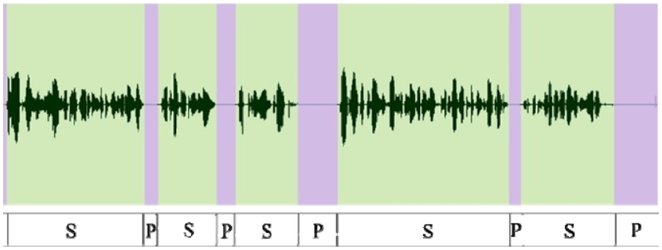
Examples of Time Features
Number of strong peaks per second
Mean and standard deviation of continuous speech segments
Analysis of speech pauses
https://ebrary.net/93224/language_literature/segmentation_speech_signal

Slide 20
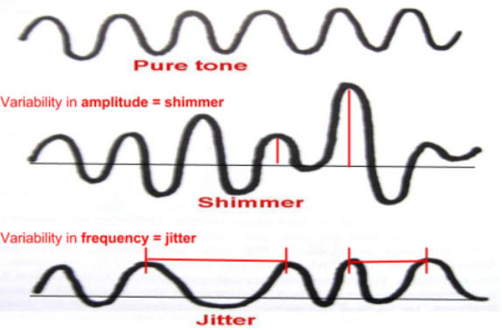
Important Speech-based Features (1)
Shimmer: Measures the short-term variability in the peak-to-peak amplitude of successive glottal cycles during sustained phonation.
Refers to the involuntary change in peak amplitude across adjacent phonatory cycles.
Clinical significance:
  High shimmer levels may indicate reduced glottic resistance
  May suggest mass lesions on the vocal
  Perceptually associated with breathiness or hoarseness in the voice
https://quizlet.com/790202689/ch67-speech-and-hearing-science-flash-cards/

Slide 21
Important Speech-based Features (2)
Jitter: Measures the short-term variability in the fundamental frequency (F0) or the duration of the glottal period.
Represents cycle-to-cycle frequency variation that cannot be explained by voluntary changes in fundamental frequency.
Clinical significance:
  Elevated jitter often results from poor control of vocal fold vibration.
  Can be caused by neurological tremors or increased vocal fold tension.
  Perceptually associated with a rough or cracked voice quality.

Slide 22
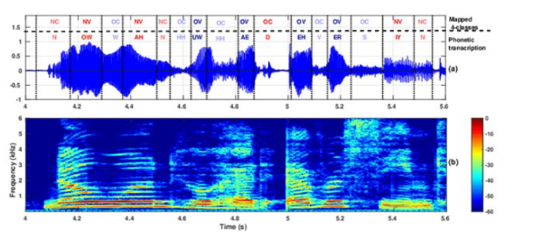
Features in Frequency Domain
Spectrum: Transformation of a signal into the frequency domain
The main frequency of a voice is denoted as F0 (fundamental frequency) and it is not a formant
The secondary frequencies are called formants, which essentially quantify the energy carried by a sound signal
https://www.researchgate.net/publication/341084647_Deep_Learning_Based_Prediction_of_Hypernasality_for_Clinical_Applications/figures?lo=1

Slide 23
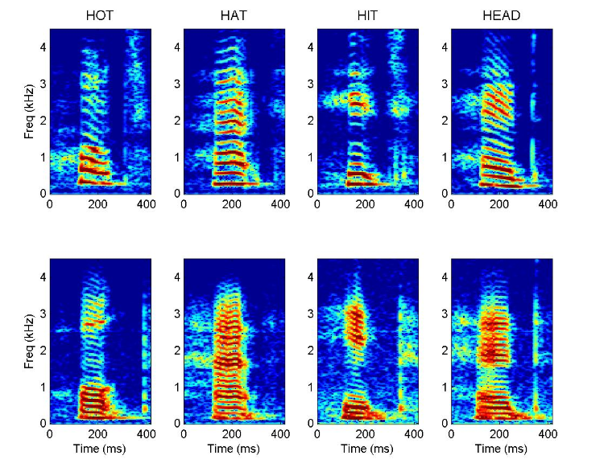
Examples of Spectrums
High Pitch Voice
Low Pitch Voice
https://auditoryneuroscience.com/vocalizations-speech/formants-harmonics

Slide 24
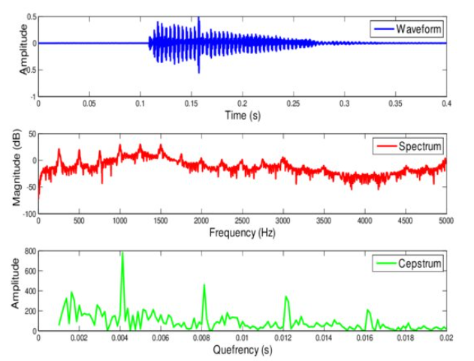
Spectrum Vs. Cepstrum
Cepstrum: Anagram of spectrum: It is related to it
Cepstrum analysis is widely used in speech processing
It is a "tool" through which we can detect periodic structures in the frequency spectrum
Key advantage: The extraction of cepstrum-based parameters quantifies the periodicity of speech signals and they have proven to be more efficient quantities compared to spectrum-based ones
https://www.researchgate.net/publication/330015428_Text_Dependent_Speaker_Recognition_Using_HTK/figures?lo=1

Slide 25
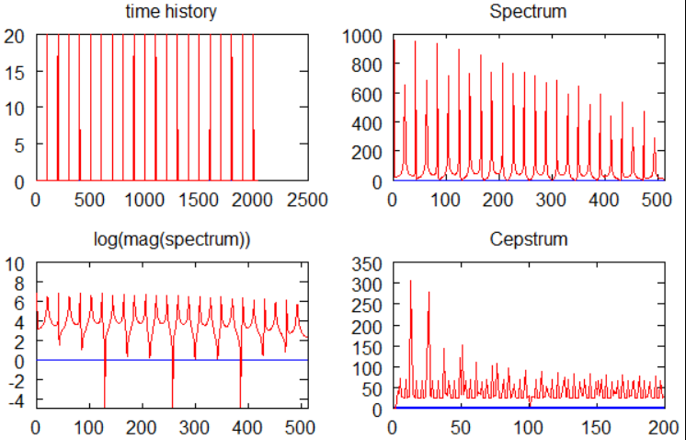
Cepstrum and MFCCs Computation
a) Conversion of a signal from the time domain to the frequency domain; b) Calculation of the logarithm of the spectrum amplitude; c) Application of Inverse Fourier Transform
Mel-Frequency Cepstrum Coefficients (MFCCs): 14 features can be extracted from the cepstrum, which focus on the way humans perceive sound, especially speech.
They reduce noise and emphasize important sound characteristics.
Source: wikipedia

Slide 26
eGeMAPS
Among the most well-known and well-established Speech-based Feature Sets: the Geneva Minimalistic Acoustic Parameter Set (GeMAPS)
As well as its extended version: The extended-GeMAPS (eGeMAPS)
The set consists of 88 speech characteristics
eGeMAPS are effective, especially in Speech Emotion Recognition
For further information: F. Eyben et al., "The Geneva Minimalistic Acoustic Parameter Set (GeMAPS) for Voice Research and Affective Computing," in IEEE Transactions on Affective Computing, vol. 7, no. 2, pp. 190-202, 1 April-June 2016

Slide 27
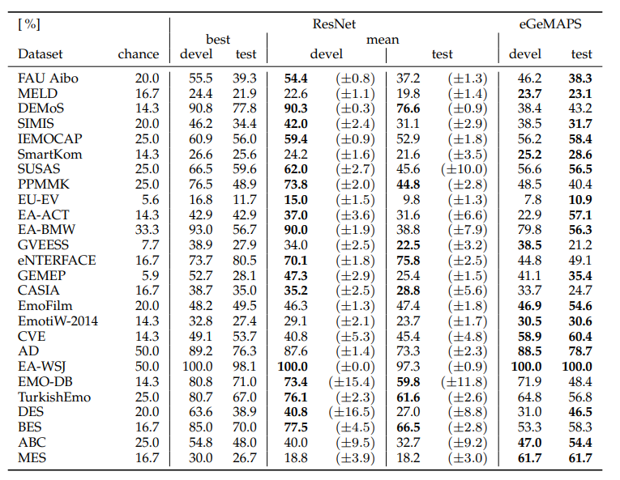
Example of eGeMAPS Efficacy
Generally, speech features can prove effective in one application but not the same in another
Main reasons:
  Different languages
  Different grammatical rules
  Different cultures
  Diversity among speakers

Slide 28
Machine Learning
Machine Learning is the field of computer science that studies the implementation of algorithms which learn without being explicitly programmed with specific rules.
Essentially, these algorithms use data in order to discover patterns and relationships between them, so they can make predictions or decisions.

Slide 29
Machine Learning Basic Techniques
Supervised Learning: In this technique, the program is trained to understand the relationship between the data it is given and a desired outcome. The data labels are provided.
Unsupervised Learning: In this technique, data is given to the algorithm, and it attempts to discover possible patterns among them, usually by creating groups (clusters). The true labels of the data are not provided.

Slide 30
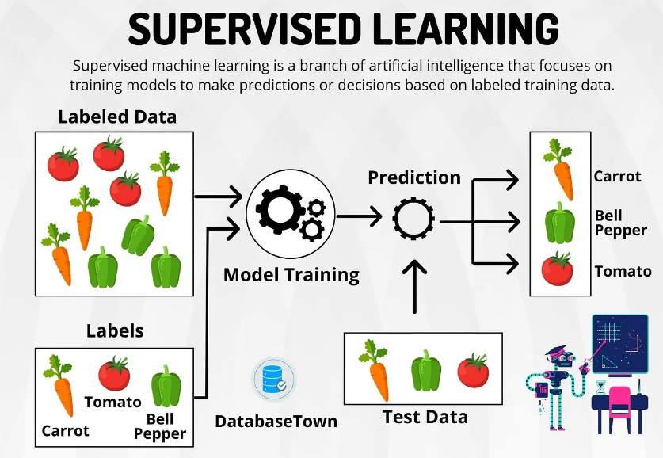
Supervised Learning
https://medium.com/@gerzson.boros/a-simple-introduction-into-supervised-learning-dcce83ee3ada

Slide 31
Supervised Learning Procedure
The basic logic follows this process:
From the available data, we extract useful information, thus creating the feature set (features).
We split the processed data (i.e., the features) into a training set (80%) and a testing set (20%) → independent sets.
Training procedure: We select the training algorithm and provide it with the training set as input along with the corresponding data labels.

Slide 32
Supervised Learning Procedure
Testing procedure: After the algorithm is trained, we move on to predicting the testing set, that is, we examine whether it can recognize the identities of the data (also in the form of features) that it has not seen before
Sometimes we need to use e.g. 10% of the data for cross-validation, that is, to find which algorithm performs best on the data or their optimal parameter values
An equally important process is hyperparameter tuning: Using a subset of the data, we examine the values ​​of the hyper-parameters that give the best performance

Slide 33
Advantages & Disadvantages
Pros
Cons
High Accuracy
Adaptability
Prune to noise
The algorithms can be effective to big/large sets of data
Need large sets of data
Usually high complexity cost
Limited Generalizability
Difficult to interpret (i.e., the features)

Slide 34

Graph Theory for Speech Signal Analysis

Slide 35
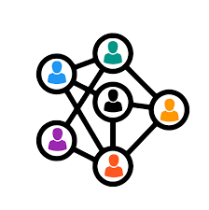
What is a graph?
Representation of the interrelations among multiple objects
Applications:
  Economy
  Telecommunications
  Neuroscience
  Recently, we applied graphs on speech signal analysis
A graph G = (V,E) consists of:
  V: number of nodes
  E: number of edges
Node: denotes the object
Edge: the interrelation between two objects

Slide 36
Types of graphs
Directed graphs (or digraph): is a representation in which the edges have direction
  an edge (v,u) is different than the (u,v)
Undirected graphs: no directions
  (v,u) edge is equal to (u,v)

Slide 37
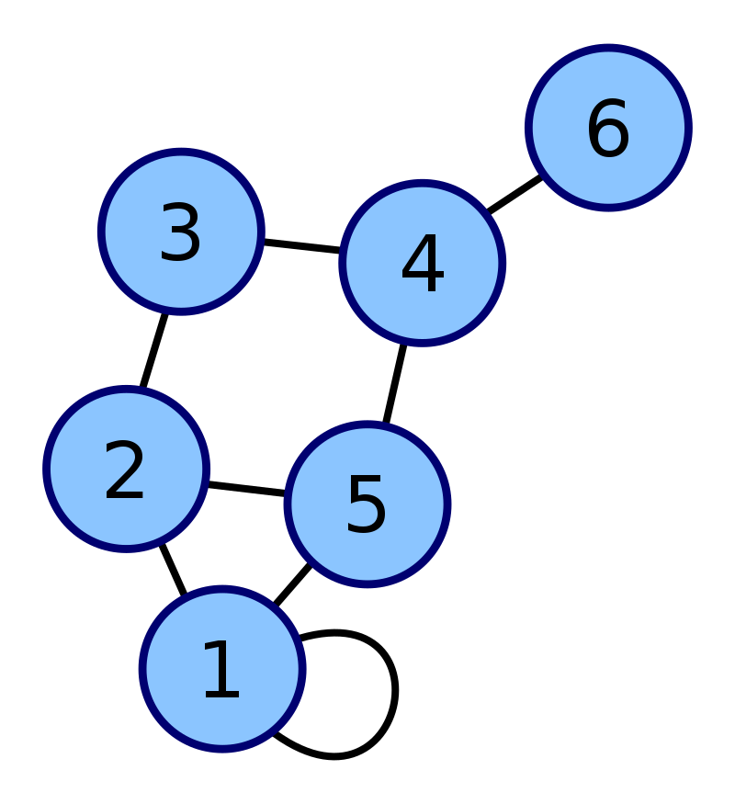
How can we represent-construct a graph?
The most important quantity of the graph theory is the adjacency matrix (A)
The adjacency matrix shows the connections among the nodes
  shows which nodes are neighboring
  Square matrix
  Its size is equal to NxN, where N is the number of available nodes
  Binary: {0,1}
  Weighted: [0,1]
Subgraph: subset of nodes
1 | 1 | 0 | 0 | 1 | 0
1 | 0 | 1 | 0 | 1 | 0
0 | 1 | 0 | 1 | 0 | 0
0 | 0 | 1 | 0 | 1 | 1
1 | 1 | 0 | 1 | 0 | 0
0 | 0 | 0 | 1 | 0 | 0

Slide 38

Ways of constructing a graph
The most well-established method: Pearson’s correlation
  where X, Y are two objects (e.g., time series)
  statistical measure
On the other hand, there exists the topological information, .e.g., geometric
A well-known geometric method: Visibility graph theory
  Exploits the visibility property

Slide 39
How to treat Speech Signals
Usually, speech signals are of long duration
The most traditional approach is window-sliding
Simply, we split the speech signals into (non)-overlapping windows
Non-overlapping windows
Overlapping windows

Slide 40
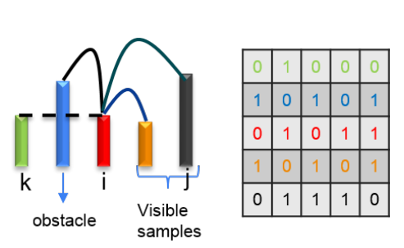
Visibility graph theory
Appropriate requirement: Positive signal amplitudes/values
Adjacency matrix:
  Binary
  Weighted: values analogous to their amplitudes
Split signals into (overlapping windows)
What kind of positive measures can we compute per segment?
  Mean value?
  Standard deviation?
  Absolute distance?
  Other ideas?

Slide 41
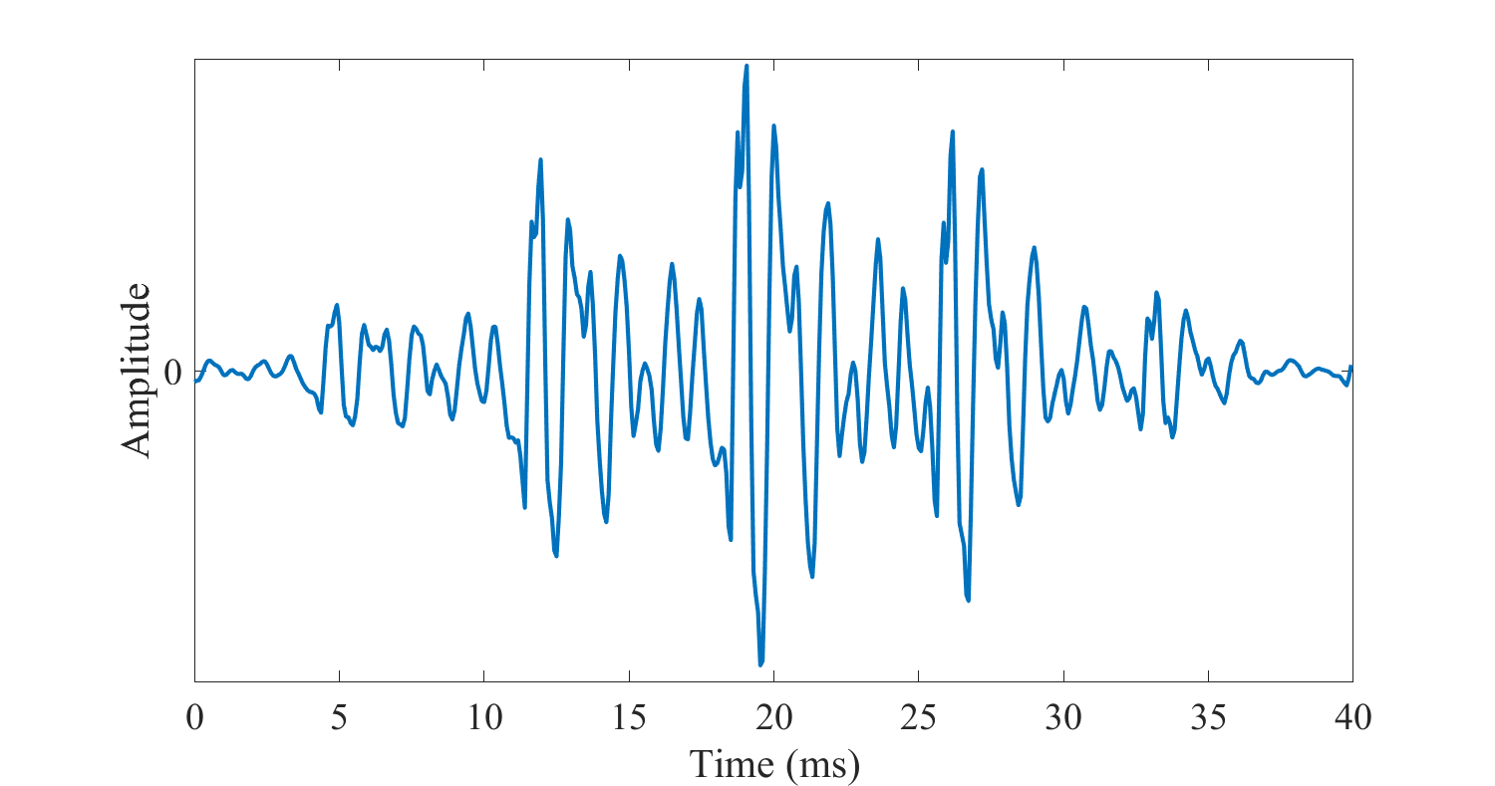
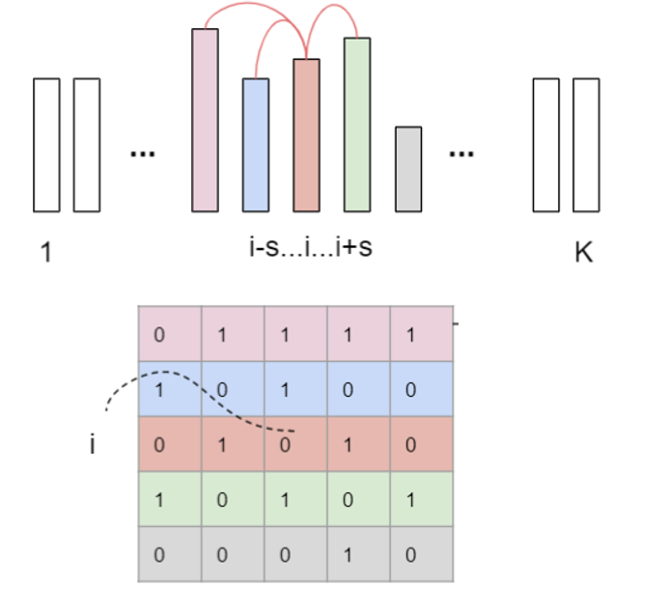
From speech signal to visibility graph
std
…

Slide 42
From graph to the graph-based characteristics
Graphs can be characterized by a variety of graph-based features:
  Degree of connectivity (DoC)
  Density (D)
  Modularity (Q)
  Averaged value of weights (M): Mean value over all the elements of a weighted adjacency matrix
  Clustering coefficient (CC)
  Shortest path length (L)
  Small-world coefficient (S)

Slide 43
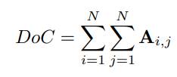
Degree of Connectivity (DoC)
Given the adjacency matrix A:
It shows how many connections (i,j) start from a specific node i to a j

Slide 44
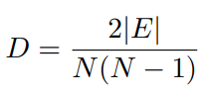
Density (D)
It shows how sparse or dense is a graph
Based on the adjacency matrix:
with |E|: the number of edges, and N: number of nodes of the graph

Slide 45
Modularity (Q) (1/2)
It describes the graph’s strength of division, i.e., its tendency to be split into cluster → the so-called modules
In each module: the connectivity is high
Between two modules: the connectivity is low
A high modularity value → Implies a graph with a tied structure

Slide 46
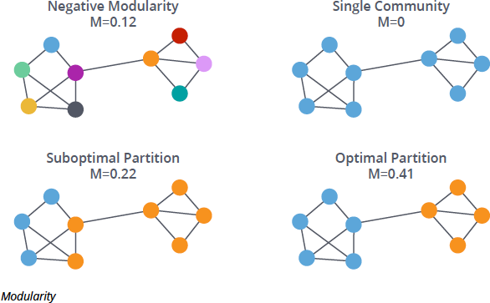
Modularity (Q) (2/2)
[1]

Slide 47
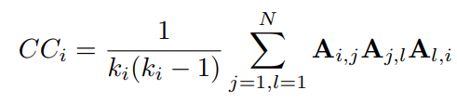

Clustering Coefficient (CC)
The tendency of a node to create cliques/triangles
with:

Slide 48
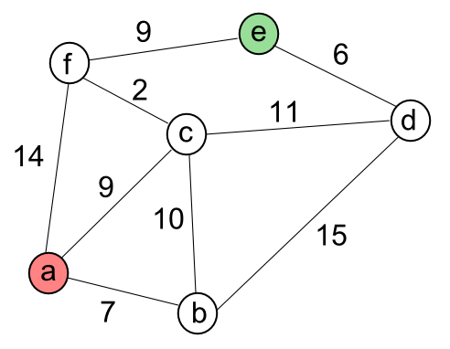
Shortest path length (L)
Characterizes the minimum path we have to pass through in order to be transferred from node i to node j
Which is the minimum cost for travelling from a to e?

Slide 49
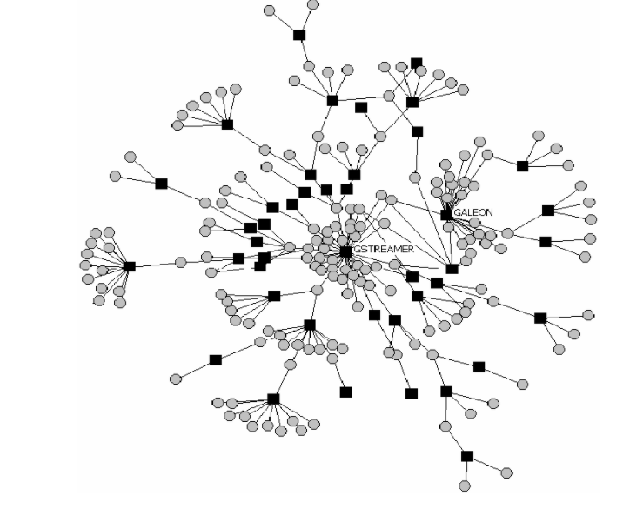
Small-world coefficient (S) (1/2)
Small-world phenomenon: the nodes tendency to create “hubs”

Slide 50
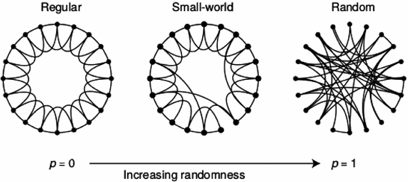
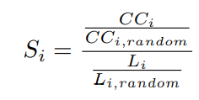
Small-world phenomenon (2/2)
Needs to construct random graph based on our adjacency matrix
  Erdos-Renyi algorithm
  Watts-Strogatz
[4]
If S>1 → There exists small-world

Slide 51
Graph-based features VS GeMAPS
Less features than the GeMAPS
Easier to be computed
Language independent
More efficient in cross-corpus

Slide 52
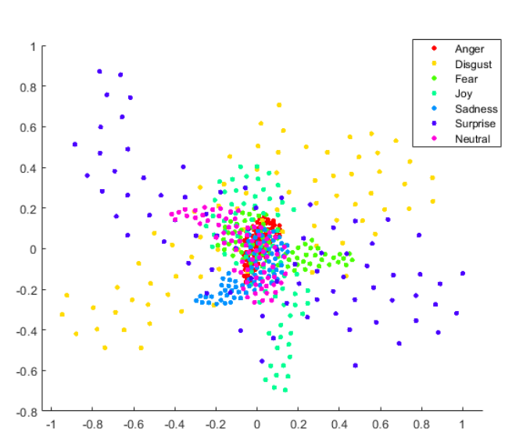
RESULTS
 | SAVEE | EMOVO
eGeMAPS | 40.8 | 37.4
Graph-based Features | 70 | 98
Unweighted Average Recall-UAR (%) Classification Accuracy, multi-class SVM, Leave-One-Speaker-Out (LOSO) Method
SAVEE: British Speech Database of 4 male actors and 480 utterance expressing 7 emotions, i.e., anger, disgust, fear, happiness, sadness, surprise and neutral.
EMOVO: Italian Speech Database of 6 actors and 7 emotional states, consisting of 588 utterances
t-SNE dimensionality reduction, from 6D to 2D feature space, EMOVO

Slide 53
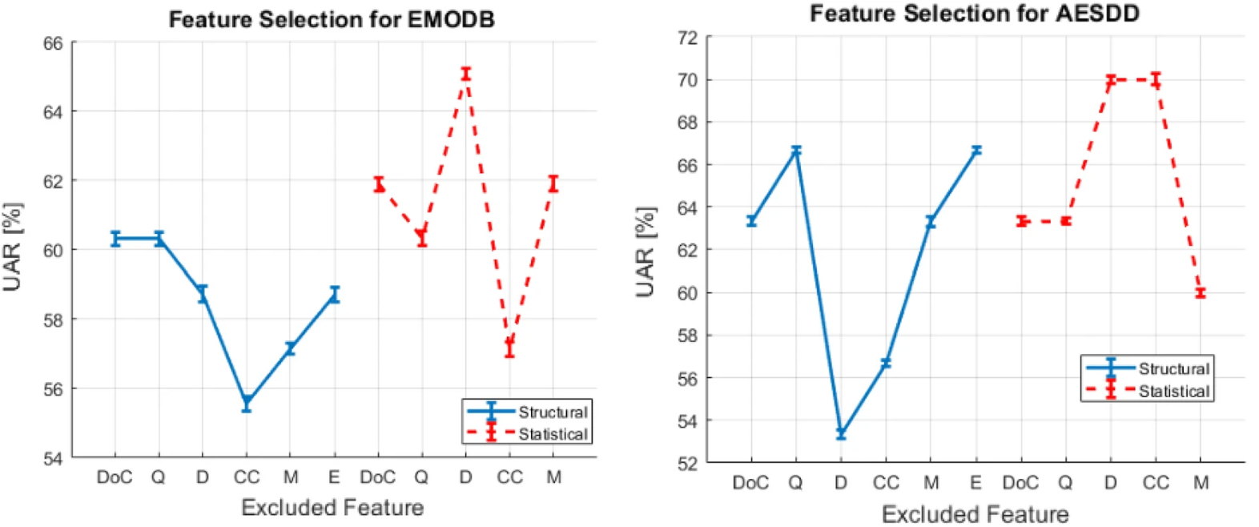
Examples of Graph-based Features
https://www.nature.com/articles/s41598-024-52989-2

Slide 54
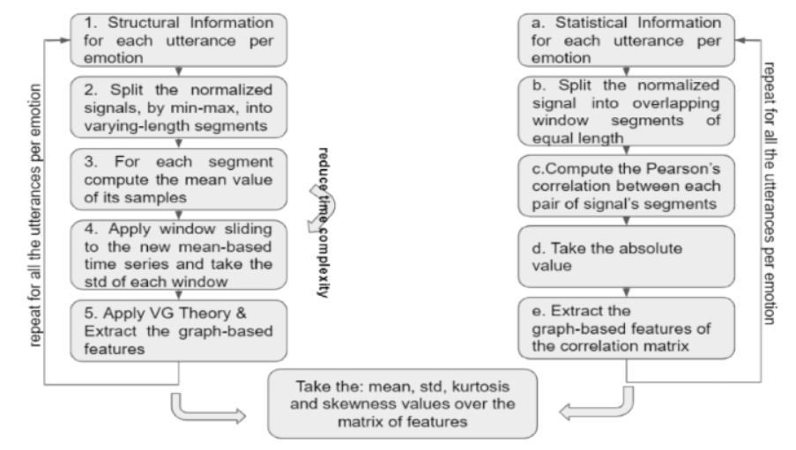
Alternative Graph-based Approach
Using Visibility Graph Theory to create an adjacency matrix of geometric information of speech signals
Using Pearson’s Correlation to create an adjacency matrix of statistical information of speech signals
Extracting graph features
Using statistical metrics

Slide 55
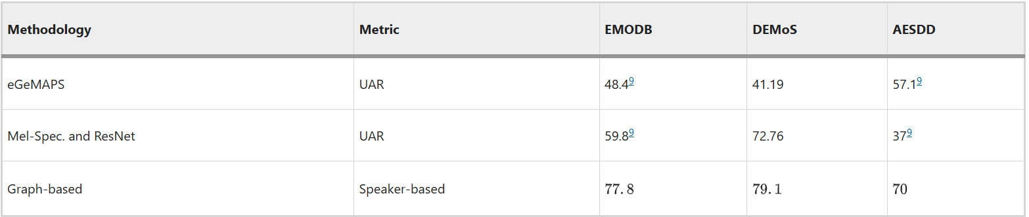
Graph-based Analysis of Speech Signals

Slide 56
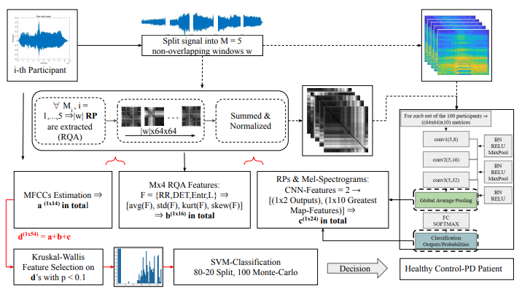
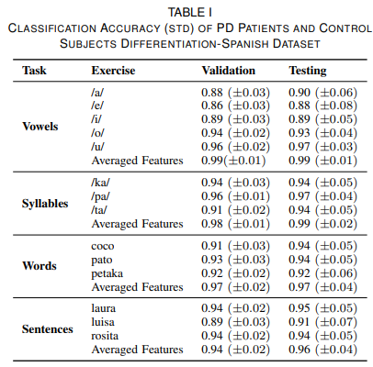
Multi-Representation Analysis of PD-Speech Signals
https://ieeexplore.ieee.org/stamp/stamp.jsp?tp=&arnumber=11250588

Slide 57


