Slide 1
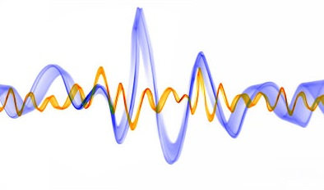
Hellenic Mediterranean University
Department of Electrical and Computer Engineering
Intelligent Systems and Computer Architecture Laboratory
Digital Signal Processing
IIR Filters
Prof. Giorgos Papadourakis, Ph.D.

Slide 2
IIR Filters
FIR vs IIR
FIR vs. IIR
  FIR : Ideal response (linear phase), stable
  IIR :
    Better magnitude response (sharper transition and/or lower stopband attenuation than FIR with the same number of parameters: HW efficient)
    IIR filters are computationally more efficient than FIR filters as they require fewer coefficients due to the fact that they use feedback or poles.
    Established filter types and design methods
    However feedback can result in the filter becoming unstable if the coefficients deviate from their true values.

Slide 3
IIR Filters
IIR filter design procedure
IIR filter design procedure
  Set up digital filter spec
  2) Determine the corresponding analog filter spec
    (frequency translation involved)
  3) Design the analog filter
  4) Transform the analog filter to digital filter using various transformation methods
    Impulse invariant method
    Bilinear transformation
This approach has been widely used for the following reasons:
(1) Analogue approximation techniques are highly advanced
(2) They usually yield closed-form solutions
(3) Extensive tables are available for analogue filter design
(4) Very often applications require digital simulation of analogue systems

Slide 4
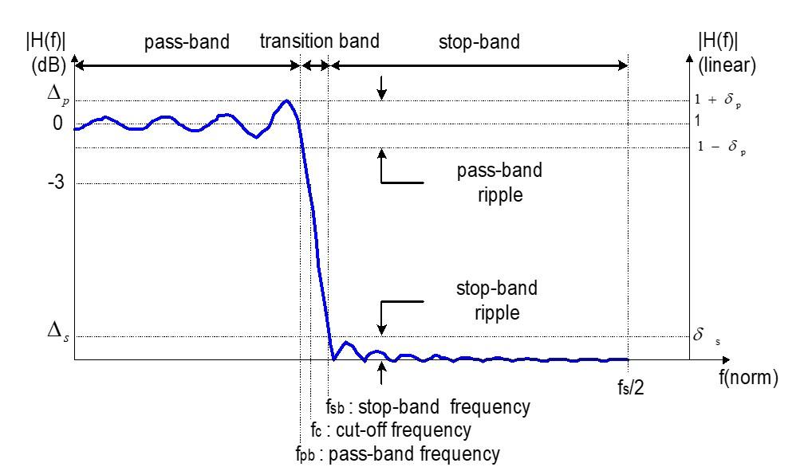
IIR Filters
Filter Specifications

Slide 5
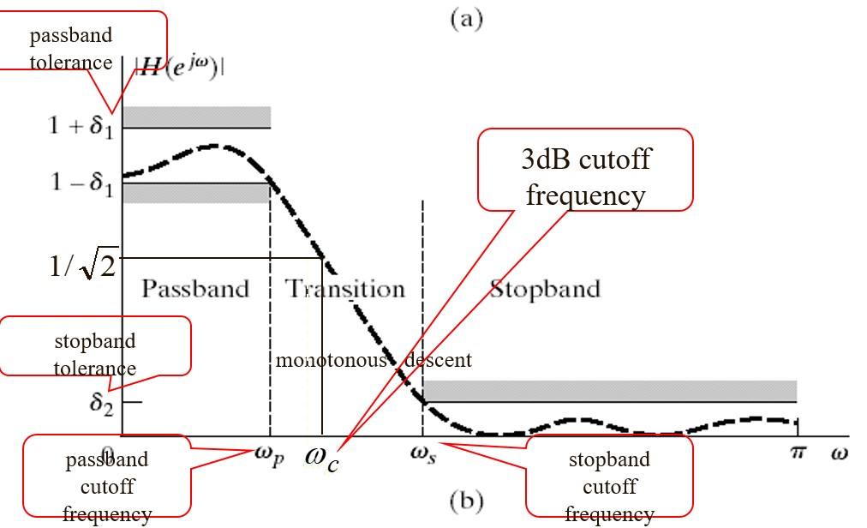
IIR Filters
Filter Specifications

Slide 6
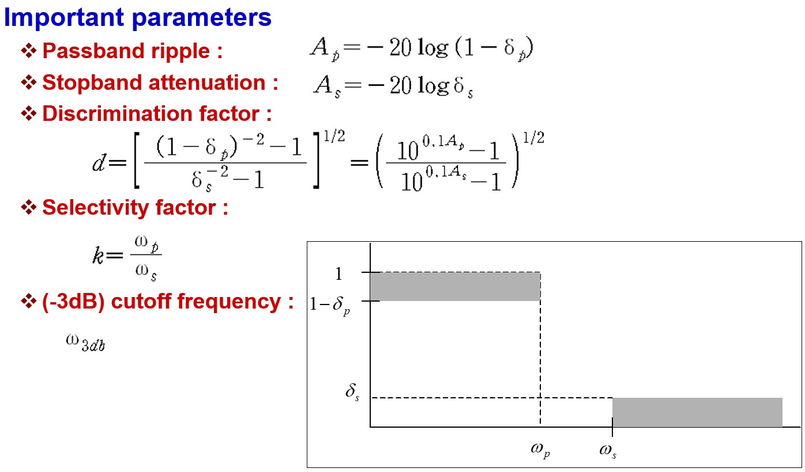
IIR Filters
Filter Specifications

Slide 7
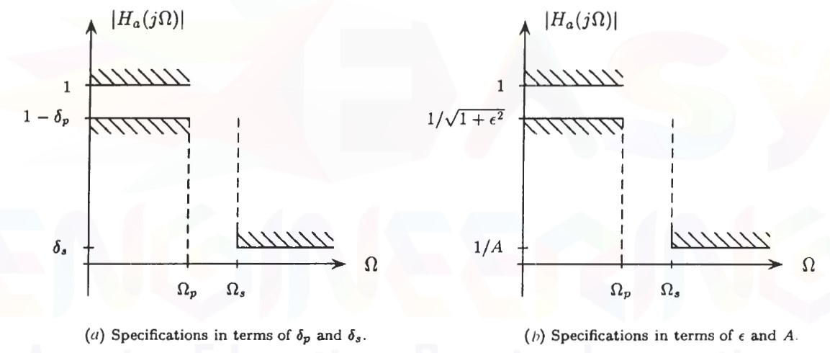
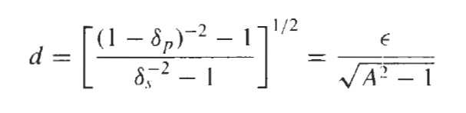
IIR Filters
Filter Specifications

Slide 8
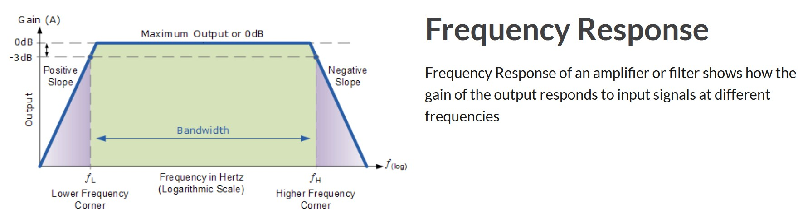
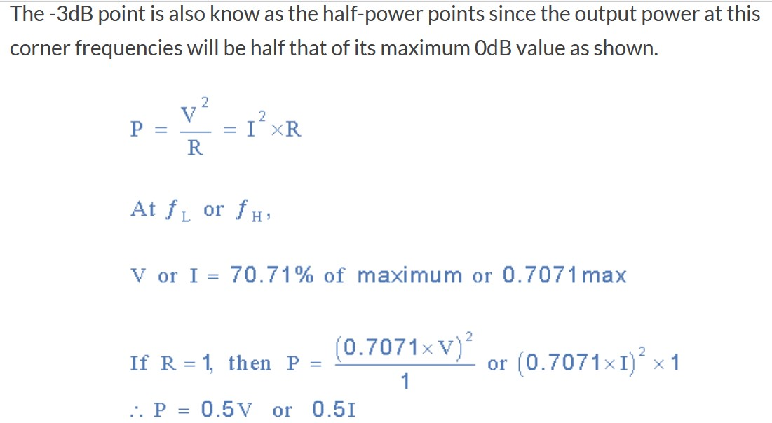
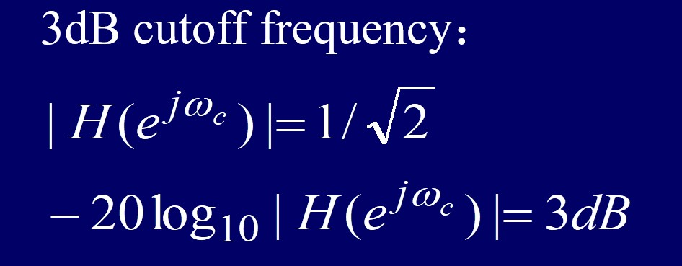
IIR Filters
Filter Specifications

Slide 9
IIR Filters
Filter Specifications
Analog filter types
  Butterworth
  Chebyshev
  Elliptic

Slide 10
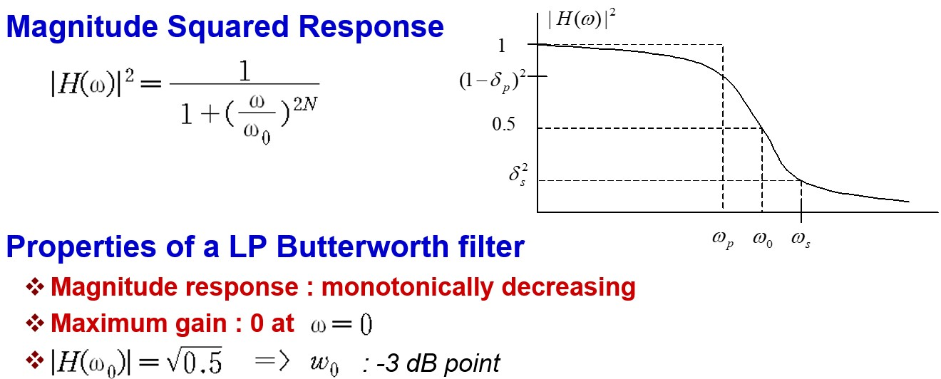
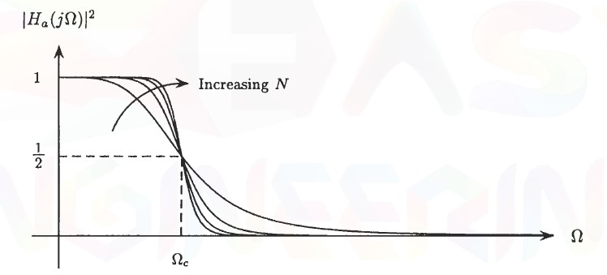
IIR Filters
Butterworth Filters

Slide 11
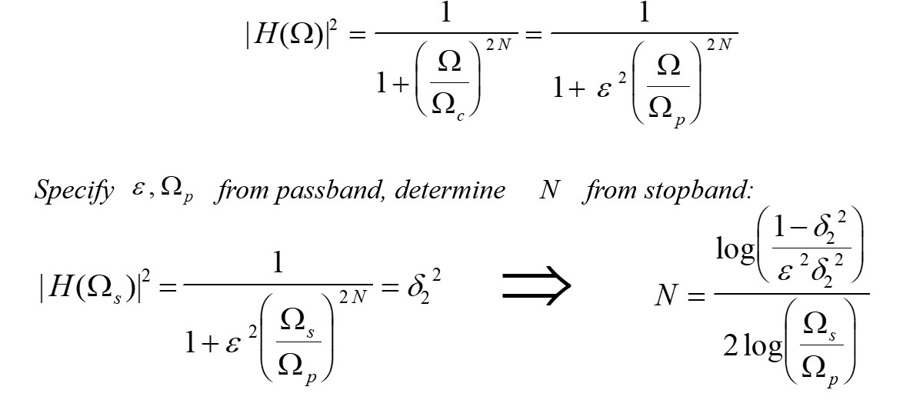
IIR Filters
Butterworth Filters

Slide 12
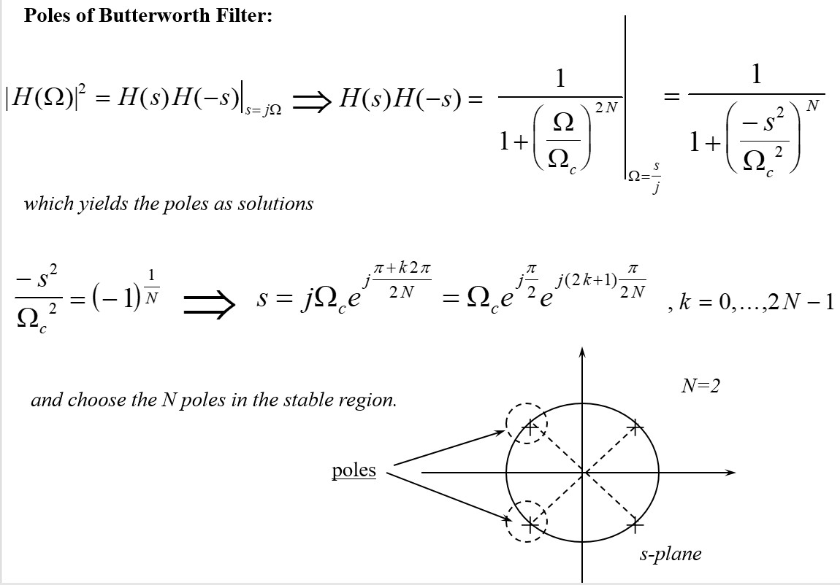
IIR Filters
Butterworth Filters

Slide 13
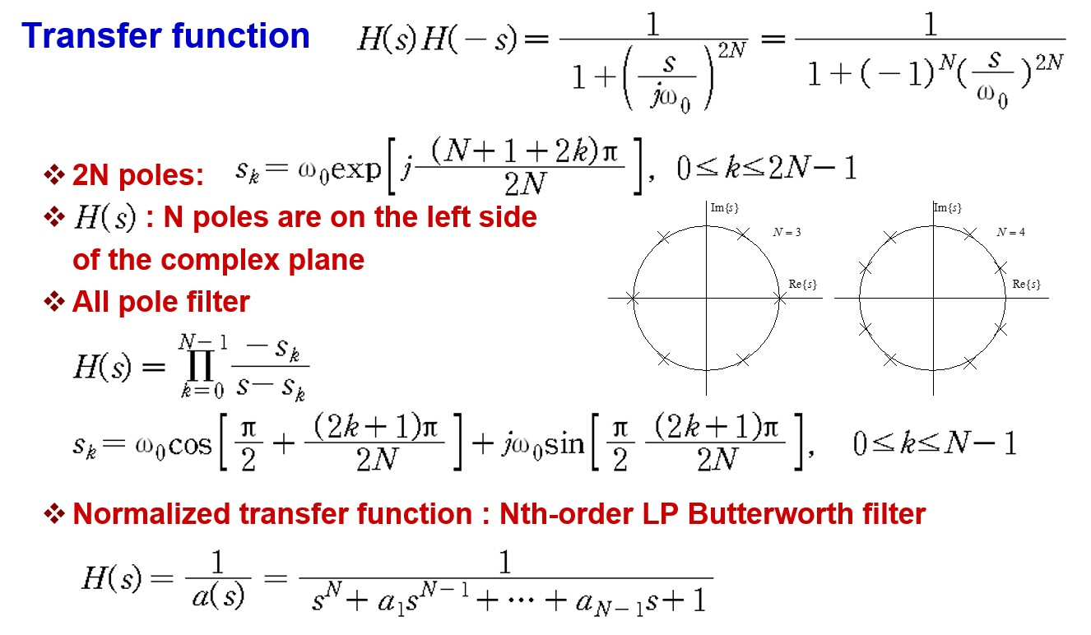
IIR Filters
Butterworth Filters

Slide 14
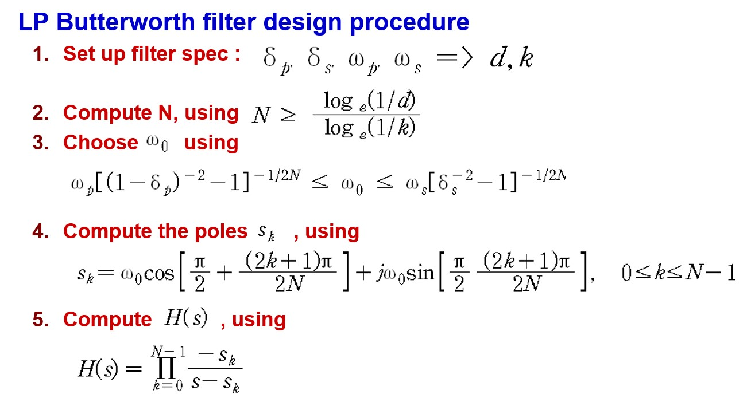
IIR Filters
Butterworth Filters

Slide 15
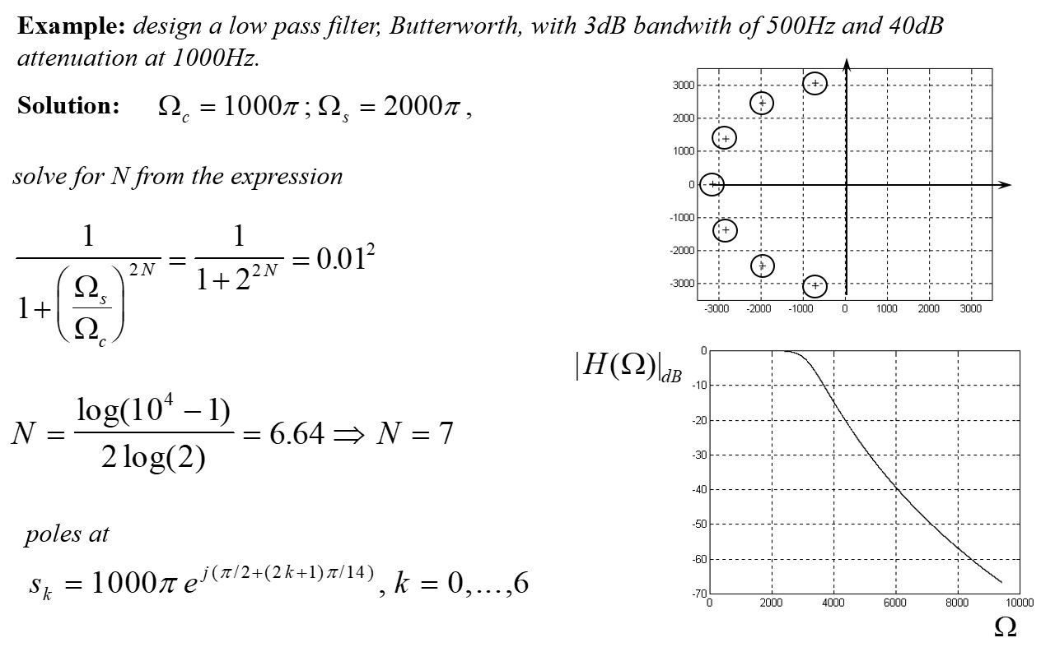
IIR Filters
Butterworth Filters

Slide 16
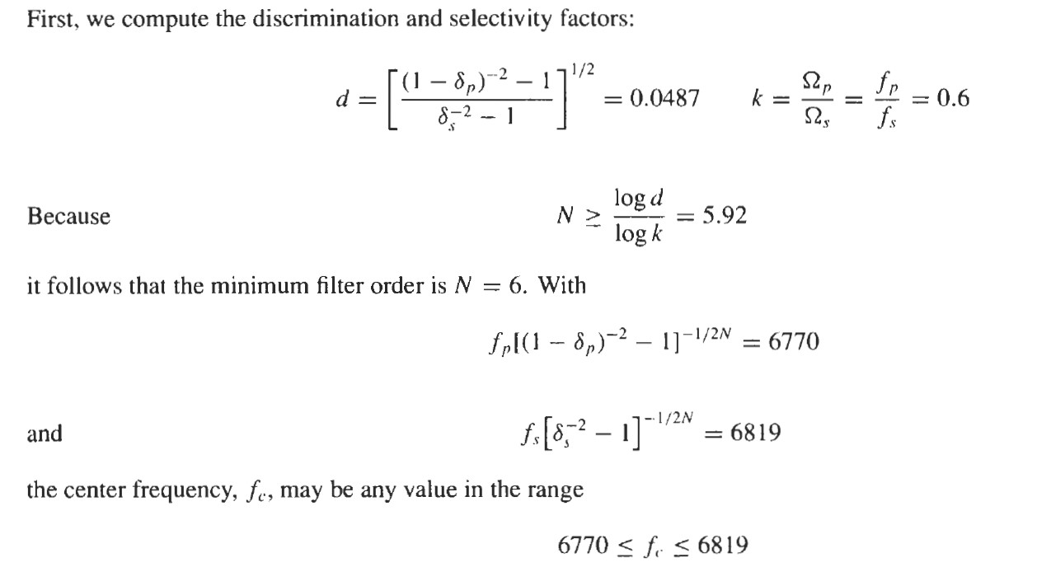
IIR Filters
Butterworth Filters
Example:
Design a low-pass Butterworth filter with the following specifications:
f_{s} = 6 KHz, f_{p} = 10 KHz, δ_{s} = δ_{p} = 0.1

Slide 17
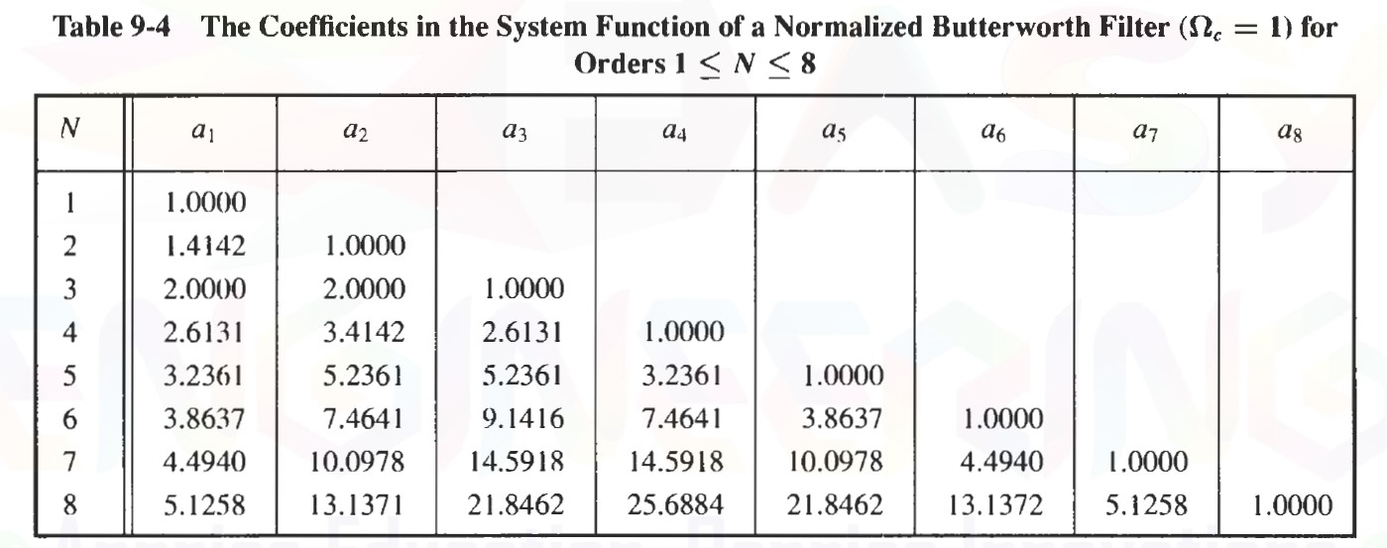
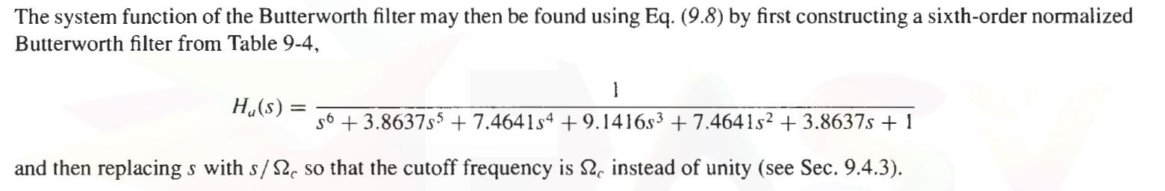
IIR Filters
Butterworth Filters

Slide 18
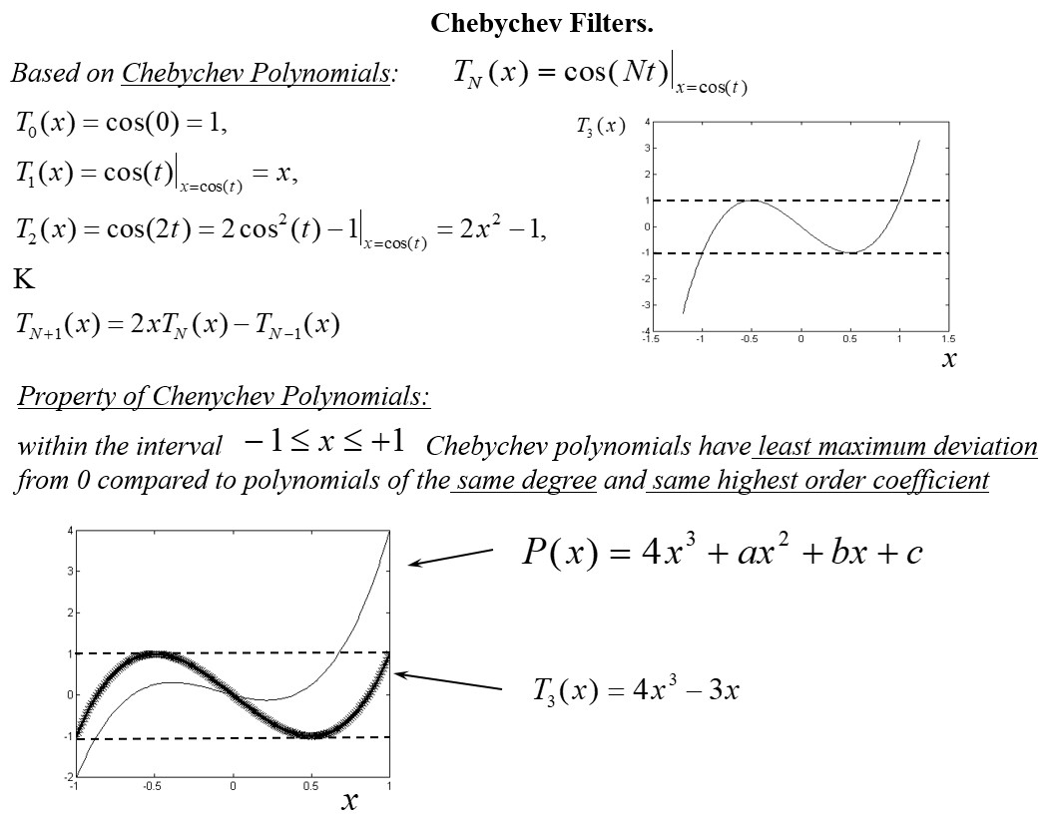
IIR Filters
Chebyshev Filters

Slide 19
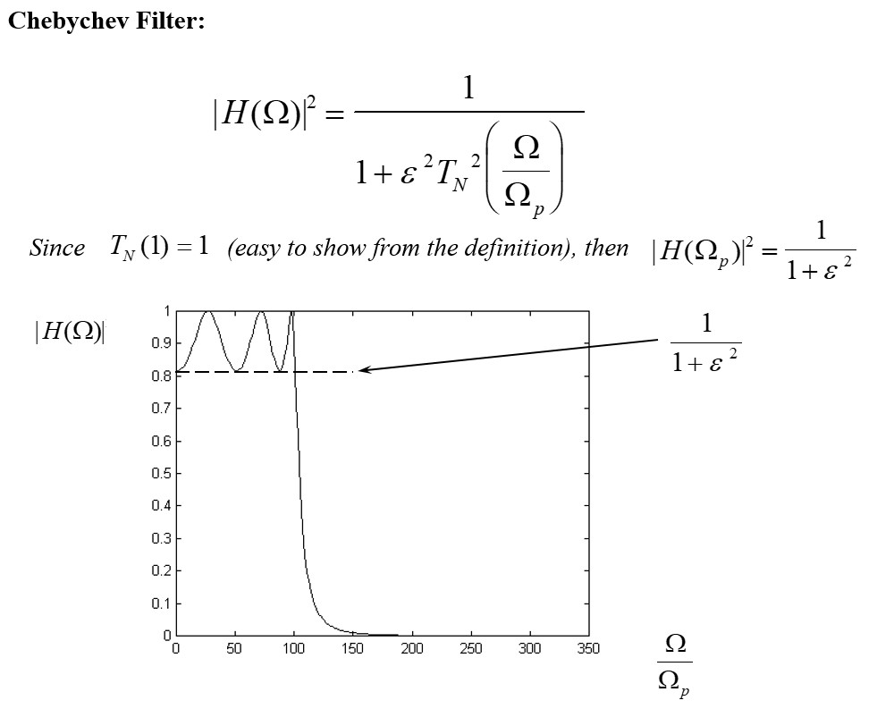
IIR Filters
Chebyshev Filters

Slide 20
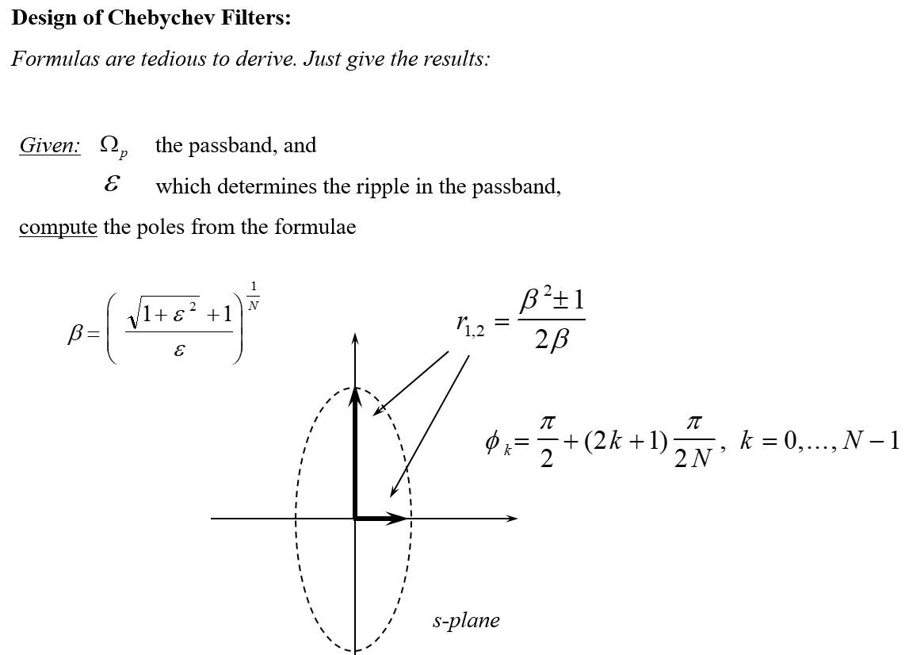
IIR Filters
Chebyshev Filters

Slide 21
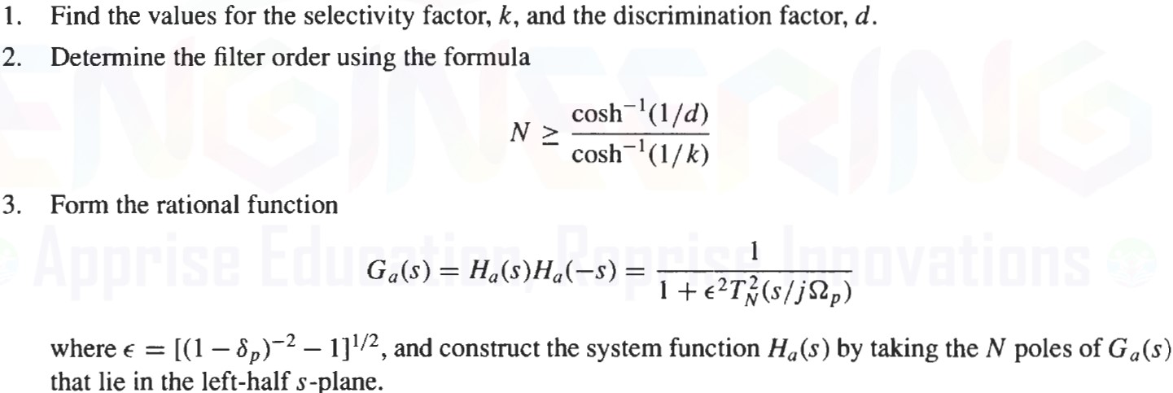
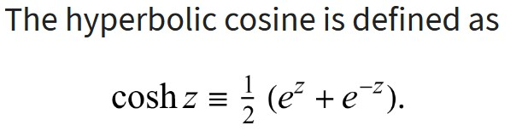

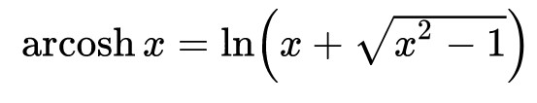
IIR Filters
Chebyshev Filters
Design of a Type I Chebychev Filter
  Given: Ω_{s}, Ω_{p}, δ_{s}, δ_{p}, (or ε and A) Design a low-pass Butterworth filter with the following specifications

Slide 22
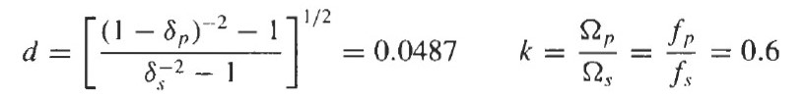
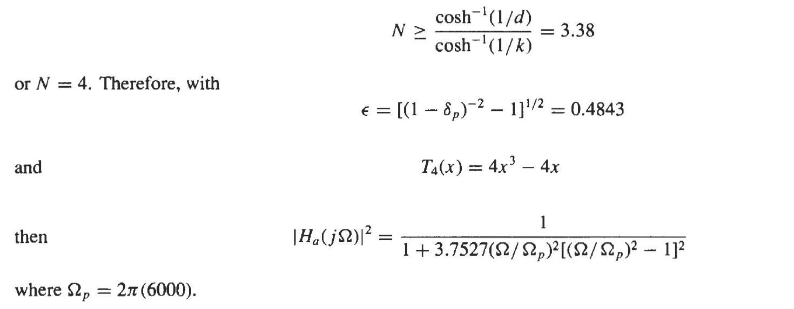
IIR Filters
Chebyshev Filters
Example:
Design a low-pass type I Chebyshev filter with the following specifications:
f_{s} = 6 KHz, f_{p} = 10 KHz, δ_{s} = δ_{p} = 0.1

Slide 23
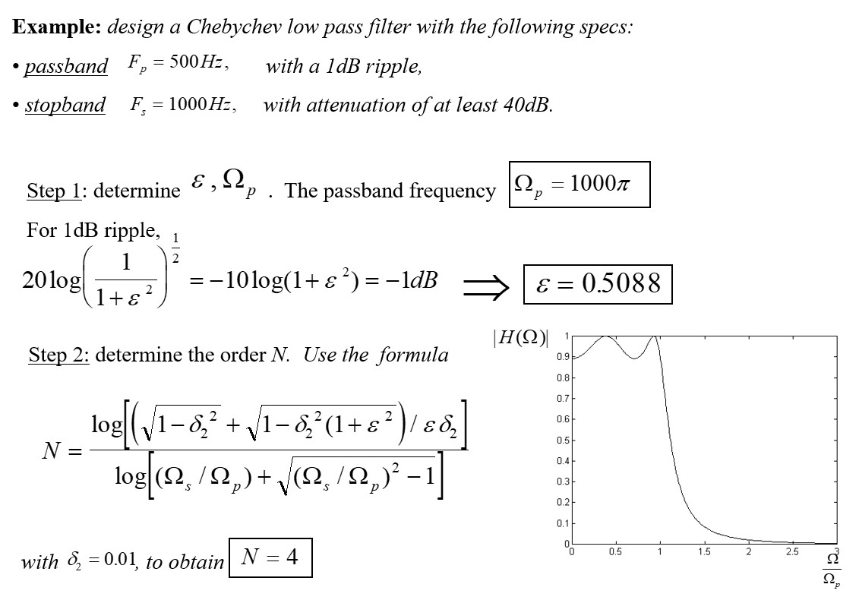
IIR Filters
Chebyshev Filters

Slide 24
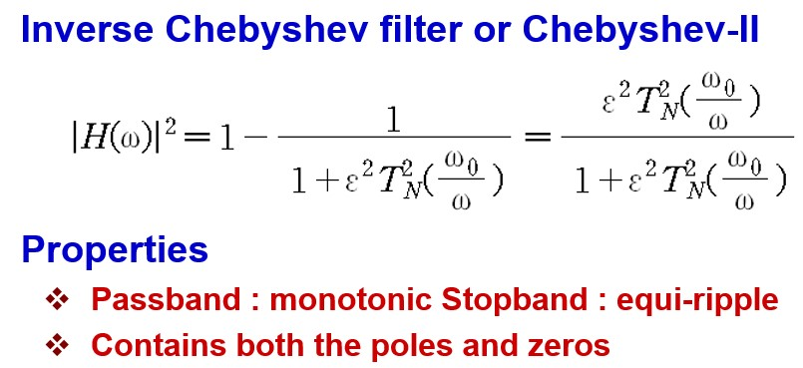
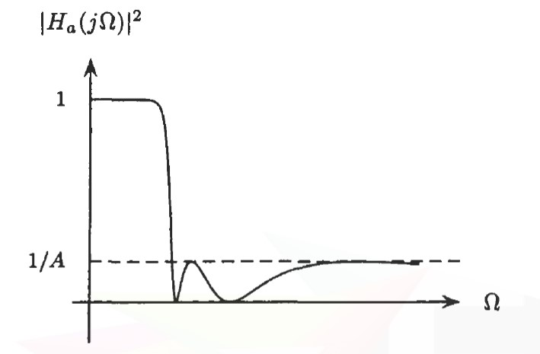
IIR Filters
Chebyshev Filters

Slide 25
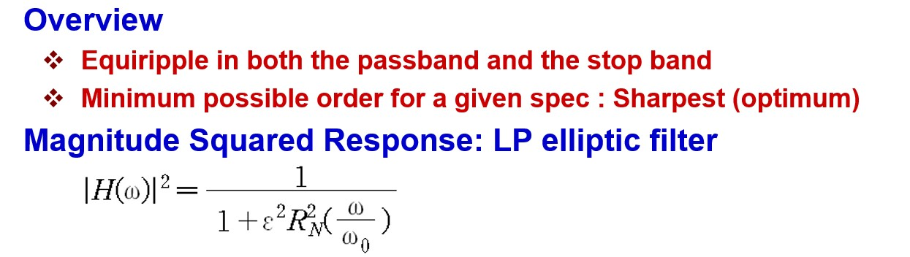
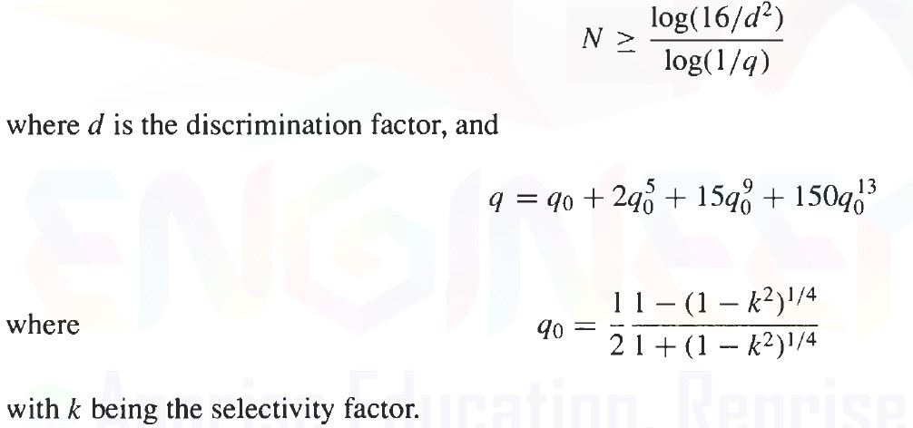
IIR Filters
Elliptic Filters
Design of Elliptic filters more difficult than of Butterworth, Chebyshev
Design relies on Tables or Series Expansions
Estimate order N:

Slide 26
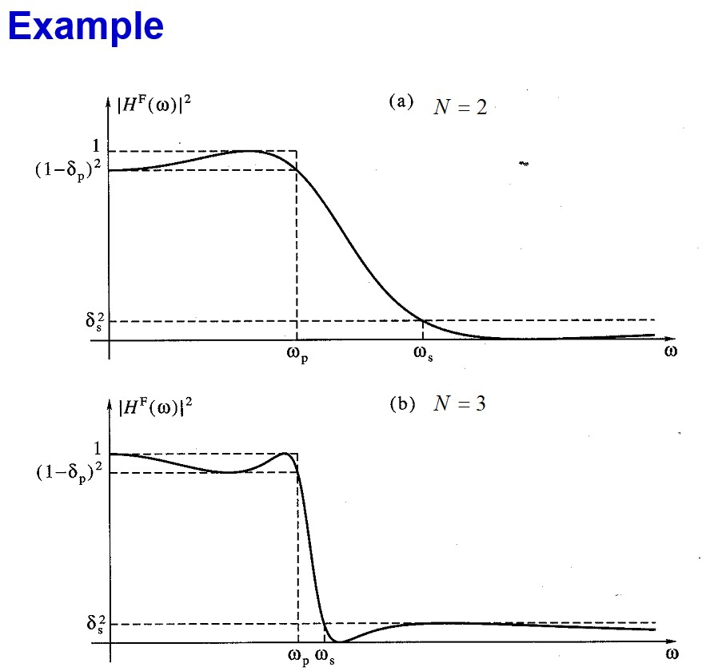
IIR Filters
Elliptic Filters

Slide 27
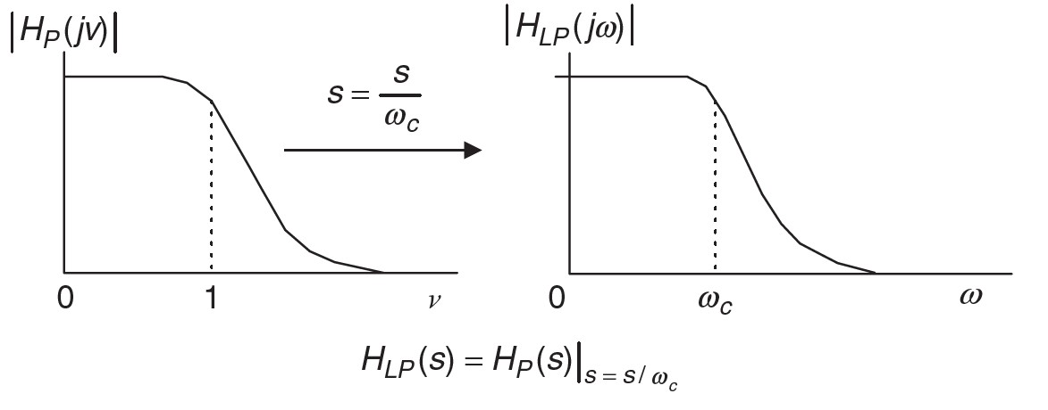
IIR Filters
Frequency Transformations
Analog filter design
  1. Design a LPF (Butterworth, Cheby shev, elliptic)
  2. Analog filters Using Lowpass Prototype Transformation
  to obtain LPF, HPF, BPF, BSF
Lowpass prototype: analog lowpass filter with a cutoff frequency 1 rad/sec
Prototype Transformation into practical analog lowpass, highpass, bandpass, bandstop filters with their frequency specifications.

Slide 28
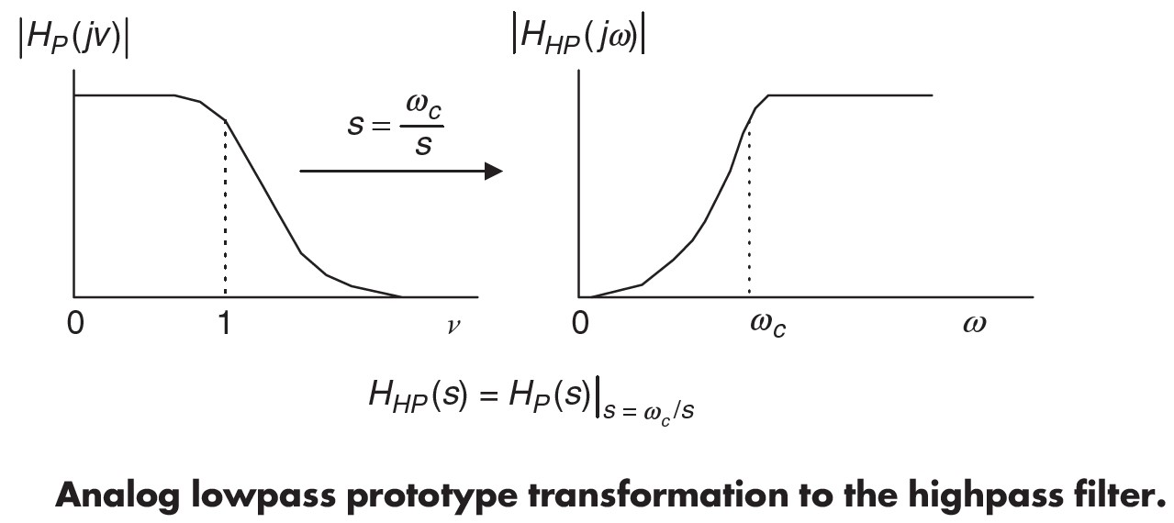
IIR Filters
Frequency Transformations

Slide 29
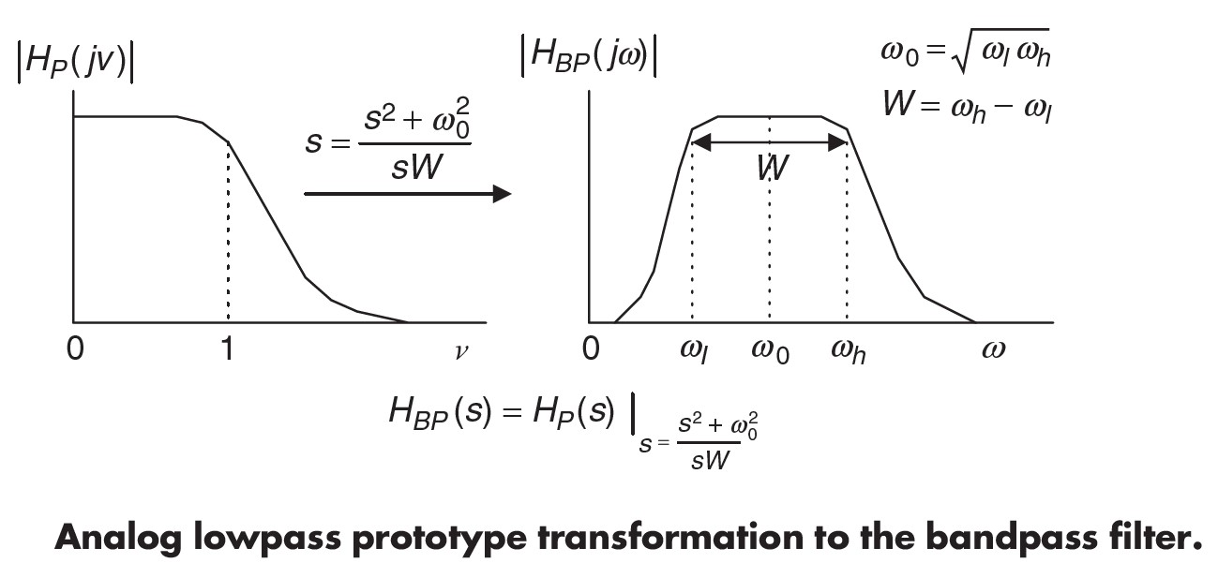
IIR Filters
Frequency Transformations

Slide 30
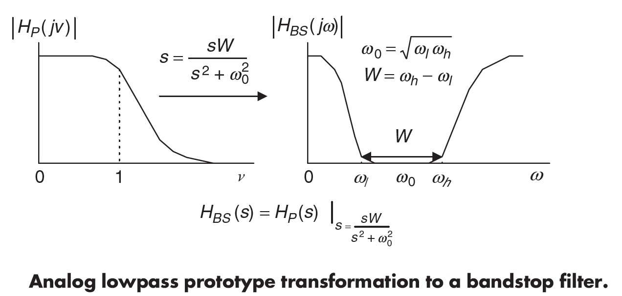
IIR Filters
Frequency Transformations

Slide 31
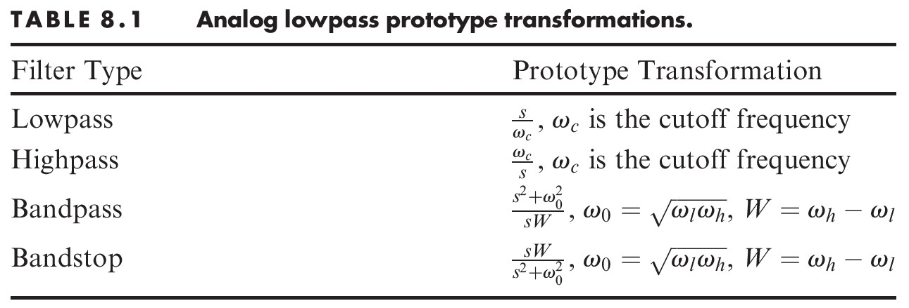

IIR Filters
Frequency Transformations

Slide 32
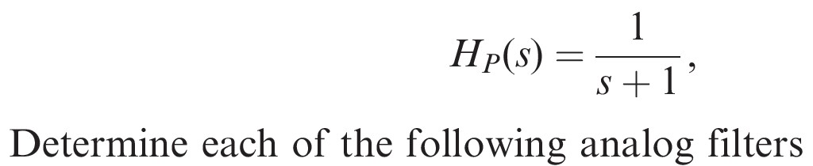
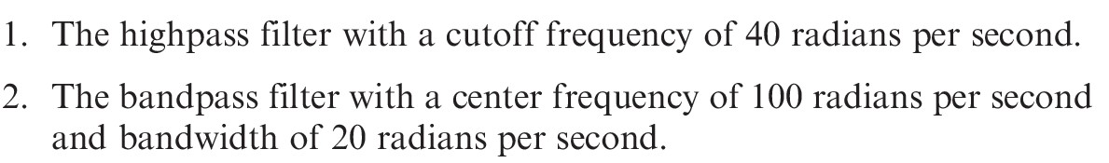
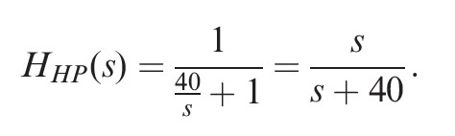
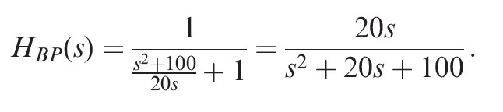
IIR Filters
Frequency Transformations
  Example: For the lowpass filter:

Slide 33
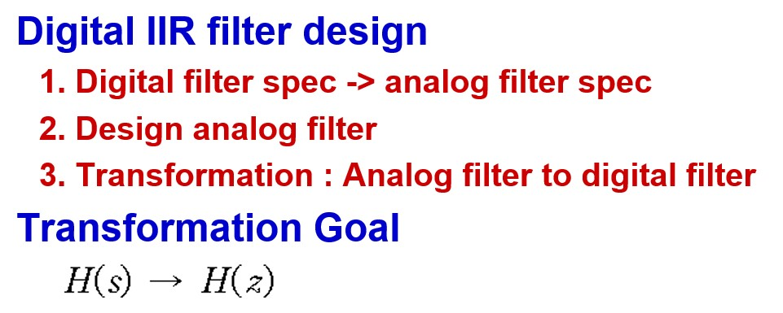
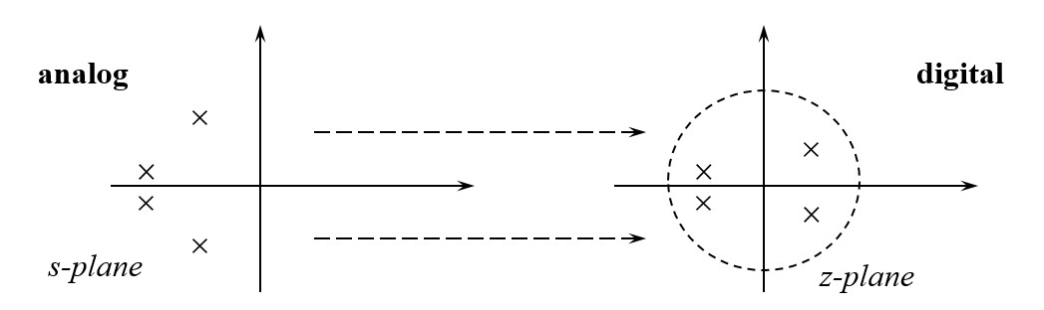
IIR Filters
Digital IIR Filter Design

Slide 34
IIR Filters
Digital IIR Filter Design
  Requirements for H(z)
    Real, causal, stable, rational
    The order of H(z) should not be greater than that of H(s)
    transform should be simple, convenient to implement and applicable to all analog filter types and classes
  Two approaches Analog filters to Digital filters
    Impulse Invariant Transformation
    Bilinear Transformation (best)

Slide 35

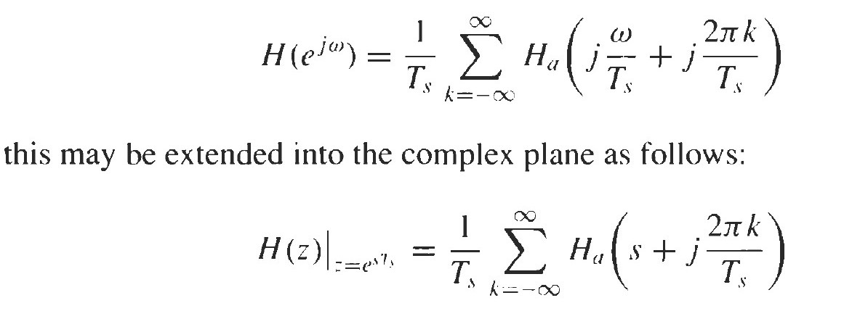
IIR Filters
  Impulse Invariant Transformation
  Impulse Invariant Transformation
    A digital filter is designed by sampling the impulse response of an analog filter
Sampling theorem

Slide 36
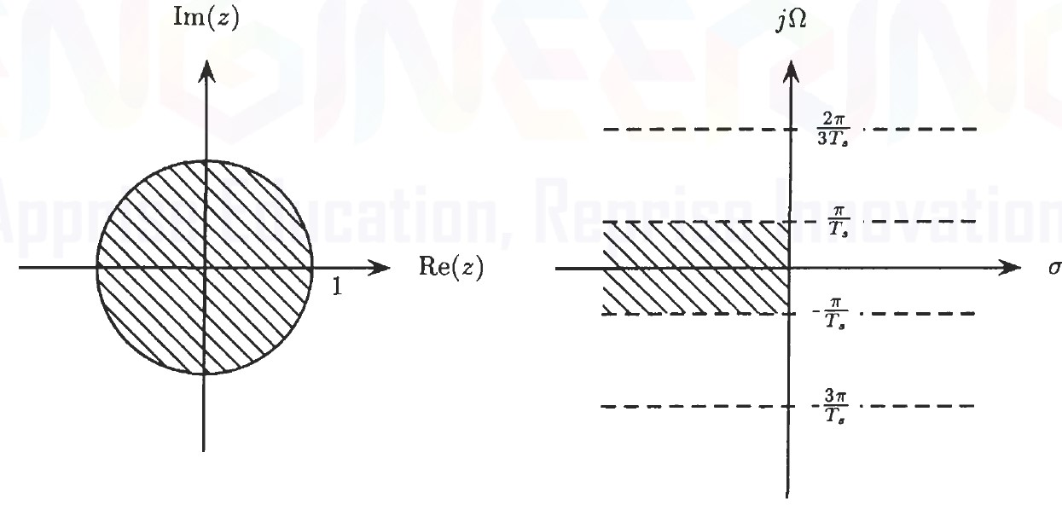
IIR Filters
  Impulse Invariant Transformation
Mapping s-plane to z-plane
  jΩ axis maps into unit circle
  jΩ axis strips of width 2π/T_{s} map into z-plane

Slide 37
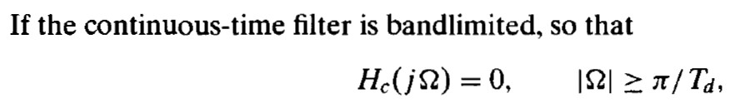
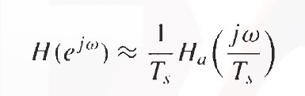
IIR Filters
  Impulse Invariant Transformation
  High-pass filter cannot be transformed !!
  Filter orders are not changed after transformation

Slide 38
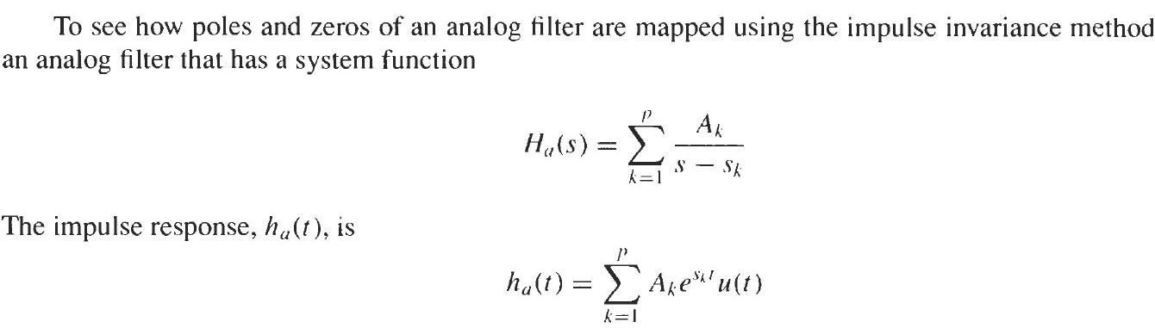
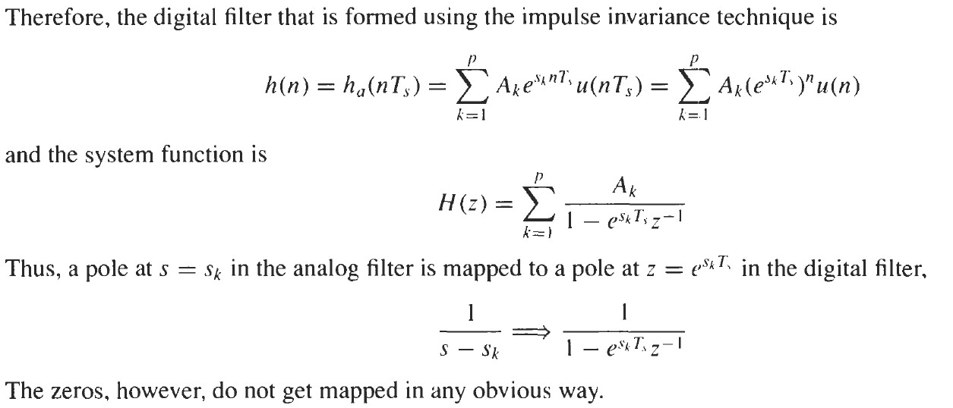
IIR Filters
  Impulse Invariant Transformation

Slide 39



IIR Filters
  Bilinear Transformation
  Bilinear Transformation
    Rational function maps:
    left-half s-plane $⇒$ inside unit circle
    jΩ axis $⇒$ onto unit circle

Slide 40
IIR Filters
  Bilinear Transformation
  Transformation is unaffected by scaling
    Consider inverse transformation with scale factor equal to unity

Slide 41


IIR Filters
  Bilinear Transformation
  Frequency warping function

Slide 42

IIR Filters
  Bilinear Transformation

Slide 43

IIR Filters
  Bilinear Transformation
  Frequency warping
    Nonlinear mapping introduces a distortion in the frequency axis

Slide 44

IIR Filters
  Bilinear Transformation

Slide 45



IIR Filters
  Bilinear Transformation
  Example: Assume T=2 s

Slide 46

IIR Filters
  Bilinear Transformation

Slide 47

IIR Filters
  Bilinear Transformation
  Example

Slide 48


IIR Filters
  Bilinear Transformation

Slide 49

IIR Filters
  Bilinear Transformation
  IIR filter Design procedure using Bilinear Transformation
    Convert each specified band-edge frequency of the digital filter to a corresponding band-edge frequency of an analog filter
      Leave the ripple values unchanged.
    Design H(s)
    H(s) $⇒$ H(z) using Bilinear Transformation

Slide 50



IIR Filters
  Filter design examples
  Example

Slide 51

IIR Filters
  Filter design examples

Slide 52

IIR Filters
  Filter design examples

Slide 53

Hellenic Mediterranean University
Department of Electrical and Computer Engineering
Intelligent Systems and Computer Architecture Laboratory

