Slide 1
Blending work and fun to assure international education for all
Nuno Escudeiro nfe@isep.ipp.pt

Slide 2
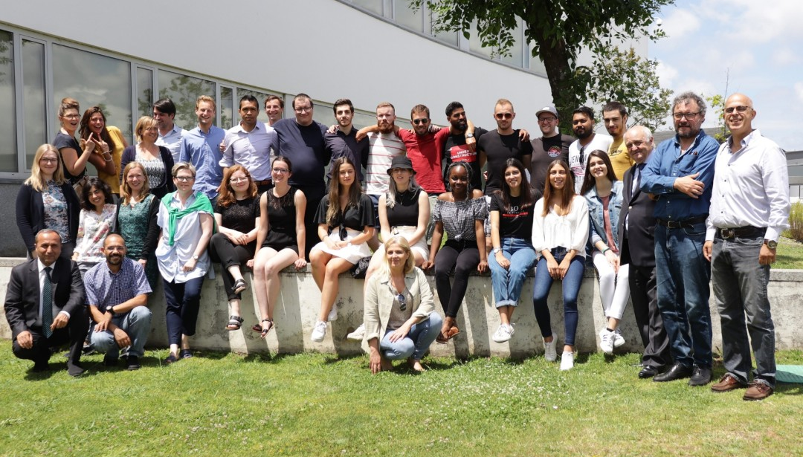

Blended Mobility to build bridges!
A project course unit empowering students to the labour market.

Slide 3
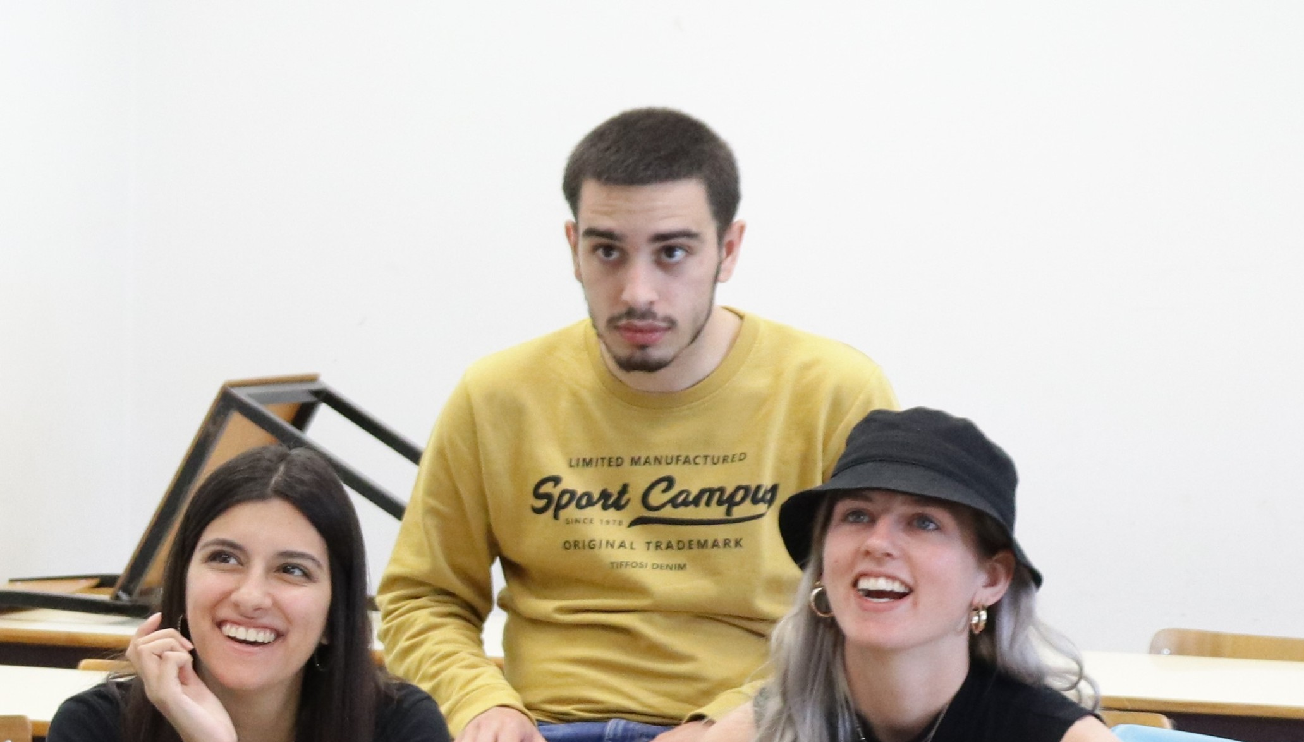
“A well-established model to enhance education, cultural awareness & employability”
Interdisciplinary international student teams
are working together,
both physically and virtually,
for a period of 4 months
in collaboration with startup founders
as real clients in the field.
The projects focus on developing a
working proof-of-concept for a challenge from a company,
including a Marketing & Business Plan.

Slide 4
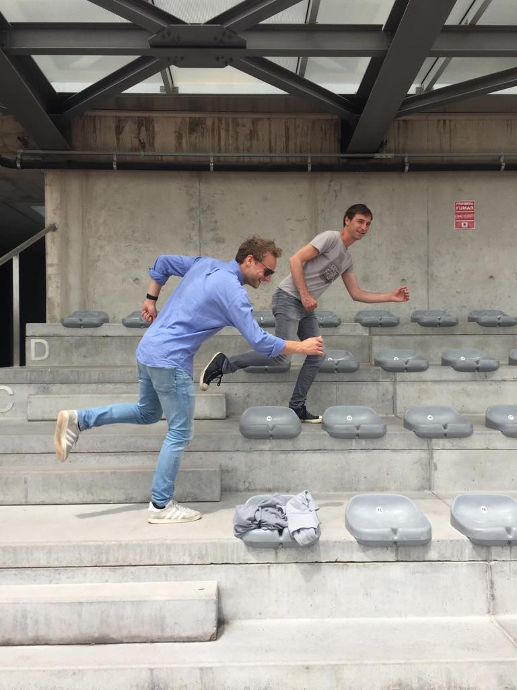
ADVANTAGES FOR STUDENTS
Develop & enhance your personal and professional competences
Work in an exciting multicultural, multidisciplinary environment
Get experience in working within a remote team
Gain international contacts, partnerships and strengthen your international network
Promote teamwork and communication skills in international context
Find your talent
Boost your employability
Overcome international mobility barriers

Slide 5
Course plan in three stages
A - PREPARATION
New edition organization (September)
Call for challenges (Praxis platform, companies, October)
Select challenges according to learning outcomes and available competences
Invite students (November till December)
Select students (December, January)
Invite supervisor teachers
Create teams
Kick-off logistics (prep phase, f2f meeting, travel and accommodation, January).
B - DEVELOPMENT
Launch the course edition (early February)
Preparatory phase (2 weeks before kick-off): team website (who we are), cultural stereotypes
Kick-off meeting (physical, 5 working days, end of February): team building, know the client and the challenge, know the team, know the ECTS-budget, organize work and tools, seminars / workshops (agile development, intercultural team work, ...), pitch and discuss proposal with the client, peer evaluation round 1
Team work at a distance, at home institution (virtual): regular meetings online, groupware platforms, distributed development environment
Peer evaluation round 2 (mid-term, April)
Closing logistics (closing f2f meeting, travel and accommodation, March/April).
C - CLOSURE
Closing meeting (physical, 5 working days, end of June): finalize deliverables (product, business plan, marketing campaign, ...), pitch and discussion with teachers and client representatives, peer evaluation round 3, assessment, give grades
Course edition debriefing: things to improve, preliminary organization of next edition
Final dinner.

Slide 6
Course plan in three stages
A - PREPARATION
New edition organization (September)
Call for challenges (Praxis platform, companies, October)
Select challenges according to learning outcomes and available competences
Invite students (November till December)
Select students (December, January)
Invite supervisor teachers
Create teams
Kick-off logistics (prep phase, f2f meeting, travel and accommodation, January).
B - DEVELOPMENT
Launch the course edition (early February)
Preparatory phase (2 weeks before kick-off): team website (who we are), cultural stereotypes
Kick-off meeting (physical, 5 working days, end of February): team building, know the client and the challenge, know the team, know the ECTS-budget, organize work and tools, seminars / workshops (agile development, intercultural team work, ...), pitch and discuss proposal with the client, peer evaluation round 1
Team work at a distance, at home institution (virtual): regular meetings online, groupware platforms, distributed development environment
Peer evaluation round 2 (mid-term, April)
Closing logistics (closing f2f meeting, travel and accommodation, March/April).
C - CLOSURE
Closing meeting (physical, 5 working days, end of June): finalize deliverables (product, business plan, marketing campaign, ...), pitch and discussion with teachers and client representatives, peer evaluation round 3, assessment, give grades
Course edition debriefing: things to improve, preliminary organization of next edition
Final dinner.
15th Edition of the course: 2024-2025
Setup phase online from 10Feb25 to 14Feb25
Kick-off meeting in-person (Maia, Portugal) 17Feb25 to 21Feb25
Midterm meeting (online) 16Apr25
Closing meeting in-person (Trier, Germany) mid/end of Jun25

Slide 7
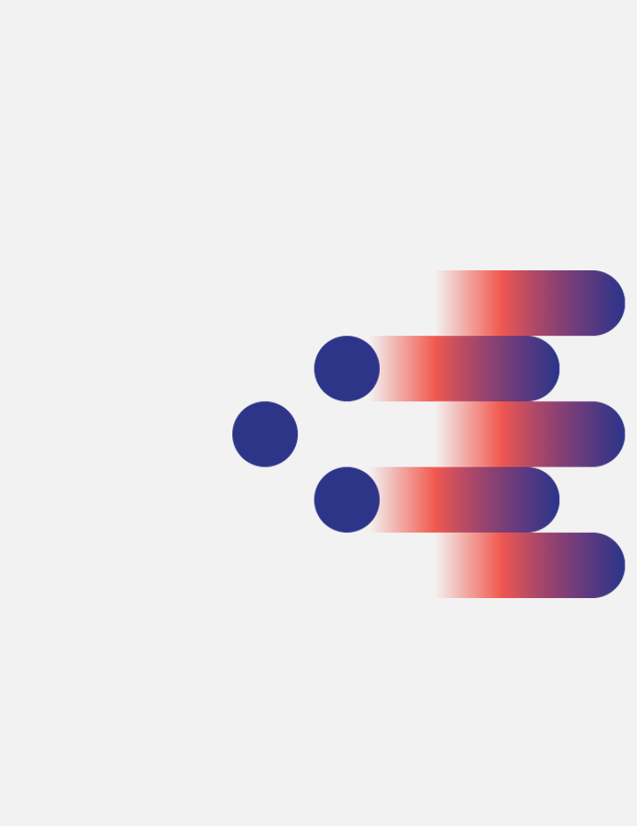
2024-25 projects
Notes:
Today, our mid-term ambition is to have a consortium of 50, 60 universities running the course with the teams of students being dynamically created depending on students’ particular interest and the available challenges submitted by companies to a centralized pool.
You are all very welcome to join us developing further this exciting paradigm.
Take a deeper look online at blendedmobility.com or search for blended mobility at the Wikipedia.
Thank you for your attention!

Slide 8
2024-25 projects
FarmIT Farmers’ and zero-waste agriculture
Sociedade Agricola Casal da Cotovia, INIAV, Portugal
BlendEd the Digital Transformation
BlendEd Consortium, Portugal-Belgium-Slovenia-Greece-Germany
Jägermeister Digital Gift
Jägermeister, Germany
More in the pipeline to be announced soon

Slide 9
2024-25 projects – FarmIT
FarmIT Farmers’ Game for efficient use of water and zero-waste agriculture
Sociedade Agricola Casal da Cotovia, INIAV, Portugal
Develop a low-cost digital assistant to farmers looking to be more sustainable and ethical.
Develop an integrated system able to manage the use of water, watering, and fertigation.
Providing visual maps of the farm with production, amount of water and fertilizers used.
Gamify the application to promote usage.

Slide 10
2024-25 projects – BlendEd
BlendEd the Digital Transformation
BlendEd Consortium, Portugal-Belgium-Slovenia-Greece-Germany
Develop a webapp to structure the BlendEd Program and manage BlendEd course editions.
Cooperate with the 17 European universities in the consortium plus 6 African universities that started the course in 2023/24.
Develop an analytical dashboard to produce key performance indicators.
The webapp will have an area open to public and another one with restricted access for teachers, students and admin staff.

Slide 11
2024-25 projects – Digital Gift
Jägermeister Digital Gift
Jägermeister, Germany
Developing a digital gift concept for Jägermeister, a leading global spirits brand.
Replace classical carton gift boxes by a digital gift to safe resources but not loose sales, even increase sales!
The goal is to identify a digital gift that adds extra value for the shopper, is attractive to our target audience, and is seamlessly connected to the Jägermeister brand.
Develop a fully digital gift that is compelling for our global target group and enhances the purchase experience for those who buy a Jägermeister bottle.
The digital gift should align with the brand's identity and promote responsible consumption.

Slide 12
2024-25 projects – in the pipeline
Bank in Austria
IMEC istart start-ups
Under discussion/agreement.

Slide 13
More info?
Notes:
Today, our mid-term ambition is to have a consortium of 50, 60 universities running the course with the teams of students being dynamically created depending on students’ particular interest and the available challenges submitted by companies to a centralized pool.
You are all very welcome to join us developing further this exciting paradigm.
Take a deeper look online at blendedmobility.com or search for blended mobility at the Wikipedia.
Thank you for your attention!

Slide 14
We have the team
Instituto Politécnico do Porto, Portugal
Universität Siegen, Germany
Odisee Technologiecampus - Ghent, Belgium
LUCA School of Arts, Belgium
Glasgow Caledonian University, United Kingdom
Hellenic Mediterranean University, Greece
University of Human Develpment, Iraq
University of Maribor, Slovenia
University Institute of Maia, Portugal
Federal University of Technology Minna, Nigeria
Rhine-Waal University of Applied Sciences, Germany
Trier University of Applied Sciences, Germany
AP University of Applied Sciences and Arts Antwerp, Belgium
Vilnius Gediminas Technical University, Lithuania
Università degli Studi Niccolò Cusano, Italy
University of Orléans, France
Universidde de Trás os Montes, Portugal
University of South Wallws, Walles
Zambeze University, Mozambique
Soroti University, Uganda
University of Nigeria Nsukka, Nigeria
Eduardo Mondlane University, Mozambique
Makerere University, Uganda
IMEC–iStart, imec’s business accelerator, Belgium
KU, Germany
FHJ, Austria
UI, Iceland
VSTU, Russia
TUS, Bulgary
UV, Spain
VTU, Bulgary
EU, Turkey
UPB, Germany
MP, Germany
GISIG, Italy
Evolaris, Austria
Trilogis, Italy
UWS, Germany
EAEC, Cyprus
EACG, Cyprus
15 startups, Belgium
Cotovia, Portugal,
2 companies, Africa.

Slide 15
We have the resources to welcome you
  Wikipedia
  https://en.wikipedia.org/wiki/Blended_mobility
MUTW white book
  https://www.amazon.com/Multinational-Undergraduate-Team-Work-International/dp/1607509830
In video
https://www.youtube.com/watch?v=czbJze0U0Sg&t=6s, 2019
  https://www.youtube.com/watch?v=pH7-70Z1zkk, 2017
  https://www.youtube.com/watch?v=3v2ri65VLFo&t=4s, 2011
  https://www.youtube.com/watch?v=Tlx2Mi-ejGw, 2011 the first two Editions of the course

Slide 16
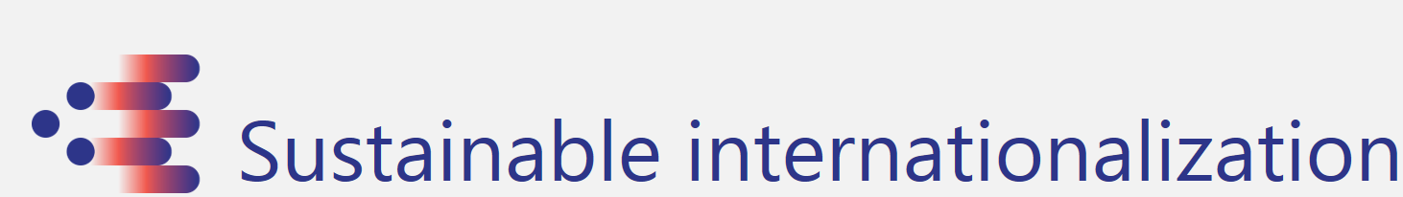
Education at a truly European dimension
Get to know your new challenge in higher education
BlendEd https://www.blended4future.com/

Slide 17
What’s next?
Notes:
Today, our mid-term ambition is to have a consortium of 50, 60 universities running the course with the teams of students being dynamically created depending on students’ particular interest and the available challenges submitted by companies to a centralized pool.
You are all very welcome to join us developing further this exciting paradigm.
Take a deeper look online at blendedmobility.com or search for blended mobility at the Wikipedia.
Thank you for your attention!

Slide 18
Until 20th December 2024
Education at a truly European dimension
Apply
By email to Nuno Escudeiro – nfe@isep.ipp.pt

Slide 19
Thank you!
Give it a try nfe@isep.ipp.pt

