Slide 1
Applications of NNs
Artificial Neural networks
Hellenic Mediterranean University | Department Of Electrical & Computer Engineering| Intelligent Systems & Computer Architecture Laboratory

Slide 2
Applications of NNs
LEARNING FROM EXPERIENCE | : | Complex difficult to solve problems, but with plenty of data that describe the problem
GENERALIZING FROM EXAMPLES | : | Can interpolate from previous learning and give the correct response to unseen data
RAPID APPLICATIONS DEVELOPMENT | : | NNs are generic machines and quite independent from domain knowledge
ADAPTABILITY | : | Adapts to a changing environment, if is properly designed
COMPUTATIONAL EFFICIENCY | : | Although the training off a neural network demands a lot of computer power, a trained network demands almost nothing in recall mode
NON-LINEARITY | : | Not based on linear assumptions about the real word
Hellenic Mediterranean University | Department Of Electrical & Computer Engineering| Intelligent Systems & Computer Architecture Laboratory

Slide 3
Neural Networks Projects Are Different
PROJECTS ARE DATA DRIVEN
Therefore, there is a need to collect and analyse data as part of the design process and to train the neural network. This task is often time-consuming and the effort, resources and time required are frequently underestimated.
IT IS NOT USUALLY POSSIBLE TO SPECIFY FULLY THE SOLUTION AT THE DESIGN STAGE
Therefore, it is necessary to build prototypes and experiment with them in order to resolve design issues. This iterative development process can be difficult to control.
PERFORMANCE, RATHER THAN SPEED OF PROCESSING, IS THE KEY ISSUE
More attention must be paid to performance issues during the requirements analysis, design and test phases. Furthermore, demonstrating that the performance meets the requirements can be particularly difficult.
Hellenic Mediterranean University | Department Of Electrical & Computer Engineering| Intelligent Systems & Computer Architecture Laboratory

Slide 4
Neural Networks Projects Are Different
HOWEVER ALL THE PREVIOUS ISSUES AFFECT THE FOLLOWING AREAS
Project planning Project management Project documentation
Hellenic Mediterranean University | Department Of Electrical & Computer Engineering| Intelligent Systems & Computer Architecture Laboratory

Slide 5
Project life cycle
Application Identification
Feasibility Study
Design Prototype
Development and validation of prototype
Build Train and Test
Data Collection
Optimize prototype
Implement System
Validate prototype
Validate System
Hellenic Mediterranean University | Department Of Electrical & Computer Engineering| Intelligent Systems & Computer Architecture Laboratory

Slide 6
NNs In Real Problems
Pre-processing
Raw data
Input encode
Feature vector
Rest of System
Neural Network
Network inputs
Output encode
Network outputs
Post-processing
Decoded outputs
Hellenic Mediterranean University | Department Of Electrical & Computer Engineering| Intelligent Systems & Computer Architecture Laboratory

Slide 7
Pre-Processing
Transform data to NN inputs
Applying a mathematical or statistical function. Encoding textual data from a database.
Selection of the most relevant data and outlier removal Should be used carefully because it can lead to various problems such as overfitting
Minimizing network inputs
Feature extraction. Principal components analysis. Waveform / Image analysis.
Coding pre-processing data to network inputs
Do not confuse it with data transformation
Hellenic Mediterranean University | Department Of Electrical & Computer Engineering| Intelligent Systems & Computer Architecture Laboratory

Slide 8
Real-World Applications
Hellenic Mediterranean University | Department Of Electrical & Computer Engineering| Intelligent Systems & Computer Architecture Laboratory

Slide 9
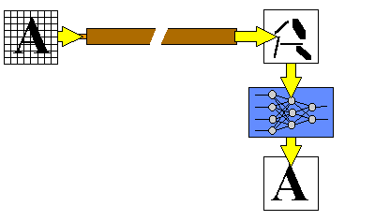
Fiber Optic Image Transmission
Transmitting image without the distortion In addition to transmitting data, they also offer a potential for transmitting images. Unfortunately images transmitted over long distance fiber optic cables are more susceptible to distortion due to noise.
Related Applications : Recognizing Images from Noisy data Speech recognition Facial identification Forensic data analysis Battlefield scene analysis
Hellenic Mediterranean University | Department Of Electrical & Computer Engineering| Intelligent Systems & Computer Architecture Laboratory

Slide 10
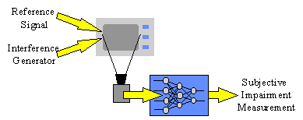
TV Picture Quality Control
Assessing picture quality One of the main quality controls in television manufacture is, a test of picture quality when interference is present. Manufacturers have tried to automate the tests, firstly by analyzing the pictures for the different factors that affect picture quality as seen by a customer, and then by combining the different factors measured into an overall quality assessment. Although the various factors can be measured accurately, it has proved very difficult to combine them into a single measure of quality because they interact in very complex ways.
Related Applications : Signal Analysis Speech recognition Facial identification Forensic data analysis Battlefield scene analysis
Hellenic Mediterranean University | Department Of Electrical & Computer Engineering| Intelligent Systems & Computer Architecture Laboratory

Slide 11
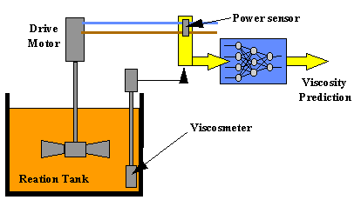
Chemical Manufacture
Getting the right mix Various catalysts are added to the base ingredients at differing rates to speed up the chemical processes required. Viscosity has to be controlled very carefully, since inaccurate control leads to poor quality and hence costly wastage The system was trained on data recorded from the production line. Once trained, the neural network was found to be able to predict accurately over the three-minute measurement delay of the viscometer, thereby providing an immediate reading of the viscosity in the reaction tank. This predicted viscosity will be used by a manufacturing process computer to control the polymerisation tank.
A more effective modelling tool Speech recognition Power demand analysis Environmental Control
Hellenic Mediterranean University | Department Of Electrical & Computer Engineering| Intelligent Systems & Computer Architecture Laboratory

Slide 12
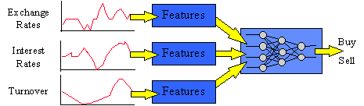
Stock Market Prediction (1/2)
Improving portfolio returns A major Japanese securities company decided to user neural computing in order to develop better prediction models. A neural network was trained on 33 months' worth of historical data. This data contained a variety of economic indicators such as turnover, previous share values, interest rates and exchange rates. The network was able to learn the complex relations between the indicators and how they contribute to the overall prediction. Once trained it was then in a position to make predictions based on "live" economic indicators.
Hellenic Mediterranean University | Department Of Electrical & Computer Engineering| Intelligent Systems & Computer Architecture Laboratory

Slide 13
Stock Market Prediction (2/2)
The neural network-based system is able to make faster and more accurate predictions than before. It is also more flexible since it can be retrained at any time in order to accommodate changes in stock market trading conditions. Overall the system outperforms statistical methods by a factor of 19%, which in the case of a £1 million portfolio means a gain of £190,000. The system can therefore make a considerable difference on returns.
MAKING PREDICTIONS BASED ON KEY INDICATORS
predicting gas and electricity supply and demand
predicting sales and customer trends
predicting the route of a projectile
predicting crop yields .
Hellenic Mediterranean University | Department Of Electrical & Computer Engineering| Intelligent Systems & Computer Architecture Laboratory

Slide 14
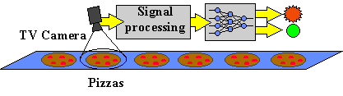
Automated Industrial Inspection
MAKING BETTER PIZZA The design of each system is specific to a particular task and product, such as examining a particular kind of pizza. If the system was required to examine a different kind of pizza then it would need to be completely re-engineered. These systems also require stable operating environments, with fixed lighting conditions and precise component alignment on the conveyer belt. The neural network was trained by personnel in the Quality Assurance Department to recognise different variations of the item being inspected. Once trained, the network was then able to identify deviant or defective items.
Hellenic Mediterranean University | Department Of Electrical & Computer Engineering| Intelligent Systems & Computer Architecture Laboratory

Slide 15
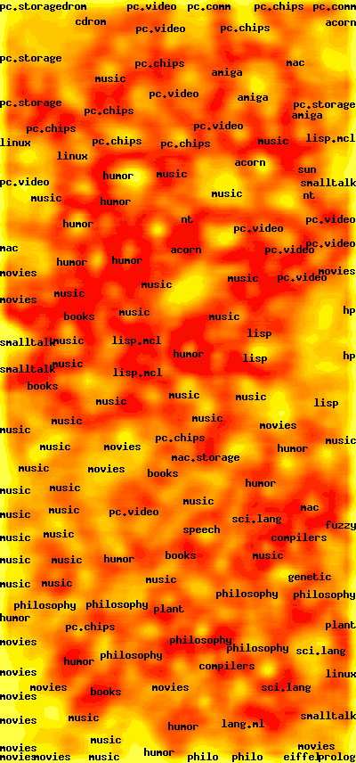
Self Organizing Maps for Web search engines
An new type of search engine. Self organization of massive document collection. Present results as a map. Graphical show related pages For Greek language. Find related document even if it didn't contains the search terms. Advanced web interface
Hellenic Mediterranean University | Department Of Electrical & Computer Engineering| Intelligent Systems & Computer Architecture Laboratory

Slide 16
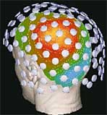
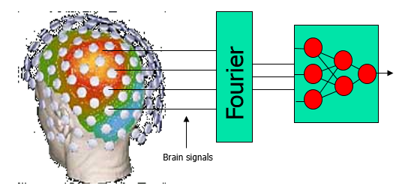
Analysis of epileptic SQUID MEG data
Brain signals
Fourier
MEG records the activity of brain surface Use neural network for the (prognosis/diagnosis/classification) of epileptic disease.
Hellenic Mediterranean University | Department Of Electrical & Computer Engineering| Intelligent Systems & Computer Architecture Laboratory

Slide 17
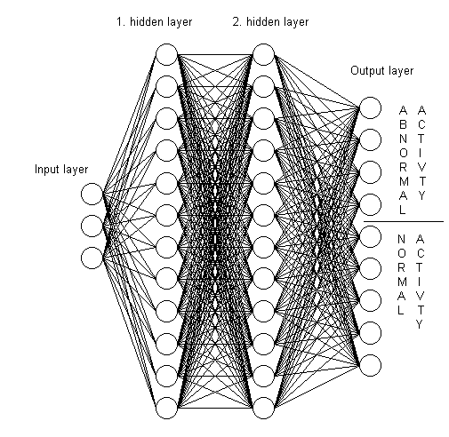
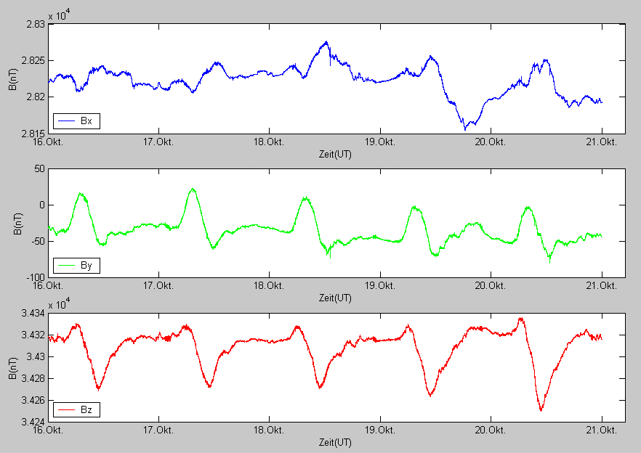
Seismic Prediction
Brain signals
Fourier
Predict earthquakes As input we have the three components of the magnetic field, as output we have normal or abnormal activity
Hellenic Mediterranean University | Department Of Electrical & Computer Engineering| Intelligent Systems & Computer Architecture Laboratory

Slide 18
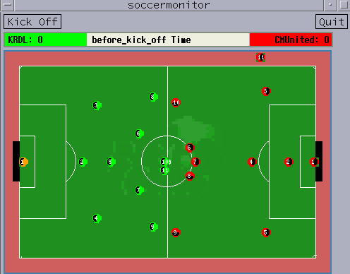
Robocup: Robot World Cup
The RoboCup Competition pits robots (real and virtual) against each other in a simulated soccer tournament. The aim of the RoboCup competition is to foster an interdisciplinary approach to robotics and agent-based AI by presenting a domain that requires large-scale coorperation and coordination in a dynamic, noisy, complex environment. Common AI methods used are variants of Neural Networks and Genetic Algorithms
Hellenic Mediterranean University | Department Of Electrical & Computer Engineering| Intelligent Systems & Computer Architecture Laboratory

Slide 19
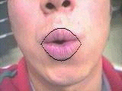

Using HMM's for Audio-to-Visual Conversion
One emerging application which exploits the correlation between audio and video is speech-driven facial animation. The goal of speech-driven facial animation is to synthesize realistic video sequences from acoustic speech. Much of the previous research has implemented this audio-to-visual conversion strategy with existing techniques such as vector quantization and neural networks. Here, they examine how this conversion process can be accomplished with hidden Markov models (HMM).
Hellenic Mediterranean University | Department Of Electrical & Computer Engineering| Intelligent Systems & Computer Architecture Laboratory

Slide 20
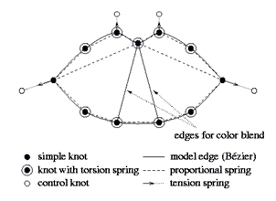
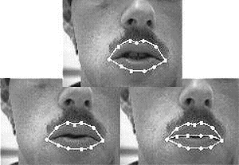
Speechreading (Lipreading)
As part of the research program Neuroinformatik the IPVR develops a neural speechreading system as part of a user interface for a workstation. A neural classifier detects visibility of teeth edges and other attributes. At this stage of the approach the edge between the closed lips is automatically modeled if applicable, based on a neural network's decision.
Hellenic Mediterranean University | Department Of Electrical & Computer Engineering| Intelligent Systems & Computer Architecture Laboratory

Slide 21
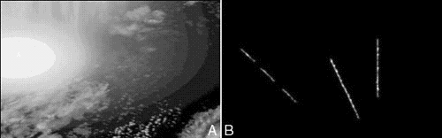
Detection and Tracking of Moving Targets
The moving target detection and track methods here are "track before detect" methods. They correlate sensor data versus time and location, based on the nature of actual tracks. The track statistics are "learned" based on artificial neural network (ANN) training with prior real or simulated data.
Hellenic Mediterranean University | Department Of Electrical & Computer Engineering| Intelligent Systems & Computer Architecture Laboratory

Slide 22
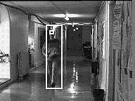
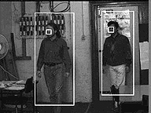
Real-time Target Identification for Security Applications
The system localises and tracks peoples' faces as they move through a scene. It integrates the following techniques: 1. Motion detection 2. Tracking people based upon motion 3. Tracking faces using an appearance model Faces are tracked robustly by integrating motion and model-based tracking.
Hellenic Mediterranean University | Department Of Electrical & Computer Engineering| Intelligent Systems & Computer Architecture Laboratory

Slide 23
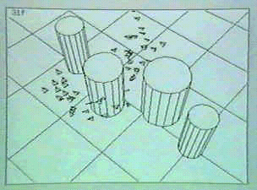
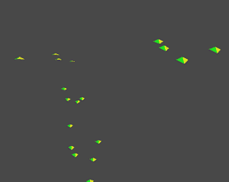
Behavioral Animation and Evolution of Behavior
This is a classic experiment (showcase at Siggraph-1995) and the flocking of ``boids,'' that convincingly bridged the gap between artificial life and computer animation. The more elaborate behavioral model included predictive obstacle avoidance and goal seeking. Obstacle avoidance allowed the boids to fly through simulated environments while dodging static objects. For applications in computer animation, a low priority goal seeking behavior caused the flock to follow a scripted path.
Hellenic Mediterranean University | Department Of Electrical & Computer Engineering| Intelligent Systems & Computer Architecture Laboratory

Slide 24
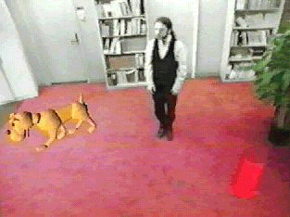

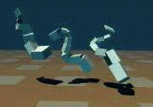
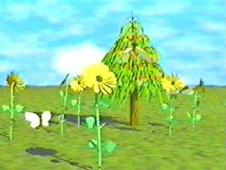
Artificial Life for Graphics, Animation, Multimedia, and Virtual Reality: Siggraph '95 Showcase
Some graphics researchers have begun to explore a new frontier--a world of objects of enormously greater complexity than is typically accessible through physical modeling alone--objects that are alive. The modeling and simulation of living systems for computer graphics resonates with the burgeoning field of scientific inquiry called Artificial Life. The natural synergy between computer graphics and artificial life can be potentially beneficial to both disciplines.
Hellenic Mediterranean University | Department Of Electrical & Computer Engineering| Intelligent Systems & Computer Architecture Laboratory

Slide 25
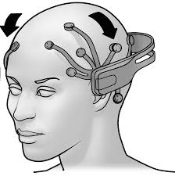
Capturing brain signals and transforming them into movement
Through specialized equipment the brain signals are captured. Afterwards, through preprocessing them they are fed to a neural network which can classify the brain signal into movement (upper right, upper left , etc.)
Hellenic Mediterranean University | Department Of Electrical & Computer Engineering| Intelligent Systems & Computer Architecture Laboratory

Slide 26

Brain signals instead of passwords in security applications
Biometric access control. Typically, a brain stimuli is needed to capture the relevant brain signal . Then the captured signal is utilized as input to a pretrained neural network, to identify a legit/malicious user.
Hellenic Mediterranean University | Department Of Electrical & Computer Engineering| Intelligent Systems & Computer Architecture Laboratory

Slide 27
Neural networks in security applications
A neural network to identify a forged file. Although this seems harmless, imagine a user who wants to hide critical evidence by changing a file’s signature i.e., an excel file (.xlsx) renamed as .pdf or an image (child pornography) presented as an innocent word document. Karampidis, K., & Papadourakis, G. (2017). File type identification-computational intelligence for digital forensics. Journal of Digital Forensics, Security and Law, 12(2), 6. Karampidis, K., Kavallieratou, E., & Papadourakis, G. (2017). Comparison of classification algorithms for file type detection a digital forensics perspective. Polibits, 56, 15-20.
Hellenic Mediterranean University | Department Of Electrical & Computer Engineering| Intelligent Systems & Computer Architecture Laboratory

Slide 28
A CNN to identify hidden content to images - Steganalysis
A neural network to identify hidden content to a cover medium. The cover medium can be: An image A text file A network packet An audio file A video file This is the most used method for terrorists to exchange messages Karampidis, K., Kavallieratou, E., & Papadourakis, G. (2018). A review of image steganalysis techniques for digital forensics. Journal of information security and applications, 40, 217-235. Karampidis, K., Kavallieratou, E., & Papadourakis, G. (2020). A dilated convolutional neural network as feature selector for spatial image steganalysis–A hybrid classification scheme. Pattern Recognition and Image Analysis, 30, 342-358.
Hellenic Mediterranean University | Department Of Electrical & Computer Engineering| Intelligent Systems & Computer Architecture Laboratory

Slide 29
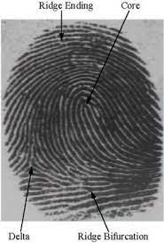
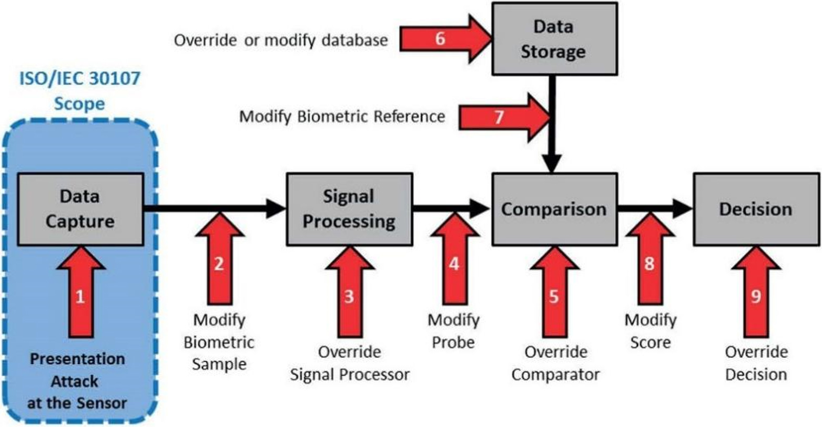
Deep learning to identify false fingerprints
Karampidis, K., Rousouliotis, M., Linardos, E., & Kavallieratou, E. (2021). A comprehensive survey of fingerprint presentation attack detection. Journal of Surveillance, Security and Safety, 2(4), 117-161.
Hellenic Mediterranean University | Department Of Electrical & Computer Engineering| Intelligent Systems & Computer Architecture Laboratory

Slide 30
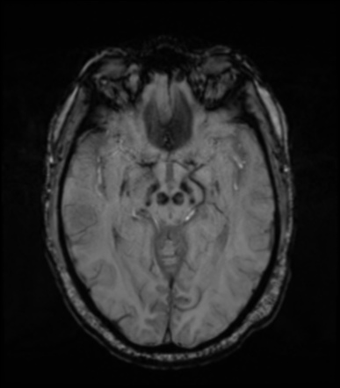
Neural network to bioinformatics
A neural network to identify parkinson's disease mri findings
Hellenic Mediterranean University | Department Of Electrical & Computer Engineering| Intelligent Systems & Computer Architecture Laboratory

Slide 31

ChatGPT - Bard AI - Bing AI – ChatSonic …..
Hellenic Mediterranean University | Department Of Electrical & Computer Engineering| Intelligent Systems & Computer Architecture Laboratory

Slide 32
Theology of AI : Can you turn these off?
QUESTIONS TO BE ANSWERED
What is “being”
Generic properties of a “being” thing
The relation and ethics and responsibility between the “creator” and the “creation”
ANSWERS BY
Ethics, philosophy, theology
Biology, physics, chemistry
Hellenic Mediterranean University | Department Of Electrical & Computer Engineering| Intelligent Systems & Computer Architecture Laboratory

