Slide 1
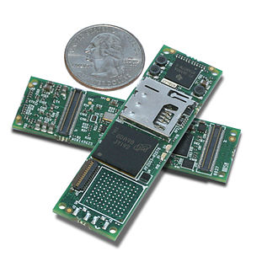
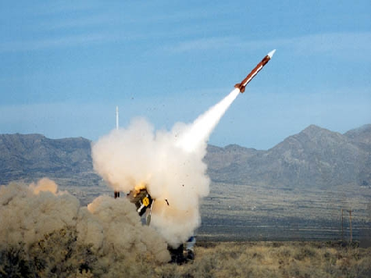
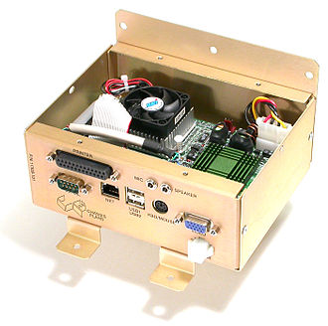
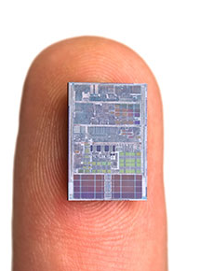
Embedded Real time Operating Systems

Slide 2
What is an embedded system?
single purpose computer
a combination of hardware and software for performing a specific task.
By contrast, a general-purpose computer (e.g. PC) is designed to be flexible and to meet a wide range of end-user needs.
Therefore, from cost and efficiency constrains it shall includes only the mandatory components for performing its specific task e.g.
air condition temperature controller doesn’t include interfaces of disk or graphic controllers etc.

Slide 3
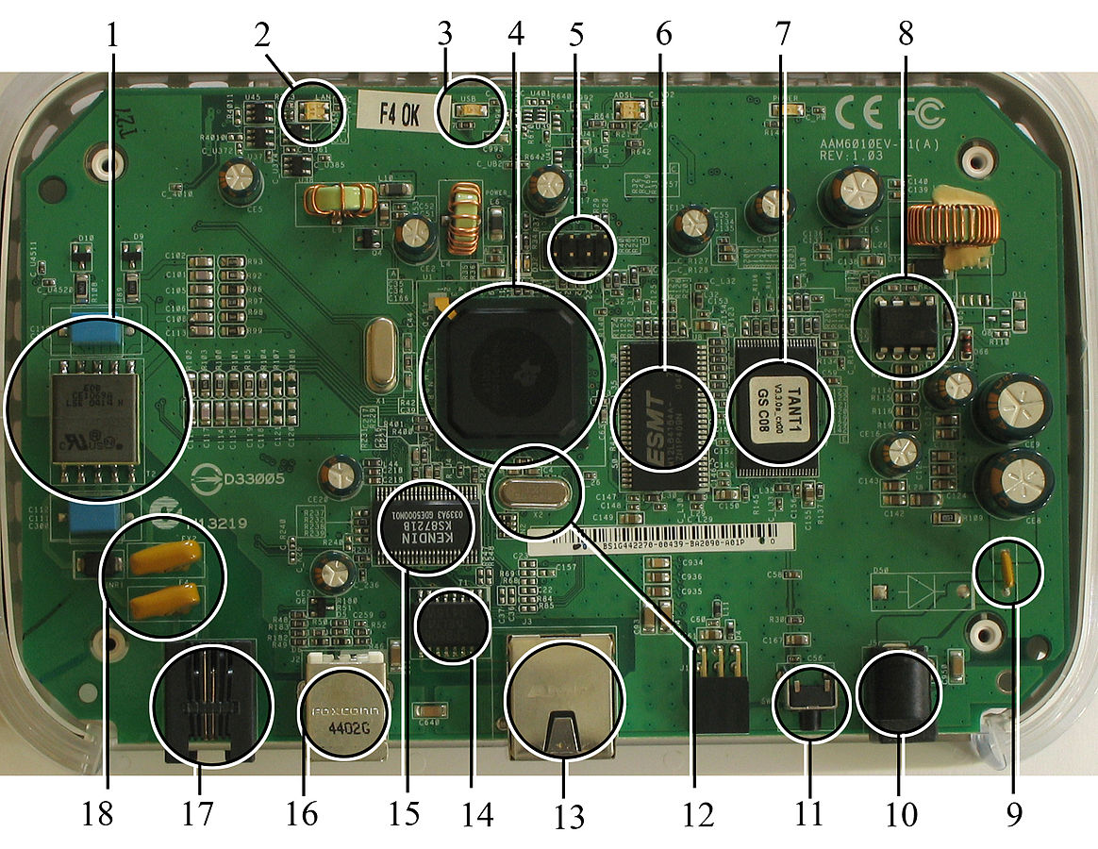
Examples of embedded systems
Missiles navigation unit
GPS device
Mobile phones
Car ABS
Intruder alarm systems
Aircraft autopilot
MP3 player
EKG
…

Slide 4
Characteristic of embedded systems
Rarely have display capabilities, and if they do have displays, they are usually limited to small text-only LCD displays
Usually have very strict memory limitations, processor limitations, and speed limitations
Other resources may not even exist
e.g. most embedded processors do not have hardware FPUs (Floating-Point Processing Unit).

Slide 5
Embedded Programming challenges
Embedded systems frequently have the cheapest processors that can do the job.
Programs need to be written as efficiently as possible.
When dealing with large data sets, issues like memory cache misses that never matter in PC programming can hurt you.
Embedded systems usually have the least memory they can get away with.
algorithms must be memory efficient (unlike in PC programs, frequently sacrifice processor time for memory, rather than the reverse
can't afford to leak memory. Embedded applications generally use deterministic memory techniques and avoid the default "new" and "malloc" functions, so that leaks can be found and eliminated more easily.
Other resources may not even exist
Resources either need to be emulated in software, or avoided altogether.

Slide 6

Type of embedded CPU
Microprocessors
Contain a processing core, and occasionally a few integrated peripherals.
Microcontrollers
all-in-one computer chips.
Contain a processing core, memory, and integrated peripherals.
Digital Signal Processor (DSP)
Designate for processing signals. DSPs frequently run very quickly, and have immense processing power.

Slide 7
Example of programming PIC simple I/O
#include <p18f452.h>
// Configurations
#pragma config OSC = HSPLL, OSCS = ON, PWRT = ON, BOR = OFF, WDT = OFF, LVP = OFF
// Main body
void main()
{
// Initializing ports
PORTA = 0; PORTB = 0;
// Set RA4 as input and RB3-RB0 as output
TRISA |= 0x10; TRISB &= 0xF0;
// Set value 0x0A to PORTB
PORTB = 0x0A;
// If button is pressed, toggle PORTB
while(1)
{
if(PORTAbits.RA4 != 0)
PORTB = ~PORTB;
}
}

Slide 8
What does Real time (RT) system mean?
System which fulfilling its task required time limitations in serving processes / tasks – “deadlines”
Almost all embedded systems need to be able to prioritize some tasks over others, and to be able to put off/skip low priority tasks such as UI in favor of high priority tasks like hardware control

Slide 9
Non Real Time systems
A non real time system is a system where there are no deadlines involved. Non-RT systems could be described as follow:
”A non real time system is a system where the programmed reaction to a stimulus will certainly happen sometime in the future”.

Slide 10
Systems’ Real time classification
Soft Real Time systems
A Soft real time system is a system where not meeting a deadline can have undesirable but not catastrophic effects, a performance degradation for example. SRTs could be described as follow:
”A soft real time system is a system where the programmed reaction to a stimulus is almost always completed within a known finite time”.
Hard Real Time systems
An Hard Real Time (HRT) system is a system where not meeting a deadline can have catastrophic effects. HRT systems require a much more strict definition and could be described as follow:
”An hard real time system is a system where the programmed reaction to a stimulus is guaranteed to be completed within a known finite time”.

Slide 11
Real time operating system (RTOS)
An RTOS is an operating system specialized for real time operations. In order to be classifiable as an RTOS an operating system must:
Have response time predictability.
Be deterministic.
Speed is not the main factor, predictability and determinism are!

Slide 12
RTOS architectures
Monolithic kernels
a relatively large kernel with sophisticated capabilities is adapted to suit an embedded environment
gives programmers an environment similar to a desktop operating system like Linux or Microsoft Windows
requires considerably more hardware resources, often more expensive, and can be less predictable and reliable

Slide 13
RTOS architectures (cont’)
Microkernels
Operating system kernel allocates memory and switches the CPU to different threads of execution.
User mode processes implement major functions such as file systems, network interfaces, etc.
In general, microkernels succeed when the task switching and intertask communication is fast, and fail when they are slow.
Exokernels
Communicate efficiently by normal subroutine calls.
The hardware, and all the software in the system are available to, and extensible by application programmers.

Slide 14
Some commonly used RTOS scheduling algorithms
Cooperative scheduling
voluntarily ceded time to one another
Preemptive scheduling
Rate-monotonic scheduling
Round-robin scheduling
Fixed priority pre-emptive scheduling, an implementation of preemptive time slicing
Fixed-Priority Scheduling with Deferred Preemption
Fixed-Priority Non-preemptive Scheduling (explained in next slides)
Critical section preemptive scheduling
Static time scheduling
Earliest Deadline First approach
Stochastic digraphs with multi-threaded graph traversal

Slide 15
Fixed priority preemptive
Most RTOSs implement “fixed priority preemptive” scheduling algorithm.
Each active thread can be in one of the following states:
Running, currently being executed by a physical core.
Ready, ready to be executed when a physical core will become available.
Waiting, not ready for execution because waiting for an external event. Most RTOSs split this state in several sub-states but those are still waiting states.

Slide 16
Fixed priority preemptive (cont’)
Each thread has its own priority level
priorities are fixed and do not change unless the system is specifically designed to do so.
Each physical core in the system always executes the highest priority thread that is ready for execution.

Slide 17
Fixed priority preemptive (cont’)
When a thread becomes ready and there is a lower priority thread being executed then preemption occurs and the higher priority thread is executed, the lower priority thread goes in the ready state.
If the system has N cores the above strategy ensures that the N highest priority threads are being executed in any moment. Small embedded systems usually have a single core so there is only one running thread in any moment.

Slide 18
Interrupts handling
Interrupts are an important events source to which a system designed around an RTOS is supposed to react.
Interrupt source classes:
RTOS-related interrupt sources.
required to interact with the RTOS in order to wakeup threads waiting for external events.
Non RTOS-related interrupt sources.
could also be able to preempt the kernel in architectures which support maskable priority levels (ARM Cortex-M3) or separate interrupt lines (ARM7).
Usually interrupt events are abstracted in a RTOS using mechanism like semaphores, event flags, queues or others (implementation are vary in different RTOSs)

Slide 19
Memory allocation
Memory allocation is more critical in an RTOS than in other operating systems.
dynamic memory allocation is frowned upon.
Whenever possible, all required memory is allocated at compile time
for stability there cannot be memory leaks (memory that is allocated, then unused but never freed). The device should work indefinitely, without ever a need for a reboot. For this reason, .
simple fixed-size-blocks algorithm
speed of allocation is important. A standard memory allocation scheme scans a linked list of indeterminate length to find a suitable free memory block. This is unacceptable in an RTOS since memory allocation has to occur within a certain amount of time.
No virtual memory is used
Mechanical disks have much longer and unpredictable response times → swapping to disk files is not used

Slide 20
What is a good RTOS?
Response Time
An efficient RTOS only adds a small overhead to the system theoretical minimal response time.
Interrupt latency,
the time from an interrupt request and the interrupt servicing.
An RTOS can add some overhead in interrupt servicing. The overhead can be caused by extra code inserted by the RTOS into the interrupt handlers code paths or by RTOS-related critical zones.
Threads fly-back time
the time from an hardware event, usually an interrupt, and the restart of the thread supposed to handle it.
Context switch time
the time required to synchronously switch from the context of one thread to the context of another thread.
what is really meaningful is the worst case value!

Slide 21
What is a good RTOS? (cont’)
Jitter
low intrinsic jitter in response time.
Size
occupied memory by OS
Reliability
Synchronization Primitives

Slide 22
List of known RTOS
LynxOS
OSE
QNX
RTLinux
VxWorks
Windows CE (now Windows RT)

Slide 23
VxWorks
VxWorks is a real-time operating system developed as proprietary software by Wind River Systems of Alameda, California, USA. It is designed for use in embedded systems
The Airbus A400M Airlifter
The BMW iDrive system
The Apache Longbow attack helicopter
First released in 1987
Intel acquired Wind River Systems on July 17, 2009

Slide 24
VxWorks characteristics
Multitasking kernel with preemptive and round-robin scheduling and fast interrupt response
Native 64-bit operating system (only one 64-bit architecture supported: x86-64).
User-mode applications ("Real-Time Processes", or RTP) isolated from other user-mode applications as well as the kernel via memory protection mechanisms.

Slide 25
VxWorks characteristics (cont’)
SMP and AMP support
Error handling framework
Binary, counting, and mutual exclusion semaphores with priority inheritance
Local and distributed message queues

Slide 26
VxWorks characteristics (cont’)
POSIX PSE52 certified conformity in user-mode execution environment
File systems:
High Reliability File System (HRFS)
FAT-based file system (DOSFS)
Network File System (NFS)
IPv6 networking stack

Slide 27
eCos
eCos (embedded configurable operating system)
A free and open source real-time operating system
Intended for embedded systems and applications which need only one process with multiple threads.
It is designed to be customizable to precise application requirements of run-time performance and hardware needs.
It is implemented in C/C++
Has compatibility layers and APIs for POSIX and µITRON
Was designed for devices with memory size in the tens to hundreds of kilobytes

Slide 28
FreeRTOS
A popular real-time operating system for embedded devices, being ported to 31 microcontrollers.
Very small memory footprint, low overhead, and very fast execution.
Scheduler can be configured for both preemptive or cooperative operation.
Thread priorities are supported

Slide 29
FreeRTOS (cont’)
Four schemes of memory allocation provided:
allocate only
allocate and free with a very simple, fast, algorithm
a more complex but fast allocate
free algorithm with memory coalescence
The thread tick method switches tasks depending on priority and a round-robin scheduling scheme via an interrupt from a hardware timer.

