Slide 1
EECS 473 Advanced Embedded Systems
An introduction to real time systems and scheduling
Chunks adapted from work by
Dr. Fred Kuhns of Washington University
and Farhan Hormasji

Slide 2
What is a Real-Time System?
What is a RTS?
Real-time systems have been defined as: "those systems in which the correctness of the system depends not only on the logical result of the computation, but also on the time at which the results are produced";
J. Stankovic, "Misconceptions About Real-Time Computing," IEEE Computer, 21(10), October 1988.

Slide 3
Real-Time Characteristics
What is a RTS?
Pretty much your typical embedded system
Sensors & actuators all controlled by a processor.
The big difference is timing constraints (deadlines).
Those tasks can be broken into two categories¹
Periodic Tasks: Time-driven and recurring at regular intervals.
A car checking for a wall every 0.1 seconds;
An air monitoring system grabbing an air sample every 10 seconds.
Aperiodic: event-driven
That car having to react to a wall it found
The loss of network connectivity.
¹Sporadic tasks are sometimes also discussed as a third category. They are tasks similar to aperiodic tasks but activated with some known bounded rate. The bounded rate is characterized by a minimum interval of time between two successive activations.

Slide 4
Some Definitions
What is a RTS?
Timing constraint: constraint imposed on timing behavior of a job: hard, firm, or soft.
Release Time: Instant of time job becomes available for execution.
Deadline: Instant of time a job's execution is required to be completed. If deadline is infinity, then job has no deadline.
Response time: Length of time from release time to the instant the job completes.

Slide 5
Soft, Firm and Hard deadlines
What is a RTS?
The instant at which a result is needed is called a deadline.
If the result has utility even after the deadline has passed, the deadline is classified as soft, otherwise it is firm.
If a catastrophe could result if a firm deadline is missed, the deadline is hard.
Definitions taken from a paper by Kanaka Juvva, not sure who originated them.

Slide 6
Different take on soft, firm and hard
A hard deadline is one where if it is missed, it is considered to be to be a system failure.
A firm deadline can be infrequently missed. In these applications the system can survive task failures so long as they are adequately spaced, however the value of the task's completion drops to zero or becomes impossible after the deadline.
A soft deadline is similar to a firm deadline, but there is still value of completing the task after the deadline.
Examples?
http://stackoverflow.com/questions/17308956/differences-between-hard-real-time-soft-real-time-and-firm-real-time

Slide 7
Why is a RTS hard? Three major issues
What is a RTS?
We want to use as cheap ($$, power) a processor as possible.
Don’t want to overpay
There are non-CPU resources to worry about.
Say two devices both on an SPI bus.
So often can’t treat tasks as independent
Validation is hard
You’ve got deadlines you must meet (at least most of the time).
How do you know you will?
Let’s discuss that last one a bit more

Slide 8
Validating a RTS is hard
What is a RTS?
Validation is simply the ability to be able to prove that you will meet your constraints
This is a hard problem just with timing restrictions
How do you know that you will meet all deadlines?
A task that needs 0.05s of CPU time and has a deadline 0.1s after release is “easy”.
But what if three such jobs show up at the same time?
And how do you know the worst-case for all these applications?
Sure you can measure a billion instances of the program running, but could something make it worse?
Caches are a pain here.
And all that ignores non-CPU resource constraints!
We need some formal definitions to make progress here…

Slide 9
Properties for Scheduling tasks
What is a RTS?
Priority
If two tasks are both waiting to run at the same time, one will be selected. That one is said to have the higher priority.
Fixed/Dynamic priority tasks
In priority driven scheduling, assigning the priorities can be done statically or dynamically while the system is running
Preemptive/Non-preemptive tasks
Execution of a non-preemptive task is to be completed without interruption once it is started
Otherwise a task can be preempted if another task of higher priority becomes ready
Multiprocessor/Single processor systems
In multiprocessor real-time systems, the scheduling algorithms should prevent simultaneous access to shared resources and devices.

Slide 10
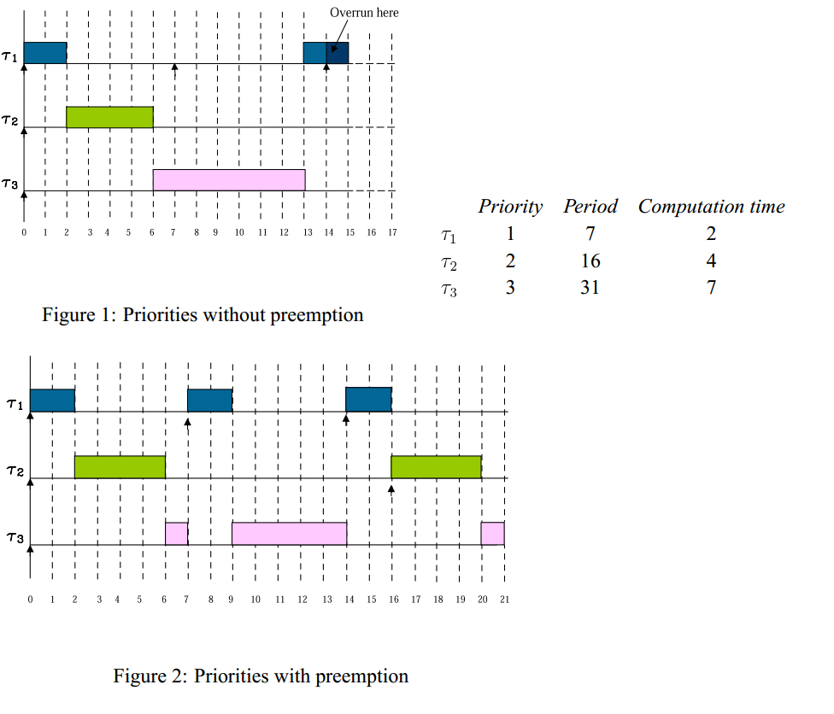
Preemption What it is and how it helps
What is a RTS?
For periodic tasks we generally
assume the deadline is the same
as the period (you must finish the
the current one before the next
one is released).
Mohammadi, Arezou, and Selim G. Akl. "Scheduling Algorithms for Real-Time Systems." (2005)

Slide 11
Scheduling algorithms
A scheduling algorithm is a scheme that selects what job to run next.
Can be preemptive or non-preemptive.
Dynamic or static priorities
Etc.

Slide 12
Two scheduling schemes
Rate monotonic (RM)
Static priority scheme
Simple to implement
Nice properties
Earliest deadline first (EDF)
Dynamic priority scheme
Harder to implement
Very nice properties
Just doing RM today.

Slide 13
RM and EDF assumptions
No task has any non-preemptable section and the cost of preemption is negligible.
Only processing requirements are significant; memory, I/O, and other resource requirements are negligible.
All tasks are independent; there are no precedence constraints.

Slide 14


Terms and definitions
Execution time of a task - time it takes for a task to run to completion
Period of a task - how often a task is being called to execute; can generally assume tasks are periodic although this may not be the case in real-world systems
CPU utilization - the percentage of time that the processor is being used to execute a specific scheduled task
where e_{i} is the execution time of task i, and P_{i} is its period
Total CPU utilization - the summation of the utilization of all tasks to be scheduled

Slide 15
RM Scheduling
RM scheduling
It is a static-priority preemptive scheme involving periodic tasks only.
Well, it mumbles about non-periodic tasks, but…
Basic idea:
Priority goes to the task with the lowest period.
Mohammadi, Arezou, and Selim G. Akl. "Scheduling Algorithms for Real-Time Systems." (2005)

Slide 16
How well does RMS work?
RM scheduling
Surprisingly well actually.
Let n be the number of tasks.
If the total utilization is less than n(2^{1/n}-1), the tasks are schedulable.
That’s pretty cool.
At n=2 that’s ~83.3%
At n=∞ that’s about 69.3%
This means that our (extremely) simple algorithm will work if the total CPU utilization is less than 2/3!
Still, don’t forget our assumptions (periodic being the big one)
Also note, this is a sufficient, but not necessary condition
Tasks may still be schedulable even if this value is exceeded.
http://cn.el.yuntech.edu.tw/course/95/real_time_os/present%20paper/Scheduling%20Algorithms%20for%20Multiprogramming%20in%20a%20Hard-.pdf

Slide 17
What if the sufficiency bound is not met?
RM scheduling
Critical instant analysis
The worst case for RMS is that all tasks happen to start at the exact same time.
If RM can schedule that, the tasks are schedulable.
Note that it might still be schedulable even if it’s not schedulable in the critical instant.
Can you find an example?
With RM scheduling we can always jump to doing the critical instant analysis
Mohammadi, Arezou, and Selim G. Akl. "Scheduling Algorithms for Real-Time Systems." (2005)

Slide 18
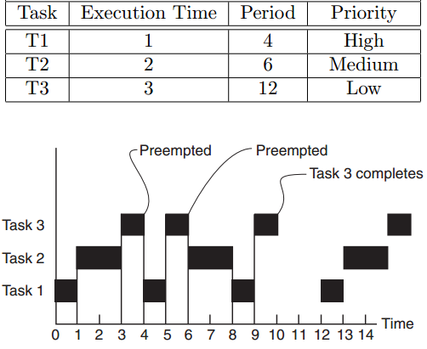
Example #1
RM scheduling
http://www.idsc.ethz.ch/Courses/embedded_control_systems/Exercises/SWArchitecture08.pdf

Slide 19
Example #2
RM scheduling
Task | Execution Time | Period | Priority
T1 | 1 | 3 | High
T2 | 1 | 4 | Low

Slide 20
Example #3
RM scheduling
Task | Execution Time | Period | Priority
T1 | 1 | 3 | High
T2 | 2.1 | 4 | Low

Slide 21
Example #4
RM scheduling
Task | Execution Time | Period | Priority
T1 | 1 | 2 | High
T2 | 2 | 5 | Low

Slide 22
Easy?
RM scheduling
Consider interrupt priorities as a way to implement…

