Slide 1
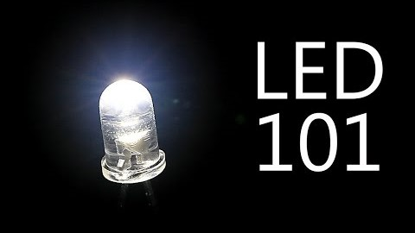
Light-emitting diodes (LEDs)

Slide 2
Light-emitting diodes (LEDs)
A light-emitting diode (LED) is a two-lead semiconductor light source.
It is a p–n junction diode, which emits light when activated. When a suitable voltage is applied to the leads, electrons can recombine with holes within the device, releasing energy in the form of photons.
This is based on the phenomenon of electroluminescence, and the color of the light (corresponding to the energy of the photon) is determined by the energy band gap of the semiconductor.

Slide 3
History of LED
1907 | Discovery of Electroluminescence (H. J. Round)
1927 | First report for LED (Oleg Losev)
1951 | Explanation of light-emitting diodes (Kurt Lehovec, Carl Accardo and Edward Jamgochian)
1955 | Infrared emission from gallium arsenide (Rubin Braunstein)
1962 | The first LED commercial product (IR GaAs)
1962 | The first visible-spectrum (red) LED was developed (Nick Holonyak, Jr.)
1972 | The first yellow LED (M. George Craford)
1994 | The first high-brightness blue LED (Shuji Nakamura)
2009 | First commercial LED lamp for lighting from Philips

Slide 4
When the electron falls down from conduction band and fills in a hole in valence band, there is an obvious loss of energy.
CB
VB
The question is;
where does that energy go?

Slide 5
In order to achieve a reasonable efficiency for photon emission, the semiconductor must have a direct band gap.
CB
The question is;
what is the mechanism
behind photon emission in LEDs?
VB

Slide 6
For example;
Silicon is known as an indirect band-gap material.
E
What this means is that
as an electron goes from the bottom of the conduction band to the top of the valence band;
CB
it must also undergo a significant change in momentum.
k
VB

Slide 7
LED, Principle of Operation
As we all know, whenever something changes state, one must conserve not only energy, but also momentum.
In the case of an electron going from conduction band to the valence band in silicon, both of these things can only be conserved:
The transition also creates a quantized set of lattice vibrations, called phonons, or "heat“ .

Slide 8
LED, Principle of Operation
Phonons possess both energy and momentum.
Their creation upon the recombination of an electron and hole allows for complete conservation of both energy and momentum.
All of the energy which the electron gives up in going from the conduction band to the valence band (1.1 eV) ends up in phonons, which is another way of saying that the electron heats up the crystal.

Slide 9
LED, Principle of Operation
In a class of materials called direct band-gap semiconductors;
the transition from conduction band to valence band involves essentially no change in momentum.
Photons, it turns out, possess a fair amount of energy (several eV/photon in some cases) but they have very little momentum associated with them.
Direct Gap Semiconductor

Slide 10
LED, Principle of Operation
Thus, for a direct band gap material, the excess energy of the electron-hole recombination can either be taken away as heat, or more likely, as a photon of light.
This radiative transition then
conserves energy and momentum
by giving off light whenever an
electron and hole recombine.
CB
VB
This gives rise to a new type of device;
the light emitting diode (LED).

Slide 11
LED, Principle of Operation
In direct band gap semiconductors most of the electrons are in the trough of the conduction band and may move to the valence band without any change in momentum from a phonon.
In indirect band gap semiconductors the electrons in the trough of the conduction band to recombine with a hole in the valence band require additional momentum in the form of a phonon.
The involvement of a phonon is not likely to occur. It is more efficient that LEDs are made from direct semiconductors so that nothing else (phonons) is required.

Slide 12
LED, Principle of Operation
The point of the device is to create photons from an electron-hole pair and it would be highly inefficient to introduce extra energy for the electron and hole to recombine.
For these reasons indirect semiconductors are not likely to be used for LEDs.
Materials and color emission when they are used for LEDs are shown in a next table

Slide 13
Material | Wavelength (µm) | Material | Wavelength (µm)
ZnS ZnO Gan ZnSe CdS ZnTe GaSe CdSe CdTe | 0.33 0.37 0.40 0.46 0.49 0.53 0.59 0.675 0.785 | GaAs InP GaSb InAs Te PbS InSb PbTe PbSe | 0.84-0.95 0.91 1.55 3.1 3.72 4.3 5.2 6.5 8.5

Slide 14
Materials for LED
The semiconductor bandgap energy defines the energy of the emitted photons in a LED.
To fabricate LEDs that can emit photons from the infrared to the ultraviolet parts of the e.m. spectrum, then we must consider several different material systems.
No single system can span this energy band at present, although the 3-5 nitrides come close.
CB
VB

Slide 15
Materials for LED
Unfortunately, many of potentiallly useful II-VI group of direct band-gap semiconductors (ZnSe,ZnTe,etc.) come naturally doped either p-type, or n-type, but they don’t like to be type-converted by overdoping.
The material reasons behind this are complicated and not entirely well-known.
The same problem is encountered in the 3-5 nitrides and their alloys InN, GaN, AlN, InGaN, AlGaN, and InAlGaN. The amazing thing about III-V nitride alloy systems is that appear to be direct gap throughout.

Slide 16


Slide 17


Slide 18
For an efficient LED
Need a p-n junction (preferably the same semiconductor material only different dopants)
Recombination must occur → Radiative transmission to give out the ‘right coloured LED’
“Right coloured LED” ⇨ hc/λ = E_{c} - E_{v} = E_{g}
⇨ so choose material with the right E_{g}
Direct band gap semiconductors to allow efficient recombination
All photons created must be able to leave the semiconductor
Little or no reabsorption of photons

Slide 19
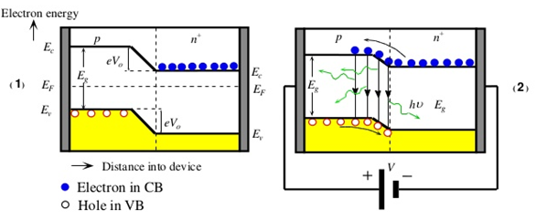
LED, Principle of Operation
(a) The energy band diagram of a pn⁺ (heavily n-type doped) junction without any bias. Built-in potential V₀ prevents electrons from diffusing from n⁺ to p side.
(b) The applied bias reduces Vo and thereby allows electrons to diffuse, be injected, into the p-side. Recombination around the junction and within the diffusion length of the electrons in the p-side leads to photon emission.

Slide 20
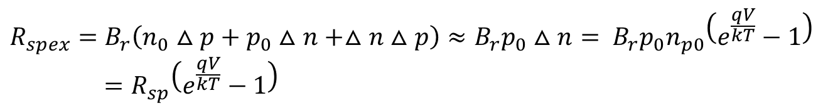

In equilibrium the minority carriers in p and n regions are given by n_{p0} and p_{n0} respectively (in our case with p-n⁺ semiconductor p_{n0} ≈ 0) and with a forward bias we have an excess of minority carriers in the p region given by:
$$∆n_{p}=n_{p}−n_{p0}=n_{p0}(e^{\frac{qV}{kT}}−1); ∆p ≈0$$
and thus:
$${R_{spex}=B}_{r}\left(n_{0}△p+p_{0}△n+△n△p\right)≈B_{r}p_{0}△n= B_{r}p_{0}n_{p0}\left(e^{\frac{qV}{kT}}−1\right)=R_{sp}\left(e^{\frac{qV}{kT}}−1\right)$$

Slide 21
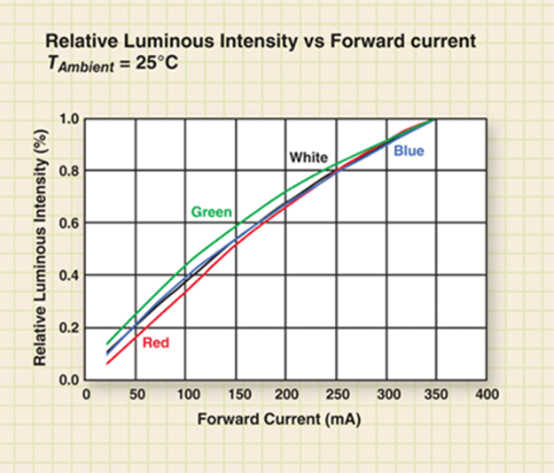


As the forward current through the p-n junction is:
$$I=I_{s}\left(e^{\frac{qV}{kT}}−1\right)$$
Hence the recombination rate increases linearly with the forward current:
$$R_{spex}\sim I$$
As shown in the figure

Slide 22
Light and Color Emission from a LED
When we talk about light ,it is conventional to specify its wavelength, λ, instead of its frequency.
Visible light has a wavelength on the order of nanometers.
Thus, a semiconductor with a 2 eV band-gap should give a light at about 620 nm (in the red). A 3 eV band-gap material would emit at 414 nm, in the violet.
The human eye, of course, is not equally responsive to all colors.

Slide 23
Relative response of the human eye to various colors
Relative eye response
10⁰
10⁻¹
10⁻²
10⁻³
10⁻⁴
GaAs_{.14}^{p}₈₆
GaAs_{.35}^{p}₆₅
GaAs_{.6}^{p}₄
GaN
ZnSe
GaP:N
violet
blue
green
yellow
orange
red
350 400 450 500 550 600 650 700 750
Wavelength in nanometers
The materials which are used for important light emitting diodes (LEDs) for each of the different spectral regions.

Slide 24
As the forward current through the p-n junction is:
$$I=I_{s}\left(e^{\frac{qV}{kT}}−1\right)$$
Hence the recombination rate increases linearly with the forward current:
$$R_{spex}\sim I$$
As shown in the figure

Slide 25
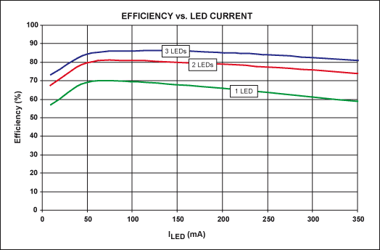

Slide 26
For an effecting LED we need a material
Correct band gap
Direct band gap
Material Requirements
Efficient radiative pathways must exist
Material can be made
p and n-type

Slide 27
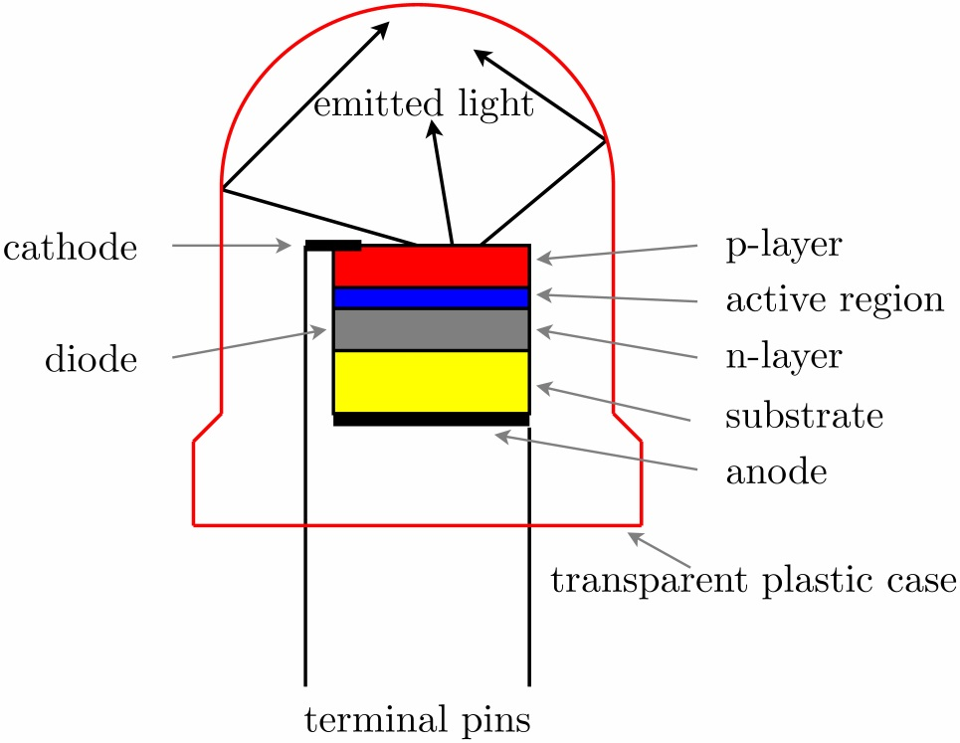
Light-emitting diode Structure
LEDs are usually built on an n-type substrate, with an electrode attached to the p-type layer deposited on its surface.
p-type substrates, while less common, occur as well.
Many commercial LEDs, especially GaN/InGaN, also use sapphire substrate.

Slide 28
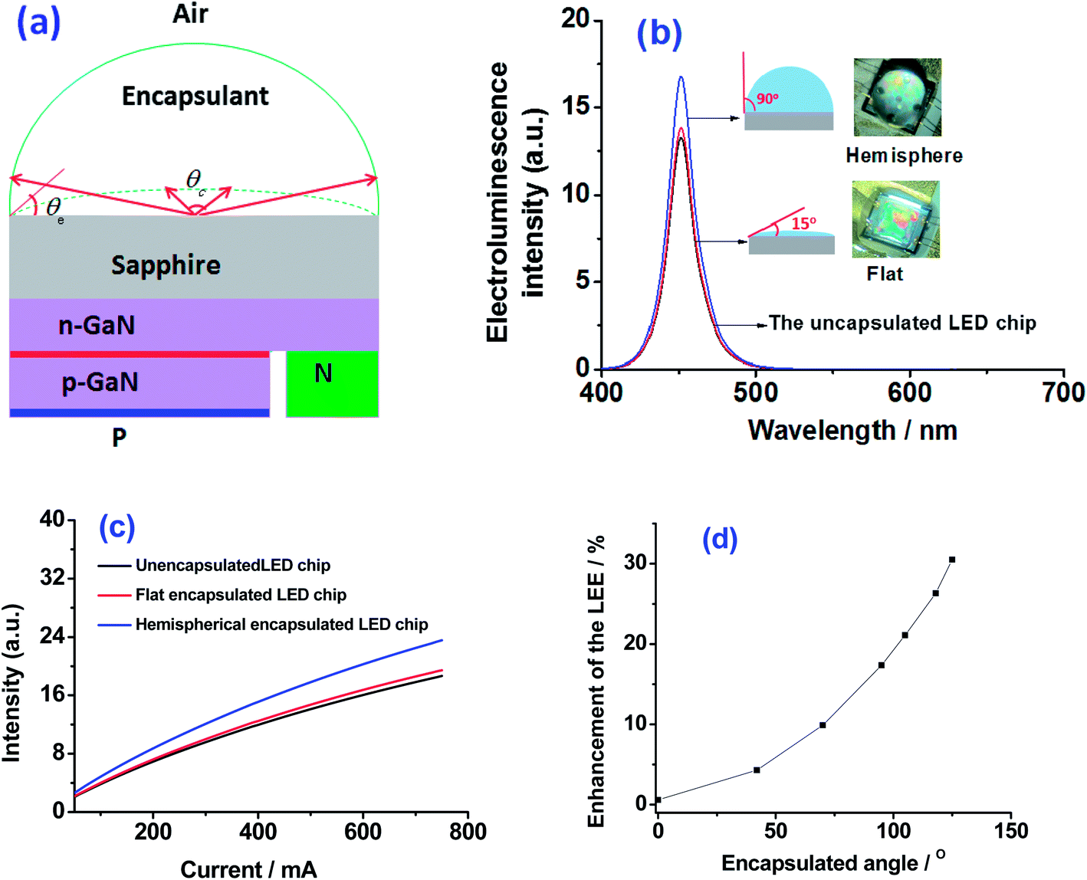
Light-emitting diode Structure
Most materials used for LED production have very high refractive indices. This means that much light will be reflected back into the material at the material/air surface interface
Thus, light extraction in LEDs is an important aspect of LED production, subject to much research and development.

Slide 29
LED STRUCTURE
There are various types of LED structure.
It depends on the application what is the favor structure.
In any case we attempt to have the highest luminous efficiency.
We prefer the most of radiative recombination to take place from the side of the junction nearest the surface, since then the chances of re-absorption are lessened.
Such a structure is shown in the next figure and it is known as planar LED

Slide 30
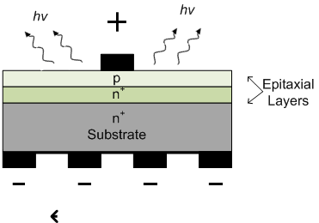
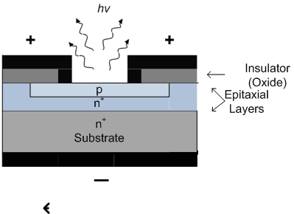
This is the simplest LED structure. It is fabricated by epitaxially growing doped semiconductor layers on a suitable substrate (e.g. GaAs or GaP) as depicted in the following figure.
a
b
The substrate is an essential mechanical support and can be of different material

Slide 31
The p-side is on the surface from which the light is emitted and is therefore made narrow (a few microns) to allow the photons to escape without being reabsorbed.
The photons that are emitted towards the n-side become either absorbed or reflected back at the substrate interface depending on the substrate thickness and the exact structure of the LED.
The use of a segment electrode will encourage reflections from the semiconductor-air interface. (fig a)
It is also possible to form the p-side by diffusing dopants into the epitaxial n⁺ - layer which is a diffuse junction planar LED as illustrated in figure (b).

Slide 32
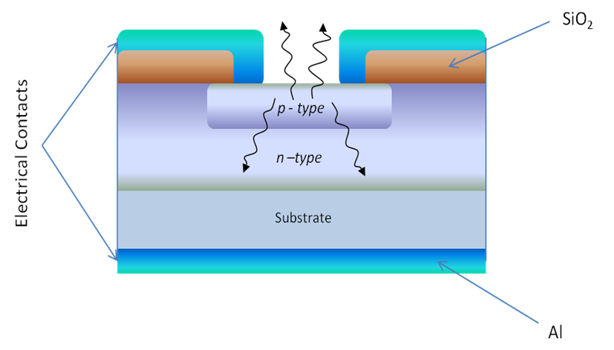
Not all light rays reaching the semiconductor – air interface can escape due to the total internal reflection.
Those rays with angles of incidence grater than the critical value θ_{C} become reflected as shown in the next figure

Slide 33
To reduce the internal total reflection we construct LED with a special structure with the same of a dom for the p-side like in the next figure (a).
As this type of construction is rather expensive and the p-side is extended to the air we prefer to encapsulate the p-side with a plastic transparent material like in figure b

Slide 34
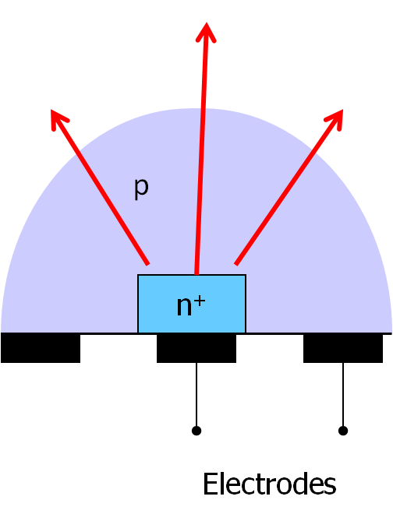
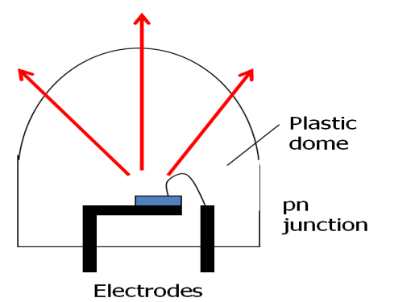

Slide 35
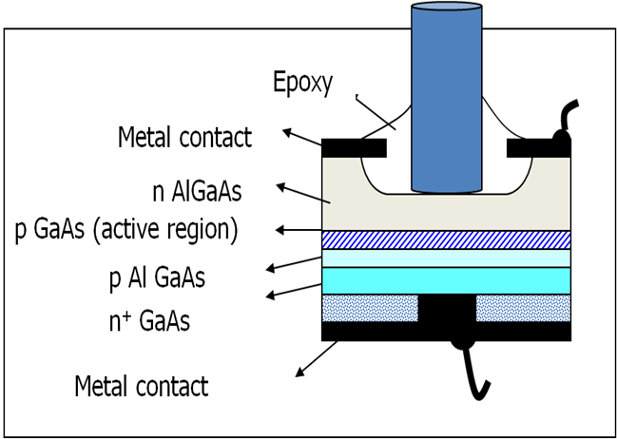
Burrus LEDs or Surface Emitter LEDs
It was design to be suitable to fiber optics communication

Slide 36
Temperature Dependence
In LEDs, the band gaps of the semiconductors increase as temperature decreases. Lower temperatures cause band gaps to increase because the semiconductor's lattice parameter becomes smaller, meaning atoms get closer together.
This results in valence electrons getting closer to other valence electrons, increasing electrostatic potential energy
U=qQ4πϵ₀r
where r is the distance between a free electron and a valence electron, ϵ₀ is the permitivity of free space, and q and Q represent individual charges. r decreases, which increases U.
The higher electrostatic potential energy of the electrons creates a higher band gap, as the interactions would make it more difficult for electrons to move to the conduction band.

Slide 37
Temperature Dependence
Compare two temperature situations for an LED: at room temperature and after it is dipped in liquid nitrogen. The increase in band gap due to lower temperature would require a higher supply voltage to turn on the LED.
This increased band gap energy would be used when an electron recombines with a hole, resulting in a shorter wavelength of light.
Conversely if the temperature is increased past room temperature the band gap would become smaller, meaning the semiconductor is becoming more conductive and less voltage would be required to power the LED.

Slide 38
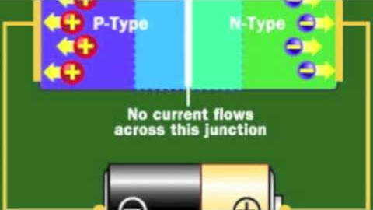

Slide 39
LED for lighting
Until our days, LEDs were too expensive to use for most lighting applications because they're built around advanced semiconductor material.
The price of semiconductor devices has plummeted since the year 2000, however, making LEDs a more cost-effective lighting option for a wide range of situations.
While they may be more expensive than incandescent lights up front, their lower cost in the long run can make them a better buy.
Several companies have begun selling LED light bulbs designed to compete with incandescent and compact fluorescents that promise to deliver long lives of bright light and amazing energy efficiency.

Slide 40
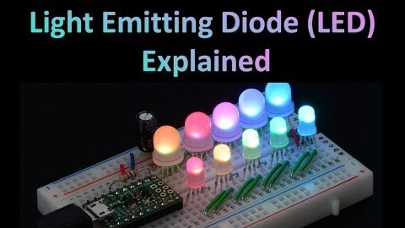

Slide 41
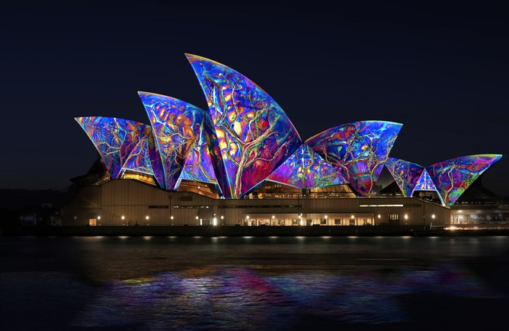
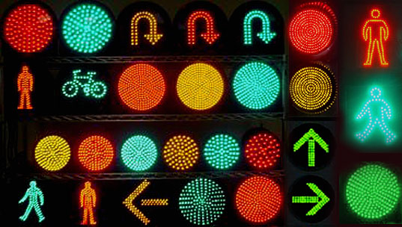


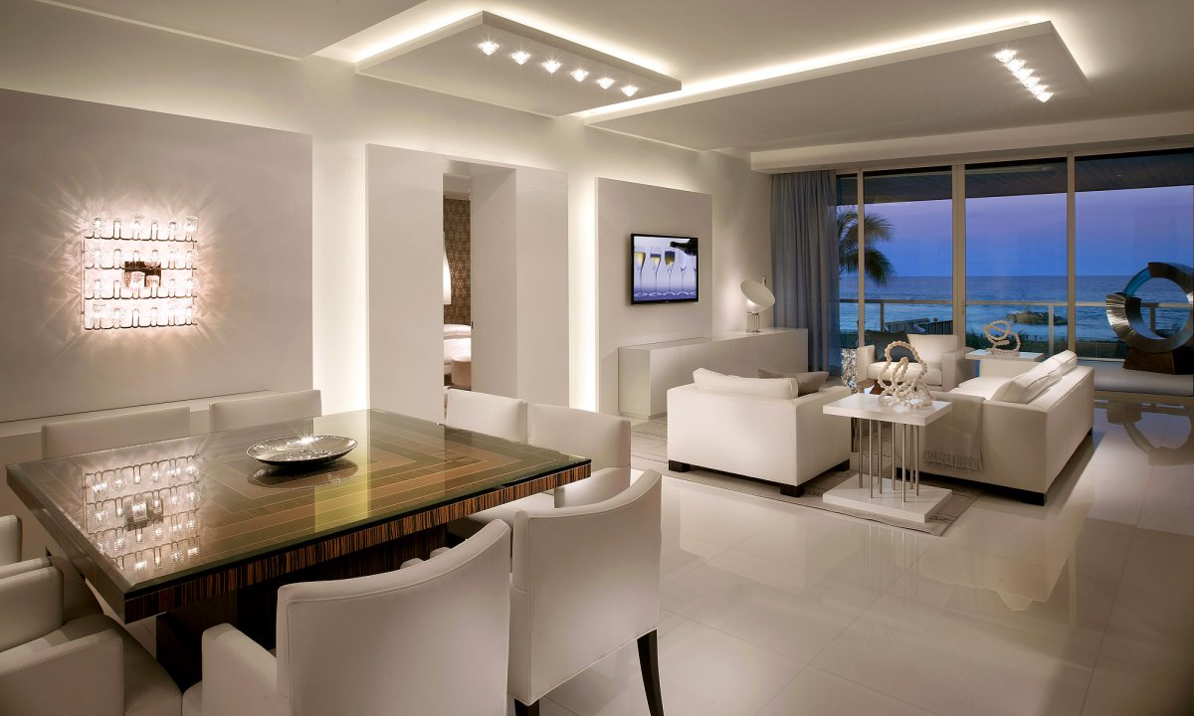
LED’s Applications
Light-emitting diodes are used in applications as diverse as aviation lighting, digital microscopes, automotive lighting, advertising, general lighting, and traffic signals.

Slide 42
LED’s Applications
LEDs have allowed new text, video displays, and sensors to be developed, while their high switching rates are also useful in advanced communications technology.
Infrared LEDs are also used in the remote control units of many commercial products including televisions, DVD players and other domestic appliances.
LEDs are also used in seven-segment display.

Slide 43
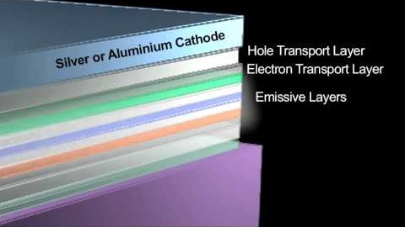
LED’s Applications

Slide 44

LED’s Applications

Slide 45
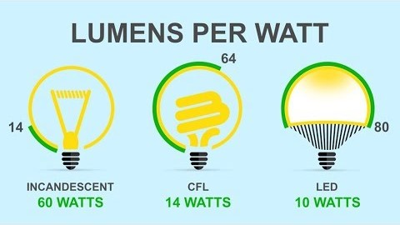
LED’s Applications

Slide 46
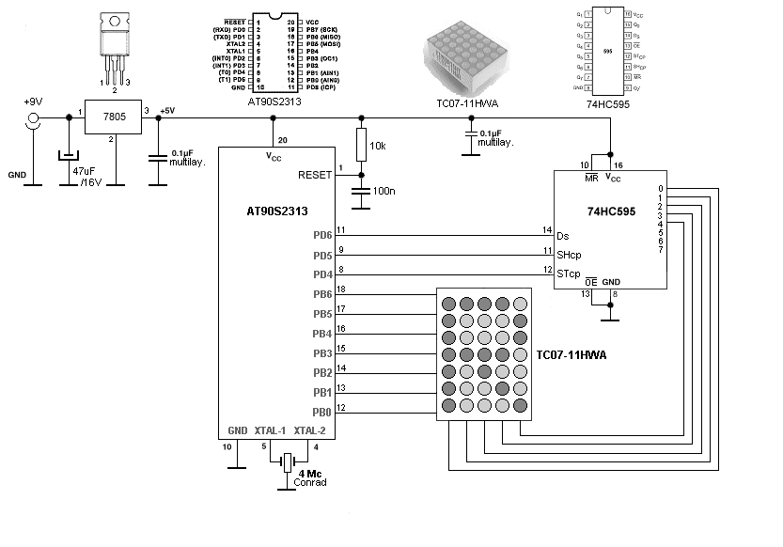
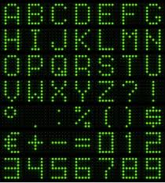
A LED panel is a small display, or a component of a larger display.
They are typically used outdoors in store signs and billboards, and in recent years have also become commonly used in destination signs on public transport vehicles or even as part of transparent glass area.
Dot Matrix LED Display

Slide 47
LED Panels
There are two types of LED panels:
conventional (using discrete LEDs) and
surface-mounted device (SMD) panels.
Most outdoor screens and some indoor screens are built around discrete LEDs, also known as individually mounted LEDs.
A cluster of red, green, and blue diodes is driven together to form a full-color pixel, usually square in shape.
These pixels are spaced evenly apart and are measured from center to center for absolute pixel resolution.

Slide 48
Components of an LED Discrete Panel

Slide 49
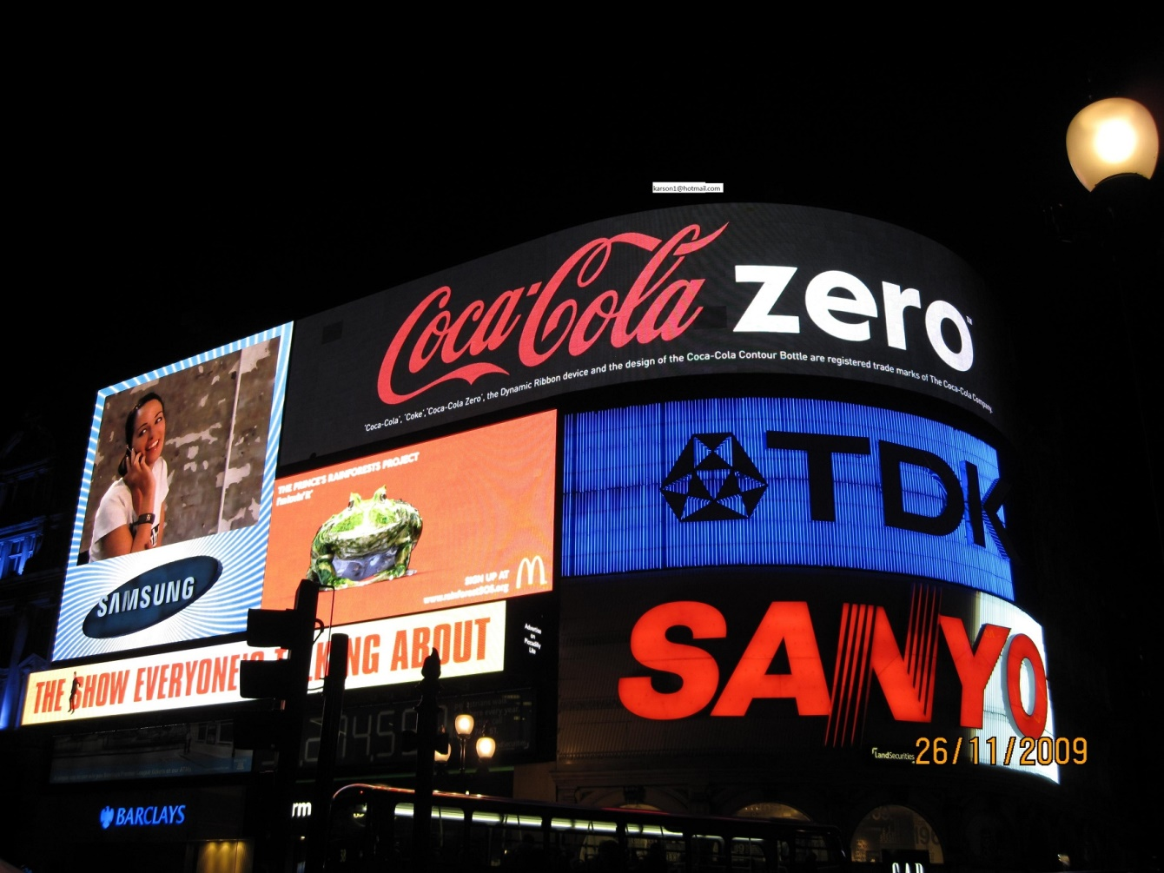
An LED display is a flat panel display, which uses light-emitting diodes as a video display.

Slide 50
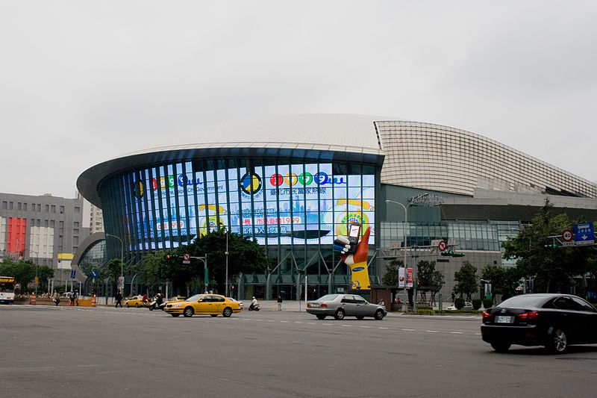
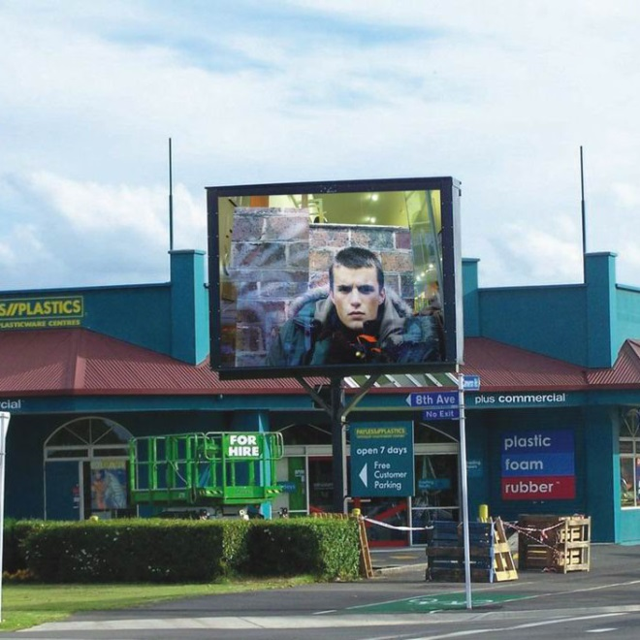
Outdoor LED Display using discrete LEDs
Taipei Mini-Big Egg/Taipei Arena

Slide 51
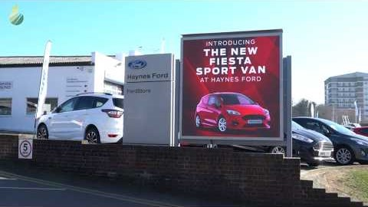
Outdoor LED Display using discrete LEDs

Slide 52
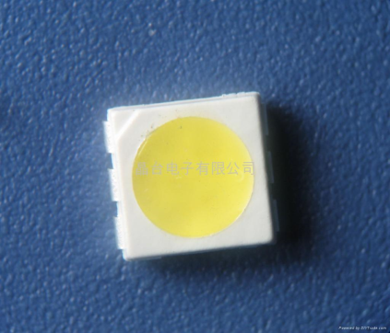
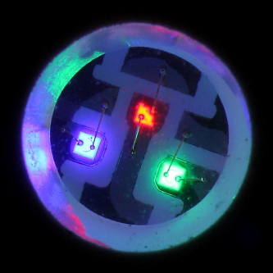
Indoor LED displays using SMDs
Most indoor screens on the market are built using SMD technology — a trend that is now extending to the outdoor market.
An SMD pixel consists of red, green, and blue diodes mounted in a single package, which is then mounted on the driver PC board.
The individual diodes are smaller than a pinhead and are set very close together.

Slide 53
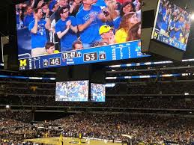
LED TV
A true LED TV is one of those giant screens you usually see at outdoor stadiums, at grand prix events and rock venues.
There are two big differences between a jumbo TV screen that you see at a stadium and the TV in your home:
it is gigantic compared to your TV.
It is incredibly bright so that people can see it in sunlight.
Today’s LED TVs are another form of LCD TV that uses LEDs to provide its light source.

Slide 54
To accomplish these feats, almost all large-screen outdoor displays use light emitting diodes (LEDs) to create the image.
The LEDs are small, extremely bright and use relatively little power for the light that they produce.
Red, green and blue LEDs are used instead of phosphor.
A "pixel" on this display is a small module that can have as few as three or four LEDs in it (one red, one green and one blue). In the biggest jumbo TVs, each pixel module could have dozens of LEDs.
Pixel modules typically range from 4 mm to 4 cm (about 0.2 to 1.5 inches) in size.

Slide 55
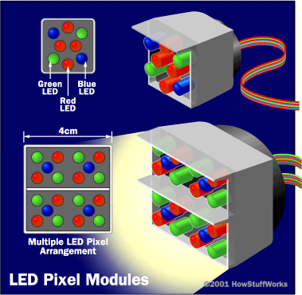
To build a jumbo TV, you take thousands of these LED modules and arrange them in a rectangular grid.
For example, the grid might contain 640 by 480 LED modules, or 307,200 modules.
The size of the ultimate screen depends on the size of the LED modules:

Slide 56
To control a huge LED screen like this, you use a computer system, a power control system and a lot of wiring.
The computer system looks at the incoming TV signal and decides which LEDs it will turn on and how brightly. The computer samples the intensity and color signals and translates them into intensity information for the three different LED colors at each pixel module.
The power system provides power to all of the LED modules, and modulates the power so that every LED has the right brightness. Turning on all of those LEDs can use a lot of power. A typical 20-meter jumbo TV can consume up to 1.2 watts per pixel, or approximately 300,000 watts for the full display.
Several wires run to each LED module, so there are a lot of wires running behind the screen.

Slide 57
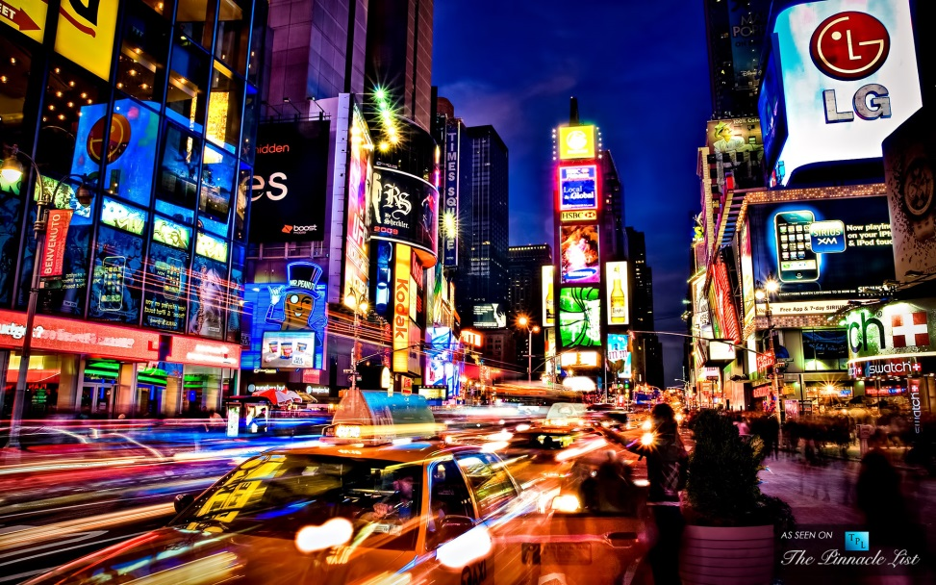
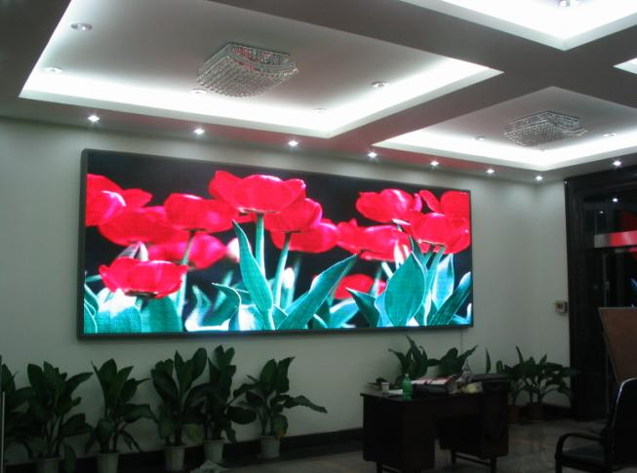
As LED prices have dropped, jumbo TV screens have started to pop up in all sorts of places, and in all sorts of sizes.
You now find LED TVs indoors (in places like shopping malls and office buildings) and in all sorts of outdoor environments -- especially areas that attract lots of tourists.

Slide 58
https://wwhttpsw.youtube.com/watch?v=GodkGafZsh4 (How LED works)
https://www.youtube.com/watch?v=5GQq8W5xu3c (How a LED is produced)
https://www.youtube.com/watch?v=6e8hBJ5-fdc (Light from Crystals)

