Slide 1


Slide 2




OLEDs
present and future applications
A presentation by: Yiannis Kaliakatsos
TEI of CRETE, Dept. of Electronics Engineering
giankal@chania.teicrete.gr
TEI of CRETE
15th Thomas More International Days
18-22 March 2019

Slide 3
"The European Commission support for the production of this publication does not constitute an endorsement of the contents which reflects the views only of the authors, and the Commission cannot be held responsi­ble for any use which may be made of the information contained therein."

Slide 4
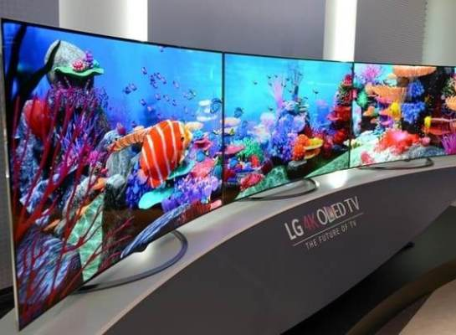
LG is hoping to rolling out a flexible 60-inch OLED display by 2020.

Slide 5
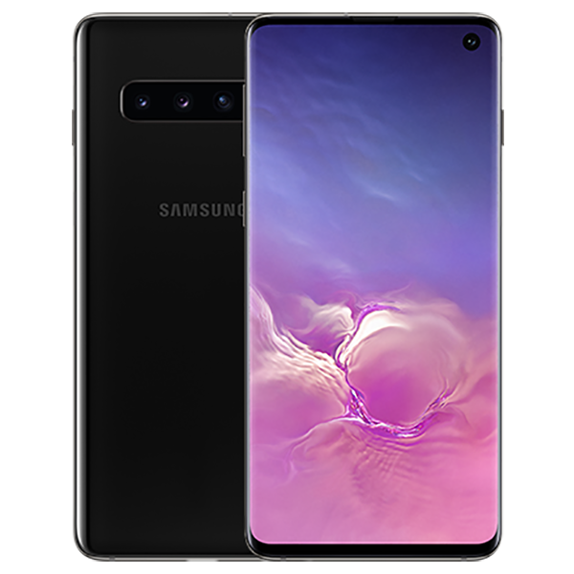
Galaxy S10.

Slide 6
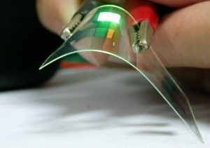
LG is hoping to rolling out a flexible 60-inch OLED display by 2020.

Slide 7
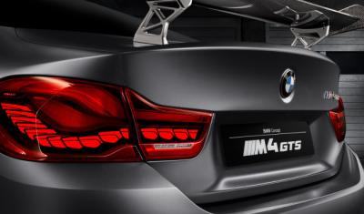
BMW's M4 GTS car uses OLED taillights .
BMW said several times that OLEDs may well become the lighting technology of choice due to OLED's flexilibility, efficiency and homogeneity.

Slide 8
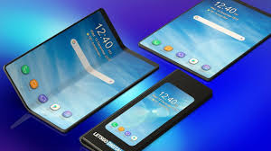
https://www.youtube.com/watch?v=aRf13KiRUVM

Slide 9
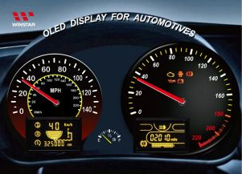
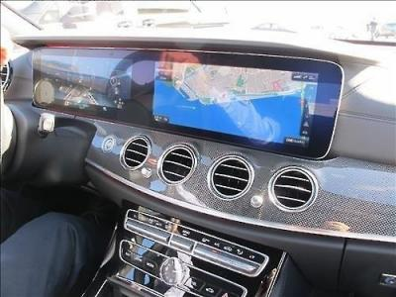

Slide 10
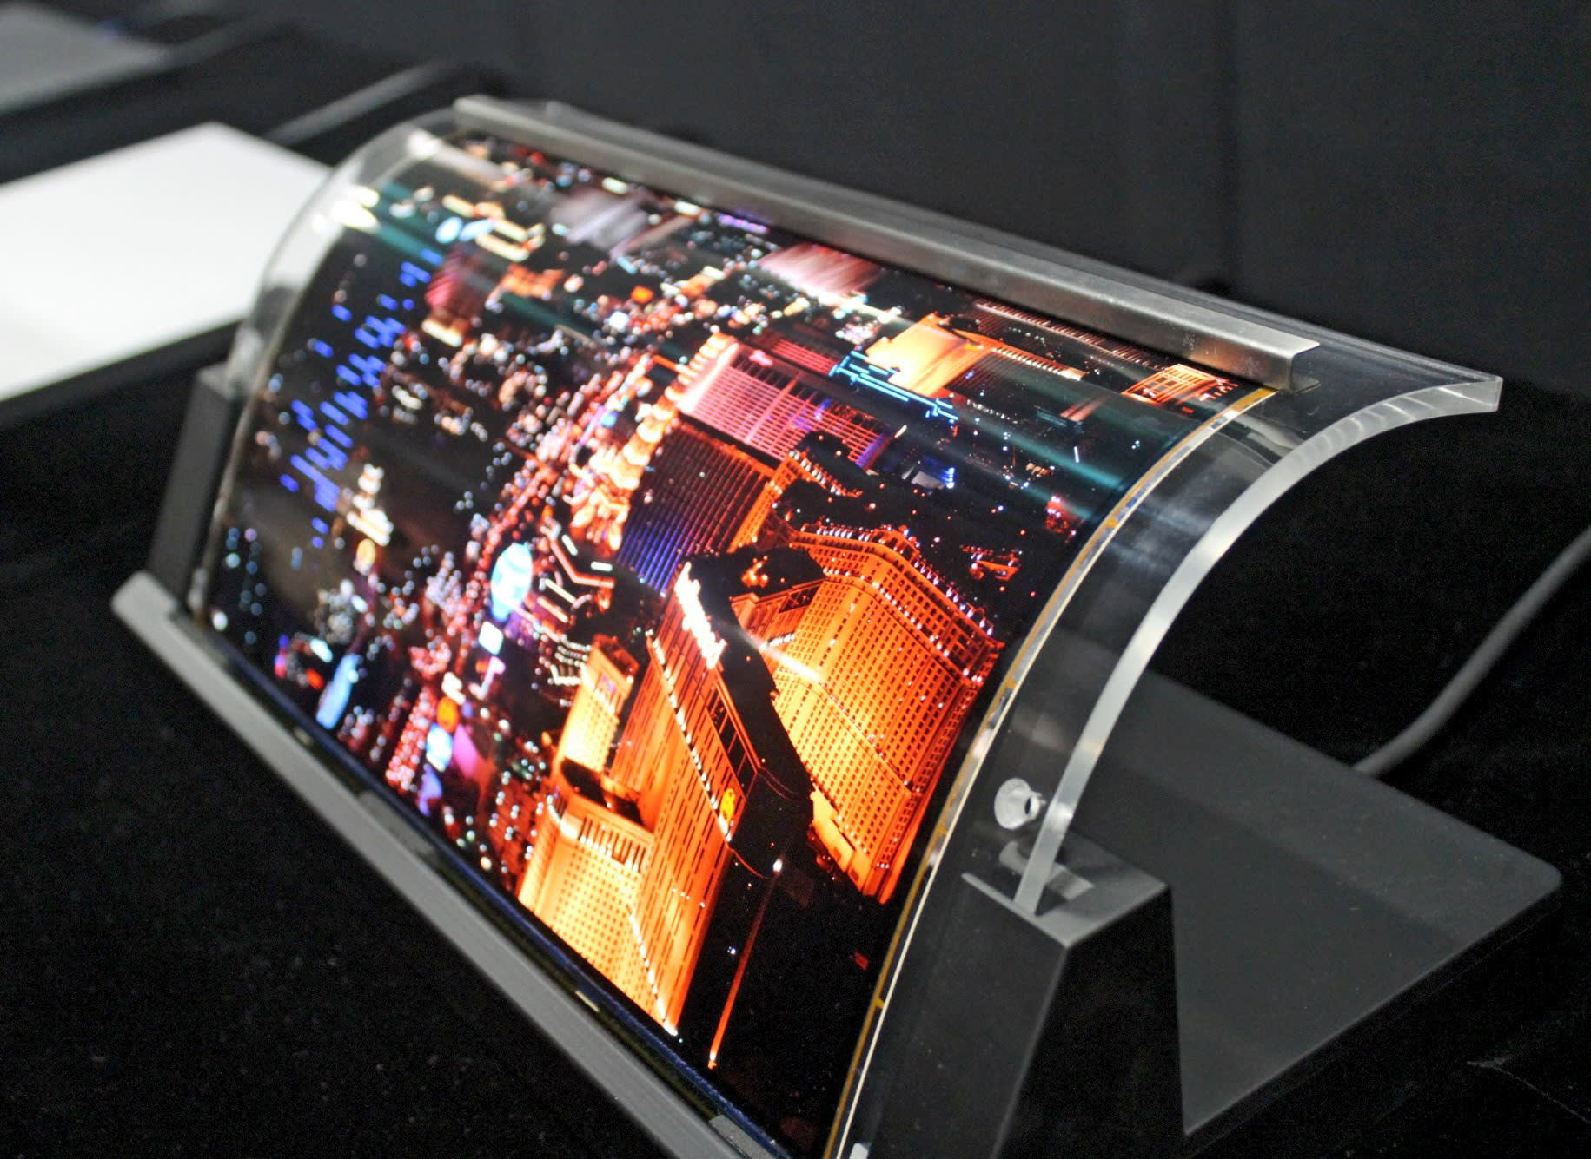
JOLED's panels are relatively lightweight and exhibit excellent color reproduction, making them suited for rail cars and aircraft among other uses.
https://asia.nikkei.com/Business/Japan-enters-display-fray-with-world-s-first-printed-OLED-panels

Slide 11
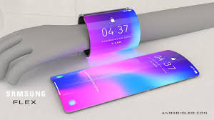
https://www.youtube.com/watch?v=tst7V_Ffn7Q

Slide 12
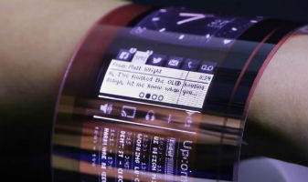
A still from Plastic Logic's video of its flexible OLED display prototype (Credit: Plastic Logic)

Slide 13
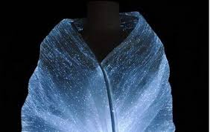
A research team integrated fabric with Organic Light Emitting Diode (OLED) and developed a highly flexible clothing-type wearable display technology.

Slide 14
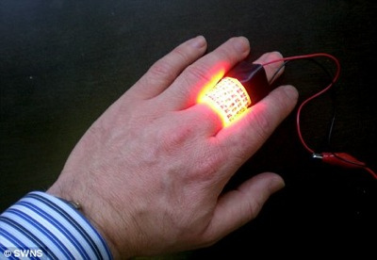
The device has a large number of red OLEDs embedded into a plastic sticking plaster, like an illuminated band aid. When it’s fixed to the skin above a skin cancer tumor it sends extremely bright red light into the skin.
https://www.fastcompany.com/1280145/oleds-best-use-yet-skin-cancer-killing-bandaid

Slide 15
DOI: 10.1002/adma.201403560

Slide 16
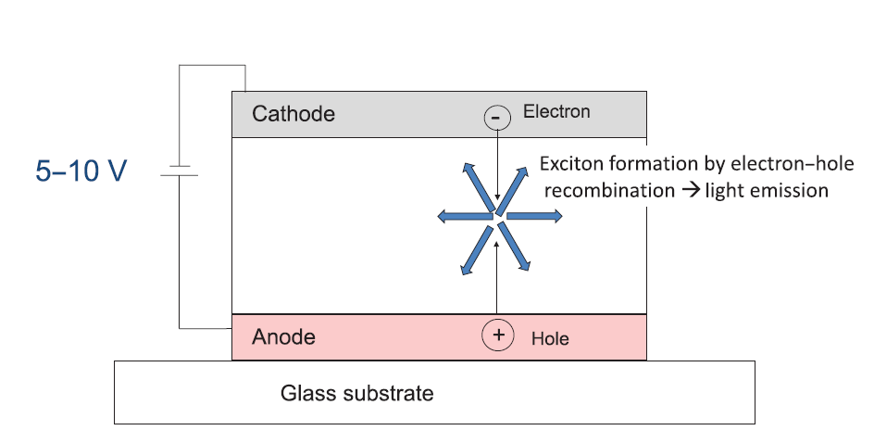
Introduction
Organic light-emitting diode (OLED) is a light-emitting diode (LED) in which the emissive electroluminescent layer is a film of organic compound
An OLED is composed of at least one semiconductive organic layer that is put between two electrodes.
Electrons and holes are injected from either side of the electrode, respectively. After applying a voltage, both carriers will drift towards the other side in the applied electrical field.
When both electrons and holes meet at the bulk or the interface, they then recombine to form excitons, which will decay to produce light emission.
OLED Displays: Fundamentals and Applications by Takatoshi Tsujimura
TEI of CRETE
15th Thomas More International Days
18-22 March 2019

Slide 17
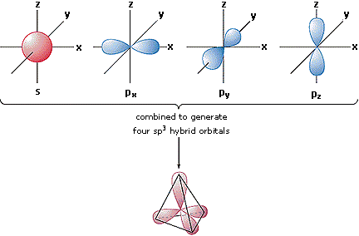
Atomic & Molecular Orbitals
http://brednest.blogspot.be/2013/05/what-is-atomic-and-molecular-orbitals.html
See more in: http://chemed.chem.purdue.edu/genchem/topicreview/bp/ch8/mo.html

Slide 18
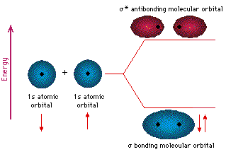
Atomic & Molecular Orbitals
http://brednest.blogspot.be/2013/05/what-is-atomic-and-molecular-orbitals.html
See more in: http://chemed.chem.purdue.edu/genchem/topicreview/bp/ch8/mo.html

Slide 19
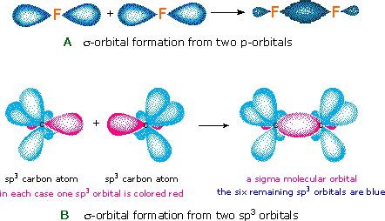
Atomic & Molecular Orbitals
http://brednest.blogspot.be/2013/05/what-is-atomic-and-molecular-orbitals.html
See more in: http://chemed.chem.purdue.edu/genchem/topicreview/bp/ch8/mo.html

Slide 20
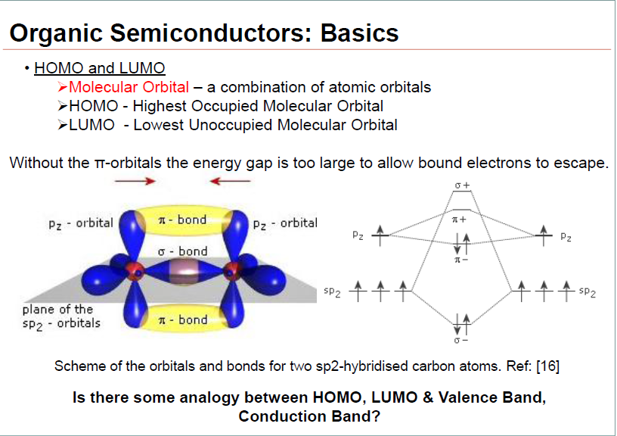
Organic Semiconductors
http://www.leb.eei.uni-erlangen.de/winterakademie/2010/
See more in: http://chemed.chem.purdue.edu/genchem/topicreview/bp/ch8/mo.html

Slide 21
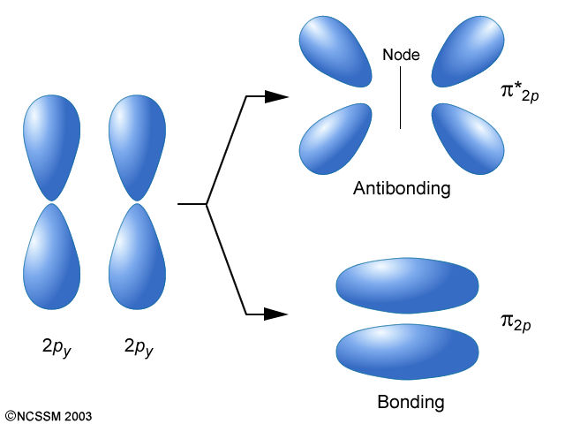
Organic Semiconductors
http://www.dlt.ncssm.edu/tiger/diagrams/bonding/p_pi_bonding.jpg/
See more in: http://chemed.chem.purdue.edu/genchem/topicreview/bp/ch8/mo.html

Slide 22
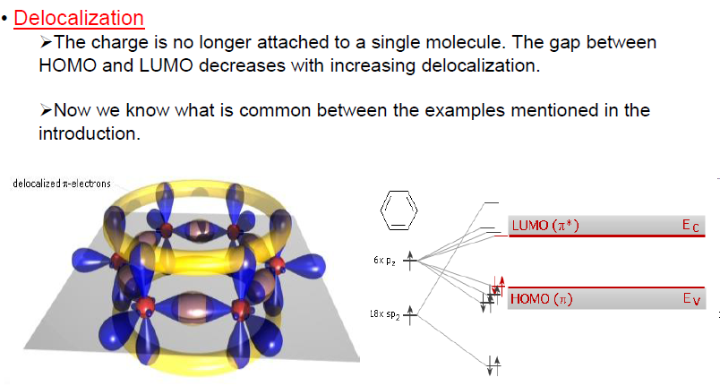

Slide 23
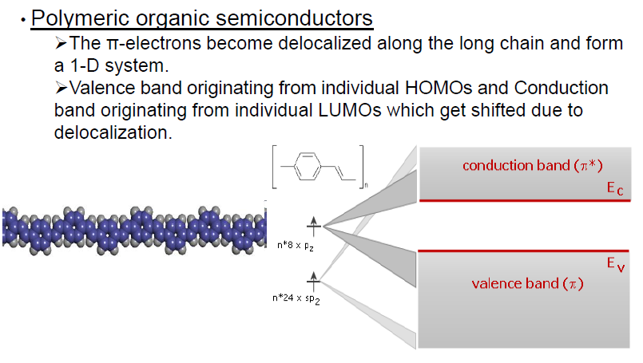

Slide 24
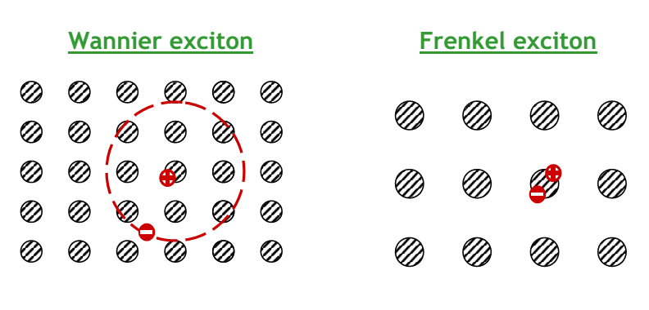
What is an exciton?
An exciton is a bound state of an electron and an electron hole which are attracted to each other by the electrostatic Coulomb force.
It is an electrically neutral quasiparticle that exists in insulators, semiconductors and in some liquids. It is mobile and does not live very long at room temperature because its binding energy is very small.
It decomposes ("get ionized") into a free electron and a free hole.
It might become trapped at certain lattice defects and then recombines, emitting light

Slide 25
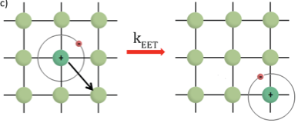
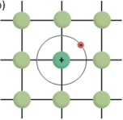
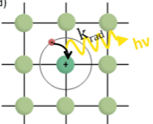
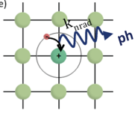
What is an exciton?

Slide 26
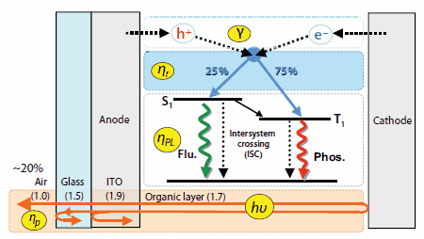
The emission mechanism of light from an OLED by trapping and decay of excitons
Organic Semiconductor Laser Materials,By: Chihaya Adachi, Hajime Nakanotani, Material Matters 2009, 4.3, 74.

Slide 27
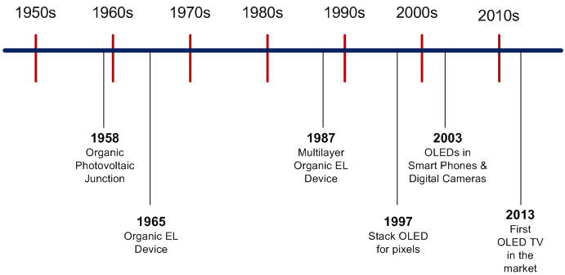
Important Dates for OLED Development & Applications

Slide 28
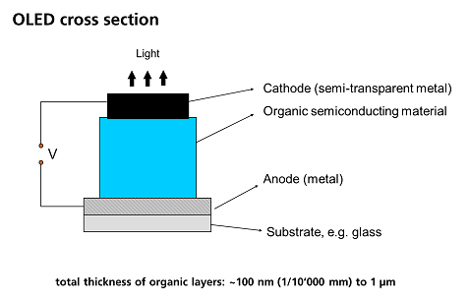
The simplest OLED structure consists of one organic layer between two electrodes. This is an electroluminescent layer.
The one organic layer device is called a single layer device.
Organic electroluminescent (OEL) materials, based on π-conjugated molecules, are almost insulators, and light is produced by recombination of holes and electrons which have to be injected at the electrodes.
http://www.hi-led.eu/lighting-technology/
The thickness of the organic layer is very thin, between 100 and 150 nm.

Slide 29
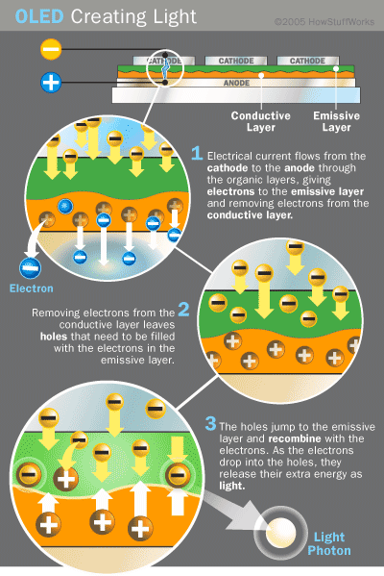
When a voltage is applied between the electrodes, holes from the anode and electrons from the cathode are injected in the organic material.
The charges move inside the material, generally by hopping processes and then recombine to form excitons.
The location of the recombination zone in the diode is a function of the charge mobility of the organic material as well as of the electric field distribution.
After diffusion, the exciton recombines and a photon is emitted.
http://electronics.howstuffworks.com/oled2.htm

Slide 30
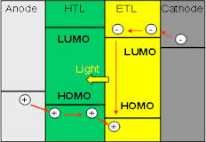
The organic electroluminescent material in order to have a significant efficiency must serve all the three main functions:
electron transport,
hole transport and
emission.
The injection rates of both carriers should be almost equal for high efficiency. Otherwise, the surplus electrons or holes will not recombine, which results in low operation efficiency.

Slide 31
In the case of OLED, what we are trying to do is to avoid recombination close to the interface with the electrodes (usually the active materials are either mainly hole transporting or electron transporting) as it may quench their emission efficiencies.
In order to move away from the interfaces with the electrodes and have a larger recombination area at the center of the active layers, using HTL/ETL can be very useful.
As mentioned above though, be careful when choosing the HTL/ETL that the energetic levels match those of your active material.

Slide 32
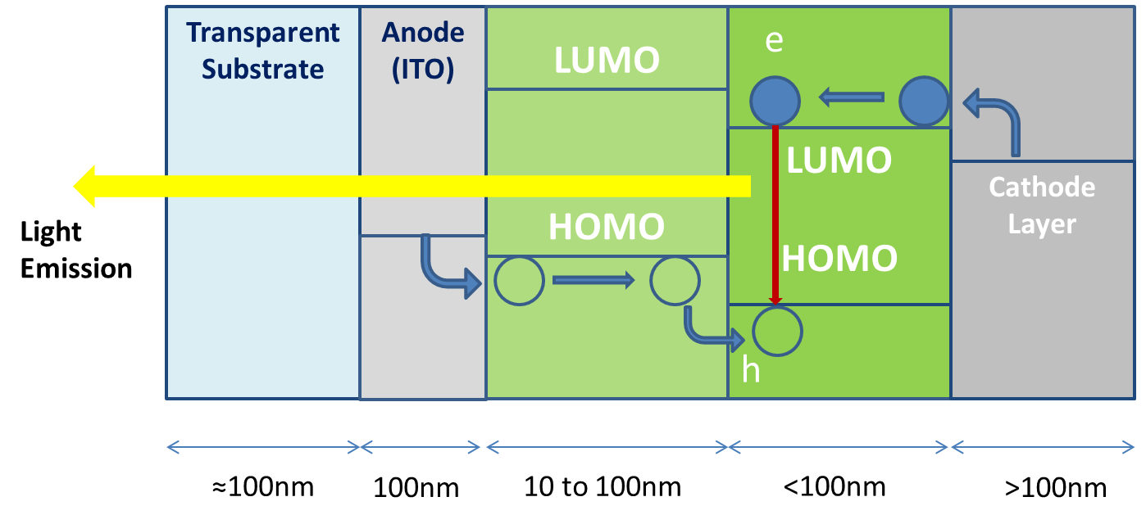
For efficient hole injection from the anode, a low barrier is required in respect of the HOMO level of the organic material (typically 5–6 eV).
On the cathode side, a low barrier for electrons is needed in respect of the LUMO level of the organic material (typically 2–3 eV).
To achieve this many techniques are used with most common the placement of two extra layers one for Electron Transport and one for Hole Transport.

Slide 33
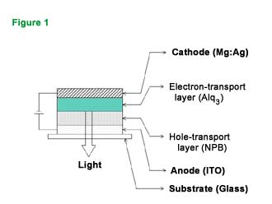
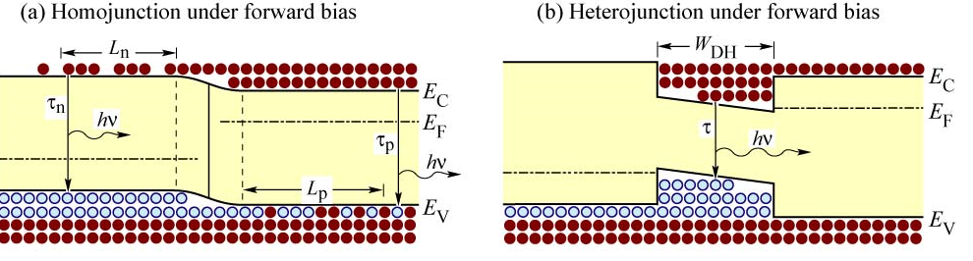
The two layers –ETL and HTL-consist something like the pn-junction in inorganic LEDs.
Like in LEDs, to have better luminous efficiency we can use different materials to create an heterojunction
A heterojunction is the interface that occurs between two layers or regions of dissimilar semiconductors. These semiconducting materials have unequal band gaps as opposed to a homojunction.

Slide 34
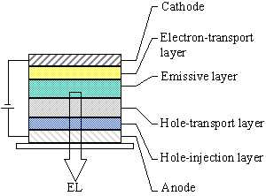
The heterojunction should be designed to facilitate hole-injection from the HTL into the ETL and to block electron injection in the opposite direction in order to enhance the probability of exciton formation and recombination near the interface region.
The simple structure can be modified to a three-layer structure, in which an additional luminescent layer is introduced between the HTL and ETL to function primarily as the site for hole–electron recombination and thus electroluminescence.
Thus, the luminescent or recombination layer can be chosen to have a desirable EL color as well as high luminance efficiency. Likewise, the ETL and HTL can be optimized primarily for the carrier transport properly.

Slide 35
The main requirements for OLED materials are:
high luminescence quantum yield in the solid state,
good carrier mobility (both n and p type),
good film forming properties (pinhole free),
good thermal and oxidative stability, and
good colour purity (adequate CIE coordinates).
The first generation of efficient devices, pioneered by Tang and Van Slyke2 from Eastman Kodak, was based on fluorescent materials.
In this case, the emission of light is the result of the recombination of singlet excitons, but the internal quantum efficiency is limited to 25 %. Typical examples of fluorescent RGB materials are shown in Table 1.

Slide 36
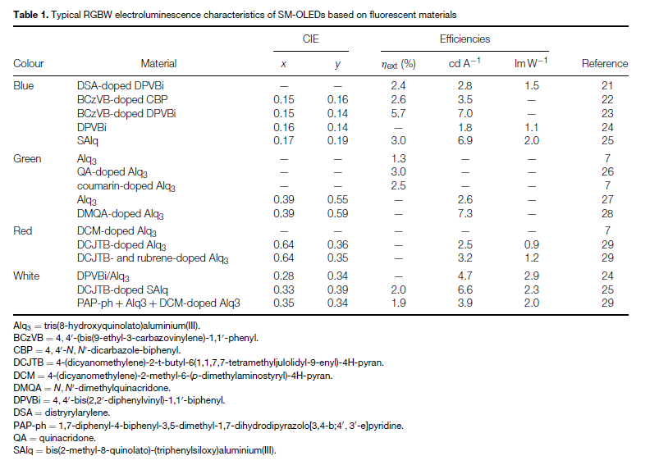



Slide 37
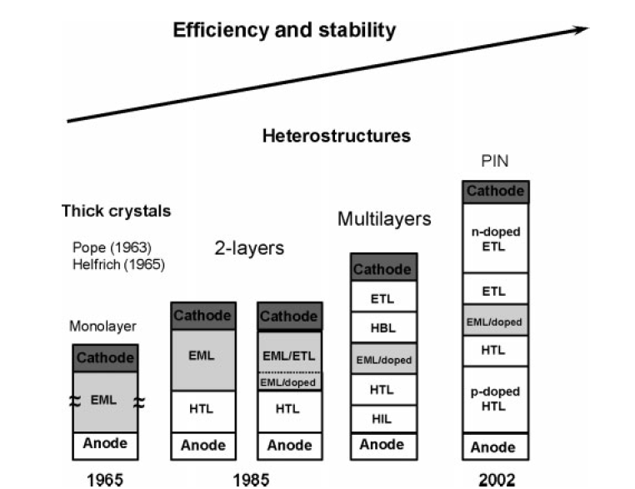
To achieve the previous referred feature for OLEDs they change the structure of the devices from year to year as is shown in the figure
As always new suitable materials are discovered you can find today any of the above structure.
Main role plays today the color emission and its purity and stability over the variation of voltages and time duration

Slide 38
Electroluminescent materials used for OLEDs
Two types of electroluminescent materials are used:
small molecules (SM-OLED) and
polymers (PLED).
The electroluminescence performance is generally very similar for the two classes of material and the main difference is the deposition process of the thin organic film.

Slide 39
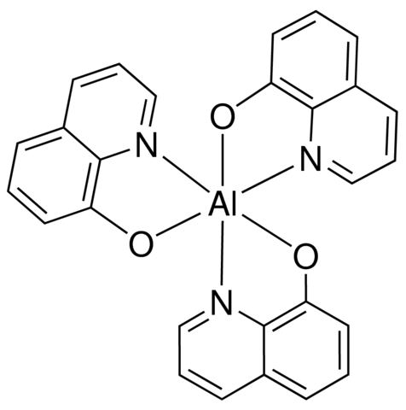
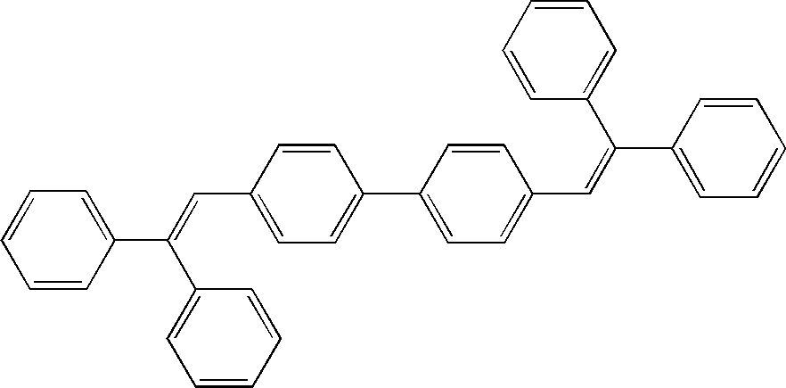
Typical Small Molecules for OLEDs
Alq₃,
Aluminum 8-hydroxyquinolinate, Aluminum oxinate,
Tris-​(8-​hydroxyquinolinato)​aluminum
Invented 1985 by Tang, van Slyke (Kodak)
C₂₇H₁₈AlN₃O₃
DPVBi
4,4′-Bis(2,2-diphenylvinyl)-1,1′-biphenyl
http://www.sigmaaldrich.com/catalog
C₄₀H₃₀

Slide 40
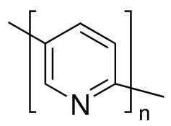
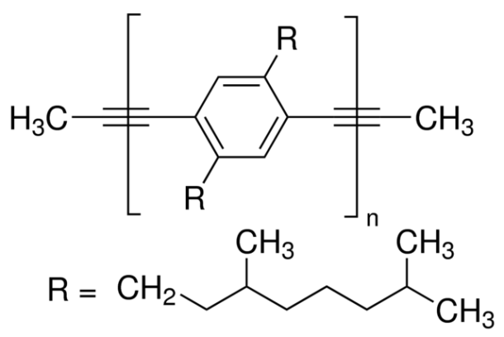
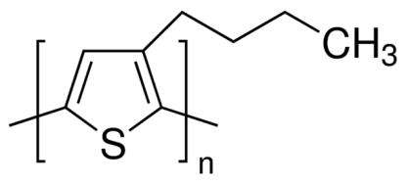
Typical Polymers for OLEDs
Poly(2,5 pyridine)
3′,7′-dimethyloctyl)phenylene-1,4-ethynylene)
Poly(3-​butylthiophene-​2,5-​diyl)
http://www.sigmaaldrich.com/catalog

Slide 41
The color of the photon is a function of the energy difference between the highest occupied molecular orbital (HOMO) and the lowest unoccupied molecular orbital (LUMO) levels of the electroluminescent molecule.
The wavelength of the light emission can thus be controlled by the extent of the conjugation in the molecule or the polymer electroluminescent layer.
Other factors affecting the emission spectrum of OLEDs are:
OLED architecture, in particular on the layer thicknesses
Doping materials

Slide 42
Color emission based mainly on the material
OLED Color Emission | Material
Blue | DSA – doped DPVBi BCzVB-doped CBP BCzVB-doped DPVBi DPVBi SAlq
Green | Alq₃ QA-doped Alq₃ Coumarin-doped Alq₃ DMQA-doped Alq₃
Red | DCM-doped Alq₃ DCJTB-doped Alq₃ DCJTB – & rubrene-doped Alq₃
White | DPVBi/Alq₃ DCJTB-doped SAlq PAP-ph+Alq₃+DCM-doped Alq₃

Slide 43
Color emission based mainly on the structure
OLED Device Performance | ITO/MoO₃/NPD/Alq₃/BPhen/LiF/Al¹ • Color: green • Max. Luminance: 20000 Cd/m² • Max. EQE: 1.2 % • Turn-On Voltage: 2.8 V
 | ITO/NPD/CBP:Ir(ppy)₃/BCP/Alq₃/Mg:Al² • Color: green • Max. Luminance: 100000 Cd/m² • Max. EQE: 8 % • Turn-On Voltage: 4.3 V
 | ITO/NPD/TCTA/BCPO:Ir(piq)​3 (7-8%)/BCP/Alq₃/LiF/Al³ • Color: red • Max. Luminance: 24529 Cd/m² • Max. EQE: 17 % • Turn-On Voltage: 2.7 V
 | ITO/NPD/TCTA/BCPO:Ir(ppy)₃ (7-8%)/BCP/Alq₃/LiF/Al³ • Color: green • Max. Luminance: 207839 Cd/m² • Max. EQE: 21.6 % • Turn-On Voltage: 2.1 V
 | ITO/m-MTDATA/NPD/TTPhPhB/​Alq₃/LiF/Al⁴ • Color: blue • Max. Luminance: 9100 Cd/m² • Max. EQE: 2.5 % • Turn-On Voltage: 3.2 V

Slide 44
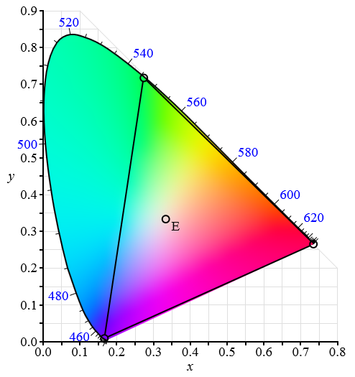
The CIE Chart
Commission internationale de l'éclairage
International Commission on Illumination
http://en.wikipedia.org/wiki/CIE_1931_color_space

Slide 45
The CIE 1931 color spaces are the first defined quantitative links between
a) physical pure colors (i.e wavelengths) in the electromagnetic Visible spectrum and
b) physiological perceived colors in human Color Vision.
The mathematical relationships that define these color spaces are essential tools for color management.
They allow one to translate different physical responses to visible radiation in color inks, illuminated displays, and recording devices such as digital cameras into a universal human color vision response.

Slide 46
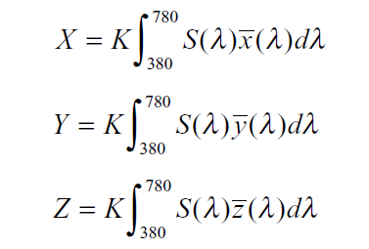
There is a relation between emission spectrum S (λ) and sensitivity of human eye to each wavelength
From these integrals we may calculate x, y coordinates in CIE Chart
$x=\frac{X}{X+Y+Z}$, $y=\frac{Y}{X+Y+Z}$

Slide 47
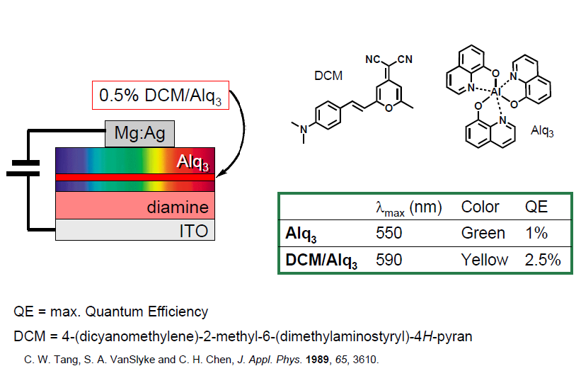
A doping material may affect efficiency, color and lifetime of an OLED.

Slide 48
OLED Color Emission | Material | CIE coordinates
 |  | X | Y
Blue | BCzVB-doped CBP BCzVB-doped DPVBi DPVBi SAlq | 0,15 0,15 0,16 0,17 | 0,16 0,14 0,14 0,19
Green | Coumarin-doped Alq₃ DMQA-doped Alq₃ | 0,39 0,39 | 0,55 0,59
Red | DCJTB – & rubrene-doped Alq₃ | 0,64 0,64 | 0,36 0,35
White | DPVBi/Alq₃ DCJTB-doped SAlq PAP-ph+Alq₃+DCM-doped Alq₃ | 0,28 0,33 0,35 | 0,35 0,39 0,34

Slide 49
The components in an OLED differ according to the number of layers of the organic material.
There is a basic single layer OLED, two layers and also three layers OLED’s.
As the number of layers increase the efficiency of the device also increases.
The increase in layers helps in injecting charges at the electrodes and thus helps in blocking a charge from being dumped after reaching the opposite electrode.
Any type of OLED consists of the following components.

Slide 50
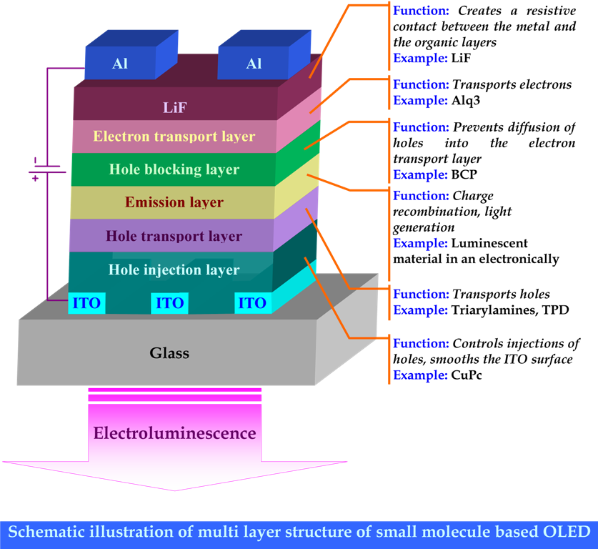
sanjaykram.blogspot.com

Slide 51
Fabrication of OLEDs
Small molecule emissive materials are typically coated as thin films via vacuum-deposition which is difficult over large areas and is not as cost effective.
Polymer-based OLEDs are attractive due to their excellent film forming properties and their ease of application over large surfaces through simple, economically viable coating techniques such as spin coating or ink-jet printing.
The main part of manufacturing OLEDs is applying the organic layers to the substrate.

Slide 52
Deposition techniques involving OLED materials can be classified as wet or dry techniques.
Dry techniques such as vacuum thermal evaporation (VTE) and organic vapor phase deposition (OVPD) have been predominantly used for small molecular organic material deposition.
This is because of the ease of depositing large area uniform and homogenous film using these dry techniques, and because the solubility of small aromatic molecules tends to be too small for solution processing of sufficiently thick films.
Polymer organic materials are deposited using wet techniques such as spin coating, ink jet printing, and contact stamping.

Slide 53
Vacuum thermal evaporation (VTE)
In evaporation, source material is heated in high vacuum chamber (P < 10⁻⁵ Torr), hence the name vacuum deposition.
High vacuum is required to minimize collisions of source atoms with background species (light of site deposition)
Heating is done by resistive or e-beam sources.
Deposition rate is determined by emitted flux and by geometry of the source and wafer.

Slide 54
Benefits of Vacuum Deposition:
High chemical purity.
Good adhesion between the thin film and substrate.
Control over mechanical stress in the film.
Deposition of very thin layers, and multiple layers of different materials.
Low gas entrapment.
Disadvantages:
Poor step coverage,
Forming alloys can be difficult
The thickness of the film will vary due to the geometry of the evaporation chamber.
Collisions with residual gases aggravate non uniformity of thickness.
In order to deposit a material, the evaporation system must be able to vaporize it.

Slide 55
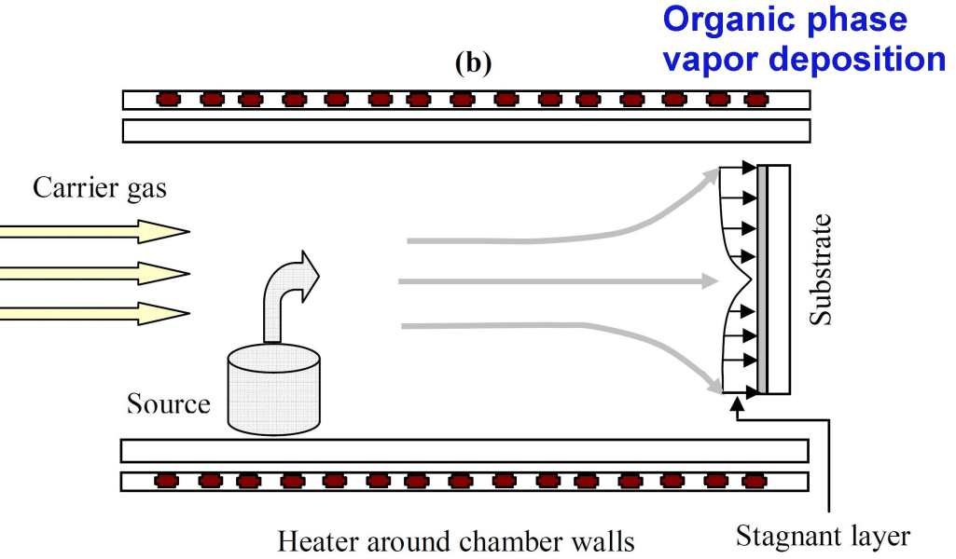
Organic vapor phase deposition (OVPD)
allows better control of the structure and morphology of the film than vacuum thermal evaporation
The process involves evaporation of the organic material over a substrate in the presence of an inert carrier gas.
The resulting film morphology can be tuned by changing the gas flow rate and the source temperature.
Uniform films can be grown by reducing the carrier gas pressure, which will increase the velocity and mean free path of the gas, and as a result boundary layer thickness decreases.
Cells produced by OVPD do not have issues related with contaminations from the flakes coming out of the walls of the chamber, as the walls are warm and do not allow molecules to stick to and produce a film upon them.

Slide 56
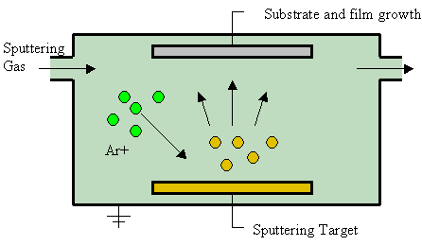
http://en.wikipedia.org/wiki/Sputter_deposition#mediaviewer/File:Sputtering.gif
Sputter deposition is a physical vapor deposition (PVD) method of thin film deposition by sputtering.
This involves ejecting material from a "target" that is a source onto a "substrate"

Slide 57
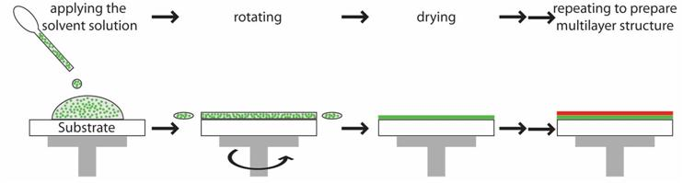
Spin-coating Technique
The 4 stages of spin coating technique
http://www.sneresearch.com/eng/info/show.php?c_id=4970&pg=5&s_sort=&sub_cat=&s_type=&s_word=

Slide 58
In spin coating, the organic material is deposited in liquid form on a substrate in excess.
The substrate is rotated at high speed causing the liquid to spread out across the substance as seen in the figure.
The liquid will form a thin layer and solidify as it evaporates.
The thickness of the film is determined by the amount of time the substrate is rotated and the drying rate of the material
Films produced this way tend to have inconsistent thickness as well as poor surface smoothness.
Due to this inconsistency, it is not the method of choice.

Slide 59
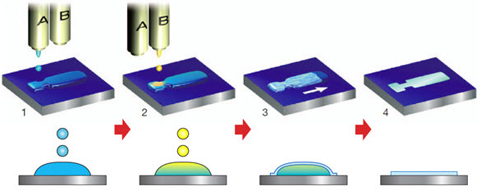
When using polymers, ink-jet technology is commonly used.
The OLED display resolution is similar to that of printed paper and so this technology is easily converted.
In ink-jet printing, the organic material is used in its liquid form in the same fashion as ink is used in a traditional printer.
There exist problems with pinholes in an ink-jet printed layer. This is addressed by first spin coating a layer and then ink-jet printing the second layer.
http://www.sigmaaldrich.com/materials-science/organic-electronics/dntt-based-organic-semiconductors.html

Slide 60
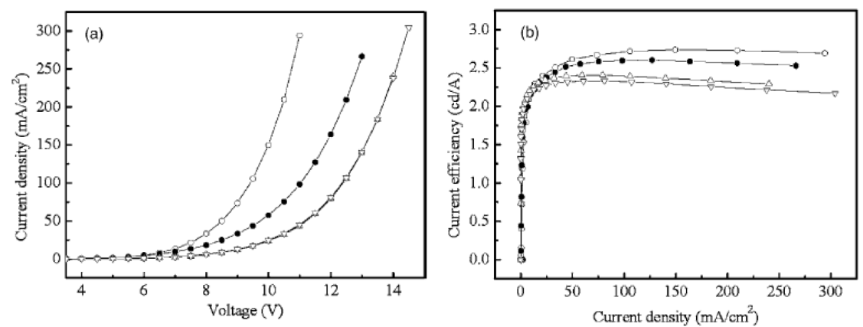
Optoelectronic Characteristics of OLEDs
a) I-V and (b) efficiency-current density curves for OLEDs with structure of ITO/ NPB spacer x nm/ PTCDA:CuPc 10 nm/ NPB 70-x nm/ Alq3 60 nm/ Mg:Ag, where NPB spacer thicknesses are 0 nm (open circles), 10 nm (filled circles), 20 nm (upward triangles), and 30 nm (downward triangles), respectively.
http://dx.doi.org/10.5772/52446

Slide 61

http://dx.doi.org/10.5772/52446

Slide 62




Slide 63
The meaning of pixel
If you divide a still image into a collection of small colored dots, your brain will reassemble the dots into a meaningful image.
On a TV or computer screen, the dots are called pixels.
If you divide a moving scene into a sequence of still pictures and show the still images in rapid succession, the brain will reassemble the still images into a single, moving scene.
Your brain is fusing the dots of each image together to form still images and then fusing the separate still images together into a moving scene. Without these two brain’s capabilities, TV as we know it would not be possible

Slide 64

Red, green and blue OLEDs maybe used to produce the various colors in a display.
A "pixel" on a screen is a small module that can have as few as three or four OLEDs in it (one red, one green and one blue).
In the biggest jumbo TVs, each pixel module could have dozens of LEDs.
Pixel modules typically range from 4 mm to 4 cm (about 0.2 to 1.5 inches) in size.
The size of the ultimate screen depends on the size of the LED modules
For example, the grid might contain 640 by 480 LED modules, or 307,200 modules.
http://electronics.howstuffworks.com/jumbo-tv2.htm

Slide 65



The meaning of pixel
Very common RGB filter. With one blue, one red, and two green.
Bayer filter
Bayer-like with one of the green filters modified to "emerald"; used in a few Sony cameras.
RGBE filter
One cyan, two yellow, and one magenta; used in a few cameras of Kodak.
CYYM filter

Slide 66

Pixel Pitch
Pixel pitch is the physical distance between the pixels (picture elements) in a display device.
Pixel pitch can affect viewability when viewing large displays up close because in some displays the pixels do not blend well and spaces between them can be discerned.
It’s for this reason that giant LED displays look beautiful from a distance but get uncomfortable to view when you approach.
LED screen minimum viewing distance
This is calculated by the pixel pitch multiplied by 750 to 1000. This value will produce a smooth image. Closer viewing will produce an image with individual LEDs appearing as dots. E.g. for screen model LVP 1650 16mm (pixel pitch) x 1000 = 16 m.

Slide 67
How an OLED panel is made
Making an OLED involves several steps: taking a substrate, cleaning it, making the backplane (the switching and driving circuitry), depositing and patterning the organic layers and finally encapsulation the whole thing to prevent dust, oxygen and moisture damage.
There are several ways to deposit and pattern the organic layers.
OLED displays may made using vacuum evaporation, using a Shadow Mask (FMM, Fine Metal Mask) to pattern. This is a relatively simple method but it is inefficient and very difficult to scale up to large substrates. There are several alternatives for next-gen deposition techniques, including laser annealing and inkjet printing. These methods will be scalable and more efficient than vacuum deposition.

Slide 68

Schematic illustration of the direct photolithography process for the fabrication of a full-color display.
The red emitting polymer is spin-coated onto the
substrate with an ITO comb structure and selectively
exposed to UV light using a contact mask-aligner.
Subsequently, the non-crosslinked parts are dissolved and the procedure is repeated for the green and the blue emitter.
Finally, cathode rows are deposited by thermal evaporation
through a shadow mask.
https://www.cdtltd.co.uk/pdf/direct-photolithography.pdf

Slide 69

Shadow Mask Patterning
The method of depositing RGB emitting layers at each pixel is called the "Shadow Mask Patterning Method". Since the displays produced by this method have independent emitting layers, they have excellent color purity and contrast.
Also, it is possible to have high luminance efficiency and low power consumption, because RGB color filters are not used.

Slide 70

Color Filter Method
With this method, the OLED materials, including RGB color elements produce white light which is then filtered to obtain the desired colors.
It is not necessary to have a wide variety of OLED materials so only one kind of OLED material is used to produce white light.
Some disadvantages are low color purity and contrast. Also, the filters used with this method absorb most of the light energy emitted, requiring the white light to be relatively strong. Therefore power consumption for the displays produced by this method is higher.

Slide 71


Slide 72

Passive – Matrix OLED (PMOLED)
The Passive-Matrix OLED or PMOLED is the first OLED to be commercialized.
PMOLED is composed of anode strips, cathode strips, an organic active layer, and a substrate.
Passive matrix is the configuration in which anode and cathode strips are arranged perpendicularly having an organic active layer in between.
The intersections between anode and cathode strips are pixels.

Slide 73


Light is generated when current passes through the selected anode and cathode strips.
Turning on/off the current that goes through strips determines which pixels will be displayed and an image is created.
Red, green, and blue subpixels are allocated to specific lines; data lines are driven by data drivers, and scan lines are driven by scan drives.

Slide 74


Slide 75

(Data line and scan line can also be driven by an ASIC chip to reduce cost in actual case.)

Slide 76
Even though PMOLED is easy to fabricate and manufacture, the external circuit that controls current source is relatively expensive.
Comparing to other OLED types, PMOLED is less efficient mostly due power loss from diodes and the strips.
Though, this type of OLED still consumes less power than LCD display.
Therefore, PMOLED is the most power efficient in and best used for small displays ranging from 2” to 3”.
Currently they are used in cell phones, music players, GPS, and portable displays.

Slide 77

Active – Matrix OLED (AMOLED)
Active matrix is a type of addressing scheme used in flat panel displays.
In this method of switching individual elements (pixels) of a flat panel display, each pixel is attached to a transistor and capacitor which actively maintain the pixel state while other pixels are being addressed.

Slide 78
In Figure 1 transistor T2 is used to turn on and off the pixel.
This is fairly similar to any other active matrix display.
T1 is used as a current source where the current is given by its gate source voltage.
To have a good current source T1 needs to be operated in the saturated region beyond the cut off voltage with sufficient drain source voltage.
Cs is the storage capacitor which holds the gate voltage of T1 and thus the current, until the pixel is addressed again until the next frame is written.
The simple single transistor current source of Figure 1 has a major cost advantage since only one transistor is required, programming the current through the OLED.

Slide 79


Color can be expressed by the combination of red, green, and blue subpixels.
Most data drivers can handle 6 - or 8 - bit grayscales , and for special applications, such as medical use, 10 or 12 bits are used.
When an 8 - bit grayscale is used, each (R, B, or G) subpixel can display
28 = 256 grayscales therefore,
256³= 16,777,216.
Almost 16 million colors can be expressed; this is sometimes called a full -color display

Slide 80
Common display technologies
Cathode ray tube display (CRT)
Light-emitting diode display (LED)
Electroluminescent display (ELD)
Electronic paper, E-Ink
Plasma display panel (PDP)
Liquid crystal display (LCD)
High-Performance Addressing display (HPA)
Thin-film transistor display (TFT)
Organic light-emitting diode display (OLED)

Slide 81
Plasma display (Disadvantages)
Large pixel pitch, meaning either low resolution or a large screen. As such, color plasma displays are only produced in sizes over 32 inches (81 cm) and 1080p displays are only available from sizes of 42" upwards.
Image flicker due to being phosphor-based though modern plasma displays make this effect less noticeable.
Glass screen can induce glare and reflections.
High operating temperature and power consumption. LCDs consume less power.
Input lag
Relatively heavy weight

Slide 82
Plasma display (Disadvantages)
For those who wish to listen to AM radio, or are amateur radio operators (hams) or shortwave listeners (SWL), the radio frequency interference (RFI) from these devices can be irritating or disabling.
Relatively fragile; should only be transported, stored, and operated upright, as the glass screen can shatter under the display's own weight if not supported properly.
Cannot be used with light guns/pens.
Defective pixels such as dead pixels and stuck pixels may occur either during manufacturing (except stuck pixels) or through use.

Slide 83
LCD displays and LCD TV (disadvantages)
Only one native resolution.
Displaying any other resolution either requires a video scaler, causing blurriness and jagged edges; or running the display at native resolution using 1:1 pixel mapping, causing the image either not to fill the screen (letterboxed display), or to run off the lower right edge of the screen.
Fixed bit depth,
many cheaper LCDs are only able to display 262,000 colors. 8-bit S-IPS panels can display 16 million colors and have significantly better black level, but are expensive and have slower response time.
Input lag,
because the LCD's A/D converter waits for each frame to be completely outputted before drawing it to the LCD panel. Also some modern LCDs do post-processing before displaying the image, which adds an additional lag.

Slide 84

OLEDs have better Power Efficiency and Thickness
https://meee-services.com/what-is-oled-and-what-are-the-applications/

Slide 85
LCD displays and LCD TV (disadvantages)
Dead or stuck pixels may occur during manufacturing or through use.
In a constant-on situation, thermalization may occur, in which part of the screen has overheated and looks discolored compared to the rest of the screen.
Unacceptably slow response times in low temperature environments.
Loss of contrast in high temperature environments.
Not usually designed to allow easy replacement of the backlight.
Poor display in direct sunlight. Transflective LCDs provide a large improvement by reflecting natural light, but have not yet been widely adopted.
Cannot be used with light guns/pens.

Slide 86
We are looking for new devices to be
Lighter
Flexible
Thinner
Brightness
Less Power Consumption
Better Efficiency
Easier to Produce in Large Sizes
Smaller Viewing Distance
Better Viewing Angle
Theoretically Cheaper to Make in the Future
Faster Response Time

Slide 87
OLED Displays (Advantages)
Very high contrast ratio - above 1,000,000:1 static.
Excellent viewing angle
Very light weight
Excellent black level
No ghosting and smearing artifacts during fast motion due to sub-millisecond response time.
Wide gamut and vivid colors because no backlight is used.
Can be fabricated on flexible plastic substrates leading to the possibility being fabricated and of creating flexible video displays.
No geographical constraints.

Slide 88
OLED Displays (Disadvantages)
Can suffer screen burn-in.
Increased power consumption when displaying white color.
Blue OLEDs degrades more rapidly than the materials that produce other colors.
Poor readability in bright ambient light such as outdoors.
Water can damage the organic materials of the display.
Can be damaged by prolonged exposure to UV light.

Slide 89
OLED Displays (Disadvantages)
Difficult and expensive to manufacture at the present time.
Organic materials used (as of 2011) are susceptible to decay over time, rendering the display unusable after some time.
Defective pixels such as dead pixels and stuck pixels may occur either during manufacturing (except stuck pixels) or through use.
Cannot be used with light guns/pens

Slide 90
New applications of OLEDs
OLED technology may usher in a new era of large-area, transparent, flexible and low-energy display and lighting products.
The flexibility of OLEDs enables manufacturers to produce OLEDs using roll-to-roll manufacturing processes, and allows for the production of flexible display and lighting products.
OLEDs today are commercially produced on rigid glass substrates mainly. However, first applications like watches or bent displays using flexible OLEDs have entered the market lately.

Slide 91
New applications of OLEDs
OLEDs due to their unique properties to be flexible and transparent, open the way for new, exciting display applications.
When the technology is ready, we may see OLED panels that you can fold, bend or stretch.
This may create all sorts of exciting designs that will enable large displays to be placed in a mobile device and only be opened when required.
Possible markets for OLEDs are, apart from displays, lighting, medical treatment, wearable electronics, automotive industry.

Slide 92
What we have to do
To develop sufficiently durable and flexible OLEDs will require better materials and further development of manufacturing tools and processes.
Flexible plastic substrates need improved barrier layers to protect OLEDs from moisture and oxygen.
Thin-film encapsulation also is needed to create thin and flexible metal- and glass-based OLEDs.

Slide 93



roll-to-roll manufacturing process
http://www.flexd.com/feature_E.html

Slide 94



These advances ultimately may lead to very flexible OLED panels for both display and lighting products, ensuring that any surface area – flat or curved – will be able to host a light source.
Wearable electronics using OLEDs, but not on a plastic

Slide 95

An example of a flexible display (demonstration at FPD International 2007 by Samsung SDI).

Slide 96

Demonstration of rollability of a flexible display: rolled (upper) and unrolled (lower) display (demonstration at SID2010 by Sony).

Slide 97

An example of a foldable display (demonstration at SID2008 by Samsung Mobile Display).

Slide 98

Flexible OLED Displays
A flexible OLED is based on a flexible substrate which can be either plastic, metal or flexible glass. The plastic and metal panels will be light, thin and very durable - in fact they will be virtually shatter-proof.
Second generation flexible OLED devices may indeed be flexible to the final user.

Slide 99
Where will OLED be used in future cars?
We can see several applications for OLED displays and lighting systems in cars:
Dashboard displays (instrument clusters, navigation, media)
Heads up displays
Internal lighting
External lighting (tail lights, turn indicators)
Digital rear-view internal mirrors
More application we cannot think about today!

Slide 100

Flexible OLED lighting
OLEDs can also be used to make white lighting panels. OLED is a diffuse area lighting source with unique characteristics. While OLED lighting is still in its infancy, many believe that flexible OLED lighting panels may provide designers with a new lighting source that will create stunning designs.
LG Chem's first batch of flexible panels (seen in the photo above) will be 210x50 mm in size and will feature a 4,000K color temperature, 73 lumens flux, 55 lm/w and a high CRI (90).

Slide 101

Transparent OLED Displays
The actual OLED materials are transparent, and indeed it's possible to fabricate transparent OLEDs (TOLEDs). There are actually some products on the market that already use such displays, although currently the largest available transparent OLED display is only 2.4" in size. OLEDs can also be used to create lighting panels, and transparent OLED lighting panels are possible and already shipping in small quantities.
Transparent displays can have interesting applications - displays embedded windows (for example in car windshields), OLED TVs that will be invisible when not used or wearable displays. The usability of transparent displays is limited, and we're still waiting for companies to find some real applications for those displays.

Slide 102

Transparent OLED Displays
Homes with OLED films applied to windows are also on the horizon. One of the most practical demonstrations of OLED’s potential outside the display market is in display films used for virtual curtains, which could be activated by the touch of a button to block sunlight. The screen could also be used to show the temperature, humidity level, and extended forecast.
https://www.flatpanelshd.com/news.php?subaction=showfull&id=1446462482
https://www.theverge.com/2015/6/10/8756355/samsung-transparent-mirror-oled-displays

Slide 103


Wearable OLEDs
The custom embedded system inside contains a powerful 32-bit microprocessor, flash memory, a sophisticated LED matrix driver and a very efficient power supply. The LED grid has elements that allow it to be extremely durable when flexing constantly. You can program it through your phone, wirelessly to personalize messages. The LEDs’ brightness will keep you visible and its video-stream capability will keep you noticed while, due to it’s lighweight, you may even forget you’re wearing it.

Slide 104

Wearable OLEDs
One of the challenges in the push for wearable displays lies in finding reliable, high-performance light emitters compatible with the rough-and-ready world of woven clothing.
A team from the Korea Advanced Institute of Science and Technology (KAIST) has come up with one candidate: a high-luminance organic LED (OLED) fiber—manufacturable using a simple, solution-based process—that can be woven into textiles and knitted garments.
Read more at:
https://www.printedelectronicsworld.com/articles/13474/oled-threads-for-weaving-wearable-displays

Slide 105
Wearable OLEDs
Dip-coating approach The KAIST team, seeking to build an OLED fiber with strong enough performance for wearable displays, and with a sustainable, low-temperature manufacturing process, began with a fiber substrate made of polyethylene terephthalate (PET), a common, widely used material for plastic fibers. The researchers then used a simple dip-coating method to deposit sequential, even layers of OLED components around the PET substrate. These included a cathode layer consisting of the conductive polymer PEDOT:PSS; a layer of polyethylenimine and zinc-oxide nanoparticles for the electron-injection layer; the light-emitting polymer Super Yellow, from Merck, as the emitting layer; a hole-injecting layer of molybdenum oxide; and an anode layer of aluminum.
The team also built up the same materials on glass to fashion a planar OLED for experimental comparisons.

Slide 106

Medical diagnostics & treatment
Now a team of researchers in Scotland has demonstrated in a pilot study that OLEDs may one day change the way photodynamic therapy (PDT) is used to treat skin cancer.
In addition to the treatment of skin cancers, the researchers believe that the technology could also be used in the cosmetic industry for anti-aging treatments or skin conditions such as acne.

Slide 107
Medical diagnostics & treatment
Using OLED technology, the PLACE-it group has created a flexible fluorescence measurement device to assess the elimination kinetics of the renal marker FITC-Sinistrin (water-soluble fructan linked to fluorescein-isothiocyanate).
Status and functionality of kidneys can be measured by this revolutionary device.
The team hopes this product will help to detect end stage renal disease (ESRD) earlier and more consistently.

Slide 108
Medical diagnostics & treatment
Arguably the most innovative and successful product developed by the team is the stretchable Blue LED Light Therapy for effective pain relief.
Blue Light enhances the body’s release of nitric oxide – which possesses pain-relieving qualities. 50 per cent stretch will be demonstrated in devices so they can be worn, for example, on the back. Clinical evidence suggesting this therapy works has already been established, and the device is comfortable to wear all day, every day.
OLED sleep masks showed no significant safety signal apart from an impairment of vigilance tasks for which the effect size was small. Sleep disturbance and light intolerance tended to cause early withdrawal. Mask and ocular discomfort were commonly reported but tended to be tolerable and not to affect mask wear. Mask usage was higher in older people. These data allow improvements in mask design and dosage and planning for future clinical trials including safety advice on tasks requiring high levels of vigilance.

Slide 109

Medical diagnostics & treatment
Preventing dark adaptation by delivering low dose light during sleep is a new approach to the treatment of diseases associated with hypoxia such as diabetic maculopathy.
They use an OLED sleep mask to deliver the dose of light to the patients
http://iovs.arvojournals.org/article.aspx?articleid=2333003

Slide 110
Suggested Text Books
OLED Displays: Fundamentals and Applications, Takatoshi Tsujimura. Published 2012 by John Wiley & Sons, Inc.
Introduction to Flat Panel Displays, Jiun-Haw Lee, David N. Liu, Shin-Tson Wu , Published 2008 by John Wiley & Sons, Inc
http://www.oled-info.com/
Principles and Applications of Organic Light Emitting Diodes (OLEDs), N. Thejo Kalyani, Hendrik Swart, S. J. Dhoble, Published 2017 by Woodhead Publishing

Slide 111
Suggested Videos
https://www.youtube.com/watch?v=Ewf7RlVNBSA&ab_channel=CrashChemistryAcademy
Orbitals, the Basics: Atomic Orbital Tutorial — probability, shapes, energy
https://www.youtube.com/watch?v=wPw_LCmyjnI&ab_channel=SponholtzProductions
Hybridization Theory
https://www.youtube.com/watch?v=jrThPKDMBW4&ab_channel=OLEDWorks
How an OLED is Made
https://www.youtube.com/watch?v=8quZrUcRFlw&t=5s&ab_channel=EdisonTechCenter
LEDs and OLEDs - How it Works, Inventors
https://www.youtube.com/watch?v=pa_VInL5W1o&ab_channel=YedaCenter
OLED - Organic Light Emitting Diodes - Part 1
https://www.youtube.com/watch?v=_cKXqnb0Hl0&ab_channel=YedaCenter
OLED - Organic Light Emitting Diodes - Part 2

Slide 112

Live your Erasmus Experience in Crete,
the ideal place for studies and entertainment
Thank you for your attention

