Slide 1
TV Features
When choosing a television, everyone always tells you to take a look at the different features, compare and contrast, and then choose! Simple, right? WRONG. Most televisions have a list of features a mile long and half of them are probably words you don’t understand, which probably means you also don’t know if they are important or not.

Slide 2
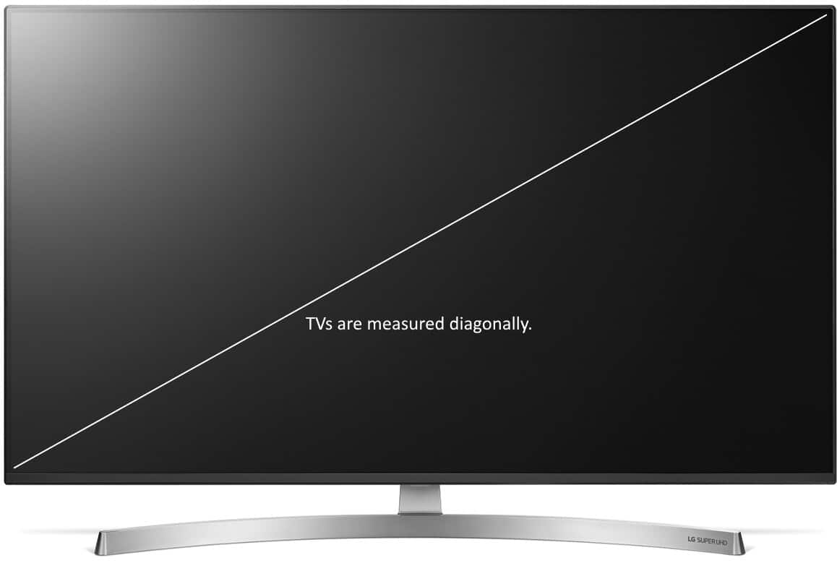
Screen’s Size
All electronic screens are measured diagonally as opposed to measuring them from side to side or bottom to top.
This is true for all whether they are on a laptop computer, a tablet, or a flat-screen TV.
This measurement gives the actual size of the screen.

Slide 3
TV Aspect Ratios
An aspect ratio is an attribute that describes the relationship between the width and height of an image.
Aspect ratio is expressed by the symbolic notation: X:Y. The values of X and Y are not the actual width and height of the image but describe the relationship between them.
Most common aspect ratios are:
4:3, 16:9, 21:9
They can also be expressed as a decimal number:
1,3:1, 1,7:1, 2,3:1
If you know the dimensions and the aspect ratio of a display you can calculate the are of a display, and if you know also the resolution you can calculate the number of pixels

Slide 4


TV Aspect Ratios
Images using the same diagonal size:
4:3
16:9

Slide 5


TV Aspect Ratios
Images using the same area / same number of pixels:
4:3
16:9

Slide 6


TV Aspect Ratios
Images using the same height / same vertical size:
4:3
16:9

Slide 7

TV Aspect Ratios

Slide 8

TV Aspect Ratios
Images using the same width/ same horizontal size:
4:3
16:9

Slide 9

TV Aspect Ratios

Slide 10
Resolution
The display resolution or display modes of a digital television, computer monitor or display device is the number of distinct pixels in each dimension that can be displayed.
It can be an ambiguous term especially as the displayed resolution is controlled by different factors in cathode ray tube (CRT) displays, flat-panel displays (including liquid-crystal displays) and projection displays using fixed picture-element (pixel) arrays.
It is usually quoted as width × height, with the units in pixels: for example, 1024 × 768 means the width is 1024 pixels and the height is 768 pixels. This example would normally be spoken as "ten twenty-four by seven sixty-eight" or "ten twenty-four by seven six eight".

Slide 11
Resolution
The eye's perception of display resolution can be affected by a number of factors
One factor is the aspect ratio.
A screen's physical aspect ratio and the individual pixels' aspect ratio may not necessarily be the same.
An array of 1280 × 720 on a 16:9 display has square pixels, but an array of 1024 × 768 on a 16:9 display has oblong pixels.
An example of pixel shape affecting "resolution" or perceived sharpness: displaying more information in a smaller area using a higher resolution makes the image much clearer or "sharper".
However, most recent screen technologies are fixed at a certain resolution; making the resolution lower on these kinds of screens will greatly decrease sharpness, as an interpolation process is used to "fix" the non-native resolution input into the display's native resolution output.

Slide 12

Resolution

Slide 13
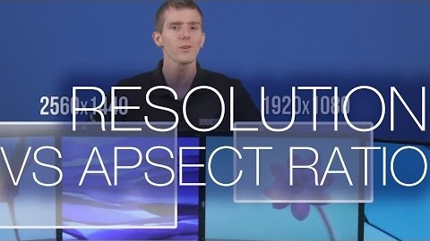
Resolution

Slide 14
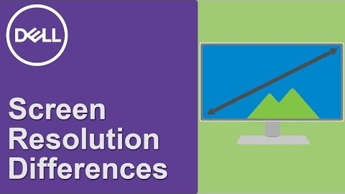
Resolution

Slide 15
Resolution
While some CRT-based displays may use digital video processing that involves image scaling using memory arrays, ultimately "display resolution" in CRT-type displays is affected by different parameters such as spot size and focus, astigmatic effects in the display corners, the color phosphor pitch shadow mask (such as Trinitron) in color displays, and the video bandwidth.

Slide 16
Contrast Ratio
The contrast ratio (CR) is a property of a display system, defined as the ratio of the luminance of the brightest color (white) to that of the darkest color (black) that the system is capable of producing. A high contrast ratio is a desired aspect of any display.
There is no official, standardized way to measure contrast ratio for a system or its parts, nor is there a standard for defining "Contrast Ratio" that is accepted by any standards organization so ratings provided by different manufacturers of display devices are not necessarily comparable to each other due to differences in method of measurement, operation, and unstated variable
Static contrast ratio is the luminosity ratio comparing the brightest and darkest color the system is capable of producing simultaneously at any instant of time, while dynamic contrast ratio is the luminosity ratio comparing the brightest and darkest color the system is capable of producing over time (while the picture is moving).

Slide 17
Contrast Ratio
An LCD technology is dynamic contrast (DC), also called advanced contrast ratio (ACR) and various other designations.
When there is a need to display a dark image, a display that supports dynamic contrast underpowers the backlight lamp (or decreases the aperture of the projector's lens using an iris), but proportionately amplifies the transmission through the LCD panel; this gives the benefit of realizing the potential static contrast ratio of the LCD panel in dark scenes when the image is watched in a dark room.
The drawback is that if a dark scene contains small areas of superbright light, the resulting image will be over exposed.
The trick for the display is to determine how much of the highlights may be unnoticeably blown out in a given image under the given ambient lighting conditions.

Slide 18
Contrast Ratio
Brightness, as it is most often used in marketing literature, refers to the emitted luminous intensity on screen, measured in candela per square metre (cd/m2). The higher the number, the brighter the screen.
It is also common to market only the dynamic contrast ratio capability of a display (when it is better than its static contrast ratio only on paper), which should not be directly compared to the static contrast ratio.
A plasma display with a 4,000,000:1 static contrast ratio will show superior contrast to an LCD (with LED or CCFL backlight) with 30,000,000:1 dynamic and 20,000:1 static contrast ratio when the input signal contains a full range of brightnesses from 0 to 100% simultaneously. They will, however, be on par when input signal ranges only from 0 to 20% brightness.

Slide 19
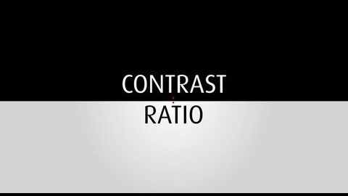
Contrast Ratio

Slide 20
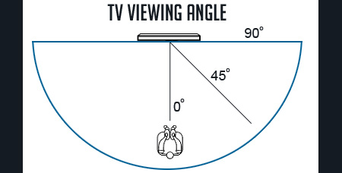
Displays’ Viewing Angles
In display technology parlance, viewing angle is the angle at which a display can be viewed with acceptable visual performance. In a technical context, the angular range is called viewing cone defined by a multitude of viewing directions.
The viewing angle can be an angular range over which the display view is acceptable or it can be the angle of generally acceptable viewing, such as a twelve o'clock viewing angle for a display optimized or viewing from the top.

Slide 21
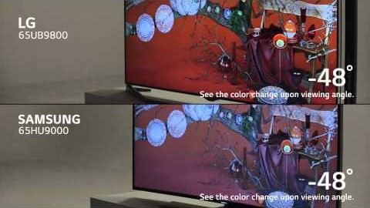
Displays’ Viewing Angles
OELDS and in-plane switching (IPS) LED/LCD panel types tend to have the best viewing angles.
In addition to great viewing angles, vertical alignment panels provide great color contrast ratios and colour reproduction

Slide 22
Viewing Distance
Optimum TV viewing distance is the distance that provides the viewer with the optimum immersive visual TV experience.
The ideal optimum viewing distance is affected by the horizontal angle of the camera capturing the image.
One concept of an ideal optimal viewing distance places the viewer where the horizontal angle subtended by the screen is the same as the horizontal angle captured by the camera.
If this is the case, the angular relationships perceived by the viewer would be identical to those recorded by the camera. A mismatch in this regard is traditionally disregarded, but some rotating motions can make these distortions very noticeable as a pincushion effect.
This is likely in 3d video games, so gamers are likely to adopt close viewing positions matched to a game's fixed field of view.

Slide 23
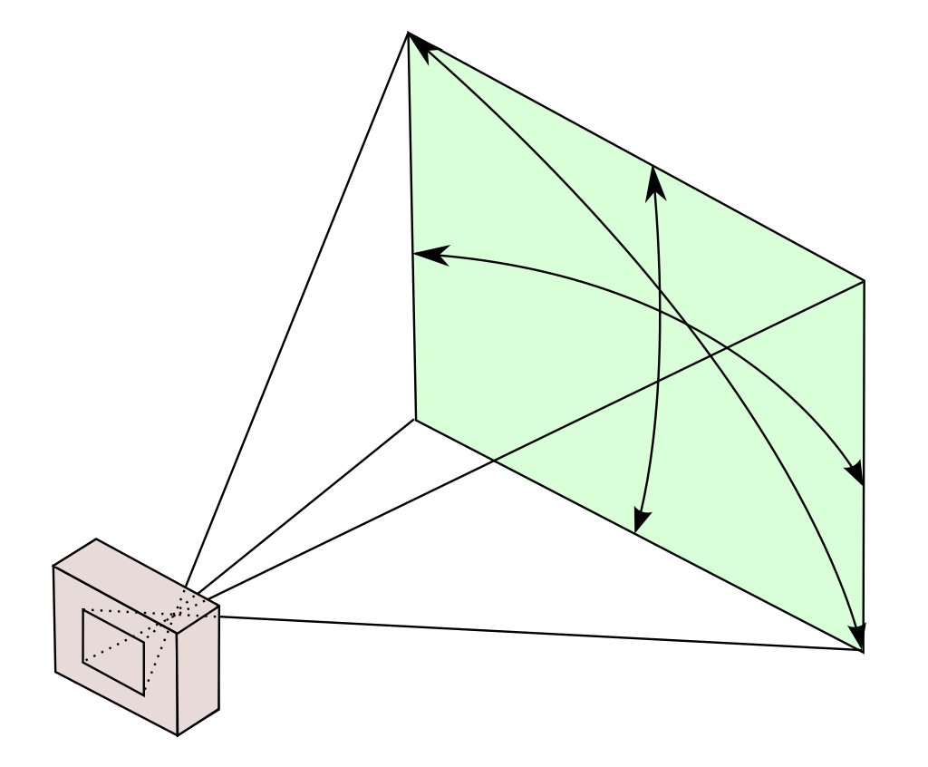
Viewing Distance
If the camera's angle were always the same, an optimal viewing distance could be easily calculated.
However the camera's horizontal angle varies as the focal length of its lens changes.
If the camera's sensor has fixed dimensions, a shorter focal length (wide angle) lens captures a wider angle of view, requiring the viewer to sit closer to the screen.
Conversely, a longer focal length (telephoto) lens captures a narrower angle of view, demanding a more distant viewer position.
Horizontal, vertical and diagonal field of view

Slide 24
Viewing Distance
Such opposing viewing distances would not only be impractical, but would negate the very purposes of telephoto shots (for example, to see a distant object in more detail, or minimize distortion in facial images) and wide-angle shots (causing the viewer to sit too close to the screen, where undesirable image artifacts would be visible).
One compromise assumes the lens is "standard" (a 50mm focal length, for a standard 35mm format). A "standard" lens preserves the same spatial relationships perceived by a spectator at the camera location. For a "standard" lens image, viewing distance should be equal to the diagonal length of the screen.
It has been demonstrated that viewing a display that occupies a greater visual angle (also referred to as field-of-view) increases the feeling of presence. More importantly, the wider the visual angle (to approximately a plateau point of 80 degrees), the greater the feeling of presence.

Slide 25
Viewing Distance
Presence
The concept of presence has been described as the sensation of “reality”, of “being there”, and as “an illusion of nonmediation”.
The concept of presence originated and was studied with regard to Virtual Reality (VR) and other 3D environments. It was later established that television viewers could also experience a feeling of presence.
Presence is influenced by a number of factors, including video camera techniques, audio fidelity, visual and aural dimensionality, and most relevantly to this topic, image size (visual angle) and quality (angular resolution).

Slide 26
Viewing Distance
Human visual system limitation
The human visual system has a fixed capacity to detect detail from a distance.
Our understanding of limitations, regarding to visual detail recognition and identification from a distance, is primarily based on the work of Dr. Hermann Snellen who developed the eye examination chart that bears his name (Snellen chart).
From his findings and the work of others over the last hundred years, one arcminute is seen as the threshold beyond which critical detail cannot be identified, by a person with normal vision.
An arcminute is an angular measurement, which is equal to 1/60 of one degree of a circle. Normal vision is referenced as 20/20 or 6/6 vision in North America and Europe respectively.

Slide 27
Viewing Distance
Human visual system limitation[edit]
The visual acuity threshold has been identified as a constraint factor in the recommendations on the optimum viewing distance for HDTV,^{[36]} and also in formal research that comment on the subject of television and angular resolution.^{[1][46][47][48]}
Assuming display is flat, with 1 arcminute as the constraint for seeing critical detail, in order not to miss any detail a viewer would need to be situated at a position where their view angle to a 1080p HDTV is approximately 31.2 degrees or greater (32 degrees for spherical display), for 2160p HDTV approximately 58.37 degrees or greater (64 degrees for spherical display) and for 4320p HDTV approximately 96.33 degrees or greater (128 degrees for spherical display).^{[1][3]} However, there is not always agreement that the Snellenian limit should be the constraining factor.

Slide 28
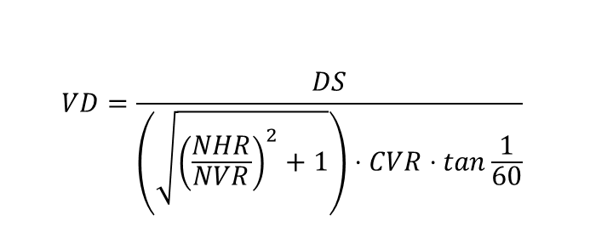
Viewing Distance
$$VD=\frac{DS}{\left(\sqrt{{\left(\frac{NHR}{NVR}\right)}^{2}+1}\right)⋅CVR⋅tan\frac{1}{60}}$$
Where:
VD: Viewing distance
DS: Display's diagonal size
NHR: Display's native horizontal resolution (in pixels)
NVR: Display's native vertical resolution (in pixels)
CVR: Vertical resolution of the video being displayed (in pixels)
Note: Make sure the angle mode is set to degrees when calculating the tangent. If using a spreadsheet such as Excel, you must multiply the angle by PI()/180. If DS is given in inches, VD will be in inches. If VD in meters is desired, multiply VD by 2.54 and divide by 100.

Slide 29
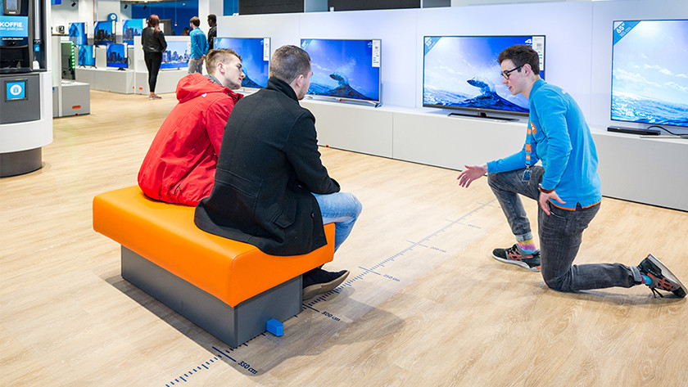
Viewing Distance
In order to calculate the minimum and maximum viewing distance for a Full HD TV, you must multiply the screen size by 1.5 and 2.5.
A 65-inch TV measures 165 diagonally, for example. This means that the viewing distance should be between 2.5 and 4.1 meters. For a 4K television, you multiply the diagonal size by 1 and 1.5. Thanks to the smaller pixels, you can sit closer to the screen. Keep in mind that this is only a rule of thumb. Your personal preference and the usage situation also play a part.

Slide 30
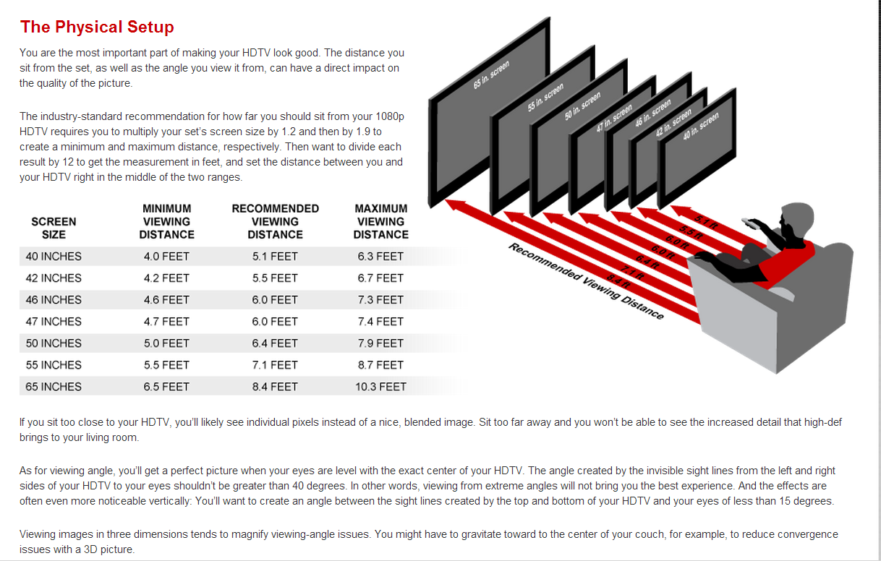
Viewing Distance

Slide 31

Viewing Distance

Slide 32
Refresh rate
The refresh rate is a measure of how many times per second the TV redraws the image on the screen.
It is measured in Hertz, which is commonly abbreviated as "Hz."
The refresh rate is often confused with the frame rate (fps or frames per second).
They are indeed very similar, and both refer to the number of times a static image is displayed per second, but the frame rate usually refers to the content itself, whereas the refresh rate refers to the video signal or display.
Many manufacturers use inflated marketing terms to make it seem like their TVs have higher refresh rates than their competitors, as outlined in our fake refresh rate article.

Slide 33
Refresh rate
Although manufacturers would like you to believe that 120Hz TVs are inherently better than their 60Hz counterparts, the refresh rate itself does not directly improve the motion performance of a TV.
In theory, 120Hz is definitely better; as the screen is refreshed twice as often, motion should look better. Unfortunately, though, there is very little 120Hz content available.
Most mid to high-end TVs these days have 120Hz screens, whereas most budget models have 60Hz screens. A handful of 240Hz displays also exist, but these are mainly used for PC monitors. But what is the refresh rate, and why does it matter?

Slide 34

Refresh rate
60p content played on 60Hz
60p content played on 120Hz TV
As you can see from the picture above, a TV with a higher refresh rate does not produce less motion blur. Since both of these TVs have a very similar response time (which causes the blur), 60 fps content results in an almost identical picture.
To better showcase these differences, we compared two TVs side-by-side; a 60Hz model, and a 120Hz model, with similar response times. We filmed these TVs in slow motion to easily compare each individual frames.

Slide 35
Refresh rate
For most people, there is little benefit to upgrading to a TV with a 120Hz refresh rate. Unless you have 120 fps content, there is very little difference between a 60Hz and a 120Hz TV, unless you enjoy the Soap Opera Effect, where the missing frames are interpolated to make 24 or 60Hz content look like it is 120Hz.
The exception to this is gaming. As gaming can generate content on the fly, it can easily scale to any refresh rate (assuming your PC can keep up). 120Hz gaming is growing rapidly in popularity and is now supported on the Xbox One with a 1080p or 1440p resolution. As HDMI 2.1 devices arrive on the market, 120Hz gaming is expected to continue growing in popularity, as HDMI 2.1 allows for gaming at 4k @ 120Hz.

Slide 36
Refresh rate
For most people, there is little benefit to upgrading to a TV with a 120Hz refresh rate. Unless you have 120 fps content, there is very little difference between a 60Hz and a 120Hz TV, unless you enjoy the Soap Opera Effect, where the missing frames are interpolated to make 24 or 60Hz content look like it is 120Hz.
The exception to this is gaming. As gaming can generate content on the fly, it can easily scale to any refresh rate (assuming your PC can keep up). 120Hz gaming is growing rapidly in popularity and is now supported on the Xbox One with a 1080p or 1440p resolution. As HDMI 2.1 devices arrive on the market, 120Hz gaming is expected to continue growing in popularity, as HDMI 2.1 allows for gaming at 4k @ 120Hz.

Slide 37
Frame rate
Frame rate (expressed in frames per second or FPS) is the frequency (rate) at which consecutive images called frames appear on a display. The term applies equally to film and video cameras, computer graphics, and motion capture systems. Frame rate may also be called the frame frequency and be expressed in hertz..

Slide 38
Frame rate
The temporal sensitivity and resolution of human vision varies depending on the type and characteristics of visual stimulus, and it differs between individuals.
The human visual system can process 10 to 12 images per second and perceive them individually, while higher rates are perceived as motion. Modulated light (such as a computer display) is perceived as stable by the majority of participants in studies when the rate is higher than 50 Hz.
This perception of modulated light as steady is known as the flicker fusion threshold.
However, when the modulated light is non-uniform and contains an image, the flicker fusion threshold can be much higher, in the hundreds of hertz. With regard to image recognition, people have been found to recognize a specific image in an unbroken series of different images, each of which lasts as little as 13 ms.
Persistence of vision sometimes accounts for very short single-millisecond visual stimulus having a perceived duration of between 100 ms and 400 ms. Multiple stimuli that are very short are sometimes perceived as a single stimulus, such as a 10 ms green flash of light immediately followed by a 10 ms red flash of light perceived as a single yellow flash of light.

Slide 39
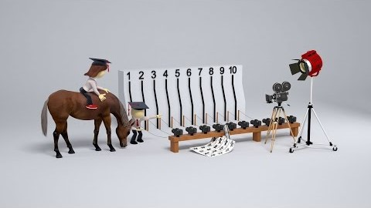
Frame rate

Slide 40
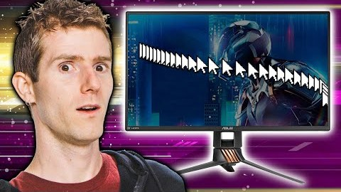
Frame rate

Slide 41
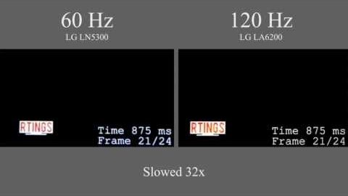
Refresh rate

Slide 42
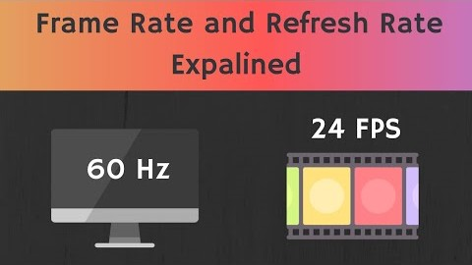
Refresh rate

Slide 43
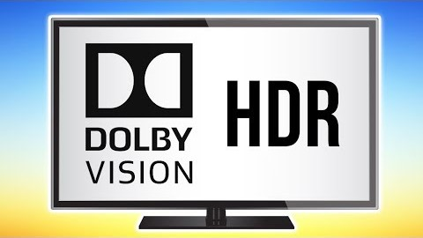
HDR (High Dynamic Range)

Slide 44


