Slide 1
Cross Cultural Management Intensive Program Vaasa, July 2012
Intercultural Knowledge Transfer and the Implications on International Co-operations
Dr. Lola Sanchez (PhD, M.Ed)
University of Nicosia
Sanchezl@cytanet.com.cy

Slide 2
Agenda
Definitions
Chances and Obstacles of cultural diversity
Knowledge transfer failures in co-operations
The importance of knowledge/types
Knowledge transfer criticism
Culture and knowledge transfer
Solution to improve cross-cultural knowledge transfer

Slide 3

Conducting business internationally

Slide 4
International Business
“is any commercial transaction that crosses the borders of two or more nations”. (Wild, Wild and Han, 2006, p.5)
It relates for example to selling products, buying raw material, designing, manufacturing…..

Slide 5
Business Co-operation definition
Refers to the quality of relationships among human beings in a context of embracing mutual understanding, shared goals and values and to the ability to work together towards a common task.
Alter and Hage (1993)
Inclination or willingness from the parts to engage in joint activities to achieve joint goals. Andaleeb (1995)
For cooperation across borders “collaboration between two or more partners from different countries”Holtbruegge (2004, p.259)

Slide 6
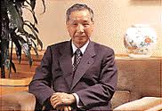
It is no longer an era in which a single company can dominate any technology or business by itself. The technology has become so advanced, and the markets so complex, that you simply can’t expect to be the best at the whole process any longer. Fumio Sato, CEO, Toshiba Electronics

Slide 7

Hewlett- Packard’s example
The idea is created in Singapore
The concept is approved in Houston
The concept design is realized in Taiwan
Final assembly in Singapore, Australia, China or India
IBM example
Computer programmer
in Seattle working with a
team of computer programmers at Beijing’s Tsinghua University

Slide 8
Strategic Alliance definition
A “relationship whereby two or more entities co-operate (but do not form a separate company) to achieve the strategic goals of each” Wild, Wild and Han (2006, p.391) .
“Strategies alliances are partnerships between two or more firms that decide they can better pursue their mutual goals by combining their resources- financial, managerial, technological- as well as their existing distinctive competitive advantages”. Deresky (2006, p.255) .

Slide 9
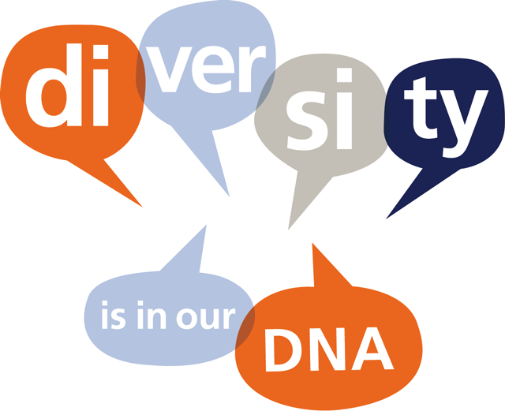

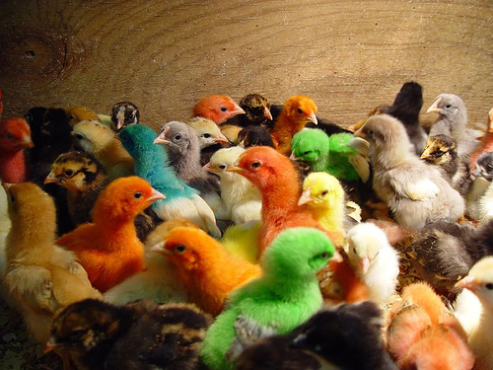

Slide 10

Chances by diversity
● Greater openness to new ideas, multiple
perspectives and alternatives (i.e.
product development, international
marketing)
● increasing creativity and innovativeness
(i.e. market research)
● increasing international problem solving
skills and flexibility(multi-cultural teams)
● Better able to market effectively to local
customers (international marketing)

Slide 11
Obstacles of diversity
Ambiguity
Complexity
Confusion
Miscommunication
Harder to agree on specific issues
Over generalizing on: practices, policies
Ethnocentrism

Slide 12
A thought
Not this makes us strong what we see weak in the other person. This makes us strong what we see positive in the other person because then, we show that we are able to carry the same positive features within us. J.W.v Goethe

Slide 13

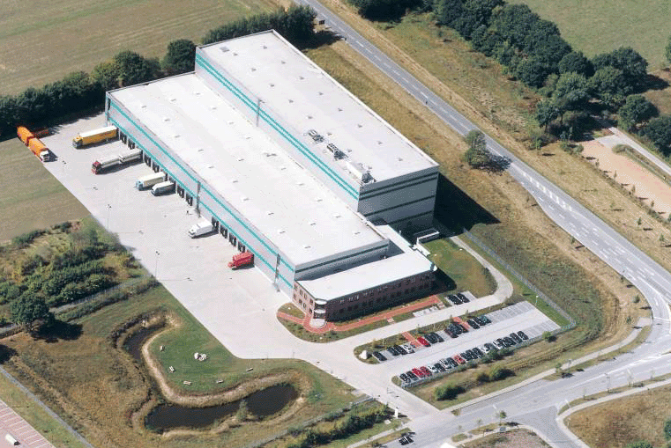

International Strategic Alliances Failures
Eastern European
Company
Western European
Company
Why: Gaps in managerial, cross cultural, knowledge transfer
and methodological skills

Slide 14

Eastern Mangement Deficiencies
East
West
Knowledge
Transfer
● Lack of managerial skills
● Strong authoritarianism, ● Overemphasis on control
● Lack of initiative
● Lack of trust
● Poor relationship between manager and employees
● Ambiguous job responsibilities
● Promotions via connections
● Linear thinking

Slide 15

Western management deficiencies
West
East
Knowledge transfer
● Questionable knowledge transfer methodologies
(ethnocentric approach)
● Different learning styles
● Lack of cultural awareness and sensitivity

Slide 16


Slide 17
Data, Information, Knowledge, Wisdom
To think of knowledge in relation to its cousins, data and information”.
Data the raw material necessary for information. Information is data that has been organized so that is has meaning for the recipient”. Ford and Chan, (2003, p.11)
Information is defined as a message
Data is a set of discrete objective facts about events”. Davenport and Prusak (1998,p.2-3)

Slide 18
Knowledge
The most valuable asset companies possess
Before terms like core competences, best practice or learning organization were en vogue, successful companies knew that their success relies on the heads of their employees. (Drucker 2003; Reich 2000)
Knowledge is possibly the only resource that, when applied, can enhance the value of the other capital and does not disminish in value. (Harris 2001)
The neccesity to apply knowledge not only to increase its value but also to avoid its loss (Leidner, 2001)

Slide 19
Knowledge definition
A fluid mix of framed experience, values, contextual information, expert insight, and intuition that provides an environment and framework for evaluating and incorporating new experiences and information. (Davenport & Prusak, 1998)

Slide 20
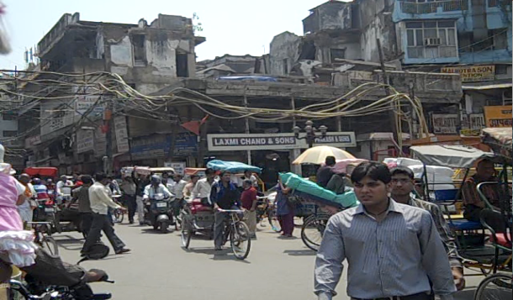
Types of Knowledge
Market specific knowledge: knowledge that
affect the way of doing business in an
specific market.
2. Firm specific knowledge: knowledge assets of a company consisting of the know-how in manufacturing a product (processes) or the experience of its employees

Slide 21
Types of Knowledge
Tacit Knowledge: what we know but we can not tell. Tacit knowledge comes from intuition, tricks, rules of thumb, and, above all, from experience constitutes about 80% of the valuable knowledge in a process. Odell, (1998)
Explicit Knowledge: Codified knowledge and embedded in books and blue prints, e.g. written reports Kumar and Nit (1998).

Slide 22
Knowledge Transfer
„Refers to the cross-cultural, cross-border and cross-organizational processes whereby information, ideas and practices move between two different business settings“ Clark&Geppert (2002, p. 264)

Slide 23
Knowledge transfer criticism
Knowledge has meaning only in a defined context: if this context is changed the transfer of this knowledge can be perturbated, misunderstood, wrongly interpreted or even resisted to learn it. (Raich 2000)
The knowledge imported from the West and applied to local circumstances often lacks any thought as to its relevance or effectiveness. (Matlay, 2001)

Slide 24
Knowledge transfer criticism
Refers to how learning is brought about and not neccesarily as to how the process is perceived by those on the receiving end. (Markoczy, 1993)
Mis-perception: Knowledge is power, and shared knowledge usually means less power. (Michailova & Husted, 2003)

Slide 25
Posible reasons for criticism
The attitudes and behaviour of the knowledge transmitters
The attitudes and behaviour of knowledge receivers
A lack of the shared understanding of the content by the transmitter and the receiver

Slide 26
It must not be forgotten that:
1. what is understood is not what is heard
2.what is heard is not what is said
3. and what is said is not what is meant.

Slide 27
Specific national cultural influences on Knowledge Transfer: Hofstede
Individualism versus Collectivism
High in Individualism place the self-interest above the group interest, and this is an important determinant of where the knowledge is being transferred to and who will acquire it.
High in Individualism will be more interested in knowing which personal benefits the KT entails for them rather than in the overall benefit for the company. Not finding a satisfactory answer the individual and subsidiaries will place a great deal of roadblocks on the efforts and willingness to share knowledge.
Conclusively, individualistic societies are more reluctant to share knowledge, since this is regarded as a powerful tool and guaranteed success for the individual. Diametrically opposed is the perspective of Eastern Europe being more group orientated which is reflected in the view that knowledge belongs to the company and is, therefore, the of benefit for the overall organization.

Slide 28
Specific national cultural influences on Knowledge Transfer
Masculinity versus Feminity
Cultures driven by competitiveness as one of the most salient features of masculinity will face difficulties in knowledge sharing because they are mainly driven by individual performance, autonomy and independence rather than by organizational performance.
“Masculine societies will only engage in KT if they determine that there is some net gain accruing to them”. Leyland (2006, p.8)
Hierarchy and status have also its influences on KT in masculine societies as it is observed by Leyland (2006, p.8): “Personnel may be less reluctant to share their experiences because they see their actions as engaging with peers rather than with subordinates”.
Knowledge flow in high femininity societies occur easily because both parts with their win-win policy in mind are interested in a bilateral successful outcome, and are more willing to find ways to bridge the differences.

Slide 29
Specific national cultural influences on Knowledge Transfer: PD
The knowledge flows between their hierarchical structures and mainly top down.
They underestimate the knowledge value from the lower levels of the organisation, missing first hand information and making the upward flow of it difficult.
The bases of these cultures are control and power, and therefore, they try to avoid any knowledge sharing facility or activities leading to treat knowledge as a private property.
The transfer of knowledge is done a very hierarchical (imposing) way where the only option is the immediate compliance of unquestioned orders. Regarding the acceptance of knowledge it is questionable if real cognitive understanding and integration of knowledge as a way of personal growth and contribution to create knowledge can occur.
“Innovation may be hindered if the subordinates do not express their ideas” Maletzky (2008, p.18)
Contrarily, societies ranking low in power distance where relations between top, middle and lower level employees are open and communication and knowledge flows in all directions are advantaged as to company growth and innovation.

Slide 30
Specific national cultural influences on Knowledge Transfer: UA
Fear of the unknown represents a major barrier in KT
Change involves taking a leap of faith because the future is unpredictable, leading to a general feelings of being careful towards new things or new ways of acting. Leyland (2006)
“Adopting something new is seen as risky and having the potential to create significant problems “Leyland (2006, p7). Instead of accepting change, there is a strong preference for dealing with – what we are already good at – and avoiding new techniques even if these offer the potential for increased efficiency”. In other words, the potential to improve and to grow is inhibited.

Slide 31

Solution
Reciprocal Learning
East + West

Slide 32
Reciprocal learning
Reciprocal learning as a way to improve knowledge transfer barriers
If you give me one dollar,
And I give you one dollar,
Each of us will still have only one dollar.
However, if we exchange ideas
- you give me one and I give you one –
then we both will have at least two ideas
Raich, (2000)

Slide 33
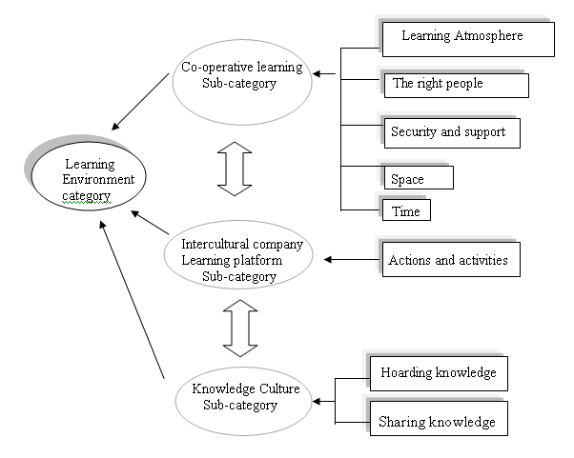
POTENTIAL SOLUTIONS

Slide 34
The Knowledge Transfer Game

Slide 35
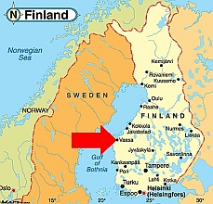
Thank you very much for your attention
Wishing you all a great and interesting time in Vaasa

