Slide 1



HYDROGEN

Slide 2


”
HYDROGEN – THE VISION
In 1874 Jules Verne, one hundred years before the modern investigations with hydrogen began, wrote in "The Mysterious Island", in which he prophesied in the mouth of the engineer Cyrus Harding:
“I think someday water will be used as fuel. That the hydrogen and oxygen that compose it, whether together or separately, will provide an inexhaustible source of light and heat, of an intensity of which coal is not capable. Water will be the coal of the future”.
Sheikh Said Yamani, Minister of Energy of Saudi Arabia, and Founder of OPEC, predicted in the 1970s that
"The stone age did not end when the stones disappeared, and the time of oil will end before it runs out"

Slide 3
HYDROGEN-CHARACTERISTICS AND HISTORY
It is the lightest and most abundant element of nature
It is rarely found pure in its natural state, and most of the time bound to oxygen forming water, and carbon in hydrocarbons
An important energy contribution is required to extract it and covert it into a secondary energy source
It is an energy vector, a secondary form of energy that must be transformed from other primary sources
1796 Cavendish discovers the electrolysis process
1839 Grove developed the first fuel cell
1920 Construction of the first electrolysers
1930 Rudolf Erren manufactured trucks and buses that used hydrogen in internal combustion engines
1959 Bacon develops the first vehicle with a fuel cell (tractor)
1983 Ballard, Prater and Howard founded Ballard Power

Slide 4
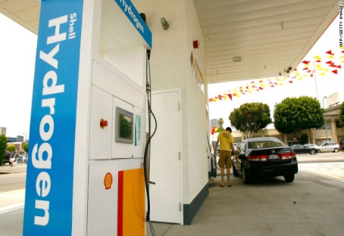



ENERGY EQUIVALENCE OF FUELS
H₂ | Methane (CH₄) | Propane (C₃H₈) | Buthane (C₄H₁₀) | Gasoline (C₈H₁₈)
1 kg | 2,26 kg | 2,47 kg | 2,45 kg | 2,69 kg
Propiedad | H₂ | Methane | Propane | Gasoline
Lower Heating Value (MJ/kg) | 120 | 50 | 46.3 | 44.5
Density (kg/Nm3) | 0.0899 | 0.72 | 1.87 | 0.73 (kg/l)
Lower Heating Value (MJ/m3) | 10.79 | 35.9 | 86.58 | 31.67 (MJ/l)
PCI - Poder Calorífico Inferior del hidrógeno (10.795 MJ/Nm³)

Slide 5
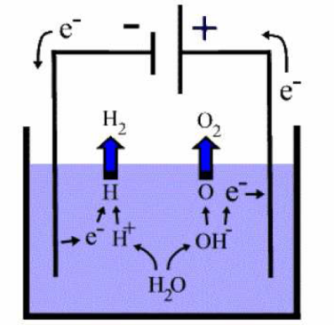
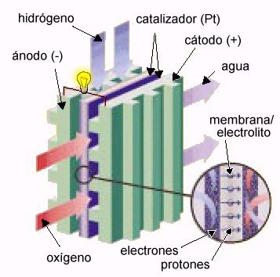
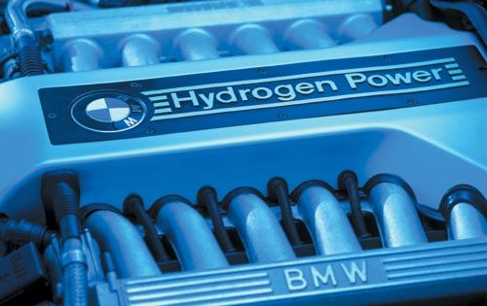


USE OF HYDROGEN AS FUEL
ELECTROLYZER: electrolysis is the process that achieves electrochemical decomposition of water in hydrogen (H₂) and oxygen (O₂), by passing an electric current between two electrodes submerged in water
H₂O + Electricity → O₂ + H₂
Fuel Cell - FC: it is based on an oxidation-reduction reaction, inverse to that produced in the electrolyser. It combines hydrogen with oxygen from the air to produce electricity, heat and water. The electrical production is carried out with a high efficiency of around 50%.
O₂ + H₂ → H₂O + Electricity (-188 kJ/mol)
INTERNAL COMBUSTION ENGINE (MCI): These are natural gas engines adapted to burn H₂. It produces work (then converted to electricity in an electric generator), with an efficiency of approximately 30%. The emissions would be water, and depending on the operating temperature, also NOx.

Slide 6
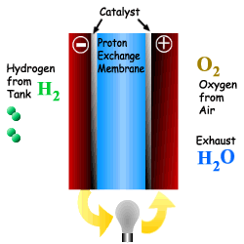
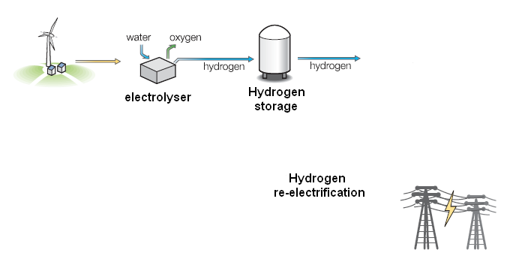
Hydrogen Generation

Slide 7
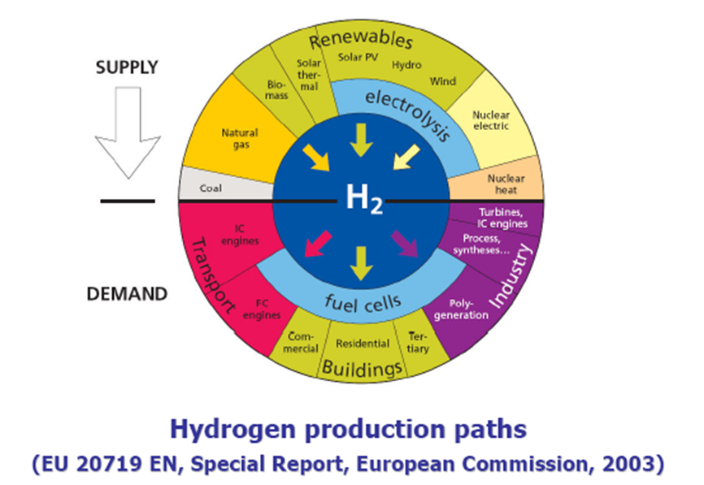
Generation of Hydrogen

Slide 8
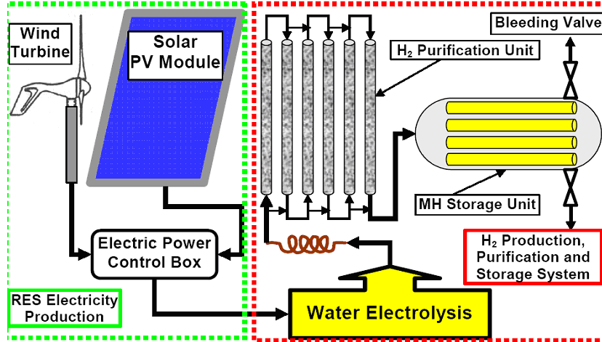
Hydrogen and Generation of RES

Slide 9
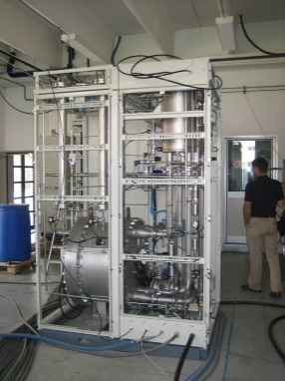
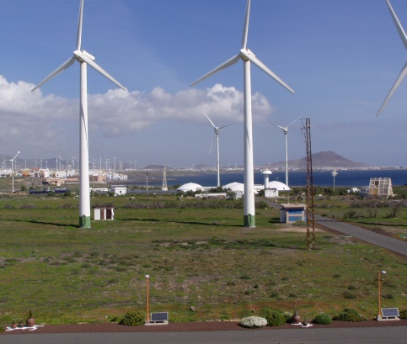
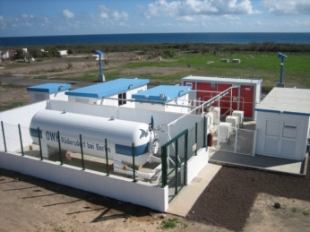
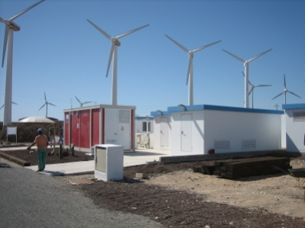
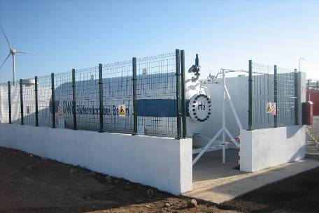
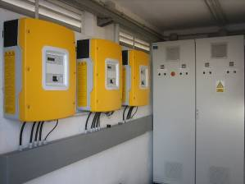
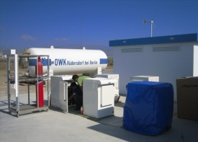
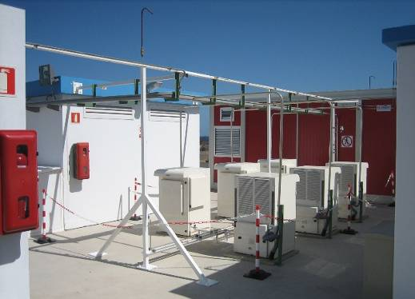
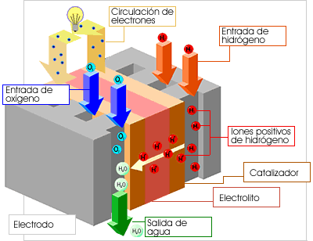
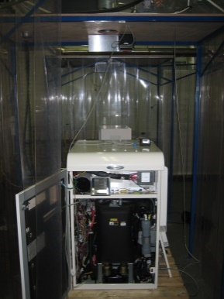
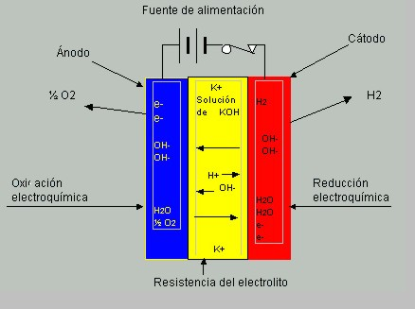
HYDROGEN ENERGY BALANCE
Electroliser
WATER
ELECTRICITY
0.8 kg H₂O/Nm³H₂
4.5 kWh/Nm³H₂
HYDROGEN (H₂)
Heating power
3 kWh/Nm³H₂
1Nm³H
0 ºC
2
89,3 g of H₂
1 atm
25 bar
Compressor
89.3 g de H
2
η = 50 %
1.5 kWh
Eléctricity
Fuel cells
1.5 kWh
Heat

Slide 10
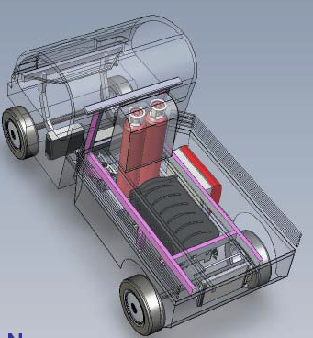
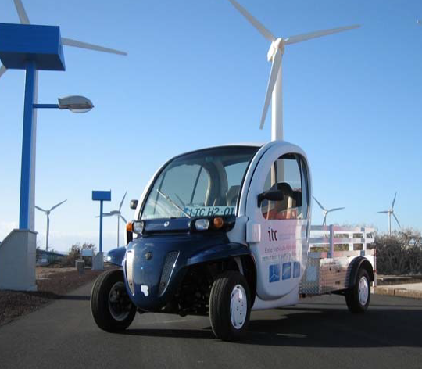
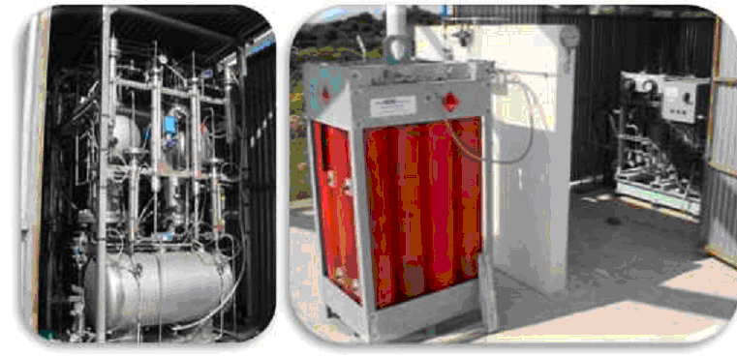
RES and Hydrogen
Truck in ITC Premises, Gran Canaria
Hydrogen Storage in Centre for Renewable Energy Source and Saving, GREECE

Slide 11
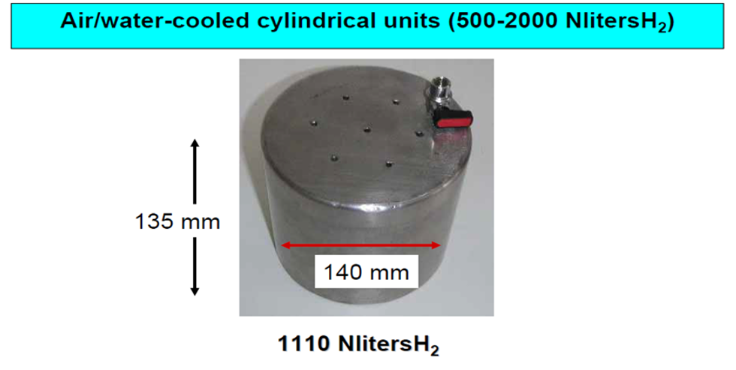
Hydrogen Storage

Slide 12
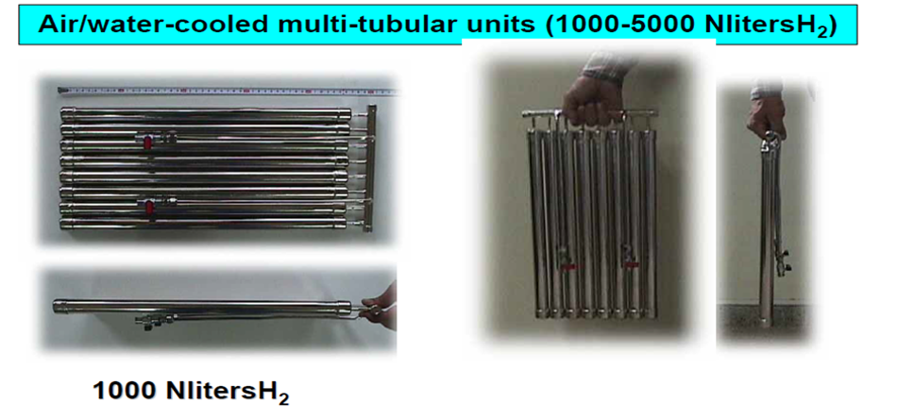
Hydrogen Storage

Slide 13
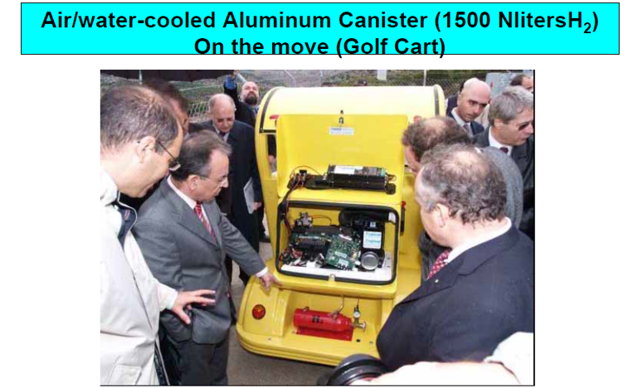
Hydrogen Storage

Slide 14
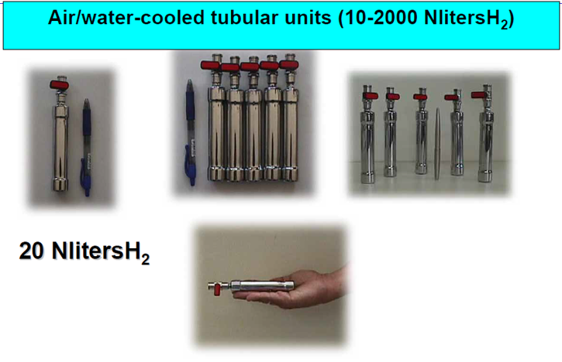
Hydrogen Storage

Slide 15
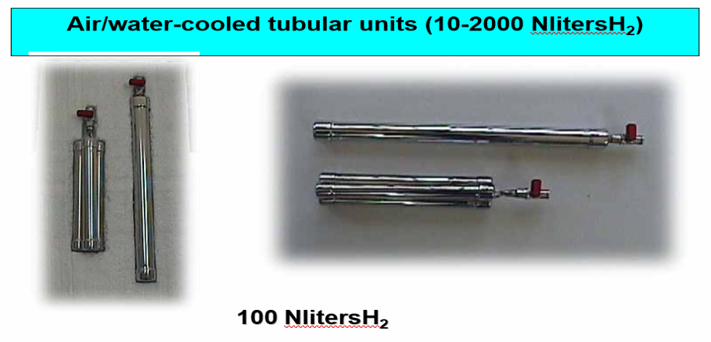
Hydrogen Storage

Slide 16
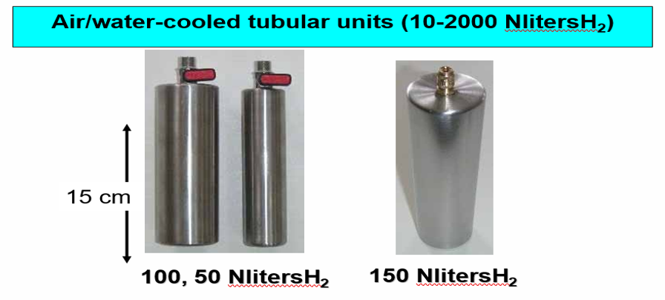
Hydrogen Storage

Slide 17
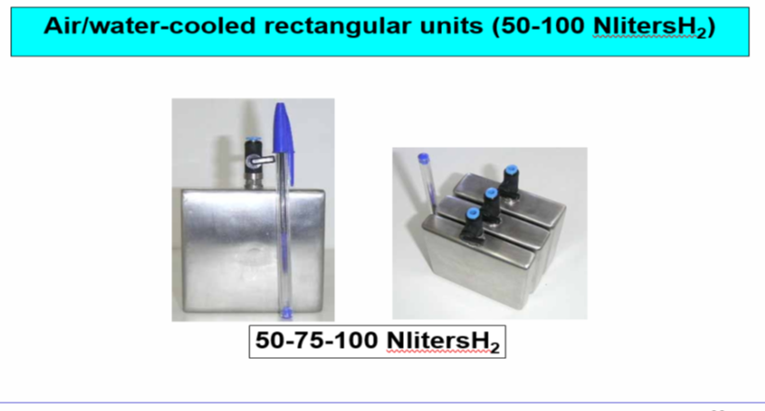
Hydrogen Storage

Slide 18
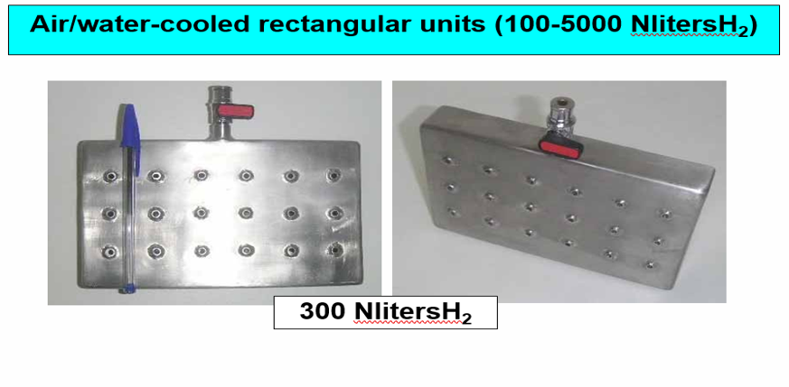
Hydrogen Storage

Slide 19

Hydrogen Storage

Slide 20
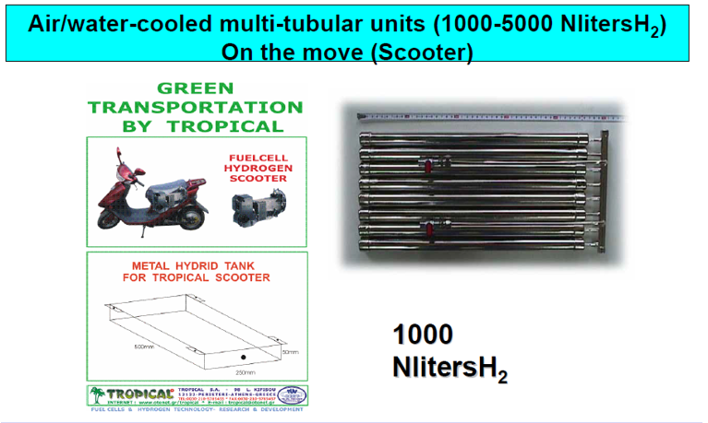
Hydrogen Storage

Slide 21
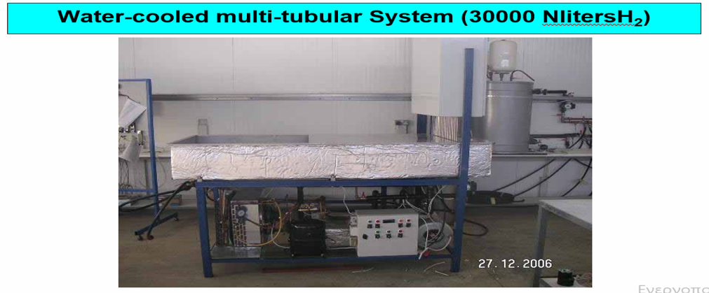
Hydrogen Storage

Slide 22
FUEL CELL characteristics

Slide 23
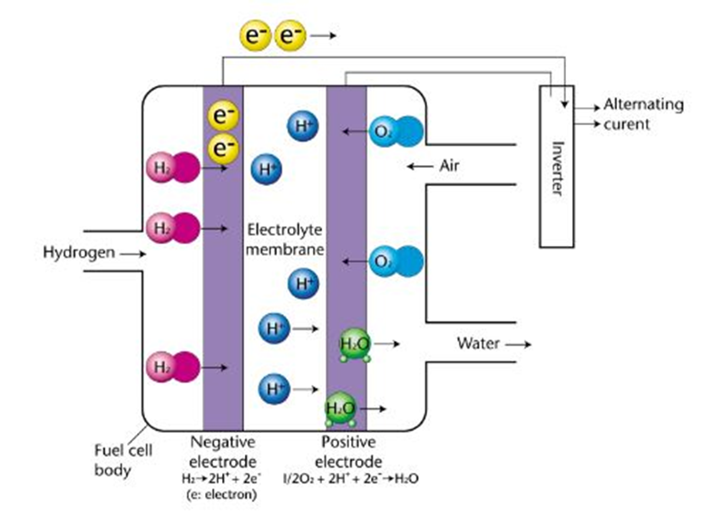
Fuel Cells
A fuel cell is an electrochemical device consuming hydrogen and oxygen generating electricity, heat and water
Fuel cells have two electrodes (one anode and Cathode) separated by an electrolyte
The electrolyte is usually by a polymer or other type of material allowing ion passing but not the one of electrons
A variety of fuels that contain hydrogen can be used and the electrons of hydrogen flow to an external circuit to provide electricity
Positive ions of Hydrogen can surpass the electrolyte and reach the cathode where they are connected with oxygen having as a by –product water.

Slide 24
Fuel cells with hydrogen
They have:
High efficiency (60%) and reliability.
Molecular structure that makes them suitable for a variety of applications.
Few or no atmospheric or acoustic emissions.
They emit only water vapor as exhaust gases.
They can be powered by hydrogen from any hydrocarbon fuel, from natural gas to methanol and even gasoline.

Slide 25
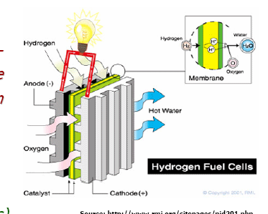
Fuel Cells types
Use Hydrogen: Convert Hydrogen and Oxygen to electricity and water
Alkaline Fuel Cells (AFCs)
Phosphoric Acid Fuel Cells (PAFCs)
Polymer Electrolyte Membrane Fuel Cells (PEMFCs)
Molten Carbonate Fuel Cells (MCFCs)
Solid Oxide Fuel Cells (SOFCs)

Slide 26
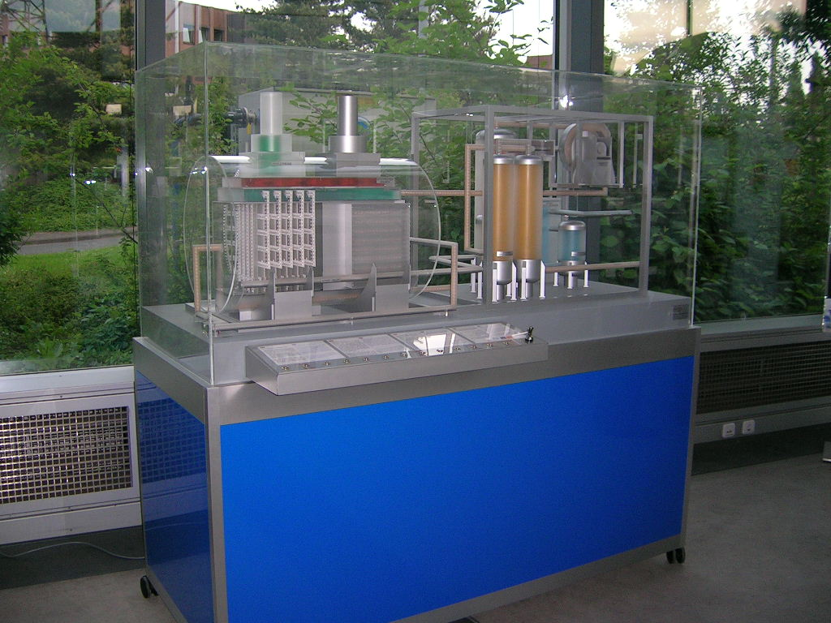
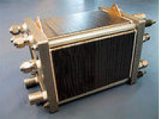
Fuel Cells
If we use Biomass (under special chemical process) or excess electricity from RES in order to produce Hydrogen, then we consider them as RES.
No emissions for the fuel cell (only during the fuel production)
High efficiency and DC units
Can be used for co-generation (especially for hot water)
Personal photos from RWE.

Slide 27
Summary of FC characteristics
Type of Fuel Cell | Electrolyte | Output | Efficiency | Fuel used
AFC | potassium hydroxide in water | Up to 20kW | 50-70% | Η2.CO2 should be taken away from the anode and cathode gases
PEMFC | Polymer | Up to 250kW | 40-50% | Η2, if this comes from Reforming, CO in the fuel should be CO<10ppm
DMFC | Polymer | <10kW | 25-40% | Methanol/Water mix
PAFC | Phosphoric Acid | >50kW | 40-45% | Η2 and Reforming
MCFC | molten carbonate salt mixture | >1MW | 50-60% | Η2, CO, Natural Gas
SOFC | zirconium oxide stabilised with yttrium oxide | >200kW | 50-60% | Η2, CO, Natural Gas

Slide 28
Fuel Cells and Co-generation
Fuel Cells can provide significant aid to applications of co-generation as they “emit” hot water
Type of Fuel Cell | Operation Temperature (°C) | Co-generation Capability
AFC | 60-90 | Negligible
PEMFC | 70-100 | Hot Water-Low Quality
DMFC | 90 | Negligible
PAFC | 150-220 | Acceptable for a variety of Applications
MCFC | 600-700 | High
SOFC | 650-1000 | High

Slide 29
Fuel Cells Applications
Alkaline Fuel Cells (AFCs) Small Units, Space applications.
Phosphoric Acid Fuel Cells (PAFCs) Commercial applications, Large Vehicle systems
Polymer Electrolyte Membrane Fuel Cells (PEMFCs) Domestic and commercial applications, Vehicle systems
Molten Carbonate Fuel Cells (MCFCs) Commercial and Industrial applications Large Scale Capacity (ΜW -class)
Solid Oxide Fuel Cells (SOFCs) Large Scale Capacity in all type of Applications

Slide 30
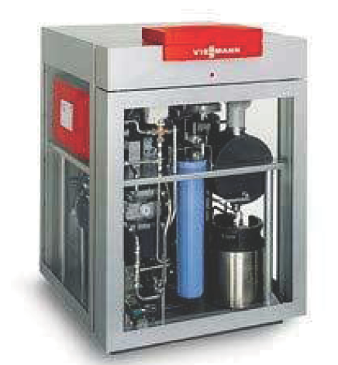
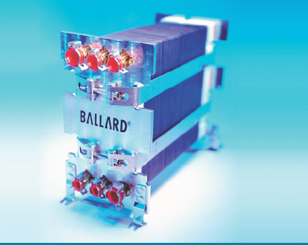
Fuel Cells-Example
PEM –2kWe and 3.5kWth, 32% electricity efficiency, 87% in total
External Dimensions 73 by 76 by 36cm-64kg
www.ballard.com

Slide 31
Fuel Cells-Start Up issues
One of the main disadvantage of the Fuel Cells is their limited flexibility
The typical start-up costs and the ramp-up times are shown per technology in the table below
QUICK |  | SLOW
Type of Fuel Cell | Start up time (h) | Type of Fuel Cell | Start up time (h)
AFC | <0.1 | PAFC | 1 to 4
PEMFC | <0.1 | MCFC | >10
DMFC | <0.2 | SOFC | 5 to 10

Slide 32
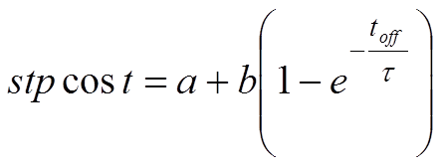
Fuel Cells-Start Up issues
For the PEMFC, the fuel cost for starting up is a function of:
  the hot start up cost (a) ,
  the cold start up cost (b),
  How long the FC is switched off (t_{off})
  the FC cooling time constant τ (expressed in h).
As shown below
The values considered are a=0.05$,b=0.15$ and τ= 0.75h (A.M. Azmy, “Simulation and Management of Distributed Generating Units using Intelligent Techniques,” PhD Dissertation, Universitat Duisburg-Essen,2005)
Typical approximation values can be a+b=0.2$

Slide 33
Hydrogen and RES Evaluation and Case studies

Slide 34
Cost-benefit ratio (CBR) analysis
The cost-benefit analysis aims to identify and assess the costs and benefits of the proposed wind & hydrogen storage power system for from the perspective of the national economy and the environment.
The analysis should include a description of the environmental and social attributes of the proposed power system followed by an attempt to quantify these impacts in order to determine the net economic impact on the society as a whole
The benefit-cost (BC) ratio is the most widely used indicator of the profitability of a project from a social point of view. The BC ratio is defined as the total benefits divided by the total costs of a project
Energy Storage-Hydrogen

Slide 35
Externe Approach for CBR
In order to assess the impacts on health, crops, building materials, forests and ecosystems EcoSenseLE can be used.
The Ecosense model, an integrated software tool for environmental impact pathway assessment and was developed within ExternE project series (http://www.externe.info/externe_2006/tools.html)
EcoSenseLE is an online tool for estimating costs due to emissions of a typical source (e.g. power plant, industry, transport) or all sources of a sector in an EU country or group of EU countries.
It is a parameterised version of EcoSense, based on European data for receptor (population, crops, building materials) distribution, background emissions (amount and spatial distribution), and meteorology
Energy Storage-Hydrogen

Slide 36
Typical Costs for wind & H2 storage power system
Cost of domestic investment
Cost imported investment
Cost of domestic Operation & Maintenance (O&M)
Cost of imported O&M
Energy Storage-Hydrogen

Slide 37
Typical Benefits for wind & H2 storage power system
Benefit from the purchase and installation phase
Benefit from the O&M phase
Benefit from the creation of new jobs
Benefit from public contributions
Benefit from the operation of the wind park
Benefit from the production of electricity
Benefit from the avoided emissions
Energy Storage-Hydrogen

Slide 38
Case Studies from the STORIES (Addressing barriers to STORage technologies for increasing the penetration of Intermittent Energy Sources ) project
Goran Krajačić, Neven Duić, Antonis G Tsikalakis.; Emmanouel Zoulias, George Caralis, Eirini Panteri, Maria da Graça Carvalho “Feed in tariffs for promotion of energy storage technologies”, J. of Energy Policy, Vol. 39, Issue 3,March Available On-line2011,pp 1410-1425.
O.-S. Parissis, E. Zoulias, E. Stamatakis, K. Sioulas, L. Alves, R. Martins, A. Tsikalakis, G. Caralis “Integration of Wind and Hydrogen Technologies in the Power System of Corvo Island, Azores:A Cost-Benefit Analysis”, Intl. J. of Hydrogen Energy, Vol 36, Issue 13, July 2011, pp 8143-8151 Available On-line.
Antonios G. Tsikalakis, Nikos D. Hatziargyriou, George Caralis, Arthouros Zervos, Emmanouel Zoulias, Emmanouel Stamatakis, George Tsamalis, Olga Parissis, Salvador Suarez Garcia, Daniel Henríquez Alamo “Impact of different applications of Storage Systems in island power systems”, DISTRES Conf. (ConferenceConf. on the promotion of Distributed Renewable Energy Sources in the Mediterranean region). Cyprus 11-12 December 2009, paper no 131
STORIES Case Studies- WP2, presented at the “Sustainable islands Conf.”, Estoril, Portugal, 25th-26th March 2010. https://ec.europa.eu/energy/intelligent/projects/en/projects/stories
Energy Storage-Hydrogen
Energy Storage-Hydrogen

Slide 39
HOMER used as the simulation tool
Hybrid Optimization Model for Electric Renewables
HOMER is a computer model that simplifies the task of evaluating design options for both off-grid and grid-connected power systems for remote, stand-alone, and distributed generation (DG) applications.
HOMER's optimization and sensitivity analysis algorithms allow you to evaluate the economic and technical feasibility of a large number of technology options.
Website: http://www.nrel.gov/homer
Energy Storage-Hydrogen

Slide 40

Corvo overview
Lying about 888 nautical miles west of Lisbon in the Atlantic Ocean, the Azores are a chain of nine mountainous islands of volcanic origin
Corvo: Europe’s most isolated island
Smallest (area: 17.5km² ) and northernmost island of the Azores Archipelago
Population: 450 inhabitants
Annual energy demand: 1,084 MWh, Peak demand:182 kW
Energy Storage-Hydrogen

Slide 41
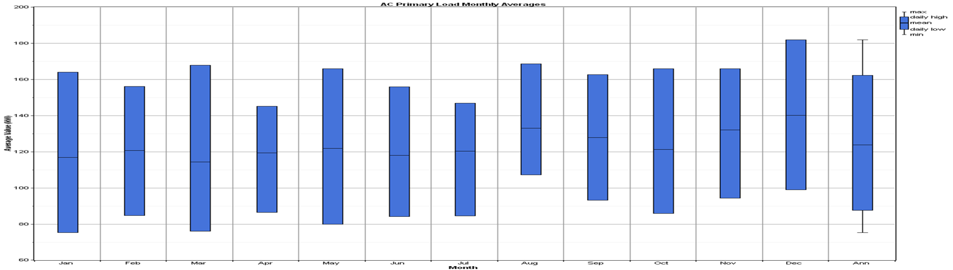
Architecture of the existing power system
All energy is supplied by diesel engines
The existing power system of Corvo consists of 4 diesel generators
    2 diesel generators of 120kW
    2 diesel generators of 160kW
Load Profile
Energy Storage-Hydrogen
Energy Storage-Hydrogen

Slide 42
Basic inputs for Corvo Analysis with Hydrogen
Diesel price: 0.816 €/L
Diesel generators capital cost: 300 €/kW
Wind turbines capital cost: 1,500 €/kW
Electrolyser capital cost: 4,000 €/kW
PEM fuel cell capital cost: 3,500 €/kW
Hydrogen tank capital cost: 800 €/kg
Wind electricity price: 0.4 €/kWh
Conventional electricity price: 0.12 €/kWh
Fuel cell electricity price: 0.15 €/kWh
Discount rate: 6%
Time horizon: 20 years
2.5% of the revenues of the wind park remuneration to the local community
Subsidies: 30% for wind energy technologies and 50% for hydrogen technologies

Slide 43
Architecture of the proposed power system
2 Fuhrländer, model FL100, wind turbines with a nominal capacity of 100 kW each
1 diesel generator set running on diesel with a nominal capacity of 120 kW
1 diesel generator set running on diesel with a nominal capacity of 160 kW
1 PEM fuel cell with a nominal capacity of 50 kW
1 alkaline water electrolyser with a nominal capacity of 80 kW, capable of producing ca.19 Nm3/hr of hydrogen
A hydrogen storage tank with a total capacity of 200 kg of hydrogen
Energy Storage-Hydrogen

Slide 44
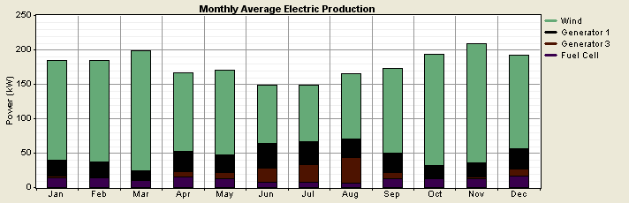
Simulation results (1)
Proposed power system
Energy Storage-Hydrogen

Slide 45
Comparison-Corvo (1)
Parameter | Existing power system | Proposed power system
COE (€/kWh) | 0.259 | 0.145
Conventional capacity (kW) | 560 | 280
Conventional Generation (MWh/yr) | 1084.4 | 315.9
Wind Generation (MWh/yr) | 0 | 1137.99
Fuel cell Generation (MWh/yr) | 0 | 104
Diesel fuel (L/yr) | 288,051 | 89,024
Renewable energy penetration | 0% | 80%
Energy Storage-Hydrogen

Slide 46
Comparison-Pollutants-Corvo
Pollutant | Emissions (kg/yr)
 | Existing power system | Proposed power system
CO₂ | 758,532 | 234,323
CO | 1,872 | 621
Unburned H/C | 207 | 68.7
PM10 | 141 | 46.8
SO₂ | 1,523 | 471
NO_{x} | 16,707 | 5,537
Energy Storage-Hydrogen

Slide 47
Financial analysis results
According to the results of the financial analysis, from the investor’s perspective the proposed wind & hydrogen storage power system is a quite profitable investment
NPV + 2,735,532 €
IRR 30%
Discounted payback period 3.2 years
Energy Storage-Hydrogen

Slide 48
Cost-benefit analysis results
According to the results of the cost-benefit analysis, from a social perspective the proposed wind & hydrogen storage power system is a profitable investment
BC ratio: 1.36
Energy Storage-Hydrogen

Slide 49
Conclusions (1)
The proposed wind & hydrogen storage power system for Corvo results in:
A considerable decrease in the power generation cost of the island (ca. 43%)
A huge increase on RE penetration on the island (80%)
A significant reduction in emissions produced (especially in CO₂, ca. over 65% for all pollutants)
A significant reduction in diesel fuel consumption (ca. 69%)
Not so significant excess electricity (<10%)
Energy Storage-Hydrogen

Slide 50
Conclusions-Corvo (2)
From the investor’s perspective the proposed wind & hydrogen storage power system is a profitable investment
From the society’s perspective the proposed wind & hydrogen storage power system is a profitable investment
There is a convergence between financial and social profitability indicating alignment of private and social interest
Energy Storage-Hydrogen

Slide 51


Milos -Overview
5000 population-5 times higher during summer
8 Thermal Units
  2 Sulzer (1,75 MW Oil-fired)
  3 MAN (0,7 MW Oil-fired)
  1 CKD (2 MW, Diesel)
  1 CKD (1,9 MW, Diesel)
  1 FINCANTIERI (1,75 MW, Diesel)
Renting units for summer periods
3 W/T
  2 Vestas V – 44 (0,6 MW)
  1 Vestas V – 52 (0,85 MW)
Homer software used for sizing/simulations
Energy Storage-Hydrogen

Slide 52
Milos & Hydrogen-Basic Inputs
Heavy Oil Price: 0,34 €/L
Diesel Price: 0,68 €/L
Generators Capital Cost: 250 – 300 €/kW
Wind Turbines Capital Cost: 1.000 €/kW
Electrolyser Capital Cost: 2.000 €/kW
PEM Fuel Cell Capital Cost: 3.000 €/kW
Hydrogen Tank Capital Cost: 1.000 €/kg
Project Lifetime: 20 years
Subsidy Scheme (30% for wind turbines and 50% regarding Hydrogen technologies)
Energy Storage-Hydrogen

Slide 53
INTRODUCING 10% H₂ (peak) in Milos
4+1 Generator Sets
2 Sulzer 7TAF48 Units (1,75 MW each, Heavy Oil)
2 MAN G9V30/45 Units (0,7 MW each, Heavy Oil)
1 Rental Unit (1 MW, April - September)
30 Wind Turbines
2 Vestas V – 44 (0,6 MW each)
28 Vestas V – 52 (0,85 MW each)
Electrolyser (2 MW)
PEM Fuel Cell (1 MW)
Hydrogen Tank (3.000 kg)
Energy Storage-Hydrogen

Slide 54
SUMMARY – COMPARISON-Hydrogen
Parameter | Milos Power System | Introducing 10% H2
COE (€/MWh) | 113 | 112
Renewable Fraction (%) | 13.4 | 86
Thermal Power Plants | 8 | 4+1
Wind Turbines | 3 | 30
Diesel (L) | 715.296 | 147.308
Heavy Oil (L) | 8.108.687 | 3.276.838

Slide 55
Milos & Hydrogen- 10%-Emissions avoided
Emissions in kg/yr
Pollutant | Current Configuration | 10% H₂
CO₂ | 26,934,542 | 10,095,664
CO | 57.3 | 22.269
PM | 4.324 | 1.679
SO₂ | 524.8 | 202.3
NO_{X} | 511.8 | 198.7

Slide 56
CONCLUSIONS-Milos-Hydrogen
The introduction of hydrogen as energy storage method in Milos results in:
huge increase on RE penetration on the island (from 13% to 85%)
significant reduction in fossil fuels consumption (ca.over 50%)
significant reduction in emissions produced (especially in CO₂, ca. over 50% for all pollutants)
further reduction on the cost of hydrogen energy equipment and the introduction of external costs makes the hydrogen-based system economically competitive to the existing one.

Slide 57
Comparative Summary-Hydrogen
Parameter | Milos | Corvo
Renewable Fraction | 13.4% before-80% | 80%
Fossil Fuel Reduction | 50+% | 69%
CO₂ reduction | 50+% | 69%
COE reduction | 0-1% | 43%
Excess electricity | 44% | 9.85%
IRR | 1% | 30%
Discounted Pay back | 17 yrs | 3.2yrs
Benefit Cost Ratio | 1,25 | 1.36
Energy Storage-Hydrogen

Slide 58
Results from Case Studies-Hydrogen
From the investor’s point of view, in Milos island the proposed RES & hydrogen storage power system is not a profitable investment mainly due to the production of a large amount of excess electricity.
  However, the proposed system may become more economically attractive if the produced excess energy is used to generate hydrogen in order to be used locally as a fuel in the transport sector or for heating purposes.
On the contrary, the proposed system for Corvo is a quite profitable investment from the investor’s perspective indicating alignment of private and social interest.
In both cases the benefits of the proposed RES & hydrogen storage system outweighed the costs proving a social profitability. Thus, the proposed systems are profitable investment from the perspective of the society
Energy Storage-Hydrogen

Slide 59
HYDROGEN for transportation

Slide 60
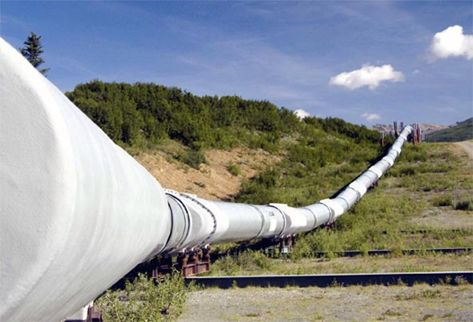
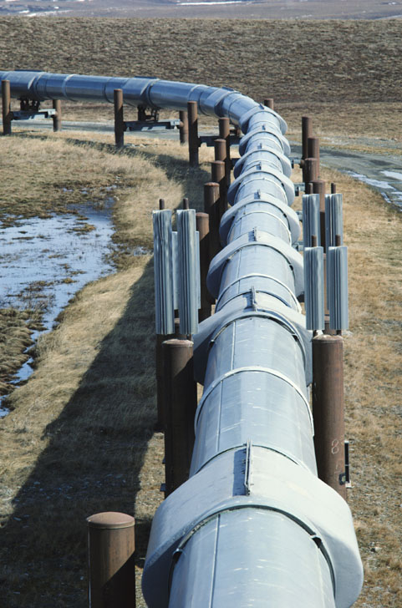


DISTRIBUTION OF H2 BY GASODUCT
Gas pipelines are the cheapest option to transport H₂ at large capacity over long distances.
The oldest existing gas pipeline is in the Ruhr region. It has 210 km and distributes H2 between 18 producers and consumers. It has been operating for more than 60 years without accidents.
The longest H₂ gas pipeline measures 400 km, and runs between France and Belgium.
In gas pipeline the pressure is usually between 1 bar and 20 bar. For long distances the pressure is usually between 11 and 30 bar.
Energy Storage-Hydrogen

Slide 61
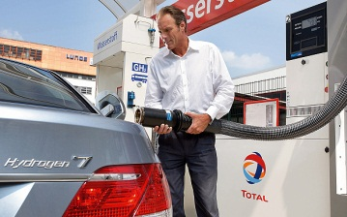
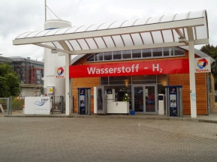
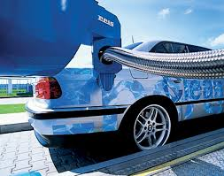
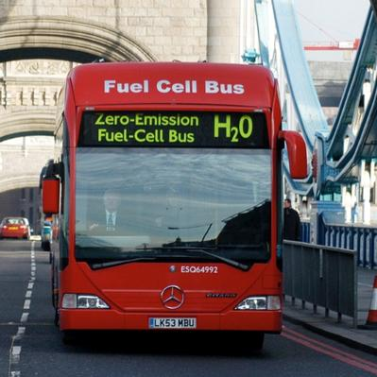
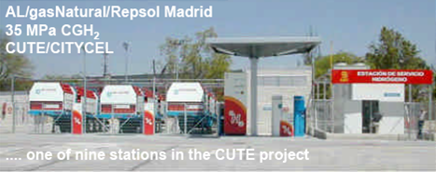
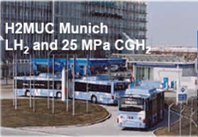
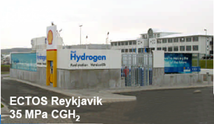

HYDROGEN REFILL STATIONS (LH2, CGH2)
Energy Storage-Hydrogen

Slide 62





HYDROGEN REFILL STATIONS (LH2, CGH2)

Slide 63

Hydrogen Bicycles
In France, Pragma Industries is the first company in the world to start producing hydrogen bicycles. At present, bicycles cost 7,500 euros each.
The hydrogen bicycle called «Alpha» can travel a distance of about 100 km with a two-liter hydrogen tank, that is, as much as a bike that runs on with electric battery.
One kilogram of hydrogen contains about 600 times more energy than one kilogram lithium battery.
Energy Storage-Hydrogen

Slide 64

Hydrogen MotorCycle
In 2005, the British company Intelligent Energy created the first hydrogen motorbike called ENV (Emission Neutral Vehicle). The motorcycle has enough fuel to run for four hours and travel for 160 km at a maximum speed of 80 km / h.
In 2004, Honda created a fuel motorcycle.
Energy Storage-Hydrogen

Slide 65

Hydrogen MotorCycle
An effort in Greece- tank and fuel cell for the scooter

Slide 66

Hydrogen Clarks
Fuel cell lift machines provide significant advantages over diesel vehicles, as they do not produce emissions
These lifts can operate for complete shifts of 8 hours with a single hydrogen tank and can be refueled in 3 minutes and have a lifespan of 8-10 years
These lifting machines are often used in cold stores, as their performance is not degraded by lower temperatures.
In 2013, there were more than 4,000 fuel cell lift trucks used to handle materials in the US, of which only 500 received funding.
Energy Storage-Hydrogen

Slide 67


Hydrogen Cars
The New Toyota Mirai named 'World Green Car 2016' at New York International Auto Show.
It uses hydrogen to produce energy and emits only water,
Equipped with 155 horses up to 178km / h, with a range of 483km and with hydrogen tanks taking about 3-5 minutes to refuel.
Greece: At the Technical University of Crete, a group of students built in 2008 the Eco Racer, which runs on hydrogen. The vehicle has excellent energy saving performance and could well go into mass production with some modifications, even at a cost of less than 10,000 euros, so that it can be fully manufactured in our country and be exported.
Energy Storage-Hydrogen

Slide 68


HYUNDAI IX35 FUEL CELL
Two H2 tanks de H₂
First car manufacturer to start series production
Pressure of 700 bar
Power: 166 CV
Capacity 5.64 kg H₂
Torque 300 N-m, available from almost 0 rpm
Refueling 3 minutes
Acceleration 0 a 100 km/h. en 12. 6 s
Maximum speed of 160 km/h
Consumption 9.5 gr H₂/km
0.95 kg/100 km
Battery 24 kW de litium polimer
Autonomy 594 km
Fuel cell of 100 kW (136 CV)
Hybrid: The Li-ion battery stores and provides electricity at certain moments to reinforce the main motor.
It can occasionally disconnect the fuel cell in city at low speed, and work only with the battery. This makes the fuel cell stop working at stops (Stop/Start feature)

Slide 69

Hydrogen Buses
More than 100 fuel cell buses have been developed around the world.
Fuel cell buses have 30-40% higher fuel economy than diesel and gas buses.
Fuel cell buses have been developed in Canada, America, Germany, China, London and Brazil.
The Fuel Cell Bus Club is a global effort to collaborate on fuel cell buses for testing.
Energy Storage-Hydrogen

Slide 70



MERCEDES-BENZ CITARO FUELCELL HYBRID BUS
CITARO H2 with fuel cell have operated more than 140,000 hours, and traveled more than 2.2 million km
New CITARO: Hybrid system with fuel cell, electric motor and Li-ion batteries.
50% reduction in H2 consumption compared to the previous generation of CITARO. Virtually maintenance free and very durable
FC: 2 stacks on the roof
H2 storage: 7 tanks on the roof
Power 120 kW const.
140 kW max.
Pressure 350 bar
Refuelling 8-10 minutos
Efficiency 51-58 %
Capacity 35 kg H₂
Life 6 years o 12,000 years
Autonomy 250 km
Batteríes Li-ion water-cooled
Consumption 10–14 kg H₂/100 km
Combined power FC + battería 250 kW-340 CV
Capacity 27 kWh
Power 120 kW-163 CV
Braking-energy recovery system that charges Li-ion batteries
Ability to travel several kilometers only with battery charge

Slide 71

Hydrogen Train
In March 2015, China South Rail Corporation (CSR) demonstrated the world's first hydrogen- electric tram at an assembly installation in Qingdao.
In 2016, Alstom made its Coradia iLint debut with a fuel cell-powered regional train that will be the world's first hydrogen-producing car.
The Coradia iLint will be able to reach 140 km / h and travel 600-800 km with a full hydrogen tank, it is quiet and when in motion, it emits steam and condensed water.
The first Coradia iLint was put into service in December 2017 on the Buxtehude-Bremervörde-Bremerhaven-Cuxhaven route in Lower Saxony, Germany

Slide 72

Hydrogen Boats
Fuel cell engines have a higher energy efficiency than combustion engines and therefore offer better range and significantly reduced emissions..
Iceland is committed to converting its huge fishing fleet by 2019.
Amsterdam recently introduced its first fuel cell ship, which transports people around the city's famous and beautiful canals.
Energy Storage-Hydrogen

Slide 73

Hydrogen Boats
Hydrogen boat in Hamburg

Slide 74

Hydrogen Submarines
The first submarine fuel cell application is the German submarine type 212, which contains 9 fuel cells, distributed throughout the ship, providing electrical power from 30 kW to 50 kW.
This allows it to remain submerged longer and makes it more difficult to determinate its location.
Fuel cell-powered submarines are also easier to design and build than nuclear submarines.
Energy Storage-Hydrogen

Slide 75

Hydrogen Aircrafts
In 2003, the first propeller-driven airplane powered entirely by a fuel cell was launched.
In February 2008, Boeing researchers and industry partners all over Europe conducted experimental tests on a manned aircraft powered only by fuel cells and lightweight batteries.The fuel cell demonstration aircraft, as it was named, used a hybrid fuel cell system to power an electric motor that was connected to a conventional propeller.
In 2009, Ion Tiger of the Marine Research Laboratory (NRL) used a hydrogen fuel cell and flew for 23 hours and 17 minutes.
Fuel cells are also used to provide auxiliary power to aircraft, replacing fossil fuel generators previously used to start engines and power consumption on board. Fuel cells can help airplanes reduce CO2 and other emissions of pollutants and noise.
The military is particularly interested in this application due to its low noise and ability to reach high altitudes.
Energy Storage-Hydrogen

Slide 76
Laboratory Teaching

Slide 77

Fuel Cells-Experimental equipment
Modular can be put on a table
Contains electrolyser of 10W and up to 5A
  Separates water into H₂ and O₂
  The students can see the bubbles of the gases and understand the procedure
If Sufficient amount of gasses is available this can be led to the PEM Fuel cell in order to generate electricity
  The Fuel cell can produce at 1.2W with 0.3-0.9V
  The students can measure open voltage characteristics etc.
http://www.estarfuturecorp.com/h-tec_brochure.pdf

Slide 78
Conclusions

Slide 79
Advantages of hydrogen over conventional fuels
It has the highest energy content per unit weight of any known known fuel, 120.7 kJ / kg, about 3 times that of conventional gasoline.
Achieves fuel economy of at least 30%, increase of horsepower and torque by 15% and reduction of exhaust gases up to 80%.
It makes "clean" combustion. When burned with oxygen it produces only water and heat. When burned with atmospheric air, whose volume is 78% nitrogen, some nitrogen oxides are also produced, to a negligible degree however.
It helps reduce the dependence on oil.
Energy Storage-Hydrogen

Slide 80
Advantages of hydrogen over conventional fuels
The operation of the vehicle with hydrogen is quieter compared to conventional fuels.
Hydrogen actually helps to remove carbon residues inside the engine. Combustion of hydrogen creates clean water. This saves fuel, money and protects the environment.
Reduces fuel consumption by increasing the octane level, forcing the fuel to burn completely and efficiently. The increase in octane leads to an increase in horsepower and efficient fuel ignition = more kilometers per liter.
It can be prepared by many methods and thus can help in the development of decentralized power generation systems.
Energy Storage-Hydrogen

Slide 81
Disadvantages of hydrogen compared to conventional fuels
In production, as in addition to H₂the product of the reaction may be also CO₂
In storage, as it occupies a large volume and its liquefaction is not easy.
Lack of an organized hydrogen distribution network.
Deviation from safety standards can make the fuel particularly dangerous.
The acceptance by the public.
Energy Storage-Hydrogen

Slide 82
Disadvantages of hydrogen compared to conventional fuels
Inadequate infrastructure of conversion workshops and refueling stations..
Lack of specialized professionals to solve technical problems.
More expensive than gasoline and diesel.
Fuel cell price remains high with which it is currently carried out the greater exploitation of hydrogen as a fuel.
Energy Storage-Hydrogen

Slide 83

Thank you

Slide 84



Thank you!
Terima kasih! Ευχαριστώ
Eyxarist;v
Mesfia.eu- info@mesfia.eu- www.facebook.com/mesfia

