Slide 1
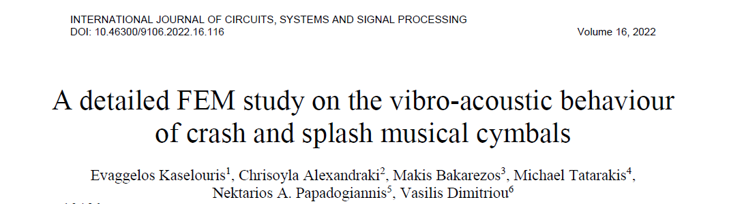
Advanced Vibro-Acoustic Simulations of Musical Cymbals
FEM and BEM Analysis of Crash vs. Splash Cymbals

Slide 2
Introduction to Cymbals
Ancient idiophone instruments, played by percussion
Made of bronze or alloys, hollow circular disk with raised center
Produce inharmonic, broad-spectrum sound rich in high frequencies
Three main physical areas: Bell (center), Bow (body), Edge (periphery)
Types studied:
Crash cymbal: 48.3 cm (19 in.) diameter
Splash cymbal: 25.4 cm (10 in.) diameter

Slide 3
Research Objectives & Methodology
Objectives:
Study vibrational behavior of crash vs. splash cymbals
Compare velocity spectrograms (on cymbal) with radiated sound pressure spectrograms (in air)
Demonstrate capability for future sound synthesis
Methods Used:
Modal Analysis (FEM) - Natural frequencies & mode shapes
Frequency Response Function (FRF) (FEM) - Acceleration/force ratio
Frequency Domain FEM-BEM - Steady-state acoustic radiation
Time Domain FEM-BEM - Transient response & spectrograms

Slide 4
Modal Analysis Results
Key Findings:
Modes designated by (m,n) where m = nodal diameters, n = nodal circles
First 8 modes resemble flat plate modes
Splash cymbal shows higher frequencies for same modes (due to smaller size)
Mode mixing occurs at higher frequencies

Slide 5
FRF & Frequency Domain FEM-BEM
The structure vibrates strongly (peaks in FRF), but the sound radiates weakly (valleys in pressure) because the vibration pattern creates acoustic cancellation. The energy goes into structural motion, not into sound waves.
FRF Analysis Results:
Acceleration amplitude ratio vs. frequency
Splash cymbal: higher frequency content
Mode mixing visible
Frequency Domain FEM-BEM:
Coupled structural-acoustic analysis
Key observation: Some vibration modes become pressure valleys!
  Crash: M6 & M8 modes become pressure minima
  Splash: M3, M5, M7 modes become pressure minima

Slide 6
Time Domain FEM-BEM Results
Method:
Time-dependent force modeled as drumstick strike
Impact duration: 1 ms, Force amplitude: 90 N
Frequency range: 0-4000 Hz
Microphone positioned 0.5m from cymbal
Key Findings:
Splash cymbal decays faster than crash cymbal
Pressure oscillations decay faster than displacement oscillations
First-ever comparison of velocity vs. pressure spectrograms

Slide 7
Spectrogram Comparison
Achievement:
First study comparing velocity spectrograms on the cymbal with radiated sound pressure spectrograms
Findings:
Splash cymbal: Higher frequency content (above 1 kHz)
Pressure and velocity spectrograms show similar patterns
Harmonics are clearer and more discrete on the vibrating structure than in air
Why this matters:
Enables future sound synthesis from physical parameters
Validates simulation approach for musical instrument design

Slide 8
Conclusions & Future Work
Conclusions:
Modal analysis matches experimental literature
FEM-BEM simulations successfully correlate structural vibration with sound radiation
Splash cymbal characteristics:
  Faster decay
  Higher frequency content (>1 kHz)
  Clearer harmonics on structure than in air
HPC (ARIS) enabled computationally intensive simulations
Future Work:
Experimental validation with pressure measurements on physical cymbals
Parametric sound synthesis based on physical attributes
Investigate mode mixing phenomena in detail

Slide 9
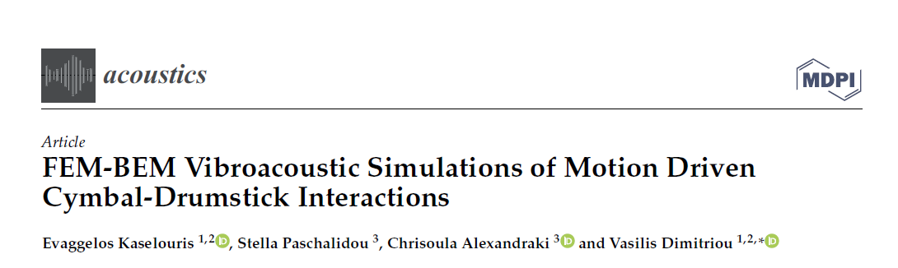
FEM-BEM Vibroacoustic Simulations of Motion-Driven Cymbal-Drumstick Interactions

Slide 10
Introduction & Research Gap
Background:
Cymbals are essential percussion instruments in all music genres
Sound depends on dimensions, shape, material, and manufacturing
Bronze alloys (B20: 80% Cu, 20% Sn; B8: 92% Cu, 8% Sn) are commonly used
The Research Gap:
"To the authors' knowledge, the motion of the real drumstick for the excitation and vibration of cymbals has neither been studied."
This Study's Innovation:
First to incorporate real 3D motion capture data of drummer-drumstick-cymbal interaction
Uses actual performance dynamics as input to FEM-BEM simulations

Slide 11
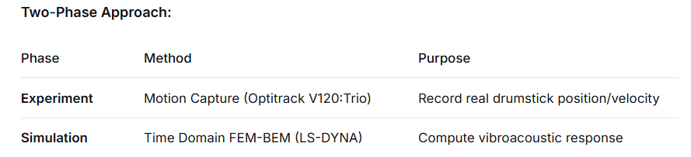
Methodology - Motion Capture + Simulation
Motion Capture Setup:
6 infrared high-speed cameras (120 Hz sampling)
3 reflective markers on drumstick + reference marker on cymbal
6 progressive stroke intensities: pp, p, mp, mf, f, ff (pianissimo to fortissimo)
Audio recorded simultaneously for comparison

Slide 12
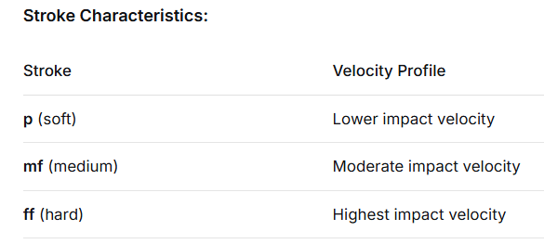
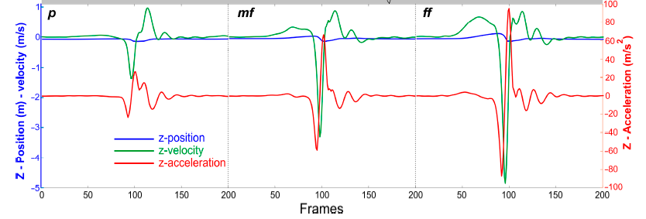
From Motion Data to Simulation Input
Data Processing:
Raw position data (120 Hz) → Interpolated → Velocity/acceleration via differentiation
Savitzky-Golay filter applied to reduce noise
Key input to simulation: Velocity values and spatial coordinates of drumstick

Slide 13
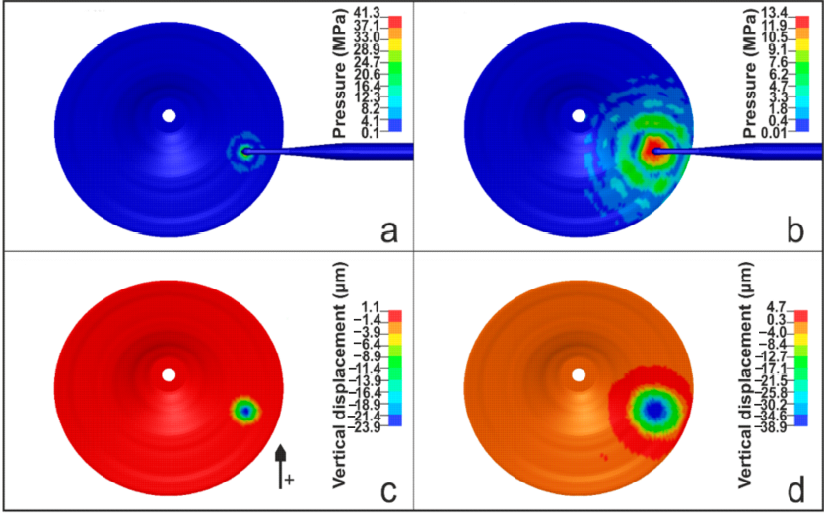
Structural Response - Wave Propagation
Key Observations:
Maximum stress at impact: 40 MPa (below yield strength of 125 MPa → no plastic deformation)
Maximum vertical displacement: 38 μm (mean ~15 μm over 2s)
Wave Propagation:
Bending waves generated at impact point
Waves propagate outward toward edges
Reflected at edges → form standing wave patterns (normal modes)
Temporal Evolution:
At 0.1 ms: Localized deformation at impact point
At 0.3 ms: Waves spreading across cymbal surface

Slide 14
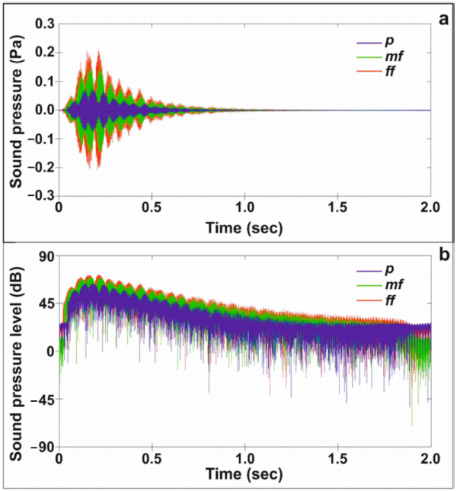
Sound Pressure Results
Progressive Intensification:
Clear trend: p → mf → ff
  Maximum SPL increases
  Attack time decreases
Quantitative Results (ff stroke):
Maximum pressure: 0.2 Pa
Maximum SPL: 70 dB (at 0.5m distance)
Validation Insight:
"The synergy of motion capturing and FEM provides a valid approximation of the dynamic vibroacoustic behaviour of the cymbal owing to the impact of the drumstick."

Slide 15
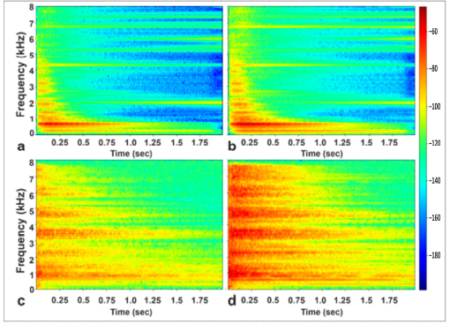
Spectrogram Comparison
Key Finding:
Harmonics on vibrating structure are more clear and discrete than in air
Frequency-dependent damping: Higher frequencies decay faster than lower frequencies (<2 kHz)
Both spectrograms show characteristic "noisy" percussive sound (vs. pitched instruments)
Simulated vs. Recorded Comparison (p and ff):
Similar relative behavior with stroke intensification

Slide 16
Conclusions
Main Achievements:
First study to incorporate real motion capture data into cymbal vibroacoustic simulations
Successfully modeled progressive stroke intensities (p, mf, ff)
Demonstrated wave propagation, contact time estimation, and sound radiation
Validated approach through heuristic comparison with recorded sound
Key Parameters for Improvement:
Sampling rate of motion capture data
Material properties accuracy
Geometrical details of CAD models
Future Work:
Build audio dataset linking computed signals to recorded sounds
Optimize parameters for accurate sound synthesis

Slide 17
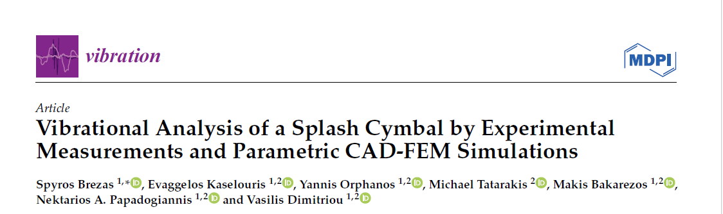
Vibrational Analysis of a Splash Cymbal-Experimental Measurements & Parametric CAD-FEM Simulations

Slide 18
Introduction & Research Motivation
Background:
Cymbals produce complex, inharmonic sound due to their geometry
Manufacturing processes (hammering, lathing, finishing) introduce non-smooth curvature
Previous studies often assume idealized smooth geometry
The Research Gap:
"To the authors' knowledge, this is the first time that a detailed CAD-FEM parametric study along with experimental measurements have been used to investigate the vibrational behavior of a cymbal."
Key Question:
How do micro-geometrical characteristics (non-smooth curvature, thickness variations) affect vibrational behavior?
Study Scope:
8-inch splash cymbal (MS63 brass alloy)
Linear regime only (amplitude < thickness → no nonlinear/chaotic behavior)
Frequency range: 0-2.5 kHz

Slide 19
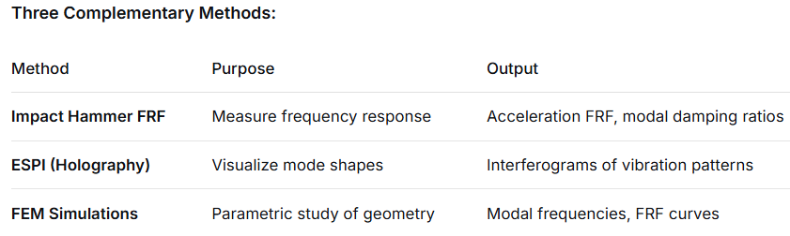
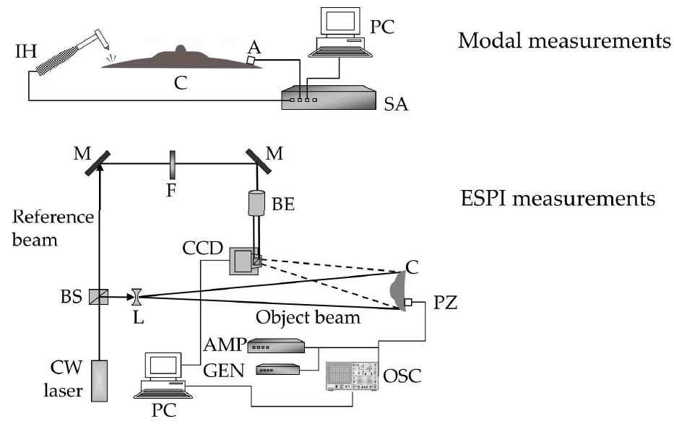
Methodology - Hybrid Approach
Novel Aspects:
Parametric CAD - Two different geometrical approximations
Modal damping ratio - Experimentally measured and adopted in simulations
13 different FEM models systematically compared
Experimental Setup:
144 grid points on cymbal (16 radii × 9 points)
Clamped at center hole (torque-controlled)
Two force levels: 2.76 N and 34.06 N (verify linearity)

Slide 20
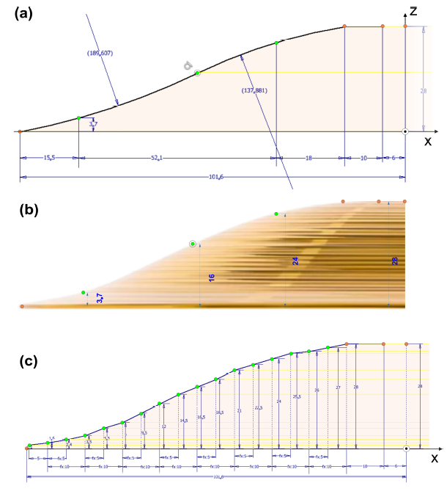
CAD Modeling - Two Geometric Approximations
Key Innovation: Modeling Real Manufacturing Finishing
Approach 1: Smooth (Three-Point Arcs)
Idealized geometry using two arcs
Radii: ~190 mm and ~138 mm
Represents "perfect" design intent
Approach 2: Non-Smooth (Linear Interpolation)
Points measured at sequential intervals
Three scanning densities: 10 mm, 5 mm, 2.5 mm
Captures the non-smooth curvature from finishing procedures
Thickness Variations Studied:
Uniform: 1.0 mm, 1.1 mm, 1.2 mm, 1.3 mm
Varying (bell/bow/edge): 1.3/1.2/1.1 mm and 1.2/1.1/1.0 mm
Total Models: 13

Slide 21
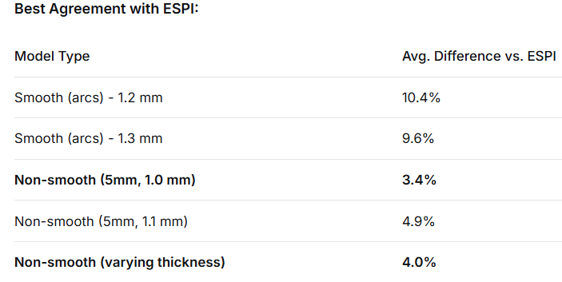
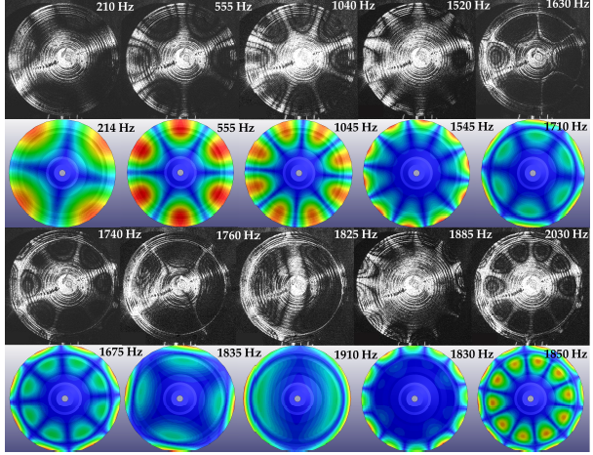
Modal Analysis (Comparison with ESPI)
Observations:
Smooth models work for low modes (2,0), (3,0) but deviate at higher modes
Non-smooth models show much better agreement across all modes
5 mm scanning interval optimal (better than 10 mm and 2.5 mm)
Varying thickness further improves accuracy

Slide 22
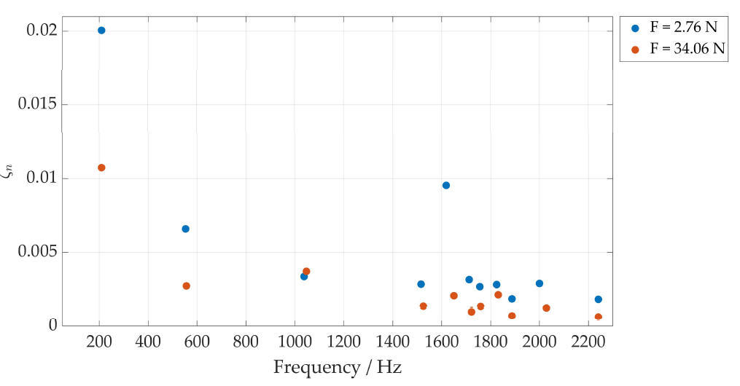
Modal Damping Ratio - Novel Experimental Input
Novel Aspect: Experimental measurement of frequency-dependent damping
Method:
From FRF measurements: ζₙ = Δω/(2ωₙ)
Δω = frequency range where amplitude drops to A/√2
Values adopted directly into FEM simulations
Key Observation:
Damping is frequency-dependent
This is implemented in the three best-fitting models
Why This Matters:
Previous studies often used constant damping
Frequency-dependent damping gives more realistic FRF curves

Slide 23
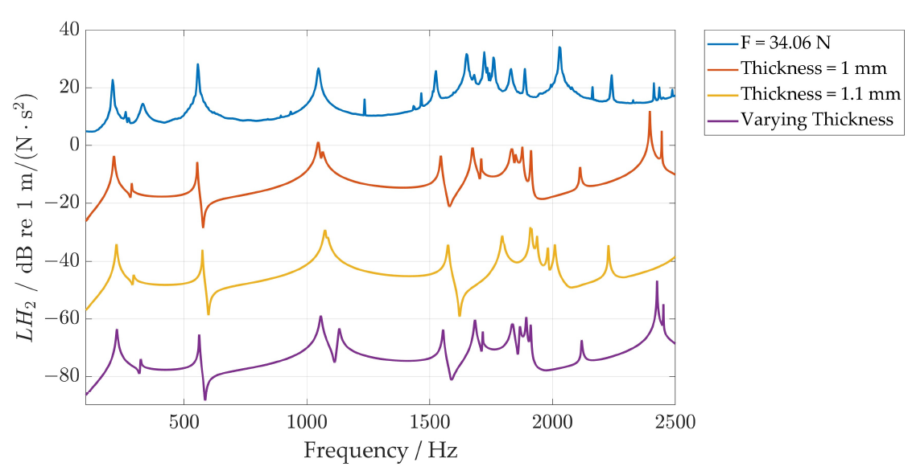
FRF Results - Validation
Three Best Models Compared with Experiment:
Non-smooth (5mm, 1.0 mm uniform)
Non-smooth (5mm, 1.1 mm uniform)
Non-smooth (5mm, varying thickness 1.2/1.1/1.0 mm)
Key Observations:
Good agreement across frequency range
Deviations: Attributed to the fact that the CAD-FEM models approximate the geometry well, but slight differences still exist in relation to the real micro-geometrical characteristics.

Slide 24
Conclusions
Main Findings:
Geometry dominates vibrational behavior
  Non-smooth curvature from manufacturing significantly affects modal frequencies
  Smooth approximations insufficient for accurate modeling
Optimal modeling approach identified
  Linear interpolation with 5 mm scanning interval
  Uniform thickness 1.0 mm or varying thickness 1.2/1.1/1.0 mm
  Average error < 5% vs. ESPI
Damping is frequency-dependent
  Experimental damping ratios improve simulation accuracy

Slide 25
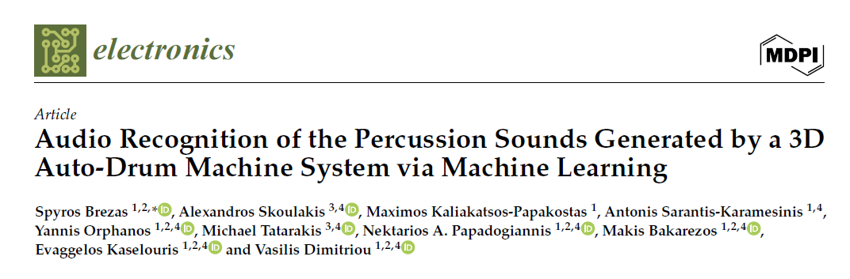
Audio Recognition of Percussion Sounds Generated by a 3D Auto-Drum Machine System via Machine Learning

Slide 26
Introduction & Research Motivation
The Problem:
Machine learning models require large, labeled datasets
Manual recording of percussion sounds is:
  Time-consuming
  Inconsistent (human variation)
  Difficult to control parameters (force, position)
The Research Gap:
"The existing research on the automated generation of databases of percussion sounds and their classification and recognition via machine learning is limited."
This Study's Innovation:
Development of 3D Auto-Drum Machine (3D-ADM) - a CNC-controlled robotic system
Automated generation of percussion sounds with known impact force and position
Creates labeled databases for ML training

Slide 27
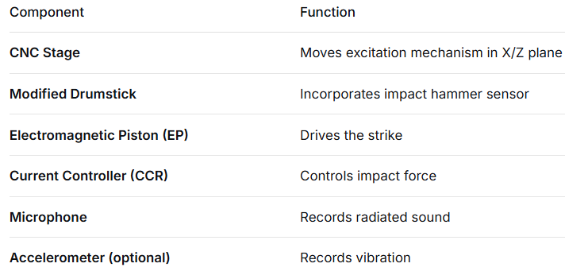
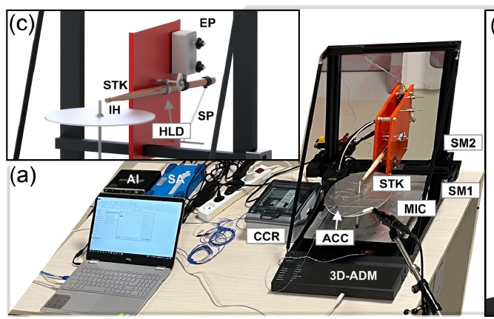
The 3D Auto-Drum Machine System
Key Features:
Fully automated and programmable (G-code)
Repeatable excitation conditions
Excites at any point along radial path
Records spatial coordinates + impact force + audio simultaneously
Objects Studied:
8" aluminum sheet (reference), 8" MS63 alloy bell-shaped splash cymbal, 8" B8 bronze medium-thin splash cymbal

Slide 28
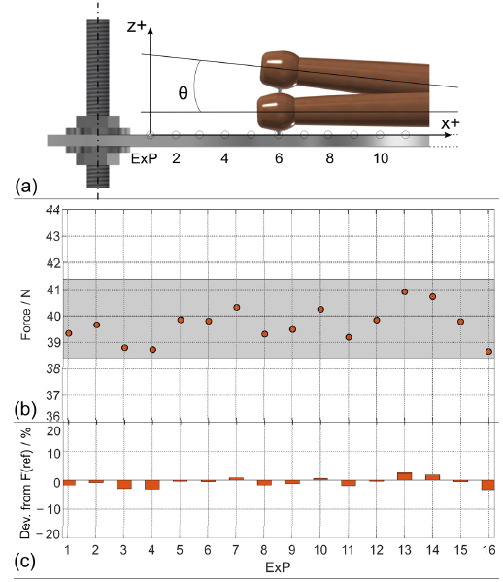
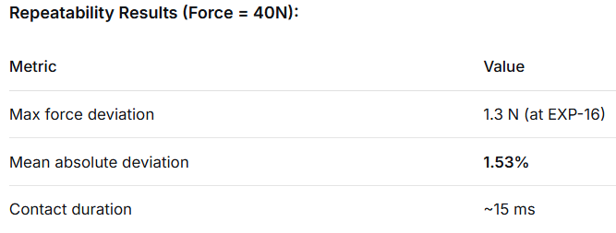
System Calibration & Repeatability
Calibration Protocol:
Zero-set: θ = 0° (perpendicular hit)
Operating angle: θ = 3° (spring-adjusted)
Force calibration: Potentiometer-controlled current
Time delay: 10s between excitations (vibration relaxation)
Excitation Points:
16 equidistant points along radius (EXP-1 to EXP-16)
From center (X=0) to edge (X=R1)
Validation:
8 repeated measurement sets
Consistent results for 20N, 30N, 50N as well
System independent of excitation parameters

Slide 29
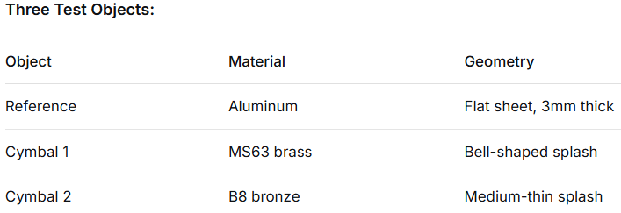
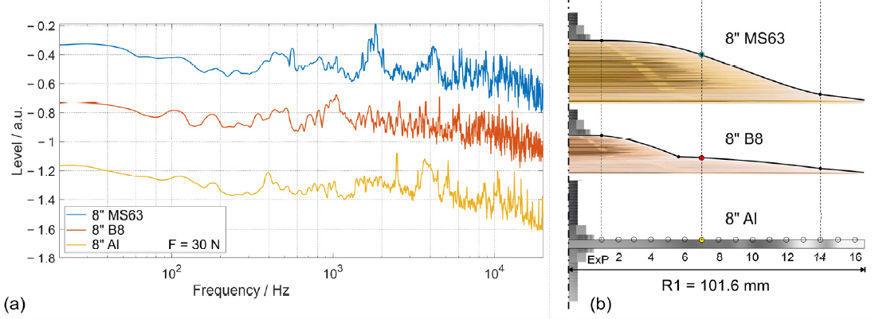
Data Collection - From Aluminum to Cymbals
Measurement Protocol:
Same 16 EXP positions (adjusted for cymbal profile)
Forces: 20N, 30N, 40N, 50N
Two repetitions per point
Total dataset: 96 audio waveforms (3 objects × 16 positions × 2 repetitions)
Key Observations:
Wooden tip vs. hammer tip produce similar spectral characteristics
Force variation (20N vs. 50N) shows expected energy increase
Different materials/geometries show distinct spectral signatures

Slide 30
Machine Learning Methodology
Why DistilHuBERT?
Pretrained on speech (not music)
Sensitive to fine spectral details (fricatives, noise)
Lightweight version of HuBERT
Used "frozen" - no fine-tuning (exploratory analysis)
Goal of ML Analysis:
Verify data consistency (repetitions cluster together)
Check separability by material/geometry
Explore feasibility of EXP position regression

Slide 31
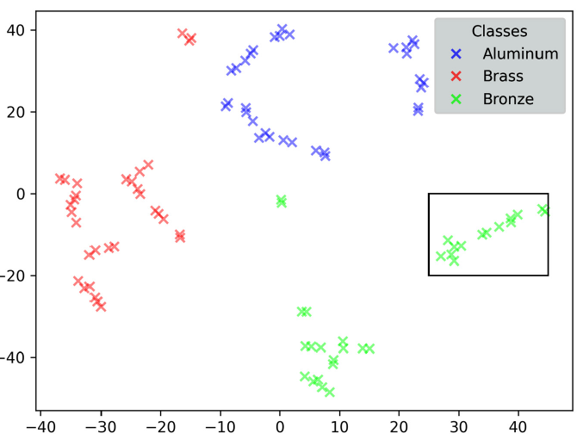
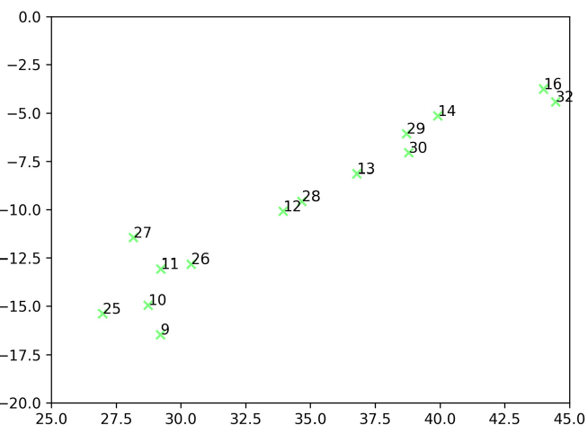
Results - ML Visualization & Analysis
96 Recordings
Key Finding 1: Clear Separability by Material/Geometry
Three distinct clusters (Al, MS63, B8)
Speech-pretrained model works well for percussion classification
Key Finding 2: Consistency of Repetitions
Repeated excitations (i and i+16) appear close together
Example: EXP-9 and its repetition (EXP-25) are neighbors
Validates measurement process reliability
Key Finding 3: Spatial Position Encoding
Consecutive EXP points form monotonic trajectories
Example: EXP-9 → EXP-10 → EXP-11 → EXP-12 shows left-to-right path
Suggests possibility of ML regression for position estimation

Slide 32
Conclusions & Future Directions
Main Achievements:
Novel 3D-ADM System Developed
  Automated, repeatable percussion sound generation
  Known impact force and spatial coordinates
  Mean force deviation < 1.5%
Data Collection Protocol Established
  96 audio files with full metadata
  Three materials/geometries
  Multiple forces and positions
ML Validation Successful
  Clear separability by material/geometry
  Repetition consistency confirmed
  Spatial information encoded in audio
Future Work:
Large-scale database generation (high repetition rate)
Fine-tune ML models for:
  Material classification
  Geometry classification
  EXP position regression
  Force estimation
Applications:
  Testing alternative/cost-effective materials
  Validating vibroacoustic FEM-BEM simulations
  Sound synthesis research

Slide 33
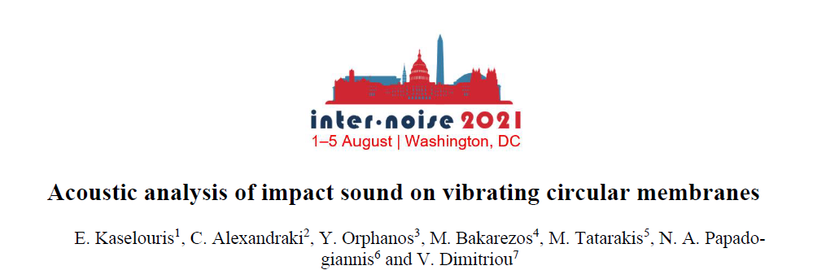
Acoustic Analysis of Impact Sound on Vibrating Circular Membranes

Slide 34
Introduction & Motivation
Why Study Drumhead Vibroacoustics?
Drums are fundamental percussion instruments
Sound depends on: tension, density, thickness, material
Manufacturers need to know the sound before manufacturing
Study's Goals:
Compute the radiated sound from circular membranes under impact
Compare three materials: Leather (animal skin), Mylar, Kevlar
Investigate pre-strain effects on vibration modes
Generate audio files for perceptual evaluation
Future goal: Create dataset for ML training (inverse problem: infer material properties from sound)

Slide 35
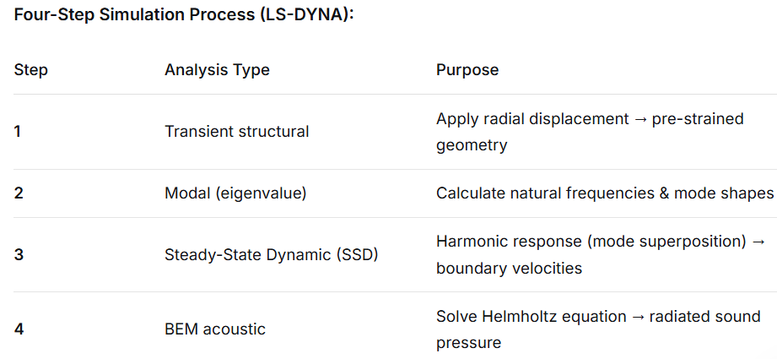
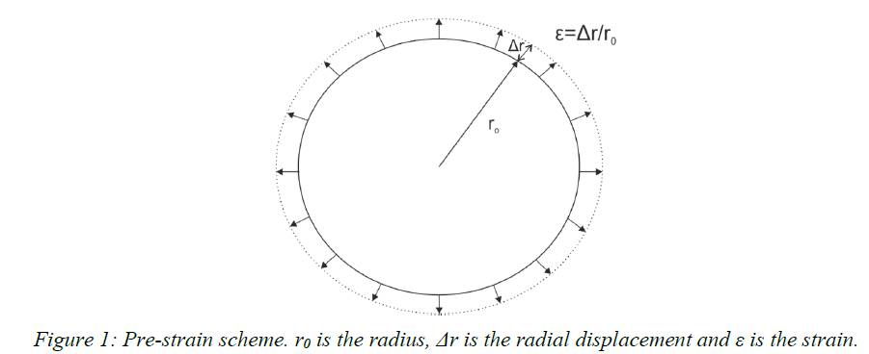
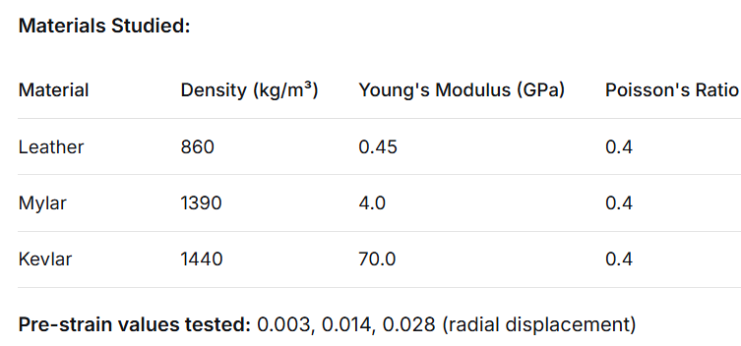
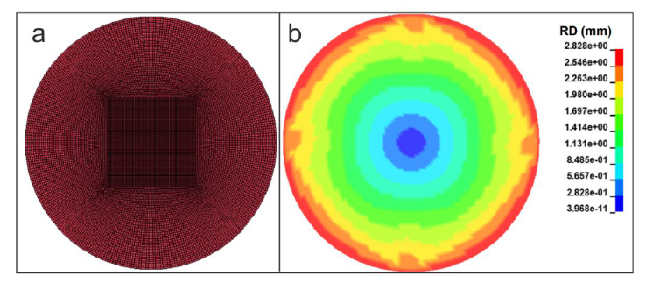
Methodology - FEM-BEM Vibroacoustic Workflow

Slide 36
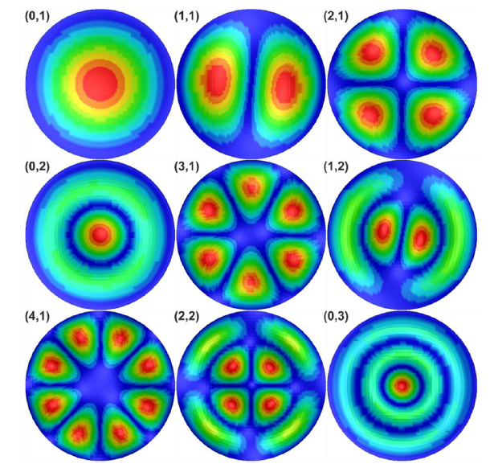
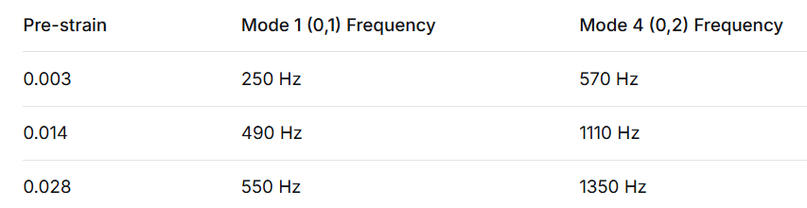
Modal Analysis & Pre-Strain Effects
Modes labeled (d,c) where:
  d = number of nodal diameters
  c = number of nodal circles
First nine modes shown (from (0,1) to (3,2))
Simulation Parameters:
Membrane radius: 0.1 m
Thickness: 0.2 mm
Excitation: Harmonic force at center
Frequency range: 0-5000 Hz (extended
Key Finding - Pre-Strain Increases Stiffness:
"The effect of pre-strain increases the stiffness of the system and therefore the natural frequencies increase."

Slide 37
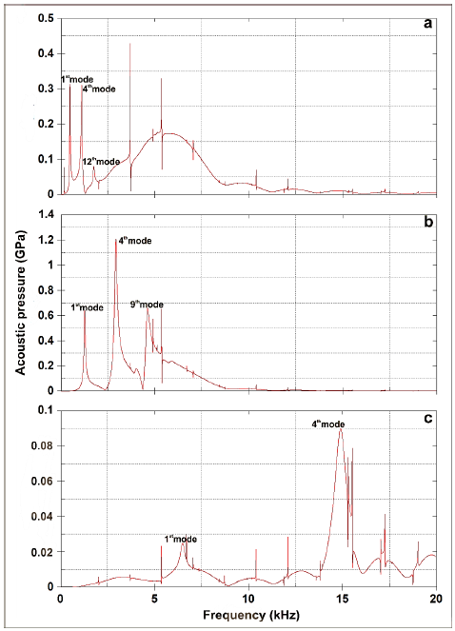
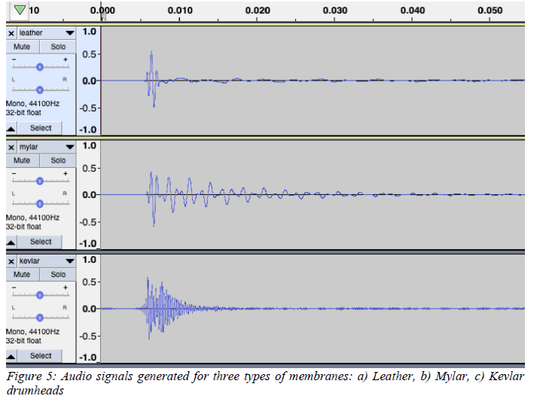
Results - Acoustic Pressure & Material Comparison
Generated Audio Signals:
1-second duration, resampled to 44.1 kHz
Leather: much faster decay than synthetic materials
Kevlar: higher pitch, metallic character

Slide 38
Conclusions
FEM-BEM model successfully developed for pre-strained circular membranes
Pre-strain effect quantified: Higher tension → higher frequencies
Material comparison complete:
  Leather: balanced, fast decay
  Mylar: strong mode 4, synthetic character
  Kevlar: very high frequencies, metallic sound
Audio files generated from simulation results

Slide 39
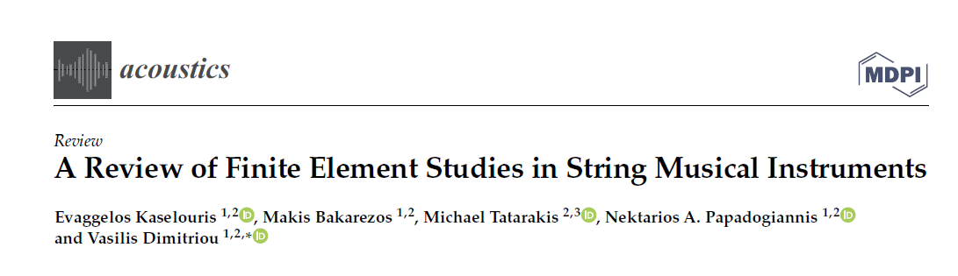
A Review of Finite Element Studies in String Musical Instruments

Slide 40
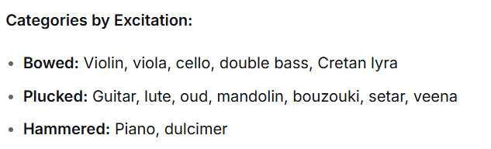
Introduction & Scope
Why String Instruments?
Complex mechanical vibrating systems (structure + fluid-structure interaction)
Sound comes primarily from body vibration, not strings alone
The instrument acts as a filter converting string excitation to radiated sound
Four Important Features of Instrument Quality:
Timbre (sound quality)
Attack behavior (fast attack → fast playing)
Overall loudness
Timbre variation (response to player control)
Scope of Review - Four Progressive Levels:
I. Soundboard behavior
II. Assembled instrument box
III. Fluid-structure interaction (enclosed air)
IV. Interaction with surrounding air

Slide 41
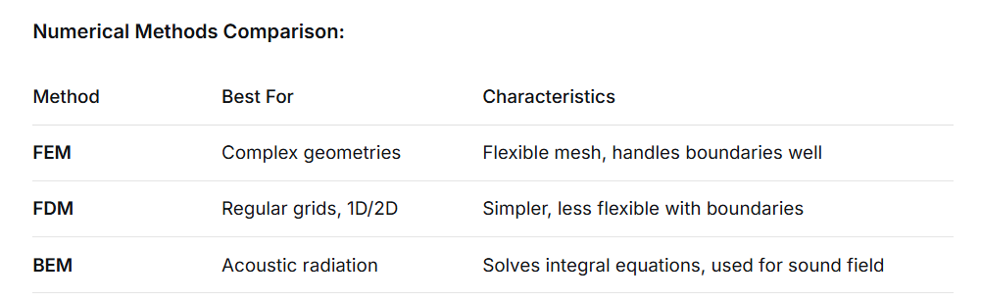
Methodology - Modal Analysis & Numerical Methods
Modal Analysis Fundamentals:
Each mode characterized by:
Natural frequency
Mode shape
Damping factor
Experimental Techniques:
Impact hammer + accelerometer
Laser Doppler Vibrometry
ESPI (Electronic Speckle Pattern Interferometry) - full-field imaging

Slide 42
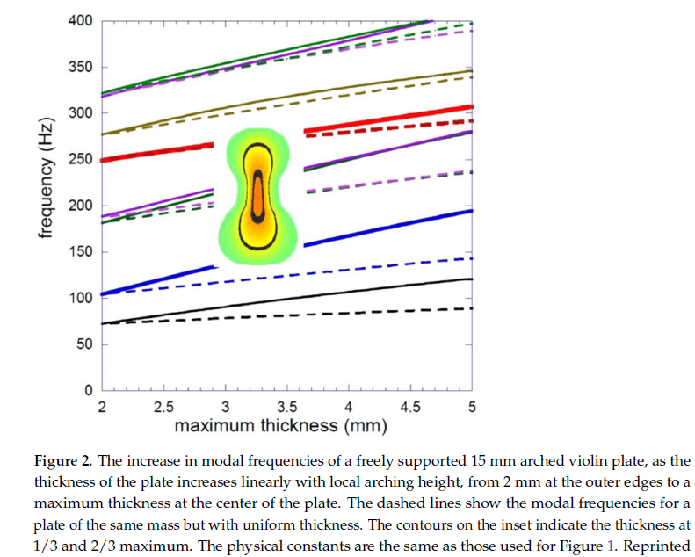
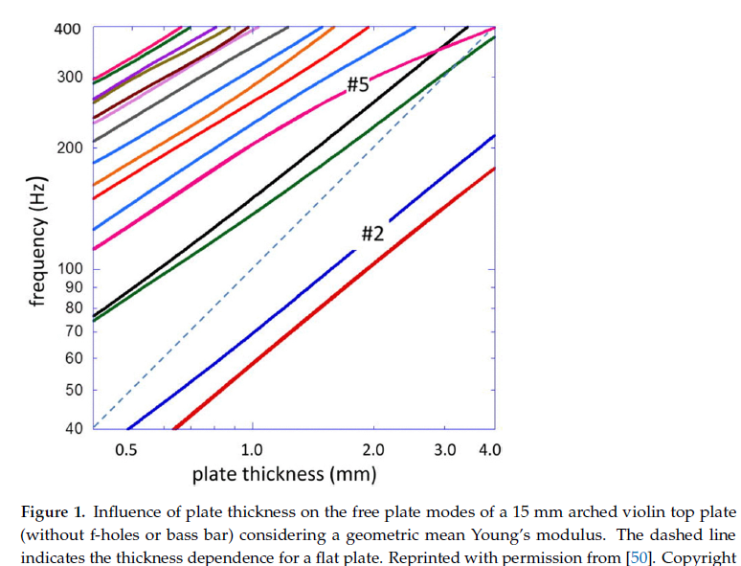
Soundboard Studies - The Heart of the Instrument
Usually made of spruce (high stiffness/density ratio)
Anisotropic material (different properties along/across grain)
Modal frequencies guide luthiers' construction decisions
Thickness Effect:
Plate thickness dramatically affects modal frequencies
#5/#2 frequency ratio important for octave tuning
Fine Italian violins (ratio ~2.3) correspond to ~2.5mm thickness
Composite Materials:
Being explored as alternative to wood
Less sensitive to humidity/temperature
But vibrational behavior differs significantly
Arching Effect:
Figure shows frequency increase with center thickness

Slide 43
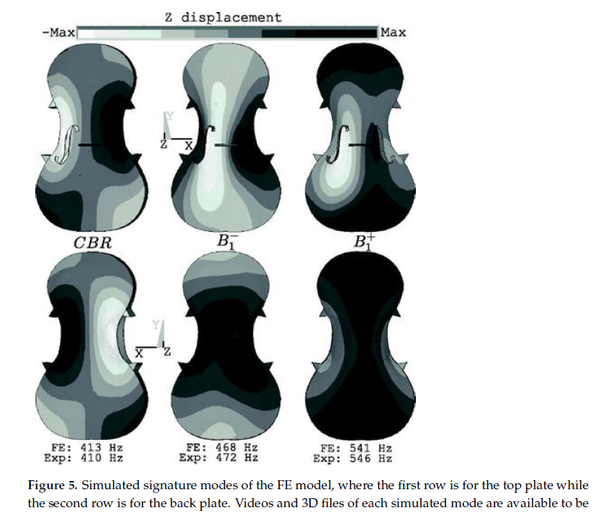
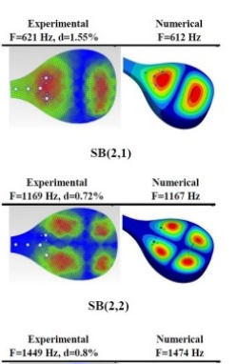
Assembled Instrument Box
Increased Complexity:
More parts → more material parameters
Higher computational cost
Validation with experimental modal analysis essential
Necessary
3D laser scanning for CAD model
Orthotropic wood properties, grain direction, string preload included

Slide 44
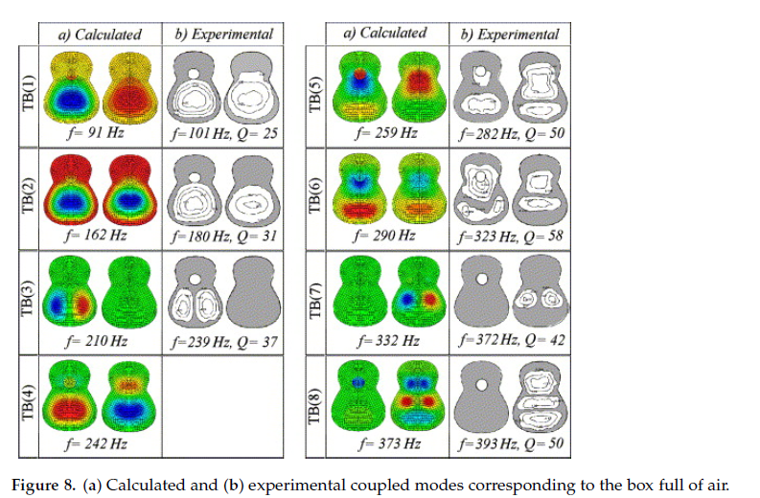
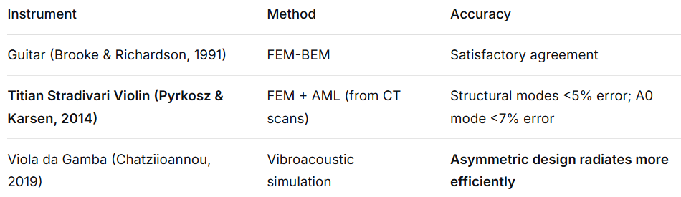
Fluid-Structure Interaction
Air cavity modes (enclosed air interact with structural modes
Lowest mode: Helmholtz resonance (A0)
Higher modes: Stationary waves inside cavity (A1, A2...)
Guitar Fluid-Structure Studies:
Sound hole affects air cavity modes
Coupled modes of wood + air differ from either alone
Type of gas matters! (He, air, Kr tested)
Density changes modal patterns and frequencies
Interaction with Surrounding Air
Most computationally demanding
Requires coupled FEM-BEM or AML techniques
Few studies due to HPC requirements
A detailed assembly including all the parts of the full instrument geometry resonance box, the fluid-structure interaction and the interaction with the surrounding air has not yet been developed and simulated.

Slide 45
Conclusions & Future Directions
Soundboard studies dominate literature - modal frequencies guide luthiers
Material properties are critical - accurate values essential for simulation
Violin most studied but still has open questions (bowed string physics)
Guitar preferred for fluid-structure studies (less complex than violin)
Non-Western instruments (setar, veena) gaining attention recently
Full vibroacoustic model (all parts + enclosed air + surrounding air) not yet achieved

Slide 46
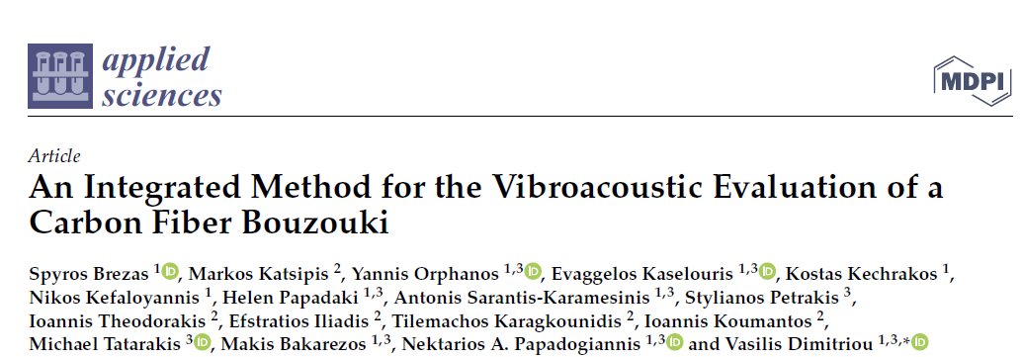
An Integrated Method for the Vibroacoustic Evaluation of a Carbon Fiber Bouzouki

Slide 47
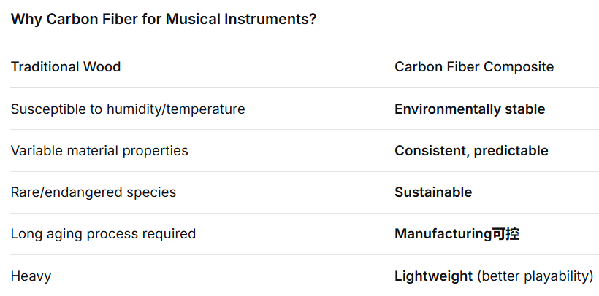
Introduction & Motivation
The construction of a bouzouki from composite materials is challenging because, apart from the process itself, the final product must be accepted by the players.
The Solution: An Integrated Method
Combining:
ESPI (Electronic Speckle Pattern Interferometry)
Impulse Response Measurements
FEM Simulations
Psychoacoustic Tests
Goal: Develop a carbon fiber bouzouki with vibroacoustic behavior matching a traditional wooden instrument

Slide 48
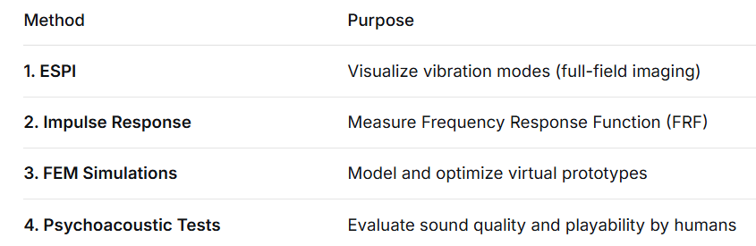
Methodology - The Integrated Approach

Slide 49
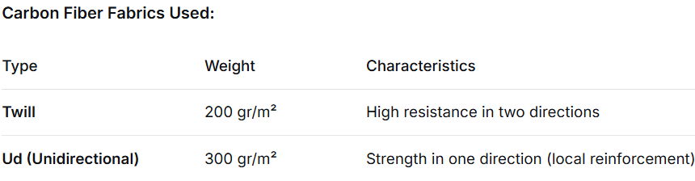
Manufacturing of Carbon Fiber Bouzouki
Process:
3D scan of traditional wooden bouzouki (reference W02)
CAD surface model from point cloud
CAM → G-code for CNC mold machining
Carbon fiber layup with varying:
  Layer sequences
  Fiber directions
  Materials (Twill vs. Ud)
The bridge and the bars of the soundboard of C01 were made from spruce wood in accordance with the wooden bouzouki for the comparison studies, while the bridge and the bars of C02 and C03 were manufactured by Twill and Ud carbon fiber layers in varying sequences and fiber directions.

Slide 50
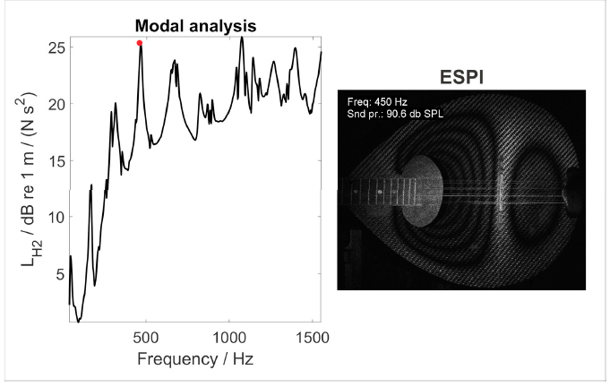
Experimental Characterization - ESPI & Impulse Response
ESPI (Electronic Speckle Pattern Interferometry):
Laser-based full-field vibration measurement
Excitation: Loudspeaker (60 cm distance) at 80 dB and 90 dB SPL
Frequency range: 40 Hz - 1500 Hz
Output: Interferograms showing mode shapes and amplitudes
Impulse Response:
Impact hammer + accelerometer
Roving hammer method (66+ grid points)
The carbon fiber bouzouki C01 behaved acoustodynamically, similar to W02, for many frequencies.

Slide 51
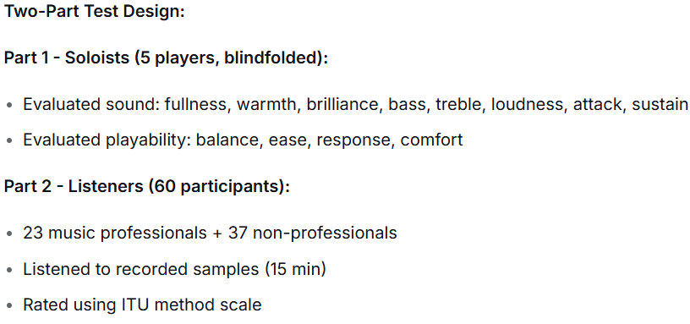
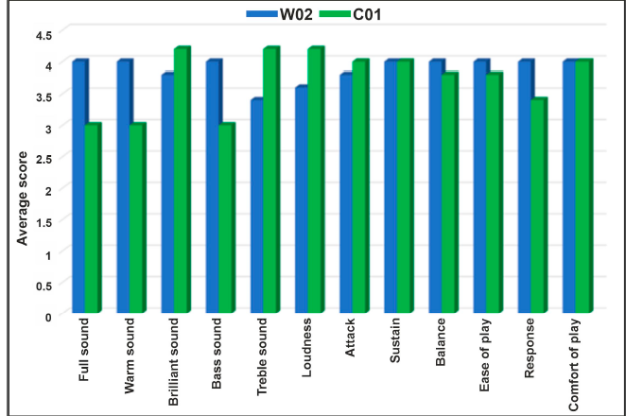

Psychoacoustic Evaluation - Human Perception
Overall Listener Score:
W02: 3.82
C01: 3.65

Slide 52


FEM Modeling & Validation
The simulation results agreed well with the experimental results, while the maximum deviation was indicated to be less than 6%.

Slide 53


Optimization & Conclusions

Slide 54

Vibrational Analysis of 3D Printed Tzouras Top Plates

Slide 55

Introduction & Motivation
The Challenge:
Traditional instruments use wood → sustainability concerns, environmental sensitivity
Need for alternative materials that maintain acoustic quality
3D printing offers precise control over geometry and properties
The Tzouras:
Traditional Greek string instrument
Top plate (soundboard) is critical for vibroacoustic behavior
Goal: Replace wooden top plate with 3D-printed PETG version
Research Questions:
How do 3D-printed top plates compare vibrationally to wooden ones?
Can FEM predict their behavior?
Which thickness (1.9 mm vs. 2.9 mm) matches wood better?

Slide 56


Methodology - Experiments & Correlation
FEM Modeling:
3D CAD from actual tzouras (260 mm length, 1.9-2.9 mm thickness)
~200,000 hexahedral elements
Materials: PETG (isotropic) vs. Spruce Engelmann (orthotropic)
Fixed boundary at top (matches experimental clamping)
The Correlation Concept:
Pristine state: Wooden tzouras (complete instrument)
Altered state: Wooden top plate (detached) or PETG printed plates
CFDAC (Complex Frequency Domain Assurance Criterion) compares FRFs
SCI (Spectral Correlation Index): 0 = perfect correlation, 1 = no correlation
Reference Value:
Complete tzouras vs. its detached wooden top plate → SCI = 0.722
This is the target for PETG plates to match

Slide 57


Results - Wooden Reference vs. 3D Printed Plates
As long as the SCI value approaches the reference value of 0.722, a vibroacoustic behavior similar to the traditional instrument is approached.
FRF Comparisons:
2.9 mm PETG shows better alignment with wooden plate peaks
1.9 mm PETG deviates more significantly
CFDAC Plots:
Diagonal symmetry indicates good correlation
2.9 mm case shows stronger diagonal features than 1.9 mm

Slide 58


Results - FEM Validation & Geometric Insights
Excellent visual correlation between ESPI fringes and FEM mode shapes. The maximum percent error between measured and simulated resonances is less than 7%.
The upper triangular area of the top plate, which is bounded (glued) with the tzouras body and the fingerboard, does not contribute to the vibroacoustic behavior of the instrument.
This area was excluded from further studies
Fixed support applied in experiments and FEM
Leads to more accurate boundary conditions

Slide 59


Conclusions & Future Work

Slide 60

FEM Simulation of Acoustic Wave Propagation in Crystals for Light Source Design

Slide 61

Introduction - A Novel Application of Acoustics
The Challenge:
The controlled production of narrowband γ radiation in the MeV range and beyond is one of the major challenges of modern physics.
Traditional Approaches:
Free electron lasers (large, expensive)
Static crystal undulators (fixed parameters, complex manufacturing)
The Novel Solution: Acoustically Driven Crystalline Undulators (A-CU)
Key Innovation:
Use acoustic waves to dynamically bend crystal planes → tunable, periodic structure → positrons emit gamma rays

Slide 62
The Physical Principle - Acoustics Meets Particle Physics
Piezoelectric transducer attached to silicon crystal
Generates longitudinal acoustic wave along [100] direction
Wave creates periodic compression/rarefaction in crystal lattice
This periodically bends the (110) crystallographic planes
Ultrarelativistic positrons enter along (110) direction
Positrons follow bent planes → undulator motion → emit gamma rays
Acoustic Wave Properties in Silicon:
Longitudinal speed of sound 8.43 × 10⁵ cm/s (along [100])
Frequencies: 10-40 MHz (this study)
Wavelengths: hundreds of micrometers

Slide 63


FEM Methodology - Simulating Acoustic Wave Propagation
Need to resolve wave propagation at MHz frequencies
Must account for boundary conditions
Essential for predicting actual bending profiles
Non-reflecting Boundary
Prevents standing wave formation
Simulates infinite medium (traveling wave)

Slide 64


FEM Results - Acoustic Wave Patterns

Slide 65

Acoustic Control of Gamma-Ray Spectra
FEM Output → Particle Simulation Input:
Bending profiles y = y(z) extracted from FEM
Used as geometry for Relativistic Molecular Dynamics (MBN Explorer)
The results clearly demonstrate the feasibility of the proposed A-CU scheme and highlight the advantages of dynamic modulation.

Slide 66
Conclusions & Future Directions
Novel A-CU device proposed based on acousto-optic modulator principle
FEM methodology established for simulating MHz acoustic waves in crystals
  Captures wave propagation, displacement fields, boundary effects
Acoustic parameters directly control gamma-ray output:
  Frequency → determines photon energy (10 MHz → 2 MeV; 40 MHz → 10 MeV)
Acoustic waves at MHz frequencies in anisotropic crystals can be engineered to create precise periodic structures at the atomic scale, enabling a new class of tunable radiation sources.
Future Work:
Experimental realization at CERN and other facilities
Exploration of other crystals (diamond, germanium)

Slide 67

Thermo-Mechanical Behavior of Thin Metal Films Under Nanosecond Laser Excitation

Slide 68


Introduction - Laser-Matter Interaction & Acoustics
Laser-generated ultrasound is a key non-destructive testing technique
Surface Acoustic Waves (SAWs) carry information about material properties
Understanding wave generation mechanisms is essential for acoustic applications

Slide 69

Experimental Methodology - Dynamic Imaging Interferometry
The Challenge:
Need nm-scale out-of-plane resolution
Need ns-scale temporal resolution
Need full-field imaging (not just point measurements)
Solution: Dynamic Imaging Michelson Interferometry
Setup Components:
Nd:YAG laser (6 ns FWHM, 532 nm)
Pump beam excites sample (Au film on BK7 glass)
Probe beam, variably delayed, images the surface
CCD camera records interferograms
Post-Irradiation Analysis: White-Light Interferometry
Measures permanent crater depth/radius
12 nm step size, 500-image stack
Constructs 3D surface maps

Slide 70


FEM Methodology - Coupled Thermal-Structural Analysis
Why FEM for Laser-Matter Interaction?
Coupled physics: heat transfer + structural dynamics
Phase changes (melting, vaporization)
Highly localized, steep gradients
Need to resolve SAW propagation

Slide 71


FEM Modeling Strategy - Handling Phase Changes

Slide 72




Results - Validation via SAW Comparison

Slide 73



Results - Crater Formation & Ablation Dynamics

Slide 74


Conclusions & Acoustic Implications

