Slide 1
2020/21 edition briefing
Nuno Escudeiro nfe@isep.ipp.pt

Slide 2
Blended-AIM path
Export
Capacity building
Export concept to EU neighbors
Inception
Co-financing EU
LLP Multilateral Erasmus
MUTW
EU countries
IT, software development, academic projects
Growing
Own funding
EU countries + Russia
Multidisciplinary (IT, Digital Arts, Management, Marketing)
Client company from 2013/14
Maturity
Co-financing EU
Erasmus+ Strategic partnership
Blended/AIM
Support companies developing innovative ideas at low cost, low cost proof of concept, Middle-East interest
Network
Service for incubators, startups and R&D
Ad-hoc International and multidisciplinary teams of students
2009/10
2010/11
2011/12
2012/13
2013/14
2014/15
2015/16
2016/17
2017/18
2018/19
1
2
3
4
5
6
2020/21
ATHENA European University
New Erasmus+ 21/27

Slide 3
Blended-AIM team
Instituto Politécnico do Porto, Portugal
Universität Siegen, Germany
Odisee Technologiecampus - Ghent, Belgium
LUCA School of Arts, Belgium
Glasgow Caledonian University, United Kingdom
Hellenic Mediterranean University, Greece
University of Human Develpment, Iraq
University of Maribor, Slovenia
University Institute of Maia, Portugal
Federal University of Technology Minna, Nigeria
Rhine-Waal University of Applied Sciences, Germany
Trier University of Applied Sciences, Germany
AP University of Applied Sciences and Arts Antwerp, Belgium
Vilnius Gediminas Technical University, Lithuania
Università degli Studi Niccolò Cusano, Italy
University of Orléans, France
IMEC–iStart, imec’s business accelerator, Belgium
KU, Germany
FHJ, Austria
UI, Iceland
VSTU, Russia
TUS, Bulgary
UV, Spain
VTU, Bulgary
EU, Turkey
UPB, Germany
MP, Germany
GISIG, Italy
Evolaris, Austria
Trilogis, Italy
UWS, Germany
EAEC, Cyprus
8 startups, Belgium.

Slide 4
Why Blended Mobility?

Slide 5
Motivations
Project/Internship activities foster students’ employability
International exposure during studies impacts students development as professionals, individuals and citizens
The Blended-AIM paradigm overcomes most barriers to mobility
Cost of international mobility
Family issues
Risk of missing local job opportunities
Anxiety while anticipating long periods abroad
Prevalence of impairments, disabilities, handicaps
Health issues, chronic diseases permanently requiring specific treatment
Geopolitical issues, visa, travel restrictions
Public health crisis
…
The carbon footprint of Blended-AIM is approximately 70% that of traditional/physical Erasmus mobility.

Slide 6
Why blended mobility?
Because it is a unique learning setting to promote equity and equal opportunities to all, despite any constraints preventing international experiences during studies that students might face
Because it tears down barriers to mobility
Because it is an eco-friendly approach to mobility
Simple to adapt to any study field, mainly for project course units, without formal curricula updates.

Slide 7
Blended-AIM course

Slide 8
Target
Final year undergraduate students
Capstone project course unit

Slide 9
Key features (MUTW)

Slide 10







Key features
MUTW – Multinational Undergraduate Team Work
MUTW – Me and U Together Win

Slide 11
Course plan

Slide 12
Course plan in three stages
A - PREPARATION
New edition organization (September)
Call for challenges (Praxis platform, companies, October)
Select challenges according to learning outcomes and available competences
Invite students (November till December)
Select students (December, January)
Invite supervisor teachers
Create teams
Kick-off logistics (prep phase, f2f meeting, travel and accommodation, January).
B - DEVELOPMENT
Launch the course edition (early February)
Preparatory phase (2 weeks before kick-off): team website (who we are), cultural stereotypes
Kick-off meeting (physical, 5 working days, end of February): team building, know the client and the challenge, know the team, know the ECTS-budget, organize work and tools, seminars / workshops (agile development, intercultural team work, ...), pitch and discuss proposal with the client, peer evaluation round 1
Team work at a distance, at home institution (virtual): regular meetings online, groupware platforms, distributed development environment
Peer evaluation round 2 (mid-term, April)
Closing logistics (closing f2f meeting, travel and accommodation, March/April).
C - CLOSURE
Closing meeting (physical, 5 working days, end of June): finalize deliverables (product, business plan, marketing campaign, ...), pitch and discussion with teachers and client representatives, peer evaluation round 3, assessment, give grades
Course edition debriefing: things to improve, preliminary organization of next edition
Final dinner.
In 2020/21, under Covid constraints:
M1: Kick-off meeting, February – Online
M2: Mid-term meeting, April – F2F
M3: Final meeting, June – F2F

Slide 13
More details ...
Student’s kit and checklist
http://blendedmobility.com/en/download-toolkit
Wikipedia
http://blendedmobility.com/en/blended-mobility-wikipedia
MUTW white book
https://www.amazon.com/Multinational-Undergraduate-Team-Work-International/dp/1607509830
In video
https://www.youtube.com/watch?v=Tlx2Mi-ejGw
https://www.youtube.com/watch?v=pH7-70Z1zkk
BlendEd website
http://www.blendedmobility.com/en
Join the consortium
http://blendedmobility.com/en/apply-as-institution
Contact us at
http://blendedmobility.com/en/contact
Or by email to nfe@isep.ipp.pt

Slide 14
Thank you! Join us in BlendEd nfe@isep.ipp.pt

Slide 15
Motivations
Survey: Sustainable education (UNESCO SDG)
How many times do you travel home during your Erasmus mobility?
612 Erasmus students from 47 countries
Standard Erasmus mobility: each student travels 2,5 times
Blended-AIM course: each student travels 1,8 times for a team with 10 universities (1,7 for a team of 6 universities)
The carbon footprint of Blended-AIM is approximately 70% that of traditional/physical Erasmus mobility.

Slide 16
Students’ budget

Slide 17
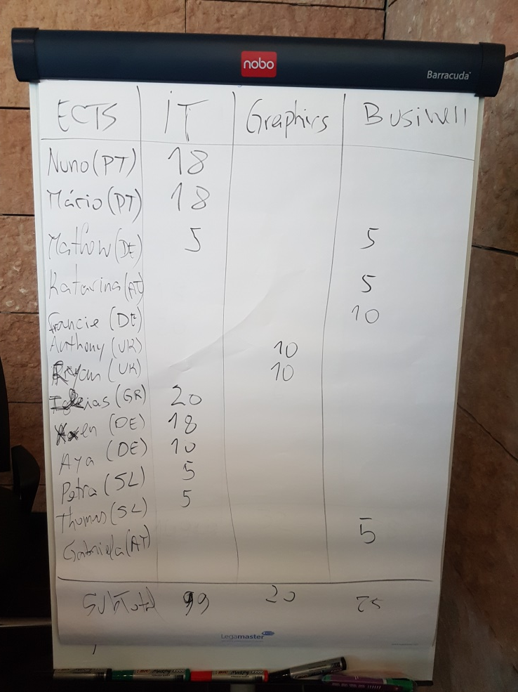
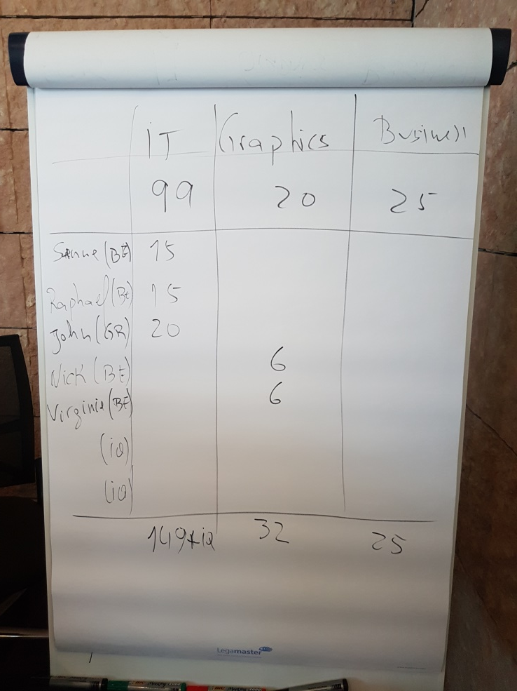
Budget estimate

Slide 18
Self-regulated approach is based on ECTS budget
Budget | ECTS | Working hours | Students
IT | 206 | 5768 | 13
Graphics | 32 | 896 | 4
Business | 25 | 700 | 4

Slide 19
Evaluation

Slide 20
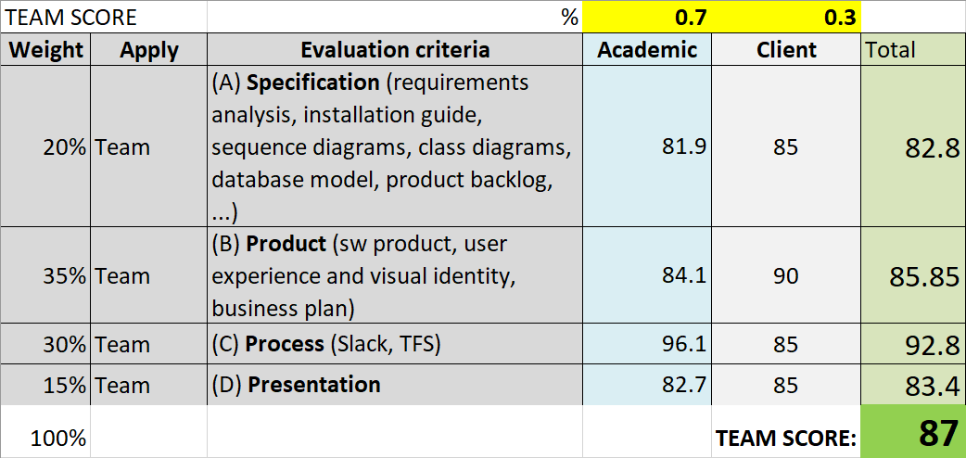
Assessment

Slide 21
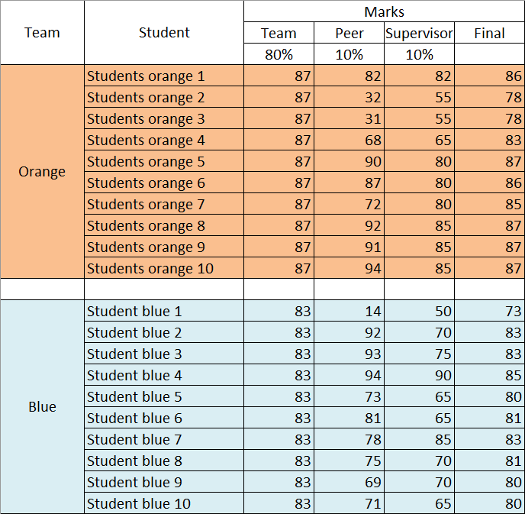
Assessment

Slide 22
Blended mobility SWOT

Slide 23
Blended mobility status-quo
Strengths
- overcomes barriers to physical mobility
- eco-friendly
- promotes equity and inclusion
- low-cost proof of concept

Slide 24
Blended mobility status-quo
Strengths | Weaknesses
- overcomes barriers to physical mobility | - depends on ICT resources and skills
- eco-friendly | - resistance to change
- promotes equity and inclusion | - requires adaptation of didactic materials
- low-cost proof of concept | - demanding approach to mobility

Slide 25
Blended mobility status-quo
Strengths | Weaknesses
- overcomes barriers to physical mobility | - depends on ICT resources and skills
- eco-friendly | - resistance to change
- promotes equity and inclusion | - requires adaptation of didactic materials
- low-cost proof of concept | - demanding approach to mobility
Opportunities
- Erasmus 2021/7
- key competences for LLL (languages, digital, cultural awareness)
- sustainable development global concerns
- micro-credentials

Slide 26
Blended mobility status-quo
Strengths | Weaknesses
- overcomes barriers to physical mobility | - depends on ICT resources and skills
- eco-friendly | - resistance to change
- promotes equity and inclusion | - requires adaptation of didactic materials
- low-cost proof of concept | - demanding approach to mobility
Opportunities | Threats
- Erasmus 2021/7 | - lack of appropriate certification mechanisms
- key competences for LLL (languages, digital, cultural awareness) | - low offer of blended mobility courses
- sustainable development global concerns | - requires deep cooperation among partners
- micro-credentials | - generalized public health crisis

Slide 27
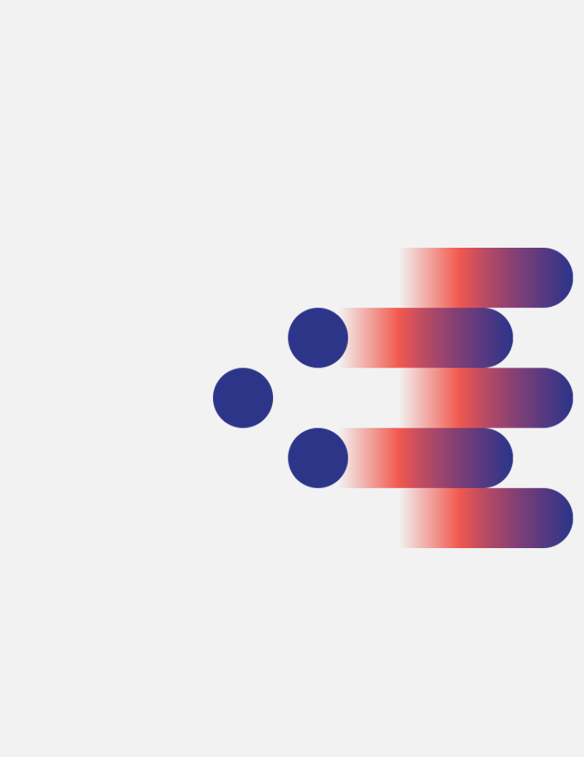
Ambition - 50/60 universities running the course - ad-hoc teams dynamicaly created by the students
(BlendEd workshop 1.2)
(BlendEd workshop 2)
Menti.com
Notes:
Today, our mid-term ambition is to have a consortium of 50, 60 universities running the course with the teams of students being dynamically created depending on students’ particular interest and the available challenges submitted by companies to a centralized pool.
You are all very welcome to join us developing further this exciting paradigm.
Take a deeper look online at blendedmobility.com or search for blended mobility at the Wikipedia.
Thank you for your attention!

