Slide 1
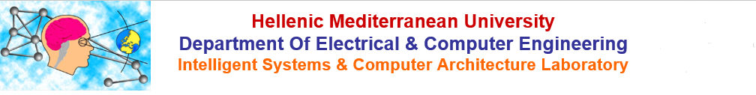

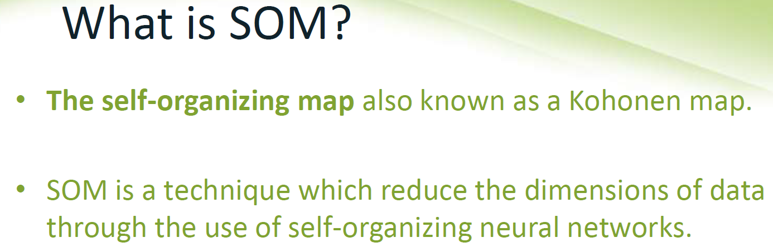
Hellenic Mediterranean University
Department Of Electrical & Computer Engineering
Intelligent Systems & Computer Architecture Laboratory

Slide 2
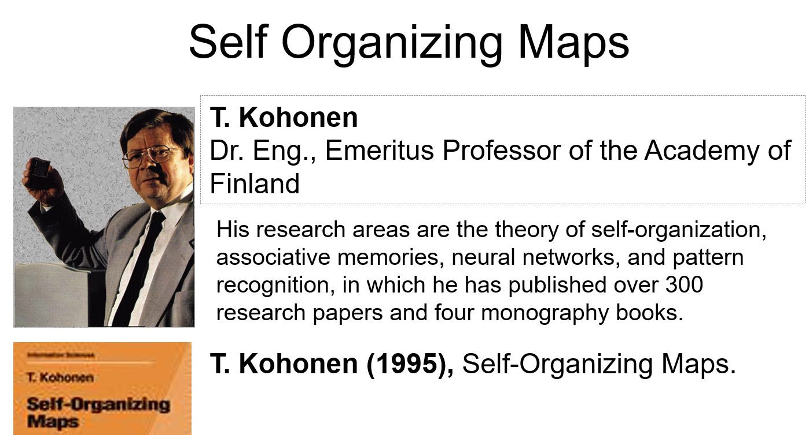
Technological Educational Institute Of Crete
Department Of Applied Informatics and Multimedia
Intelligent Systems Laboratory

Slide 3
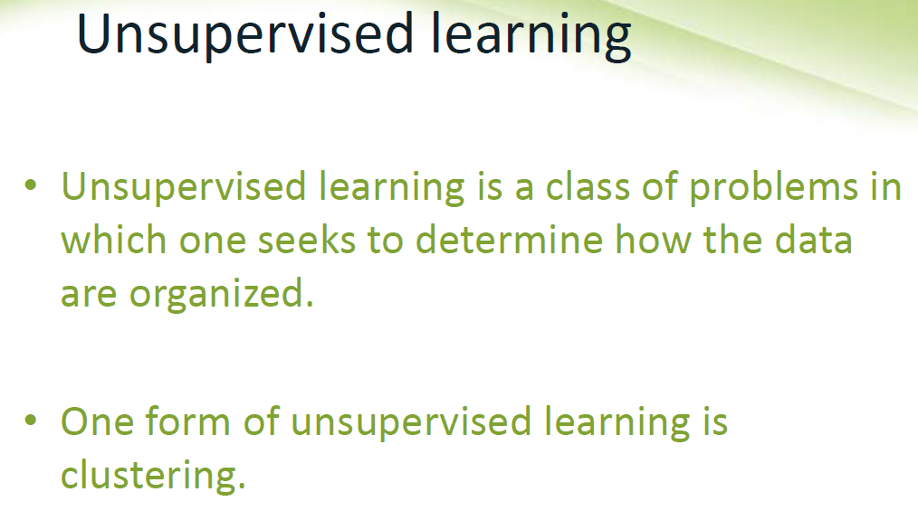
Technological Educational Institute Of Crete
Department Of Applied Informatics and Multimedia
Intelligent Systems Laboratory

Slide 4
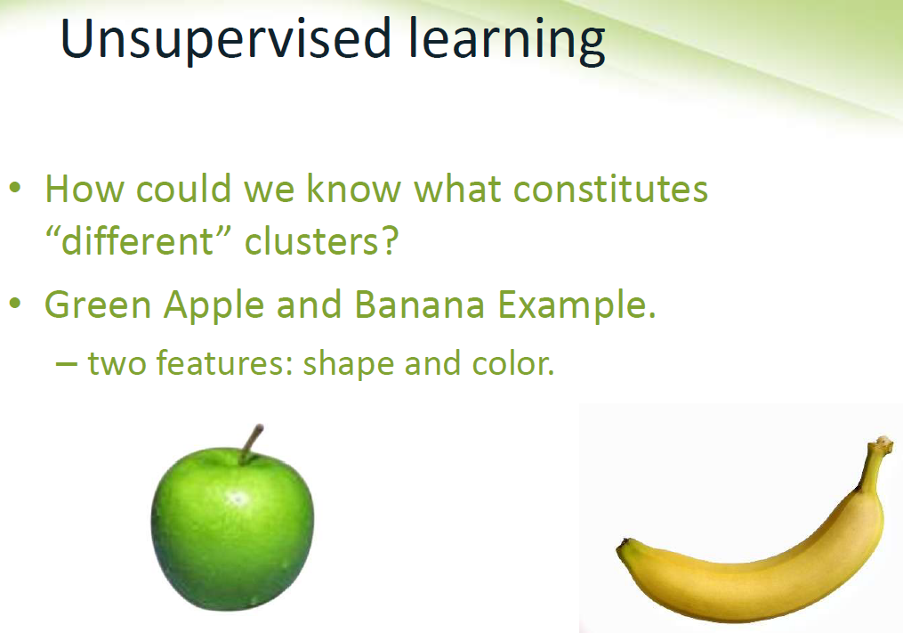
Technological Educational Institute Of Crete
Department Of Applied Informatics and Multimedia
Intelligent Systems Laboratory

Slide 6
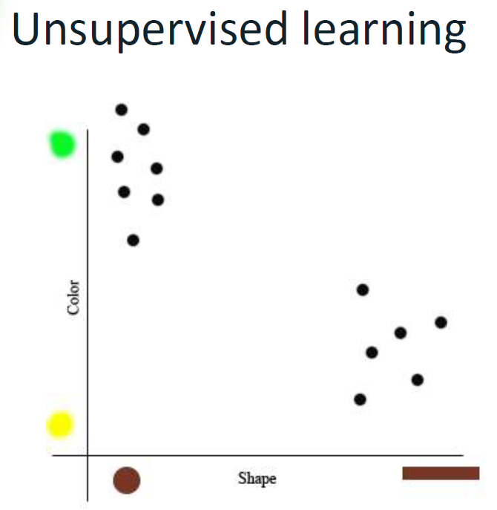
Technological Educational Institute Of Crete
Department Of Applied Informatics and Multimedia
Intelligent Systems Laboratory

Slide 7
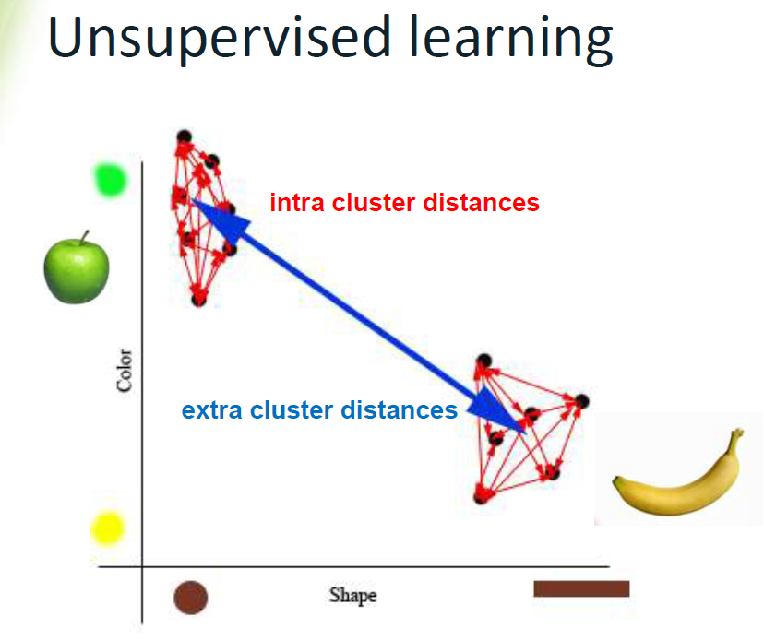
Technological Educational Institute Of Crete
Department Of Applied Informatics and Multimedia
Intelligent Systems Laboratory

Slide 8
Technological Educational Institute Of Crete
Department Of Applied Informatics and Multimedia
Intelligent Systems Laboratory
Biological Background
Kohonen: Was Lecturer in the university of Helsinki.
He tried to model the auto-organization and readjusted learning of the brain.
Neurologists have define and prove that brain works locally.
  E.g. Talking, eye, movement control local features.
  E.g. Hearing system (cortex region)
It was the theory “Grandmother cell” too, that it’s out of date.
The theory says that there are special units for each notion. E.g. there is a neuron which is responsible for the recognition of the “grandmother”

Slide 9
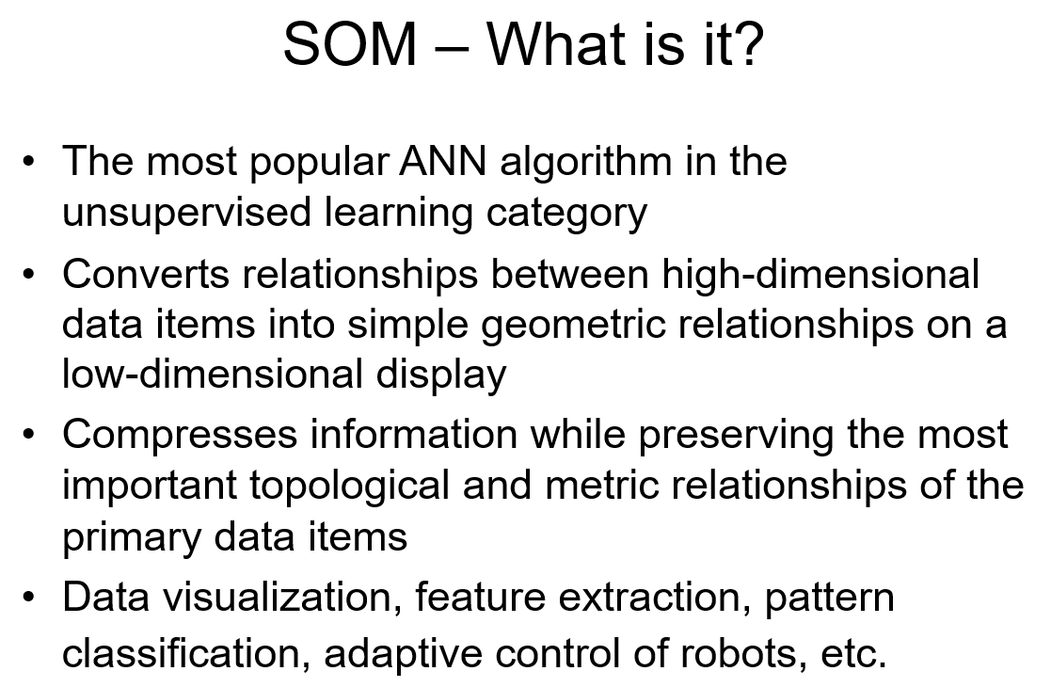
Technological Educational Institute Of Crete
Department Of Applied Informatics and Multimedia
Intelligent Systems Laboratory

Slide 10
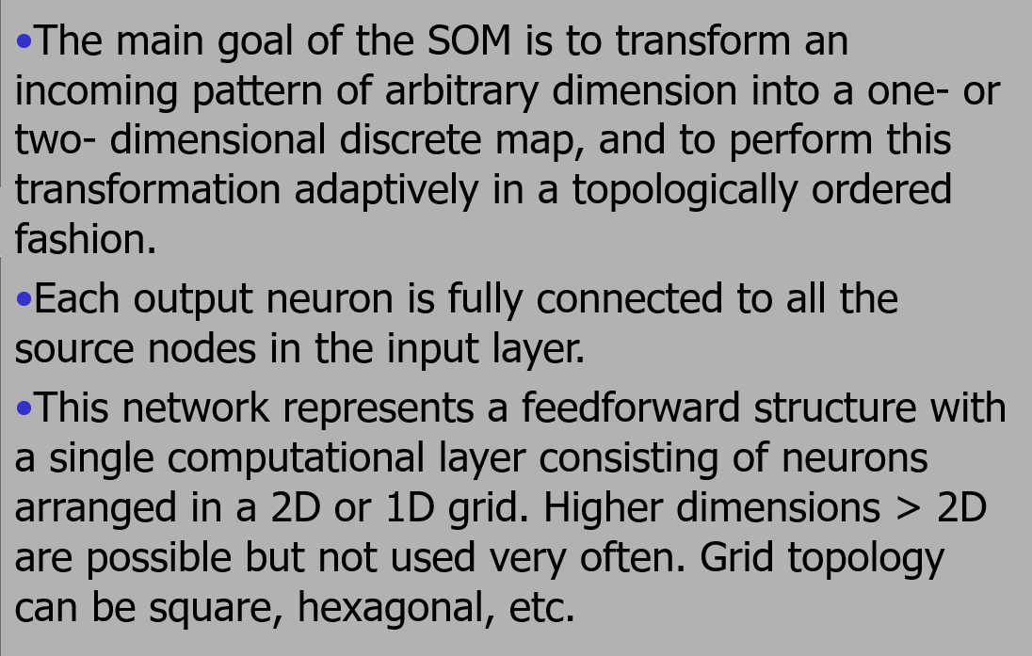
Technological Educational Institute Of Crete
Department Of Applied Informatics and Multimedia
Intelligent Systems Laboratory

Slide 11
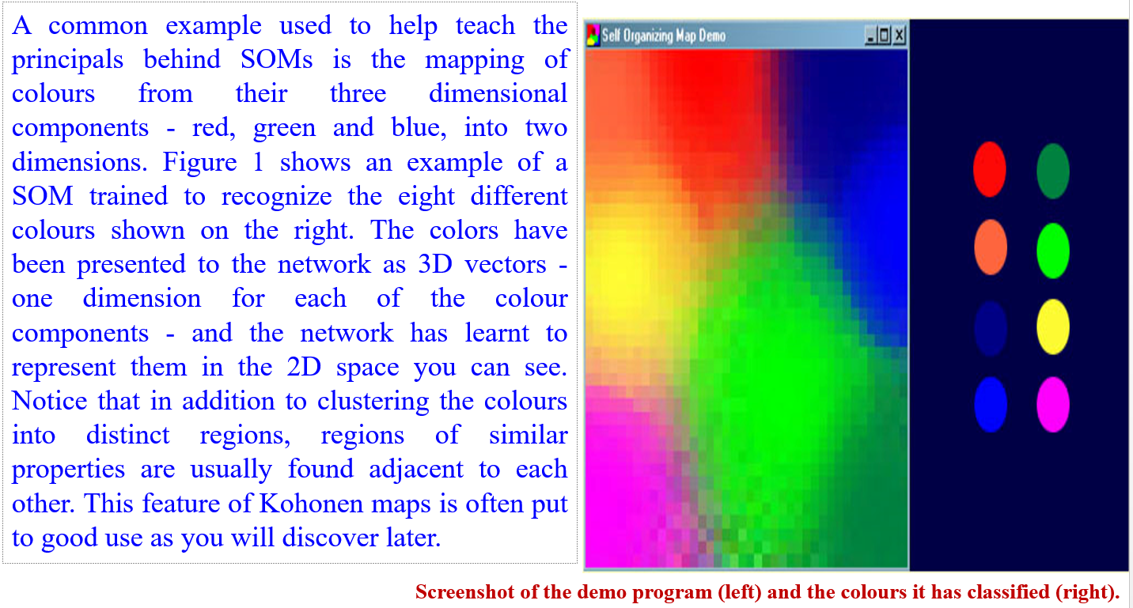
Technological Educational Institute Of Crete
Department Of Applied Informatics and Multimedia
Intelligent Systems Laboratory

Slide 12
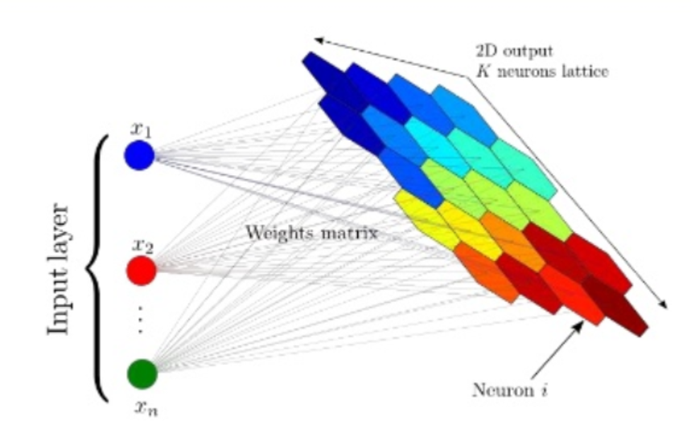
Technological Educational Institute Of Crete
Department Of Applied Informatics and Multimedia
Intelligent Systems Laboratory

Slide 13
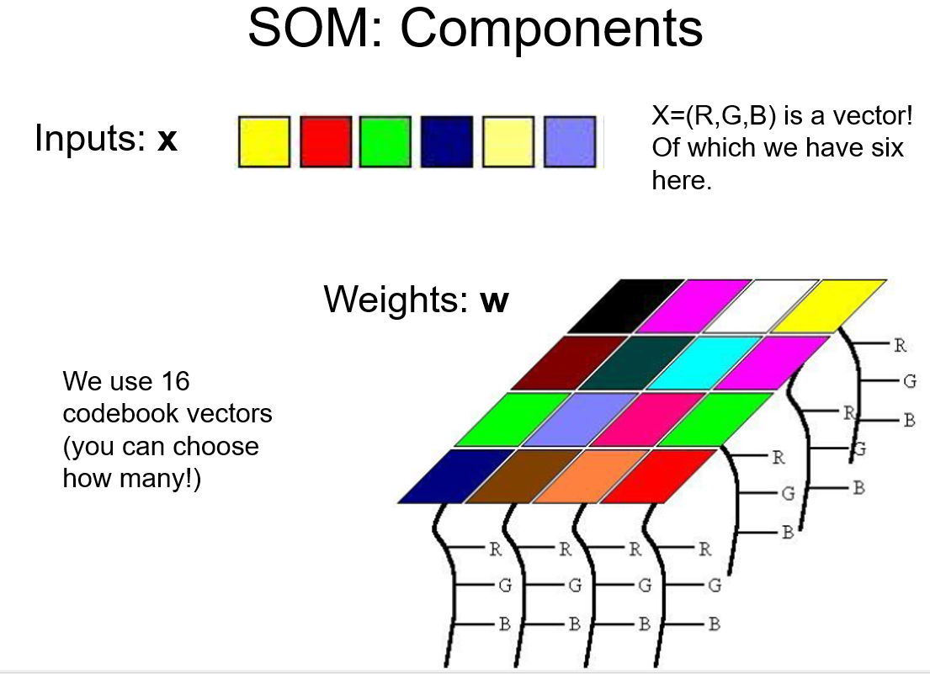
Technological Educational Institute Of Crete
Department Of Applied Informatics and Multimedia
Intelligent Systems Laboratory

Slide 14
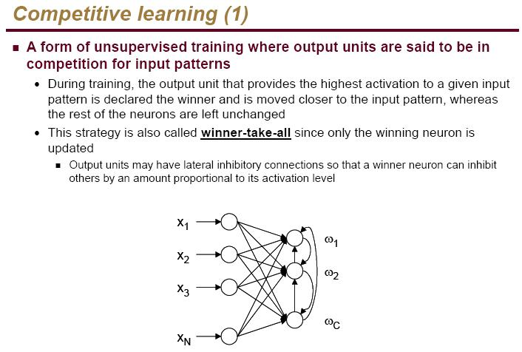
Technological Educational Institute Of Crete
Department Of Applied Informatics and Multimedia
Intelligent Systems Laboratory

Slide 15
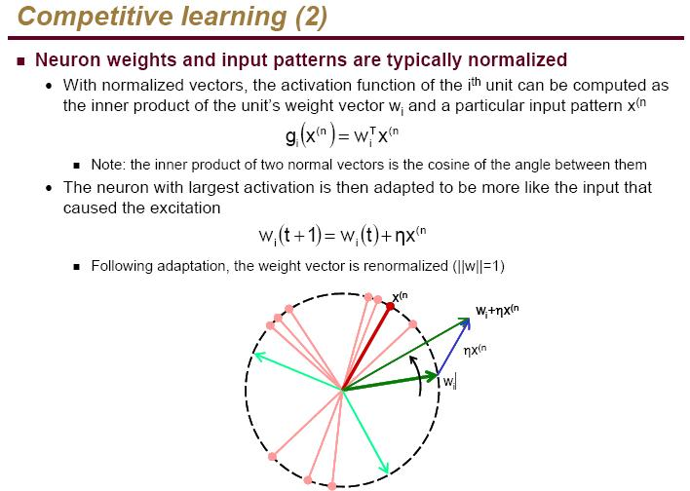
Technological Educational Institute Of Crete
Department Of Applied Informatics and Multimedia
Intelligent Systems Laboratory

Slide 16
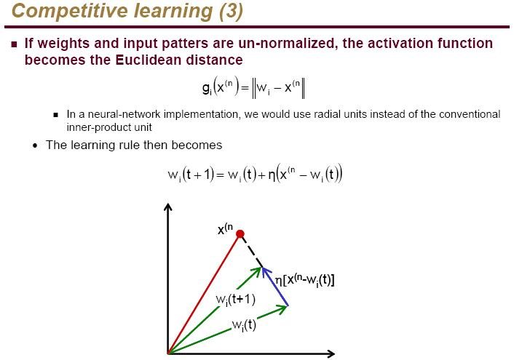
Technological Educational Institute Of Crete
Department Of Applied Informatics and Multimedia
Intelligent Systems Laboratory

Slide 17
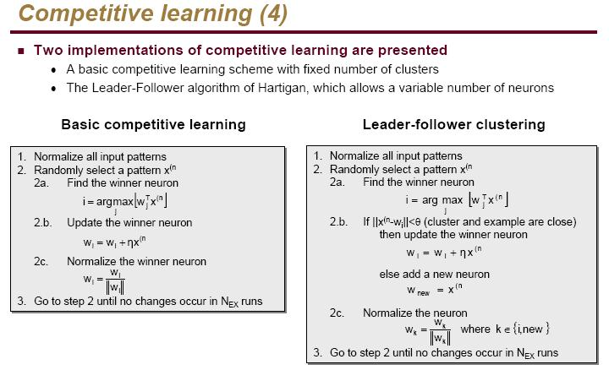
Technological Educational Institute Of Crete
Department Of Applied Informatics and Multimedia
Intelligent Systems Laboratory

Slide 18
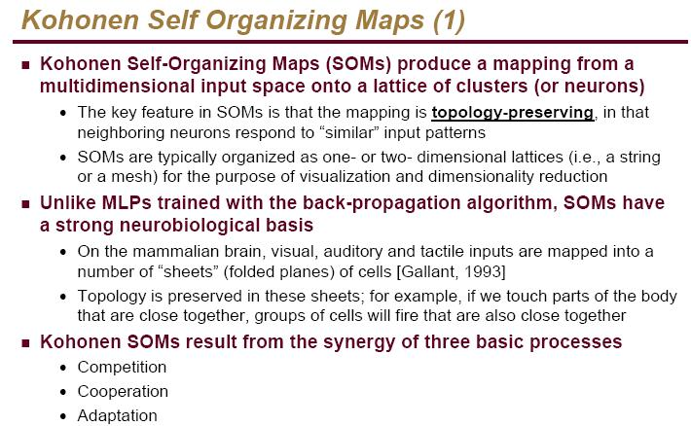
Technological Educational Institute Of Crete
Department Of Applied Informatics and Multimedia
Intelligent Systems Laboratory

Slide 19
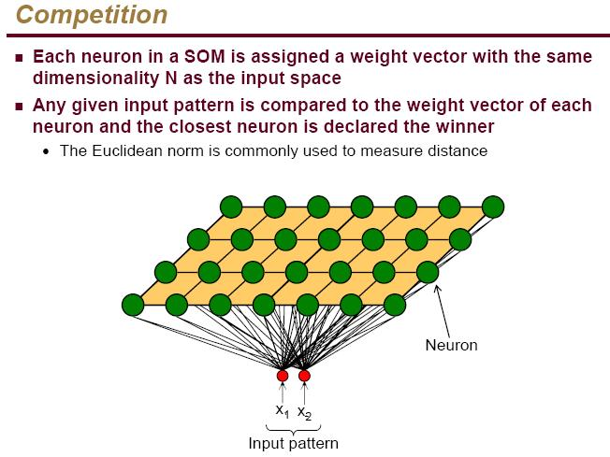
Technological Educational Institute Of Crete
Department Of Applied Informatics and Multimedia
Intelligent Systems Laboratory

Slide 20
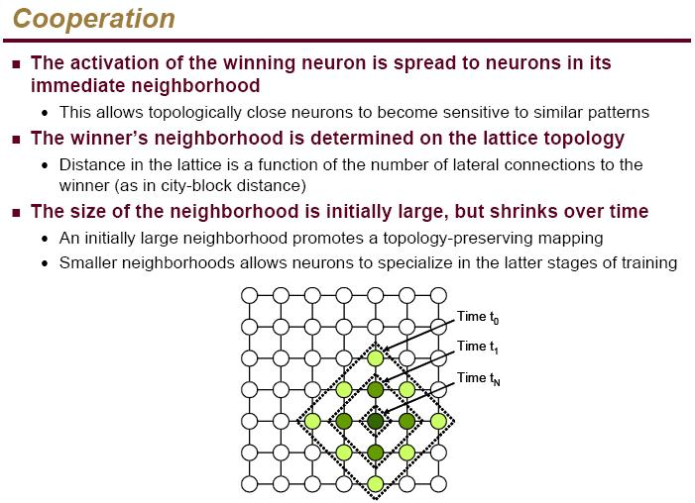
Technological Educational Institute Of Crete
Department Of Applied Informatics and Multimedia
Intelligent Systems Laboratory
Technological Educational Institute Of Crete
Department Of Applied Informatics and Multimedia
Intelligent Systems Laboratory

Slide 21
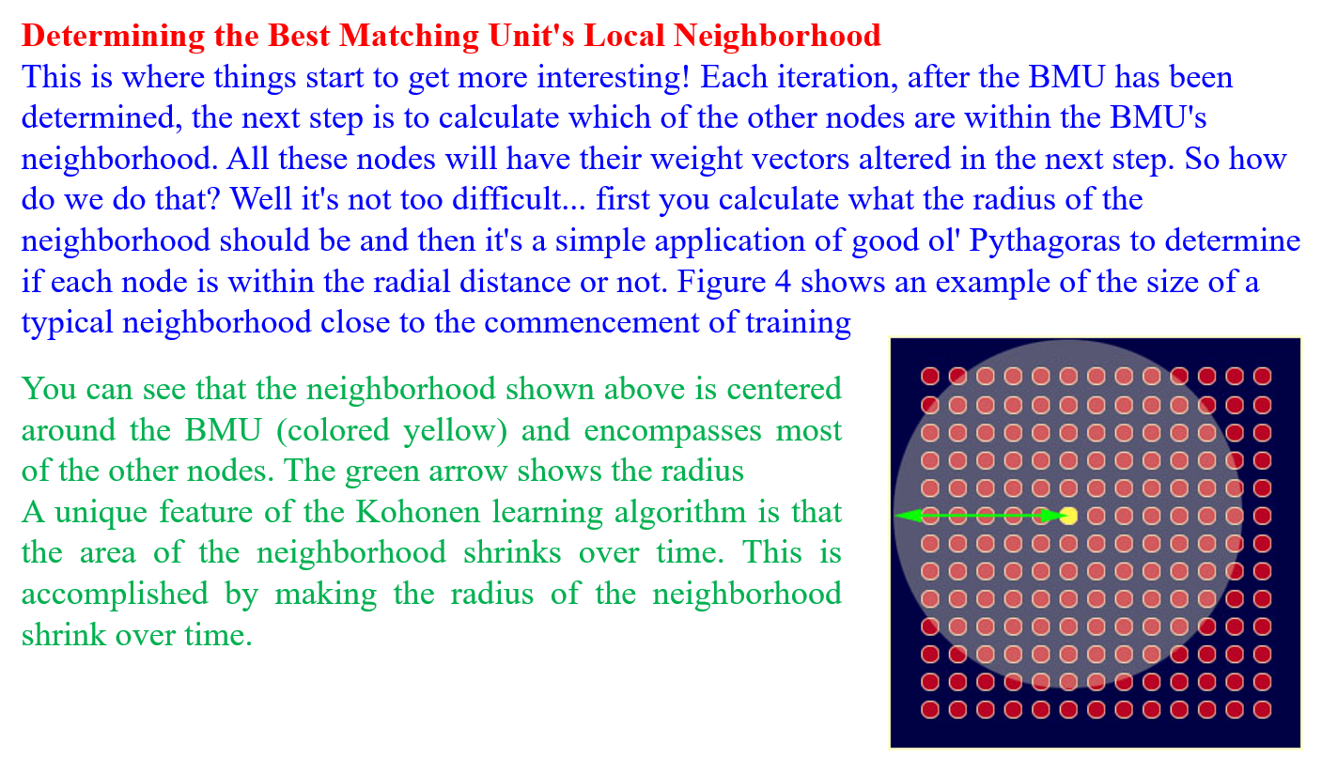

Slide 22
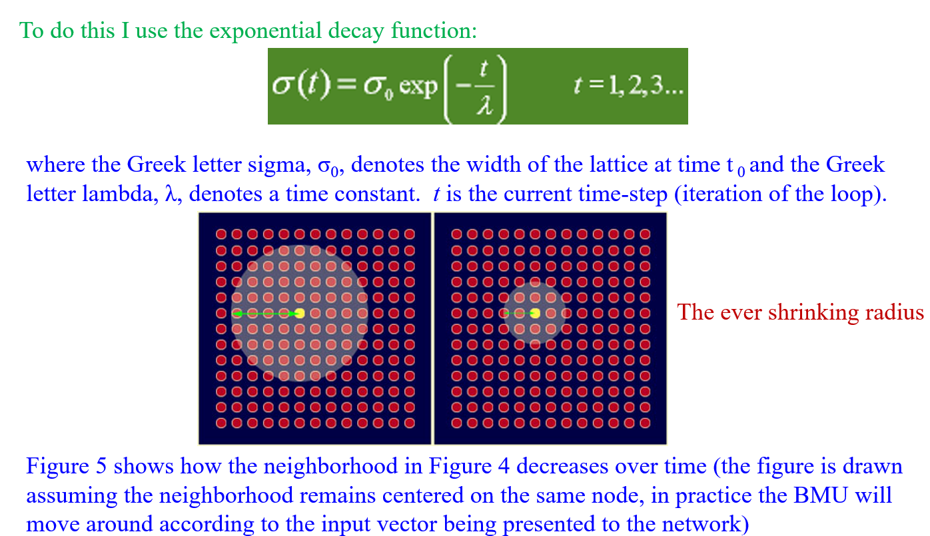

Slide 23
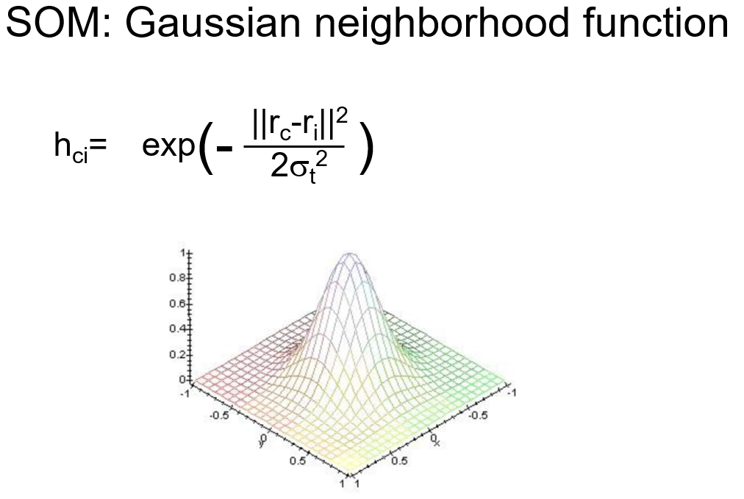

Slide 24
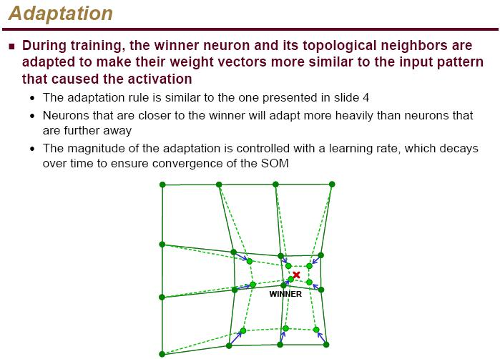
Technological Educational Institute Of Crete
Department Of Applied Informatics and Multimedia
Intelligent Systems Laboratory

Slide 25
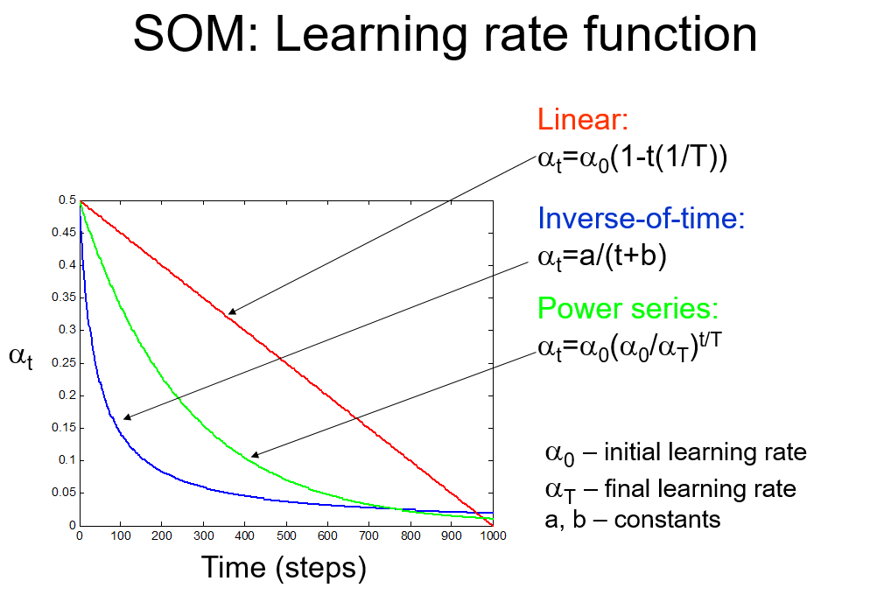

Slide 26
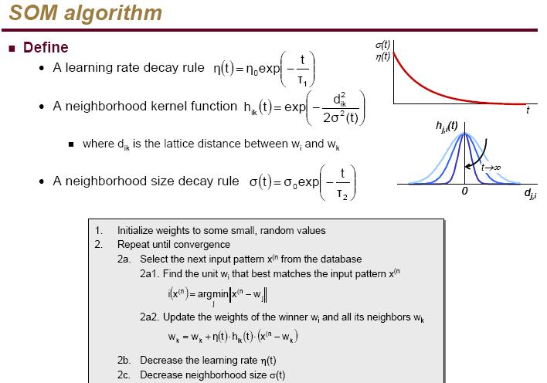
Technological Educational Institute Of Crete
Department Of Applied Informatics and Multimedia
Intelligent Systems Laboratory

Slide 27
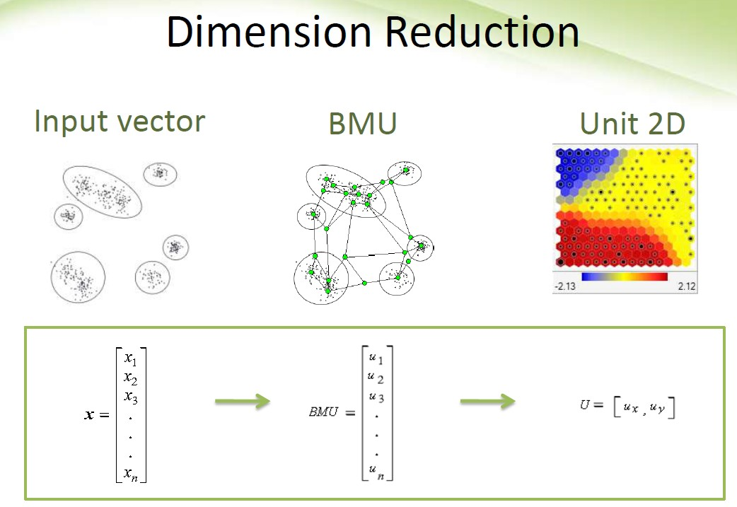

Slide 28
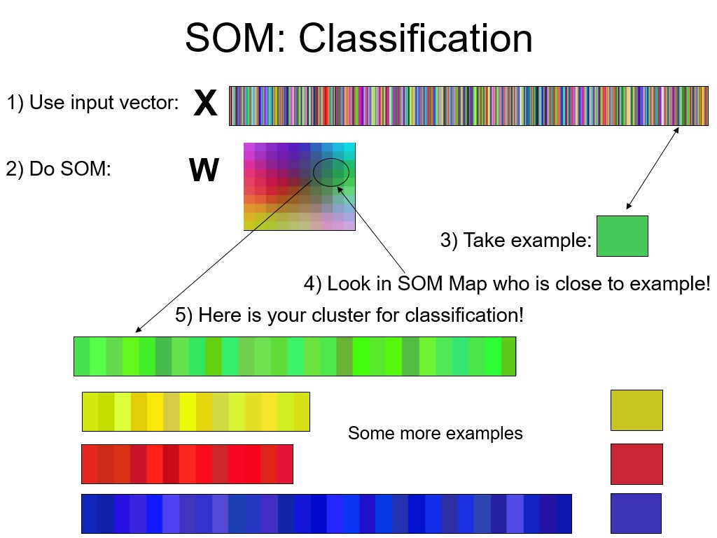

Slide 29
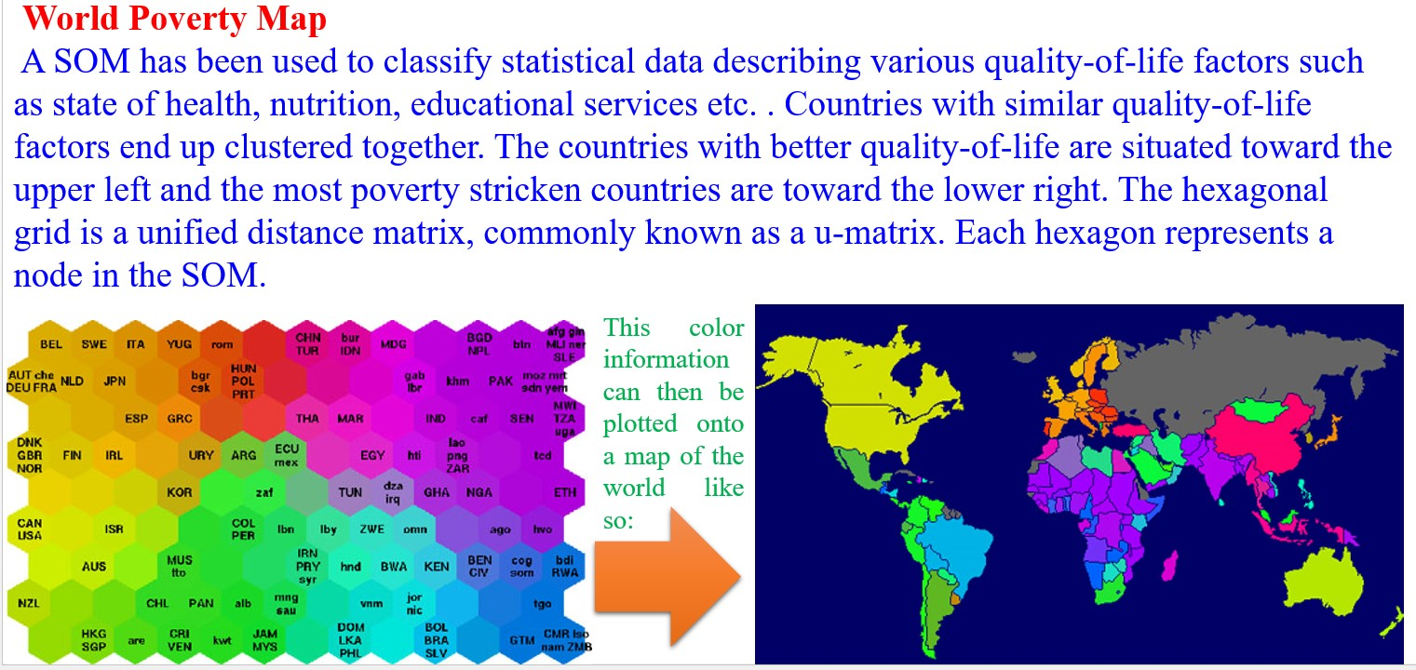

Slide 30
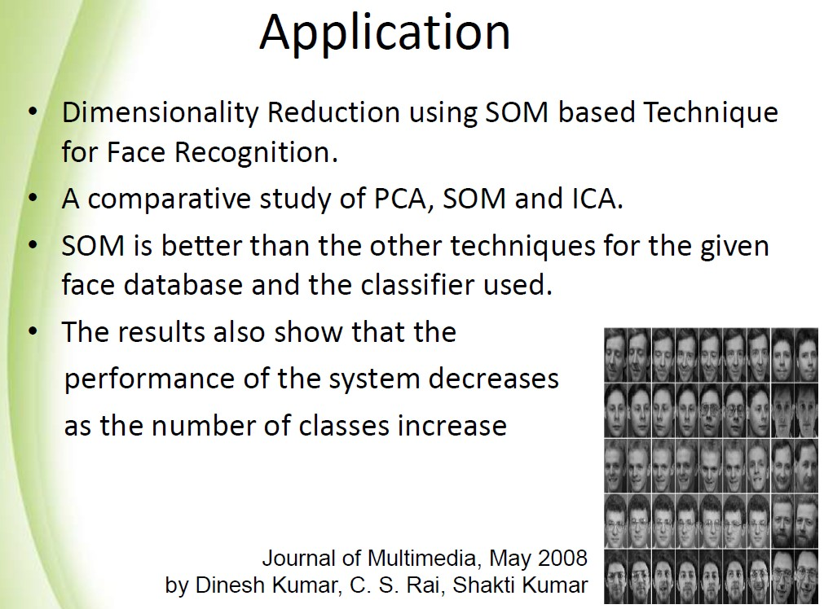

Slide 31
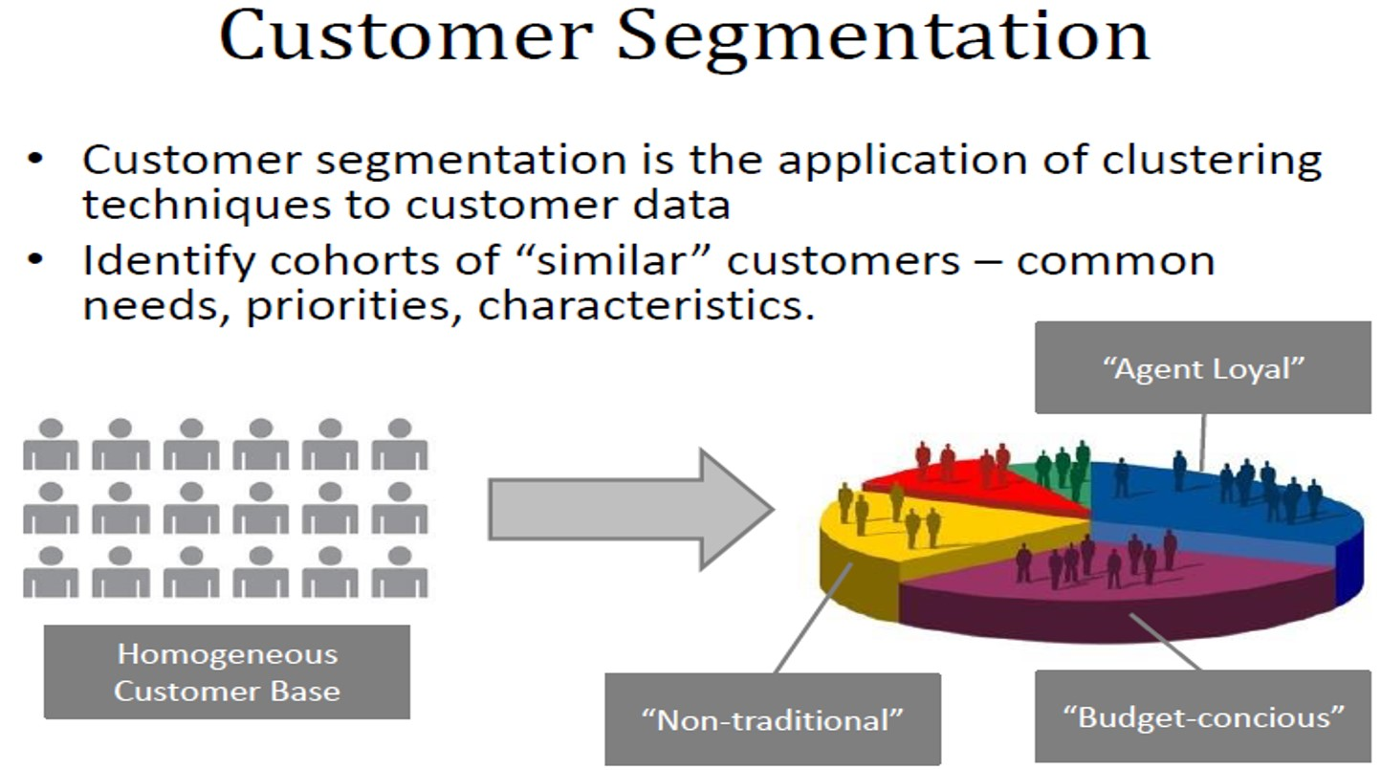

Slide 32
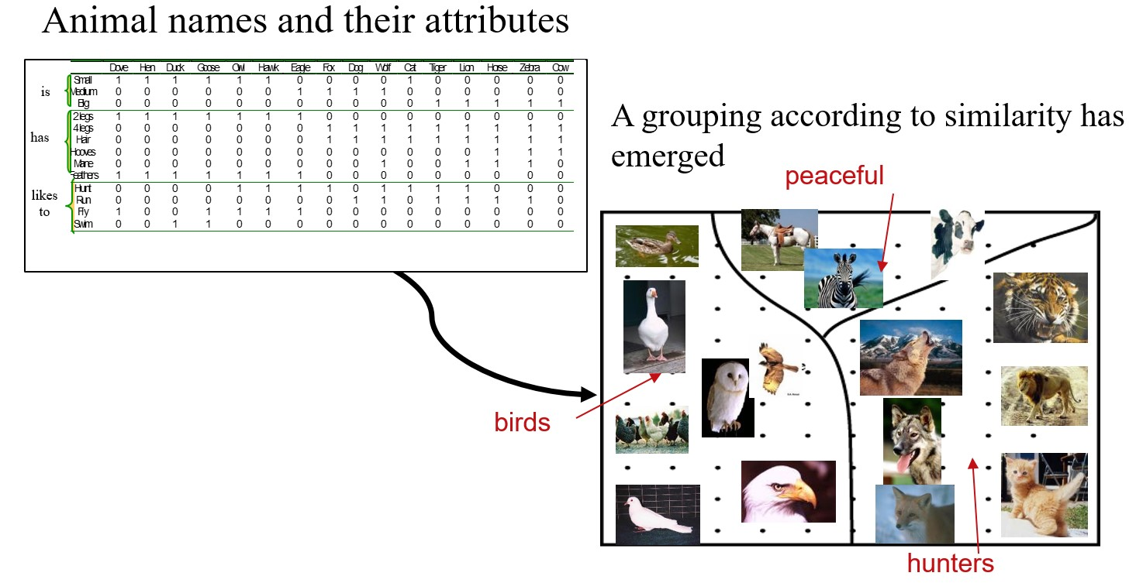

Slide 33
