Slide 1
Laboratory work in Octave: Today’s tasks
Explain a simple code to implement the GLCM
Extract 3 important features from images and explain their meaning
See the influence of image filtering and other operations in the features
Pathology images from https://www.webpathology.com/case.asp?case=468

Slide 2
Texture Analysis and its role in Radiomics
Many thanks to Ulas Bagci (Northwestern University)
for sharing his experience and course material
Notes:
<title> = Prof., Dr., etc
Xxxxxxx Yyyyyyyy = name of the presenter
<Full Laboratory Name> = e.g. Computational Vision and Robotics
<Lab short name> = e.g. CVRL
e.t.c.

Slide 3
Contents of the talk
Why computer measures of tissue appearance are so important?
A technical view on texture analysis
From simple texture features to high-throughput feature extraction-> Radiomics (intro)
Conclusions

Slide 4
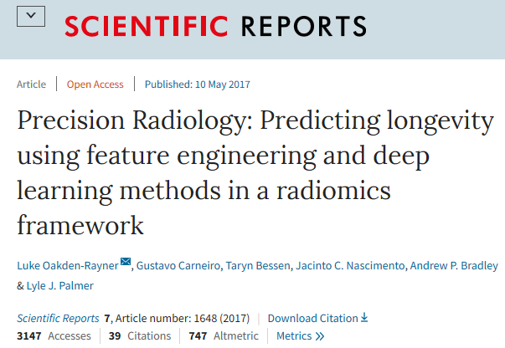
The rise of machine learning in radiology-why computer measures of tissue appearance are so important?
Why computer measures of tissue appearance are so important?
Medical images are informative but need to be processed to extract quantitative info!
Medical Imaging assisted diagnosis or assessment of response to treatment requires the extraction of quantitative characteristics (such as size, shape, texture, and activity).

Slide 5
The rise of machine learning in radiology-why computer measures of tissue appearance are so important?
Why computer measures of tissue appearance are so important?
Quantitative imaging and machine learning approaches, provide a wide range of techniques for the extraction of objective and quantifiable information towards precision radiology.
Biology is a system of systems, therefore it is reasonable to assume that such features may convey multi-level pathophysiology information.

Slide 6
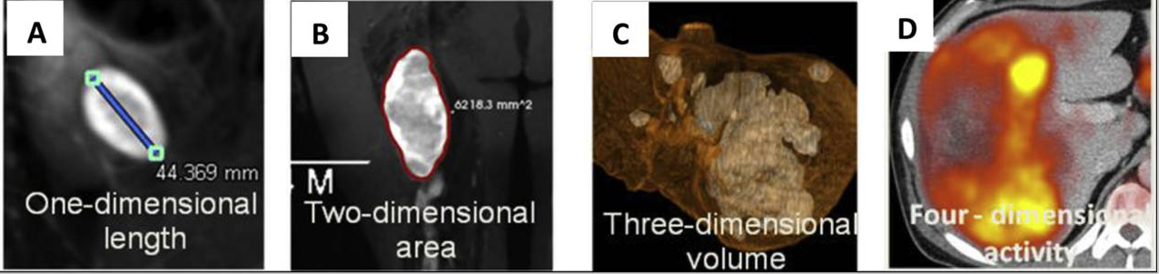
The rise of machine learning in radiology-why computer measures of tissue appearance are so important?
Why computer measures of tissue appearance are so important?
Lets take as an example from oncology regarding imaging biomarkers of tumor burden for characterizing microscopic/macroscopic tumor properties in one or more time points
Cai, W. L., & Hong, G. B. (2018). Quantitative image analysis for evaluation of tumor response in clinical oncology.
Chronic diseases and translational medicine, 4(1), 18–28. doi:10.1016/j.cdtm.2018.01.002

Slide 7
The rise of machine learning in radiology-why computer measures of tissue appearance are so important?
Why computer measures of tissue appearance are so important?
Personalised medicine needs quantitative information regarding both microscopic and macroscopic properties such as size, shape and structure.
This is important since in clinical practice subjective characterizations might be used (e.g. average heterogeneity, speculated mass, necrotic core).
To make things worse, several studies have reported very high intra/inter-observed variability in linear metrics (e.g. longer lesion diameter) estimation 6% -14% /10% -25% * which can lead to the wrong assessment of tumor response.
*Zhao B., et al.. Exploring intra- and inter-reader variability in uni-dimensional, bi-dimensional, and volumetric measurements of solid tumors on CT scans reconstructed at different slice intervals. Eur J Radiol. 2013;82:959–968.
**Erasmus J.J., Gladish G.W., Broemeling L. Interobserver and intraobserver variability in measurement of non-small-cell carcinoma lung lesions: implications for assessment of tumor response. J Clin Oncol. 2003;21:2574–2582.

Slide 8
The rise of machine learning in radiology-why computer measures of tissue appearance are so important?
Why computer measures of tissue appearance are so important?
Other studies report false tumor response classification accuracy due to inter-observer variability in the order of 43% (WHO) and 30% (RECIST)**.
Microscopic properties such as micro-perfusion or tumor heterogeneity (texture) can be derived via advanced quantitative studies requiring computer-based analysis algorithms
Quantitative biomarkers must be precise and reproducible!
*Zhao B., et al.. Exploring intra- and inter-reader variability in uni-dimensional, bi-dimensional, and volumetric measurements of solid tumors on CT scans reconstructed at different slice intervals. Eur J Radiol. 2013;82:959–968.
**Erasmus J.J., Gladish G.W., Broemeling L. Interobserver and intraobserver variability in measurement of non-small-cell carcinoma lung lesions: implications for assessment of tumor response. J Clin Oncol. 2003;21:2574–2582.

Slide 9
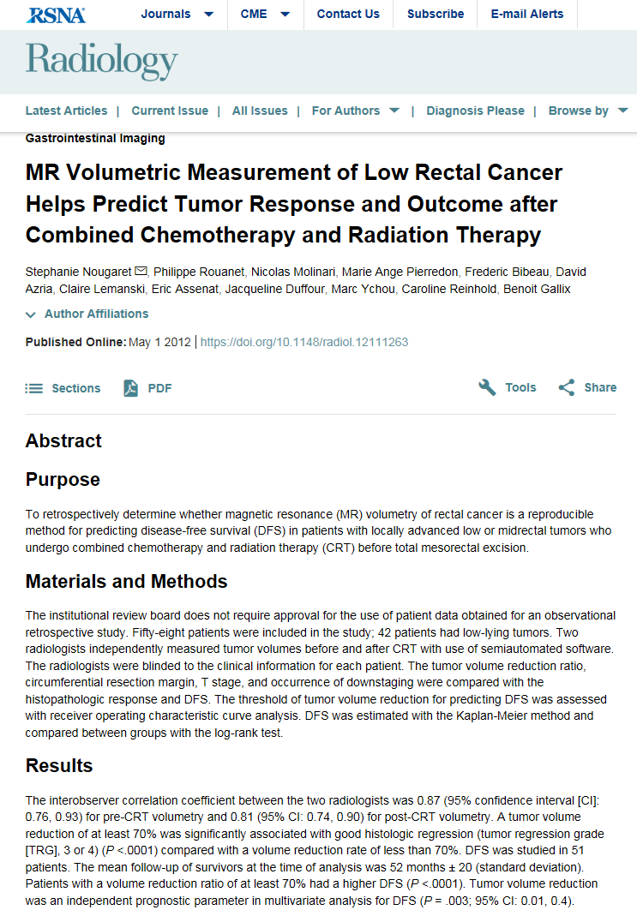
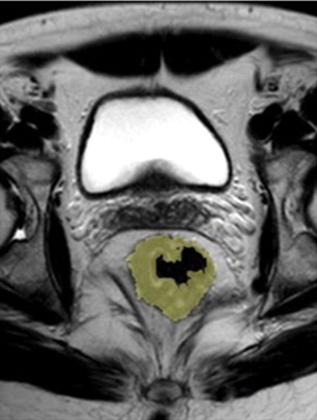
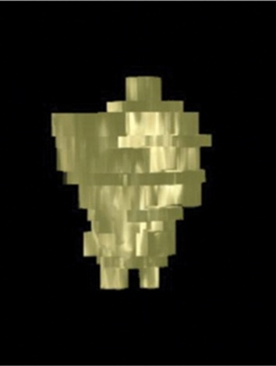
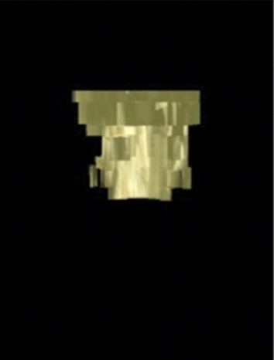
The rise of machine learning in radiology-why computer measures of tissue appearance are so important?
Why computer measures of tissue appearance are so important?
Moving from linear measures to 3D measures such as lesion volume in mm3, can alleviate the problem.
For example a tumor with BL diameter 4cm is considered SD within 2,8-4,8 cm follow-up diameters according to RECIST which might be far too broad.
Several studies have shown that 3D quantitative response assessment is better correlated with disease progression than those based on 1D linear measurements**.
T2-weighted fast spin-echo axial oblique MR image
Conclusion
The results demonstrate that volumetric measurements are reliable markers of rectal cancer prognosis, enabling the prediction of DFS and tumor regression grade (TRG). The cutoff of 70% is an easy parameter to use as a surrogate for clinical response to predict both TRG and outcome.
Cai, W. L., & Hong, G. B. (2018). Quantitative image analysis for evaluation of tumor response in clinical oncology. Chronic diseases and translational medicine, 4(1), 18–28. doi:10.1016/j.cdtm.2018.01.002
**Duran R., Chapiro J., Frangakis C. Uveal melanoma metastatic to the liver: the role of quantitative volumetric contrast-enhanced MR imaging in the assessment of early tumor response after transarterial chemoembolization. Transl Oncol. 2014;7:447–455

Slide 10
The rise of machine learning in radiology-why computer measures of tissue appearance are so important?
Why computer measures of tissue appearance are so important?
Conventional tumor quantitation methods based on linear or 3D tumor measurements have demonstrated significant limitations in evaluating response especially to new oncology therapies such as targeted, anti-angiogenic therapies, immunotherapies or topical therapies.
In patients undergoing targeted therapies tumors may exhibit internal necrosis formation with or without reduction in lesion size (as in conventional cytotoxic therapy) -> size-based tumor measurements do not necessarily reflect tumor response to therapy.
Cai, W. L., & Hong, G. B. (2018). Quantitative image analysis for evaluation of tumor response in clinical oncology. Chronic diseases and translational medicine, 4(1), 18–28.doi:10.1016/j.cdtm.2018.01.002

Slide 11
The rise of machine learning in radiology-why computer measures of tissue appearance are so important?
Why computer measures of tissue appearance are so important?
This is one of the many examples where texture analysis provides powerful tools to quantitatively describe tissue structure and characterize patterns linked to disease or response.
Texture is a regular repetition of an element or pattern in an image.
Texture provides information in the spatial arrangement of colours or intensities in an image.
Texture analysis refers to the characterization of an image region by its texture.
Cai, W. L., & Hong, G. B. (2018). Quantitative image analysis for evaluation of tumor response in clinical oncology. Chronic diseases and translational medicine, 4(1), 18–28.doi:10.1016/j.cdtm.2018.01.002

Slide 12
The rise of machine learning in radiology-why computer measures of tissue appearance are so important?
Why computer measures of tissue appearance are so important?
Texture analysis attempts to quantify intuitive properties described by terms such as rough, smooth, silky or irregular as a function of spatial variation in pixel intensities.
The purpose of texture analysis is to classify, segment, and identify different areas of interest.
Texture heterogeneity features, calculated from both spatial and time-series images, can provide reliable biomarkers in oncology (treatment response).
Haralick R.M., Shanmugam K., Dinstein I. Textural features for image classification. IEEE Trans Syst Man Cybern. 1973;SMC-3:610–621.
O'Sullivan F., Roy S., O'Sullivan J., Vernon C., Eary J. Incorporation of tumor shape into an assessment of spatial heterogeneity for human sarcomas imaged with FDG-PET. Biostatistics. 2005;6:293–301.
Jain A.K. Prentice Hall; Englewood Cliffs, NJ: 1989. Fundamentals of Digital Image Processing
Ganeshan B., Miles K.A. Quantifying tumour heterogeneity with CT. Canc Imaging. 2013;13:140–149
Alic L., van Vliet M., van Dijke C.F., Eggermont A.M., Veenland J.F., Niessen W.J. Heterogeneity in DCE-MRI parametric maps: a biomarker for treatment response. Phys Med Biol. 2011;56:1601–1616.

Slide 13
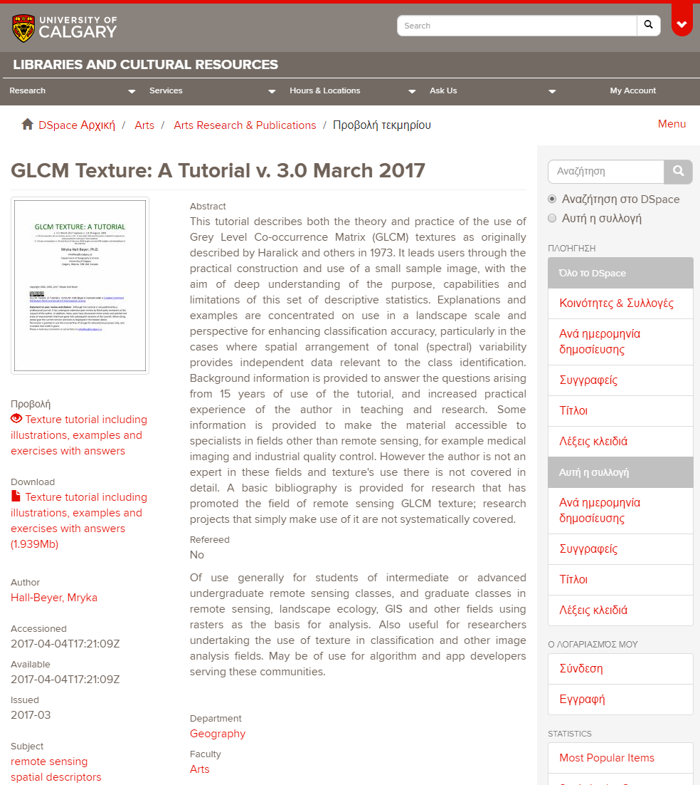
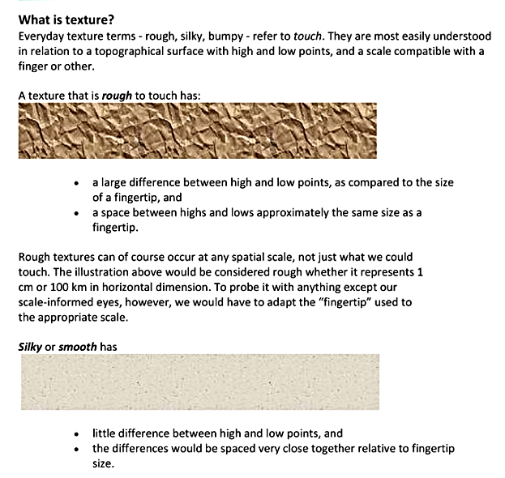
Texture Analysis tutorial
Why computer measures of tissue appearance are so important?

Slide 14
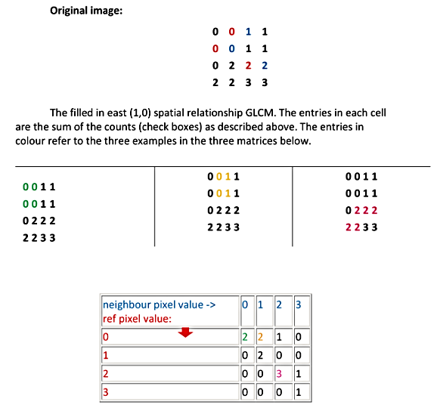
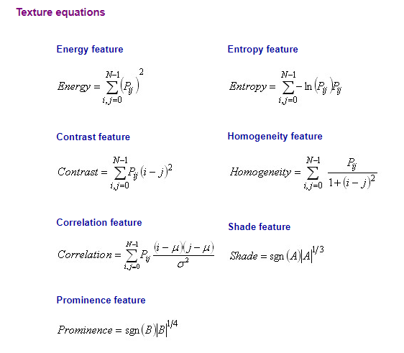
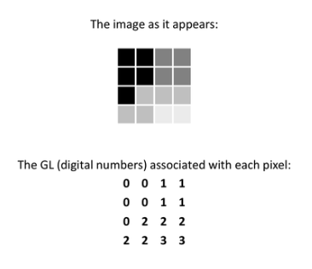
Gray-level Co-occurrence Matrix Texture
Why computer measures of tissue appearance are so important?
aka second order statistics
The computation of large number of texture features lead to the advancement of Radiomics approaches
https://prism.ucalgary.ca/handle/1880/51900

Slide 15
Texture analysis in practise
Why computer measures of tissue appearance are so important?
Texture information of lesion (heterogeneous vs homogeneous)
TEXTURE ANALYSIS?
Technique used in image processing to identify, characterize, and compare regions with distinct patterns
Measure and capture local image properties which are not necessarily based on intensity properties
spiculated focal

Slide 16
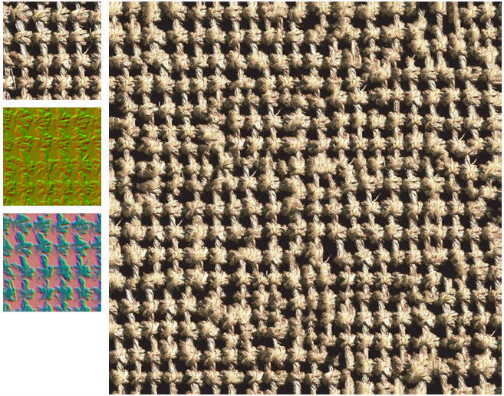
What to Measure in PET/SPECT/.. Images?
Why computer measures of tissue appearance are so important?
Texture information of lesion (heterogeneous vs homogeneous)
TEXTURE ANALYSIS?
Technique used in image processing to identify, characterize, and compare regions with distinct patterns
Measure and capture local image properties which are not necessarily based on intensity properties

Slide 17
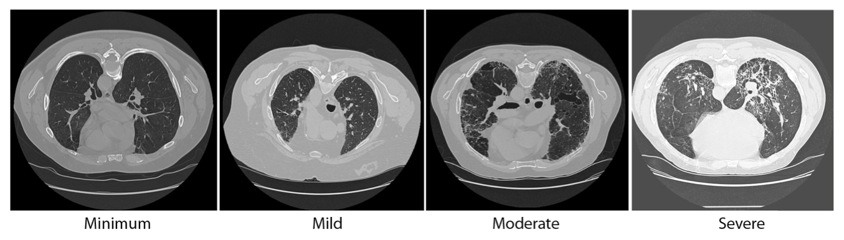
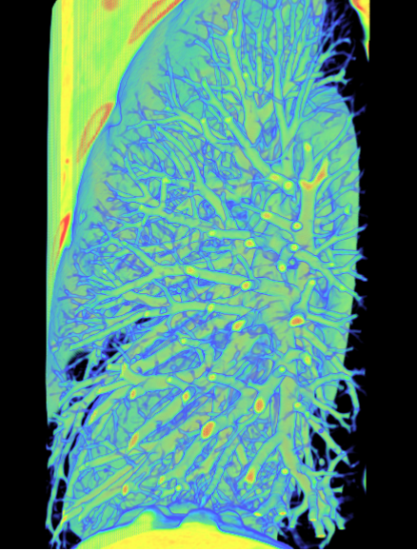
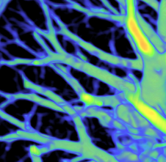
What to Measure in PET/SPECT/.. Images?
Why computer measures of tissue appearance are so important?
Texture information of lesion (heterogeneous vs homogeneous)
A spatial arrangement of a predefined number of voxels allowing the extraction of complex image properties.
Credit to:
Bagci EMBC 2011, RSNA 2011, 2012, ISBI 2012, PlosOne 2013.

Slide 18
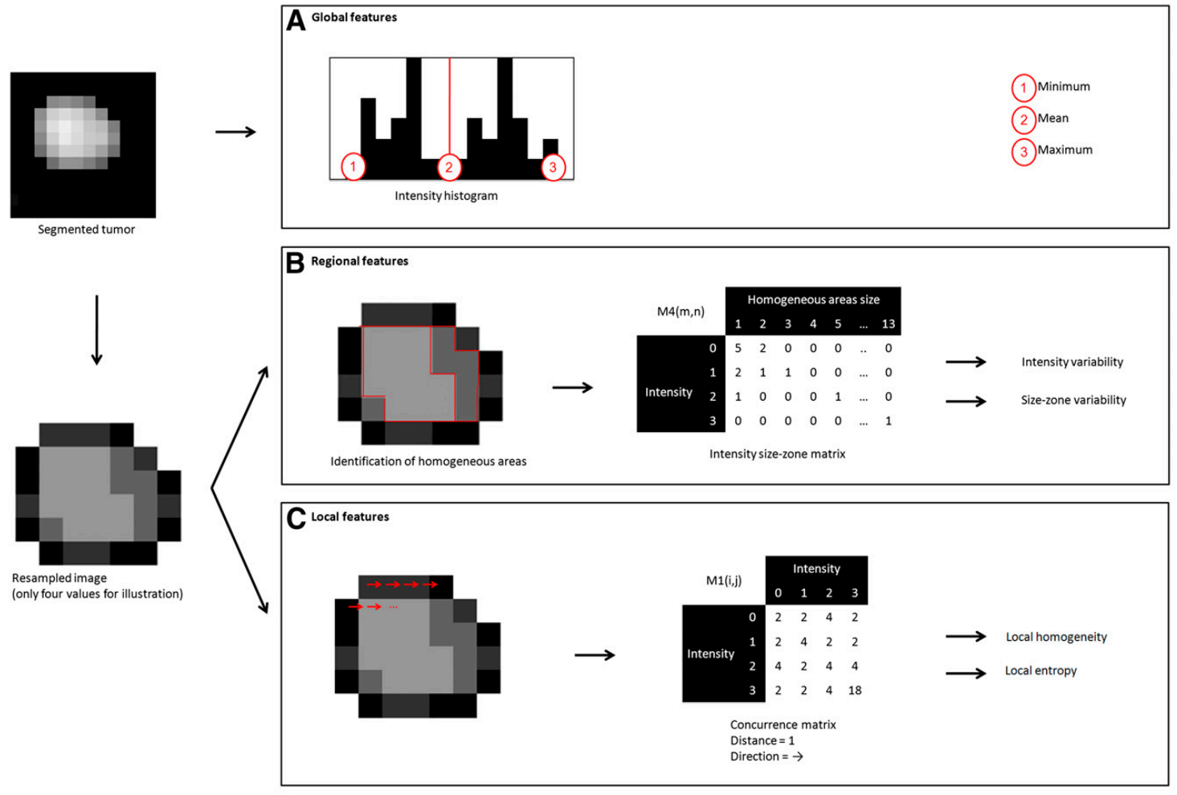
Example Texture Analysis Strategy
Why computer measures of tissue appearance are so important?
Credit to: M. Hatt, JNM

Slide 19
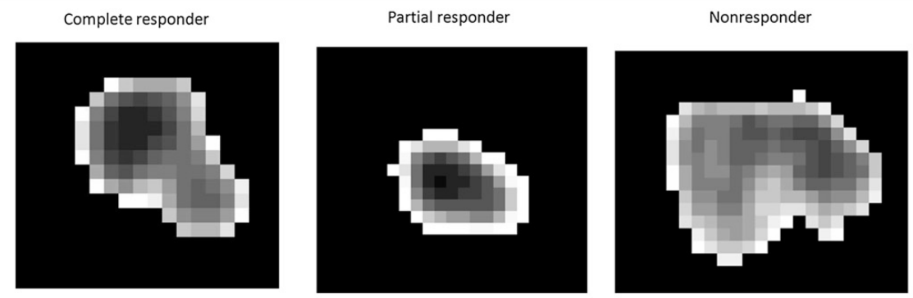
Why computer measures of tissue appearance are so important?
Example Texture Analysis in PET Images
Complete responder, non-responder, and
partial responder tumors ?

Slide 20
Why computer measures of tissue appearance are so important?
Example Texture Analysis in PET Images
11.7 11.0 9.6
8.2 7.3 5.3
11.7 11.0 9.6 8.2 7.3 5.3
Simple Histogram metrics can’t tell the whole story

Slide 21
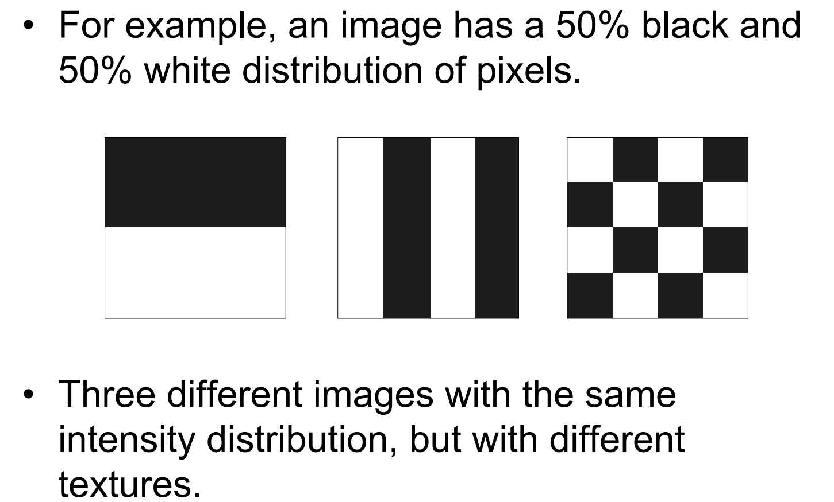
Simple Histogram can’t tell the whole story
Why computer measures of tissue appearance are so important?
Credit to: Michael A. Wurth from Purdue University

Slide 22
A technical view on texture analysis

Slide 23
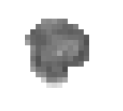
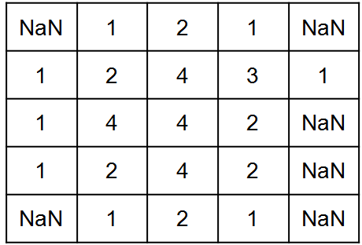

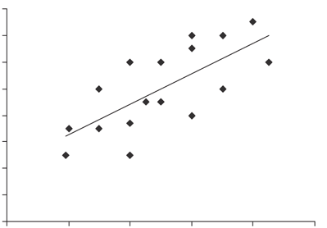
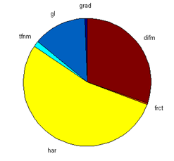
Workflow
A technical view on texture analysis
ROI
Texture Image
Statistical Measures
Vector
Linear Regression
Exploratory Statistical
Analysis

Slide 24
TA Example from PaC DW-MRI Dataset
A technical view on texture analysis
This material was developed within the context of Iosif Serafeimides thesis (supervised by K. Marias and N. Papanikolaou).
The aim was to investigate the use of TA for discriminating between benign and malignant masses on a dataset of pancreatic MRIs.

Slide 25







TA Example from PaC DW-MRI Dataset
A technical view on texture analysis
D
fD
I
IVIM
D*
fD*
f
From each MRI slice we get two ROIs. One of tumorous tissue and one of normal appearing tissue.
From each ROI we calculate through the IVIM method 3 expressions D, D* and f.
From these expresions we clalculate 2 products fD and fD*.
We have the 2 ROIs expressed in 6 different ways for a total of 12 expressions.

Slide 26
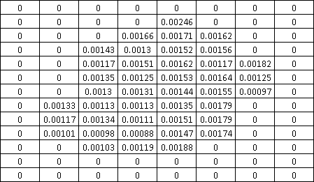
DW-MRI Dataset
A technical view on texture analysis
Each DW-MRI map is a compination of multiple slices representing a 3D volume.

Slide 27
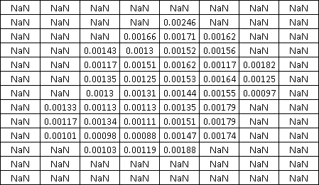
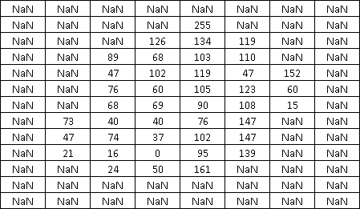
Conversion of MRI Slice to Gray Scale Image
A technical view on texture analysis
Rescale range of values to
{0-255}

Slide 28
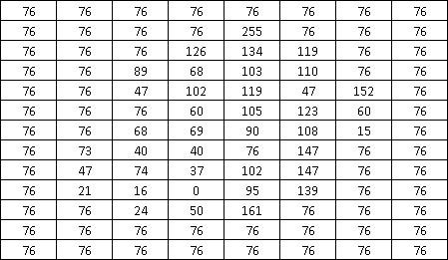
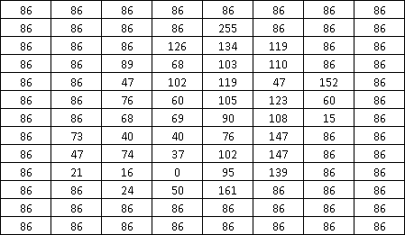
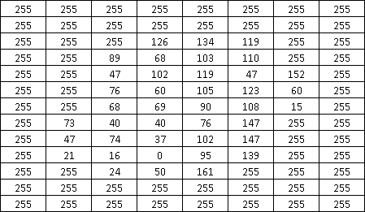
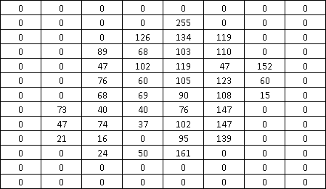
Different non-ROI pixels values.
A technical view on texture analysis
Median Value
of ROI
NAN values are replaced by the median value.
Non-ROI pixels might affect the outcome of a TA method.
NAN values are replaced by the mean value.
Mean Value
of ROI
Maximum Value
of ROI
Minimum Value
of ROI
[2015 Vignati A. Et al.]
NAN values are replaced by the maximum value.
NAN values are replaced by the minimum value.

Slide 29
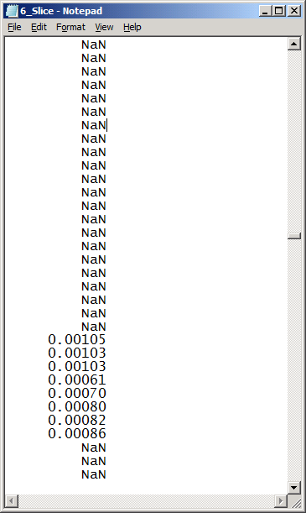
From Raw Data to Texture Image
A technical view on texture analysis
The sample on the left converted to a grayscale texture with range 0-255.
Sample of DW-MRI file.

Slide 30
Texture Feature Maps
A technical view on texture analysis
Written custom code in Matlab to implement texture analysis (TA) methods:
  Haralick [1973 Haralick Robert M., Shanmugam K., Dinstein]
  Gray Level Difference Method [2014 Duda Dorota]
  Gradient Matrix [1993 Lerski, R. A. et al.]
  Texture Feature Coding Method [2002 Horng Ming-Huwi et al.]
  Fractal Dimension [1984 Pentland Alex P]
  Gray Level Statistics (from original MRI Values)
Compared to what?

Slide 31
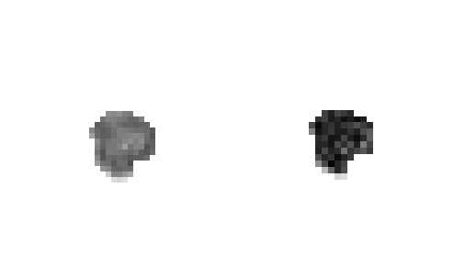

From ROI to Texture Image.
A technical view on texture analysis
(3x3 Block)
Aply TA Method
(Value: 53)
Extract Block
Remap ROI

Slide 32
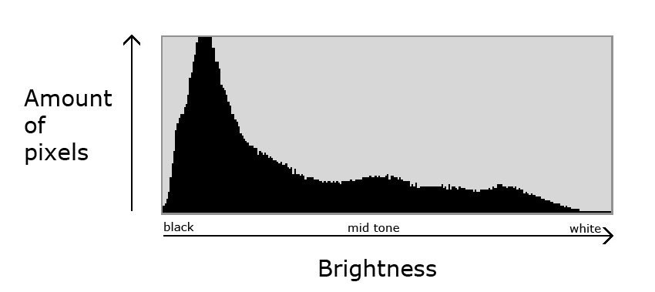
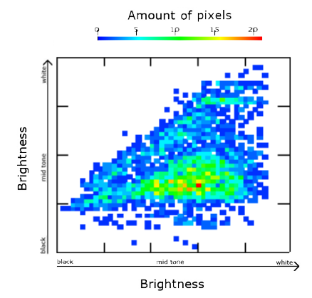
Method 1: Haralick features and feature maps.
A technical view on texture analysis
Gray Level Histogram
Gray Level Coocurence Matrix (GLCM)

Slide 33
Method 1: Gray Level Co-occurrence Matrix (GLCM) of a Region of Interest (ROI).
A technical view on texture analysis
Intensities | Intensities
 |  | 1 | 2 | 3 | 4
 | 1 | (1,1) | (2,1) | (3,1) | (4,1)
 | 2 | (1,2) | (2,2) | (3,2) | (4,2)
 | 3 | (1,3) | (2,3) | (3,3) | (4,3)
 | 4 | (1,4) | (2,4) | (3,4) | (4,4)
NaN | 1 | 2 | 1 | NaN
1 | 2 | 4 | 3 | 1
1 | 4 | 4 | 2 | NaN
1 | 2 | 4 | 2 | NaN
NaN | 1 | 2 | 1 | NaN
Gray levels
intensity range:
{1-4}
Intensities | Intensities
 |  | 1 | 2 | 3 | 4
 | 1 | (1,1) | (2,1) | (3,1) | (4,1)
 | 2 | (1,2) | (2,2) | (3,2) | (4,2)
 | 3 | (1,3) | (2,3) | (3,3) | (4,3)
 | 4 | (1,4) | (2,4) | (3,4) | (4,4)

Slide 34
Method 1: Gray Level Co-occurrence Matrix (GLCM) of a Region of Interest (ROI).
A technical view on texture analysis
Intensities | Intensities
 |  | 1 | 2 | 3 | 4
 | 1 | (1,1) | (2,1) | (3,1) | (4,1)
 | 2 | (1,2) | (2,2) | (3,2) | (4,2)
 | 3 | (1,3) | (2,3) | (3,3) | (4,3)
 | 4 | (1,4) | (2,4) | (3,4) | (4,4)
NaN | 1 | 2 | 1 | NaN
1 | 2 | 4 | 3 | 1
1 | 4 | 4 | 2 | NaN
1 | 2 | 4 | 2 | NaN
NaN | 1 | 2 | 1 | NaN
Intensities | Intensities
 |  | 1 | 2 | 3 | 4
 | 1 | 1 | 6 | 1 | 1
 | 2 | 6 | 0 | 0 | 4
 | 3 | 1 | 0 | 0 | 1
 | 4 | 1 | 4 | 1 | 2
0
6
1
1
4
0
4
1
0
6
1
0
0
1
1
4
1
2
A | B | C
D | X | E
F | G | H
Steps to create the GLCM of the ROI with orientation Θ = 0⁰ or 180⁰, and distance d = 1.

Slide 35
Method 1: Gray Level Co-occurrence Matrix (GLCM) of a Region of Interest (ROI).
A technical view on texture analysis
NaN | 1 | 2 | 1 | NaN
1 | 2 | 4 | 3 | 1
1 | 4 | 4 | 2 | NaN
1 | 2 | 4 | 2 | NaN
NaN | 1 | 2 | 1 | NaN
Intensities | Intensities
 |  | 1 | 2 | 3 | 4
 | 1 | 4 | 1 | 0 | 3
 | 2 | 1 | 2 | 1 | 3
 | 3 | 0 | 1 | 0 | 0
 | 4 | 3 | 3 | 0 | 2
A | B | C
D | X | E
F | G | H
Steps to create the GLCM of the ROI with orientation Θ = 45⁰, and distance d = 1.

Slide 36
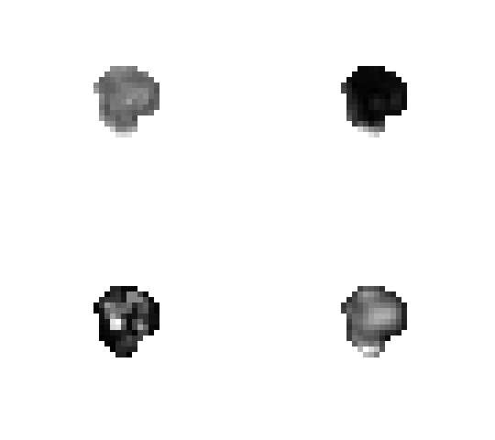
Method 1: Haralick feature maps examples.
A technical view on texture analysis
Original ROI of an MRI slice of a pancreas carcinoma.
Map of the ROI constructed from the mean of contrast feature maps.
Map of the ROI constructed from the mean of homogeneity feature maps.
Map of the ROI constructed from the mean of sum average feature maps.

Slide 37
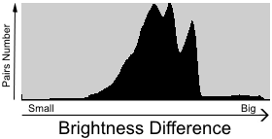
Method 2: GLDM features and feature maps.
A technical view on texture analysis
-
Gray Level Histogram
Gray Level Difference Matrix (GLDM)

Slide 38
A technical view on texture analysis
Method 2: Gray Level Difference Method (GLDM) of a Region of Interest.
NaN | 1 | 2 | 1 | NaN
1 | 2 | 4 | 3 | 1
1 | 4 | 4 | 2 | NaN
1 | 2 | 4 | 2 | NaN
NaN | 1 | 2 | 1 | NaN
Gray levels
intensity range:
{1-4}
Intensity differences | 0 | 1 | 2 | 3
frequencies

Slide 39
A technical view on texture analysis
Method 2: GLDM of a Region of Interest.
NaN | 1 | 2 | 1 | NaN
1 | 2 | 4 | 3 | 1
1 | 4 | 4 | 2 | NaN
1 | 2 | 4 | 2 | NaN
NaN | 1 | 2 | 1 | NaN
Intensity differences | 0 | 1 | 2 | 3
frequencies
1
7
5
1
A | B | C
D | X | E
F | G | H
Steps to create the GLDM of the ROI with orientation Θ = 0⁰, and distance d = 1.

Slide 40
A technical view on texture analysis
Method 2: GLDM of a Region of Interest.
NaN | 1 | 2 | 1 | NaN
1 | 2 | 4 | 3 | 1
1 | 4 | 4 | 2 | NaN
1 | 2 | 4 | 2 | NaN
NaN | 1 | 2 | 1 | NaN
Intensity differences | 0 | 1 | 2 | 3
frequencies | 4 | 3 | 2 | 3
A | B | C
D | X | E
F | G | H
GLDM of the ROI with orientation Θ = 45⁰, and distance d = 1.

Slide 41
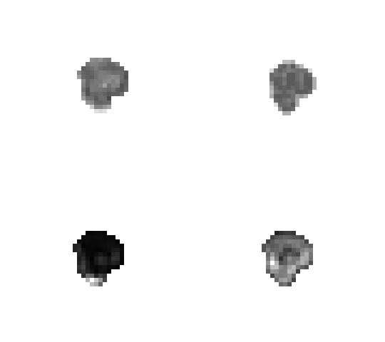
Method 2: GLDM feature maps examples.
A technical view on texture analysis
Original ROI of an MRI slice of a pancreas carcinoma.
Map of the ROI constructed from the mean of energy feature maps.
Map of the ROI constructed from the mean of inertia feature maps.
Map of the ROI constructed from the mean of mean feature maps.

Slide 42


Method 3: Gradient Matrix (GM) of a Region of Interest.
A technical view on texture analysis
A | B | C | D | E
F | G | H | I | J
K | L | M | N | O
P | Q | R | S | T
U | V | W | X | Y
A | B | C
D | E | F
G | H | I
$$Grad= \sqrt{{\left(W−C\right)}^{2}+{\left(O−K\right)}^{2}}$$
$$Grad= \sqrt{{\left(H−B\right)}^{2}+{\left(F−D\right)}^{2}}$$

Slide 43
Method 3: Gradient Matrix of a ROI with 4 gray levels (1-4).
A technical view on texture analysis
NaN | 1 | 2 | 1 | NaN
1 | 2 | 4 | 3 | 1
1 | 4 | 4 | 2 | NaN
1 | 2 | 4 | 2 | NaN
NaN | 1 | 2 | 1 | NaN
NaN
NaN
NaN
NaN
NaN
NaN
4.24
2.23
3.16
NaN
NaN
3
2
NaN
NaN
NaN
4.24
2
NaN
NaN
NaN
NaN
NaN
NaN
NaN
The ROI on the left is remapped to the matrix on the right using a 3x3 window.

Slide 44

Method 3: Gradient Matrix feature maps examples.
A technical view on texture analysis
Original ROI of an MRI slice of a pancreas carcinoma.
Map of the ROI constructed from the Gradient values.

Slide 45
Method 4: Texture Feature Coding Method (TFCM) of a Region of Interest.
A technical view on texture analysis
F₁: | D | X | E
A | B | C
D | X | E
F | G | H
F₂: | B | X | G
S₁: | A | X | H
S₂: | F | X | C

Slide 46
Method 4: Texture Feature Coding Method (TFCM) of a Region of Interest.
A technical view on texture analysis
F₁: | 4 | 4 | 2
F₁: | D | X | E
2 | 4 | 3
4 | 4 | 2
2 | 4 | 2
A | B | C
D | X | E
F | G | H
F₂: | 4 | 4 | 4
F₂: | B | X | G
S₁: | 2 | 4 | 2
S₁: | A | X | H
S₂: | 2 | 4 | 3
S₂: | F | X | C

Slide 47
Method 4: Texture Feature Coding Method (TFCM) of a Region of Interest.
A technical view on texture analysis
(A₁
B₁)/(A₂
B₂)
F₁: | 4 | 4 | 2
4=4
4>2
(2)
(1)
(2)
(3)
(4)
2 | 4 | 3
4 | 4 | 2
2 | 4 | 2
F₂: | 4 | 4 | 4
4=4
4=4
(1)
S₁: | 2 | 4 | 2
2<4
4>2
(4)
S₂: | 2 | 4 | 3
2<4
4>3
(4)
F₁ = 2
F₂ = 1
S₁ = 4
S₂ = 4
Graphical representation of all the possible gray-level variations.
A=B
A<B
A>B

Slide 48
Method 4: Texture Feature Coding Method of a Region of Interest.
A technical view on texture analysis
 | F₁/S₁
F₂/S₂ |  | (1) | (2) | (3) | (4)
 | (1) | 1 | 2 | 3 | 4
 | (2) | 2 | 5 | 6 | 7
 | (3) | 3 | 6 | 8 | 9
 | (4) | 4 | 7 | 9 | 10
F₁ = 2
F₂ = 1
S₁ = 4
S₂ = 4
F = 2
S = 10
  F x S = 2 x 10 = 20

Slide 49
Method 4: Texture Feature Coding Method of a Region of Interest.
A technical view on texture analysis
Texture Feature Number (TFN)
2 | 4 | 3
4 | 4 | 2
2 | 4 | 2
  TFN = 20

Slide 50
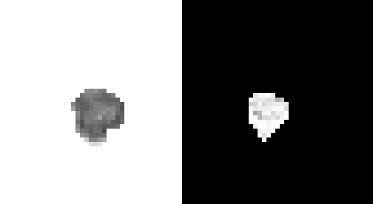
Method 4: TFCM feature maps examples.
A technical view on texture analysis
Map of the ROI constructed from the TFN values.
Original ROI of an MRI slice of a pancreas carcinoma.

Slide 51

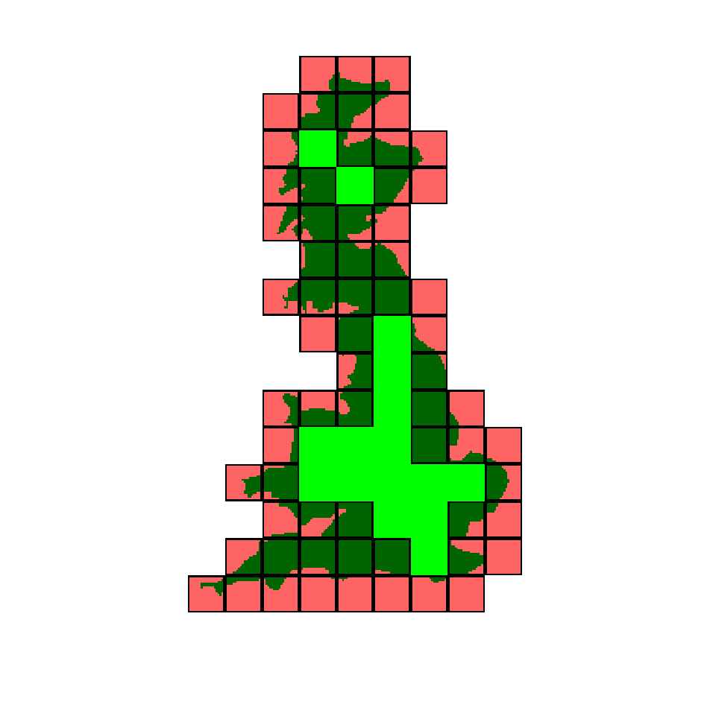
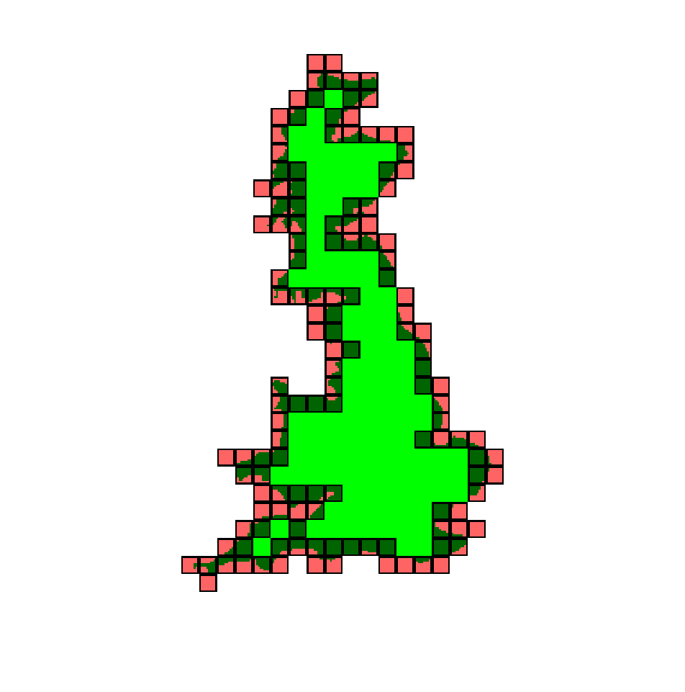
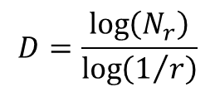
Method 5: Fractal Dimension (Box Counting Method).
A technical view on texture analysis
To calculate the FD of a line using the Box Counting Method, we count how many squares of a given size are required to cover the line.
The FD is calculated by the rate of the number of boxes needed to cover the line over the size of the boxes.
$$D=\frac{\log\left(N_{r}\right)}{\log\left(1/r\right)}$$

Slide 52
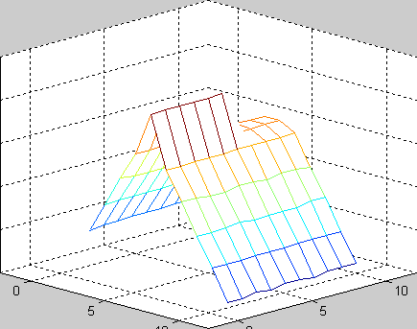
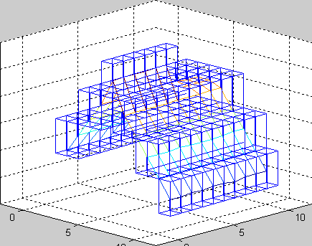
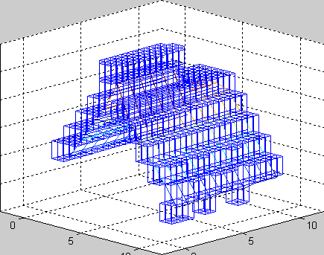
Method 5: Fractal Dimension.
A technical view on texture analysis

Slide 53

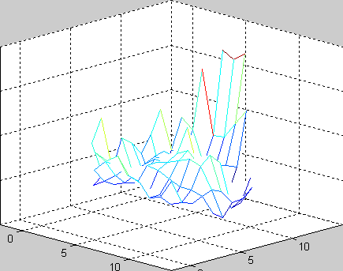
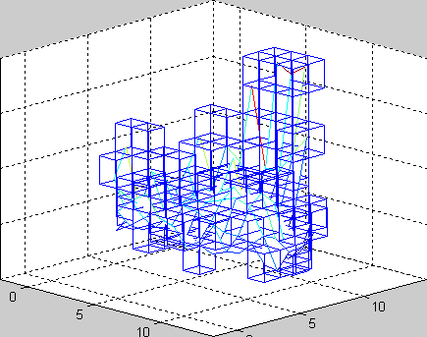
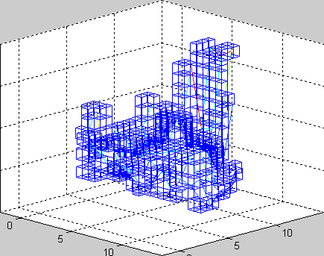
Method 5: Fractal Dimension.
A technical view on texture analysis

Slide 54
From simple texture features to high-throughput feature extraction-> Radiomics

Slide 55
Artificial Intelligence (AI) in imaging and diagnostics
From simple texture features to high-throughput feature extraction-> Radiomics
P-MED and AI
One-third of startups receiving first funding since 2015 are in AI imaging and diagnostics, which has seen investment from VCs including Data Collective, Khosla Ventures, and Google Ventures.
IBM researchers estimate that medical images currently account for at least 90 percent of all medical data, making it the largest data source in the healthcare industry.
Deep Learning applications are matching the performance of experts in melanoma detection, tumor segmentation and therapy outcome prediction, diabetic retinopathy etc.
Bradley Erickson from the Mayo Clinic in Rochester, Minnesota, believes that computers will be contributing significantly to automatic diagnostic imaging in the next 15 to 20 years.
https://www.cbinsights.com/research/artificial-intelligence-healthcare-new-startups/
https://www.healthcare-informatics.com/news-item/analytics/ibm-unveils-watson-powered-imaging-solutions-rsna
https://www.techemergence.com/deep-learning-applications-in-medical-imaging/
http://www.auntminnie.com/index.aspx?sec=ser&sub=def&pag=dis&ItemID=114910

Slide 56

Radiology and Personalised Medicine
From simple texture features to high-throughput feature extraction-> Radiomics
However, the ESR, as the organised representation of radiological disciplines in Europe, is of the opinion that, from a scientific and medical perspective, it is absolutely essential that medical imaging be recognised alongside -omics technologies as an integral part in the development of personalised medicine.
Imaging’s contributions – detection and staging of disease, guiding tissue sampling for molecular profiling, imaging biomarkers in patient profiling for preventive and predictive medicine, assessment and prediction of response to treatment – are vital necessities for the very concept of personalised medicine.

Slide 57
Radiology and Personalised Medicine
From simple texture features to high-throughput feature extraction-> Radiomics
The SWD does not mention the promising field of radiogenomics, which the ESR considers to have enormous potential for the development of personalised medicine. It should therefore be an indispensable part of any document on this subject. As a rapidly growing discipline that correlates radiological information with genomic data, it links imaging with -omics technologies and is therefore a particularly relevant field for personalised medicine.
The ESR considers it very important that research in the field of radiogenomics is strengthened, which is why it is deemed necessary that the European Commission recognise this in the report and take it into consideration in the development of research agendas and regulatory frameworks.

Slide 58
The role of medical imaging in precision medicine
From simple texture features to high-throughput feature extraction-> Radiomics
Traditional Medical Image Analysis worked for decades with human-defined features usually inspired from low-level image properties such as intensity/contrast/image texture.
Although so far such methods were successfully used e.g. in cancer subclassification, it is hard to use them to derive high-level features representative of the complex patterns that an expert Radiologist uses to define the presence or absence of a lung cancer.
That said, in some cases these high level features are amenable to mathematical definition or can be constructed by combining a number of low-level features such as shape and texture metrics.
Precision Radiology: Predicting longevity using feature engineering and deep learning methods in a radiomics framework, Scientific Reports volume 7, Article number: 1648 (2017)

Slide 59
The role of medical imaging in precision medicine
From simple texture features to high-throughput feature extraction-> Radiomics
This is a central concept in Radiomics: In analogy to genomics where only the advent of whole genome association scans and next generation sequencing used in a hypothesis free paradigm has enabled the discovery of thousands of novel genetic variants robustly associated with chronic diseases, Radiomics deploy high-throughput imaging feature extraction in an effort to analyze all of the available variation in an image and correlate it with pathophysiology.
Deep learning offers an alternative approach to computational medical imaging by learning complex, high-level features directly from large number of medical images which contain variable instances of a particular pathology.
Precision Radiology: Predicting longevity using feature engineering and deep learning methods in a radiomics framework, Scientific Reports volume 7, Article number: 1648 (2017)

Slide 60
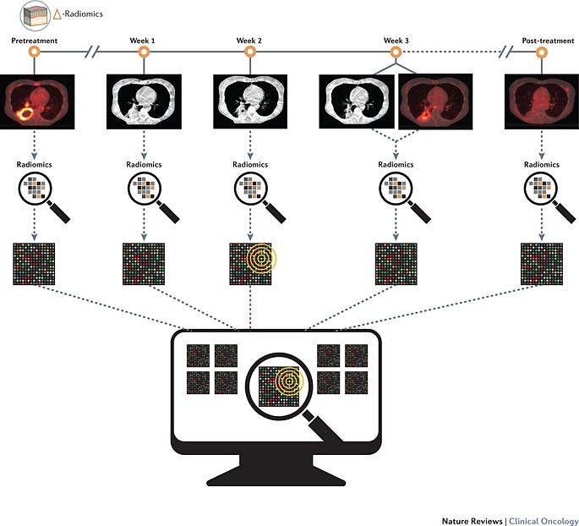
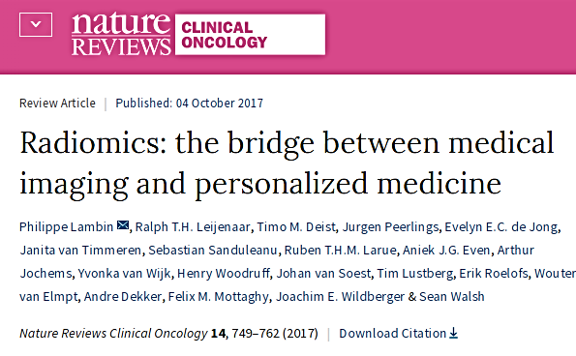
Radiomics
From simple texture features to high-throughput feature extraction-> Radiomics
The term radiomics refer to the high-throughput feature extraction from medical images using advanced multi-resolution image processing feature extraction techniques.
This offers massive opportunities for discovering more correlations with pathophysiology.

Slide 61
Radiogenomics
From simple texture features to high-throughput feature extraction-> Radiomics
The term radiogenomics refer to the correlation between cancer imaging features and gene expression (Imaging Genomics).
Human body is a system of systems therefore it is reasonable to assume that imaging phenotype reflects pathophysiology changes from several levels.
Deep learning Radiogenomics aim to reveal more complex relationships between genetic/molecular characteristics and imaging phenotype which are literally invisible to the human eye.

Slide 62
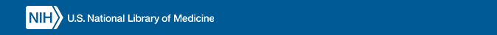
The role of medical imaging in precision medicine
From simple texture features to high-throughput feature extraction-> Radiomics
Medical images are routinely collected and contain rich diagnostic and prognostic information.
A variety of human and machine detectable changes have been shown to quantify clinical and preclinical disease states while Imaging biomarkers can be correlated to both macroscopic tissue properties as well as finer ones such as texture and heterogeneity.
Machine and Deep Learning in medical image analysis have demonstrated computational paradigms where imaging biomarkers can match the descriptive power of biopsy, microscopy and even DNA analysis for a number of pathologies.
Medical image analysis is therefore highly attractive for precision medicine phenotyping.
“to predict more accurately which treatment and prevention strategies for a particular disease will work in which groups of people.”
https://ghr.nlm.nih.gov/primer/precisionmedicine/definition

Slide 63
End of today’s lecture
Thank you for your attention!
Credits to Ulas Bagci and Michael A. Wurth from Purdue University http://www.cyto.purdue.edu/cdroms/micro2/content/education/wirth06.pdf

