Slide 1
Arithmetic Operations part A

Slide 2
ALU ->Arithmetic Logic Unit in Mips
Το ALU είναι ένα βασικό στοιχείο της CPU που είναι υπεύθυνη για την εκτέλεση αριθμητικών και λογικών πράξεων.
Στη MIPS assembly η ALU χειρίζεται ακέραιες λειτουργίες όπως:
Αριθμητικές Πράξεις (Arithmetic Operations): Πρόσθεση (Addition), αφαίρεση (subtraction), πολλαπλασιασμός (multiplication) και διαίρεση (division).
Λογικές πράξεις (Logical Operations): AND, OR, XOR, NOR.
Shift Operations: Shift left (sll), shift right (srl, sra).
Λειτουργίες σύγκρισης (Comparison Operations): Ρύθμιση σε λιγότερο από (slt, sltu) κ.α..

Slide 3
Α. Αριθμητικές Πράξεις (Arithmetic Operations)
1. Addition (add, addi)
add rd, rs, rt → rd = rs + rt (registers only)
addi rt, rs, immediate → rt = rs + immediate (register + constant)
Example: Add Two Numbers
add $t0, $t1, $t2 # $t0 = $t1 + $t2
addi $t3, $t1, 5 # $t3 = $t1 + 5

Slide 4
Another Example:
addi $t0, $zero, 10 # Load 10 into $t0
addi $t1, $zero, 20 # Load 20 into $t1
add $t2, $t0, $t1 # $t2 = $t0 + $t1 (10 + 20 = 30)
2. Subtraction (sub)
sub rd, rs, rt → rd = rs - rt
Example: Subtract Two Numbers
sub $t0, $t1, $t2 # $t0 = $t1 - $t2

Slide 5
3. Multiplication (mul, mult, multu)
mul rd, rs, rt → rd = rs × rt (pseudo-instruction)
mult rs, rt → Stores low result in LO, high result in HI
multu rs, rt → Unsigned multiplication # δε χρησιμοποιείται ευρέως στα πλαίσια του μαθήματος
Example: Multiply Two Numbers
mul $t0, $t1, $t2 # $t0 = $t1 × $t2
If using mult:
mult $t1, $t2 # Multiply $t1 × $t2
mflo $t0 # Move lower 32 bits of result to $t0
mfhi $t1 # Move upper 32 bits to $t1 (if needed)
t1 and t2 are the multiplicands (operands).
The 64-bit product is stored in HI and LO registers.
To use the result, you must move LO to a general-purpose register.

Slide 6
Example: Multiplying Two Numbers
.data
.text
.globl main
main:
li $t1, 5 # Load 5 into register $t1
li $t2, 7 # Load 7 into register $t2
mult $t1, $t2 # Multiply: $t1 * $t2
mflo $t3 # Move lower 32 bits to $t3
sw $t3, result # Store result in memory ! further details about sw instruction in lab3
li $v0, 10 # Exit
syscall

Slide 7
Step-by-Step Execution
$t1 = 5, $t2 = 7
mult $t1, $t2 → Computes 5 × 7 = 35
mflo $t3 → Moves 35 from LO into $t3
sw $t3, result → Stores 35 in memory.
✅ The result is stored in LO, since it fits within 32 bits.
When to Use mult vs. mul
✅ Use mult when:
You need full 64-bit precision.
You need to check overflow.
You are working with large numbers.
✅ Use mul when:
You only need low 32 bits.
You are working with small numbers (where overflow is not a concern

Slide 8
4. Division (div, divu)
div rs, rt → Stores quotient in LO, remainder in HI
divu rs, rt → Unsigned division # δε χρησιμοποιείται στα πλαίσια του μαθήματος
Example: Divide Two Numbers
div $t1, $t2 # $t1 / $t2
mflo $t0 # Move quotient to $t0
mfhi $t1 # Move remainder to $t1

Slide 9
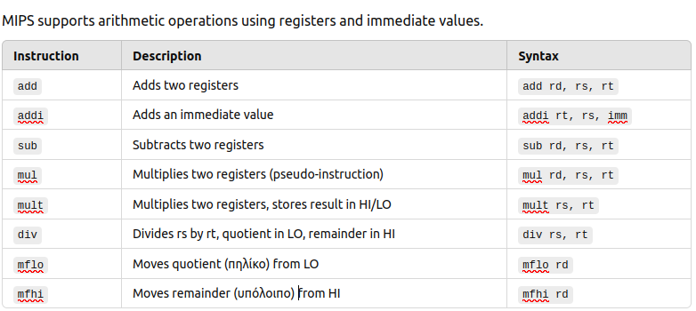

Slide 10
Basic Addition and Subtraction Program (α’ τρόπος)
.data
.text
.globl main
main:
li $t0, 10 # Load 10 into $t0
li $t1, 5 # Load 5 into $t1
add $t2, $t0, $t1 # $t2 = $t0 + $t1 (10 + 5 = 15)
li $v0, 1 # Print result syscall
move $a0, $t2
syscall
li $v0, 10 # Exit program
syscall
output sum: 15

Slide 11
(β’ τρόπος) αυτόν χρησιμοποιούμε πιο πολύ
.data
.text
.globl main
main:
addi $8,$0, 10 # Load 10 into $t0 (register $t10= register$8)
addi $9, $0,5 # Load 5 into $9
add $10, $8, $9 # $10 = $8 + $9 (10 + 5 = 15)
li $v0,1 # Print result syscall
move $a0, $10
syscall
li $v0, 10 # Exit program
syscall
output sum: 15

Slide 12
Multiplication and Division Exercise (α’ τρόπος)
.data
.text
.globl main
main:
li $t0, 12 # Load 12 into $t0
li $t1, 3 # Load 3 into $t1
mul $t2, $t0, $t1 # Multiply $t0 * $t1
li $v0, 1 # Print product result
move $a0, $t2
syscall
div $t0, $t1 # Divide $t0 by $t1
mflo $t3 # Get quotient (πηλίκο)
mfhi $t4
li $v0, 1 # Print quotient result
move $a0, $t3
syscall

Slide 13
li $v0, 1 # Print remainder (υπόλοιπο) result
move $a0, $t4
syscall
li $v0, 10 # Exit program
syscall
36 (product)
4 (Quotient)
0 (Remainder)

Slide 14
(β’ τρόπος) αυτόν χρησιμοποιούμε πιο πολύ
.data
.text
.globl main
main:
addi $8,$0, 12 # Load 12 into $8
addi $9, $0,3 # Load 3 into $9
mul $10, $8, $9 # Multiply $8 * $9
li $v0, 1 # Print product result
move $a0, $10
syscall
div $8, $9 # Divide $8 by $9
mflo $11 # Get quotient (πηλίκο)
mfhi $12
li $v0, 1 # Print quotient result
move $a0, $11
syscall

Slide 15
li $v0, 1 # Print remainder (υπόλοιπο) result
move $a0, $12
syscall
li $v0, 10 # Exit program
syscall
36 (product)
4 (Quotient)
0 (Remainder)
αν θέλετε να τυπώσετε τα αποτελέσματα σε διαφορετικές γραμμές πρέπει να βάλετε μετά τις εντολές Print
# Print newline
li $v0, 11
li $a0, 10
syscall
Βιβλιογραφία: MIPS Assembly Language using QtSpim Ed Jorgensen Version 1.0 January 2013

