Slide 1
  Swarm Intelligence
  By
  Nasser M.

Slide 2
Outline
Swarm Intelligence
Metahuristics
Particle Swarm Optimization (PSO)
Ant Colony Optimization (ACO)
Case Study: Data Clustering Using PSO
Conclusion

Slide 3
Swarm Intelligence
“The emergent collective intelligence of groups of simple agents.”
(Bonabeau et al, 1999)

Slide 4
Characteristics of Swarms
Composed of many individuals
Individuals are homogeneous
Local interaction based on simple rules
Self-organization ( No centralized Control)

Slide 5
Swarm Intelligence Algorithms
Particle Swarm Optimization (PSO)
Ant Colony Optimization
Artificial Bee Colony Algorithm
Artificial Immune Systems Algorithm

Slide 6
Search Techniques
Deterministic Search Techniques
  Branch and Bound
  Steepest Descent
  Newton-Raphson
  Simplex based Technique
Stochastic or Random Search Techniques
  Swarm Intelligence
  Genetic Algorithm
  Differential Evolution
  Simulated Annealing

Slide 7
Components of Search Techniques
Initial solution
Search direction
Update criteria
Stopping criteria
All above elements can be either
  Deterministic or Stochastic
  Single points or population based

Slide 8
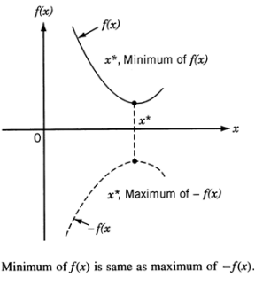
Heuristics
Heuristic (or approximate) algorithms aim to find a good solution to a problem in a reasonable amount of computation time – but with no guarantee of “goodness” or “efficiency” (cf. exact or complete algorithms).
Heuristic is used to solve NP-Complete Problem , a class of decision problem.
Every decision problem has equivalent optimization problem

Slide 9
Metaheuristics
Metaheuristics are (roughly) high-level strategies that combining lower-level techniques for exploration and exploitation of the search space.
Metaheristcs refers to algorithms including
  -Evolutionary Algorithms
  Swarm Intelligence , Genetic Algorithm , Differential Evolution , Evolutionary programing
  - Simulated Annealing
  - Tabu Search,

Slide 10
Fundamental Properties of Metaheuristics
Metaheuristics are strategies that “guide” the search process.
The goal is to efficiently explore the search space in order to find (near-)optimal solutions.
Metaheuristic algorithms are approximate and usually non-deterministic.
Metaheuristics are not problem-specific.

Slide 11
Outline
Swarm Intelligence
Metahuristics
Particle Swarm Optimization (PSO)
Ant Colony Optimization (ACO)
Case Study: Data Clustering Using PSO
Conclusion

Slide 12

Particle Swarm Optimization
Source https://encrypted-tbn0.gstatic.com/images?q=tbn:ANd9GcSKhLOQonxCPbIKl6GE0UWhaJJByuKpYFtWDUovH1Ss0HUaaWcq

Slide 13
Particle Swarm Optimization (PSO)
PSO is stochastic optimization technique proposed by Kennedy and Eberhart ( 1995) [2].
A population based search method with position of
particle is representing solution and Swarm of
particles as searching agent.
PSO is a robust evolutionary optimization technique
based on the movement and intelligence of swarms.
PSO find the minimum value for the function.

Slide 14
Particle Swarm Optimization (PSO)
The idea is similar to bird flocks searching for food.
  Bird = a particle, Food = a solution
  pbest = the best solution (fitness) a particle has achieved so far.
  gbest = the global best solution of all particles within the swarm

Slide 15
PSO Search Scheme
- pbest : the best solution achieved so far by that particle.
- gbest : the best value obtained so far by any particle in the
neighborhood of that particle.
The basic concept of PSO lies in accelerating each
particle toward its pbest and the gbest locations, with a
random weighted acceleration at each time.

Slide 16
PSO Search Scheme
- PSO uses a number of agents, i.e., particles, that constitute a swarm flying in the search space looking for the best solution.
- Each particle is treated as a point (candidate solution) in a N-dimensional space which adjusts its “flying” according to its own flying experience as well as the flying experience of other particles.

Slide 17
Global best
New Velocity
Position X
Personal best

Slide 18
Particle Swarm Optimization (PSO)
Each particle tries to modify its position X using the following formula:
X (t+1) = X(t) + V(t+1) (1)
V(t+1) = wV(t) +
c₁ ×rand ( ) × ( X_{pbest} - X(t)) + c₂ ×rand ( ) × ( X_{gbest} - X(t)) (2)
V(t) | velocity of the particle at time t
X(t) | Particle position at time t
w | Inertia weight
c₁ , c₂ | learning factor or accelerating factor
rand | uniformly distributed random number between 0 and 1
X_{pbest} | particle’s best position
X_{gbest} | global best position

Slide 19
Alpine function
Particle fly and search for the highest peak in the search space
Notes:
This function is interesting for it has as many optima as we want, just by changing its definition area, and for we can easily compute exactly these optima.
I hope you do recognize the French Mont-Blanc and the Côte d'Azur ...

Slide 20
PSO Algorithm
The PSO algorithm pseudocode [2] as following:
Input: Randomly initialized position and velocity of Particles:
Xi (0) andVi (0)
Output: Position of the approximate global minimum X*
1: while terminating condition is not reached do
2: for i = 1 to number of particles do
3: Calculate the fitness function f
4: Update personal best and global best of each particle
5: Update velocity of the particle using Equation 2
6: Update the position of the particle using equation 1
7: end for
8: end while

Slide 21
Outline
Swarm Intelligence
Metahuristics
Particle Swarm Optimization (PSO)
Ant Colony Optimization (ACO)
Case Study: Data Clustering Using PSO
Conclusion

Slide 22
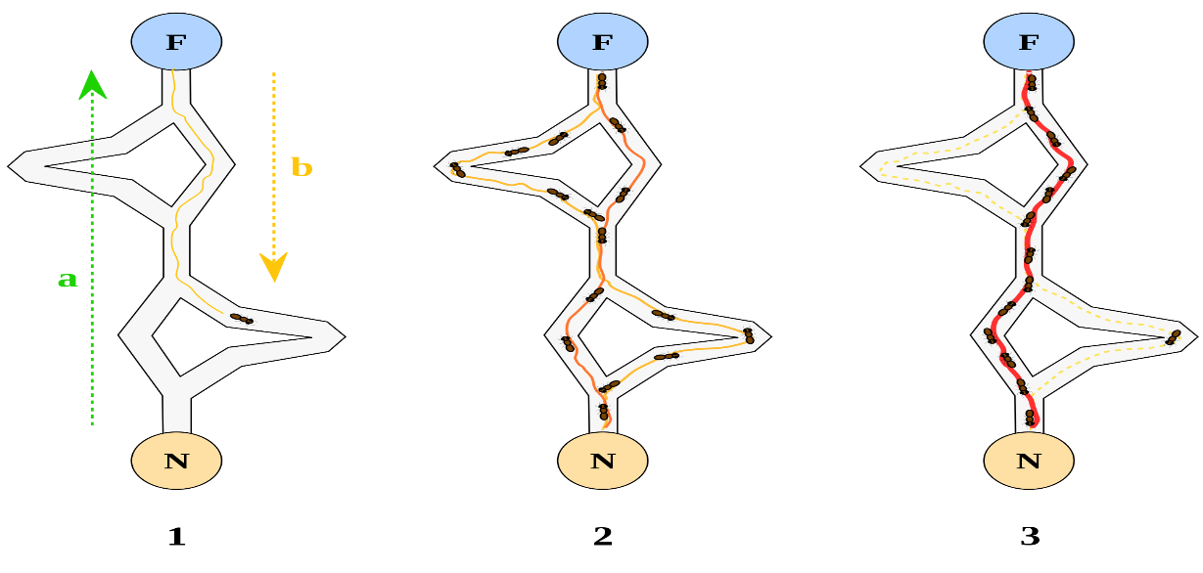

Ant Colony Optimization
“Ant Colony Optimization (ACO) studies artificial systems that take inspiration from the behavior of real ant colonies and which are used to solve discrete optimization problems.” ACO Website [1]
Source: http://upload.wikimedia.org/wikipedia/commons/thumb/a/af/Aco_branches.svg/2000px-Aco_branches.svg.png
Notes:
Was first introduced in Marco Dorigo’s Ph.D. thesis.
As we have seen, the TSP provides an excellent test environment…
In problems like the quadratic assignment problem and the sequential ordering problem these ACO algorithms outperform all known algorithms on vast classes of benchmark problems.

Slide 23
Ant Colony Optimization
Probalistic Techniques to solve optimization Problem
It is a population based metaheuristic used to find approximate solution to an optimization problem.
The Optimization Problem must be written in the form of path finding with a weighted graph
Application of ACO
Shortest paths and routing
Assignment problem
Set Problem

Slide 24
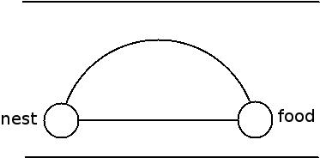
Idea
The way ants find their food in shortest path is interesting.
Ants hide pheromones to remember their path.
These pheromones evaporate with time.
Whenever an ant finds food , it marks its return journey with pheromones.
Pheromones evaporate faster on longer paths.

Slide 25
Idea (cont.)
Shorter paths serve as the way to food for most of the other ants.
The shorter path will be reinforced by the pheromones further.
Finally , the ants arrive at the shortest path.

Slide 26
ACO Concept
Ants navigate from nest to food source. Ants are blind!
Shortest path is discovered via pheromone trails. Each ant moves at random
Pheromone is deposited on path
More pheromone on path increases probability of path being followed

Slide 27

Ant Colony Optimization
Source: http://upload.wikimedia.org/wikipedia/commons/thumb/a/af/Aco_branches.svg/2000px-Aco_branches.svg.png

Slide 28
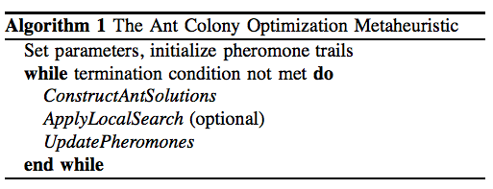
Ant Colony Algorithm
ConstructAntSolutions: Partial solution extended by adding an edge based on stochastic and pheromone considerations.
ApplyLocalSearch: problem-specific, used in state-of-art ACO algorithms.
UpdatePheromones: increase pheromone of good solutions, decrease that of bad solutions (pheromone evaporation).

Slide 29
Outline
Swarm Intelligence
Metahuristics
Particle Swarm Optimization (PSO)
Ant Colony Optimization (ACO)
Case Study: Data Clustering Using PSO
Conclusion

Slide 30
Clustering
Clustering : partitioning of a data set into subsets - clusters, so that the data in each subset share some common features
often based on some similarity.
Clustering is NP-hard problem
- No optimal solution in polynomial time
- We need heuristic efficient algorithm ( approximation solution )
- can be formulated as optimization problem

Slide 31
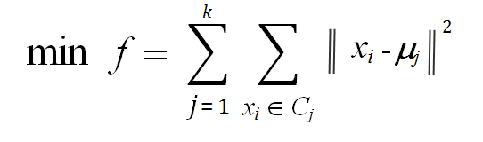
Partitioning Clustering
The partitioning techniques usually produce clusters by optimizing a criterion function
In partitioning clustering ,the squared error criterion is minimized, which tends to work well with isolated and compact clusters [3].
Where x_{i} data pattern belong to cluster i and μ_{j} is the center of cluster j
and k is number of clusters

Slide 32
Continue
Partitioning clustering algorithms such as Kmeans , Kmodes are relatively efficient but have several drawbacks.
drawbacks
  Often terminate at local minimum
  Generate empty clusters
  Unable to handle noisy data and outliers
  Solution : Clustering using PSO algorithm
Idea: Using PSO algorithm to minimize the objective function of clustering (squared error criterion )

Slide 33
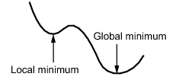
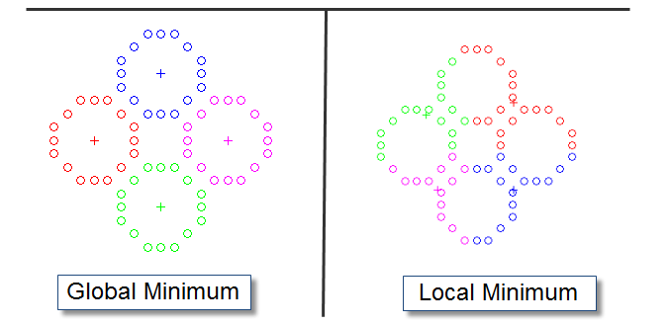
Continue
Why PSO based clustering
Terminate at global optimum
High quality than tradition methods such as Kmeans
Not sensitive for noisy and outlier data
Avoid problem of generating empty clusters

Slide 34
PSO Algorithm
The PSO algorithm peudocode [2] as following:
Input: Randomly initialized position and velocity of Particles:
Xi (0) andVi (0)
Output: Position of the approximate global minimum X*
1: while terminating condition is not reached do
2: for i = 1 to number of particles do
3: Calculate the fitness function f
4: Update personal best and global best of each particle
5: Update velocity of the particle using Equation 2
6: Update the position of the particle using equation 1
7: end for
8: end while

Slide 35
Data Clustering Formulation
The aim is to partition unlabeled data to k disjoint classes
by optimizing a criterion function ( square error function )
This is achieved by optimizing the following objective
Where x_{i} Where data pattern belong to cluster i
μ_{j} is the center of cluster j and k is number of clusters
Result in
  high intra-class similarity: maximize distances between clusters
  low inter-class similarity: minimize distances within clusters

Slide 36
PSO Clustering Algorithm
Each particle maintains a vector Vi = (C₁ , C₂ , …, C_{i} , ..,
C_{k} ), where C_{i} represents the ith cluster centroid vector
and k is the number of clusters.
The particle adjusts the centroid vector’ position in the
vector space at each generation ( iteration )
X (t+1) = X(t) + V(t+1)
For example : suppose the k= 4 , and the particle i
maintain vector Vi ={(1,2), (3,5) ,(7,4) ,(8,2) } at t =1
at t = 2 , particle i update its vector
Vi ={(5,2), (9,4) ,(7,3) ,(6,5) }

Slide 37
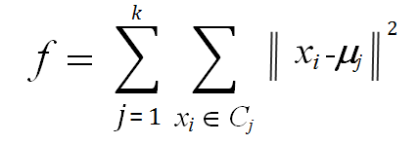
PSO Clustering Algorithm
The PSO Clustering Algorithm [4] pseudocode as follow:
Initialize each particle with K random cluster centers.
for iteration count = 1 to maximum iterations do
for all particle i do
for all pattern Xp in the dataset do
calculate Euclidean distance of Xp with all cluster center
assign Xp to the cluster that have nearest center to Xp
end for
calculate the fitness function f.
end for
Find the personal best and global best position of each particle.
Update cluster center according to velocity and coordinate
updating formula of PSO.
end for

Slide 38
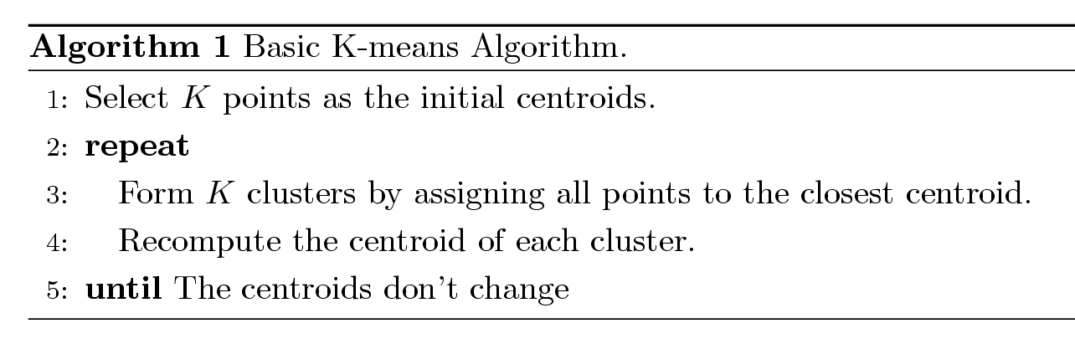
K-means Clustering
Partitioning clustering approach
Each cluster is associated with a centroid (center point)
Each point is assigned to the cluster with the closest centroid
Number of clusters, K, must be specified
The basic algorithm is very simple [3]

Slide 39
Experimental Results
The software implemented using Matlab
PSO clustering algorithm and Kmeans were tested using three type of data set
Large data set
Small data set
Small data set with noisy and outliers

Slide 40
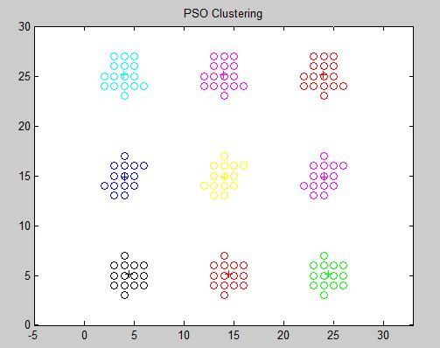
Experimental Results
PSO generate high quality clustering

Slide 41
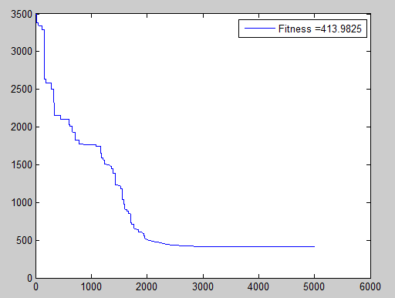
Experimental Results
PSO generate high quality clustering
PSO fitness at each iteration

Slide 42
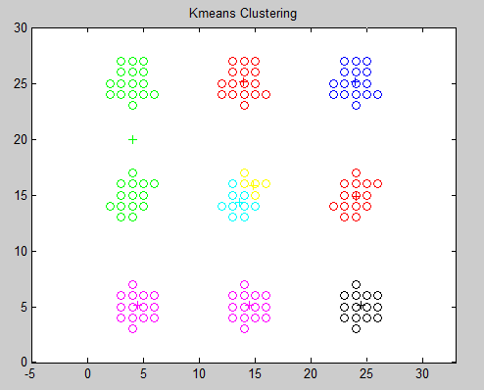
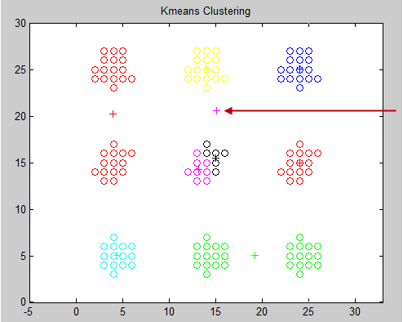
Experimental Results
Kmeans terminate at local menimum
Kmeans generate empty cluster

Slide 43
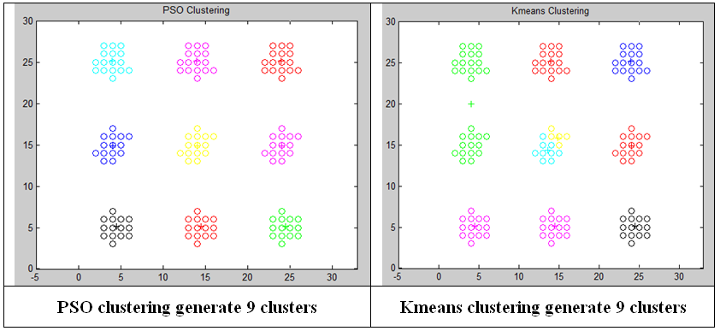
PSO vs Kmeans

Slide 44
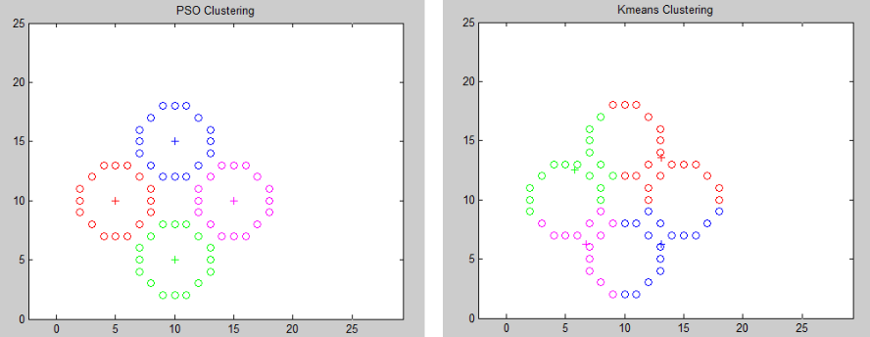
PSO vs Kmeans
PSO terminate at global minimum
Kmeans often terminates at local minimum
PSO Clustering Kmeans Clustering

Slide 45
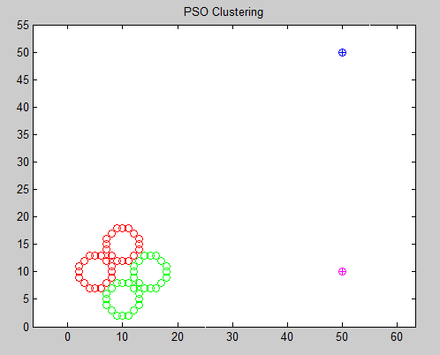
Experimental Results
PSO clustering does not affected by noisy and outlier

Slide 46
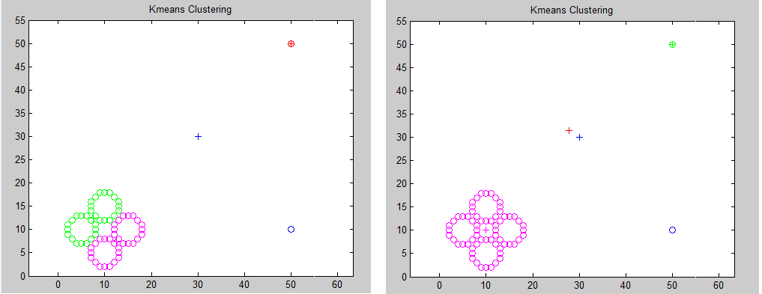
Kmeans Clustering
Kmeans affected by noisy data and outlier

Slide 47
Conclusion
Swarm Intelligence is population based search technique.
PSO is robust stochastic optimization technique and can be applied for data clustering.
In ACO algorithm, the optimization problem must be written in the form of path finding with a weighted graph
PSO clustering algorithm avoid the problems that arise with Kmeans clustering such as terminating at local minimum, generating empty clusters and sensitivity to noisy data and outliers.

Slide 48
References
[1] Ant Colony Optimization website, http://iridia.ulb.ac.be/~mdorigo/ACO/about.html
[2] J. Kennedy and R.C. Eberhart, “Particle swarm optimization,” in IEEE Int. Conf.
on Neural Networks., Perth, Australia, vol. 4, 1995, pp. 1942-1948.
[3] J. Ham and M. Kamber, “Data mining: concepts and techniques (2nd edition,”
Morgan Kaufman Publishers, pp. 1-6, 2006.
[4] Van der Merwe, D. W. and Engelbrecht, A. P. “Data clustering using particle swarm
optimization”. Proceedings of IEEE Congress on Evolutionary Computation 2003
(CEC 2003), Canbella, Australia. pp. 215-220, 2003.
[5] E. Bonabeau, M. Dorigo, and G. Theraulaz. Swarm Intelligence: From Natural to
Artificial System. Oxford University Press, New York, 1999

Slide 49
Questions
Q1: Define Swarm Intelligence and what is the characteristics of the swarm?
Q2: What is the difference between heuristic and metaheuristic?
Q3 What are the types of search techniques and mentioned the components of the search technique?
Q4: What is the Particle Swarm Optimization and show the algorithm?
Q5: Define Ant Colony Optimization and show the algorithm?

