Slide 1
Chapter 5
Fuzzy Logic
(Knowledge-Based Systems; R Akerkar, P Sajja)

Slide 2
Fuzzy Logic
Flexible machine learning technique
Mimicking the logic of human thought
Logic may have two values and represents two possible solutions
Fuzzy logic is a multi valued logic and allows intermediate values to be defined
Provides an inference mechanism which can interpret and execute commands
Fuzzy systems are suitable for uncertain or approximate reasoning

Slide 3
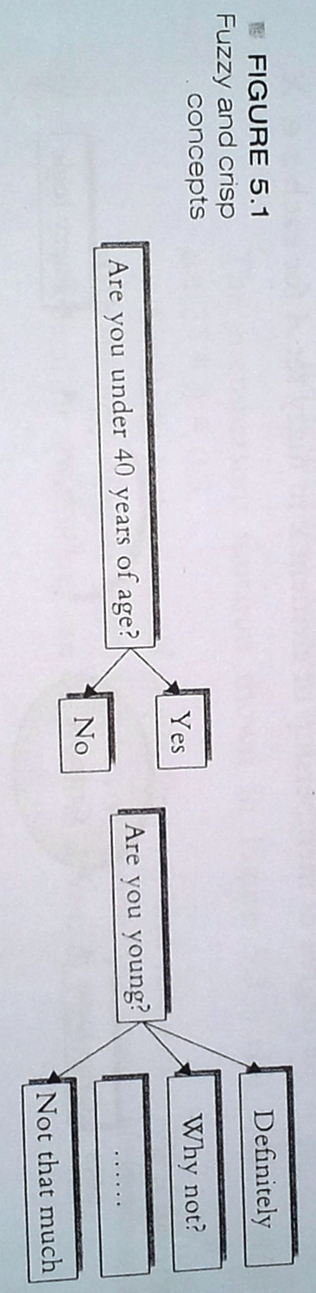
Fuzzy Logic Vs Bivalued Logic
Bivalued logic can have only two possible values as 0/1, yes/no, right/wrong etc
Fuzzy logic can be multi valued. It can have relative values like yes, not, not so much, a little bit etc.

Slide 4
Characteristics of Fuzzy Logic
Exact reasoning is viewed as a limiting case of approximate reasoning
Everything is a matter of degree
Knowledge is interpreted as a collection of elastic or equivalently fuzzy constraints on a collection of variables
Inference is viewed as a process of propagating elastic constraints
Any logical system can be fuzzified

Slide 5

Fuzzy Set
Let X be a non empty set, A fuzzy set A in X is characterized by its membership function μA: X -> [0,1], where μA(x) is the degree of membership of element x in fuzzy set A for each x ∈ X

Slide 6
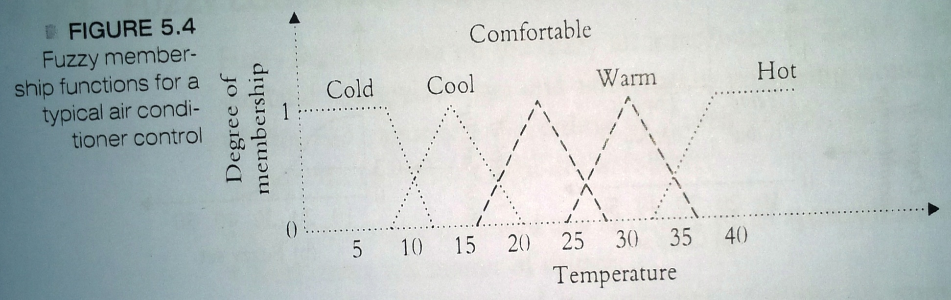
Membership Function
Maps elements of a fuzzy set to real numbered values in the interval 0 to 1.
The curve representing the mathematical function is a membership function that determines the degree of belonging of member x to the fuzzy set T.

Slide 7
Fuzzification
The process of transforming crisp(bivalued) input values into linguistic values is called fuzzification
Steps of Fuzzification:
Step 1: Input values are translated into linguistic concepts, which are represented by fuzzy set.
Step 2: Membership functions are applied to the measurements, and the degree of membership is determined

Slide 8
Defuzzification
Defuzzification converts the fuzzy values into crisp (bivalued) value.
Example methods of defuzzification:
Max-membership method: This method chooses the elements with maximum value
Centroid method: This method find the centre point of the targeted fuzzy region by calculating the weighted mean of the output fuzzy region
Weighted average method: Assigns weight to each membership function in the output by its respective maximum membership value

Slide 9
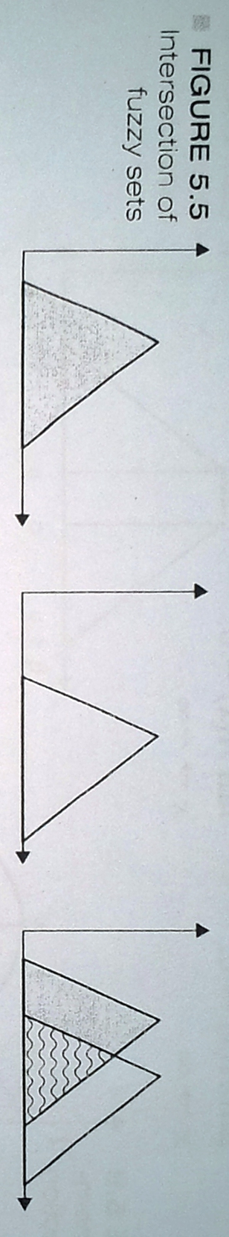
Operations on Fuzzy set
Intersection of Fuzzy Set
The intersection of A and B is defined as (A ∩ B)(x) = min{A(x), B(x)} = A(x)∩B(x), ∀ x ∈ X, as demonstrated in figure

Slide 10

Operations on Fuzzy set
Union of Fuzzy Set
The union of A and B is defined as (A ∪ B)(x) = max{A(x), B(x)} = A(x)∪B(x), ∀ x ∈ X, as demonstrated in figure

Slide 11
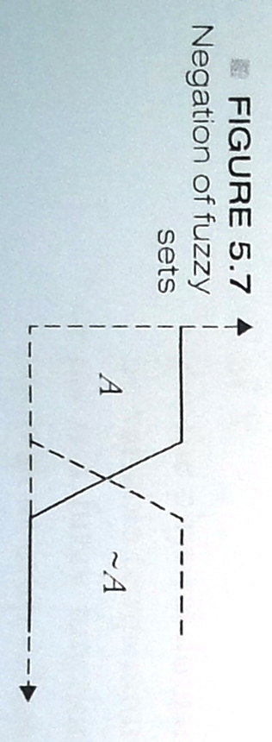
Operations on Fuzzy set
Complement of Fuzzy Set
The complement of a fuzzy set A is defined as (~ A)(x) = 1 - A(x) as demonstrated in figure

Slide 12
Operations on Fuzzy set
Equality of Fuzzy Sets
Let A and B are fuzzy sets on classical set X. A and B are said to be equal, denoted as A = B if A ⊂ B and B ⊂ A. That is A = B, if and only if A(x) = B(x) ∀ x ∈ X

Slide 13
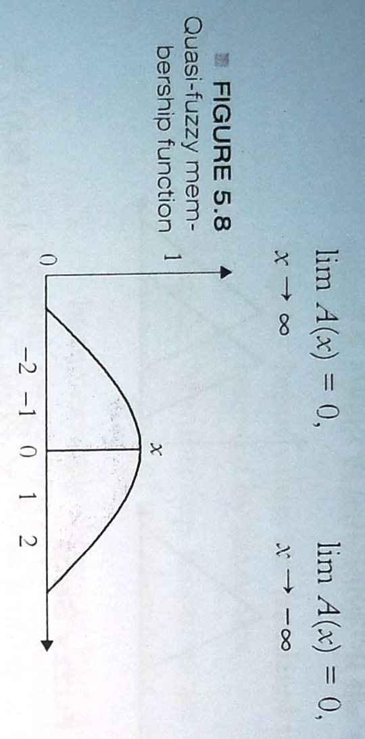
Types of Fuzzy Function
Quasi-Fuzzy Membership Functions:
The membership function follows a quasi curve. A quasi curve is a real line with a normal fuzzy convex and a continuous membership function satisfying the limit conditions as below:

Slide 14
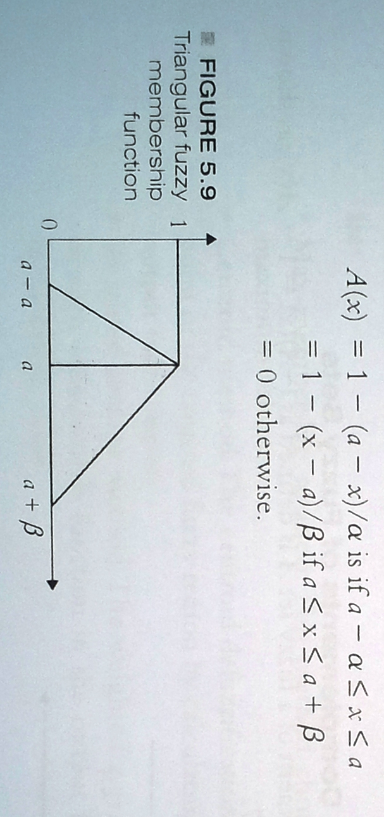
Types of Fuzzy Function
Triangular Fuzzy Membership Functions:
The membership curve follows a triangular shape then it is triangular membership function. Fuzzy function A is called triangular fuzzy function(A=a,α,β) with peak a, left width α>0 and right width β>0

Slide 15
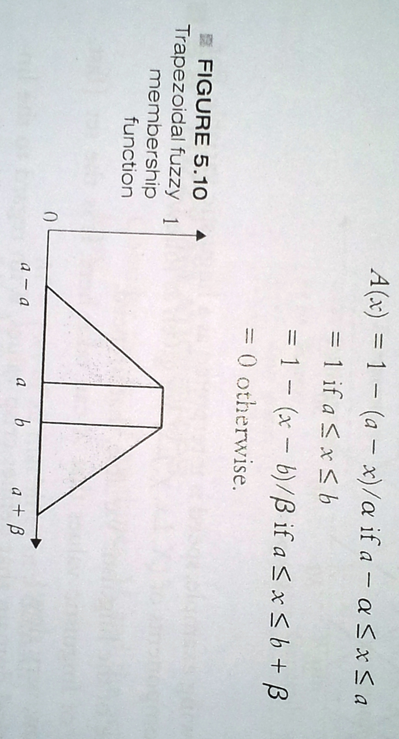
Types of Fuzzy Function
Trapezoidal Fuzzy Membership Functions:
The membership curve follows a trapezoidal shape. Fuzzy function A is called triangular fuzzy function(A=a,α,β) with tolerance interval [a, b], left width α and right width β

Slide 16
Linguistic Variable
A variable whose values are words or sentences in natural language. Example: Temperature is linguistic variable if it takes values hot, cool, warm, comfortable etc.
The framework of linguistic variable is given as (X, Lx, χ, µx) where
X denotes the symbolic name of linguistic variable
Lx is a set of linguistic values that X can take
χ is the physical domain that defines crisp values
µx is a fuzzy function that maps linguistic terms of variables to the equivalent crisp values

Slide 17
Fuzzy Propositions
A fuzzy proposition is a statement that drives a fuzzy truth value.
Fuzzy Connectives: Fuzzy connectives are used to join simple fuzzy propositions to make compound propositions. Examples of fuzzy connectives are:
Negation
Disjunction
Conjunction
Imlication

Slide 18
Fuzzy Rules
The power and flexibility of simple If-Then-Else logic rules is enhanced by adding linguistic parameter.
Fuzzy rules are expressed in the form:
IF variable IS set THEN action
Examples:
IF temperature is very cold THEN stop air conditioner
IF temperature is normal THEN adjust air conditioner
IF temperature is hot THEN start air conditioner

Slide 19
Fuzzy Control System
A fuzzy control system is based on Fuzzy Logic. The process of designing fuzzy control system can be described using following steps
Step 1: Identify the principal input, output and process tasks
Step 2: Identify linguistic variables used and define fuzzy sets and memberships accordingly
Step 3: Use these fuzzy sets and linguistic variables to form procedural rules
Step 4: Determine the defuzzification method
Step 5: Test the system and modify if necessary

Slide 20
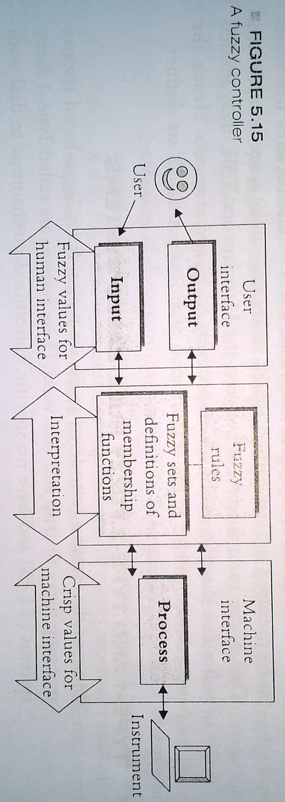
Fuzzy Control System

Slide 21
Modeling Fuzzy Systems
Fuzzy system modeling can be pursued using the following steps
Step 1: Choose the relative input and output variables
Step 2: Determine the number of linguistic terms associated with each input/output variables
Step 3: Select a specific type of fuzzy system
Step 4: Design a collection of fuzzy if-then rules. To formulate initial rule base, the input space is divided into multi dimensional partitions and then actions are assigned to each of the partitions

Slide 22
Limitations of Fuzzy Systems
Fuzzy systems lack the capability of machine learning as-well-as neural network type pattern recognition
Verification and validation of a fuzzy knowledge-based system require extensive testing with hardware
Determining exact fuzzy rules and membership functions is a hard task
Stability is an important concern for fuzzy control

Slide 23
Applications of Fuzzy Logic
Automatic control system
Prediction, diagnostic and advisory systems
User interface and neural language processing
Domestic appliances and embedded systems
Soft computing and hybrid systems with artificial neural networks
Very Large Scale Integrated circuits (VLSI) micro controller
Fuzzy expert system and fuzzy inference

