Slide 1
Current trends in Neural Networks
Dr. Konstantinos Karampidis Department of Electrical and Computer Engineering Hellenic Mediterranean University

Slide 2
Introduction
Deep Learning is a new area of Machine Learning research, which has been introduced with the objective of moving Machine Learning closer to one of its original goals
Deep Learning is about learning multiple levels of representation and abstraction that help to make sense of data such as images, sound, and text.

Slide 3
Motivations for Deep Architectures
Why Deep Learning?
Insufficient depth can hurt
With shallow architecture (SVM, NB, KNN, etc.), the required number of nodes in the graph (i.e. computations, and also number of parameters, when we try to learn the function) may grow very large.
Many functions that can be represented efficiently with a deep architecture cannot be represented efficiently with a shallow one.

Slide 4
Motivations for Deep Architectures
Why Deep Learning?
The brain has a deep architecture*
The visual cortex shows a sequence of areas each of which contains a representation of the input, and signals flow from one to the next.
Note that representations in the brain are in between dense distributed and purely local: they are sparse: about 1% of neurons are active simultaneously in the brain.
*86 billion neurons

Slide 5
Motivations for Deep Architectures
Why Deep Learning?
Cognitive processes seem deep
Humans organize their ideas and concepts hierarchically.
Humans first learn simpler concepts and then compose them to represent more abstract ones.
Engineers break-up solutions into multiple levels of abstraction and processing

Slide 6
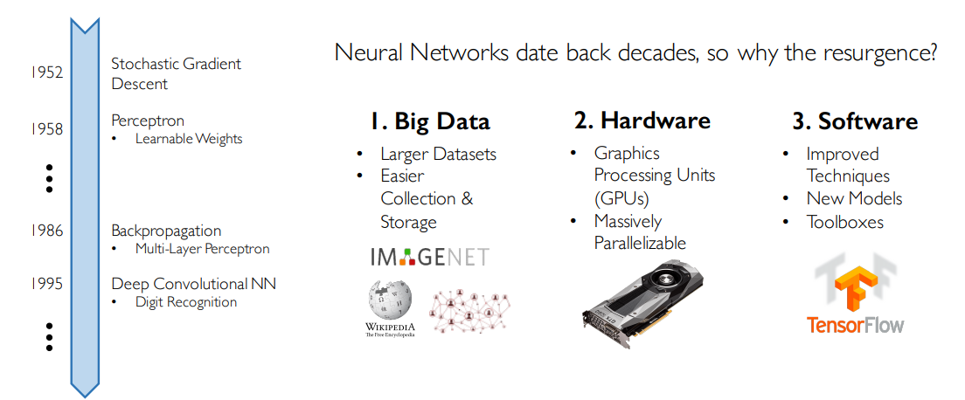
Why Now ?

Slide 7
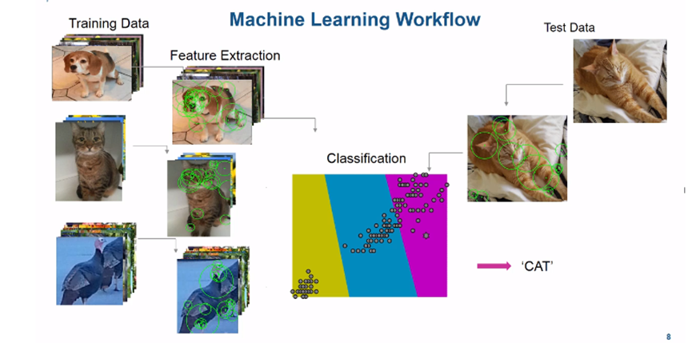
Until Now…

Slide 8
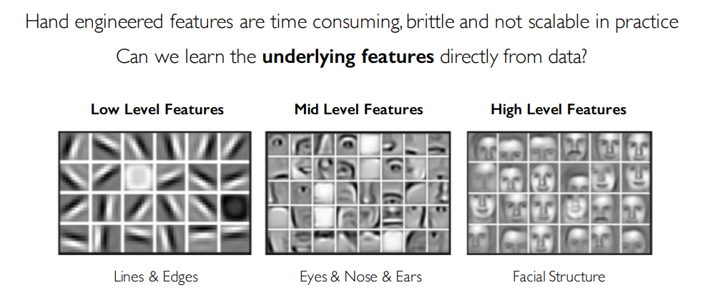
Deep Learning = Learning Hierarchical Representations

Slide 9
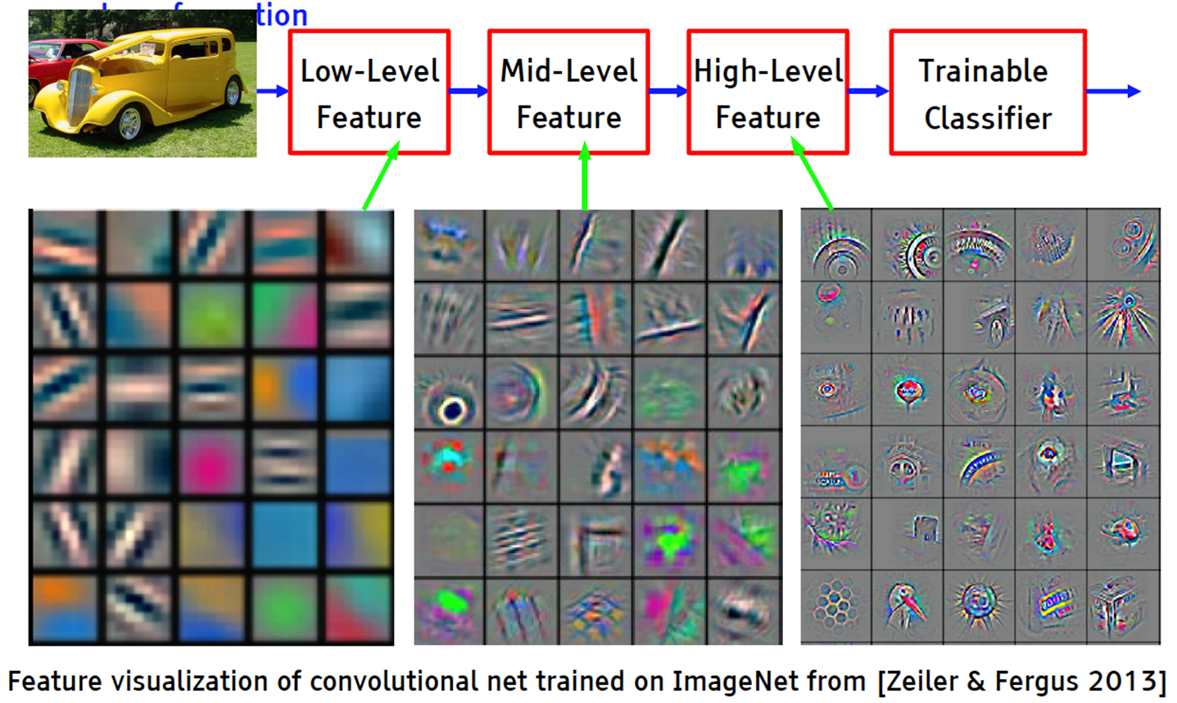
Deep Learning = Learning Hierarchical Representations

Slide 10
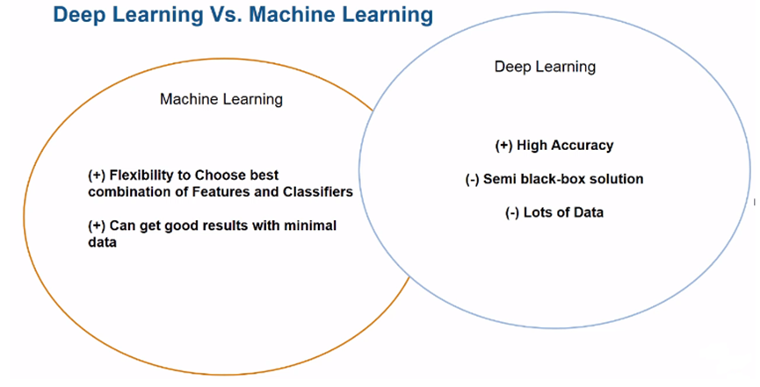

Slide 11
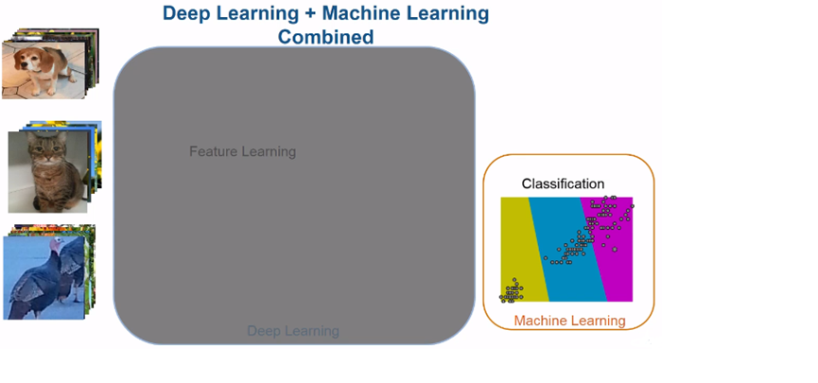

Slide 12
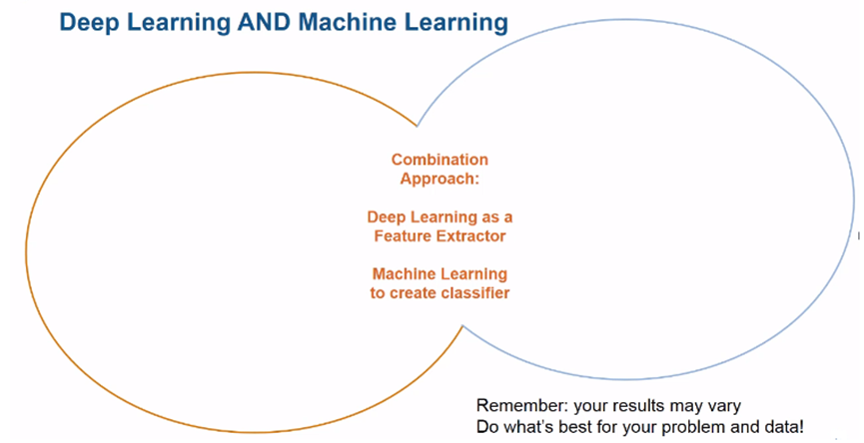

Slide 13
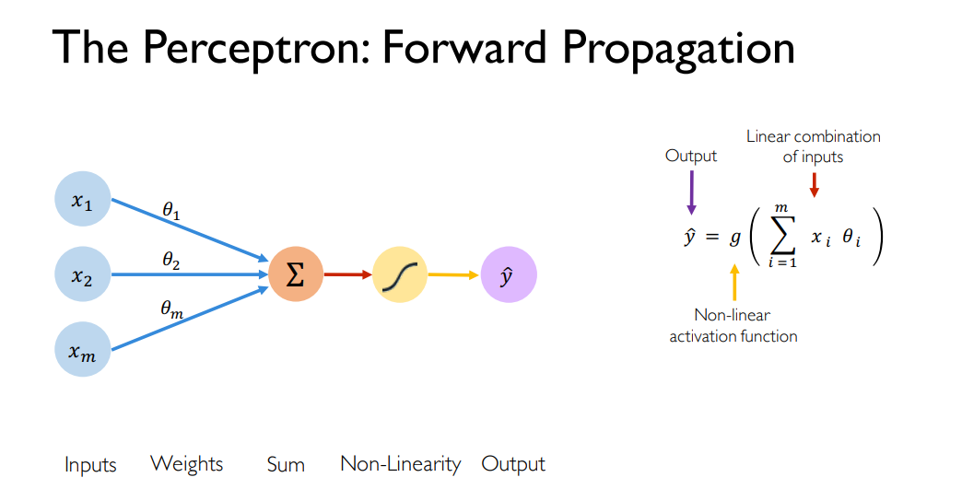

Slide 14
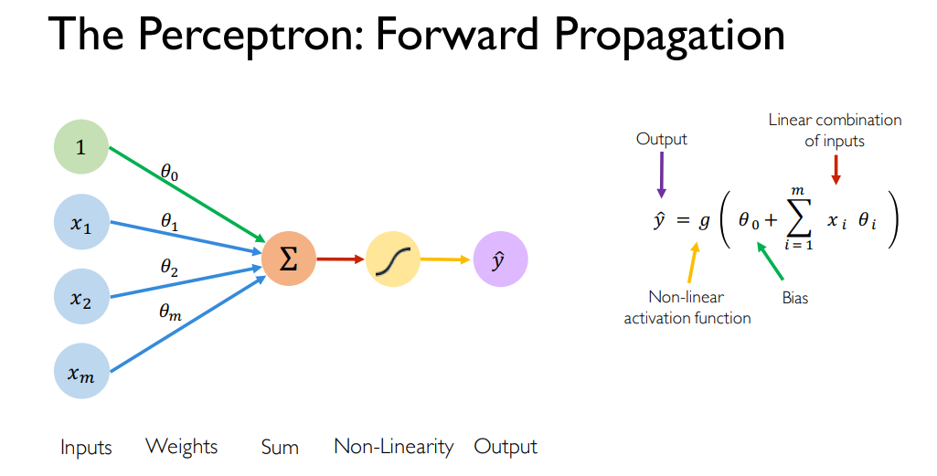

Slide 15
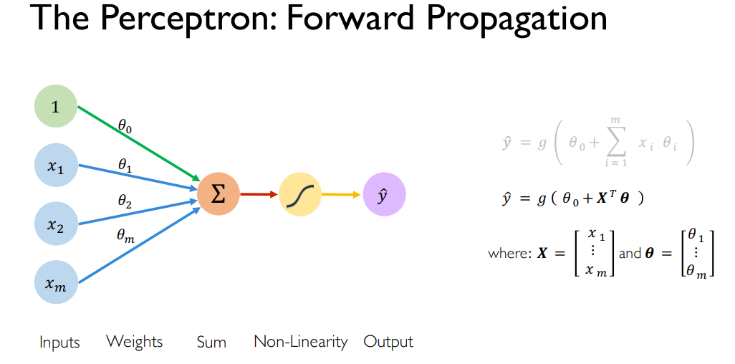

Slide 16
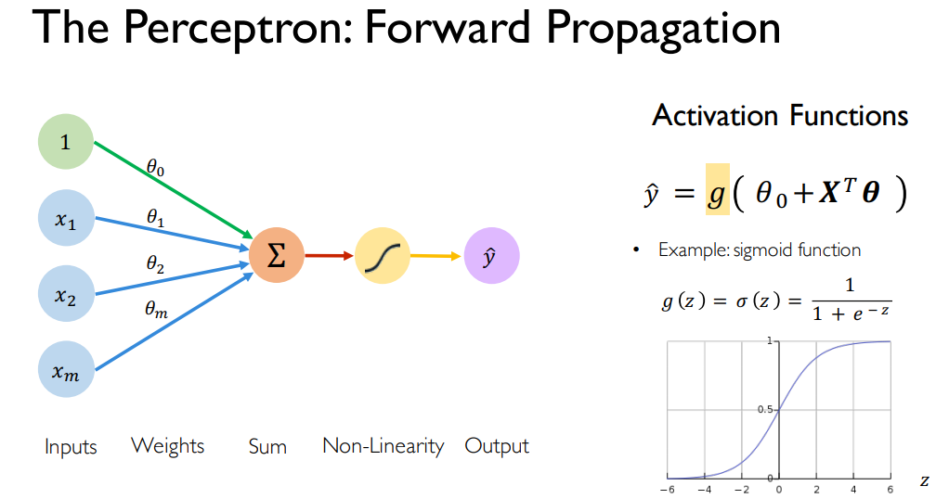

Slide 17
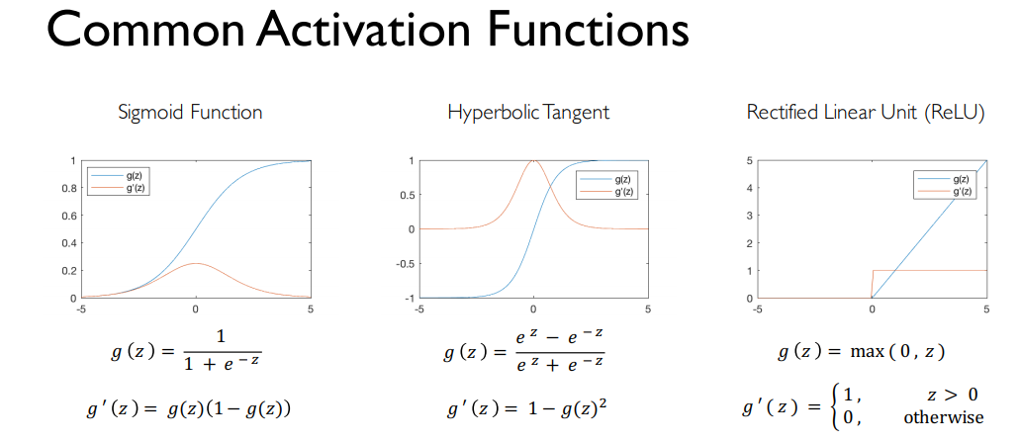

Slide 18
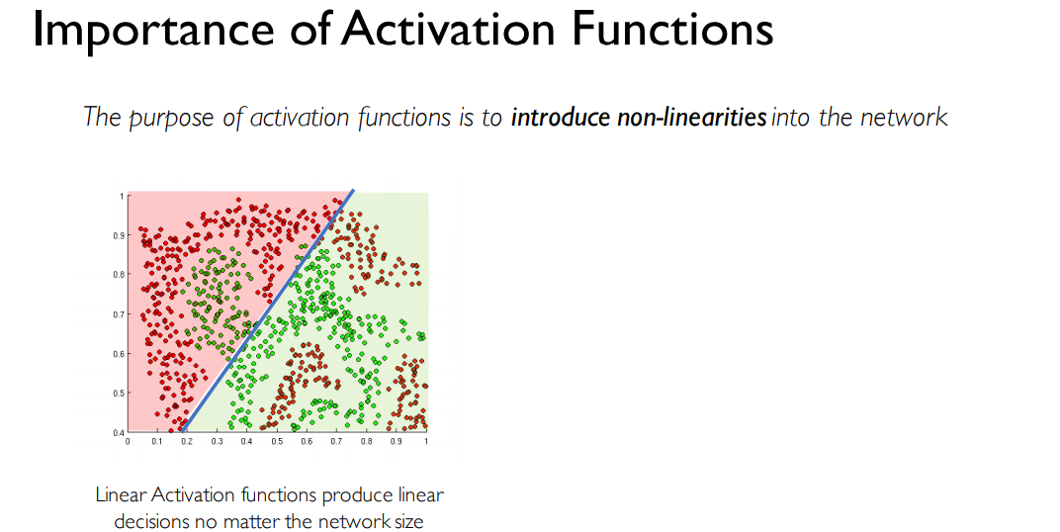

Slide 19
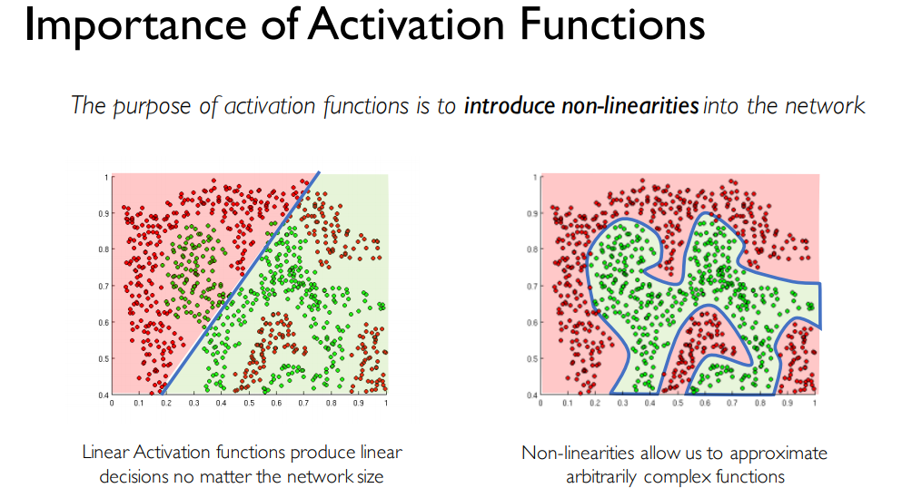

Slide 20
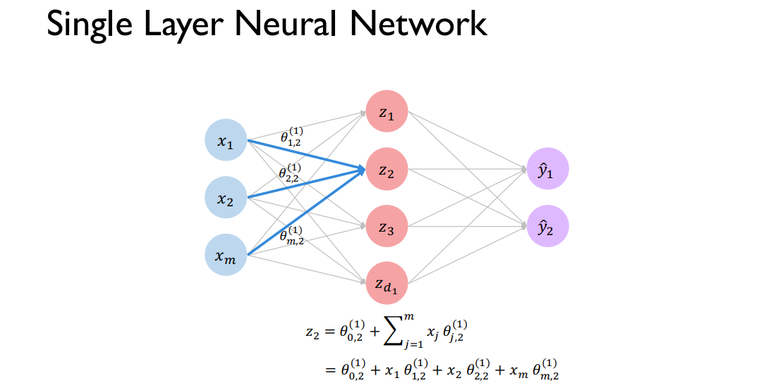

Slide 21
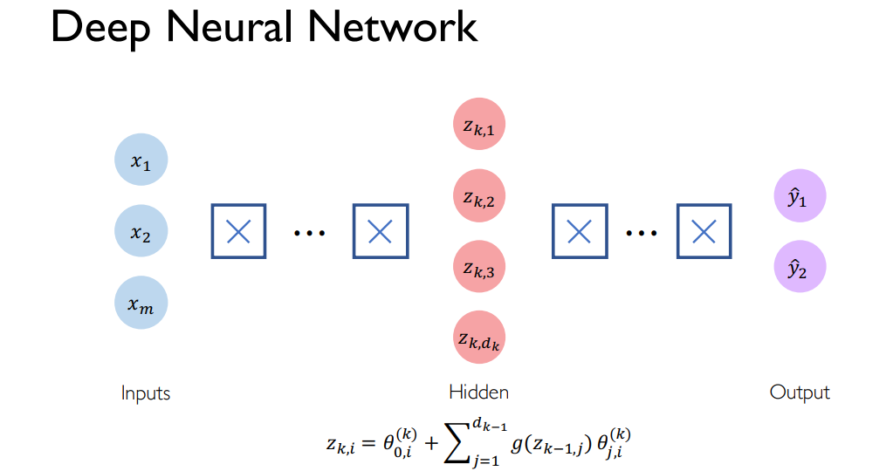

Slide 22
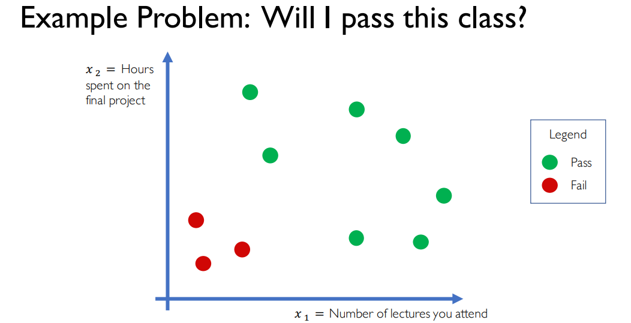

Slide 23
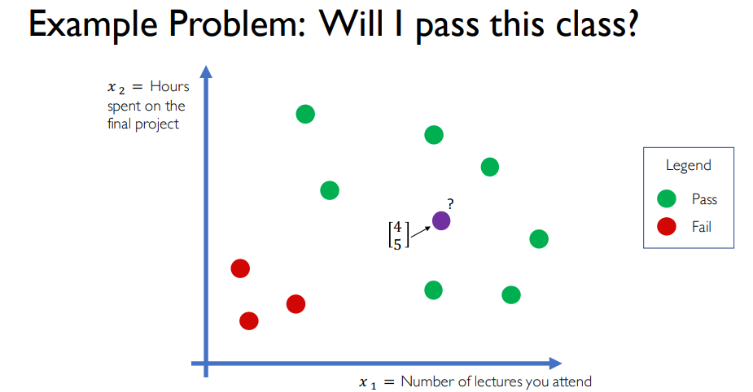

Slide 24
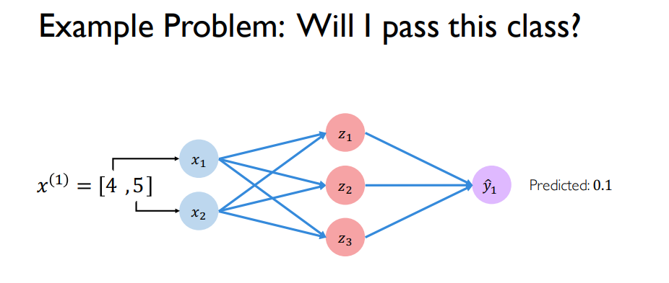

Slide 25
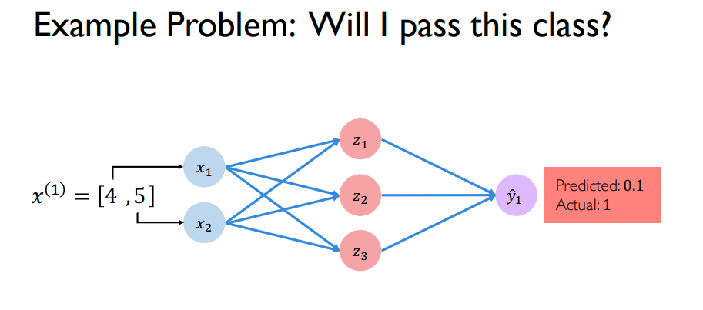

Slide 26
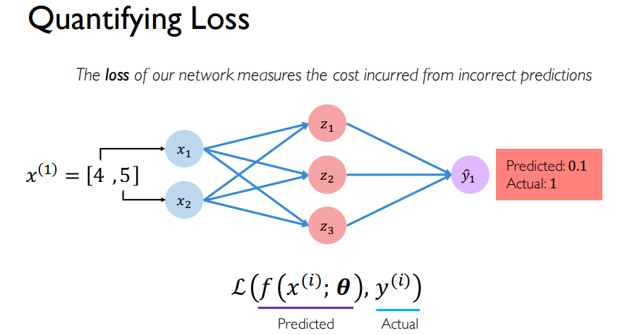

Slide 27
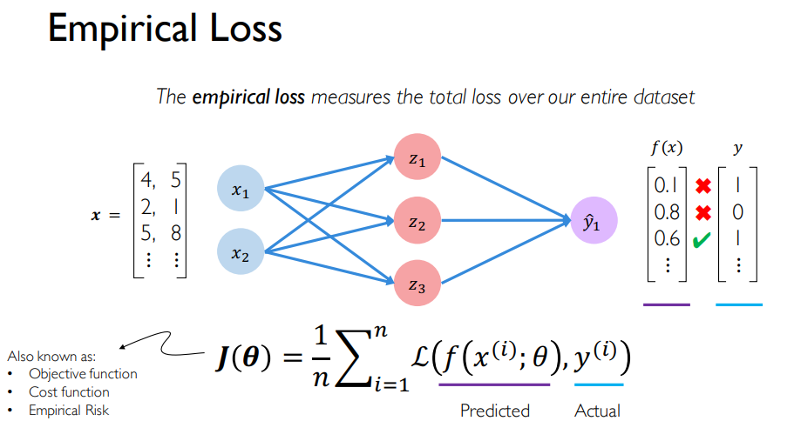

Slide 28
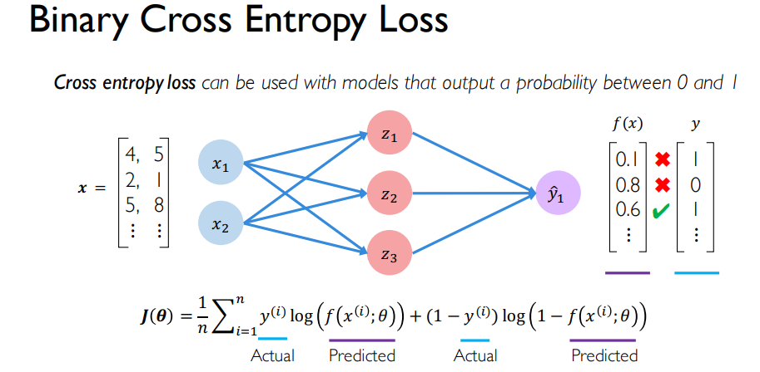

Slide 29
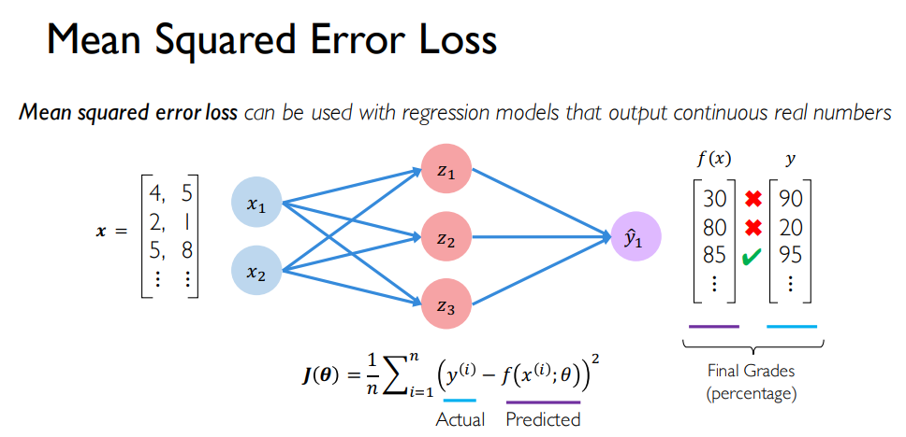

Slide 30
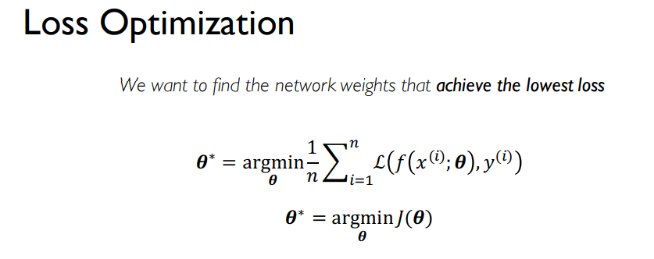
Training Neural Networks

Slide 31
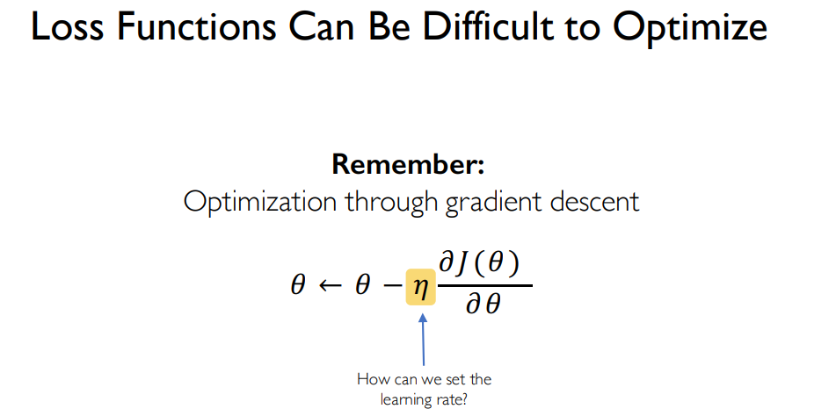

Slide 32
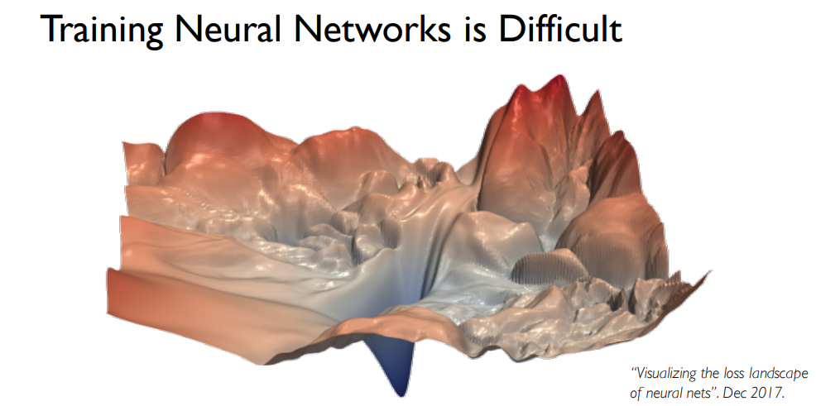

Slide 33
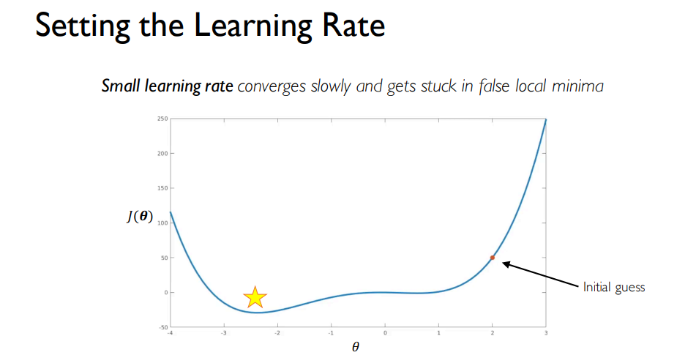

Slide 34
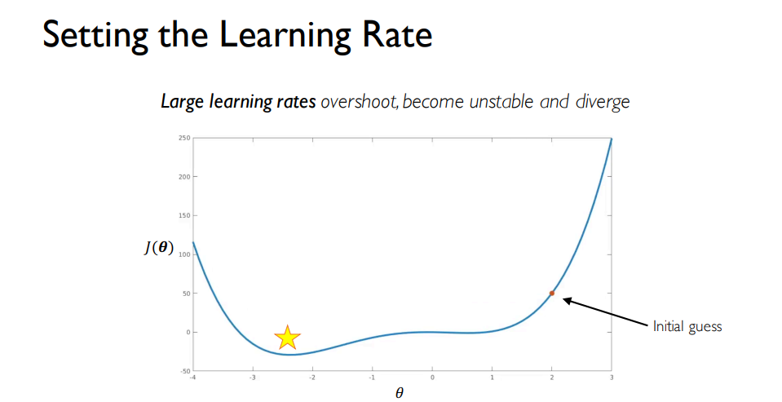

Slide 35
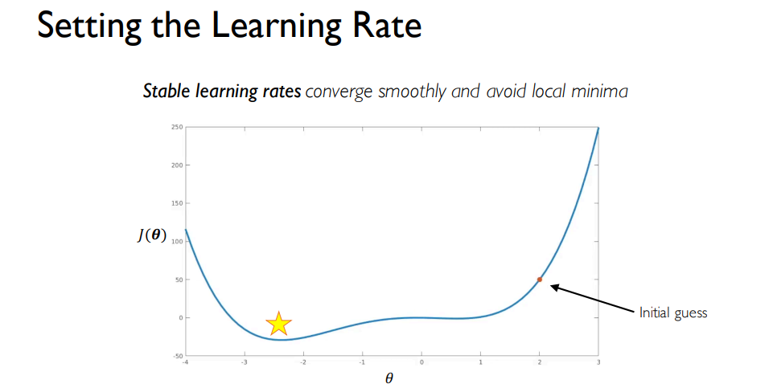

Slide 36
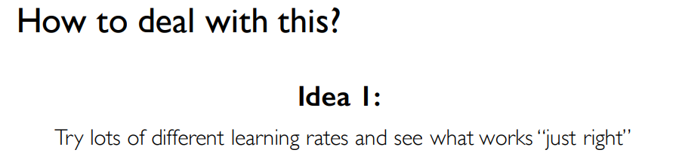
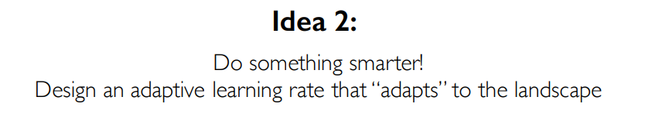
Or

Slide 37
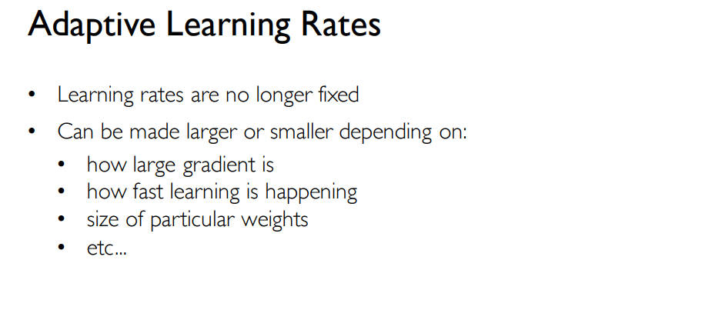

Slide 38
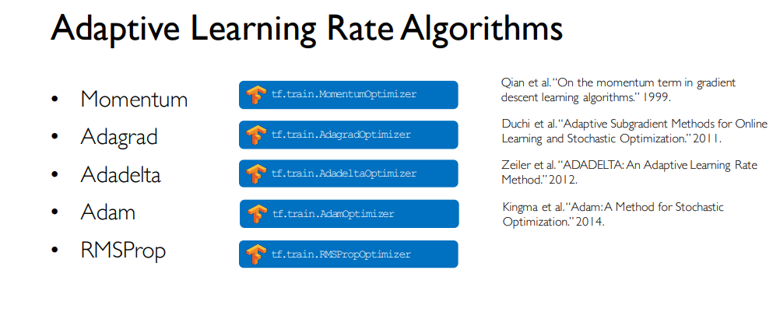

Slide 39
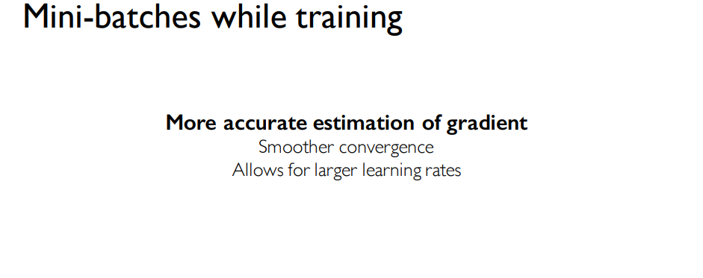

Mini-batches
Mini-batch training is a combination of batch and stochastic training. Instead of using all training data items to compute gradients (as in batch training) or using a single training item to compute gradients (as in stochastic training), mini-batch training uses a user-specified number of training items

Slide 40
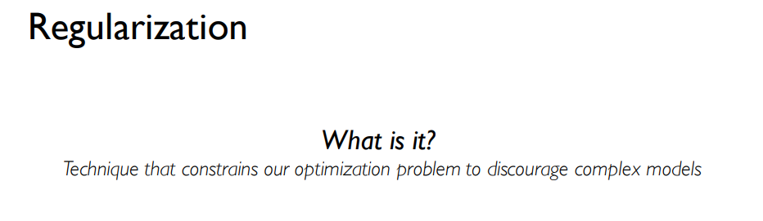
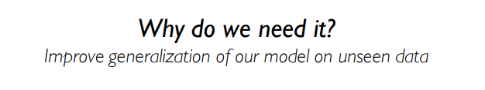

Slide 41
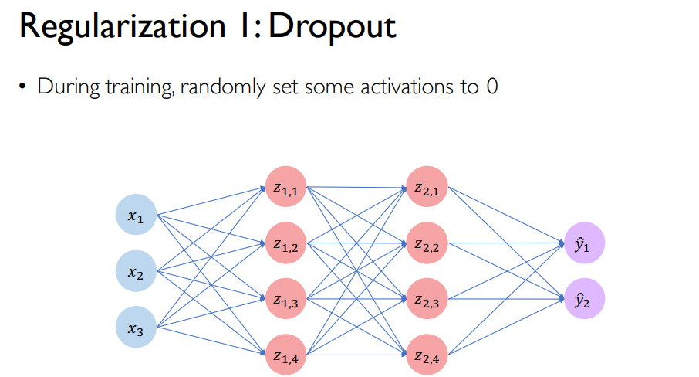

Slide 42
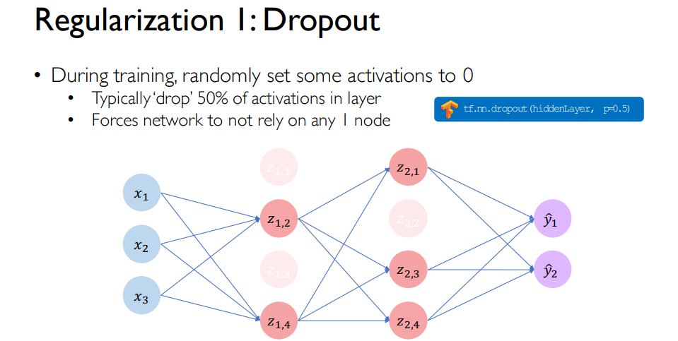

Slide 43
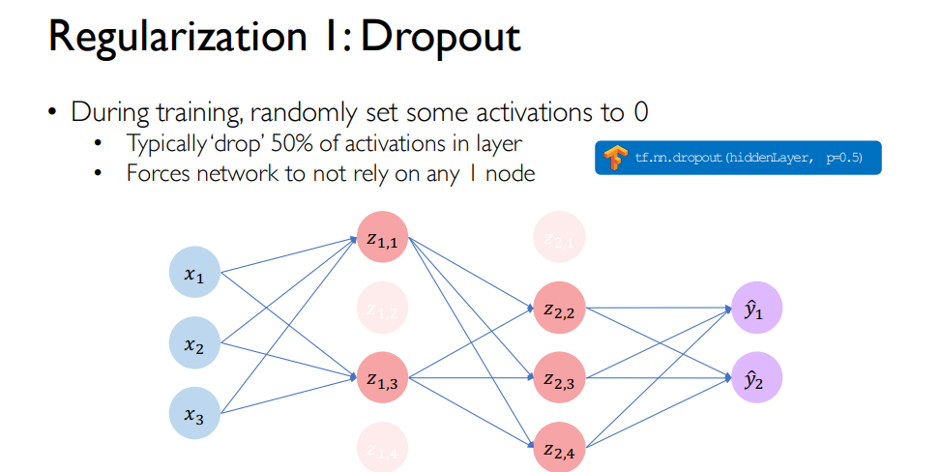

Slide 44
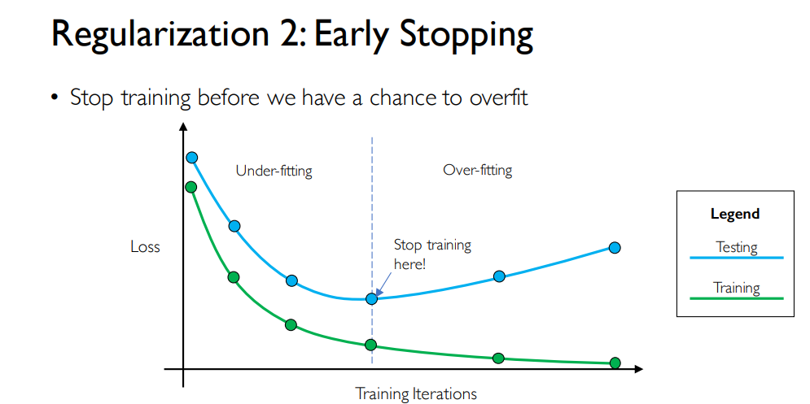

Slide 45
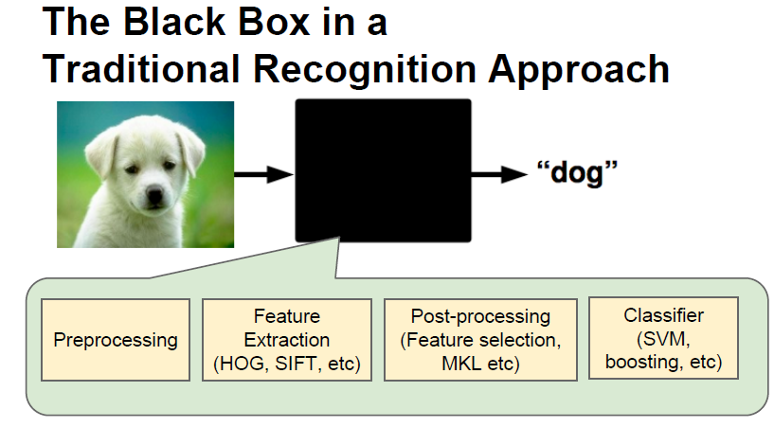
ConvNets
A supervised deep learning method.

Slide 46
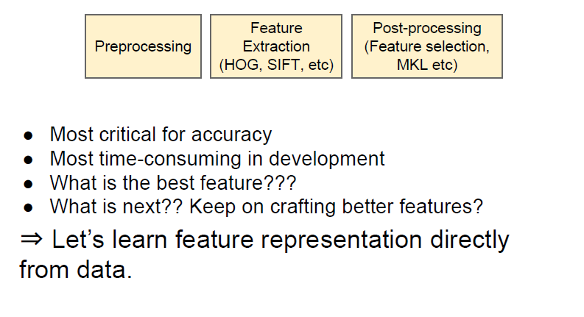
ConvNets

Slide 47
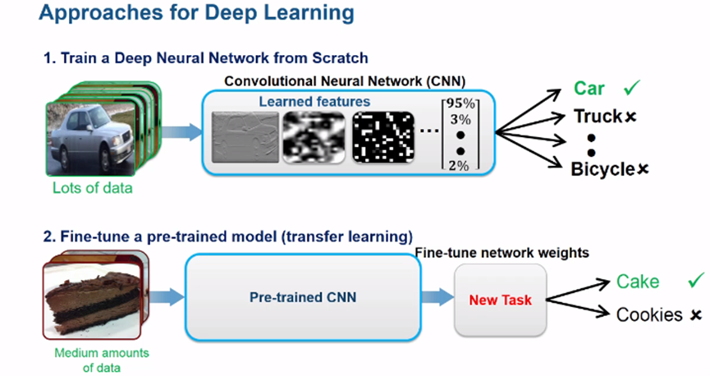
ConvNets

Slide 48
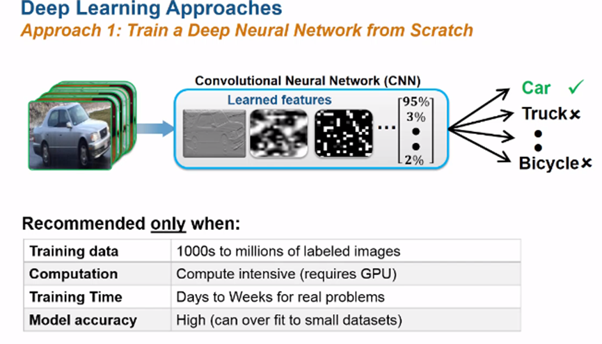
ConvNets

Slide 49
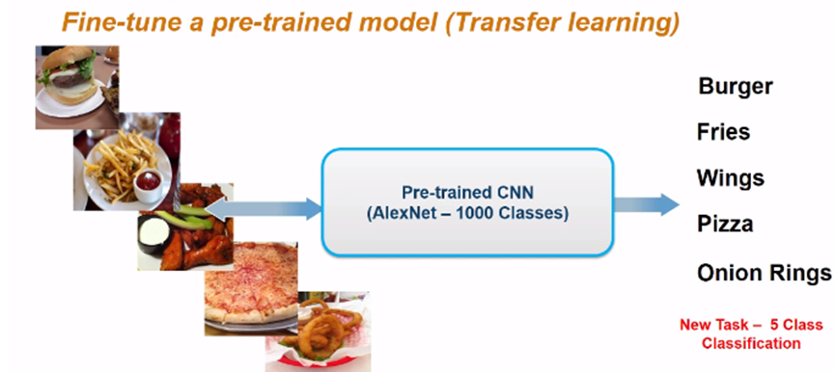
ConvNets

Slide 50
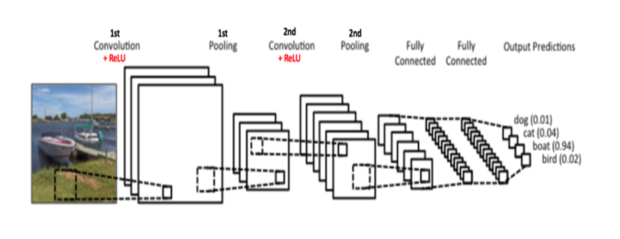
ConvNets

Slide 51
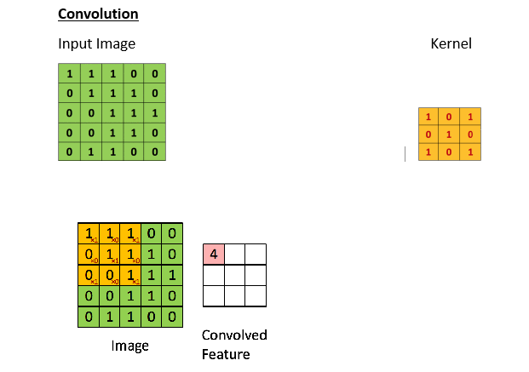
In CNN terminology, the 3×3 matrix is called a ‘filter‘ or ‘kernel’ or ‘feature detector’ and the matrix formed by sliding the filter over the image and computing the dot product is called the ‘Convolved Feature’ or ‘Activation Map’ or the ‘Feature Map‘. It is important to note that filters act as feature detectors from the original input image.

Slide 52
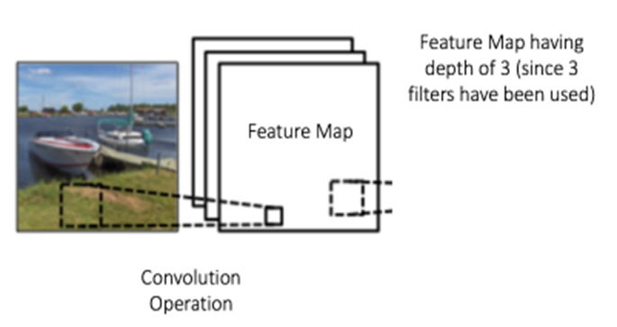
Feature Map Parameters
The size of the Feature Map (Convolved Feature) is controlled by three parameters that we need to decide before the convolution step is performed:
Depth: Depth corresponds to the number of filters we use for the convolution operation. In the network shown in Figure, we are performing convolution of the original boat image using three distinct filters, thus producing three different feature maps as shown. You can think of these three feature maps as stacked 2d matrices, so, the ‘depth’ of the feature map would be three.

Slide 53
Feature Map Parameters
Stride: Stride is the number of pixels by which we slide our filter matrix over the input matrix. When the stride is 1 then we move the filters one pixel at a time. When the stride is 2, then the filters jump 2 pixels at a time as we slide them around. Having a larger stride will produce smaller feature maps.
Zero-padding: Sometimes, it is convenient to pad the input matrix with zeros around the border, so that we can apply the filter to bordering elements of our input image matrix. A nice feature of zero padding is that it allows us to control the size of the feature maps. Adding zero-padding is also called wide convolution, and not using zero-padding would be a narrow convolution.

Slide 54
Feature Map Parameters
Zero-padding: By default, a filter starts at the left of the image with the left-hand side of the filter sitting on the far left pixels of the image. The filter is then stepped across the image one column at a time until the right-hand side of the filter is sitting on the far right pixels of the image.
An alternative approach to applying a filter to an image is to ensure that each pixel in the image is given an opportunity to be at the center of the filter.
By default, this is not the case, as the pixels on the edge of the input are only ever exposed to the edge of the filter. By starting the filter outside the frame of the image, it gives the pixels on the border of the image more of an opportunity for interacting with the filter, more of an opportunity for features to be detected by the filter, and in turn, an output feature map that has the same shape as the input image.
For example, in the case of applying a 3×3 filter to the 8×8 input image, we can add a border of one pixel around the outside of the image. This has the effect of artificially creating a 10×10 input image. When the 3×3 filter is applied, it results in an 8×8 feature map. The added pixel values could have the value zero value that has no effect with the dot product operation when the filter is applied.

Slide 55
Size of Feature Map
Output width=((W-F_{w}+2*P )/S)+1
Output height=((H-F_{h}+2*P)/S)+1
Example
Tensor size or shape: (width = 28, height = 28)
Convolution filter size (F): (F_width = 5, F_height = 5)
Padding (P): 0
Stride (S): 1
Output width=((28-5+2*0)/1)+1=24
Output height=((28-5+2*0)/1)+1=24
The output dimension will be (24,24)

Slide 56
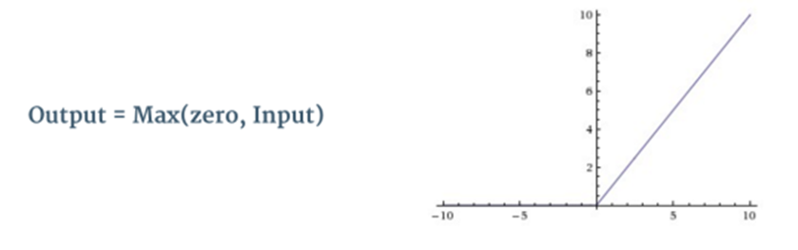

Non Linearity (ReLU)
ReLU stands for Rectified Linear Unit and is a non-linear operation. Its output is given by:

Slide 57

Non Linearity (ReLU)
Pros
It avoids and rectifies vanishing gradient problem.
ReLu is less computationally expensive than tanh and sigmoid because it involves simpler mathematical operations.
Cons
One of its limitation is that it should only be used within Hidden layers of a Neural Network Model.
Some gradients can be fragile during training and can die. It can cause a weight update which will makes it never activate on any data point again. Simply saying that ReLu could result in Dead Neurons.
In another words, For activations in the region (x<0) of ReLu, gradient will be 0 because of which the weights will not get adjusted during descent. That means, those neurons which go into that state will stop responding to variations in error/ input (simply because gradient is 0, nothing changes ). This is called dying ReLu problem.
The range of ReLu is [0, inf). This means it can blow up the activation.

Slide 58

Leaky ReLU
LeakyRelu is a variant of ReLU. Instead of being 0 when z<0, a leaky ReLU allows a small, non-zero, constant gradient α (normally, α=0.01).
Pros
Leaky ReLUs are one attempt to fix the
“dying ReLU” problem by having
a small negative slope (of 0.01, or so).
Cons
As it possess linearity, it can’t be used
for the complex Classification.
It lags behind the Sigmoid and Tanh
for some of the use cases.

Slide 59

Other Activation Functions - Sigmoid
Sigmoid takes a real value as input and outputs another value between 0 and 1. It’s easy to work with and has all the nice properties of activation functions: it’s non-linear, continuously differentiable, monotonic, and has a fixed output range.

Slide 60

Other Activation Functions - Tanh
Tanh squashes a real-valued number to the range [-1, 1]. It’s non-linear. But unlike Sigmoid, its output is zero-centered.

Slide 61
Other Activation Functions - Softmax
Softmax function calculates the probabilities distribution of the event over ‘n’ different events. In general way of saying, this function will calculate the probabilities of each target class over all possible target classes. Later the calculated probabilities will be helpful for determining the target class for the given inputs.

Slide 62
Pooling
Spatial Pooling (also called subsampling or downsampling) reduces the dimensionality of each feature map but retains the most important information. Spatial Pooling can be of different types: Max, Average, Sum etc.
In case of Max Pooling, we define a spatial neighborhood (for example, a 2×2 window) and take the largest element from the rectified feature map within that window. Instead of taking the largest element we could also take the average (Average Pooling) or sum of all elements in that window. In practice, Max Pooling has been shown to work better.

Slide 63


Pooling

Slide 64
Pooling
In particular, pooling:
makes the input representations (feature dimension) smaller and more manageable
reduces the number of parameters and computations in the network, therefore, controlling overfitting
makes the network invariant to small transformations, distortions and translations in the input image (a small distortion in input will not change the output of Pooling – since we take the maximum / average value in a local neighborhood).
helps us arrive at an almost scale invariant representation of our image (the exact term is “equivariant”). This is very powerful since we can detect objects in an image no matter where they are located

Slide 65

Fully Connected Layer
The Fully Connected layer is a traditional Multi Layer Perceptron that uses a softmax* activation function in the output layer (other classifiers like SVM can also be used). The term “Fully Connected” implies that every neuron in the previous layer is connected to every neuron on the next layer.
*Softmax classifiers give you probabilities for each class label. Softmax classifier is a generalization of the binary form of Logistic Regression

Slide 66

The network

Slide 67
Training the network
The overall training process of the Convolution Network may be summarized as below:
Step1: We initialize all filters and parameters / weights with random values
Step2: The network takes a training image as input, goes through the forward propagation step (convolution, ReLU and pooling operations along with forward propagation in the Fully Connected layer) and finds the output probabilities for each class.
Step3: Calculate the total error at the output layer
Step4: Use Backpropagation to calculate the gradients of the error with respect to all weights in the network and use gradient descent to update all filter values / weights and parameter values to minimize the output error.
Step5: Repeat steps 2-4 with all images in the training set.

Slide 68
Testing the network
When a new (unseen) image is input into the ConvNet, the network would go through the forward propagation step and output a probability for each class (for a new image, the output probabilities are calculated using the weights which have been optimized to correctly classify all the previous training examples). If our training set is large enough, the network will (hopefully) generalize well to new images and classify them into correct categories.

Slide 69
Some Network Architectures
LeNet (1990s)
1990s to 2012: In the years from late 1990s to early 2010s convolutional neural network were in incubation. As more and more data and computing power became available, tasks that convolutional neural networks could tackle became more and more interesting.
AlexNet (2012) – In 2012, Alex Krizhevsky (and others) released AlexNet which was a deeper and much wider version of the LeNet and won by a large margin the difficult ImageNet Large Scale Visual Recognition Challenge (ILSVRC) in 2012. It was a significant breakthrough with respect to the previous approaches and the current widespread application of CNNs can be attributed to this work.
ZF Net (2013) – The ILSVRC 2013 winner was a Convolutional Network from Matthew Zeiler and Rob Fergus. It became known as the ZFNet (short for Zeiler & Fergus Net). It was an improvement on AlexNet by tweaking the architecture hyperparameters.
GoogLeNet (2014) – The ILSVRC 2014 winner was a Convolutional Network from Szegedy et al.from Google. Its main contribution was the development of an Inception Module that dramatically reduced the number of parameters in the network (4M, compared to AlexNet with 60M).

Slide 70
Some Network Architectures
VGGNet (2014) – The runner-up in ILSVRC 2014 was the network that became known as the VGGNet. Its main contribution was in showing that the depth of the network (number of layers) is a critical component for good performance.
ResNets (2015) – Residual Network developed by Kaiming He (and others) was the winner of ILSVRC 2015. ResNets are currently by far state of the art Convolutional Neural Network models and are the default choice for using ConvNets in practice (as of May 2016).
DenseNet (August 2016) – Recently published by Gao Huang (and others), the Densely Connected Convolutional Network has each layer directly connected to every other layer in a feed-forward fashion. The DenseNet has been shown to obtain significant improvements over previous state-of-the-art architectures on five highly competitive object recognition benchmark tasks.

Slide 71
Some Network Architectures - Parameters
Network | Number of Parameters
LeNet-5 | 60000
AlexNet | 60 million
VGG-16 | 138 million
GoogleNet | 5 million (V1) - 23 million (V3)
ResNet50 | 25 million
DenseNet-190 | 40 million
KarNet | 16 million

Slide 72


Autoencoders
The autoencoder tries to learn a function . In other words, it is trying to learn an approximation to the identity function, so as to output that is similar to x.
Typically used for unsupervised learning or for feature extraction

Slide 73

Autoencoders
Source : https://towardsdatascience.com/applied-deep-learning-part-3-autoencoders-1c083af4d798

Slide 74
Trends
Few-shot learning
GANs
Federated Learning
Meta-learning

Slide 75
Meta Learning Few Shot Learning Federated Learning
Meta-learning refers to learning algorithms that learn from other learning algorithms.
This means the use of learning algorithms that learn how to best combine the predictions from other learning algorithms in the field of ensemble learning.
Few shot learning learning means making classification or regression based on a very small number of samples.
Federated learning is a way to train AI models without anyone seeing or touching your data. It is a technique that trains an algorithm across multiple decentralized edge devices or servers holding local data samples, without exchanging them.

Slide 76

Generative Adversarial Networks (GANs)
GANs are generative models: they create new data instances that resemble your training data.
Images created by a GAN created by NVIDIA

Slide 77

Generative Adversarial Networks (GANs)
Source : https://sthalles.github.io/intro-to-gans/

Slide 78
Other Deep Learning algorithms
Long Short-Term Memory (LSTM)
Restricted Boltzmann Machine (RBM)
Deep Belief Networks (DBN)

Slide 79
Deep Learning Frameworks
Tensorflow
Caffe
PyTorch
MxNet
The Microsoft Cognitive Toolkit/CNTK
Chainer
Keras
Deeplearning4j
Matlab

Slide 80
Deep Learning Projects
Crowd Counting
EEG biometrics
ECG biometrics
Fake fingerprints generated by a GAN
Object Detection and Recognition with transfer learning
Financial Forecasting – Computational Finance
Computational Medicine

Slide 81
Equipment – ISCA Lab - 1
2 x Intel Xeon 2680v5 2.4 Ghz – 56 cores
64GB RAM
2 x Nvidia 1080ti 11GB in SLI mode
500GB SSD
3TB HDD
1500W

Slide 82

Equipment – ISCA Lab - 2
Nvidia DGX Workstation

Slide 83



Equipment – HMU
Nvidia DGX-A100
Dell Storage Server 20x1.92TB SSD

Slide 84
Thank you

Slide 85
References
http://ufldl.stanford.edu/tutorial/unsupervised/Autoencoders/
https://ujjwalkarn.me/2016/08/11/intuitive-explanation-convnets/
http://introtodeeplearning.com/
http://www.iro.umontreal.ca/~pift6266/H10/notes/deepintro.html
https://ml-cheatsheet.readthedocs.io/en/latest/activation_functions.html
https://www.jeremyjordan.me/convnet-architectures/

