Slide 1
Divide and Conquer
Data Structures and Algorithms
A. G. Malamos

Slide 2
Divide and Conquer
The divide-and-conquer strategy solves a problem by:
1. Breaking it into subproblems that are themselves smaller instances of the same type of problem
2. Recursively solving these subproblems
3. Appropriately combining their answers
When the subproblems are large enough to solve recursively, we call that the recur-sive case. Once the subproblems become small enough that we no longer recurse,
we say that the recursion “bottoms out” and that we have gotten down to the base
case. Sometimes, in addition to subproblems that are smaller instances of the same
problem, we have to solve subproblems that are not quite the same as the original
problem. We consider solving such subproblems as part of the combine step.
References:
Algorithms, 2006, S. Dasgupta, C. H. Papadimitriou, and U . V . Vazirani
Introduction to Algorithms, Cormen, Leiserson, Rivest & Stein

Slide 3

Complexity of Div & Conq problems
This chapter offers three methods for solving complexity of divide and conquer problem for obtaining asymptotic “Θ”or “O” bounds on the solution:
In the substitution method, we guess a bound and then use mathematical induction to prove our guess correct.
The recursion-tree method converts the recurrence into a tree whose nodes
represent the costs incurred at various levels of the recursion. We use techniques
for bounding summations to solve the recurrence.
The master method provides bounds for recurrences of the form
Here a>1, b>1,andf(n) is a given function. A recurrence of that form characterizes a divide-and-conquer algorithm that creates (a) subproblems, each of which is (1/b) the
size of the original problem, and in which the divide and combine steps together
Take f(n).
Notes:
Artroisma gewm proodoy in=i1*a^n-1 s=((a^n)-1)/(a-1)

Slide 4
Family of Bachmann–Landau notations
Big Omicron; Big O; Big Oh | is bounded above by (up to constant factor) asymptotically | for some k
Big Omega | is bounded below by (up to constant factor) asymptotically | for some positive k | Since the beginning of the 20th century, papers in number theory have been increasingly and widely using this notation in the weaker sense that f = o(g) is false.
Big Theta | is bounded both above and below by asymptotically | for some positive k₁, k₂
Small Omicron; Small O; Small Oh | is dominated by asymptotically | for every
Small Omega | dominates asymptotically | for every k
On the order of | is equal to asymptotically

Slide 5
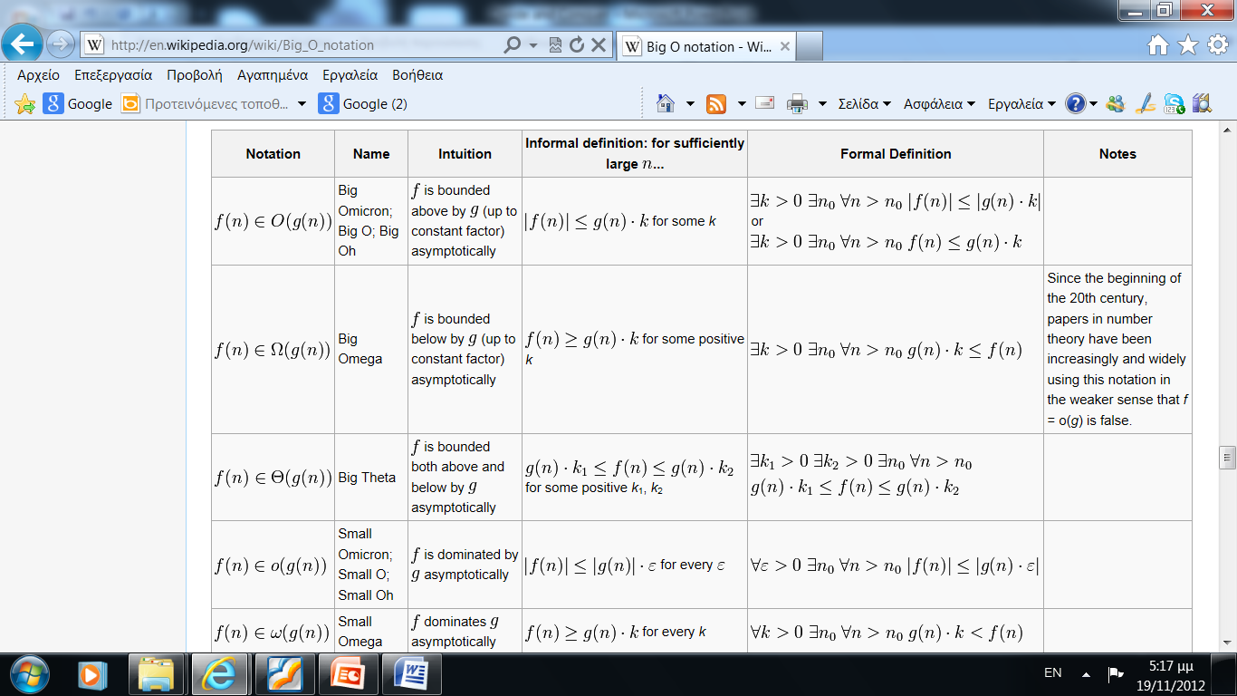
Family of Bachmann–Landau notations
At most
At least
between
absolutely

Slide 6
Multiplication
The mathematician Carl Friedrich Gauss (17771855) once noticed that although the product of two complex numbers
(a + bi)(c + di) = ac-bd + (bc + ad)i
seems to involve four real-number multiplications, it can in fact be done with just three: ac,bd, and (a + b)(c + d), since
bc + ad = (a + b)(c + d)-ac-bd:
In our big-O way of thinking, reducing the number of multiplications from four to three seems wasted ingenuity . But this modest improvement becomes very significant when applied recursively.

Slide 7
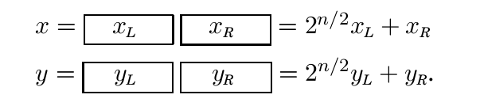

Multiplication
Suppose x and y are two n-bit integers, and assume for convenience that n is a power of
2. As a first step toward multiplying x and y, split each of them into their left and right halves, which are n/2 bits long:
We will compute xy via the expression on the right. The additions take linear time, as do the
multiplications by powers of 2 (which are merely left-shifts). The significant operations are
the four n/2-bit multiplications

Slide 8


Multiplication
Thus our method for multiplying n-bit numbers starts by making recursive calls to
multiply these four pairs of n/2-bit numbers (four subproblems of half the size), and then evaluates the preceding expression in O(n) time. Writing T (n) for the overall running time on n-bit inputs, we get the recurrence relation
THE IMPROVEMENT! This is where Gauss's trick comes to mind. Although the expression for xy seems to demand four n/2-bit multiplications, as before just three will do

Slide 9
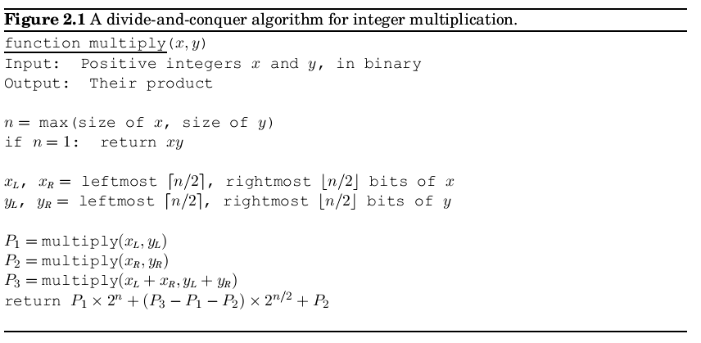
Multiplication

Slide 10
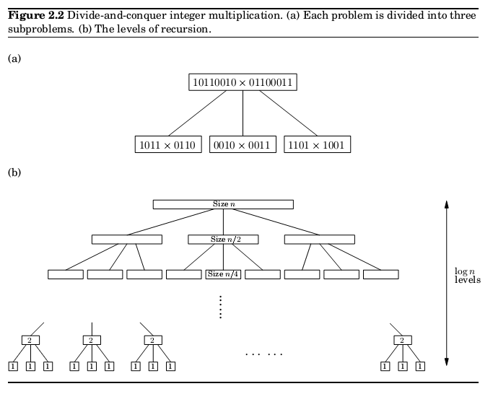

Multiplication recursion Complexity
Therefore, the height of the tree is log₂n. The branching factor is 3 each problem recursively produces three smaller ones with the result that at depth k in the tree there are 3^{k} subproblems, each of size n/2^{k}
For each subproblem, a linear amount of work is done in identifying further subproblems and combining their answers. Therefore the total time spent at depth k in the tree is
At the very top level, when k = 0, this works out to O(n). At the bottom, when k = log₂n,
it is O(3^log₂n), which can be rewritten as O(n^log₂3) =O(n^{1,59})

Slide 11

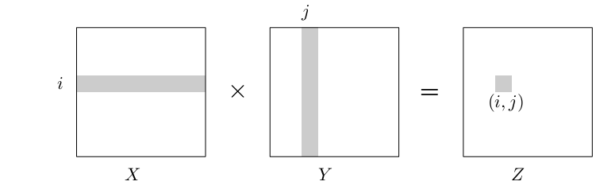
Matrix multiplication
The product of two nxn matrices X and Y is a third nxn matrix Z = XY , with (I,j )th entry
In general, XY is not the same as YX; matrix multiplication is not commutative.

Slide 12


Matrix multiplication
The preceding formula implies an O(n³) algorithm for matrix multiplication: there are n² entries to be computed, and each takes O(n) time.
For quite a while, this was widely believed to be the best running time possible, and it was even proved that in certain models of com-putation no algorithm could do better . It was therefore a source of great excitement when in 1969, the German mathematician Volker Strassen announced a signcantly more efficient algorithm, based upon divide-and-conquer
Matrix multiplication is particularly easy to break into subproblems, because it can be
performed blockwise. To see what this means, carve X into four n/2 Xn/2 blocks, and also Y

Slide 13

Matrix multiplication
We now have a divide-and-conquer strategy: to compute the size-n product XY , recursively compute eight size-n/2 products AE BG AF BH CE DG CF DH, and then do a few O(n²)-time additions. The total running time is described by the recurrence relation
This comes out to an unimpressive O(n³), the same as for the default algorithm. But the
efficiency can be further improved, and as with integer multiplication, the key is some clever algebra. It turns out XY can be computed from just seven n/2 x n/2 subproblems, via a decomposition so tricky and intricate that one wonders how Strassen was ever able to discover it!

Slide 14
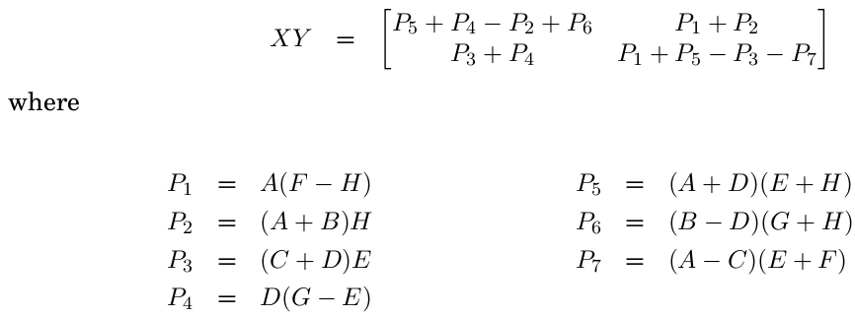
Matrix multiplication

Slide 15
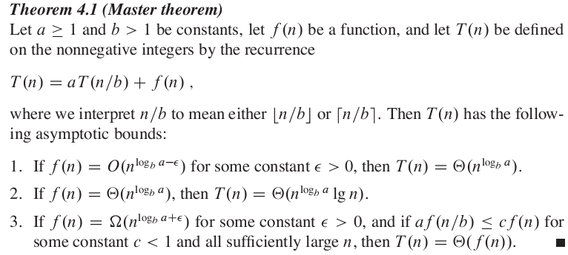
Master theorem

Slide 16
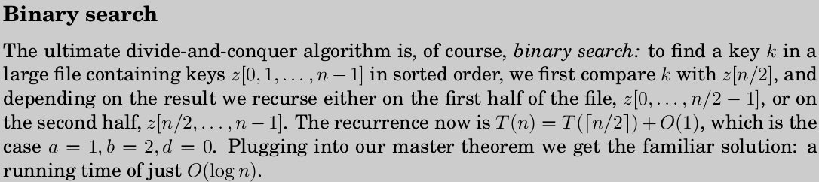
Binary search

Slide 17
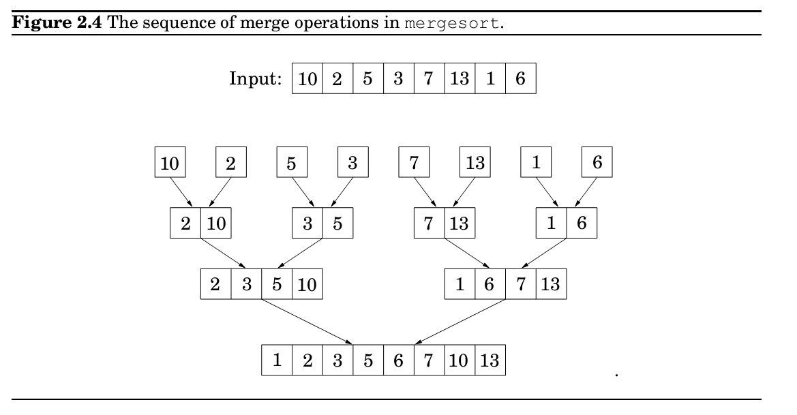
Merge sort

Slide 18
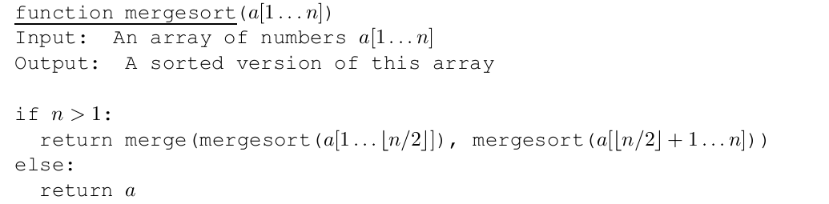
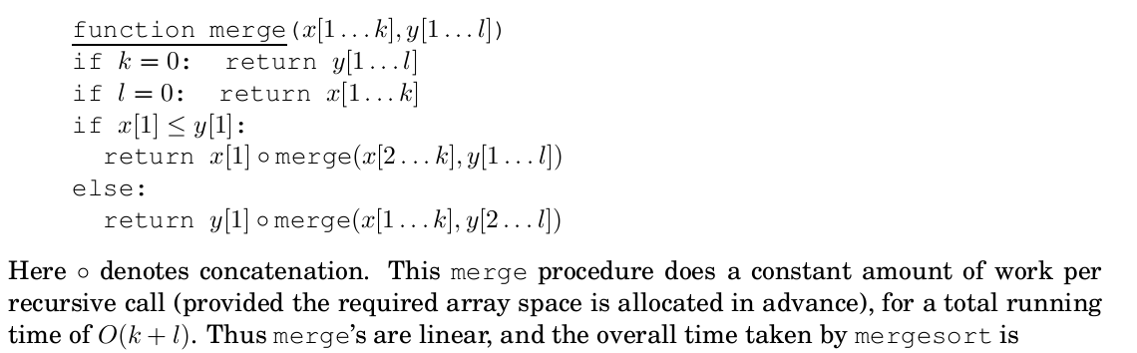


Merge sort

