Slide 1
Greedy Algorithms
Data Structures and Algorithms
A. G. Malamos

Slide 2
Introduction
Greedy algorithms build up a solution piece by piece, always choosing the next piece that offers the most obvious and immediate benefit. Although such an approach can be
disastrous for some computational tasks, there are many for which it is optimal.

Slide 3

Activity Selection and Scheduling
The first problem to discuss is scheduling several competing activities that require exclusive use of a common resource, with a goal of selecting a maximum-size
set of mutually compatible activities.
Assume S={a₁, a₂,..a_{n}} activities each with a finite start time s_{i} and finish time f_{i}
In the activity-selection problem, we wish to select a maximum-size subset of mutually compatible activities. We assume that the activities are sorted in monotonically increasing order of finish time.

Slide 4
Activity Selection and Scheduling
The Greedy choice is to choose first the activity that finishes first, thus leaves enough time for more…
If we make the greedy choice, we have only one remaining subproblem to solve:
finding activities that start after a₁ finishes. Why don’t we have to consider activities that finish before a₁starts? We have that s₁ <f₁, and f₁ is the earliest
finish time of any activity, and therefore no activity can have a finish time less than or equal to s₁. Thus, all activities that are compatible with activity a₁ must start after a₁ finishes.
Let
be the set of activities that start after activity a_{k} finishes. If we make the greedy choice of activity a₁,then S₁ remains as the only subproblem to solve.
Optimal substructure tells us that if a₁ is in the optimal solution, then an optimal solution to the original problem consists of activity a₁ and all the activities in an optimal solution to the subproblem S₁
One big question remains: is our intuition correct?

Slide 5
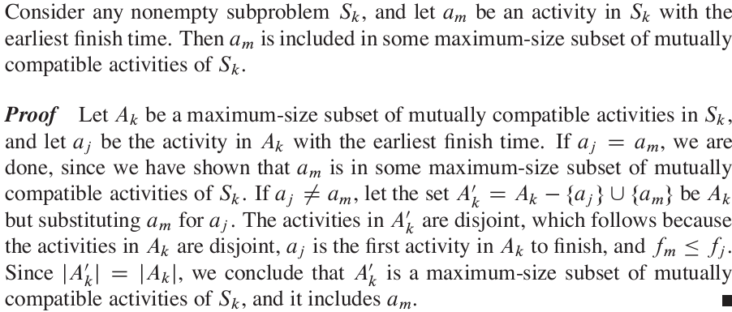
Activity Selection and Scheduling Theorem
In other words.. Since f_{m}<=f_{j} then if a_{j} belongs to a optimal subset… then a_{m} belongs as well

Slide 6
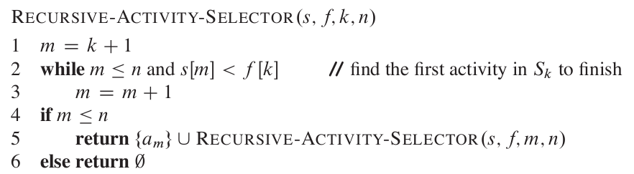
Activity Selection and Scheduling The recursive solution

Slide 7
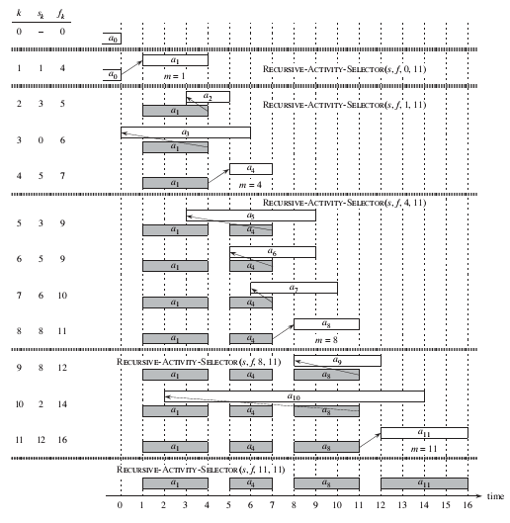

Slide 8
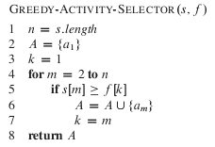
Activity Selection and Scheduling The iterative solution

Slide 9
The Greedy Strategy
A greedy algorithm obtains an optimal solution to a problem by making a sequence
of choices. At each decision point, the algorithm makes choice that seems best at
the moment. This heuristic strategy does not always produce an optimal solution,
but as we saw in the activity-selection problem, sometimes it does. This section
discusses some of the general properties of greedy methods.
The process that we followed in Section 16.1 to develop a greedy algorithm was
a bit more involved than is typical. We went through the following steps:
1. Determine the optimal substructure of the problem.
2. Develop a recursive solution. (For the activity-selection problem, we formu-lated recurrence (16.2), but we bypassed developing a recursive algorithm based
on this recurrence.)
3. Show that if we make the greedy choice, then only one subproblem remains.
4. Prove that it is always safe to make the greedy choice. (Steps 3 and 4 can occur
in either order.)
5. Develop a recursive algorithm that implements the greedy strategy.
6. Convert the recursive algorithm to an iterative algorithm.

Slide 10
The Greedy Strategy
More generally, we design greedy algorithms according to the following sequence
of steps:
1. Cast the optimization problem as one in which we make a choice and are left
with one subproblem to solve.
2. Prove that there is always an optimal solution to the original problem that makes
the greedy choice, so that the greedy choice is always safe.
3. Demonstrate optimal substructure by showing that, having made the greedy
choice, what remains is a subproblem with the property that if we combine an
optimal solution to the subproblem with the greedy choice we have made, we
arrive at an optimal solution to the original problem

Slide 11
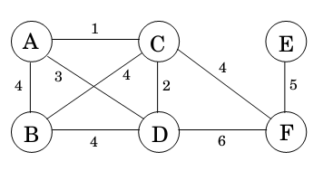
Minimum spanning trees
Suppose you are asked to network a collection of computers by linking selected pairs of them.This translates into a graph problem in which nodes are computers, undirected edges are potential links, and the goal is to pick enough of these edges that the nodes are connected.
But this is not all; each link also has a maintenance cost, reflected in that edge's weight. What is the cheapest possible network?
One immediate observation is that the optimal set of edges cannot contain a cycle, because removing an edge from this cycle would reduce the cost without compromising connectivity.

Slide 12
MST
Property 1 Removing a cycle edge cannot disconnect a graph.
So the solution must be connected and acyclic: undirected graphs of this kind are called trees.
The particular tree we want is the one with minimum total weight, known as the minimum spanning tree.

Slide 13
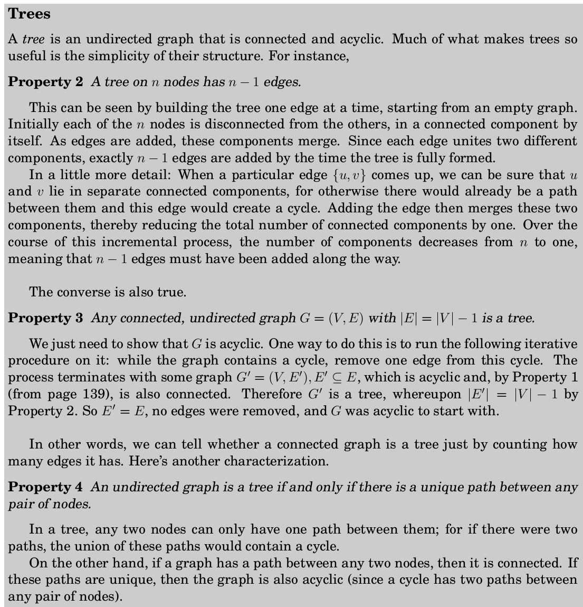
To remember

Slide 14
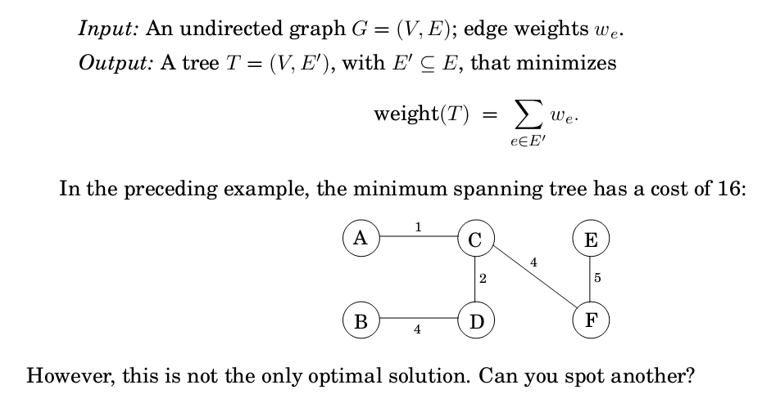
MST

Slide 15
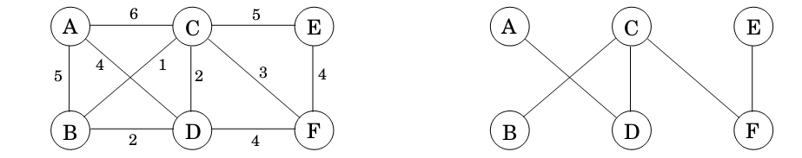
MST Kruskal
Kruskal's minimum spanning tree algorithm starts with the empty graph and then selects
edges from E according to the following rule.
Repeatedly add the next lightest edge that doesn't produce a cycle.
This is a greedy algorithm: Every decision it makes is the one with the most obvious immediate advantage.
In the example. We start with an empty graph and then attempt to add
edges in increasing order of weight (ties are broken arbitrarily):
B C; C D; B D; C F; D F; E F; A D; A B; C E; A C:
The first two succeed, but the third, B D, would produce a cycle if added. So we ignore it and move along. The final result is a tree with cost 14, the minimum possible.

Slide 16
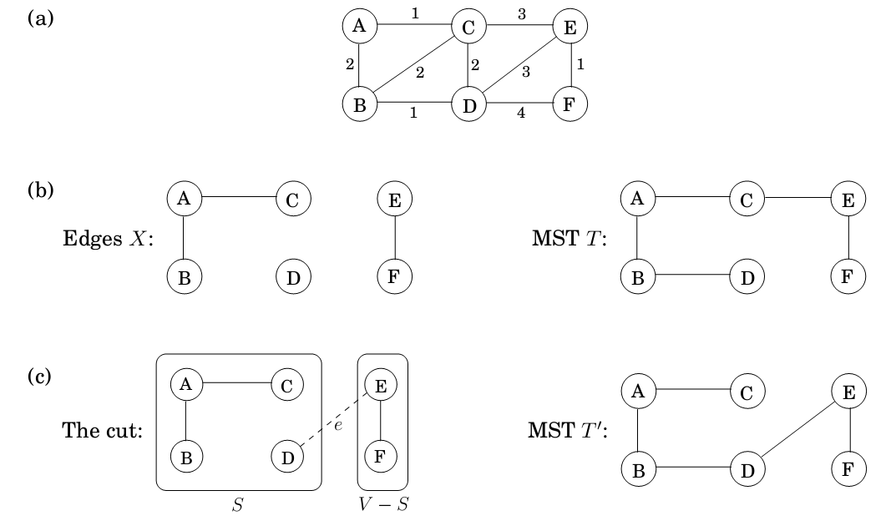
Cut Property
Cut property: Suppose edges X are part of a minimum spanning tree of G = (V; E). Pick any subset of nodes S for which X does not cross between S and V-S, and let e be the lightest edge across this partition. Then X Ue is part of some MST
A cut is any partition of the vertices into two groups, S and V-S. What this property says is that it is always safe to add the lightest edge across any cut (that is, between a vertex in S and one in V -S), provided X has no edges across the cut.

Slide 17
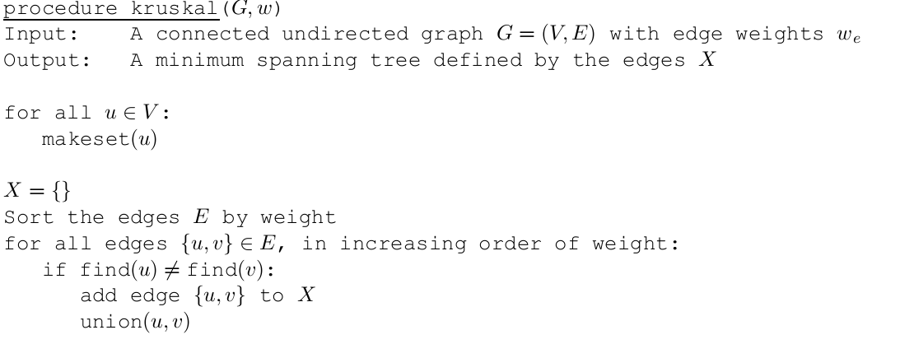
MST Kruskal
makeset(x): create a singleton set containing just x.
find(x): to which set does edge x belong?
Union u,v produces a new set from the union of the u,v, thus all the corresponding nodes are related now in the same set.
The algorithm creates sets of vertices and checks if a new edge connect two vertices of the same set. If so then it is an edge that produces a cycle and must be ignored

Slide 18
Huffman encoding
In the MP3 audio compression scheme, a sound signal is encoded in three steps.
It is digitized by sampling at regular intervals, yielding a sequence of real numbers
s1,s2,s3….
For instance, at a rate of 44;100 samples per second, a 50-minute symphony
would correspond to T = 50 x 60 x 44.100 = 130 million measurements.
2. Each real-valued sample s is quantized: approximated by a nearby number from a
finite set Γ. This set is carefully chosen to exploit human perceptual limitations, with
the intention that the approximating sequence is indistinguishable from by the human ear .
3. The resulting string of length T over alphabet Γ is encoded in binary .
It is in the last step that Huffman encoding is used. To understand its role, let's look at a toy example in which T is 130 million and the alphabet consists of just four values, denoted by the symbols A; B; C; D. What is the most economical way to write this long string in binary?
The obvious choice is to use 2 bits per symbolsay codeword 00 for A, 01 for B, 10 for C , and 11 for D in which case 260 megabits are needed in total. Can there possibly be a better encoding than this?

Slide 19
Huffman
Is there some sort of variable-length encoding, in which just one bit is used for the frequently occurring symbol A, possibly at the expense of needing three or more bits for less common symbols?
A danger with having codewords of different lengths is that the resulting encoding may not be uniquely decipherable. For instance, if the codewords are 0; 01; 11; 001, the decoding of strings like 001 is ambiguous. We will avoid this problem by insisting on the prefix-free property: no codeword can be a prex of another codeword.
Any prefix free encoding can be represented by a full binary tree that is, a binary tree in
which every node has either zero or two children where the symbols are at the leaves, and
where each codeword is generated by a path from root to leaf , interpreting left as 0 and right as 1

Slide 20
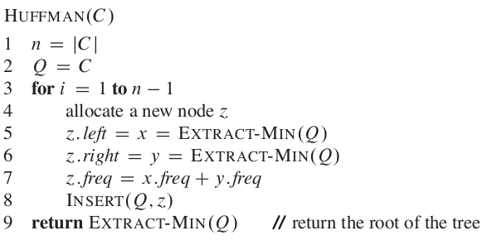
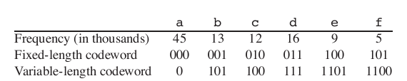
Huffman

Slide 21
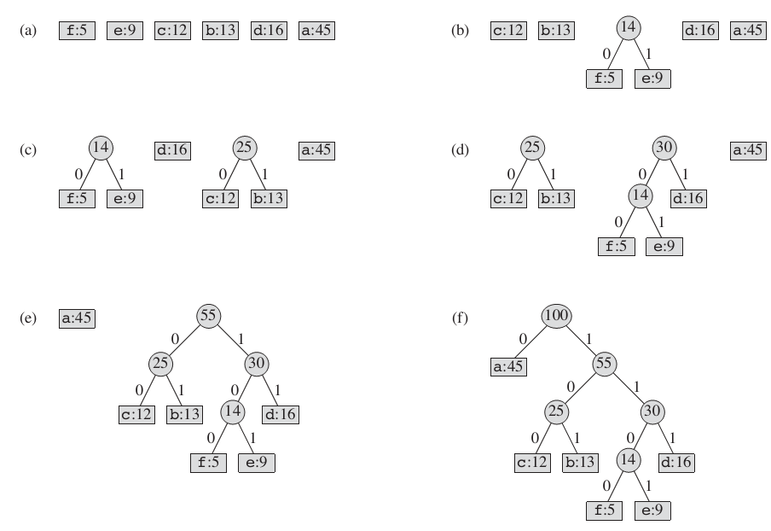
Huffman

