Slide 1
Linear Programming
Data Structures and Algorithms
A.G. Malamos
References:
Algorithms, 2006, S. Dasgupta, C. H. Papadimitriou, and U . V . Vazirani
Introduction to Algorithms, Cormen, Leiserson, Rivest & Stein

Slide 2
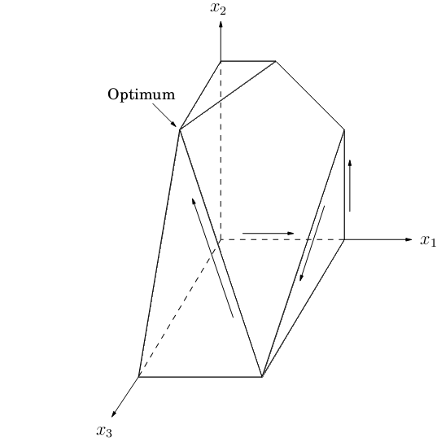
Intro
Linear programming describes a broad class of optimization tasks in which both the constraints and the optimization criterion are linear functions.
In a linear programming problem we are given a set of variables, and we want to assign real values to them so as to
(1) satisfy a set of linear equations and/or linear inequalities involving
these variables and
(2) maximize or minimize one (or more) given linear objective function
Feasible solutions are in the polyhedron that is produced by the constraints and is usually the highest point of the volume

Slide 3
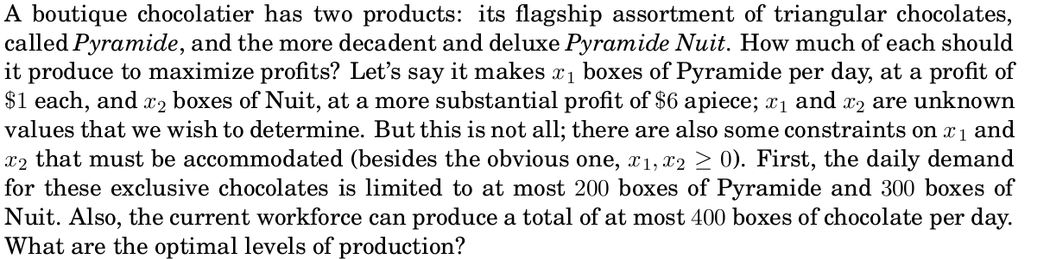
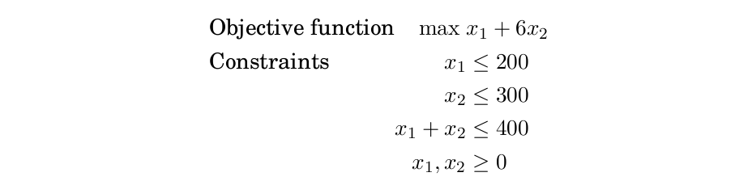
Profit Maximization

Slide 4
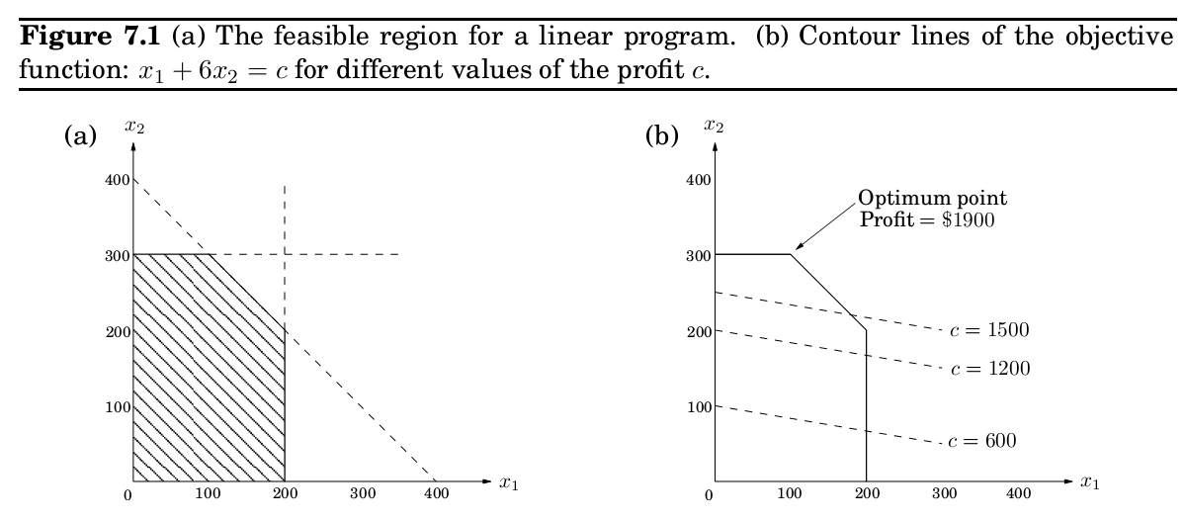
Profit Maximization (feasible and optimal)

Slide 5
Feasible and optimal solution
It is a general rule of linear programs that the optimum is achieved at a vertex of the feasible region. The only exceptions are cases in which there is no optimum; this can happen in two ways:
1. The linear program is infeasible; that is, the constraints are so tight that it is impossible to satisfy all of them.
2. The constraints are so loose that the feasible region is unbounded, and it is possible to achieve arbitrarily high objective values.

Slide 6
Variants of linear programming
As evidenced in our example, a general linear program has many degrees of freedom.
1. It can be either a maximization or a minimization problem.
2. Its constraints can be equations and/or inequalities.
3. The variables are often restricted to be nonnegative, but they can also be unrestricted in sign.
How can we transform on LP problem to another?
By applying transformations we can reduce any LP (maximization or minimization, with both inequalities and equations, and with both nonnegative and unrestricted variables) into an LP of a much more constrained kind that we call the standard form, in which the variables are all nonnegative, the constraints are all equations, and the objective function is to be minimized.

Slide 7
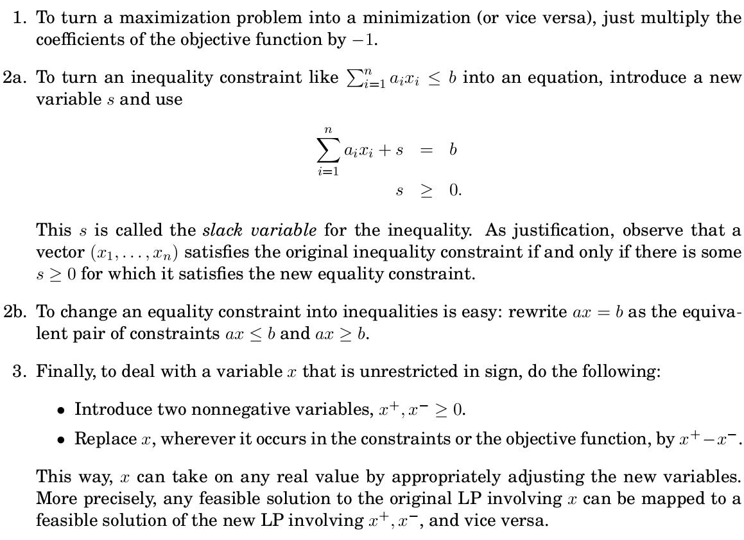
Variants of linear programming

Slide 8
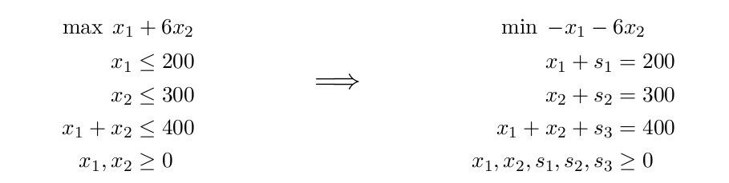
Variants of linear programming

Slide 9
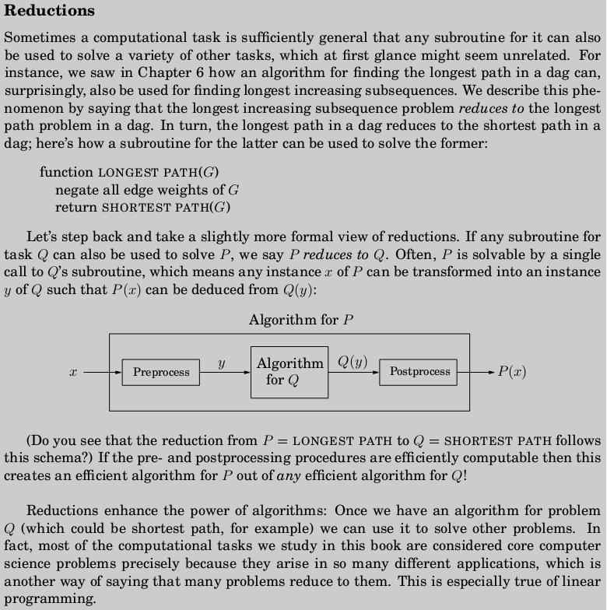
Important! Think theoretically with sets, graphs etc not with code and programming APIs

Slide 10
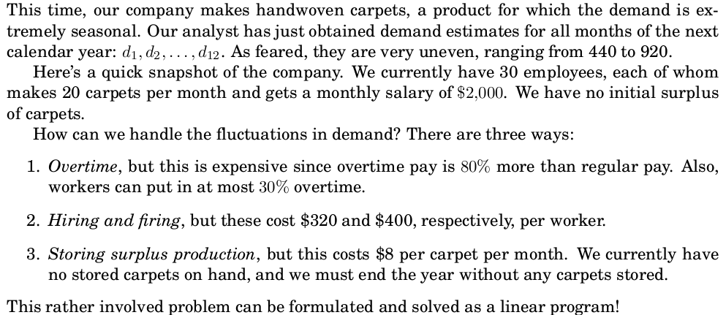
Examples: Production Planning

Slide 11
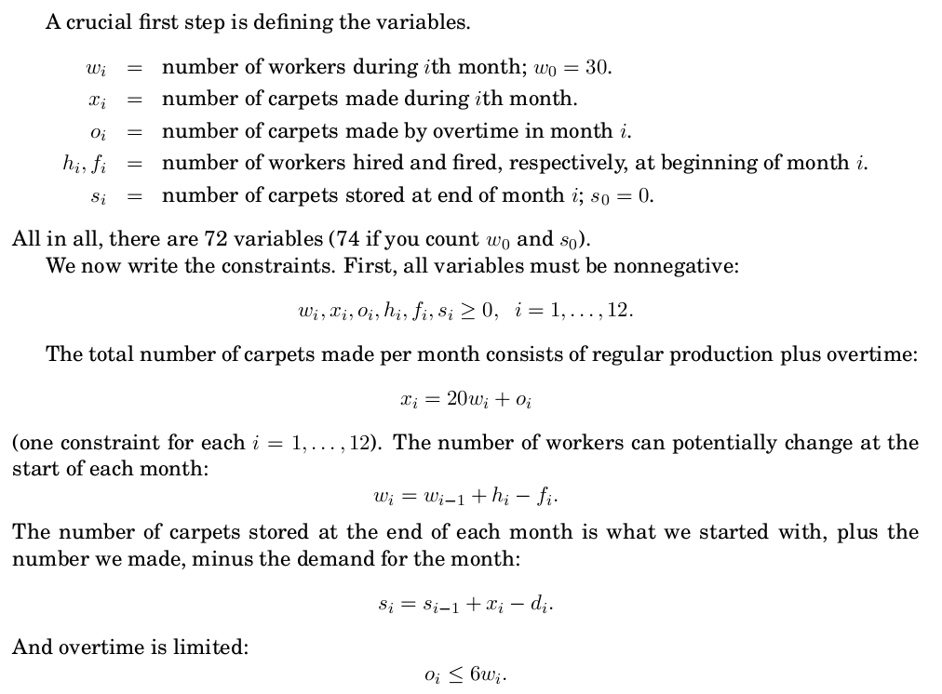
Production Planning

Slide 12
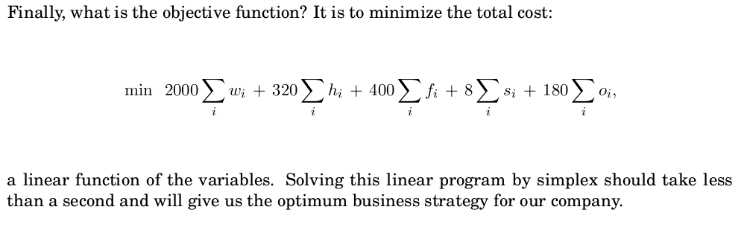
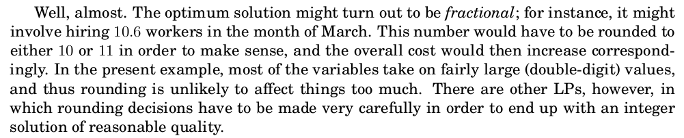
Production Planning

Slide 13
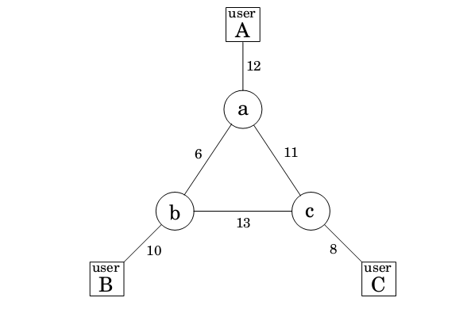
Optimum Bandwidth Allocation
Suppose we are managing a network whose lines have the bandwidths shown in Fig. and we need to establish three connections: between users A and B, between B and C , and between A and C .
Each connection requires at least two units of bandwidth, but can be assigned more. Connection AB pays $3 per unit of bandwidth, and connections BC and AC pay $2 and $4, respectively .
Each connection can be routed in two ways, a long path and a short path, or by a combination: for instance, two units of bandwidth via the short route, one via the long route. How do we route these connections to maximize our network's revenue?

Slide 14
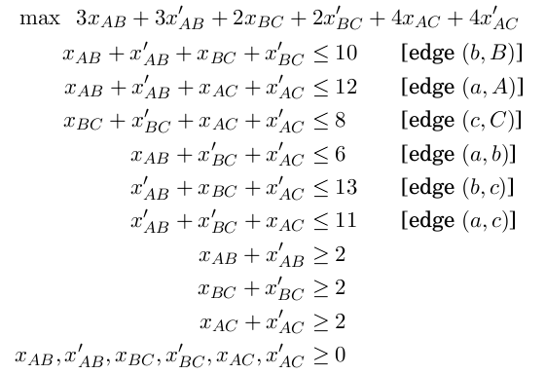
Optimum Bandwidth Allocation
This is a linear program. We have variables for each connection and each path (long or short); for example, x_{AB} is the short-path bandwidth allocated to the connection between A and B, and x’_{Ab} the long-path bandwidth for this same connection. We demand that no edge‘s bandwidth is exceeded and that each connection gets a bandwidth of at least 2 units.

Slide 15
Optimum Bandwidth Allocation
Even a tiny example like this one is hard to solve on one's own (try it!), and yet the optimal solution is obtained instantaneously via simplex:
Every edge except a-c is used at full capacity .

Slide 16
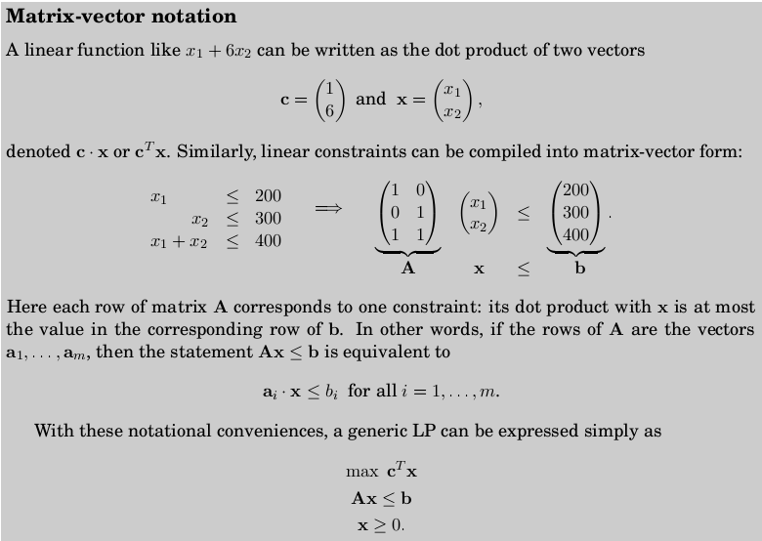

Slide 17
Assignments
1. A store has requested a manufacturer to produce shirts and trousers.
For materials, the manufacturer has 750 m² of cotton textile and 1,000 m² of wool. Every pair of shirts (1 unit) needs 1 m² of cotton and 2 m² of wool. Every trouser needs 1.5 m² of cotton and 1 m² of wool.
The price of the shirts is fixed at 34€ and the trousers 64€ .
What is the number of shirts and trousers that the manufacturer must give to the stores so that these items obtain a maximum sale? (Just Express the problems into matrix vector LP format. Do not solve it.)
2. Express 7.2, 7.3, 7.4 and 7.5 prob;lems of textbook in matrix vector LP format. Do not solve them.

Slide 18
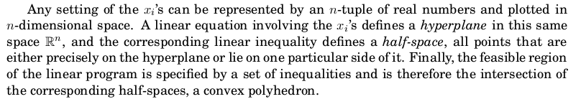
The Simplex algorithm
At a high level, the simplex algorithm takes a set of linear inequalities and a linear objec-tive function and finds the optimal feasible point by the following strategy:
let v be any vertex of the feasible region
while there is a neighbor v’ of v with better objective value:
set v = v’

Slide 19
Simplex
Pick a subset of the inequalities. If there is a unique point that satisfies them with
equality , and this point happens to be feasible, then it is a vertex.
Each vertex is specified by a set of n inequalities
Two vertices are neighbors if they have n-1 defining inequalities in common
I have reached optimality when all objective function coefficients in LP are becoming negative… ( objective function changes slope from increasing –positive coeficient to decreasing –negative coeficient)

Slide 20
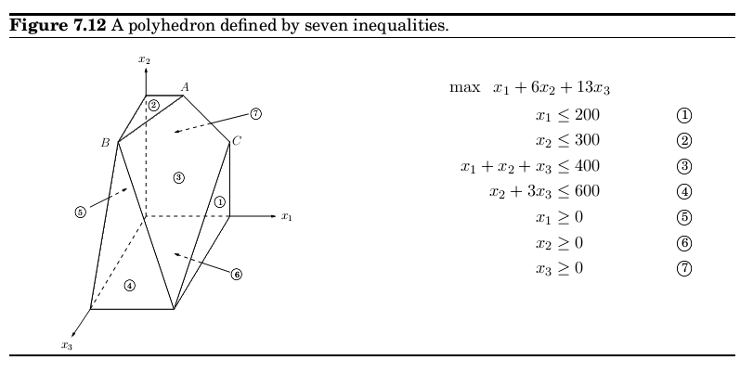
Simplex
Neighbors

Slide 21
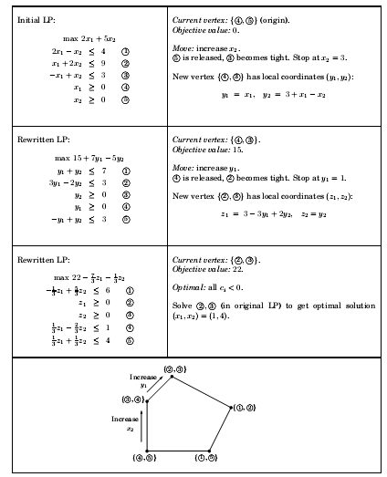

Slide 22
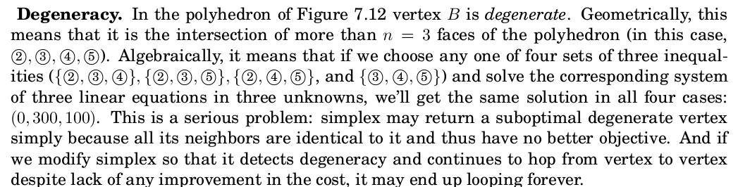
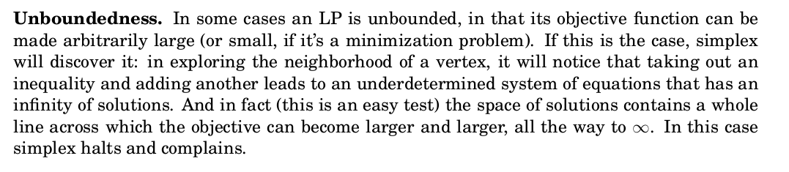
Degeneracy in vertices of solution spaces in Simpex

Slide 23

Simplex complexity
What is the running time of simplex, for a generic linear program
max c^{T}x such that Ax =<0 and x>=0;
where there are n variables and A contains m inequality constraints?
It is proved that the running time per iteration of simplex is just O(mn). But how many
iterations could there be? Naturally , there can't be more than , * which is an upper bound on the number of vertices. But this upper bound is exponential in n. And in fact, there are examples of LPs for which simplex does indeed take an exponential number of iterations. In other words, simplex is an exponential-time algorithm. However , such exponential examples do not occur in practice, and it is this fact that makes simplex so valuable and so widely used.
*

Slide 24
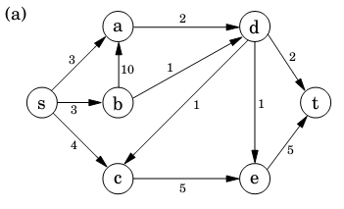
Flow Algorithms
Figure shows a directed graph representing a network of pipelines along which oil can be sent. The goal is to ship as much oil as possible from the source s to the sink t. Each pipeline has a maximum capacity it can handle, and there are no opportunities for storing oil

Slide 25
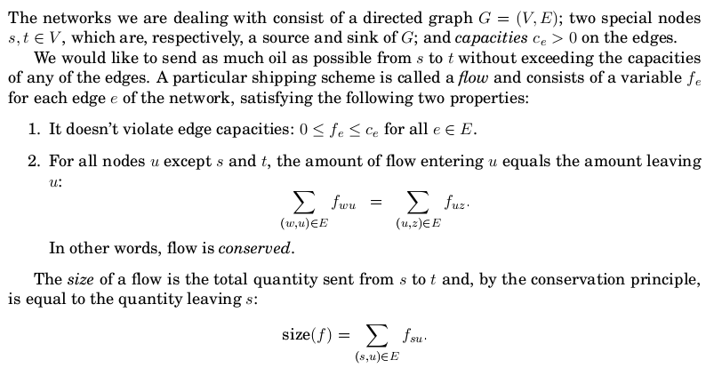
Max Flow

Slide 26

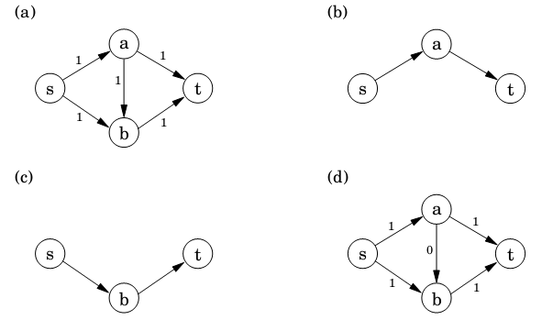
Max Flow

Slide 27
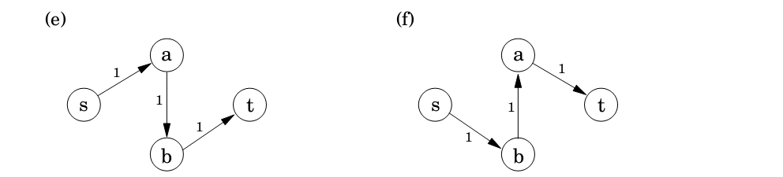
Max Flow
Start with zero flow .
Repeat: choose an appropriate path from s to t, and increase flow along the edges
of this path as much as possible.
Figure 7.5(a)(d) shows a small example in which simplex halts after two iterations. The
final flow has size 2, which is easily seen to be optimal.
There is just one complication. What if we had initially chosen a different path, the one in
Figure 7.5(e)? This gives only one unit of flow and yet seems to block all other paths. Simplex gets around this problem by also allowing paths to cancel existing flow. In this particular
case, it would subsequently choose the path of Figure 7.5(f). Edge (b; a) of this path isn't in
the original network and has the effect of canceling flow previously assigned to edge (a; b).

Slide 28
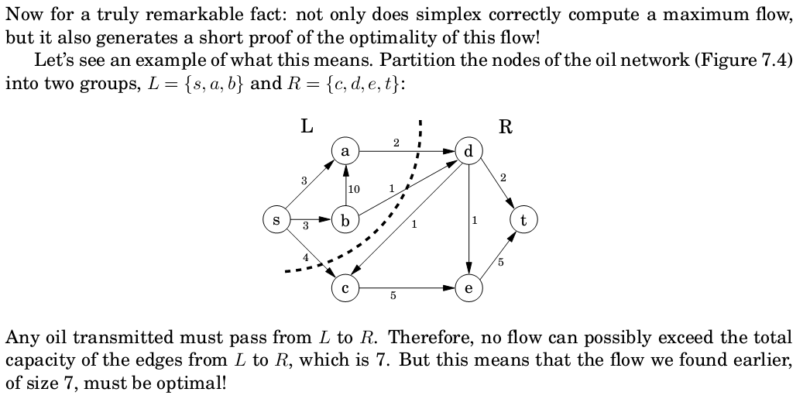
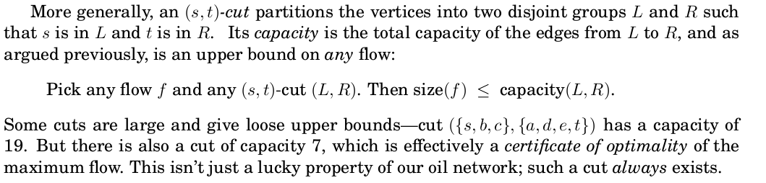
Max Flow – Min Cut
Max-Flow min-cut theorem: The size of the maximum flow in a network equals the capacity of the smallest (s; t)-cut

Slide 29
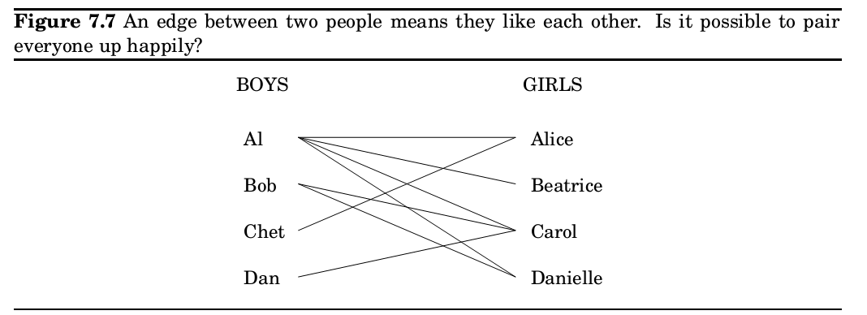
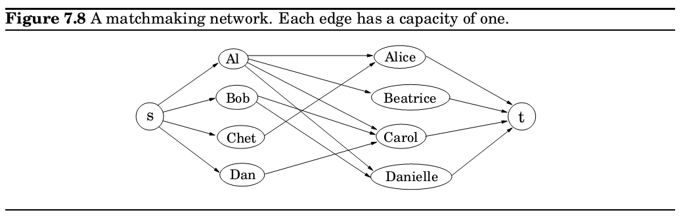
Bipartite matching

Slide 30
Duality
We have seen that maximum flow and minimum cut exactly coincide and each is therefore a certificate of the other's optimality .
It turns out that every linear maximization problem has a dual minimization problem, and they relate to each other in much the same way as flows and
cuts

Slide 31
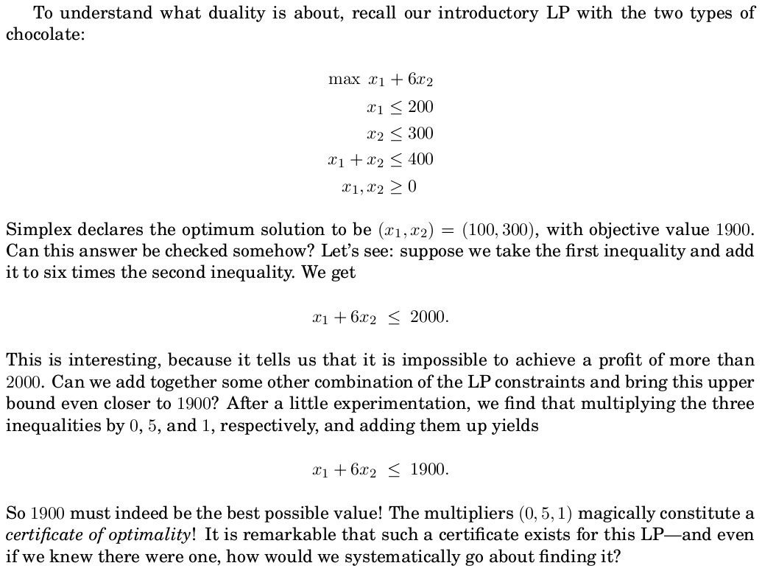

Slide 32
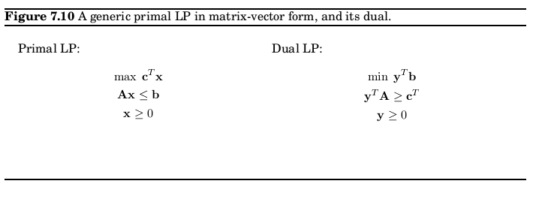
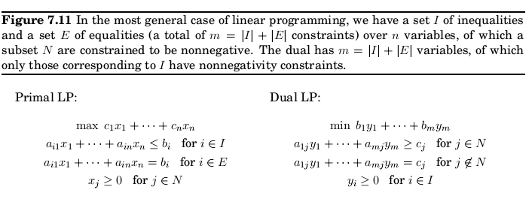
Primal Dual
Duality theorem If a linear program has a bounded optimum, then so does its dual, and the two optimum values coincide.

