Slide 1
NP-Complete Problems
Data Structures and Algorithms
A.G. Malamos
References:
Algorithms, 2006, S. Dasgupta, C. H. Papadimitriou, and U . V . Vazirani
Introduction to Algorithms, Cormen, Leiserson, Rivest & Stein

Slide 2
Intro
Over the course we have developed algorithms for finding shortest paths and
minimum spanning trees in graphs, matchings in bipartite graphs, maximum increasing sub-sequences, maximum flows in networks, and so on. All these algorithms are efficient, because in each case their time requirement grows as a polynomial function (such as n, n^2, n^3 of the size of the input.
To better appreciate such efficient algorithms, consider the alternative: In all these problems we are searching for a solution (path, tree, matching, etc.) from among an exponential population of possibilities. Indeed, n boys can be matched with n girls in n! different ways, a graph with n vertices has n^(n-2) spanning trees, and a typical graph has an exponential number of paths from s to t. All these problems could in principle be solved in exponential time by checking through all candidate solutions, one by one. But an algorithm whose running time is 2^n, or worse, is all but useless in practice (see the next box). The quest for efficient algorithms
is about finding clever ways to bypass this process of exhaustive search, using clues from the input in order to dramatically narrow down the search space.

Slide 3
Intro
We will introduce a number of important search problems, some of which are familiar from earlier lectures and for which there are efficient algorithms, and others which
are different in small but crucial ways that make them very hard computational problems.

Slide 4
Satisfiability
The SAT problem is the following: given a Boolean formula in conjunctive normal form, either find a satisfying truth assignment or else report that none exists.
In the instance shown
(x+y+z)*(x’+y’)*(x’+y’+x)
SAT is a typical search problem. We are given an instance I (that is, some input data
specifying the problem at hand, in this case a Boolean formula in conjunctive normal form), and we are asked to find a solution S (an object that meets a particular specification, in this case an assignment that satisfies each clause). If no such solution exists, we must say so.
A search problem is specified by an algorithm C that takes two inputs, an instance I and a proposed solution S, and runs in time polynomial in jI j. We say S is a solution to I if and only if C (I ; S) = true.
researchers over the past 50 years have tried hard to find efficient ways to solve it, but without success. The fastest algorithms we have are still exponential on their worst-case inputs

Slide 5
Satisfiability
However…..If all clauses contain at most one positive literal, then the Boolean formula is called a Horn formula, and a satisfying truth assignment, if one exists, can be found by the greedy algorithm
Alternatively , if all clauses have only two literals, then graph theory comes into play , and SAT can be solved in linear time by finding the strongly connected components of a particular graph constructed from the instance
On the other hand, if we are just a little more permissive and allow clauses to contain three literals, then the resulting problem, known as 3SAT (an example of which we saw earlier), once again becomes hard to solve!

Slide 6
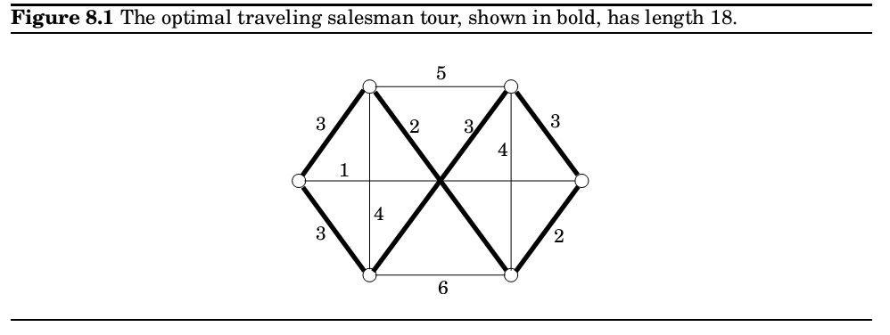
The travelling salesman problem
In the traveling salesman problem (TSP) we are given n vertices 1… n and all n(n -1)/2 distances between them, as well as a budget b. We are asked to find a tour, a cycle that passes through every vertex exactly once, of total cost b or less or to report that no such tour exists.
That is, we seek a permutation τ1…τn of the vertices such that when they are toured in this order , the total distance covered is at most b:

Slide 7
TSP
Notice how we have defined the TSP as a search problem: given an instance, find a tour within the budget (or report that none exists).
Turning an optimization problem into a search problem does not change its difficulty at all ,because the two versions reduce to one another. Any algorithm that solves the optimization TSP also readily solves the search problem find the optimum tour and if it is within budget, return it; if not, there is no solution.
There are no known polynomial-time algorithms for the TSP, despite much
effort by researchers over nearly a century . Of course, there is an exponential algorithm for solving it, by trying all (n-1)! tours, and in previous lecture we saw a faster , yet still exponential, dynamic programming algorithm.

Slide 8
MSP
The minimum spanning tree ( MST) problem, for which we do have efficient algorithms, provides similarities with TSP. To phrase it as a search problem, we are again given a distance matrix D{dij} and a bound b, and are asked to find a tree T with total weight P = Σdij<=b.
The TSP can be thought of as a tough cousin of the MST problem, yet MST has efficient solution while TSP doesn’t.

Slide 9
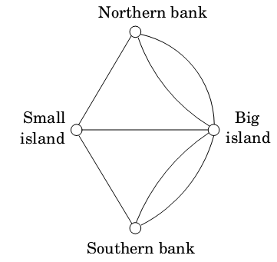
Euler: The bridges of Konigsberg
In the summer of 1735 Leonhard Euler was walking the bridges of the East Prussian town of Konigsberg. After a while, he noticed in that, no matter where he started his walk, no matter how cleverly he continued, it was impossible to cross each bridge exactly once. This was the beginning of graph theory….

Slide 10
Euler: The bridges of Konigsberg
This graph has multiple edges between two vertices since each bridge should be represented by an individual edge. We are looking for a path that goes through each edge exactly once (the path is allowed to repeat vertices only not edges). In other words, we are asking this question:
When can a graph be drawn without lifting the pencil from the paper?
The answer discovered by Euler is simple, elegant, and intuitive: If and only if
The graph is connected and
every vertex, with the possible exception of two vertices (the start and final vertices of the walk), has even degree This is why Konigsberg's park was impossible to traverse: all four vertices have odd degree (number of edges)
Expressing Euler problem as a search problem.
EULER PATH: Given a graph, find a path that contains each edge exactly once. It follows from Euler‘s observation, and a little more thinking, that this search problem can be solved in polynomial time.

Slide 11
Euler and Rudrata
Almost a millennium before Euler', a Kashmiri poet named Rudrata had asked this question: Can one visit all the squares of the chessboard, without repeating any square, in one long walk that ends at the starting square and at each step makes a legal knight move? This is again a graph problem: the graph now has 64 vertices, and two squares are joined by an edge if a knight can go from one to the other in a single move
This is a different kind of search problem in graphs: we want a cycle that goes through all vertices (as opposed to all edges in Euler's problem), without repeating any vertex. And there is no reason to stick to chessboards; this question can be asked of any graph.
RUDRATA CYCLE search problem to be the following
Given a graph, find a cycle that visits each vertex exactly once or report that no such cycle exists.
This problem looks like of the TSP, and indeed no polynomial algorithm is known for it.

Slide 12
Euler and Rudrata
There are two differences between the definitions of the Euler and Rudrata problems.
The fist is that Euler's problem visits all edges while Rudrata's visits all vertices.
But there is also the issue that one of them demands a path while the other requires a cycle.
Which of these differences accounts for the huge disparity in computational complexity between the two problems? It must be the first, because the second difference can be shown to be purely cosmetic.
Indeed, define the RUDRATA PATH problem to be just like RUDRATA CYCLE, except that the goal is now to find a path that goes through each vertex exactly once.

Slide 13
Cuts and bisections
A cut is a set of edges whose removal leaves a graph disconnected.
It is often of interest to find small cuts, and the MI NIMUM CUT problem is, given a graph and a budget b, to find a cut with at most b edges. This problem can be solved in polynomial time by n-1 max-flow computations: give each edge a capacity of 1, and find the maximum flow between some fixed node and every single other node. The smallest such flow will correspond (via the max-flow min-cut theorem) to the smallest cut
Far more interesting are small cuts that partition the vertices of the graph into nearly equal-sized sets (BALANCED CUT).
More precisely , the BALANCED CUT problem is this: given a graph with n vertices and a number b, partition the vertices into two sets S and T such that S, T >= n/3 and such that there are at most b edges between S and T .
Another hard problem!!!!

Slide 14
Bisections application ideas
Balanced cuts arise in a variety of important applications, such as clustering. Consider
for example the problem of segmenting an image into its constituent components (say , an elephant standing in a grassy plain with a clear blue sky above). A good way of doing this is to create a graph with a node for each pixel of the image and to put an edge between nodes whose corresponding pixels are spatially close together and are also similar in color . A single object in the image (like the elephant, say) then corresponds to a set of highly connected vertices in the graph. A balanced cut is therefore likely to divide the pixels into two clusters without breaking apart any of the primary constituents of the image. The first cut might, for instance, separate the elephant on the one hand from the sky and from grass on the other . A further cut would then be needed to separate the sky from the grass.

Slide 15
Integer linear programming
Even though the simplex algorithm is not polynomial time, we mentioned in previous lecture that there is a different, polynomial algorithm for linear programming. Therefore, linear programming is efficiently solvable both in practice and in theory .
But the situation changes completely if , in addition to specifying a linear objective function and linear inequalities, we also constrain the solution (the values for the variables) to be integer. This latter problem is called INTEGER LINEAR PROGRAMMING (ILP).
We define ILP to be following search problem: given A and b, find a nonnegative integer vector x satisfying the inequalities Ax <= b, or report that none exists. Despite the many crucial applications of this problem, and intense interest by researchers, no efficient algorithm is known for it.

Slide 16
Three-dimensional matching
Recall the BI PARTI TE MATCHI NG problem: given a bipartite graph with n nodes on each side (the boys and the girls), find a set of n disjoint edges, or decide that no such set exists. In previous section, we saw how to efficiently solve this problem by a reduction to maximum flow.
However , there is an interesting generalization, called 3D MATCHI NG, for which no polynomial algorithm is known. In this new setting, there are n boys and n girls, but also n pets, and the compatibilities among them are specied by a set of triples, each containing a boy , a girl, and a pet. Intuitively , a triple (b; g; p) means that boy b, girl g, and pet p get along well together . We want to find n disjoint triples and thereby create n harmonious households.

Slide 17
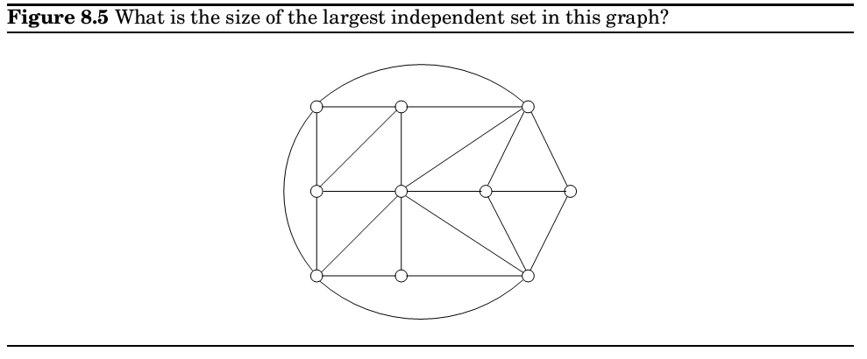
Independent set, vertex cover , and clique
In the I NDEPENDENT SET problem (recall Section 6.7) we are given a graph and an integer g, and the aim is to find g vertices that are independent, that is, no two of which have an edge between them. We saw in Section 6 that this problem can be solved efficiently on trees, but for general graphs no polynomial algorithm is known.
There are many other search problems about graphs. In VERTEX COVER, for example, the input is a graph and a budget b, and the idea is to find b vertices that cover (touch) every edge. Can you cover all edges of Figure 8.5 with seven vertices? With six? (And do you see the intimate connection to the I NDEPENDENT SET problem?

Slide 18
Independent set, vertex cover , and clique
VERTEX COVER is a special case of SET COVER, which we encountered in Chapter 5. In that problem, we are given a set E and several subsets of it, S1… Sm, along with a budget b. We are asked to select b of these subsets so that their union is E.
VERTEX COVER is the special case in which E consists of the edges of a graph, and there is a subset Si for each vertex, containing the edges adjacent to that vertex. Can you see why 3D MATCHI NG is also a special case of SET COVER?
The CLI QUE problem: given a graph and a goal g, find a set of g vertices such that all possible edges between them are present. What is the largest clique in
Figure 8.5? (3 is for sure but is it 4?)

Slide 19
Longest path
We all know that shortest path is a problem with efficient solution.
On the other hand
Assume graph G with nonnegative edge weights and two distinguished vertices s and t, along with a goal g. We are asked to find a path from s to t with total weight at least g.
Naturally , to avoid trivial solutions we require that the path be simple, containing no repeated vertices.
No efficient algorithm is known for this problem (which sometimes also goes by the name of TAXI CAB RIP- OFF).

Slide 20
Knapsack and subset sum
the KNAPSACK problem we are given integer weights w1,..,wn
And integer values v1…vn for n items. We are also given a weight capacity W and a goal g (the former is present in the original optimization problem, the latter is added to make it a search problem). We seek a set of items whose total weight is at most W and whose total value is at least g. As always, if no such set exists, we should say so.
In a previous session we developed a dynamic programming scheme for KNAPSACK with running time O(nW ), which we noted is exponential in the input size, since it involves W rather than log W . And we have the usual exhaustive algorithm as well, which looks at all subsets of items all 2^{n} of them. Is there a polynomial algorithm for KNAPSACK? Nobody knows of one.
A different variation: suppose now that each item's value is equal to its weight (all given in binary), and to top it off, the goal g is the same as the capacity W .

Slide 21
SUBSET SUM
The goal now is to find a subset of a given set of integers that adds up to exactly W . Since it is a special case of KNAPSACK, it cannot be any harder . But could it be polynomial? As it turns out, this problem, called SUBSET SUM, is also very hard.

Slide 22
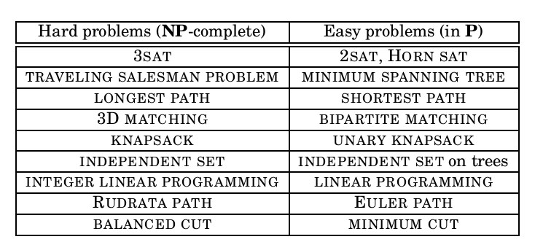
NP-complete problems

Slide 23
P&NP
We know what a search problem is: its defining characteristic is that any proposed solution can be quickly checked for correctness, in the sense that there is an efficient checking algorithm C that takes as input the given instance I (the data specifying the problem to be solved), as well as the proposed solution S, and outputs true if and only if S really is a solution to instance I .
We denote the class of all search problems by NP.
Moreover sometimes the running time of C (I ; S) is bounded by a polynomial in |I| , the length of the instance. The class of all search problems that can be solved
in polynomial time is denoted P.

Slide 24
P<>NP
Are there search problems that cannot be solved in polynomial time? In other words, is P<>NP? Most algorithms researchers think so. It is hard to believe that exponential search can always be avoided, that a simple trick will crack all these hard problems, famously unsolved for decades and centuries. And there is a good reason for mathematicians to believe that P 6 = NP the task of finding a proof for a given mathematical assertion is a search problem and is therefore in NP (after all, when a formal proof of a mathematical statement is written out in excruciating detail, it can be checked mechanically , line by line, by an efficient algorithm). So if P = NP, there would be an efficient method to prove any theorem, thus eliminating the need for mathematicians! All in all, there are a variety of reasons why it is widely believed that P <>NP. However , proving this has turned out to be extremely difficult, one of the deepest and most important unsolved puzzles of mathematics.
Next Thursday Reductions !!!!!!!!

Slide 25
Reductions
What evidence do we have that the left side problems have no
efficient algorithm (besides, of course, the historical fact that many clever mathematicians and computer scientists have tried hard and failed to find any)?
Such evidence is provided by reductions, which translate one search problem into another.
What's more, we will also use reductions to show that these problems are the hardest search problems in NP if even one of them has a polynomial time algorithm, then every problem in NP has a polynomial time algorithm.

Slide 26
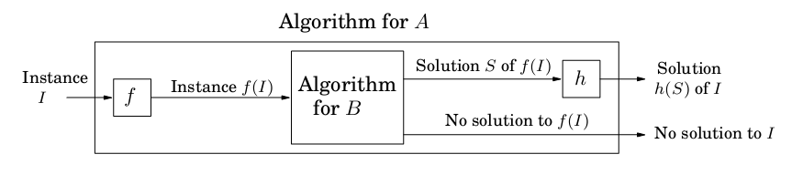
Reductions
A reduction from search problem A to search problem B is a polynomial-time algorithm f that transforms any instance I of A into an instance f (I ) of B, together with another polynomial-time algorithm h that maps any solution S of f (I ) back into a solution h(S) of I
A search problem is NP-complete if all other search problems reduce to it.

Slide 27
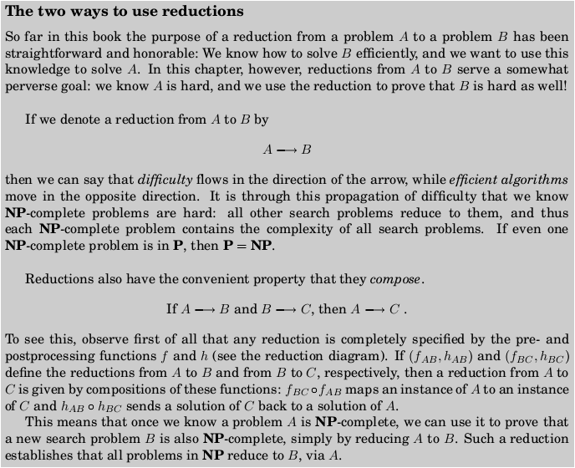
Reductions

Slide 28
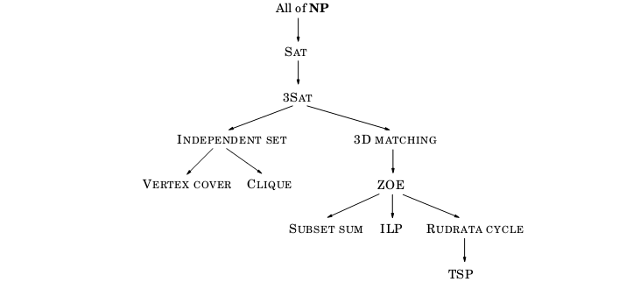
Reductions

Slide 29
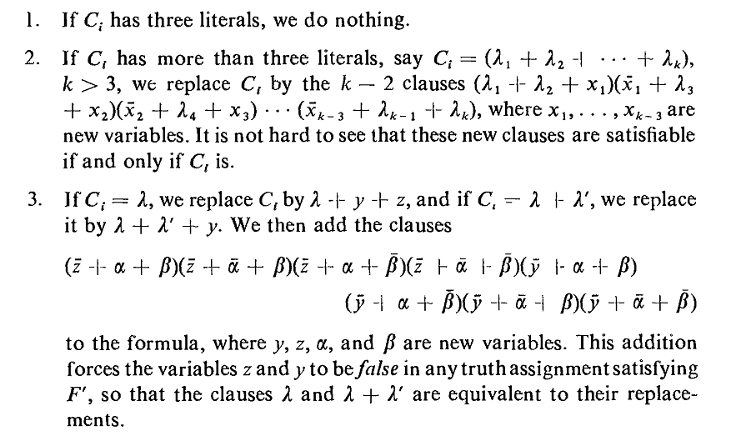
SAT→3SAT
Assume F binary function with more than 3 variables per clause.
We shall construct a F’ that is equivalent to F (has exact truth table)
The construction is as follows*:
Papadimitriou and Steiglitz , “Combinatorial Optimization – Algorithms and Complexity”, Dover Publications 1982

Slide 30
3SAT → INDEPENDENT SET
In 3SAT the input is a set of clauses, each with three or fewer literals, for example
In INDEPENDENT SET the input is a graph and a number g, and the problem is to find a set of g pair-wise non-adjacent vertices.

Slide 31
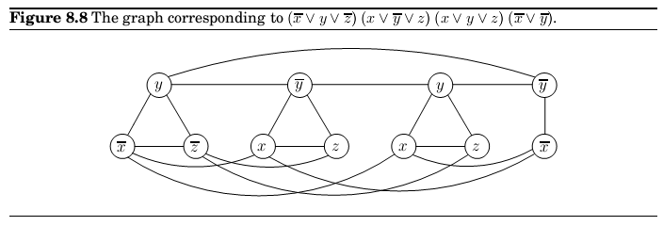
3SAT → INDEPENDENT SET
So, let us represent a clause, say (x _ y _ z), by a triangle, with vertices labeled x y, z. Why
triangle? Because a triangle has its three vertices maximally connected, and thus forces us
to pick only one of them for the independent set.
Repeat this construction for all clauses a clause with two literals will be represented simply by an edge joining the literals.
Put an edge between any two vertices that correspond to opposite literals.
Given an instance I of 3SAT, we create an instance (G, g) of INDEPENDENT SET

Slide 32
3SAT → INDEPENDENT SET
Clearly , this construction takes polynomial time. However , recall that for a reduction we do not just need an efficient way to map instances of the first problem to instances of the second, but also a way to reconstruct a solution to the first instance from any solution of the second (the function h).
There are two things to show:
Given an independent set S of g vertices in G, it is possible to efficiently recover a satisfying truth assignment to I .
(The clause contain OR operations, thus if atleast one is TRUE then all clause is TRUE)
If graph G has no independent set of size g, then the Boolean formula I is unsatisfiable
(If there is no independent set with size g then one or more clauses will be FALSE and since clauses are related with AND the whole function will become FALSE )

Slide 33
Independent Set → Vertex Cover
Some reductions aim to relate two very different problems. Others simply record the fact that one problem is slightly different to the another.
To reduce INDEPENDENT SET to VERTEX COVER we just need to notice that a set of nodes S is a vertex cover of graph G = (V,E) (that is, S touches every edge in E) if and only if the remaining nodes, V-S, are an independent set of G.
Therefore, to solve an instance (G, g) of INDEPENDENT SET, simply look for a vertex cover of G with |V |-g nodes. If such a vertex cover exists, then take all nodes not in it. If no such vertex cover exists, then G cannot possibly have an independent set of size g.

Slide 34
INDEPENDENT SET →CLIQUE
INDEPENDENT SET and CLIQUE are also easy to reduce to one another. Define the complement of a graph G = (V,E) to be G’ = (V,E’), where E’ contains precisely those unordered pairs of vertices that are not in E. Then a set of nodes S is an independent set of G if and only if S is a clique of G’. To paraphrase, these nodes have no edges between them in G if and only if they have all possible edges between them in G’.
Therefore, we can reduce INDEPENDENT SET to CLIQUE by mapping an instance (G, g) of INDEPENDENT SET to the corresponding instance (G’,g) of CLIQUE the solution to both is identical.

Slide 35
ANY PROBLEM IN NP →SAT
All problems in NP can be reduced to a generalization of SAT which we call CIRCUIT SAT. In CIRCUIT SAT we are given a (Boolean) circuit (a dag whose vertices are gates of five different types:
AND gates and OR gates have in-degree 2.
NOT gates have in-degree 1.
Known input gates have no incoming edges and are labeled false or true
Unknown input gates have no incoming edges and are labeled ?.
One of the sinks of the dag is designated as the output gate.
Given an assignment of values to the unknown inputs, we can evaluate the gates of the
circuit in topological order, using the rules of Boolean logic (such as false OR true = true), until we obtain the value at the output gate. This is the value of the circuit for the particular assignment to the inputs.

Slide 36
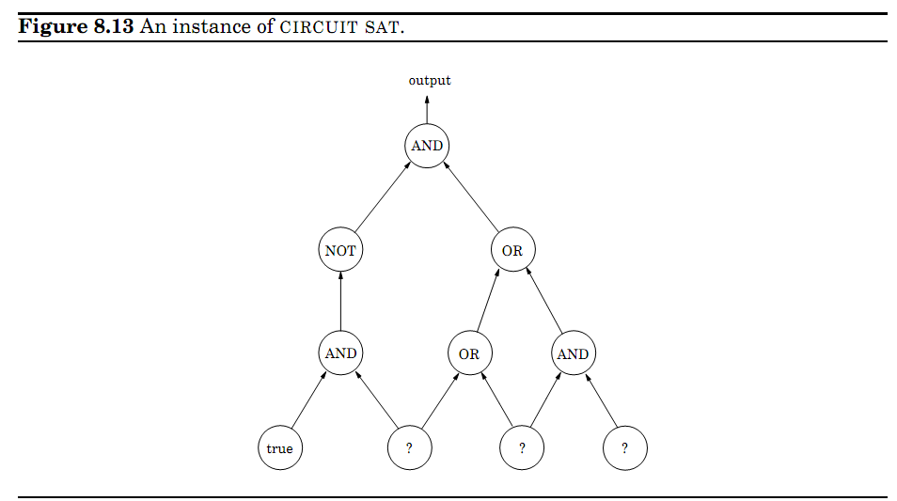
ANY PROBLEM IN NP →SAT
CIRCUIT SAT is then the following search problem: Given a circuit, find a truth assignment for the unknown inputs such that the output gate evaluates to true, or report that no such exist.

Slide 37
ANY PROBLEM IN NP →SAT
Any polynomial algorithm can be rendered as a circuit, whose input gates encode the input to the algorithm.
Naturally, for any input length (number of input bits) the circuit will be scaled to the appropriate number of inputs, but the total number of gates of the circuit will be polynomial in the number of inputs.
If the polynomial algorithm in question solves a problem that requires a yes or no answer (as is the situation with C: Does S encode a solution to the instance encoded by I), then this answer is given at the output gate.
We conclude that, given any instance I of problem A, we can construct in polynomial time
a circuit whose known inputs are the bits of I, and whose unknown inputs are the bits of S,
such that the output is true if and only if the unknown inputs spell a solution S of I. In other words, the satisfying truth assignments to the unknown inputs of the circuit are in one-to-one correspondence with the solutions of instance I of A. The reduction is complete

Slide 38
Assignment 6
8.10, 8.13

